Slide 1
MARQUIS TECHNOLOGIES
Drive Route

Slide 2
Content
Seattle
New York
Dallas & Lewisville
Myrtle Beach
Albuquerque
Yakima
Los Angeles
Kansas
Chicago
Austin

Slide 3
Operator Details:
S. No. | Operator |  | Supported Bands | Supported Features by Network
1 | Major | T-Mobile | Band 2(1900 Mhz), Band 4 (1700 Mhz), Band 12(700 Mhz), 66(2100Mhz), 71 | VoLTE /VoWiFi/ 5G / 4G / 3G/ 2G
2 |  | AT&T | Band 2(1900 Mhz), Band 4 (1700 Mhz) Band 5(850 Mhz), Band 12(700Mhz) ,Band 17 (700 Mhz) | VoLTE / 5G / 4G
3 |  | Verizon | Band 2(1900MHz), Band 5(850MHz), Band 4 (1700-2100MHz) | VoLTE / 5G / 4G

Slide 4
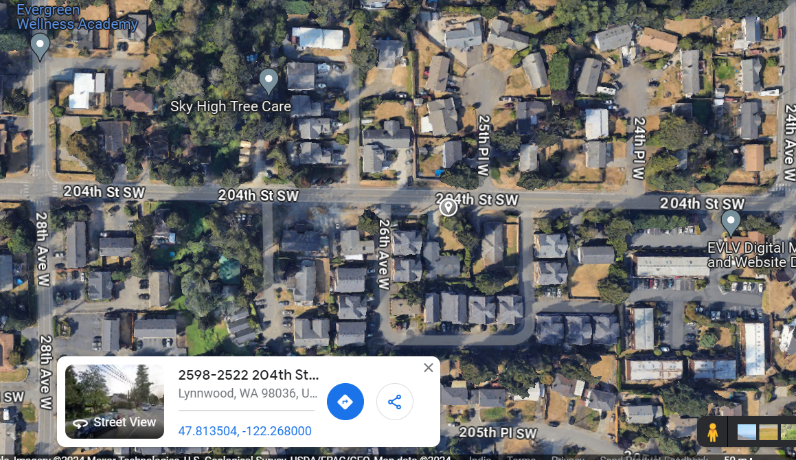
TMO 5G Near Cell
Lat/Long 47°48'48.8"N 122°16'04.8"W
Specification – T-Mobile 5G SA network

Slide 5
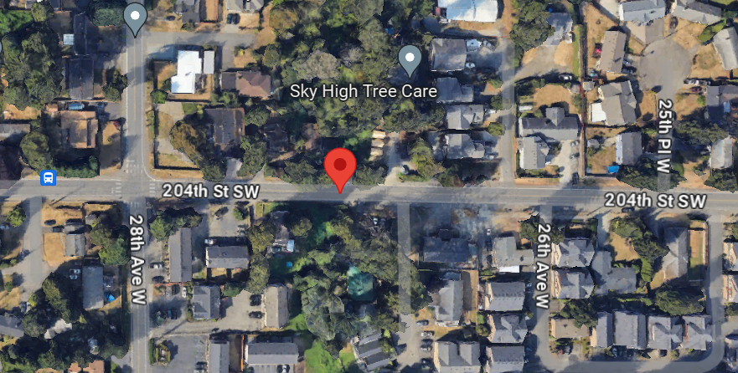
NR to LTE Handover TMO
Lat. 47°48'48.9"N 122°16'10.9"W
Specification –Band Handover

Slide 6
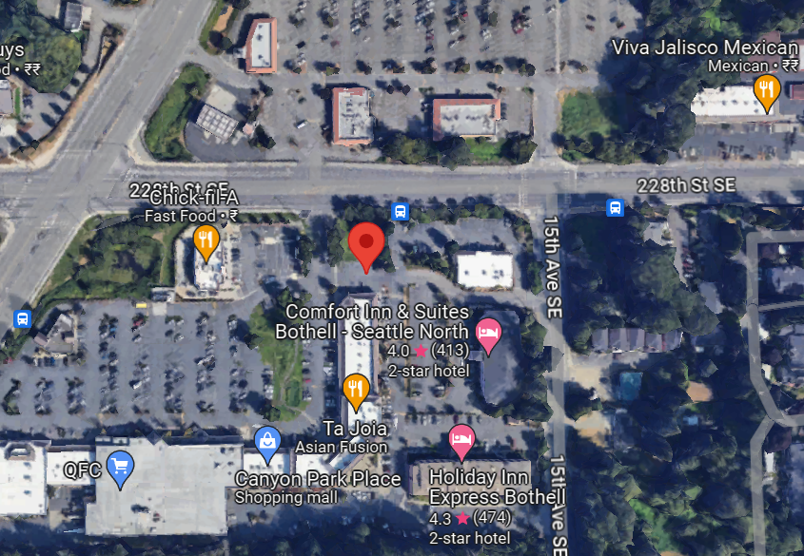
Verizon 5G near cell
Lat. 47°47'27.2"N 122°12'52.2"W

Slide 7
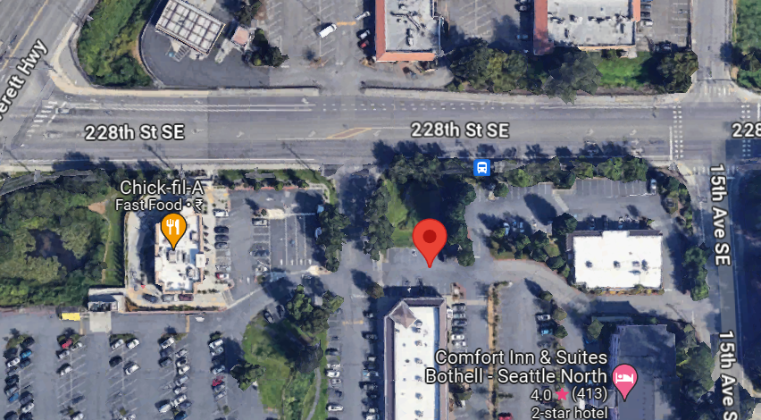
AT&T 5G NEAR CELL
47°47'27.2"N 122°12'52.2"W

Slide 8
DRIVE ROUTE- Seattle/USA
Operators in USA:
T-Mobile
Location | Slides | Technology | RAN infra | Bands
Seattle | 4-37 | LTE, LAA, SA & NSA | Nokia | Band 2, 12, 46, 66, 71, n41, n71 ,n261

Slide 9
These are Development sites. Need to confirm the operator before execute test case
n66 DSS
Market | SiteID | Latitude | Long | LTE_BW | LTE_MIMO | NR_BW | NR_MIMO | NBIOT | NBIOT_MODE
Seattle | SE01523A | 47.99991 | -122.208 | L19(20), L21(20), L7(5) | L19(2x2), L21(4x4), L7(2x2) | N21(20) | N21(2x2) | L19 | Guardband
n71 DSS
Market | SiteID | Latitude | Long | LTE_BW | LTE_MIMO | NR_BW | NR_MIMO | NBIOT | NBIOT_MODE
SEATTLE | SE04115B | 47.15562 | -122.044 | L19(15), L21(20), L6(20), L7(5) | L19(4x4), L21(4x4), L6(4x2), L7(4x2) | N6(20) | N6(2x2) | L21 | Guardband
SEATTLE | SE04117B | 47.12963 | -122.094 | L21(20), L6(20), L7(5) | L21(4x4), L6(4x2), L7(4x2) | N6(20) | N6(2x2) | L21 | Guardband
SEATTLE | SE05132A | 47.15035 | -122.133 | L21(20), L6(20), L7(5) | L21(4x4), L6(4x2), L7(4x2) | N6(20) | N6(2x2) | L21 | Guardband

Slide 10
These are Development sites. Need to confirm the operator before execute test case
LTE B41 UL CA
Market | SiteID | Latitude | Long | LTE_BW | LTE_MIMO | NR_BW | NR_MIMO | NBIOT | NBIOT_MODE
Seattle | SE02541A | 47.77971 | -122.175 | L19(20), L21(20), L25(5), L41(20+20), L6(5), L7(5) | L19(4x4), L21(4x4), L25(4x4), L41(DualBeam+DualBeam), L6(4x2), L7(4x2) | N21(20), N41(60), N6(15) | N21(2x2), N41(2x2), N6(2x2) | L19 | Guardband
Seattle | SE01623A | 47.79208 | -122.21 | L19(20), L21(20), L25(5), L41(20+20), L6(5), L7(5) | L19(4x4), L21(4x4), L25(4x4), L41(DualBeam+DualBeam), L6(4x2), L7(4x2) | N41(60), N6(15) | N41(2x2), N6(2x2) | L21 | Inband

Slide 11
These are Development sites. Need to confirm the operator before execute test case
n66 ENDC Super sets
Market | SiteID | Latitude | Long | Backhaul | NR PCI | n2/n25 | n66 | n41 | n71
Seattle | SE01721A | 47.934506 | -122.12235 | 700 | n41: 10, 17, 12 n66: 114, 376, 203 n71:141, 376, 203 | 15 | 20 | 40 | 15
Market | SiteID | LTE PCI | B2 | B66 | B71 | B12 | B41 | B46 | ENDC Super Sets
Seattle | SE01721A | B2: 182, 181, 60 B12:B66:B 71 141, 376, 203 B41: 6, 10, 2 B46:276 | 15 | 20 | 5 | 5 | 3x20 | 3x20 | 2A_66A-(n)71AA 2A_66A-n41A DC_12A_n2A DC_12A-66A_n25A DC_12A_n25A, DC_66A_n25A DC_2A-12A_n66A DC_2A_n66A, DC_12A_n66A DC_2A_46D_66A_n 41A, DC_2A_46D_66A_n 71A

Slide 12
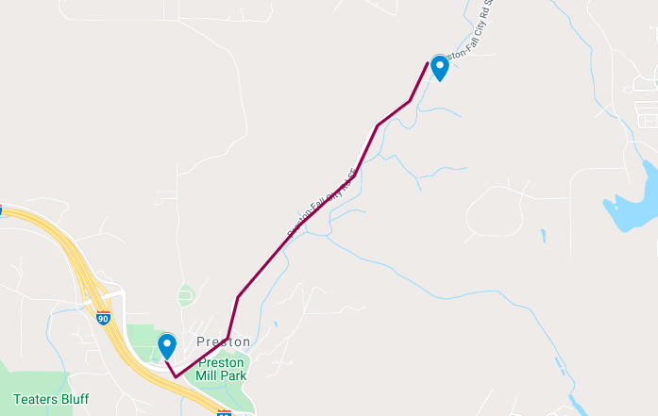
SRVCC location 4G->3G/2G & 3G/2G->4G:
From location A(47.52269, -121.93259) to location B(47.53981, -121.90783)
4G-3G/2G IRAT/Cell reselection
3G/2G-4G IRAT/Cell reselection

Slide 13
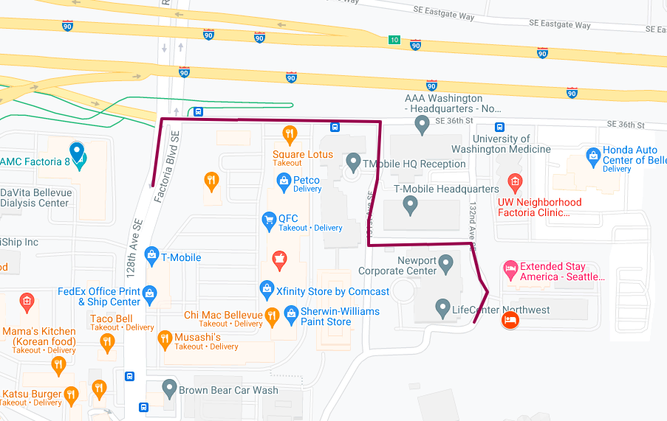
HO from B41 to B2/B4/B12/B66/B71:
From location A(47.57915, -122.17031) to location B(47.57762, -122.16401)
Note:
Fedex office front we can get B41 then will move towards hotel. Hotel parking we can get B2/B4/B12/B66/B71
Some times we’re observing HO B2/B4/B12/B66/B71 to B41 from hotel to towards fedex office.
Location:
https://www.google.com/maps/dir/47.57915,-122.17031/47.57762,+-122.16401/@47.5781862,-122.1691074,17z/data=!4m6!4m5!1m0!1m3!2m2!1d-122.16401!2d47.57762

Slide 14
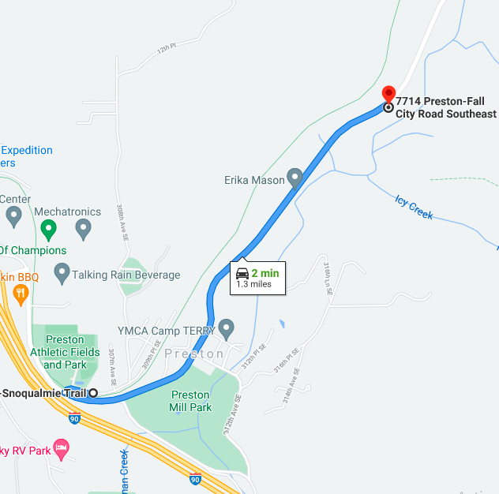
LTE to 3G (SrVCC)
Note:
This route is only good for SrVCC from Band 4 & 12. But Sometimes DUT goes out of service during this route.
Location:
https://www.google.com/maps/dir/47.5224624,-121.9329047/7714+Preston-Fall+City+Rd+SE,+Issaquah,+WA+98027/@47.527601,-121.9344285,15z/data=!3m1!4b1!4m9!4m8!1m0!1m5!1m1!1s0x54907ae42c2a2221:0x90835128fe789f1f!2m2!1d-121.9168741!2d47.5329598!3e0

Slide 15
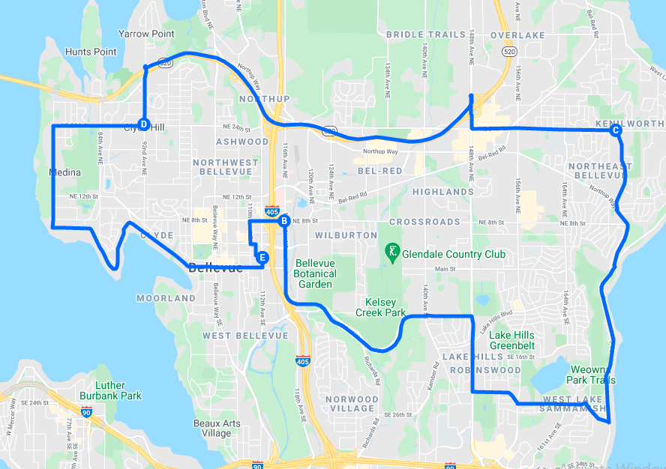
LTE to 3G (SrVCC)
Note 1:
This route is only good for SrVCC from Band 4
Note 2:
It is preferred to disable 2G.
Location:
https://www.google.com/maps/d/viewer?mid=1AIGOivJdNeLnI6Rybc9_frBdRMU&ll=47.61467275840911%2C-122.17302999999998&z=13

Slide 16
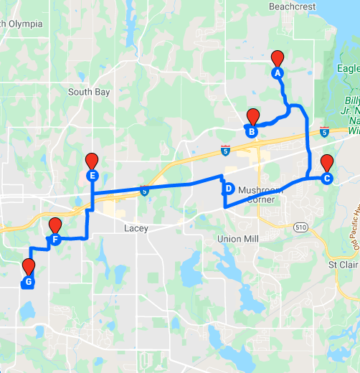
Band 4 + Band 12 , BW 10+5
Note:
B4(10MHz) & B12(5MHz) available here
Location : https://www.google.com/maps/d/viewer?mid=13XIm-pYsqwQ5a74RqzcflPw74LY&ll=47.05196676524398%2C-122.80498399999999&z=12

Slide 17
B71->B2/B4:
From location A(47.52269, -121.93259) to location B(47.53981, -121.90783)
Need to lock the Bands B71, B2 & B4
Need to move from Point A to Point B
Mid of the route we can get handover from B2->B71->B2

Slide 18
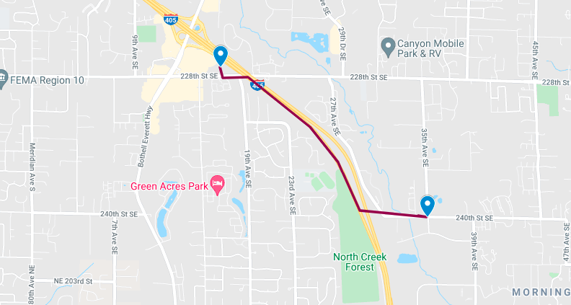
PS HO n41 SA -> n41/n71 NSA
PS HO SA-NSA location A(47.79203, -122.2106) to location B(47.78003, -122.186)
Make sure device 5G & 4G Auto mode.
Attach n41 SA in Location A.
Move from Location A to Location B. We can get handover n41/n71 NSA

Slide 19
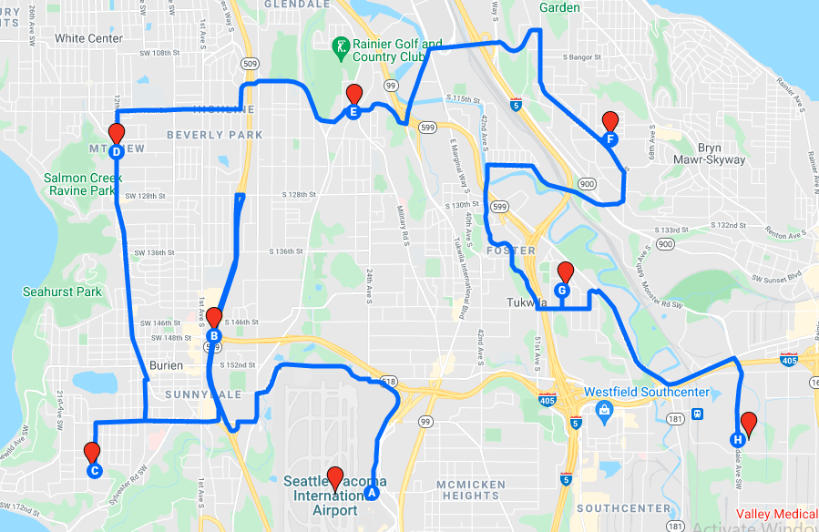
CA, NB IOT & 4x4 MIMO (Band 4 + Band 2 + Band 12)
Notes:
NB IOT is available across the network, following is the band priority:4, 2, 12
Location
https://www.google.com/maps/d/viewer?mid=1G1Y_7XGpglxUNoQobYuPxqc_juI&ll=47.47991832207361%2C-122.29268075&z=13

Slide 20
NB-IOT with GB
Site ID | MRBTS | latitude | longitude | GB+Multitone
SE01001T | 80171 | 47.772435 | -122.18777 | GB+Multitone
SE01008A | 84436 | 47.8138053 | -122.18725 | GB+Multitone
SE01015A | 84439 | 47.795537 | -122.17198 | GB+Multitone
SE01623A | 84570 | 47.792087 | -122.21047 | GB+Multitone
SE01624D | 84571 | 47.8125573 | -122.20944 | GB+Multitone
SE01637G | 84581 | 47.802987 | -122.23855 | GB+Multitone
SE01662E | 84606 | 47.834431 | -122.1743 | GB+Multitone
SE01688A | 84599 | 47.909507 | -122.21996 | GB+Multitone
SE01700A | 93433 | 47.840806 | -121.8895 | GB+Multitone
SE01748A | 91515 | 48.245107 | -122.33344 | GB+Multitone
SE01762B | 94612 | 48.086361 | -121.96517 | GB+Multitone
SE01810E | 84628 | 47.85017 | -122.21674 | GB+Multitone
SE01837B | 84630 | 47.791226 | -122.2438 | GB+Multitone
SE01941A | 80096 | 47.578734 | -122.16491 | GB+Multitone
SE02404B | 84712 | 47.624056 | -122.15963 | GB+Multitone
SE02637B | 84765 | 47.777629 | -122.20205 | GB+Multitone
SE02638A | 84767 | 47.769953 | -122.24005 | GB+Multitone
SE02701A | 84795 | 47.760492 | -122.20464 | GB+Multitone
SE02703E | 84797 | 47.758027 | -122.22259 | GB+Multitone
SE03585C | 84919 | 47.781799 | -122.25971 | GB+Multitone
SE07161A | 85284 | 48.437244 | -122.31533 | GB+Multitone

Slide 21
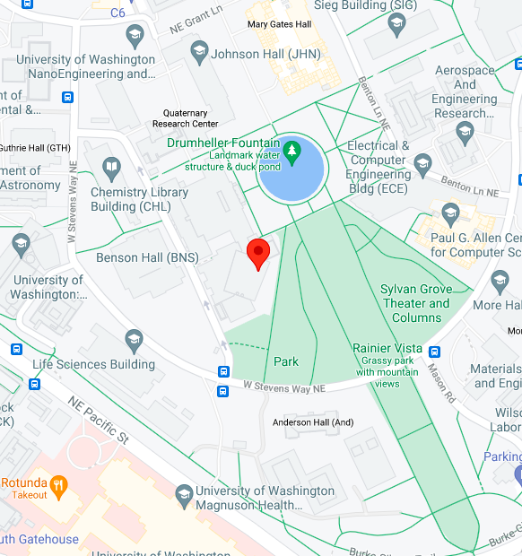
Band 2 LTE
Note:
B2(20MHz)
Location :
https://www.google.com/maps/place/47%C2%B039'10.8%22N+122%C2%B018'29.5%22W/@47.6529925,-122.3103947,17z/data=!3m1!4b1!4m5!3m4!1s0x0:0x0!8m2!3d47.6529889!4d-122.308206

Slide 22
Band 2 Sites more locations
Site ID | Latitude | Longitude | Name
SE01125A | 47.65298889 | -122.308206 | King
SE01126A | 47.64965278 | -122.307489 | King
SE01139A | 47.6497 | -122.3 | King
SE01201C | 47.679372 | -122.321837 | King
SE01303A | 47.660286 | -122.312714 | King
SE01418E | 47.64704722 | -122.365358 | King
SE01419C | 47.66114167 | -122.390056 | King
SE01702B | 47.694558 | -121.3376 | King
SE01704B | 47.76625 | -121.478944 | King
SE01717A | 47.753242 | -121.093614 | King
SE01904A | 47.61795321 | -122.195815 | King

Slide 23
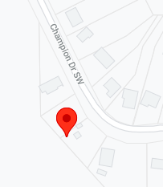
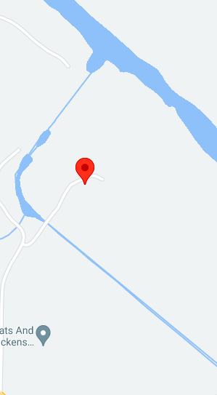
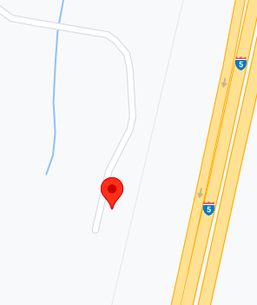
UL CA (Band 2 +12)
Location 1 : https://www.google.com/maps/place/46%C2%B054'16.1%22N+122%C2%B056'04.4%22W/@46.9044686,-122.9367437,17z/data=!3m1!4b1!4m5!3m4!1s0x0:0x0!8m2!3d46.904465!4d-122.934555
Location 2: https://www.google.com/maps/place/46%C2%B052'00.7%22N+122%C2%B058'18.3%22W/@46.8668736,-122.9739287,17z/data=!3m1!4b1!4m5!3m4!1s0x0:0x0!8m2!3d46.86687!4d-122.97174
Location 3 : https://www.google.com/maps/place/46%C2%B058'21.9%22N+122%C2%B038'08.5%22W/@46.9727536,-122.6378827,17z/data=!3m1!4b1!4m5!3m4!1s0x0:0x0!8m2!3d46.97275!4d-122.635694

Slide 24
UL CA (Band 2 +12) more sites
Infra | Combination | Region | Market | Site ID | Latitude | Longitude
Nokia | 2A-12A | West | Seattle | SE05027C | 46.904465 | -122.934555
Nokia | 2A-12A | West | Seattle | SE05037A | 46.86687 | -122.97174
Nokia | 2A-12A | West | Seattle | SE05084A | 46.97275 | -122.635694
Nokia | 2A-12A | West | Seattle | SE05101C | 47.08437 | -123.03732
Nokia | 2A-12A | West | Seattle | SE05102A | 47.140209 | -123.0897113
Nokia | 2A-12A | West | Seattle | SE05103B | 47.182294 | -123.0875727
Nokia | 2A-12A | West | Seattle | SE05105C | 47.226714 | -123.1236655
Nokia | 2A-12A | West | Seattle | SE05118A | 47.080868 | -123.1854393
Nokia | 2A-12A | West | Seattle | SE05144B | 48.041622 | -122.7868113
Nokia | 2A-12A | West | Seattle | SE05147D | 47.635422 | -122.7586023
Nokia | 2A-12A | West | Seattle | SE05166A | 46.864889 | -122.666508
Nokia | 2A-12A | West | Seattle | SE05168A | 46.933301 | -122.331529
Nokia | 2A-12A | West | Seattle | SE05172A | 47.284861 | -123.1719273
Nokia | 2A-12A | West | Seattle | SE05173B | 46.839773 | -122.2583879
Nokia | 2A-12A | West | Seattle | SE05223A | 46.870383 | -124.103427
Nokia | 2A-12A | West | Seattle | SE05301A | 46.424064 | -124.051413
Nokia | 2A-12A | West | Seattle | SE06012A | 47.877912 | -122.72707
Nokia | 2A-12A | West | Seattle | SE06013A | 47.797556 | -122.563222
Nokia | 2A-12A | West | Seattle | SE06023A | 47.758861 | -122.590791
Nokia | 2A-12A | West | Seattle | SE06024A | 47.810983 | -122.6237307
Nokia | 2A-12A | West | Seattle | SE06044A | 47.462242 | -122.813321
Nokia | 2A-12A | West | Seattle | SE06054A | 47.274028 | -122.982778

Slide 25
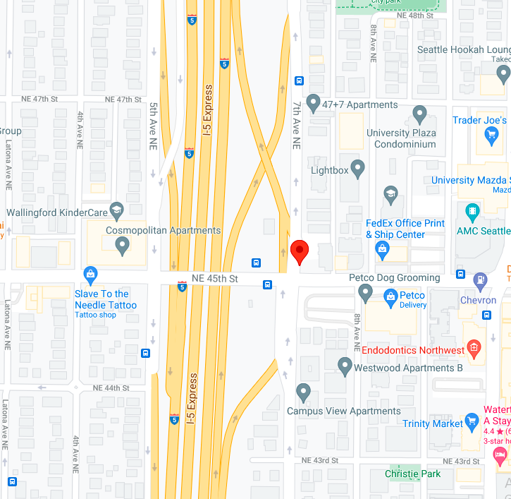
4CC LAA CA Capability: [B4 + 3UL],[B2 + 3UL], 3GPP Combination:- 4C CA (4A-46D), (2A-46D)
Note:
4CC LAACA Capability: [B4 + 3UL],[B2 + 3UL], 3GPP Combination:- 4C CA (4A-46D), (2A-46D)
Location :
https://www.google.com/maps/place/47%C2%B039'41.3%22N+122%C2%B019'14.4%22W/@47.6614736,-122.3228587,17z/data=!3m1!4b1!4m5!3m4!1s0x0:0x0!8m2!3d47.66147!4d-122.32067

Slide 26
4CC LAA more sites
site_sector_calc | Latitude | Longitude | Tech freq | LAA of carrier | CA capability | 3GPP Combination
SE0037BA_31LGB | 47.66147 | -122.32067 | LAA | 3 | [B4 + 3UL], [B2 + 3UL] | 4C CA (4A-46D), (2A-46D)
SE0037BA_61LGB | 47.656548 | -122.319878 | LAA | 3 | [B4 + 3UL], [B2 + 3UL] | 4C CA (4A-46D), (2A-46D)
SE0037BA_71LGB | 47.657617 | -122.320723 | LAA | 3 | [B4 + 3UL], [B2 + 3UL] | 4C CA (4A-46D), (2A-46D)
SE0037BA_81LGB | 47.657022 | -122.317737 | LAA | 3 | [B4 + 3UL], [B2 + 3UL] | 4C CA (4A-46D), (2A-46D)
SE0037BA_91LGB | 47.658874 | -122.320745 | LAA | 3 | [B4 + 3UL], [B2 + 3UL] | 4C CA (4A-46D), (2A-46D)
SE0039BA_71LGB | 47.664378 | -122.300771 | LAA | 3 | [B4 + 3UL], [B2 + 3UL] | 4C CA (4A-46D), (2A-46D)
SE0040BA_11LGB | 47.66642 | -122.30048 | LAA | 3 | [B4 + 3UL], [B2 + 3UL] | 4C CA (4A-46D), (2A-46D)
SE0040BA_21LGB | 47.668649 | -122.300472 | LAA | 3 | [B4 + 3UL], [B2 + 3UL] | 4C CA (4A-46D), (2A-46D)

Slide 27
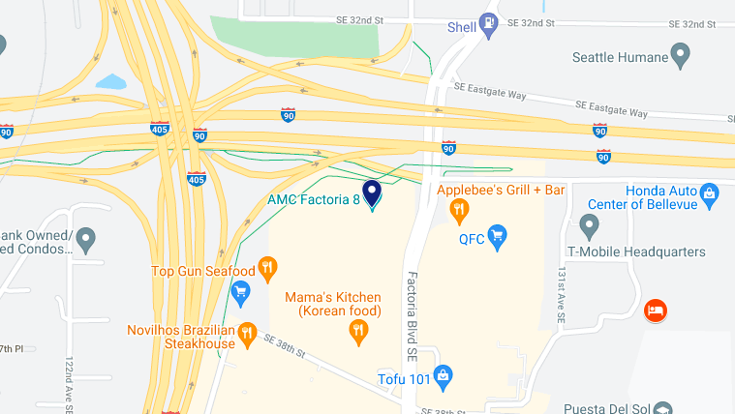
B41+B41(2CA)
B41+B41(2CA) (47.57915, -122.17031)

Slide 28
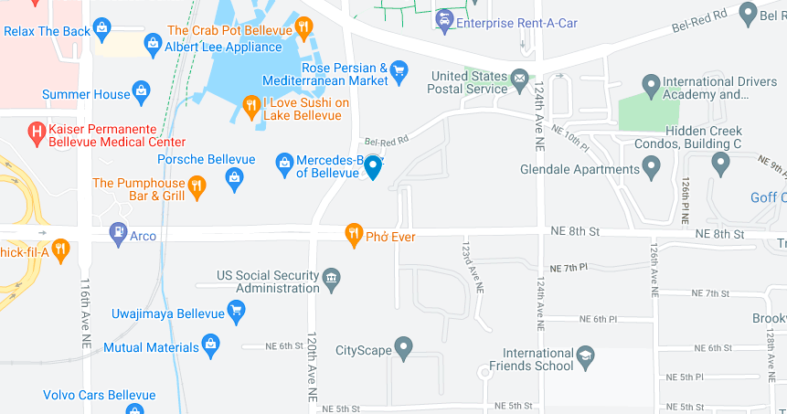
B4+B12(2CA)
B4+B12(2CA) – Location (47.61811, -122.17894)

Slide 29
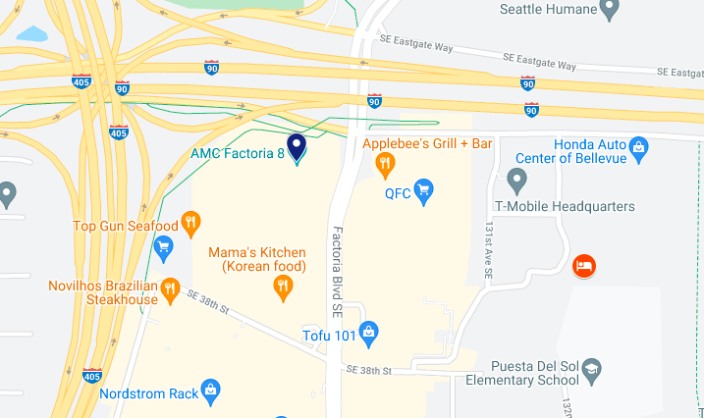
B2+B4(2CA)
B2+B4(2CA) – Location (47.57915, -122.17031)

Slide 30
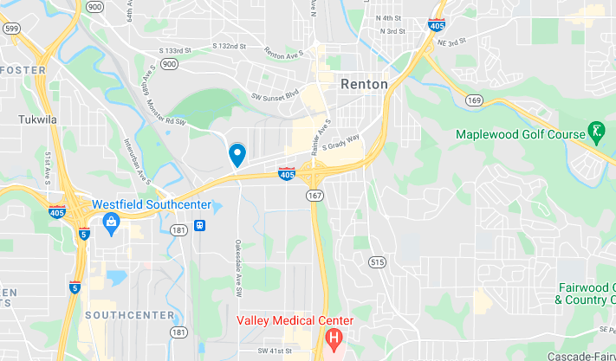
B2+B4+B12(3CA)
B2+B4+B12(3CA) – Location (47.4683, -122.23316)

Slide 31
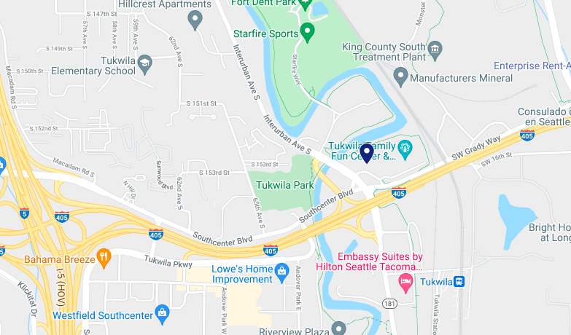
2(4*4 MIMO)+4(4*4 MIMO) 2CA
2(4*4 MIMO)+4(4*4 MIMO) 2CA – Location (47.46536, -122.24598)

Slide 32
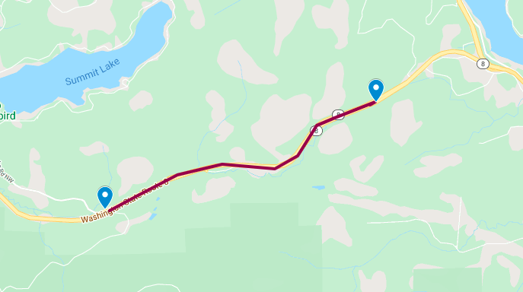
MOCN drive route
MOCN Drive from location A(47.05076, -123.03739) to B(47.03422, -123.09851)
MOCN Location

Slide 33
NR-Seattle

Slide 34
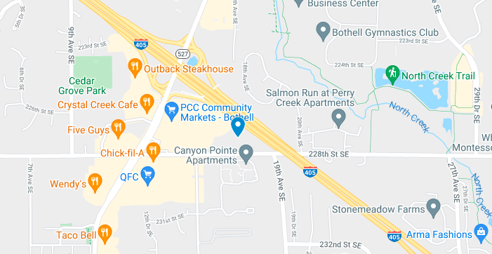
n41 SA Location
n41 SA Location (47.79203, -122.2106)
Notes:
Make sure we need to disable all NSA bands & enable n41 SA band only.
LTE we should keep on Auto mode.

Slide 35
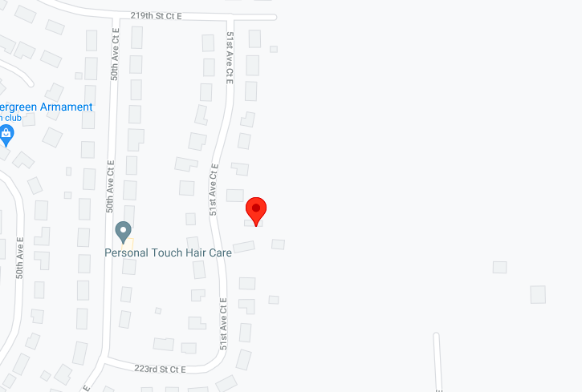
n41 SA Location
Site ID | Test category | PCI LTE | NR PCI | Lat | Long | n41 | B2 | B66 | B12 | B41 | DSS | NSA/SA | Supported ENDC Combinations
SE05064D | n41 SA | 453, 85, 359, 427 | 453, 85, 359 | 47.05493 | -122.36 | 60 | 10 | 20 | 5 | 20 | No | SA | DC_2A-66A_n41A, DC_2A_n41A, DC_66A_n41A, DC_(n)41AA, DC_41A_n41A
Notes:
Make sure we need to disable all NSA bands & enable n41 SA band only.
LTE we should keep on Auto mode.

Slide 36
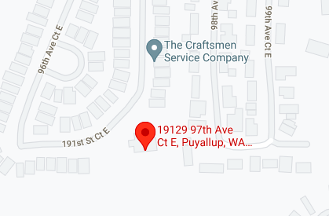
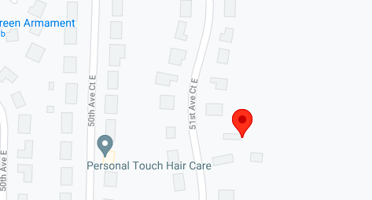
n41 (NSA)
Location 1:
https://www.google.com/maps/place/19129+97th+Ave+Ct+E,+Puyallup,+WA+98375,+USA/@47.0821696,-122.3017527,17z/data=!3m1!4b1!4m5!3m4!1s0x54911d5f748f6847:0x59fb9089d4b65362!8m2!3d47.082166!4d-122.299564
Location 2:
https://www.google.com/maps/place/47%C2%B003'17.8%22N+122%C2%B021'36.0%22W/@47.0549536,-122.3621887,17z/data=!3m1!4b1!4m5!3m4!1s0x0:0x0!8m2!3d47.05495!4d-122.36

Slide 37
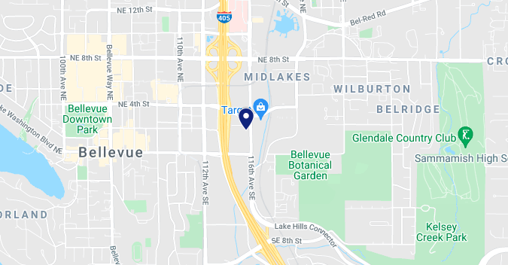
n71 SA Location
n71 SA Location (47.61183, -122.18613)
Notes:
Make sure we need to disable all NSA bands & enable n71 SA band only.
LTE we should keep on Auto mode.

Slide 38
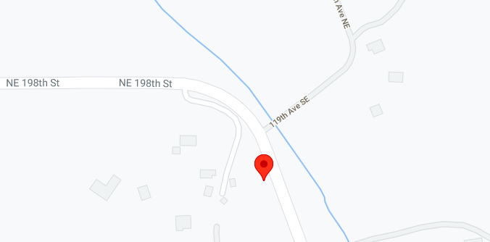
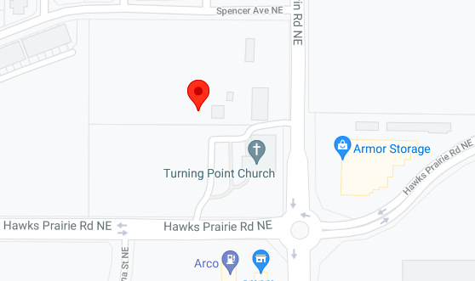
n71 (SA)
NR PCI : 414, 472, 206
Supported ENDC combination: DC_2A-66A_n71A, DC_2A_n71A, DC_66A_n71A
Location 1 : https://www.google.com/maps/place/47%C2%B046'12.6%22N+122%C2%B003'50.4%22W/@47.7701736,-122.0661887,17z/data=!3m1!4b1!4m5!3m4!1s0x0:0x0!8m2!3d47.77017!4d-122.064
NR PCI : 220, 283, 338
Supported ENDC combination: DC_2A-66A_n71A,DC_2A_n71A, DC_66A_n71A
Location 2: https://www.google.com/maps/place/47%C2%B005'03.0%22N+122%C2%B046'55.2%22W/@47.0841636,-122.7841887,17z/data=!3m1!4b1!4m5!3m4!1s0x0:0x0!8m2!3d47.08416!4d-122.782

Slide 39
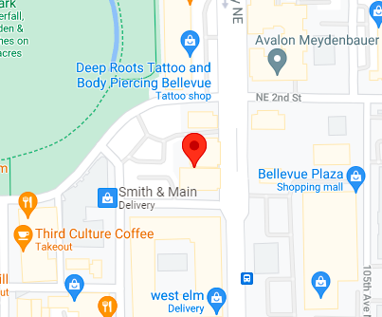
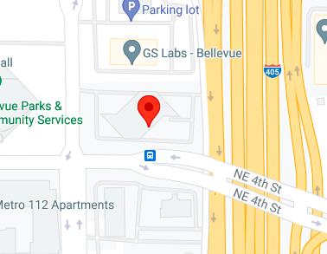
n71
Location 1:
NR PCI : 357, 136,7
LTE PCI: 357, 136, 7, 278
https://www.google.com/maps/place/47%C2%B036'41.4%22N+122%C2%B012'07.2%22W/@47.6114936,-122.2041887,17z/data=!3m1!4b1!4m5!3m4!1s0x0:0x0!8m2!3d47.61149!4d-122.202
Location 2:
NR PCI : 41, 309, 190
LTE PCI: 41, 1, 309, 6, 190
https://www.google.com/maps/place/47%C2%B036'50.5%22N+122%C2%B011'24.0%22W/@47.6140336,-122.1921887,17z/data=!3m1!4b1!4m5!3m4!1s0x0:0x0!8m2!3d47.61403!4d-122.19

Slide 40
n71 more sites
Site ID | Status | NR PCI | LTE PCI | Lat | Long | n71 | B2 | B66 | B71 | B12
SE03312B | Co-located | 357, 7, 136 | 357, 136, 7, 278 | 47.61149 | -122.202 | 10 | 15 | 20 | 10 | 5
SE02301A | Co-located | 41, 309, 190 | 41, 1, 309, 6, 190 | 47.61403 | -122.19 | 10 | 15 | 20 | 15 | 5
SE03416B | Co-located | 189, 138 | 189, 138, 155 | 47.60553 | -122.184 | 10 | 15 | 20 | 15 | 5
SE02407A | Non-collocated | NA | 103, 63 | 47.60688 | -122.201 | 0 | 15 | 20 | 0 | 0
SE03943B | Non-collocated | NA | 288, 289, 413 | 47.61579 | -122.198 | 0 | 15 | 20 | 0 | 5
SE01904A | Non-collocated | NA | 84, 43, 335 | 47.61795 | -122.196 | 0 | 15 | 20 | 0 | 5

Slide 41
LTE 4x4MIMO & n71 supported EN-DC combination sites & locations
LTE Bandwidth(MHz) |  |  |  |  |  |  |  |  |  |  | LTE : 4x4MIMO
Market | PCI(midband) | long | lat | Backhaul | 5G Band | 5G Bandwidth | B2 | B66 | B71 | B12 | B2 | B66 | B71 | B12 | Supported EN-DC Combinations
Spokane | 96 | -117.4 | 47.668 | 460 | n71 | 5,10,15,20 | 10 | 20 | 5,10,15,20 | 5 | 4x4 | 4x4 | 4x2 | 4x2 | DC_66A_n71A,DC_2A_n71A,DC_2A-66A_n71A,DC_66A-(n)71AA,DC_2A-(n)71AA,DC_2A-66A-(n)71AA
Spokane | 98 | -117.4 | 47.668 | 460 | n71 | 5,10,15,20 | 10 | 20 | 5,10,15,20 | 5 | 4x4 | 4x4 | 4x2 | 4x2 | DC_66A_n71A,DC_2A_n71A,DC_2A-66A_n71A,DC_66A-(n)71AA,DC_2A-(n)71AA,DC_2A-66A-(n)71AA
Spokane | 97 | -117.4 | 47.668 | 460 | n71 | 5,10,15,20 | 10 | 20 | 5,10,15,20 | 5 | 4x4 | 4x4 | 4x2 | 4x2 | DC_66A_n71A,DC_2A_n71A,DC_2A-66A_n71A,DC_66A-(n)71AA,DC_2A-(n)71AA,DC_2A-66A-(n)71AA
Spokane | 70 | -117.4 | 47.698 | 900 | n71 | 5,10,15,20 | 10 | 20 | 5,10,15,20 | 5 | 4x4 | 4x4 | 4x2 | 4x2 | DC_66A_n71A,DC_2A_n71A,DC_2A-66A_n71A,DC_66A-(n)71AA,DC_2A-(n)71AA,DC_2A-66A-(n)71AA
Spokane | 71 | -117.4 | 47.698 | 900 | n71 | 5,10,15,20 | 10 | 20 | 5,10,15,20 | 5 | 4x4 | 4x4 | 4x2 | 4x2 | DC_66A_n71A,DC_2A_n71A,DC_2A-66A_n71A,DC_66A-(n)71AA,DC_2A-(n)71AA,DC_2A-66A-(n)71AA
Spokane | 69 | -117.4 | 47.698 | 900 | n71 | 5,10,15,20 | 10 | 20 | 5,10,15,20 | 5 | 4x4 | 4x4 | 4x2 | 4x2 | DC_66A_n71A,DC_2A_n71A,DC_2A-66A_n71A,DC_66A-(n)71AA,DC_2A-(n)71AA,DC_2A-66A-(n)71AA
Spokane | 48 | -117.4 | 47.661 | 180 | n71 | 5,10,15,20 | 10 | 20 | 5,10,15,20 | 5 | 4x4 | 4x4 | 4x2 | 4x2 | DC_66A_n71A,DC_2A_n71A,DC_2A-66A_n71A,DC_66A-(n)71AA,DC_2A-(n)71AA,DC_2A-66A-(n)71AA
Spokane | 49 | -117.4 | 47.661 | 180 | n71 | 5,10,15,20 | 10 | 20 | 5,10,15,20 | 5 | 4x4 | 4x4 | 4x2 | 4x2 | DC_66A_n71A,DC_2A_n71A,DC_2A-66A_n71A,DC_66A-(n)71AA,DC_2A-(n)71AA,DC_2A-66A-(n)71AA
Spokane | 50 | -117.4 | 47.661 | 180 | n71 | 5,10,15,20 | 10 | 20 | 5,10,15,20 | 5 | 4x4 | 4x4 | 4x2 | 4x2 | DC_66A_n71A,DC_2A_n71A,DC_2A-66A_n71A,DC_66A-(n)71AA,DC_2A-(n)71AA,DC_2A-66A-(n)71AA
Spokane | 83 | -117.4 | 47.658 | 900 | n71 | 5,10,15,20 | 10 | 20 | 5,10,15,20 | 5 | 4x4 | 4x4 | 4x2 | 4x2 | DC_66A_n71A,DC_2A_n71A,DC_2A-66A_n71A,DC_66A-(n)71AA,DC_2A-(n)71AA,DC_2A-66A-(n)71AA
Spokane | 82 | -117.4 | 47.658 | 900 | n71 | 5,10,15,20 | 10 | 20 | 5,10,15,20 | 5 | 4x4 | 4x4 | 4x2 | 4x2 | DC_66A_n71A,DC_2A_n71A,DC_2A-66A_n71A,DC_66A-(n)71AA,DC_2A-(n)71AA,DC_2A-66A-(n)71AA
Spokane | 112 | -117.4 | 47.658 | 900 | n71 | 5,10,15,20 | 10 | 20 | 5,10,15,20 | 5 | 4x4 | 4x4 | 4x2 | 4x2 | DC_66A_n71A,DC_2A_n71A,DC_2A-66A_n71A,DC_66A-(n)71AA,DC_2A-(n)71AA,DC_2A-66A-(n)71AA
Spokane | 100 | -117.4 | 47.643 | 280 | n71 | 5,10,15,20 | 10 | 20 | 5,10,15,20 | N/A | N/A | 4x4 | 4x2 | N/A | DC_66A_n71A,DC_66A-(n)71AA
Spokane | 222 | -117.9 | 47.65 | 400 | n71 | 5,10,15,20 | 10 | 20 | 5,10,15,20 | 5 | N/A | 4x4 | 4x2 | 4x2 | DC_66A_n71A,DC_66A-(n)71AA
Spokane | 58 | -117.9 | 47.65 | 400 | n71 | 5,10,15,20 | 10 | 20 | 5,10,15,20 | 5 | N/A | 4x4 | 4x2 | 4x2 | DC_66A_n71A,DC_66A-(n)71AA
Spokane | 59 | -117.9 | 47.65 | 400 | n71 | 5,10,15,20 | 10 | 20 | 5,10,15,20 | 5 | N/A | 4x4 | 4x2 | 4x2 | DC_66A_n71A,DC_66A-(n)71AA
Spokane | 108 | -117.4 | 47.739 | 630 | n71 | 5,10,15,20 | 10 | 20 | 5,10,15,20 | 5 | 4x4 | 4x4 | 4x2 | 4x2 | DC_66A_n71A,DC_2A_n71A,DC_2A-66A_n71A,DC_66A-(n)71AA,DC_2A-(n)71AA,DC_2A-66A-(n)71AA
Spokane | 109 | -117.4 | 47.739 | 630 | n71 | 5,10,15,20 | 10 | 20 | 5,10,15,20 | 5 | 4x4 | 4x4 | 4x2 | 4x2 | DC_66A_n71A,DC_2A_n71A,DC_2A-66A_n71A,DC_66A-(n)71AA,DC_2A-(n)71AA,DC_2A-66A-(n)71AA
Spokane | 110 | -117.4 | 47.739 | 630 | n71 | 5,10,15,20 | 10 | 20 | 5,10,15,20 | 5 | 4x4 | 4x4 | 4x2 | 4x2 | DC_66A_n71A,DC_2A_n71A,DC_2A-66A_n71A,DC_66A-(n)71AA,DC_2A-(n)71AA,DC_2A-66A-(n)71AA
Spokane | 46 | -117.4 | 47.661 | 650 | n71 | 5,10,15,20 | 10 | 20 | 5,10,15,20 | 5 | 4x4 | 4x4 | 4x2 | 4x2 | DC_66A_n71A,DC_2A_n71A,DC_2A-66A_n71A,DC_66A-(n)71AA,DC_2A-(n)71AA,DC_2A-66A-(n)71AA
Spokane | 45 | -117.4 | 47.661 | 650 | n71 | 5,10,15,20 | 10 | 20 | 5,10,15,20 | 5 | 4x4 | 4x4 | 4x2 | 4x2 | DC_66A_n71A,DC_2A_n71A,DC_2A-66A_n71A,DC_66A-(n)71AA,DC_2A-(n)71AA,DC_2A-66A-(n)71AA
Spokane | 494 | -117.4 | 47.661 | 650 | n71 | 5,10,15,20 | 10 | 20 | 5,10,15,20 | 5 | 4x4 | 4x4 | 4x2 | 4x2 | DC_66A_n71A,DC_2A_n71A,DC_2A-66A_n71A,DC_66A-(n)71AA,DC_2A-(n)71AA,DC_2A-66A-(n)71AA

Slide 42
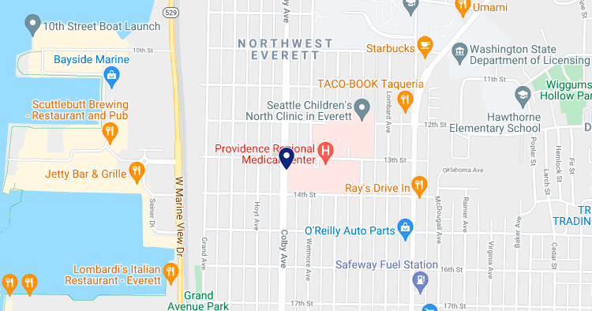
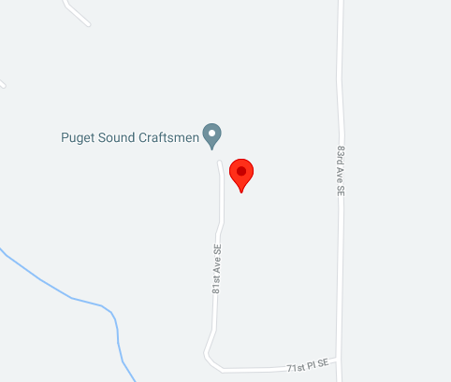
n66 DSS
n66 DSS Location 1 (47.99991, -122.208)
n66 DSS Location 2 (47.934506 -122.12235 )
Site ID | Test category | Market | Market vendor | Latitude | Longitude
SE01721A | n66 DSS(Maintenance window) | Seattle(Snohomish) | Nokia | 47.934506 | -122.12235

Slide 43
DRIVE ROUTE- Los Angeles/USA
Operators in USA:
T-Mobile

Slide 44
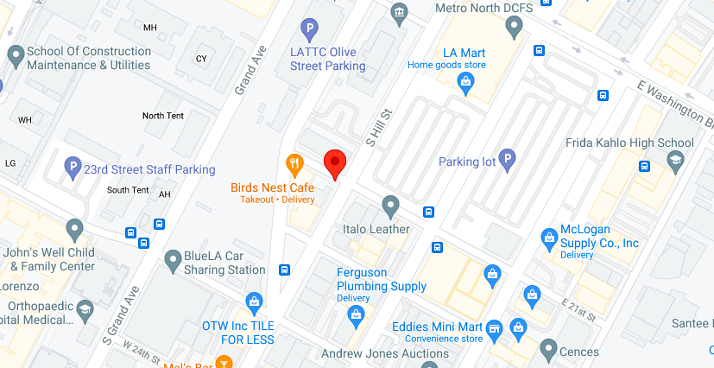
LAA Test Locations
LAA Test Locations (34.02993 -118.26832)
Customer Node ID | PCI | Equipment Configuration | Height | Latitude | Longitude | Cluster | Address | City | State | Zip
LA0024BA_21LAB | 481 | Strand Mount | 25m | 34.02993 | -118.26832 | Urban | 220 W 21st St | Los Angeles | CA | 90007

Slide 45
LAA Test Locations more locations
Customer Node ID | PCI | Equipment Configuration | Height | Latitude | Longitude | Cluster | Address | City | State | Zip
LA0024BA_21LAB | 481 | Strand Mount | 25m | 34.02993 | -118.26832 | Urban | 220 W 21st St | Los Angeles | CA | 90007
LA0024BA_61LAB | 482 | Strand Mount | 25m | 34.028754 | -118.270949 | Urban | 2301 S Grand Ave | Los Angeles | CA | 90007
LA0100BA_11LAB | 484 | Strand Mount | 25m | 33.99744 | -118.24988 | Suburban | 1402 E 50th St | Los Angeles | CA | 90011
LA0100BA_21LAB | 488 | Strand Mount | 25m | 33.997625 | -118.252051 | Suburban | 4916 Hooper Ave | Los Angeles | CA | 90011
Vendor | Region | Market | NodeName | Site Name | Sector | CA Capability | 3GPP Combinations | Ant. Lat | Ant. Long | HUB | HUB Total CIR(Mbps) | HUB Adjusted CIR(Mbps)
Ericsson | WEST | Los Angeles | LLA0001BA | LA0001BA | LA0001BA1 | B66 + B2 + 3UL | 5C CA (2A-46D-66A) | 33.80077 | -118.176 | LAH0039A | 4000 | 4000
Ericsson | WEST | Los Angeles | LLA0001BA | LA0001BA | LA0001BA2 | B66 + B2 + 3UL | 5C CA (2A-46D-66A) | 33.78584 | -118.148 | LAH0039A | 4000 | 4000
Ericsson | WEST | Los Angeles | LLA0001BA | LA0001BA | LA0001BA6 | B66 + B2 + 3UL | 5C CA (2A-46D-66A) | 33.77586 | -118.162 | LAH0039A | 4000 | 4000

Slide 46
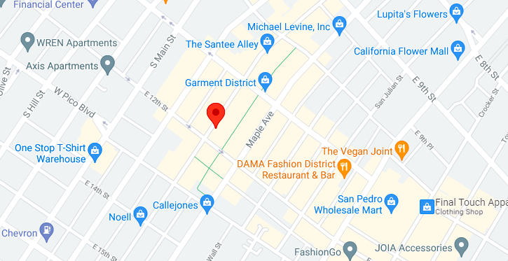
5G CA Site
Market | Site ID | Latitude | Longitude | 5G BW | 5G Bandwidth | AWS | PCS | 700 | Dual connectivity (LTE+NR) Combinations
Los Angeles | LA03101E | 34.03658 | -118.257 | 2*100MHz | N261 | 20 | 10 | 5 | DC_2A_n261(2A), DC_66A_n261(2A), DC_2A_n261G, DC_66A_n261G

Slide 47
5G CA more sites
Market | Site ID | Latitude | Longitude | 5G BW | 5G Bandwidth | AWS | PCS | 700 | Dual connectivity (LTE+NR) Combinations
Los Angeles | LA03101E | 34.03658 | -118.257 | 2*100MHz | N261 | 20 | 10 | 5 | DC_2A_n261(2A), DC_66A_n261(2A), DC_2A_n261G, DC_66A_n261G
Los Angeles | LA02139A | 34.03294 | -118.262 | 2*100MHz | n261 | 20 | 10 | 5 | DC_2A_n261(2A), DC_66A_n261(2A), DC_2A_n261G, DC_66A_n261G
Los Angeles | SV11069C | 34.04533 | -118.249 | 2*100MHz | n261 | 20 | 10 | 5 | DC_2A_n261(2A), DC_66A_n261(2A), DC_2A_n261G, DC_66A_n261G
Los Angeles | LA02256A | 34.02867 | -118.256 | 2*100MHz | n261 | 20 | 10 | 5 | DC_2A_n261(2A), DC_66A_n261(2A), DC_2A_n261G, DC_66A_n261G
Los Angeles | LA92648A | 34.03703 | -118.241 | 2*100MHz | n261 | 20 | 10 | 5 | DC_2A_n261(2A), DC_66A_n261(2A), DC_2A_n261G, DC_66A_n261G
Los Angeles | LA02648A | 34.04003 | -118.241 | 2*100MHz | n261 | 20 | 10 | 5 | DC_2A_n261(2A), DC_66A_n261(2A), DC_2A_n261G, DC_66A_n261G

Slide 48
DRIVE ROUTE- California/USA
Operators in USA:
T-Mobile

Slide 49
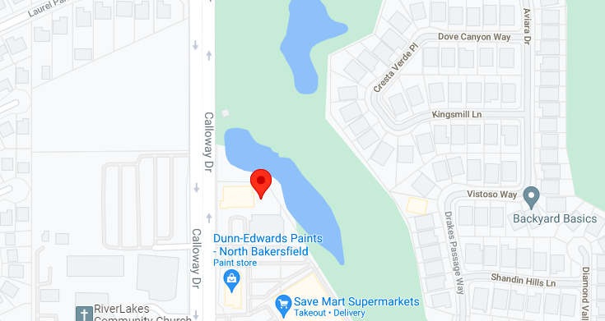
n2/n25
Site ID | Market | Market Vendor | LTE PCI | NR PCI | Latitude | Longitude | 5G Bandwidth | Supported ENDC Combinations
SV11608C | LA North (Bakersfield) | Ericsson | 116, 166, 165, 104 | 116, 166, 165, 104 | 35.4012 | -119.1092 | n71:10 n2/n25:15 | DC_66A_n71A, DC_66A-(n)71AA, DC_12A_n2A, DC_66A_n25A

Slide 50
n71 DSS
Market Vendor | LTE PCI | NR PCI | Latitude | Longitude | 5G Band | 5G Bandwidth | DSS | Supported ENDC Combinations
Ericsson | 386, 144, 187 | 386, 144, 187 | 33.7117 | -117.8667 | n71 | 10 | Yes | DC_2A-66A_n71A, DC_2A_n71A, DC_66A_n71A, DC_2A-66A-(n)71AA, DC_66A-(n)71AA, DC_2A- (n)71AA
Ericsson | 382, 496, 68, 348 | 348, 382, 68 | 33.7005 | -117.866 | n71 | 10 | Yes | DC_2A-66A_n71A, DC_2A_n71A, DC_66A_n71A, DC_2A-66A-(n)71AA, DC_66A-(n)71AA, DC_2A- (n)71AA
Ericsson | 219, 343, 157 | 219, 343, 157 | 33.7154 | -117.8764 | n71 | 10 | Yes | DC_2A-66A_n71A, DC_2A_n71A, DC_66A_n71A, DC_2A-66A-(n)71AA, DC_66A-(n)71AA, DC_2A- (n)71AA
Ericsson | 18, 361, 194 | 18, 361, 194 | 33.707 | -117.8597 | n71 | 10 | Yes | DC_2A-66A_n71A, DC_2A_n71A, DC_66A_n71A, DC_2A-66A-(n)71AA, DC_66A-(n)71AA, DC_2A- (n)71AA

Slide 51
DRIVE ROUTE- Newyork/USA
Operators in USA:
T-Mobile

Slide 52
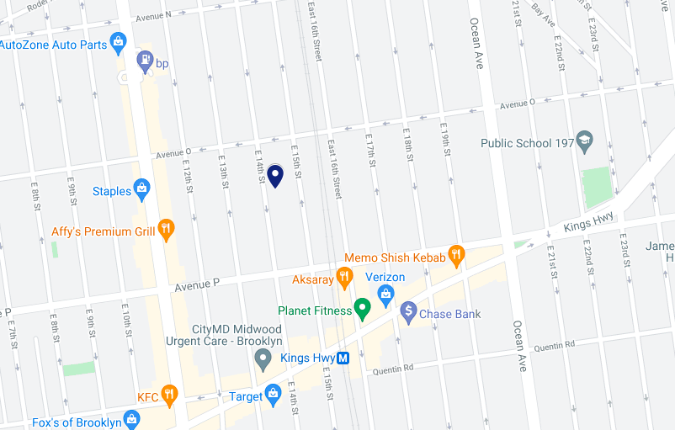
B66+B2(2CA)
B66+B2(2CA) – Location (40.61193, -73.95955)

Slide 53
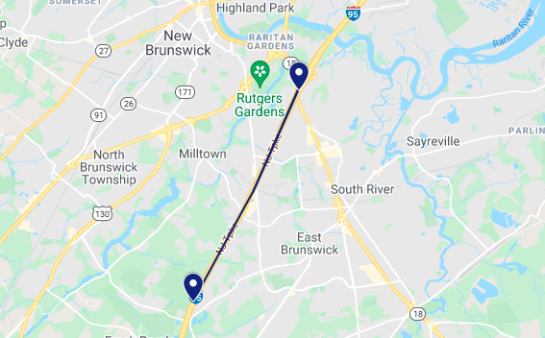
Handover B66->B4->B66
HO B66 location A(40.4734, -74.40917) to B4 location B(40.41583, -74.44667)
Handover between B66->B4->B66

Slide 54
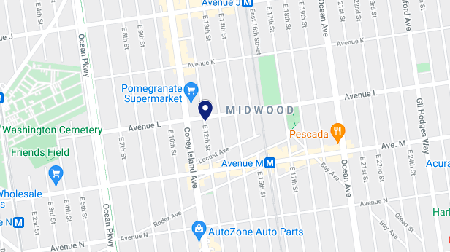
B4(DL256QAM SINR-28dBm RSRP-71dBm)
B4(DL256QAM SINR-28dBm RSRP-71dBm) Location (40.6199, -73.96324)
Need to lock B4
Download big size file
Go to PDSCH demapper configuration
Check transmission modulation

Slide 55
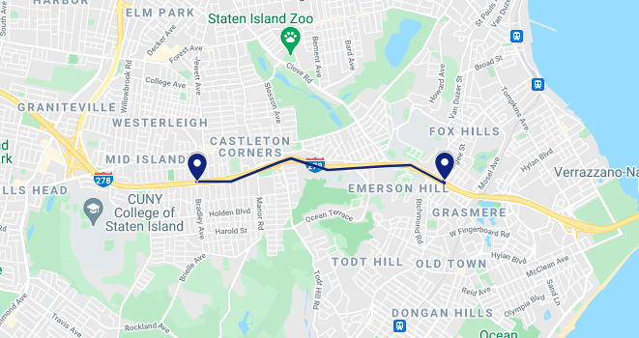
PS HO B66->B2->B66
From Location A(40.60847, -74.08827) to Location B(40.60829, -74.13213)

Slide 56
B4(UL64QAM)
B4(UL64QAM) – Location (40.61193, -73.95955)

Slide 57
TM9 (8x2) NY location
Site ID PCI Lat Long Address
BX03001A 68 40.86313742 -73.92624200 75 Sherman Avenue, New York, NY 10040
NY02093B 6 40.84894907 -73.93689880 661 West 179 Street, New York, NY 10033

Slide 58
B2+B4(2CA)
B2+B4(2CA) – Location (40.61193, -73.95955)

Slide 59
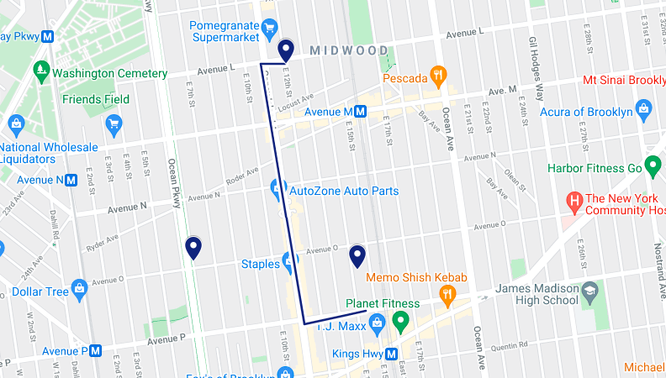
B4(DL256QAM)-B2(64ULQAM)
B4(DL256QAM)-B2(64ULQAM)
PS HO between
B4->B2->B4

Slide 60
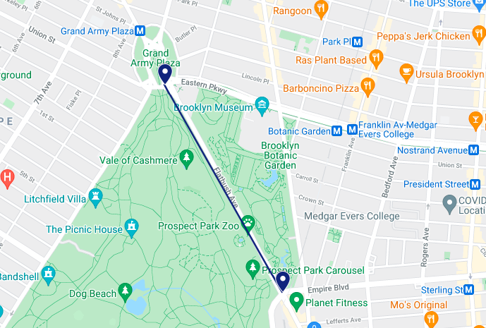
PS HO/Cell Resel B4->B71->B4
B4<->B71 Location A(40.67275, -73.96959) to Location B(40.66318, -73.96242)
PS HO/Cell reselection between B4->B71->B4

Slide 61
B2+B4(2CA)
B2+B4(2CA) – Location (40.6199, -73.96324)

Slide 62
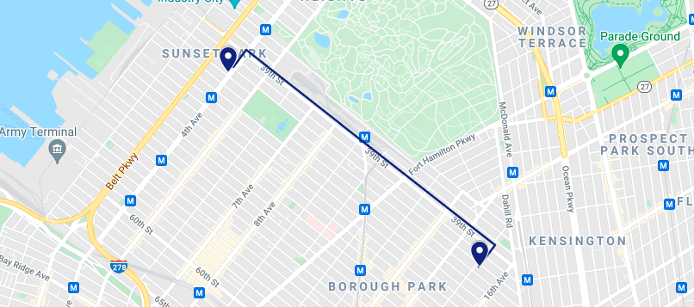
B12->B71->B12 PS HO
From Location A(40.6513, -74.008) to Location B(40.63656, -73.98296)
PS HO/Cell reselection between B12->B71->B12

Slide 63
B2+B12(2CA)
B2+B12(2CA) – Location (40.6199, -73.96324)

Slide 64
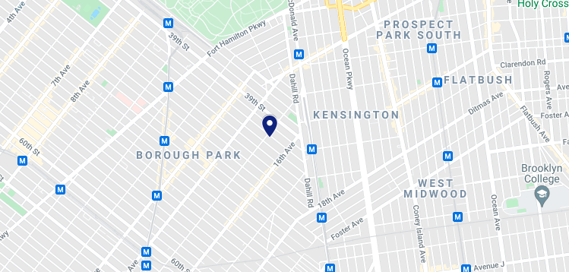
B2+B4+B12(3CA)
B2+B4+B12(3CA) – Location (40.63656, -73.98296)

Slide 65
B4 Cell resel to B2
B4 Cell resel to B2 Cell resel to B4
Cell reselection between B4->B2->B4

Slide 66
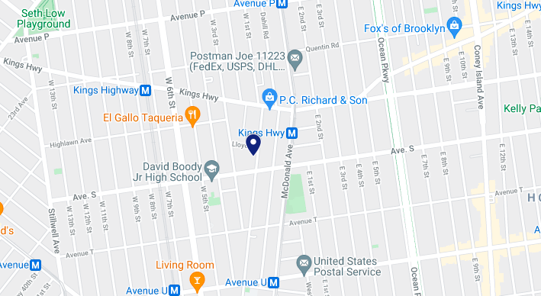
n71 SA
n71 SA Location (40.60223, -73.97453)
For n71 SA we need to lock the LTE band to B71 and disable all NSA band
Few other location are as follow :
  40.69389 -74.4112
  40.69 -74.3822

Slide 67
5G & LTE (B2,B12, B66, B71, & N71)
Co-ordinates : 40.611934 -73.959559
Site Id : BK04013A
LTE Bandwidth : 5MHz, 15MHz
4X4 MIMO : Available for B2 at this
location.
NR Band NSA : N71
For NR band 71 we need to disable all SA bands
and locked the NSA band to B71
Please refer next slides for more location info

Slide 68
5G & LTE (B2,B12, B66, B71, & N71)
Site ID | gNB | NR Band | LTE Band | Latitude | Longitude
BK04000A | NSA | N71 | B2, B12, B66, B71 | 40.704562 | -73.96137
BK04003A | NSA | N71 | B2, B12, B66, B71 | 40.674597 | -73.86384
BK04004C | NSA | N71 | B2, B12, B66, B71 | 40.711 | -73.9576
BK04008A | NSA | N71 | B2, B12, B66, B71 | 40.6513 | -74.008
BK04009A | NSA | N71 | B2, B12, B66, B71 | 40.63656 | -73.98296
BK04010D | NSA | N71 | B2, B12, B66, B71 | 40.602236 | -73.97453
BK04011A | NSA | N71 | B2, B12, B66, B71 | 40.59742766 | -73.970061
BK04012B | NSA | N71 | B2, B12, B66, B71 | 40.6277 | -73.9508
BK04013A | NSA | N71 | B2, B12, B66, B71 | 40.611934 | -73.959559
BK04015A | NSA | N71 | B2, B12, B66, B71 | 40.622588 | -73.96173
BK04017D | NSA | N71 | B2, B12, B66, B71 | 40.667 | -73.9786

Slide 69
5G & LTE (B2,B12, B66, B71, & N71)
Site ID | gNB | NR Band | LTE Band | Latitude | Longitude
BK04001E | SA+NSA | N71 | B2,B12,B66,B71 | 40.68540706 | -73.974385
BK04054A | SA+NSA | N71 | B2,B12,B66,B71 | 40.691415 | -73.986473
BK04068D | SA+NSA | N71 | B2,B12,B66,B71 | 40.694046 | -73.977558
BK04121A | SA+NSA | N71 | B2,B12,B66,B71 | 40.6776 | -73.9725
BK04127B | SA+NSA | N71 | B2,B12,B66,B71 | 40.68039465 | -73.9778719
BK04818A | SA+NSA | N71 | B2,B12,B66,B71 | 40.681321 | -73.974092
BK04995C | SA+NSA | N71 | B2,B12,B66,B71 | 40.69154723 | -73.98126667
BKM4036A | SA+NSA | N71 | B2,B12,B66,B71 | 40.69734 | -73.9863
BKM4093A | SA+NSA | N71 | B2,B12,B66,B71 | 40.6781 | -73.9807
BQ04048A | SA+NSA | N71 | B2,B12,B66,B71 | 40.697327 | -73.982377
BQ04117A | SA+NSA | N71 | B2,B12,B66,B71 | 40.683311 | -73.978156
BQ04150A | SA+NSA | N71 | B2,B12,B66,B71 | 40.691644 | -73.987452
BQ04184B | SA+NSA | N71 | B2,B12,B66,B71 | 40.681981 | -73.986295

Slide 70
5G & LTE (B2,B12, B66, B71, & N71)
Site ID | gNb | NR Band | LTE Band | Latitude | Longitude
BQ04387E | SA+NSA | N71 | B2,B12,B66,B71 | 40.690287 | -73.985202
BQ04186N | SA+NSA | N71 | B2,B12,B66,B71 | 40.702576 | -73.986877
BQ04389A | SA+NSA | N71 | B2,B12,B66,B71 | 40.69459 | -73.982687
BQ04391B | SA+NSA | N71 | B2,B12,B66,B71 | 40.68716 | -73.978007
BQ04394D | SA+NSA | N71 | B2,B12,B66,B71 | 40.67758946 | -73.9674208
BQ04465A | SA+NSA | N71 | B2,B12,B66,B71 | 40.6916027 | -73.9699975
BQ04582A | SA+NSA | N71 | B2,B12,B66,B71 | 40.695785 | -73.987448
BQ04604E | SA+NSA | N71 | B2,B12,B66,B71 | 40.67538928 | -73.9813813
BQ04642A | SA+NSA | N71 | B2,B12,B66,B71 | 40.695691 | -73.971109
BQ04644A | SA+NSA | N71 | B2,B12,B66,B71 | 40.68099 | -73.965223
BQ04799B | SA+NSA | N71 | B2,B12,B66,B71 | 40.687163 | -73.984076
BQ04873C | SA+NSA | N71 | B2,B12,B66,B71 | 40.683498 | -73.970241
BQ04985B | SA+NSA | N71 | B2,B12,B66,B71 | 40.67766615 | -73.9753655

Slide 71
5G & LTE (B2,B12, B66 & N41)
Site ID | gNB | NR Band | LTE Band | Latitude | Longitude
BK04080A | NSA | N41 | B2,B12,B66 | 40.65213 | -73.9508
BKM4055A | NSA | N41 | B2,B12,B66 | 40.65797 | -73.9521
BQ04335C | NSA | N41 | B2,B12,B66 | 40.6551 | -73.9508
BQ04454C | NSA | N41 | B2,B12,B66 | 40.70842 | -73.926
BQ04861A | NSA | N41 | B2,B12,B66 | 40.6239 | -74.0277
NY01904D | NSA | N41 | B2,B12,B66 | 40.71831 | -73.9755
NY02086A | NSA | N41 | B2,B12,B66 | 40.82736 | -73.844

Slide 72
LAA, n71, mmWave
Lat Long NR Band LTE Band
40.7587316 -73.9916633 n71,n261 B2,B12,B66,B46,B71
40.76488428 -73.9880845 n71,n261 B2,B12,B66,B46,B71
40.76710305 -73.9861169 n71,n261 B2,B12,B66,B46,B71
NR Bandwidth : LTE Bandwidth:
N71 : 5 MHz B2 : 10 MHz
N261 : 2x50 MHz B66: 20 MHz
B71 & B12 : 5 MHz
B46 : 3x20 MHz

Slide 73
5G NSA (E//) with LAA
Site ID LTE PCI NR PCI Latitude Longitude
NY01440A B2: 30, 31, 32 n71: 273, 274, 275 40.731358 -73.9829055
B4: 153, 154, 155 n261: 153, 154, 155
B12: 273, 274, 275 n41: 153, 154
B71: 273, 274, 275
LAA: 153, 154, 155
NY01846A B2: 281, 402, 403 n71: 255, 256, 257 40.72547224 -73.9780175
B4: 315, 316, 317 n261: 217, 316
LAA: 316, 317 n41: 315, 316, 317
B12: 255, 256, 257
B71: 255, 256, 257
NY01177B B2: 142, 216, 470 n71: 309, 310, 311 40.7276924 -73.9905902
B4: 321, 322, 323 n261: 323, 322
LAA: 322, 323 n41: 321, 322, 323
B12: 309, 310, 311
B71: 309, 310, 311

Slide 74
5G NSA (E//) with LAA
Site ID LTE PCI NR PCI Latitude Longitude
NY01871A B2: 42, 43, 44 n71: 108, 109, 110 40.72851054 -73.9762066
B4: 471, 472, 473 n261: 473, 472, 471
LAA: 471, 472, 473 n41: 471, 472, 473
B12: 108, 109, 110
B71: 108, 109, 110
NY01919B B12: 24, 25, 413 n261: 93, 94, 95 40.72320492 -73.9828022
B2: 174, 175, 176 n71: 24, 25, 413
B4: 93, 94, 95 n41: 93, 94, 95
B71: 24, 25, 413
LAA: 93, 95
Few other location as as follows :
40.73039079 -73.9861287
40.72802249 -73.9789568
40.72546321 -73.9841761
40.72878333 -73.9841715
40.7287929 -73.9877506

Slide 75
DRIVE ROUTE- Myrtel Beach/USA
Operators in USA:
T-Mobile

Slide 76
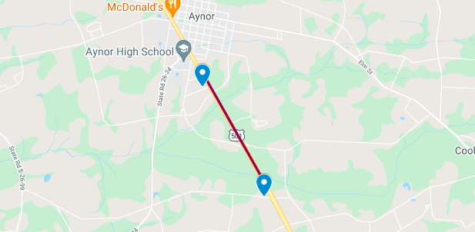
B5-B2 Handover
B5->B2 HO Location A(33.98672, -79.19933) to Location B(33.96643, -79.18569)
B5->B2 Handover

Slide 77
DRIVE ROUTE- Dallas & Lewisville/USA
Operators in USA:
T-Mobile

Slide 78
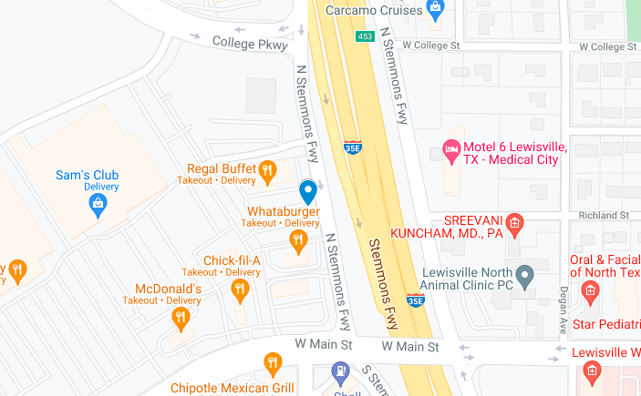
B2 & B66_TM9(8*2)_DL256QAM
B2 & B66_TM9(8*2)_DL256QAM
Location 1 : Near Cell RF test location (33.04778, -97.00996)
Location 2 : Near Cell RF test location (33.04764, -97.01099)
Location 3 : Mid Cell RF test Location (33.04543, -97.01512)

Slide 79
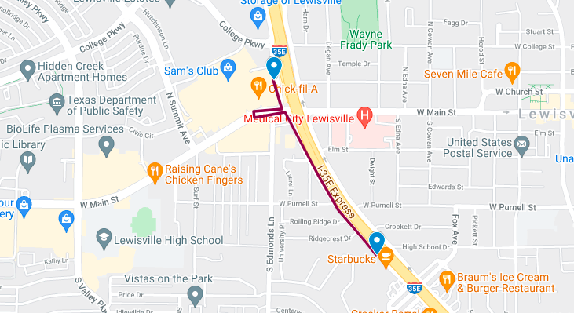
TM9(8x2)<->TM4 PS HO
Location A(33.04778, -97.00996) to Location B(33.03974, -97.00435)
TM4-TM9 HO
TM9-TM4 HO

Slide 80
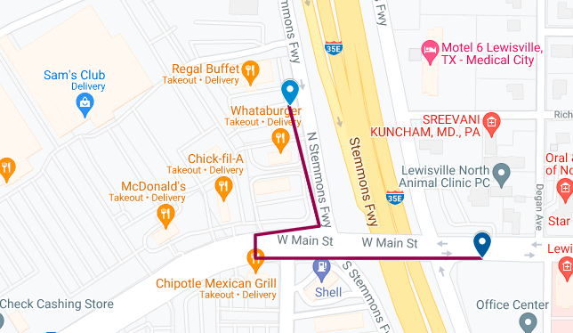
B2 & B66_TM9-TM9 HO
From Location A(33.04778, -97.00996) to Location B(33.04624, -97.00764)
TM9-TM9 HO

Slide 81
LAA, n71, & mmWave
Market Lat Long NR Band LTE Band
Dallas 32.76979 -97.10451 n71, n261 B2,B46,B66
Dallas 32.76754 -97.09989 n71, n261 B2,B46,B66
Site ID Lat Long
DA01004 32.783593 -96.801413
DA01061 32.797965 -96.805019
N260/39Ghz, configured as 8CC for 39Ghz mmW.

Slide 82
DRIVE ROUTE- Yakima/USA
Operators in USA:
T-Mobile

Slide 83
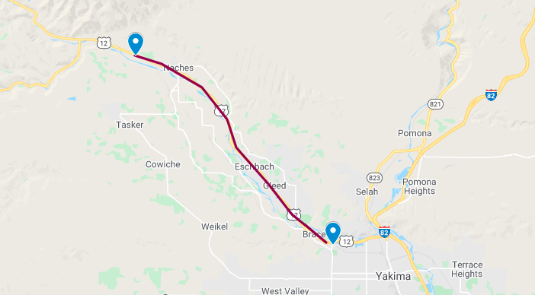
Home PLMN to Roaming PLMN
From Location A(46.62107, -120.56097) – Location B(46.73865, -120.73925)
Home PLMN to Roaming PLMN

Slide 84

B71 CA Yakima location
71+2, 71+4, 71+2+4 available in this location (46.56942, -120.474306)
https://goo.gl/maps/ujWG3vpAXVVAG18S6

Slide 85

n71 DSS
Market Vendor | LTE PCI | NR PCI | Latitude | Longitude | 5G Band | 5G Bandwidth | DSS | Supported ENDC Combinations
Ericsson | 386, 144, 187 | 386, 144, 187 | 33.7117 | -117.8667 | n71 | 10 | Yes | DC_2A-66A_n71A, DC_2A_n71A, DC_66A_n71A, DC_2A-66A-(n)71AA, DC_66A-(n)71AA, DC_2A- (n)71AA

Slide 86
DRIVE ROUTE- Albuquerque/USA
Operators in USA:
T-Mobile

Slide 87

B2+B71(2CA)
B2+B71(2CA) – Location (35.68773, -105.93489)

Slide 88
B66(20MHz)+B66(10MHz) (2CA)
B66(20MHz)+B66(10MHz) – Location (35.68773, -105.93489)

Slide 89
B66+B71(2CA)
B66+B71(2CA) – Location (35.68773, -105.93489)

Slide 90
DRIVE ROUTE- Kansas City/USA
Operators in USA:
T-Mobile

Slide 91

Please find the more n41 location in Kansas city:
38.76537 -93.7424
38.8158, -94.5358
38.83053,-94.5324
SiteID:- A5C0195B
NR_Bandwidth:- N41(60), N6(10)
NR MIMO:- N41(2x2), N6(2x2)
LTE Bandwidth:- L19(20), L21(10), L41(20+20), L6(5), L7(5)
LTE MIMO:- L19(4x4), L21(4x4), L41(DualBeam+DualBeam), L6(4x2), L7(4x2)
Location: https://www.google.com/maps/place/38%C2%B045'11.2%22N+93%C2%B044'13.6%22W/@38.7531042,-93.7392887,17z/data=!3m1!4b1!4m5!3m4!1s0x0:0x0!8m2!3d38.7531!4d-93.7371
Urban 5G & LTE (B2, B25, B12, B4, B66, B41, B71, N41)

Slide 92

Reverse MOCN sites
SiteID:- A5D0145B
Location:39.01333, -94.66639
https://www.google.com/maps/place/39%C2%B000'48.0%22N+94%C2%B039'59.0%22W/@39.0133341,-94.6685787,17z/data=!3m1!4b1!4m5!3m4!1s0x0:0x0!8m2!3d39.01333!4d-94.66639
Please find the more reverse MOCN location:-
38.81975,-94.5837
38.74531,-94.6708

Slide 93
DRIVE ROUTE- Chicago/USA
Operators in USA:
T-Mobile

Slide 94

Band 48 CBRS
Site ID: CH1332BA_51LAB
Location: https://www.google.com/maps/place/41%C2%B057'41.0%22N+87%C2%B040'42.4%22W/@41.961383,-87.6806297,17z/data=!3m1!4b1!4m5!3m4!1s0x0:0x0!8m2!3d41.961379!4d-87.678441
Please find the more band 48 CBRS location:
41.961491, -87.681476
41.961417, -87.688829
41.961571, -87.675344
41.961076, -87.68375

Slide 95
DRIVE ROUTE- Austin/USA
Operators in USA:
T-Mobile

Slide 96

Band 66 (20 Mhz) + Band 66 ( 5 Mhz)+ Band2 ( 10 Mhz)+ Band 12 ( 5 Mhz)
Site ID: SA01310C
Location: 29.36742 -98.5402 https://www.google.com/maps/place/29%C2%B022'02.7%22N+98%C2%B032'24.7%22W/@29.3674247,-98.5423887,17z/data=!3m1!4b1!4m5!3m4!1s0x0:0x0!8m2!3d29.36742!4d-98.5402

Slide 97

(Band 4+Band 4+ Band12, BW 10+10+10)
Location: https://www.google.com/maps/d/viewer?mid=1VTdrtbwl-aXZ4eY6pXr5XLyJO8E&ll=30.21927429838685%2C-97.76492500000002&z=13

Slide 98

(Band 4+Band 4+ Band12, BW 10+10+5)
Location: https://www.google.com/maps/d/viewer?mid=1AIh_-AjpVxRzEPaHOVYGSpnesMc&ll=30.2143808661117%2C-97.764845&z=13

Slide 99

Band 2 ( 10 Mhz) , Band 4 (10 Mhz), Band4 ( 10 Mhz), Band 12 ( 5 Mhz)
Location: 30.370886 -97.693375
https://www.google.com/maps/place/30%C2%B022'15.2%22N+97%C2%B041'36.2%22W/@30.3698446,-97.6951023,17z/data=!4m5!3m4!1s0x0:0x0!8m2!3d30.370886!4d-97.693375
Note: N/W only aggregates up to 3CC

Slide 100
2A+4A+4A & 2A+66A+66A
Band Combination: 2A-4A-4A
Bandwidth: B2-10Mhz, B4-10Mhz, B4-10Mhz
4X4 MIMO : Not Available
256QAM – Available
Location : 30.370886, -97.693375
Band Combination: 2A-66A-66A
Bandwidth: B2-10Mhz, B66-5Mhz, B66-5Mhz
4X4 MIMO : Available
256QAM – Available
Location : 29.485185,-98.559232

Slide 101

5G n2/n25/n66 5G SA
NR PCI : n71(687,67, 692), n66(687,670,692), n2(687,670,692)
NR Bandwidth: n25: 5MHz, n66:5MHz, n2:5MHz, n71: 10 MHz
Supported EnDC combination: DC_2A-12A_n66A, DC_12A_n66A,DC_2A_n66A, DC_12A_n2A,DC_66A_n25A, DC_2A-66A-(n)71AA, DC_66A-(n)71AA, DC_2A-(n)71AA, DC_2A-71AA
PCI LTE: B12: 247,146,154,318
B2: 220,243,221,219
B66:371,487,369,370
B71: 435,31,326,94
Location: https://www.google.com/maps/place/30%C2%B015'57.0%22N+97%C2%B044'19.0%22W/@30.2658376,-97.7407997,17z/data=!3m1!4b1!4m5!3m4!1s0x0:0x0!8m2!3d30.265833!4d-97.738611

Slide 102
THANKS

