Slide 1
MARQUIS TECHNOLOGIES
Drive Route

Slide 2
Taipei/Taiwan
Operator Details:
S. No. | Operator |  | Supported Bands | Supported Features by Network
1 | Major | Chunghwa | B3 (1800) B7 (2600) B8 (900) | VoWiFi/VoLTE/4G/5G
2 |  | Far Eastone | B3 (1800) B7 (2600) B28 (700) | VoWiFi/VoLTE/4G/5G
3 |  | Taiwan Mobile | B38 (2600) B28 (700) | VoWiFi/VoLTE/4G/5GNSA&5GSA
4 | Minor | GT | B3 (1800) B28 (700) | VoWiFi/VoLTE/4G/5G
5 |  | Tstar | B7 (2600) B8(900) | VoLTE/4G/5G

Slide 3
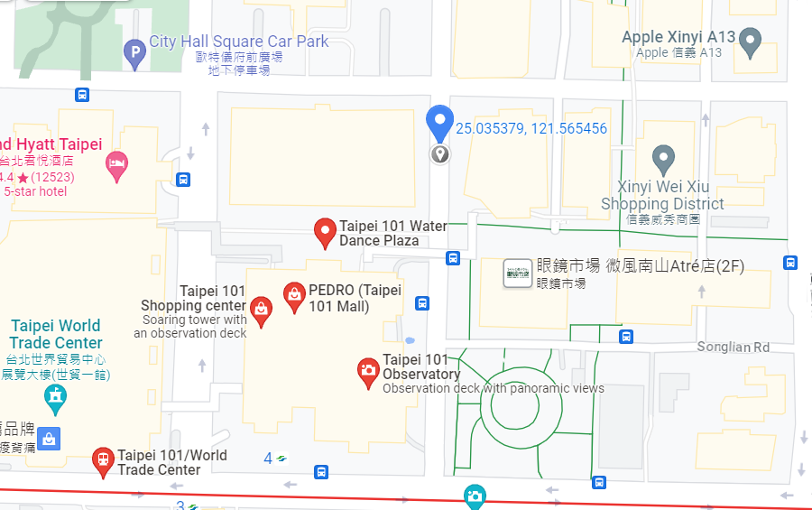
5G Near Cell, Chunghwa
Lat/Long -25.035379° N, 121.565456° E
Specification –Stable 5G NSA network for Chunghwa
Good Throughput

Slide 4
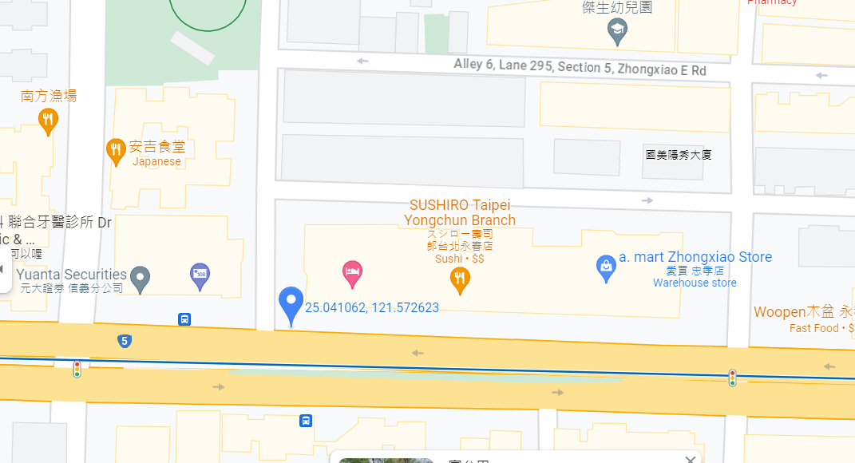
5G Near Cell, GT
Lat/Long -25.041062° N, 121.572623° E
Specification –Stable 5G NSA network for GT
Good Throughput

Slide 5
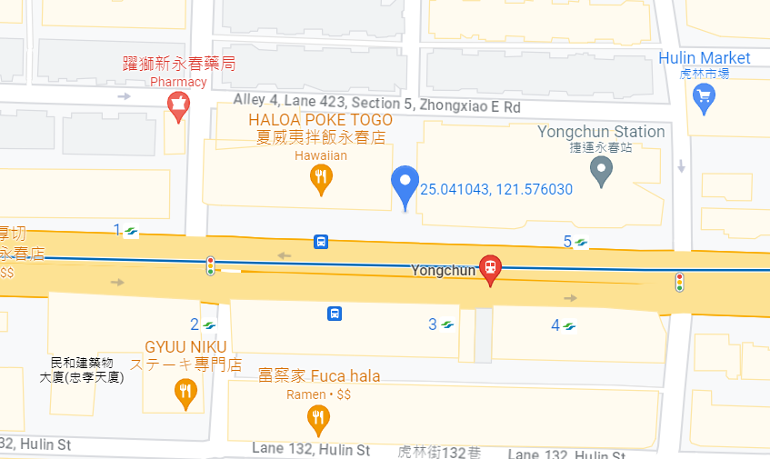
5G Near Cell, Taiwan Mobile
Lat/Long -25.041043° N, 121.576030° E
Specification –Stable 5G NSA network for Taiwan Mobile
Good Throughput

Slide 6
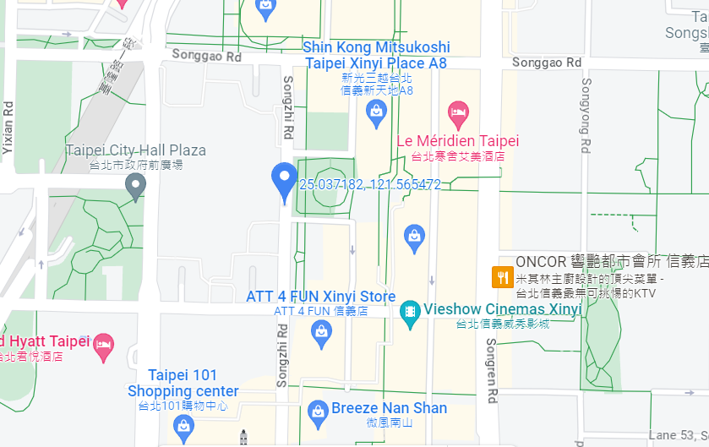
5G Near Cell, Tstar
Lat/Long -25.037182° N, 121.565472° E
Specification –Stable 5G NSA network for Tstar
Good Throughput

Slide 7
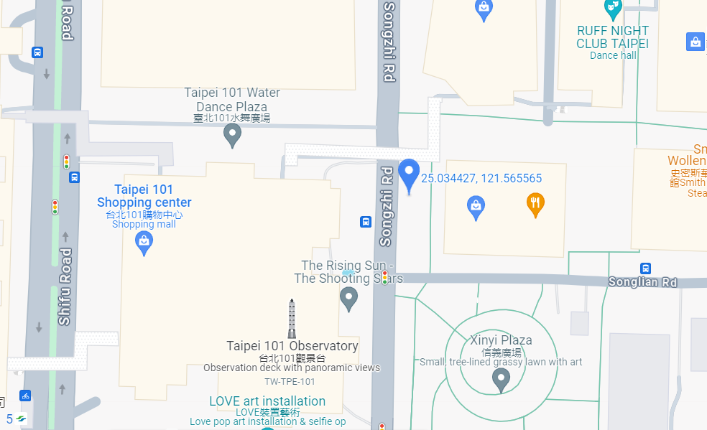
5G Near Cell, FET
Lat/Long -25.037182° N, 121.565472° E
Specification –Stable 5G NSA network for FET
Good Throughput

Slide 8
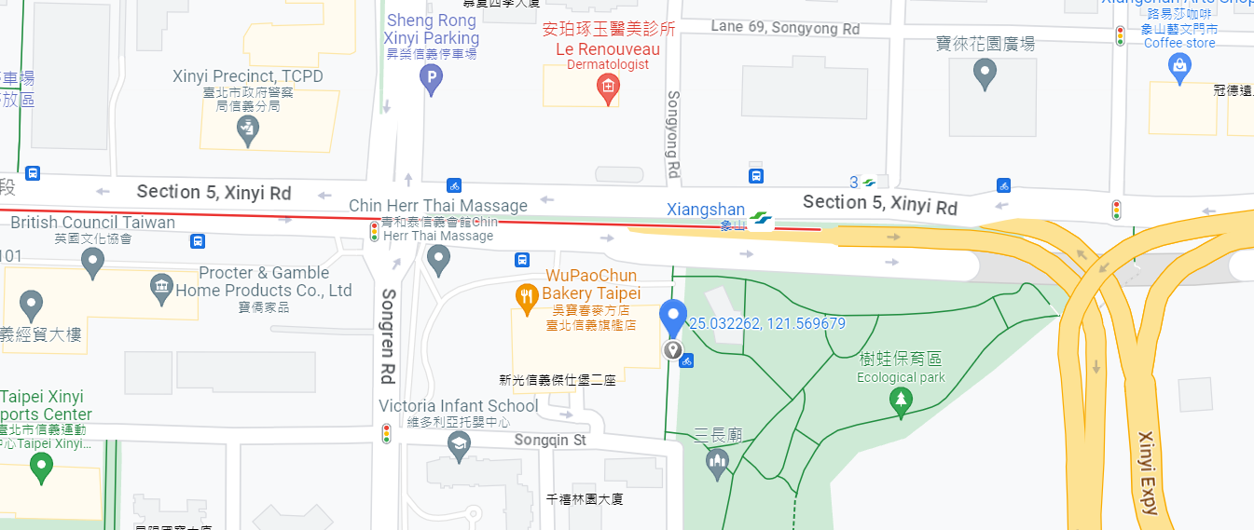
SA, Taiwan Mobile
Lat/Long -25.032262° N, 121.569679° E
Specification –Stable SA for Taiwan Mobile
Good Throughput

Slide 9
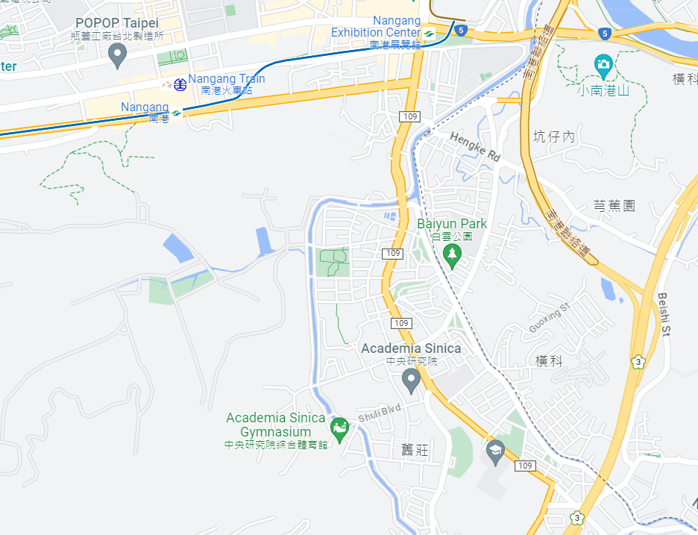
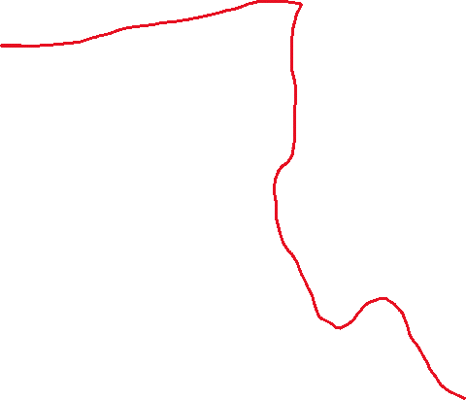
NR TO LTE TO NR Handover,Chunghwa, FET
Lat/Long - 25.042216, 121.620151 to 25.052743, 121.611345
4G
5G
4G

Slide 10
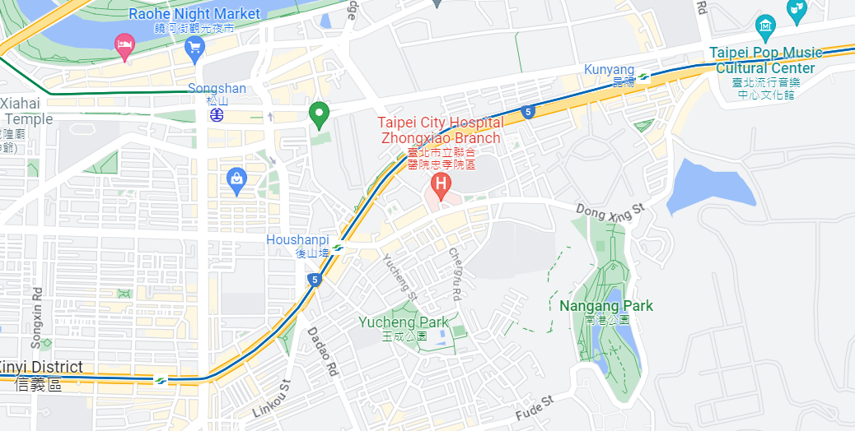


NR TO LTE TO NR Handover,GT, Tstar, Taiwan Mobile
Lat/Long - 25.049931, 121.592869 to 25.041071, 121.582403
4G
5G
4G

Slide 11
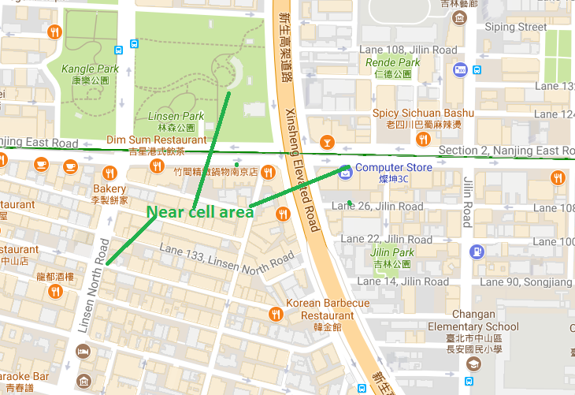
TW mobile: Near cell

Slide 12
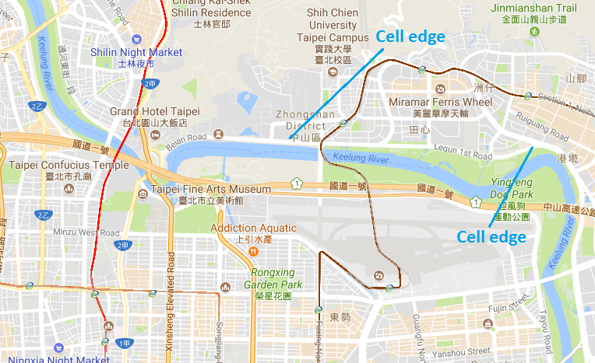
TW mobile: Edge cell

Slide 13
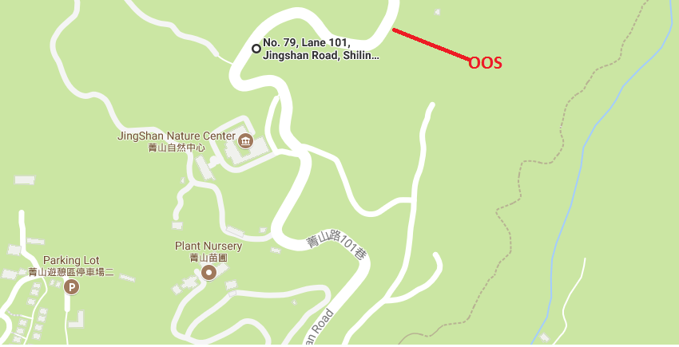
TW mobile: OOS area (No. 79, Lane 101, Jingshan Road, Shilin District, Taipei City, 111)

Slide 14
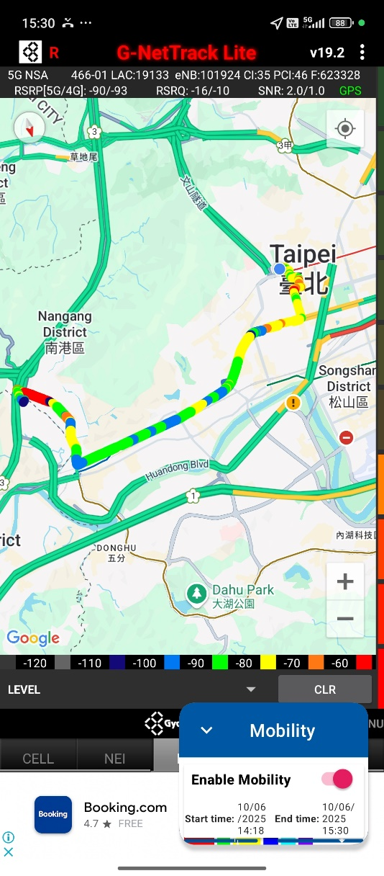
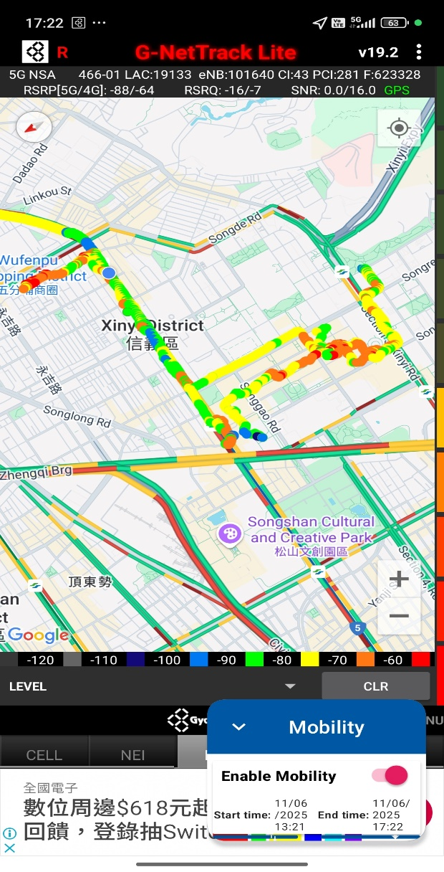
DRIVE ROUTE

Slide 15
THANK YOU
MARQUIS TECHNOLOGIES
www.marquistech.com

