Slide 1
MARQUIS TECHNOLOGIES
Drive Route- Dubai, UAE

Slide 2
Travel to Dubai (UAE)
Country | UAE
Continent | Asia
City | Dubai
Time Zone | GMT +4 Hour
Currency | AED
International Dialing Code | +971

Slide 3
Operators in UAE
MCC | MNC | Operator
431 | 2 | Etisalat
424 | 3 | Du
DU Network Info
RAT | Band | Comment
5G | n78, n41
4G | B3 (1800 MHz), B20 (800 MHz)
3G | B1 (2100 MHz)
2G | GSM-900 MHz
Etisalat Network Info
RAT | Band | Comment
5G | n78
4G | B3/B7/B41/B20/B42
3G | B1
2G | GSM-900 MHz

Slide 4
Operators and general Information
Etisalat- Supports 5G, VoLTE, LTE, WCDMA and 2G
DU- Supports 5G, LTE, WCDMA and 2G
DU and Etisalat doesn’t support ViLTE, VoWi-Fi, ViWi-Fi services.

Slide 5
USSD codes for balance check
Etisalat balance check: *121#
Etisalat Internet balance check: *170#
DU balance check: *135# or SMS Balance to 1355.
DU Move balance check: *#055# or SMS Balance to 1355.

Slide 6

Supplementary Services
Etisalat: Call forwarding and Call Waiting supported
DU: Call forwarding and Call Waiting supported

Slide 7
RSRP Criteria
Near Cell :-Stationary: RSRP : -65dbm to -85dbm
Cell Edge :-Stationary: RSRP : -95dbm to -110dbm
Mixed :-Mobility: RSRP : -65dbm to -120dbm

Slide 8
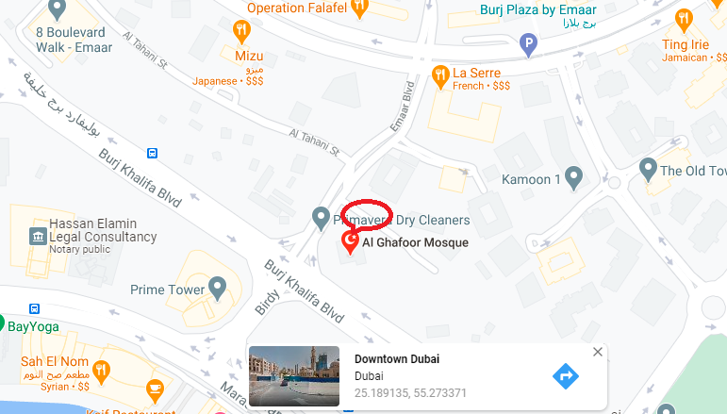
5G Near Cell (DU & Etisalat):

Slide 9
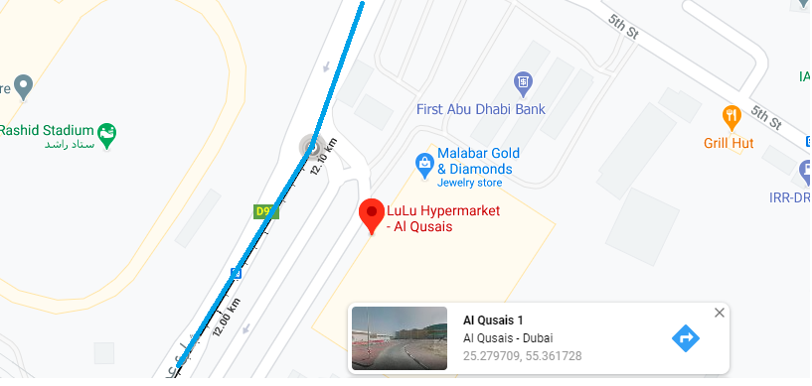
Edge Cell(DU & Etisalat)

Slide 10
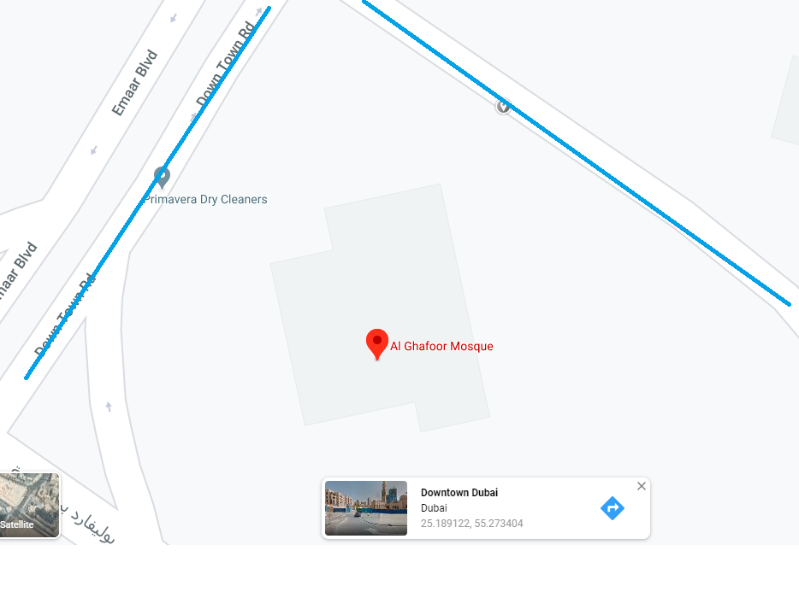
Near cell Etisalat 5G Coverage:

Slide 11
Near cell DU 5G Coverage:

Slide 12
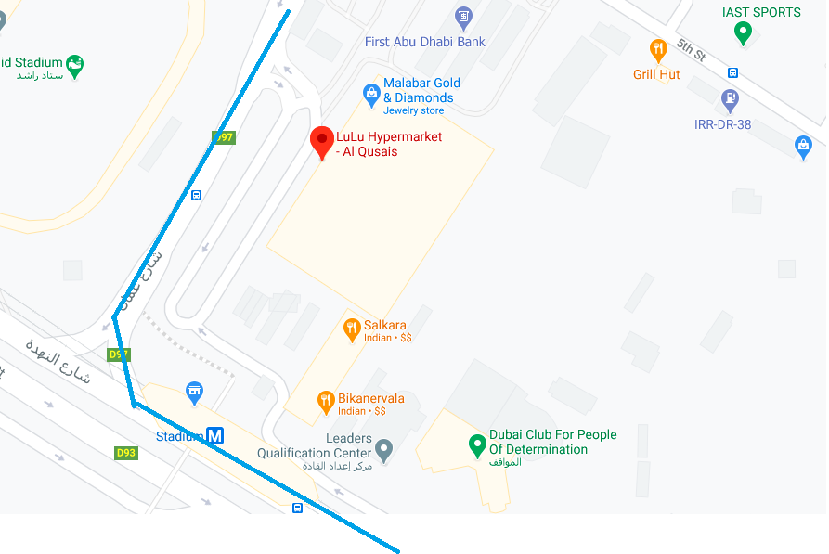
Etisalat 5G to 4G & 4G to 5G for DU and Etisalat:

Slide 13
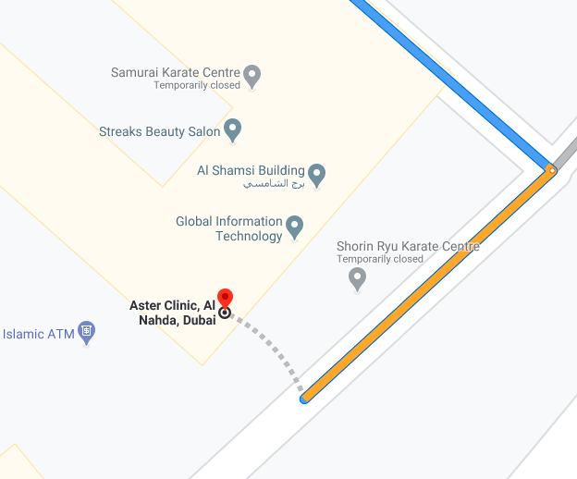
DU 5G N41-N78 Handover:
Inside Aster building

Slide 14
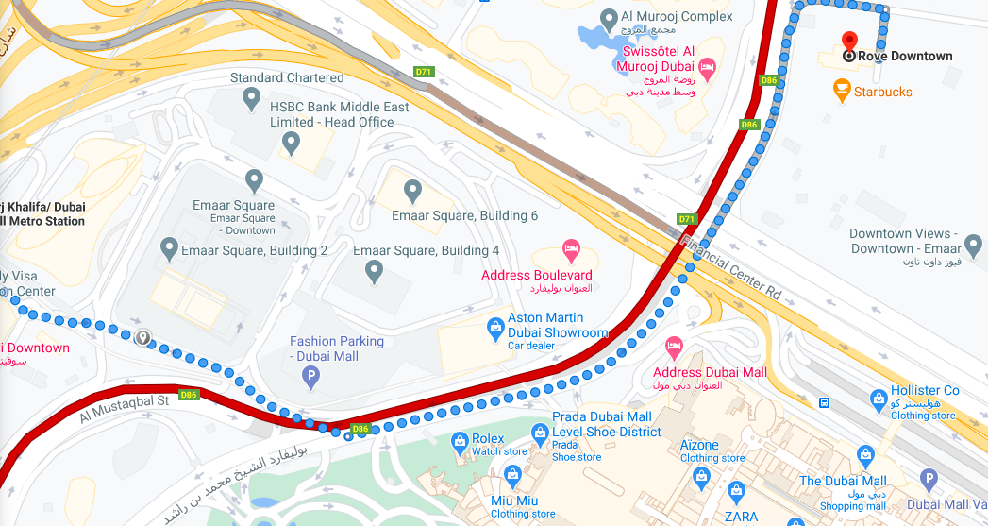
DU & Etisalat 5G Area without fluctuation:

Slide 15
THANK YOU
MARQUIS TECHNOLOGIES
www.marquistech.com

