Slide 1
MARQUIS TECHNOLOGIES
Drive Route –Airtel, Idea, VODAFONE & Reliance JIO (FDD/TDD) LTE

Slide 2
Operator Information:
Operator | JIO 4G
MCC | 404
MNC | 97
APN | Jionet
Operator | Airtel 4G
MCC | 404
MNC | 56
APN | Airtelgprs.com
Operator | VI
MCC | 404
MNC | 56
APN | www
Operator | BSNL
MCC | 404
MNC | 54
APN | bsnlnet

Slide 3
Operator Information 1
Functionality | Airtel
Website: http://www.airtel.com/ WAP APN: airtelgprs.com
Customer care | 199
MNC | 56
Bands supported | Both FDD and TDD
 | LTE 2300 MHz – TDD(Band 40)
 | LTE 1800,850 MHz – FDD(Band 3)
USSD | To check MDN: *282#
 | Balance check: *123#
 | Data Balance check: *121*114#
VoLTE | Supported
CSFB | Supported (CSFB to 2G)

Slide 4
Operator Information 2
Functionality | RELIANCE JIO
Website: http://www.jio.com WAP APN: jionet
Customer care | 198
MNC | 97
Bands supported | Both FDD and TDD
 | LTE 2300 MHz –TDD(Band 40)
 | LTE 850 MHz – FDD(Band 5)
 | LTE 1800 MHz –FDD(Band 3)
USSD | NA
 | NA
 | NA
VoLTE | Supported
CSFB | Not Supported

Slide 5
Operator Information 3
Functionality | VI
Website: http://www.myvi.in WAP APN: WWW
Customer care | 198
MNC | 56
Bands supported | Both FDD and TDD
 | LTE 2300 MHz –TDD(Band 40,41)
 | LTE 850 MHz – FDD(Band 5)
 | LTE 1800 MHz –FDD(Band 3)
USSD | To check MDN*199#
 | Balance check198
 | Data Balance check: 121
VoLTE | Supported
CSFB | Supported to 2G / 3G

Slide 6
Operator Information 4
Functionality | BSNL
Website: http://portal.bsnl.in WAP APN: bsnlnet
Customer care | 1503
MNC | 54
Bands supported | Both FDD and TDD
 | GSM 2G 900 – B - PGSM
 | UMTS 3G 2100 – B - U1[5]
USSD | To check No.-*222#
 | Main Balance check-*123*1#
 | 2G&3G Data Balance check- *123*5#
VoLTE | Not Supported
CSFB | Not Supported

Slide 7
Drive Route
Near Cell :- Stationary: RSRP : -65dbm to -75dbm
Cell Edge :- Stationary: RSRP : -95dbm to -110dbm
Mixed :- Mobility: RSRP : -65dbm to -110dbm

Slide 8
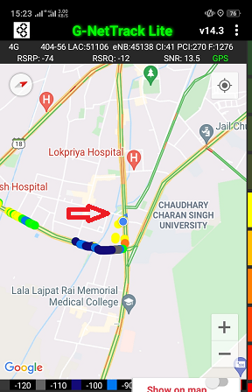
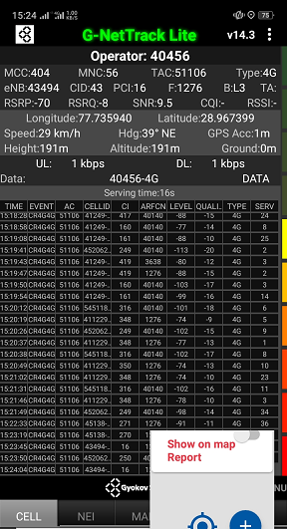
Near Cell (Airtel)
Near cell(NC) | longitude | latitude | RSRP | Cell id | FDD E-ARFCN
1 | 77.735940 | 28.967399 | -70 | 43 | 1276
Garh road near Hotel Broadway inn, mangal Pandey Nagar ,Meerut.
RSRP:
-65dbm to 75dbm

Slide 9
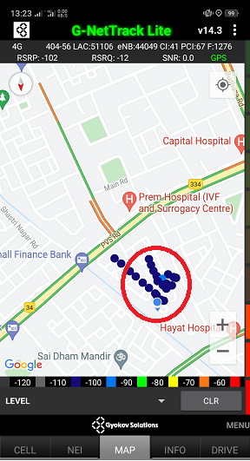
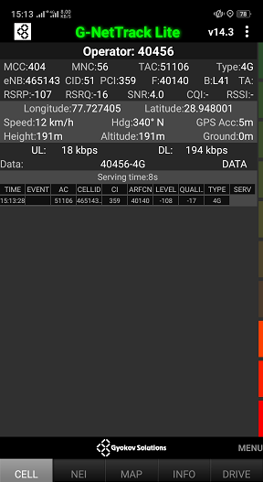
Edge Cell (Airtel)
Edge cell(EC) | longitude | latitude | RSRP | Cell id | TDD E-ARFCN
1 | 77.727405 | 28.948001 | -107 | 51 | 40140
Shastri Nagar, L Block, Meerut
RSRP:
-95dbm to -110dbm

Slide 10
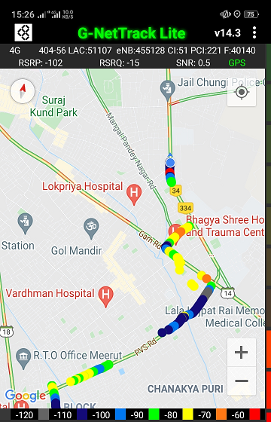
Mixed Mobility:- University road ,Meerut, U.P
University road ,Meerut, U.P
RSRP: -65dbm to -110dbm

Slide 11
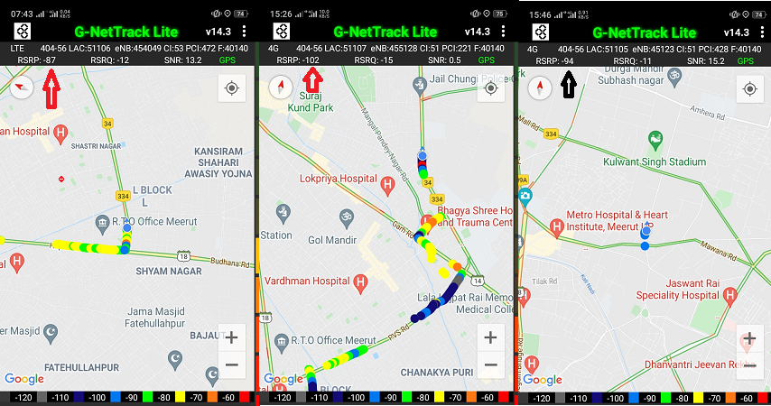
Airtel Band HO
Band Hand Over | longitude | Latitude | RSRP
1 | 77.717114 | 28.961156 | -85 to 105 dBM

Slide 12
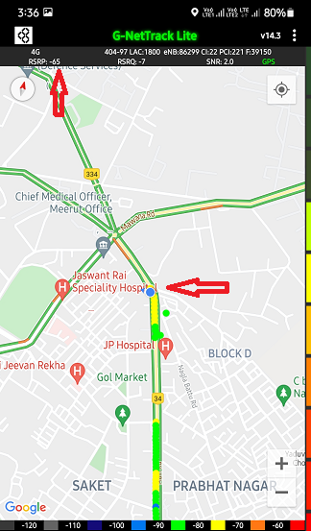
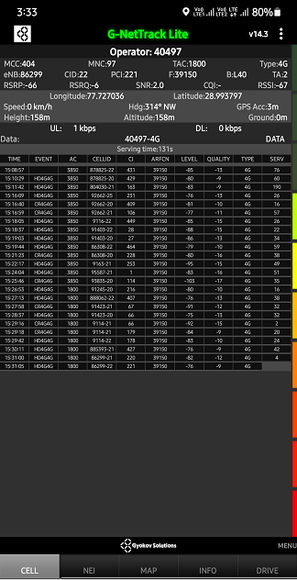
Near Cell (Reliance JIO)
Near cell(NC) | longitude | latitude | RSRP | Cell id | TDD E-ARFCN
1 | 77.727036 | 28.993797 | -66 | 22 | 39150
CCS university road ,Pulse of market, Meerut, U.P
RSRP:
-65dbm to -75dbm

Slide 13
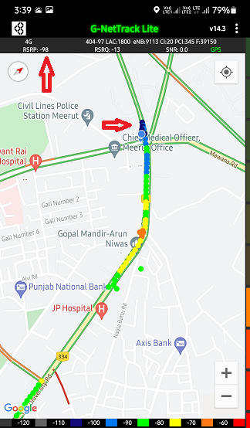
Edge Cell (Reliance JIO)
Edge cell(NC) | longitude | latitude | RSRP | Cell id | TDD E-ARFCN
1 | 77.727036 | 28.993797 | -98 | 20 | 39150
Cant, CMO office, Civil Lines , Meerut, U.P
RSRP:
-95dbm to -110dbm

Slide 14
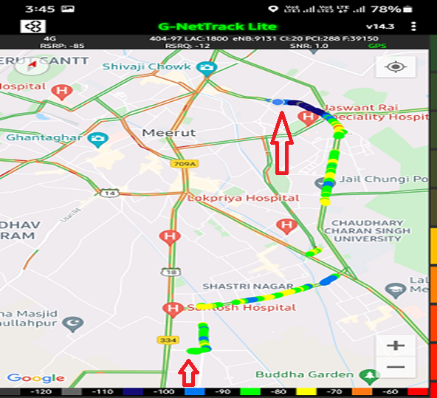
Mixed Mobility:-Cant Meerut , U.P
RSRP: -65dbm to -110dbm

Slide 15
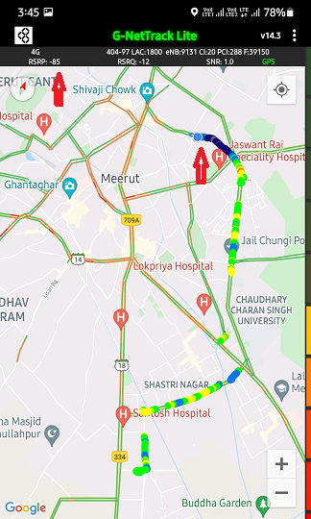
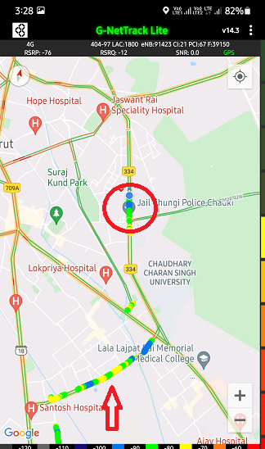
Inter Band Handover (FDD-TDD), JIO 4G
Band Handover | longitude | latitude | RSRP | PCI | TDD E-ARFCN
1 | 77.727036 | 28.993797 | -85 | 288 | 39348

Slide 16
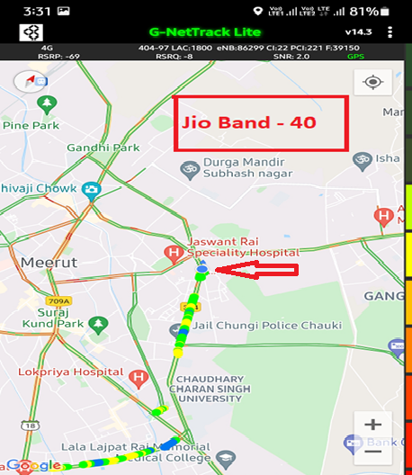
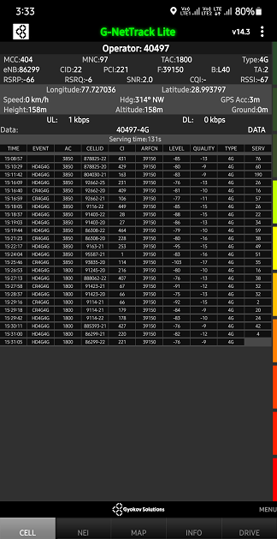
RJIO Band 40 Near Cell:
CCS university road ,Pulse of market, Meerut, U.P

Slide 17
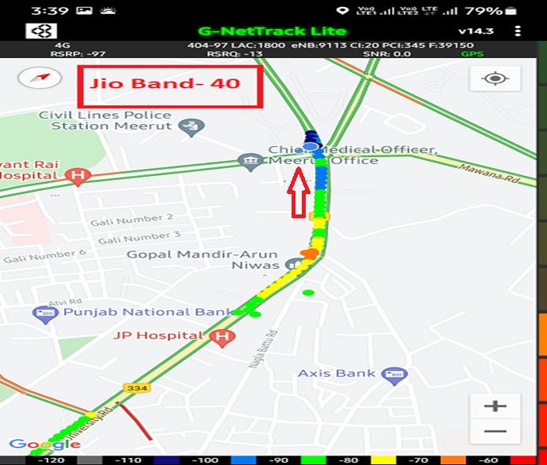
RJIO Band 40 Edge Cell:
Cant, CMO office, Civil Lines , Meerut, U.P

Slide 18
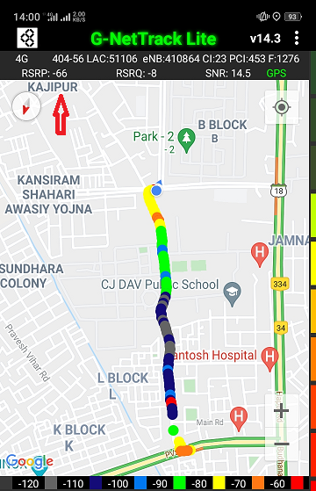
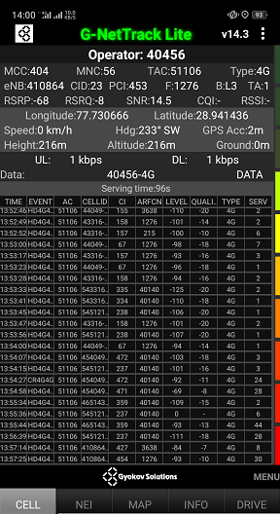
Near Cell VI:
Near cell(NC) | longitude | latitude | RSRP | Cell id | TDD E-ARFCN
1 | 77.730666 | 28.941436 | -68 | 23 | 1276
Police line road Meerut , U.P
RSRP:
-65dbm to -75dbm

Slide 19
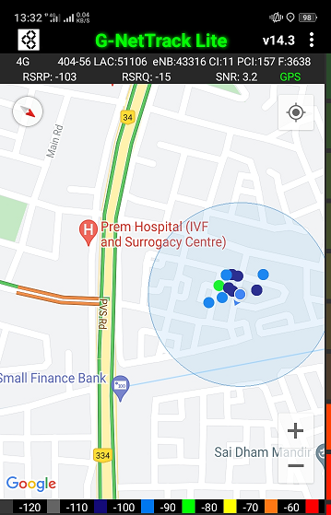
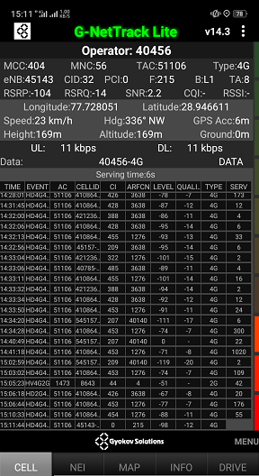
Edge Cell VI:
Edge cell(EC) | longitude | latitude | RSRP | Cell id | TDD E-ARFCN
1 | 77.728051 | 28.946611 | -104 | 32 | 215
Shastri Nagar ,L Block, Meerut U.P
RSRP:
-95dbm to -110dbm

Slide 20
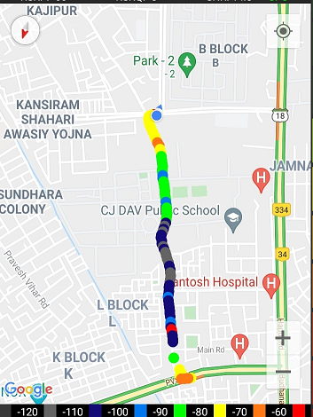
Mixed coverage area Vodafone:
Shastri Nagar L-Block to
Police line road Meerut , U.P
RSRP: -65dbm to -110dbm

Slide 21
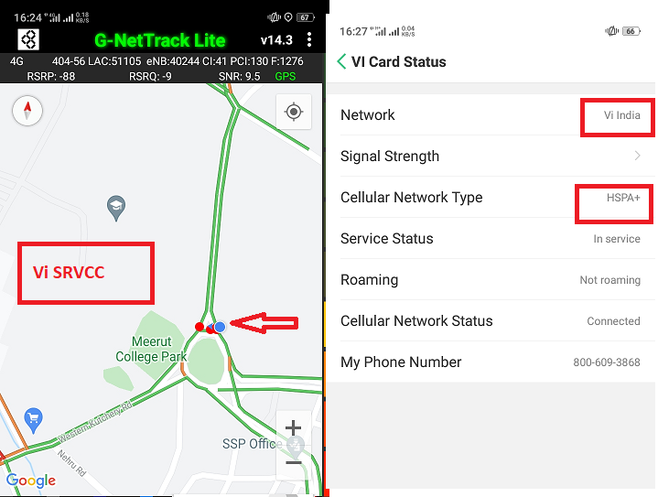
VI SRVCC to HSPA:

Slide 22
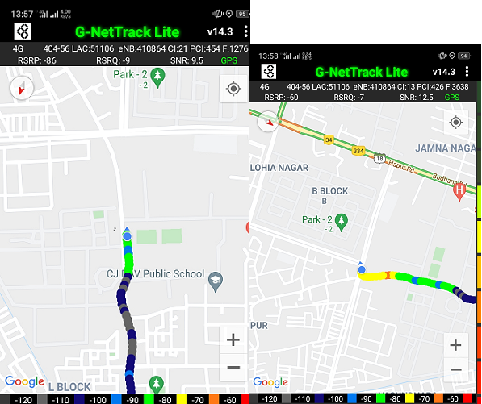
Vi Band 3<>8<>41 Handover

Slide 23
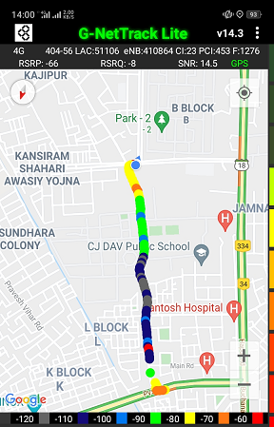
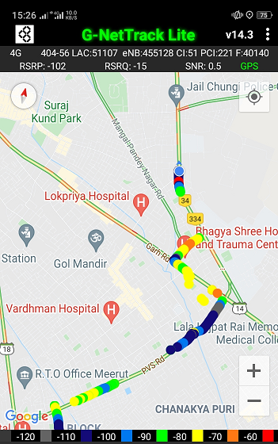
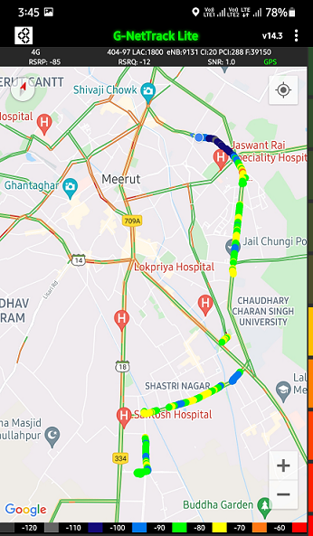
G net Tracker Drive Route

Slide 24
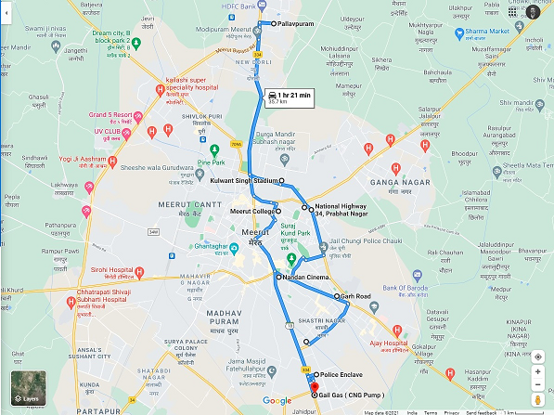
Google drive route-

Slide 25
THANK YOU
MARQUIS TECHNOLOGIES

