Slide 1
Siliguri/West Bengal
Network Information
Siliguri
(West Bengal)
S.NO | Operator Name | Service Supported | Band Supported | Band Tested | Endc Combination tested | CA Combination
1 | Airtel | 2G/4G/5G/VoLTE/VoWiFi | 4G BAND 1/3/8/40,5GBand N78 | B40,B1,B3,N78 | N78+B1,N78+B3 | B40+B40/B3+B40
2 | RJIO | 4G/5G/VoLTE/VoWiFi | 4G BAND 3/5/40,5G Band N78/N28 | B40,B1,N78,N28 | NA | B40+B40
3 | VI | 2G/4G/VoLTE/VoWiFi | 4G BAND 1/3/8/41 | B3,41 | NA | B3+B1+B8/B3+B8+B41/B3+B8/B3+B41+B1
4 | BSNL | 2G/3G | B1 | 2100MZH/900MHZ | NA | NA

Slide 2
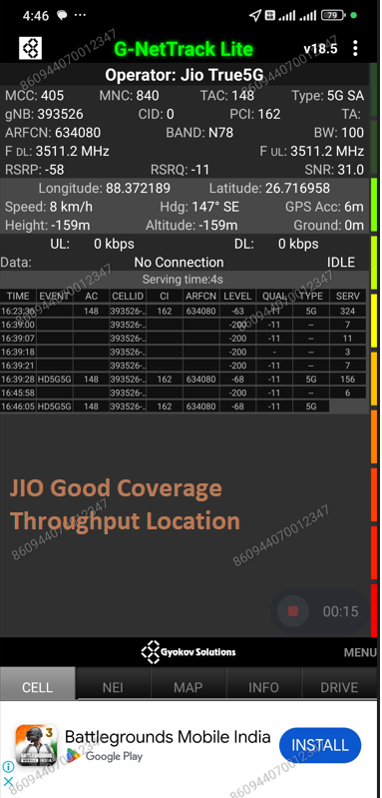
JIO 5G SA Good Coverage Location
Description | Operator | Band | Lat. | Long.
5G SA Good coverage Location | JIO | N78 | 26.71696 | 88.37219

Slide 3
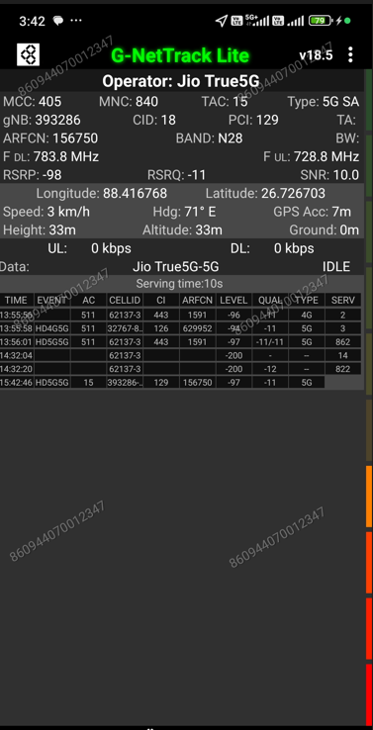
JIO 5G SA N28 Location
Discerption | Operator | Band | Lat. | Long.
5G SA N28 Location | JIO | N28 | 26.726703 | 88.416768

Slide 4
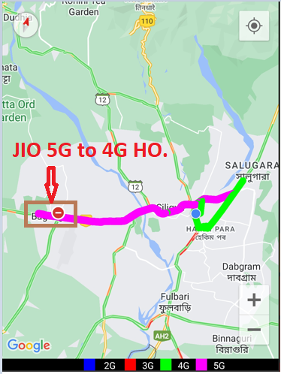
JIO 5G to 4G Handover Location
Discerption | Operator | Technology/ Band | Lat. | Long.
5G to 4G Handover Location | JIO | 5G>>4G>>5G | 26.695080 | 88.292736

Slide 5
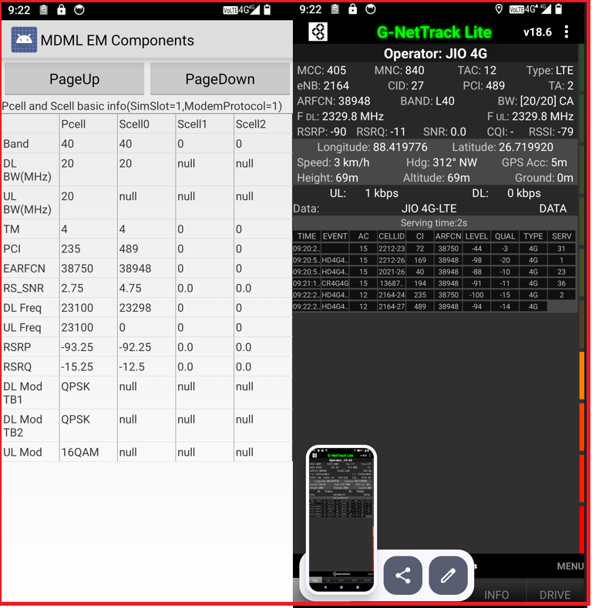
JIO LTE 2CA Location
Discrption | Operator | Band | Lat. | Long.
LTE 2CA Location | JIO | B40+B40 | 26.719920 | 88.419776

Slide 6
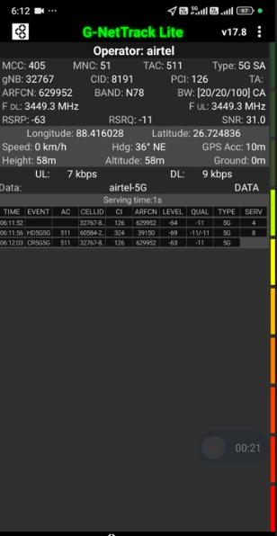
Airtel 5G NSA Good coverage Location
Discerption | Operator | Band | Lat. | Long.
5G NSA Good Coverage Location | Airtel | N78+B3 | 26.724836 | 88.416028

Slide 7
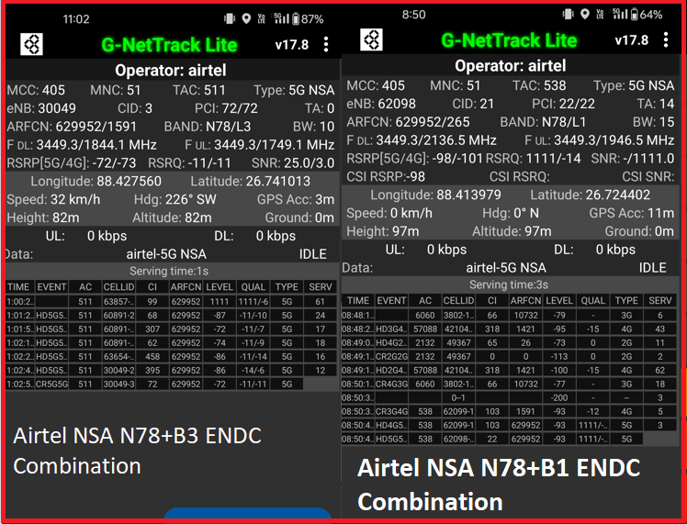
Airtel ENDC Combination
Discerption | Operator | ENDC Combination | Lat. | Long.
Airtel ENDC Combination | Airtel | N78+B3 | 26.741013 | 88.427560
 |  | N78+B1 | 26.724402 | 88.413979

Slide 8
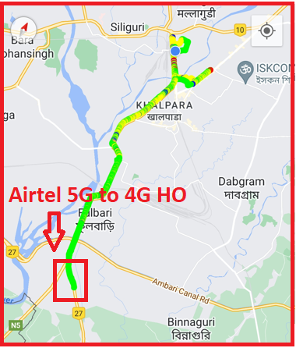
Airtel 5G to 4G Handover Location
Discerption | Operator | Technology/ Band | Lat. | Long.
5G to 4G Handover Location | Airtel | 5G>>4G>>5G | 26.644407 | 88.423993

Slide 9
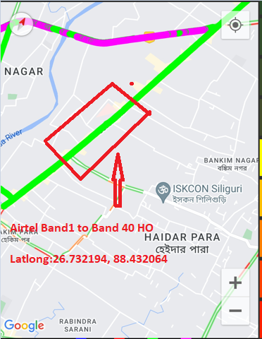
Airtel LTE BAND Handover
Discerption | Operator | BAND | Lat. | Long.
Airtel LTE Band Handover | Airtel | TDD>>FDD>>TDD | 26.732194 | 88.432064

Slide 10
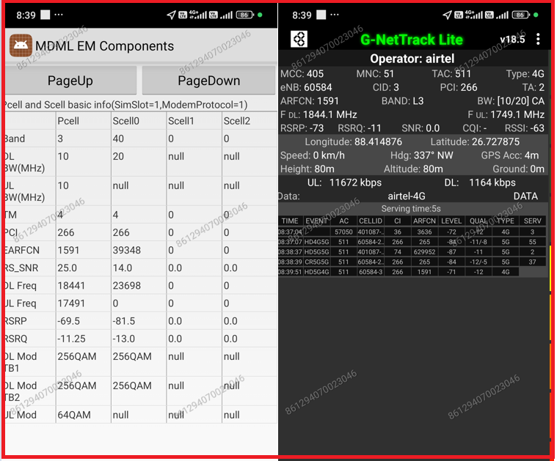
Airtel LTE 2CA Location
Discrption | Operator | Band | Lat | Long
LTE 2CA Location | Airtel | B3+B40 | 26.72787 | 88.414876

Slide 11
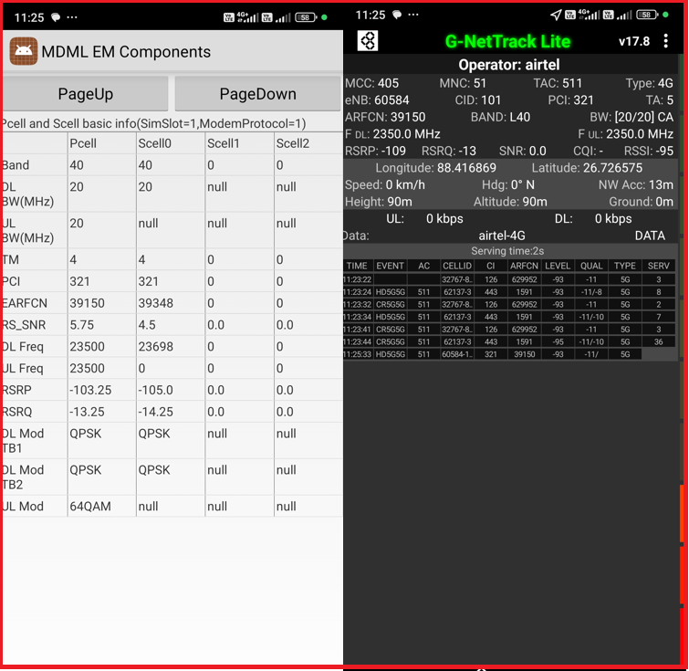
Airtel LTE 2CA Location
Discerption | Operator | Band | Lat. | Long.
LTE 2CA Location | Airtel | B40+B40 | 26.726575 | 88.416869

Slide 12
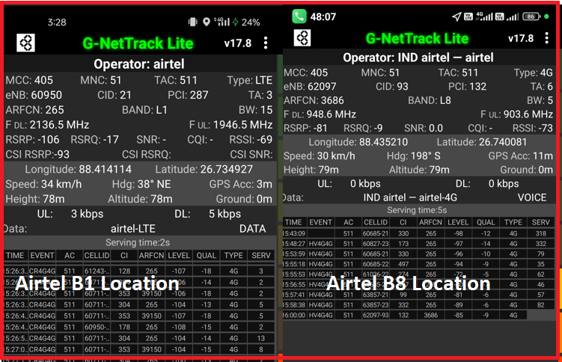
Airtel 4G BAND Location
Discerption | Operator | BAND | Lat | Long
Airtel 4G Band Location | Airtel | B1 | 26.734927 | 88.414114
 |  | B8 | 26.740081 | 88.435210

Slide 13
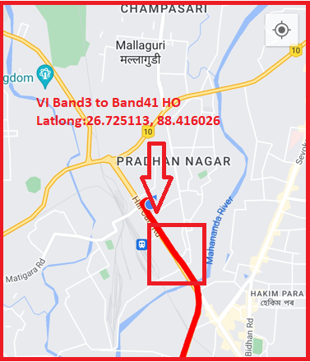
VI LTE BAND Handover
Discerption | Operator | Band | Lat. | Long.
VI LTE Band Handover | VI | TDD>>FDD>>TDD | 26.725113 | 88.416026

Slide 14
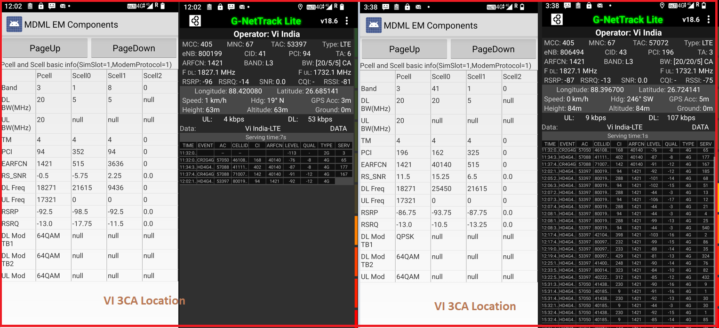
VI LTE 3CA Location
Discerption | Operator | Band | Lat. | Long.
VI LTE 3CA Location | VI | B3+B1+B8 | 26.685141 | 88.420080
 |  | B3+B41+B1 | 26.724141 | 88.396700

Slide 15
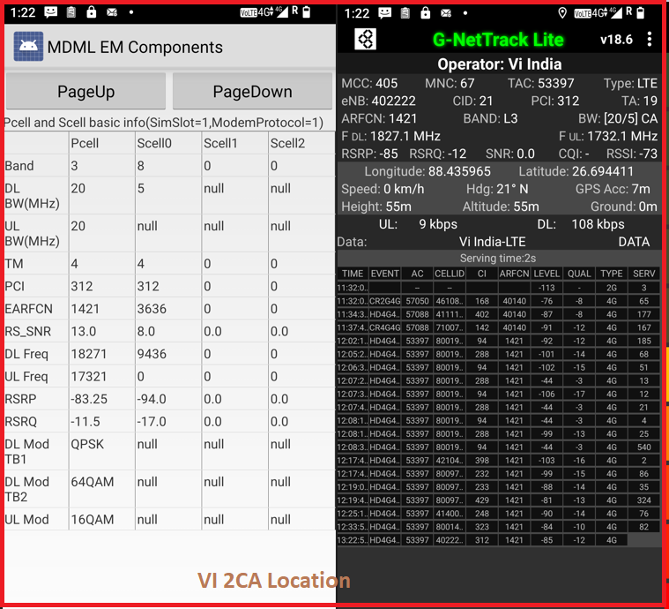
VI LTE 2CA Location
Discerption | Operator | Band | Lat. | Long.
VI LTE 2CA Location | VI | B3+B8 | 26.694411 | 88.435965

Slide 16
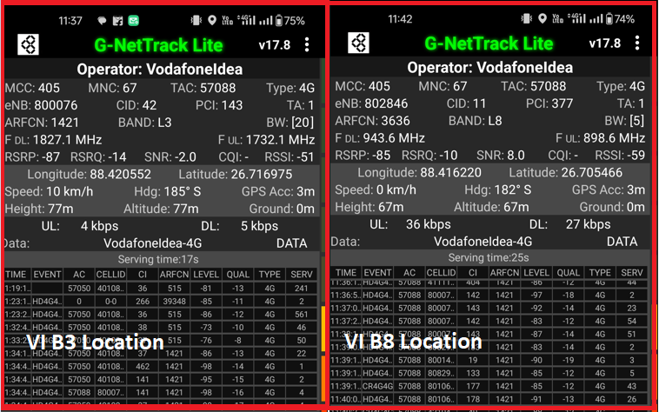
VI 4G BAND Location
Discerption | Operator | Band | Lat. | Long.
VI 4G Band Location | VI | B3 | 26.716975 | 88.420552
 |  | B8 | 26.705466 | 88.416220

Slide 17

THANK YOU

