Slide 1
MARQUIS TECHNOLOGIES
Drive Route –Airtel, VI & Reliance JIO (FDD/TDD) LTE
MATHURA

Slide 2
Operator Information:
Operator | JIO 4G
MCC | 405
MNC | 870
APN | Jionet
Operator | Airtel 4G
MCC | 404
MNC | 97
APN | Airtelgprs.com
Operator | VI
MCC | 405
MNC | 870
APN | internet
Operator | BSNL
MCC | 404
MNC | 54
APN | BSNLMMS

Slide 3
Operator Information 1
Functionality | Airtel
Website: http://www.airtel.com/ WAP APN: airtelgprs.com
Customer care | 199
MNC | 40
Bands supported | Both FDD and TDD
 | LTE 2300 MHz – TDD(Band 40)
 | LTE 1800,850 MHz – FDD(Band 3)
USSD | To check MDN: *282#
 | Balance check: *123#
 | Data Balance check: *121*114#
VoLTE | Supported
CSFB | Supported (CSFB to 2G)

Slide 4
Operator Information 2
Functionality | RELIANCE JIO
Website: http://www.jio.com WAP APN: jionet
Customer care | 198
MNC | 862
Bands supported | Both FDD and TDD
 | LTE 2300 MHz –TDD(Band 40)
 | LTE 850 MHz – FDD(Band 5)
 | LTE 1800 MHz –FDD(Band 3)
USSD | NA
 | NA
 | NA
VoLTE | Supported
CSFB | Not Supported

Slide 5
Operator Information 3
Functionality | VI
Website: http://www.vi.com WAP APN: internet
Customer care | 198
MNC | 870
Bands supported | Both FDD and TDD
 | LTE 2300 MHz –TDD(Band 40,41)
 | LTE 850 MHz – FDD(Band 5)
 | LTE 1800 MHz –FDD(Band 3) ,LTE 900 MHZ-FDD(BAND 8)
USSD | To check MDN*199#
 | Balance check198
 | Data Balance check: 121
VoLTE | Supported
CSFB | Supported(3G)

Slide 6
Operator Information 4
Functionality | BSNL
Website: http://www.BSNL.com WAP APN: bsnlnet
Customer care | 198
MNC | 54
Bands supported | WCDMA&GSM
 | WCDMA 2100 MHz –(Band 1)
 | GSM 900 MHz – FDD(Band 5)
USSD | Night data balance*123*8#
 | Balance check *123#
 | Data Balance check: *124#
VoLTE | Not Supported
CSFB | Not Supported

Slide 7
Drive Route
Near Cell :- Stationary: RSRP : -65dbm to -75dbm
Cell Edge :- Stationary: RSRP : -95dbm to -110dbm
Mixed :- Mobility: RSRP : -65dbm to -110dbm

Slide 8
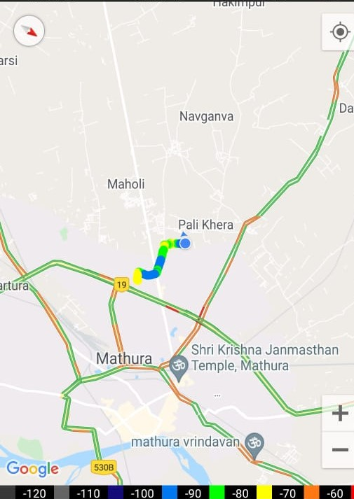
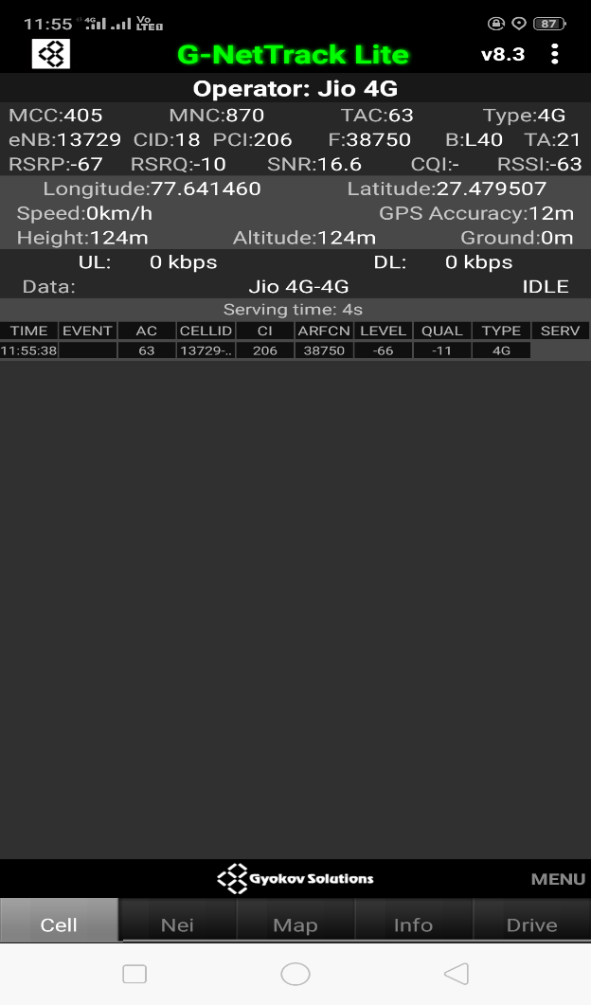
Near Cell (Airtel)
Near cell(NC) | longitude | latitude | RSRP | Cell id | FDD E-ARFCN
1 | 77.641460 | 27.479507 | -67 | 18 | 38750
VIRI SINGH CHOWK,PALI KHEDA, MATHURA
RSRP:
-65dbm to 75dbm

Slide 9
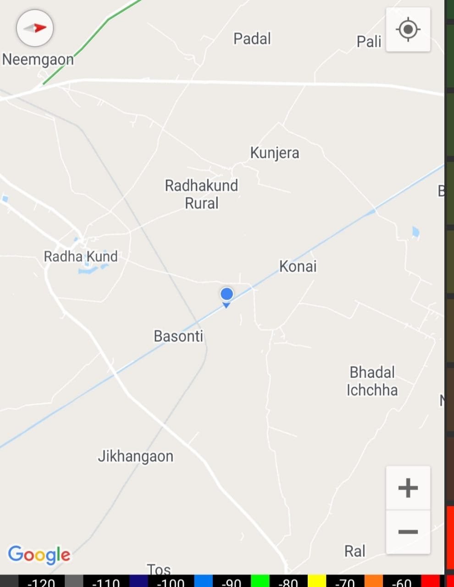
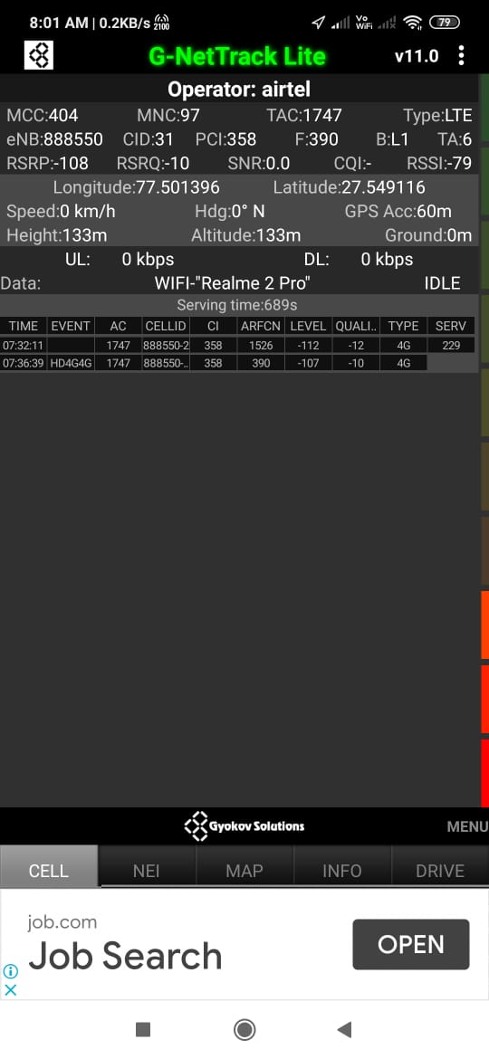
Edge Cell (Airtel)
Edge cell(EC) | longitude | latitude | RSRP | Cell id | TDD E-ARFCN
1 | 77.501396 | 27.549116 | 108 | 31 | 390
KONAI ,MATHURA
RSRP:
-95dbm to -110dbm

Slide 10
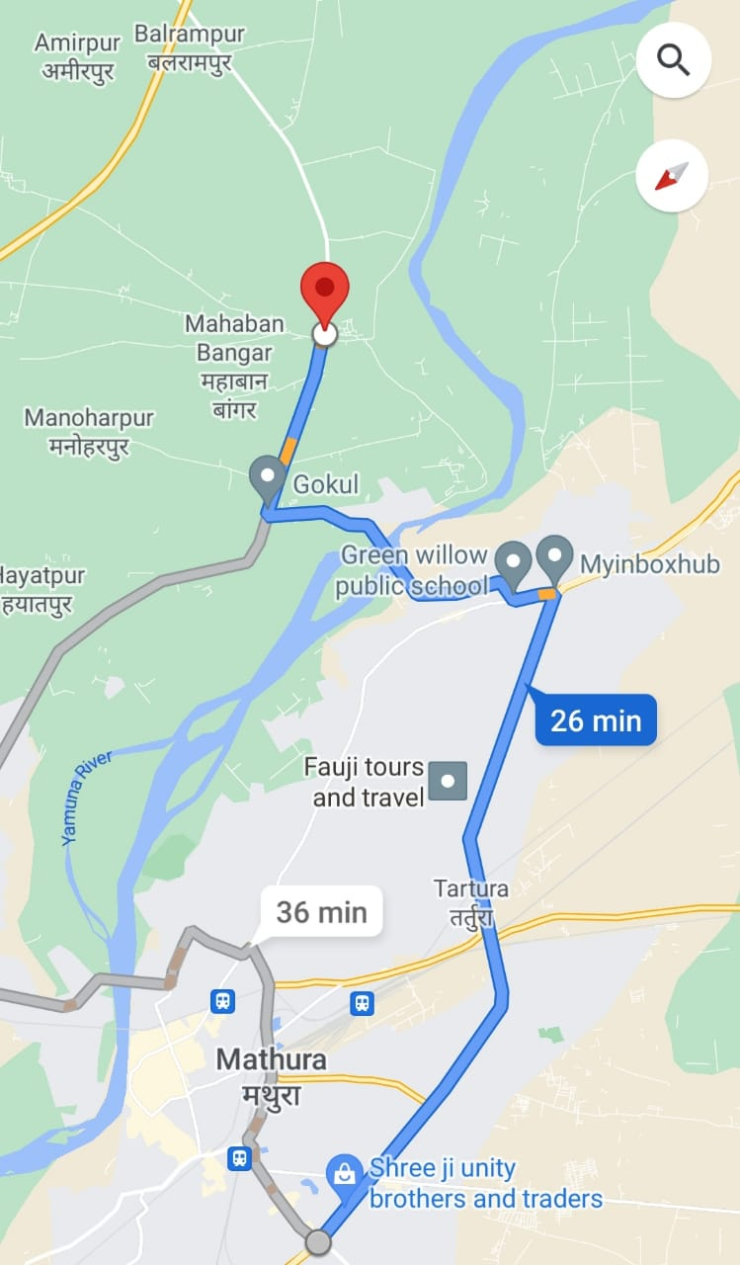
Mixed Mobility:-Goverdhan chauraha,satoha,mahaban
RSRP: -65dbm to -110dbm

Slide 11
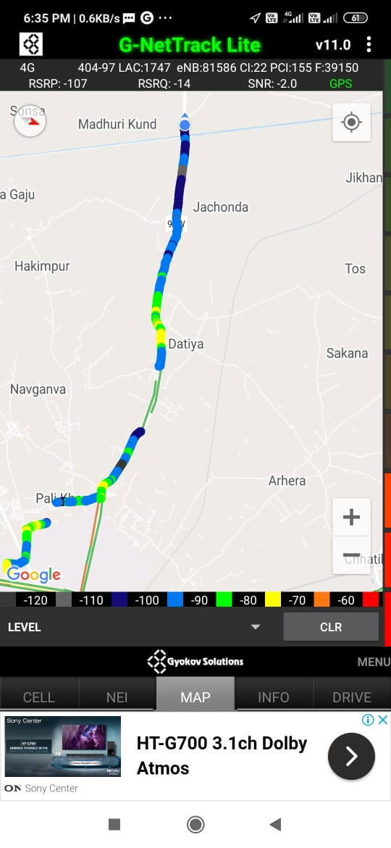
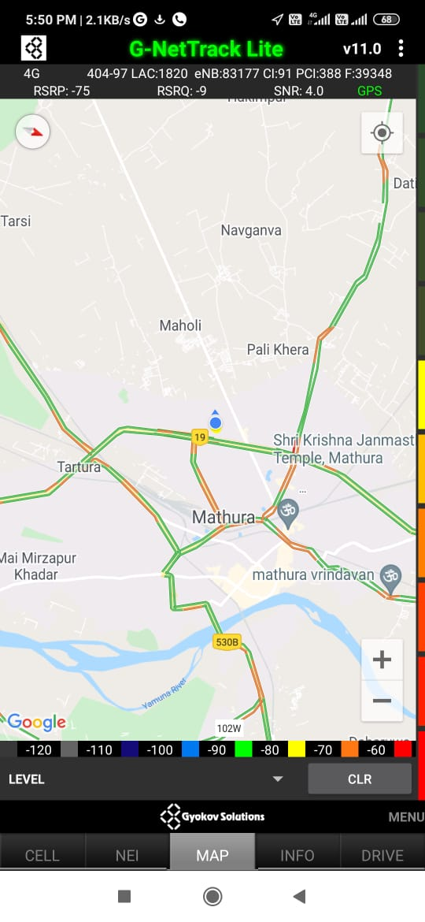
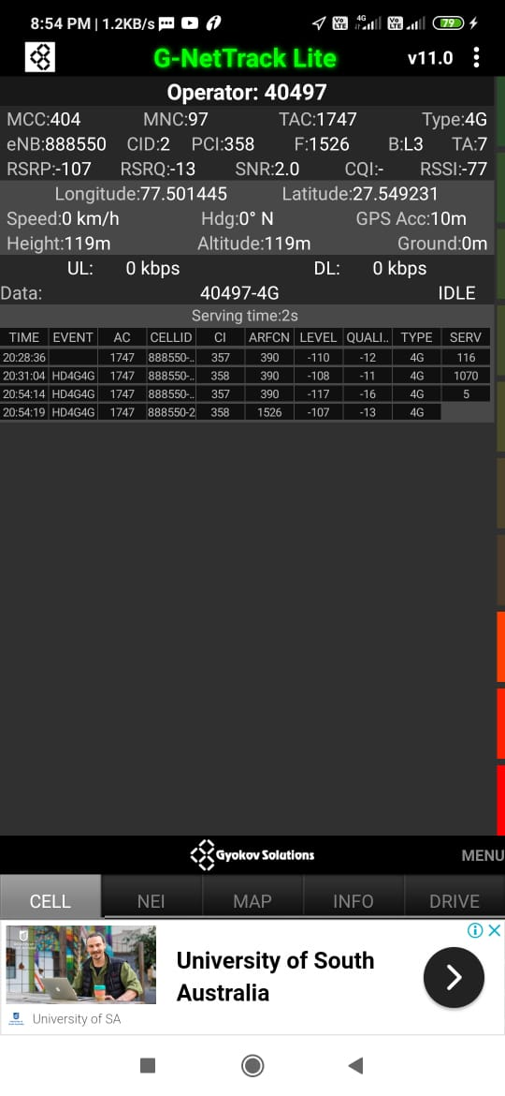
Airtel Band HO
Band Hand Over | longitude | Latitude | RSRP
1 | 77.501445 | 27.549231 | -85 to 105 dBM

Slide 12
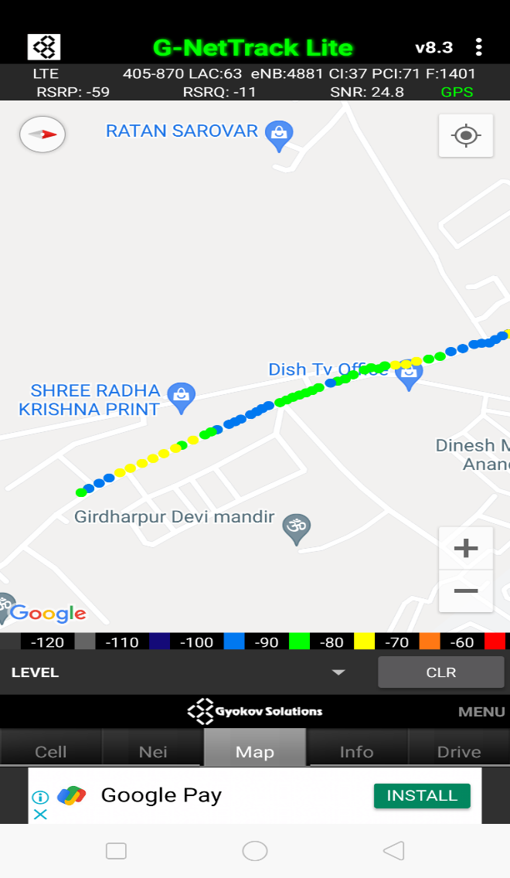
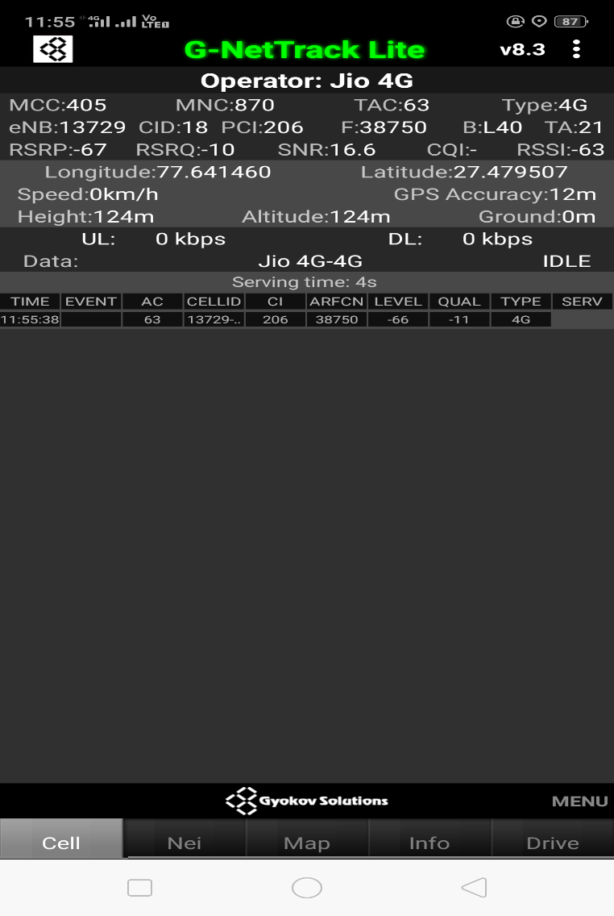
Near Cell (Reliance JIO)
Near cell(NC) | longitude | latitude | RSRP | Cell id | TDD E-ARFCN
1 | 77.641460 | 27.479507 | -67 | 206 | 38750
Viri singh chauraha ,girdharpur,sabji mandi
RSRP:
-65dbm to -75dbm

Slide 13
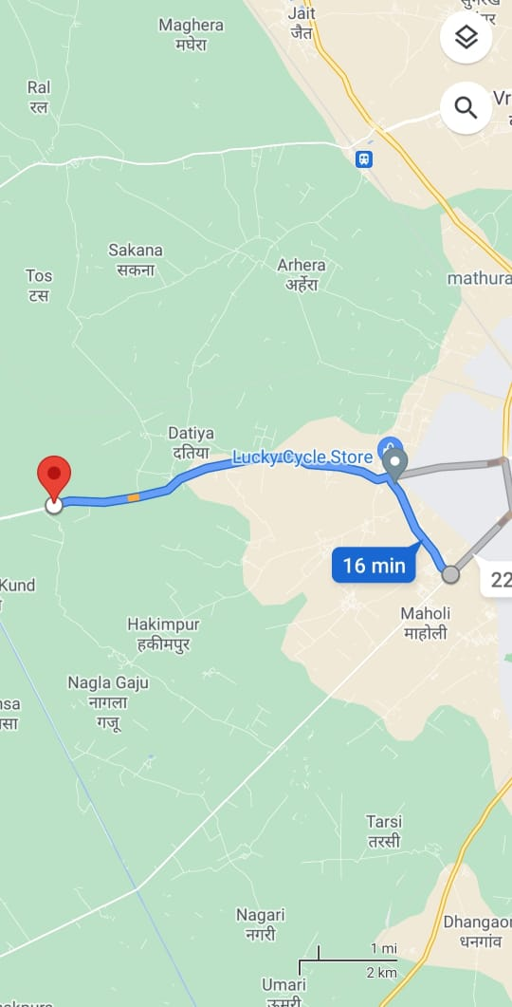
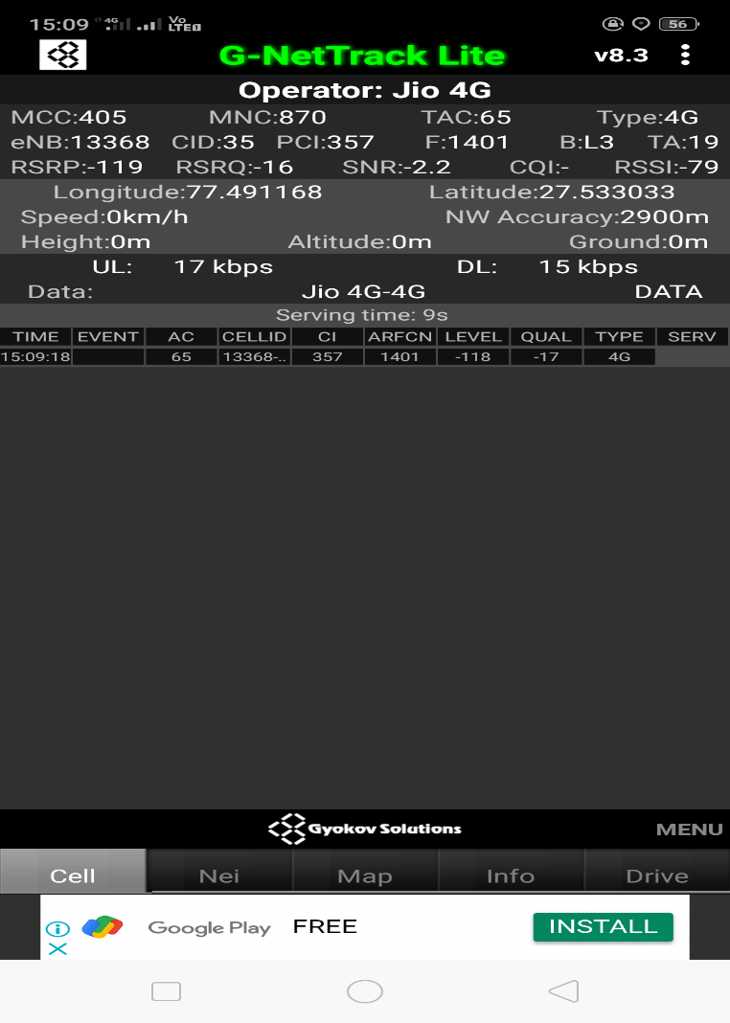
Edge Cell (Reliance JIO)
Edge cell(NC) | longitude | latitude | RSRP | Cell id | TDD E-ARFCN
1 | 77.491168 | 27.533033 | -119 | 357 | 1401
Datiya, MATHURA , UP
RSRP:
-95dbm to -110dbm

Slide 14
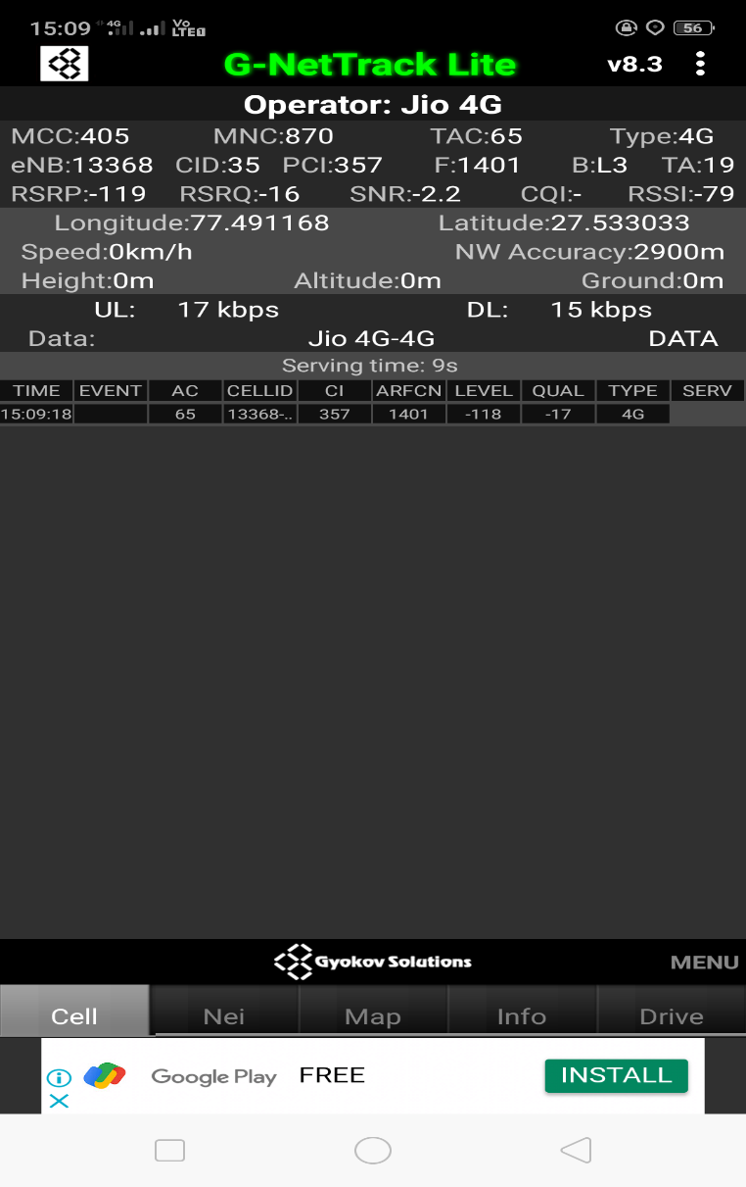
Mixed Mobility:- Goverdhan chauraha to Adeeng Mathura U.P.
RSRP: -95dbm to -110dbm

Slide 15
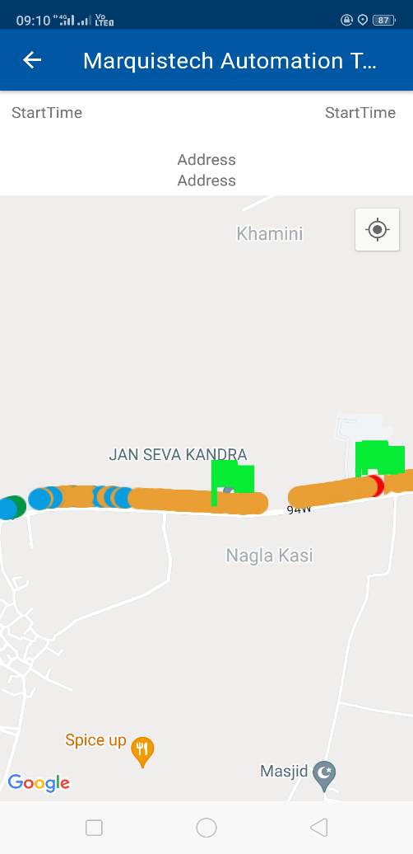
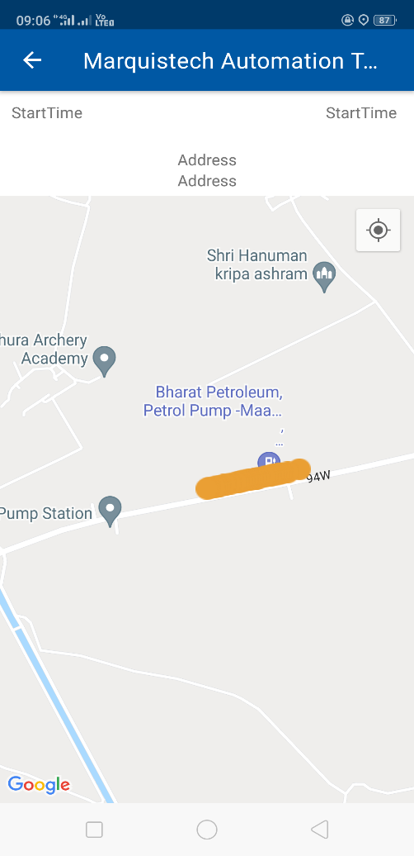
Inter Band Handover (FDD-TDD), JIO 4G
Band Handover | longitude | latitude | RSRP | PCI | D E-ARFCN
1 | 77.50139491 | 27.54923569 | 114 | 424 | 38948

Slide 16
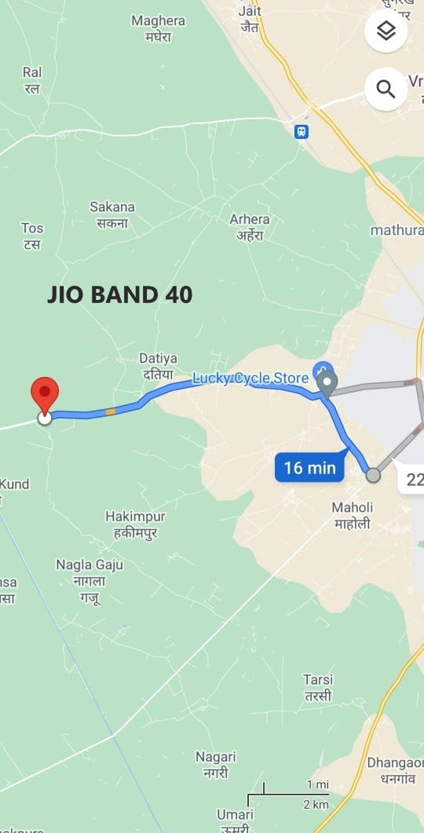
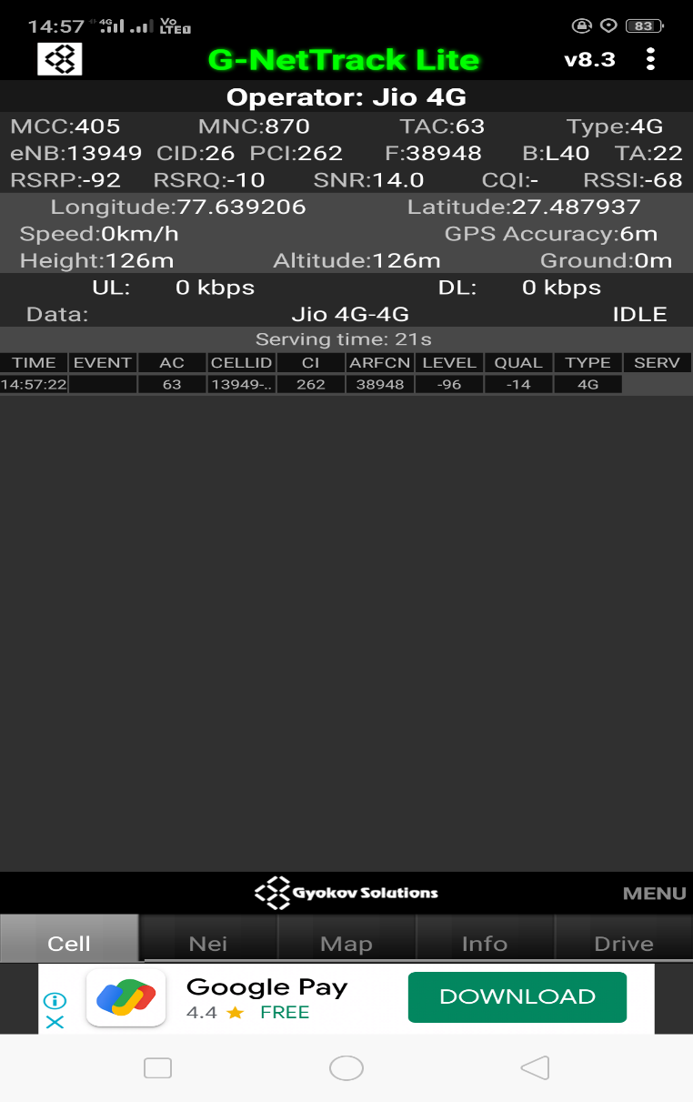
RJIO Band 40 Near Cell:

Slide 17
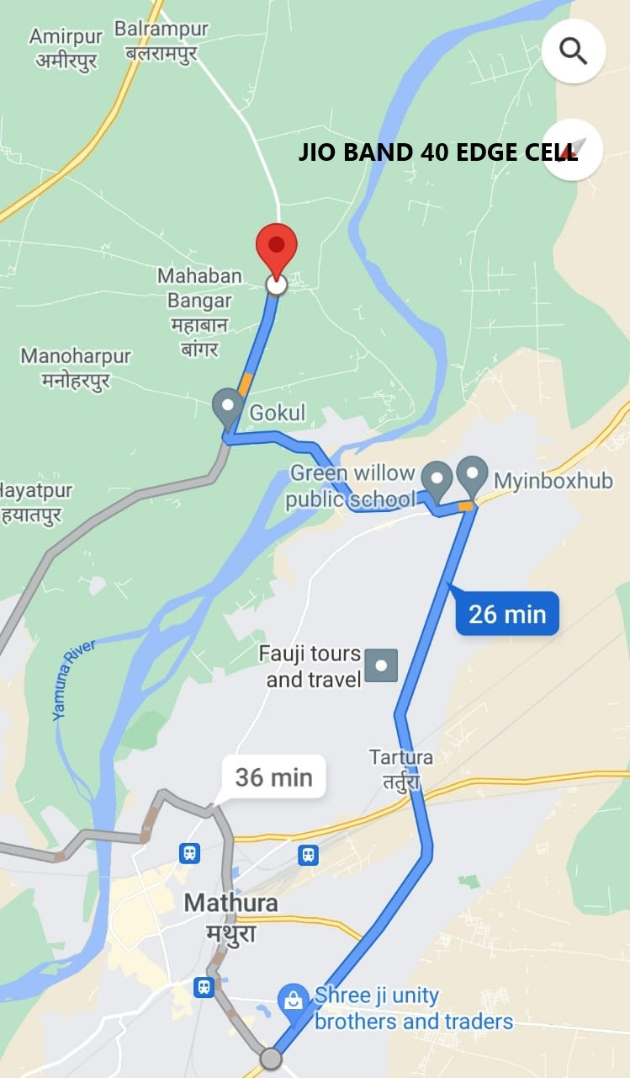
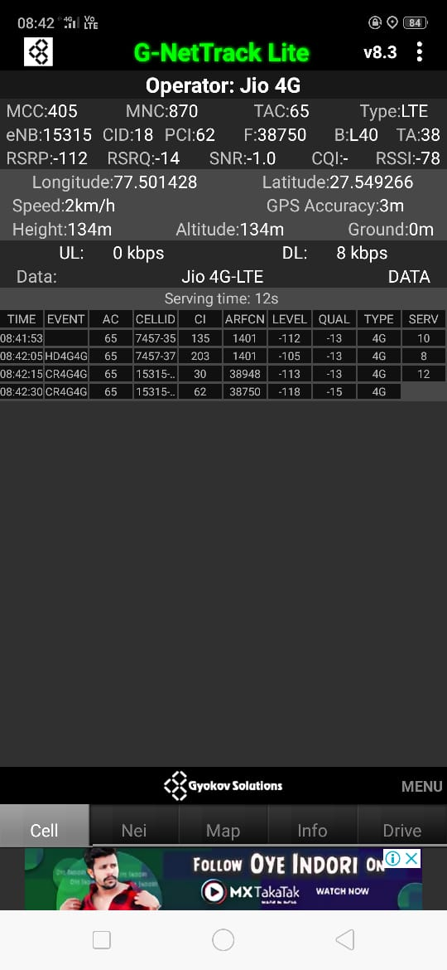
RJIO Band 40 Edge Cell:

Slide 18
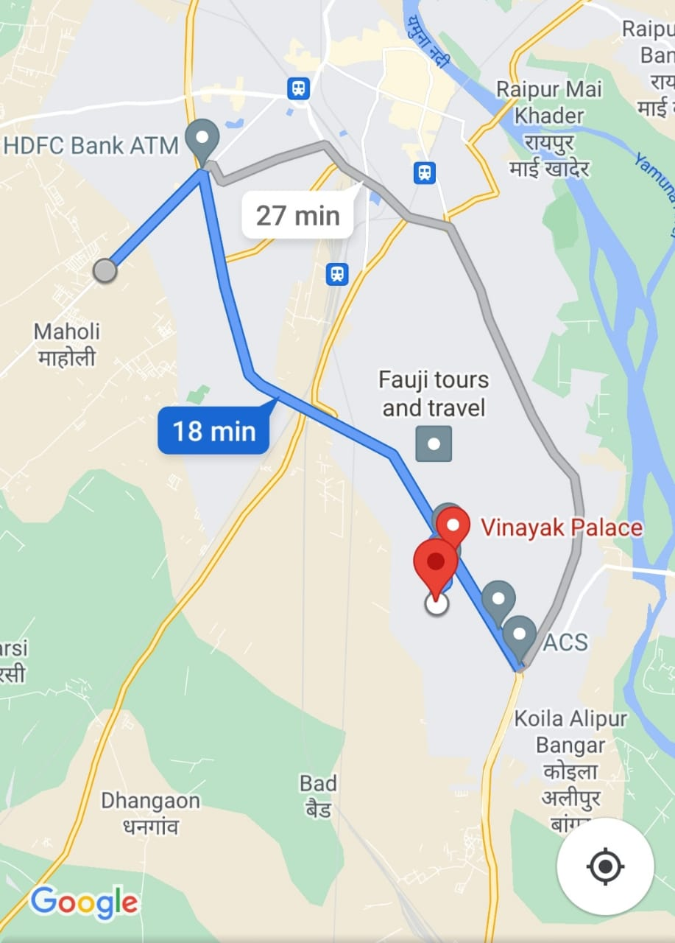
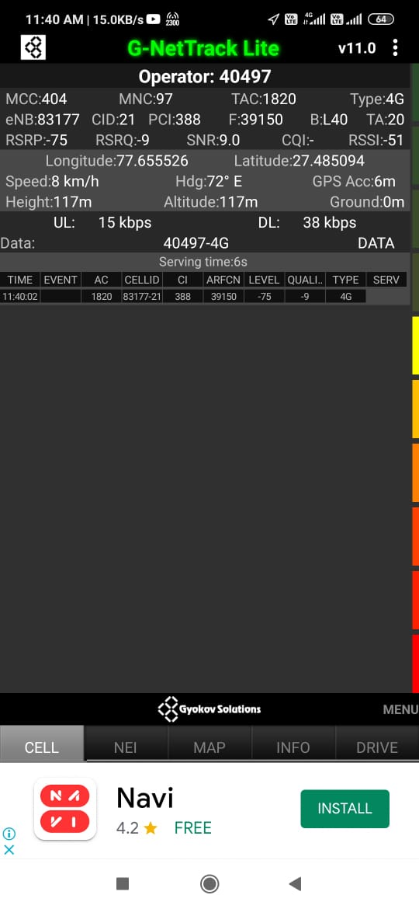
Near Cell VI:
Near cell(NC) | longitude | latitude | RSRP | Cell id | TDD E-ARFCN
1 | 77.655526 | 27.485094 | -75 | 348 | 39150
VINAYAK PALACE MATHURA , UP
RSRP:
-65dbm to -75dbm

Slide 19
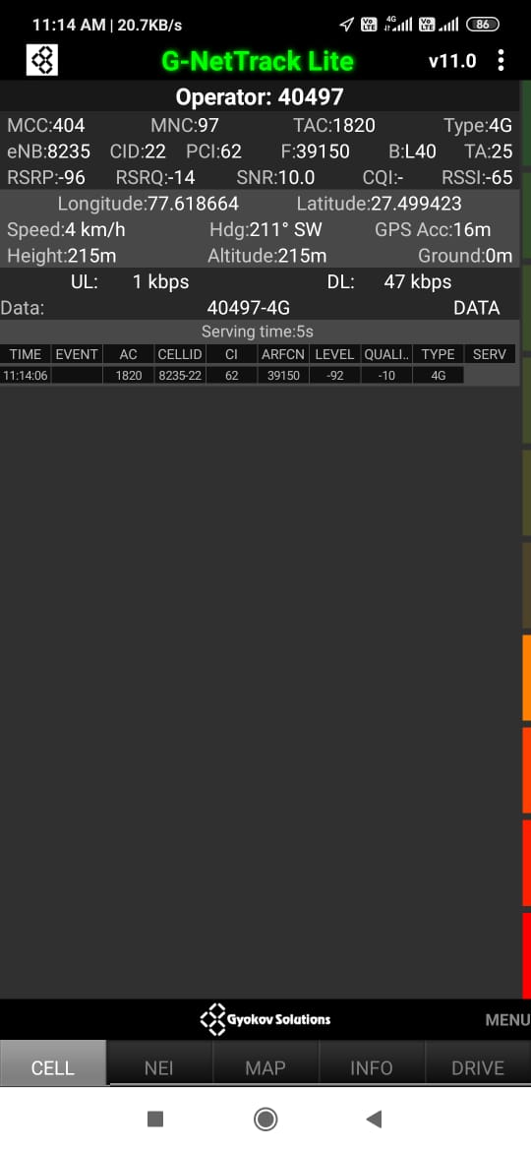
Cell Edge VI
Near cell(NC) | longitude | latitude | RSRP | Cell id | TDD E-ARFCN
1 | 77.618664 | 27.499423 | -96 | 62 | 39150
Datiya,Mathura,UP
RSRP:
-95dbm to -105dbm

Slide 20
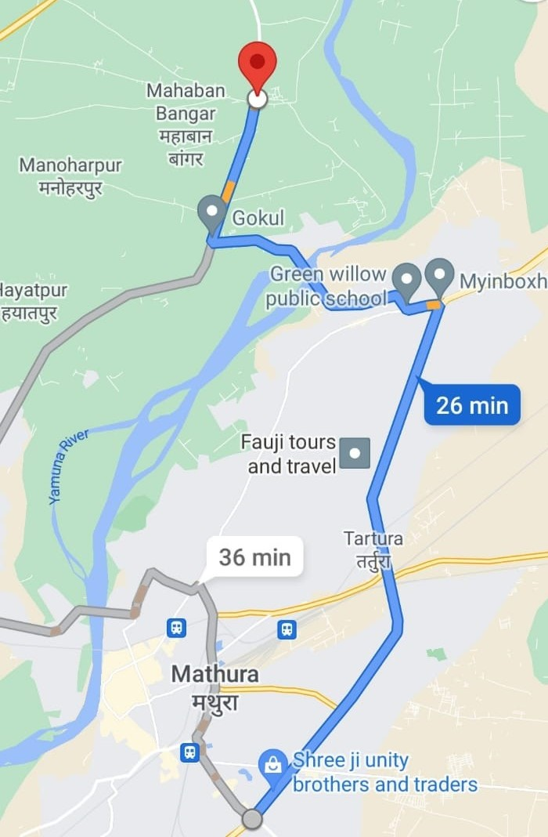
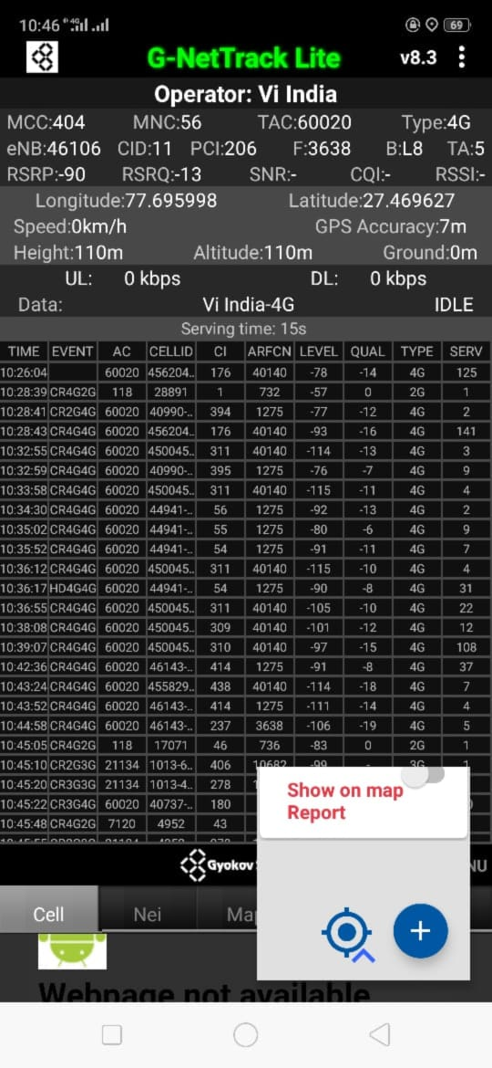
Mixed coverage area Vodafone:

Slide 21
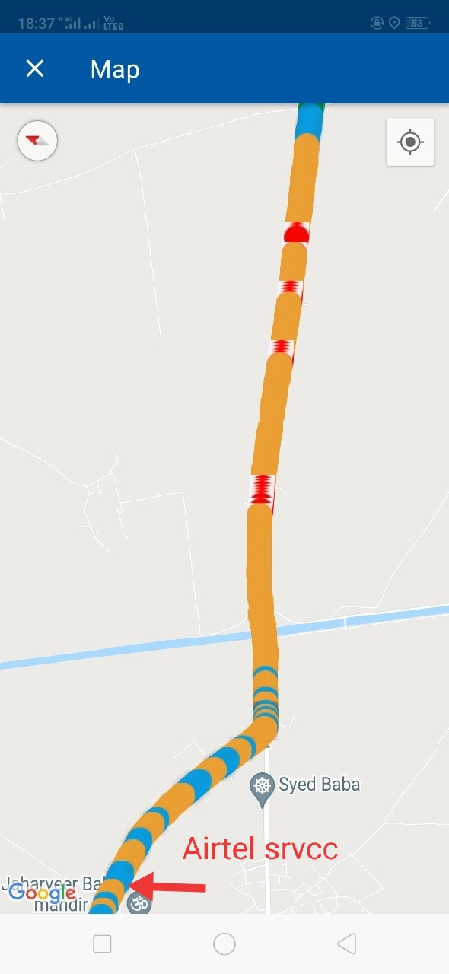
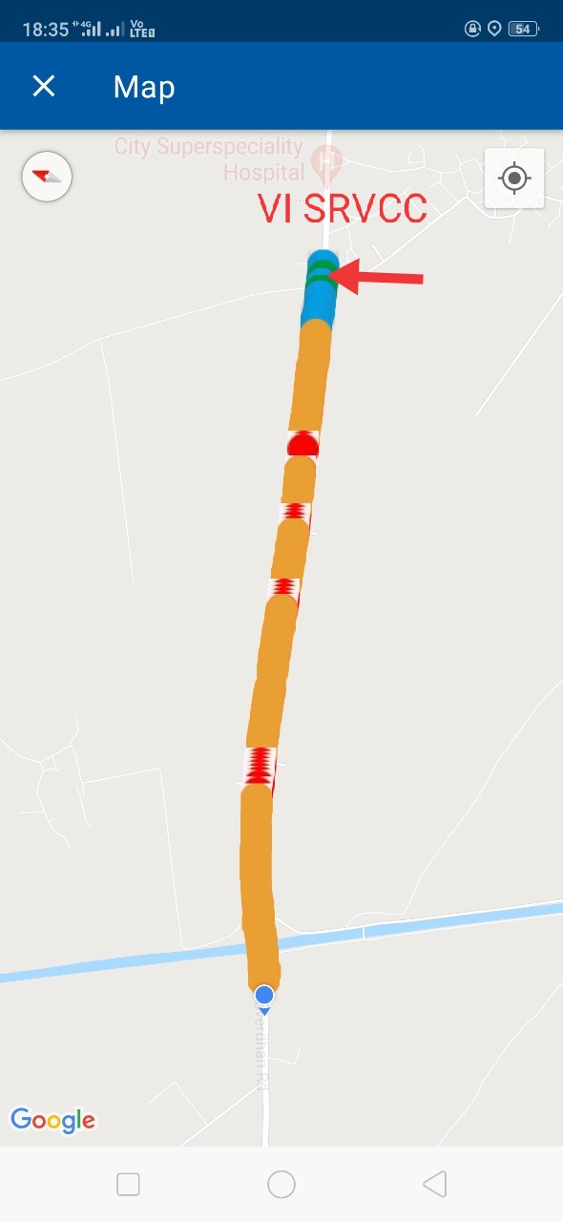
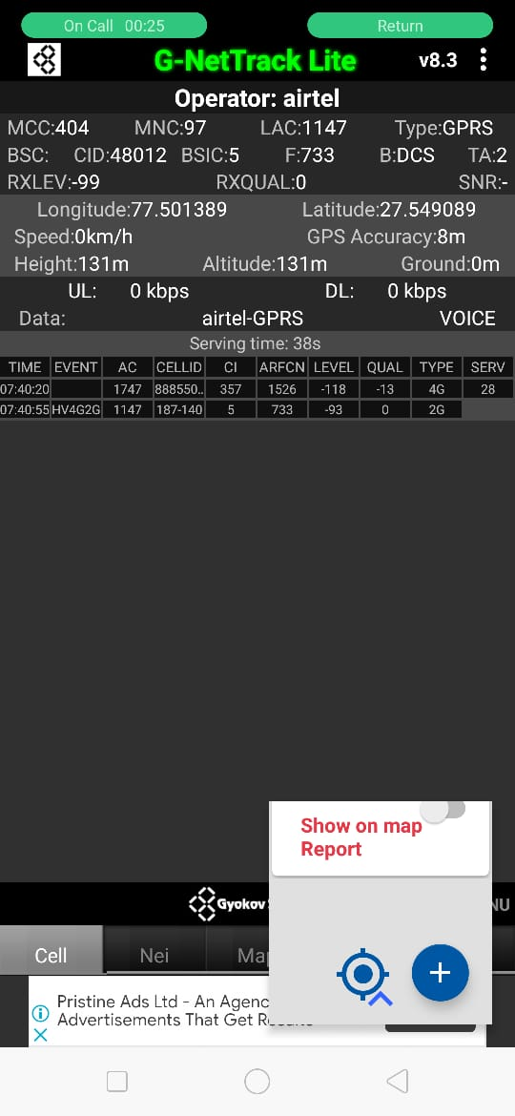
Airtel & VI SRVCC to UTRAN:

Slide 22

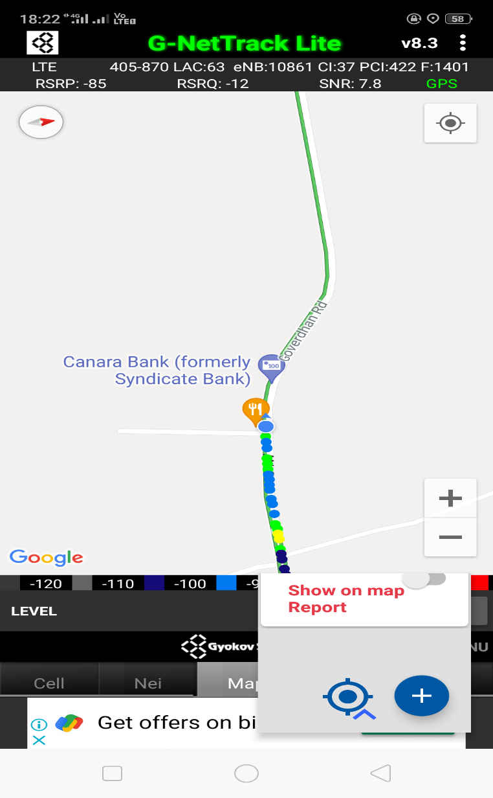
VIBand 3<>5<>41 Handover

Slide 23

G net Tracker Drive Route

Slide 24
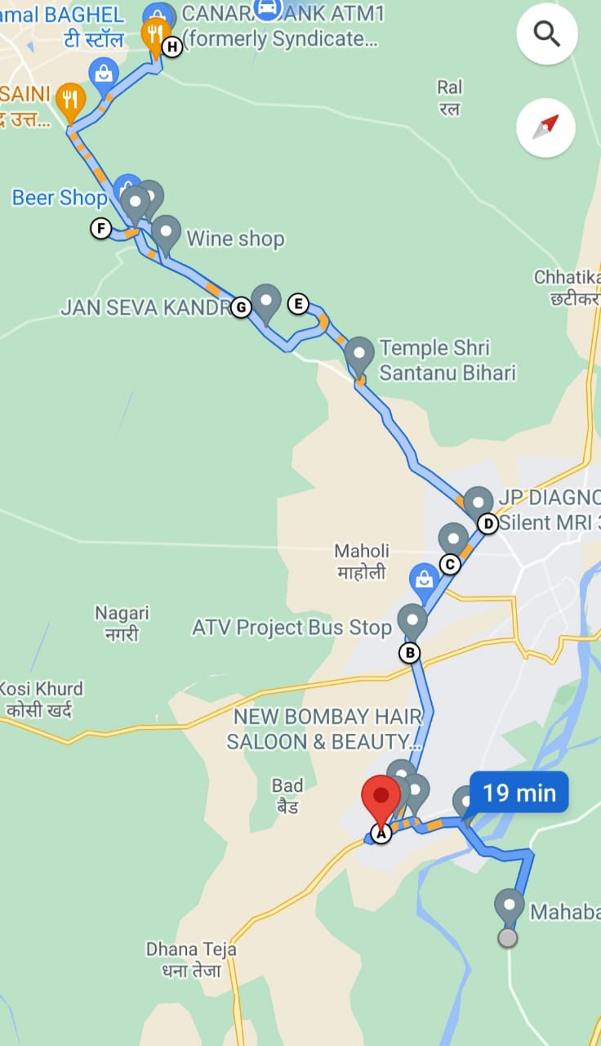
Drive Route

Slide 25
THANK YOU
MARQUIS TECHNOLOGIES

