Slide 1
MARQUIS TECHNOLOGIES
Drive Route- Manila, Philippines

Slide 2
Country | Philippines
Continent | APAC
City | Manila
Time Zone | GMT +8 hour
Currency | PHP
International Dialing Code | +63

Slide 3
Operators in Philippines
MCC | MNC | Operator
515 | 03 | Smart
515 | 02 | Globe
515 | 66 | DITO
Smart Network Info
RAT | Band | Comment
5G | NSA n78, n41, n28
4G | B1(2100MHz), B3(1800MHz), Band 5(850Mhz), Band 28(700mhz), Band 40(2300 MHz - 2400 MHz)
3G | B5(850 MHz), Band 8(900Mhz), B1(2100MHz)
2G | 900Mhz, 1800MHz

Slide 4
Globe Network Info
RAT | Band | Comment
5G | NSA n78, n41, n28
4G | B3(1800MHz), Band 28(700mhz), Band 38 (2570 MHz - 2620 MHz), Band 40(2300 MHz - 2400 MHz), Band 41(2496-2690mhz)
3G | NA
2G | 900Mhz,
DITO Network Info
RAT | Band | Comment
5G | SA n78
4G | B1(2100MHz), B3(1800MHz), Band 28(700mhz)
3G | NA
2G | NA

Slide 5
Operators and General Information
Smart- Supports 5G NSA, VoLTE, LTE, WCDMA and 2G
Globe- Supports 5G NSA, VoLTE, LTE and 2G only
DITO- Supports 5G SA, VoLTE and LTE only

Slide 6
USSD codes for balance check
Smart balance check: *123#
Globe balance check: *143#
DITO balance check: *185#

Slide 7

Supplementary Services
Smart: Call Waiting supported
Globe: Call forwarding, and Call Waiting supported
DITO: Call forwarding, and Call Waiting supported

Slide 8
RSRP Criteria
Near Cell :-Stationary: RSRP : -65dbm to -85dbm
Cell Edge :-Stationary: RSRP : -95dbm to -110dbm
Mixed :-Mobility: RSRP : -65dbm to -120dbm

Slide 9
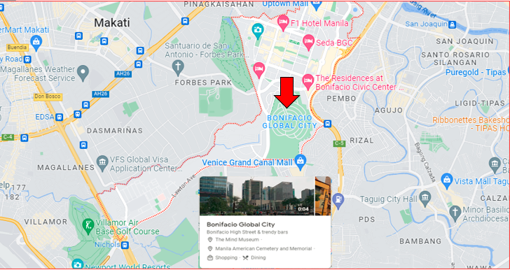
5G Near Cell (Smart, Globe, DITO):

Slide 10
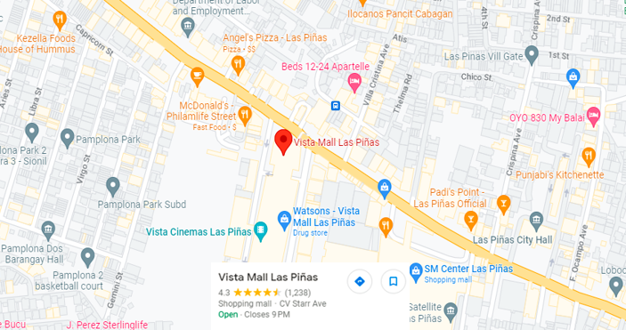
Edge Cell(Smart, Globe, DITO):
Inside Vista Mall Las Pinas

Slide 11
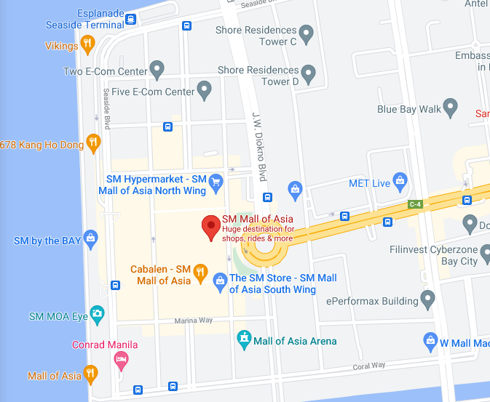
Near cell Smart 5G NSA Coverage:

Slide 12
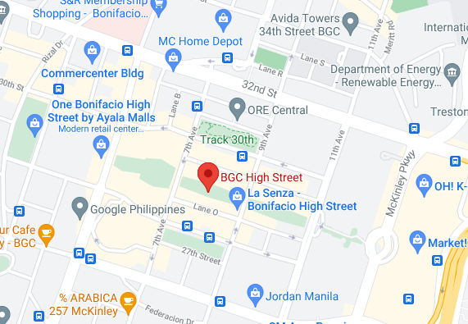
Near cell Globe 5G NSA Coverage:

Slide 13
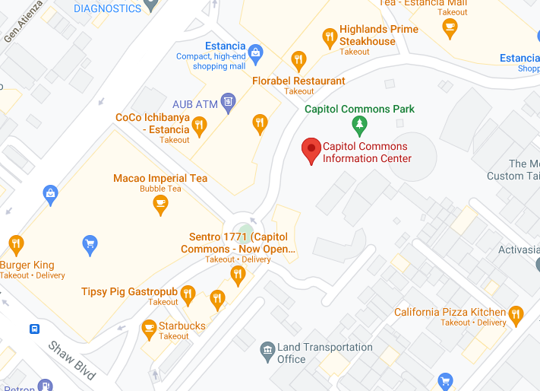
Near cell DITO 5G SA Coverage:

Slide 14
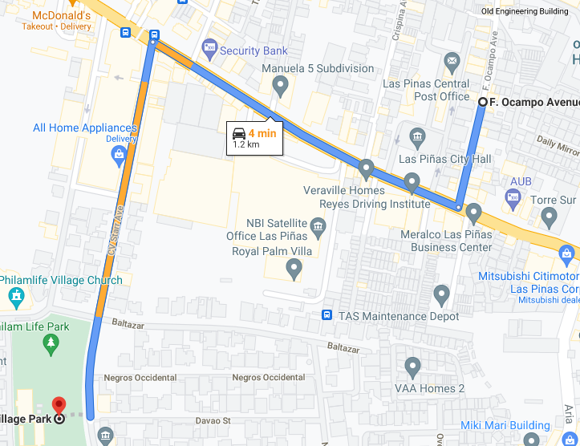
Smart 5G to 4G & 4G to 5G:
Drive from 22 F De Ocampo, Las Pinas, 1750 Metro Manila to Philam Life Village Park, Our Lady of Fatima Rd, Las Pinas, Metro Manila

Slide 15
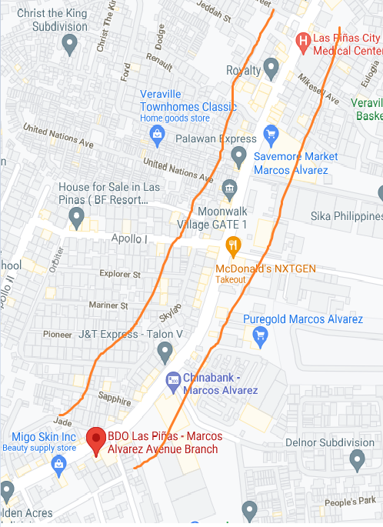
Globe 5G to 4G & 4G to 5G:
Drive from Cinco, B-2 L-19 Kimberkay Bldg, Marcos Alvarez Ave, Talon Uno, Las Pinas, Metro Manila to 19 Marcos Alvarez Ave, Las Pinas, 1747 Metro Manila.

Slide 16
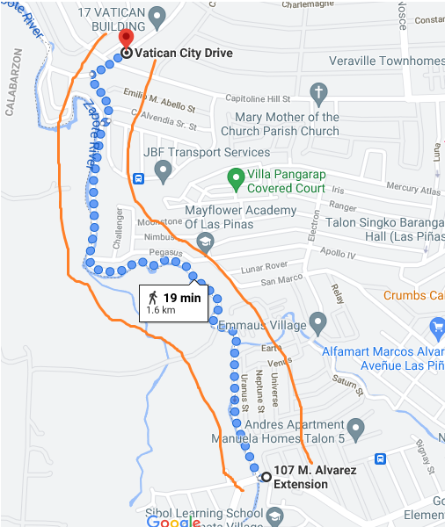
DITO 5G to 4G & 4G to 5G:
Drive from 107 M. Alvarez Ext, Las Pinas, 1747 Metro Manilato 19 Marcos Alvarez Ave, Las Pinas, 1747 Metro Manila.

Slide 17
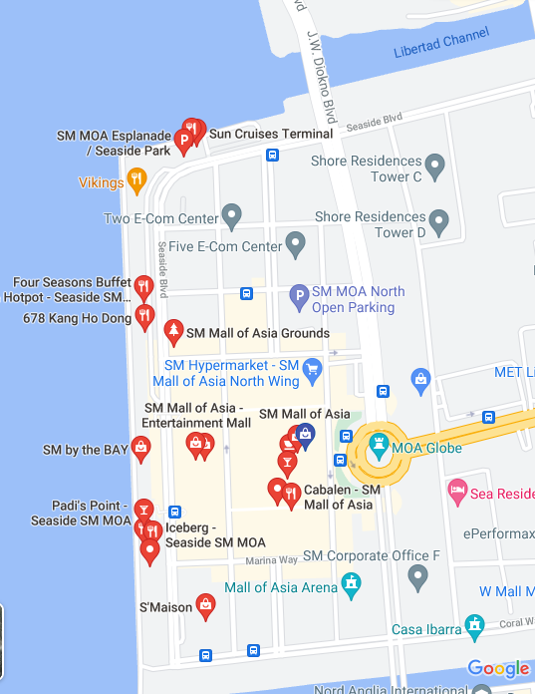
Smart 5G NR Handover Test Location
NR handover location: Drive from Seaside Boulevard, Mall of Asia Complex, Pasay, 1300 Metro Manila to J.W. Diokno Boulevard, Pasay, Metro Manila

Slide 18
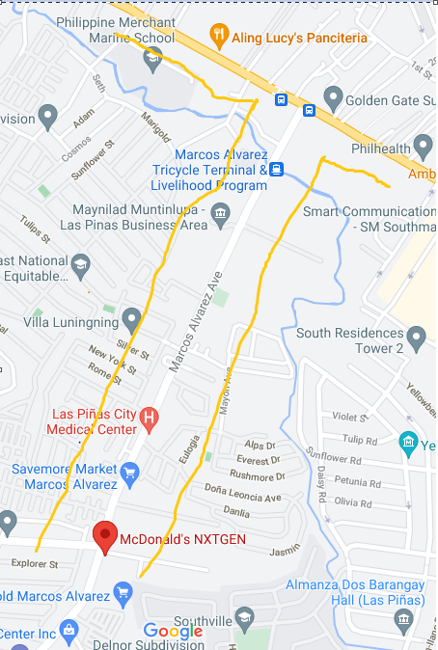
Globe 5G NR Handover Test Location
NR handover location: Drive from McDonald's NXTGEN, Marcos Alvarez Avenue, Las Pinas, Metro Manila to Alabang-Zapote Road, Las Pinas City

Slide 19
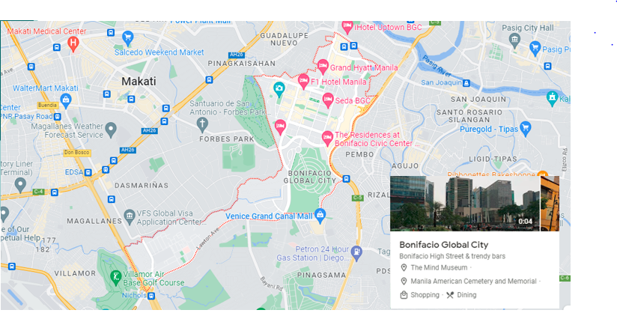
Smart, Globe & DITO 5G Area without fluctuation:

Slide 20
THANK YOU
MARQUIS TECHNOLOGIES
www.marquistech.com

