Slide 1
MARQUIS TECHNOLOGIES
Drive Route – Kathmandu( Nepal)

Slide 2
Travel to Barcelona (SPAIN)
Country | Nepal
Continent | Asia
City | Kathmandu
Time Zone | GMT +2 Hour
International Dialing Code | +977
VISA | Travel Visa
VISA Duration | 6 Month , Multiple Entry
VISA Fees | Contact Nisha Deshpande
VISA Requirements | Need to provide 3 passport size photographs, 6 month bank statement
Yellow Fever Vaccination Certificate | Not Required

Slide 3
Operator Information
MCC | MNC | Operator | Bands (MHz)
429 | 2 | Ncell | GSM bands: 900 (E-GSM), 1800 (DCS) UMTS bands: B1 (2100) LTE bands: B3 (1800+),B20(800)
429 | 1 | NTC | GSM bands: 900 (E-GSM), 1800 (DCS) UMTS bands: B1 (2100), B8 (900 GSM) LTE bands: B3 (1800+)
429 | 4 | Scell | GSM bands900 (E-GSM), 1800 (DCS) LTE bands: B3 (1800+)

Slide 4
USSD Codes for operators
No. | Operator | Balance Check Code | Customer Care | Voice Mail No.
1 | Ncell | *101# | 9005
2 | NTC | *400# | 191/1415
3 | Scell | *123# | 4242

Slide 5
Manual APN Settings
Attached is a sheet which has Manual APN Settings for all operators in (NEPAL)

Slide 6
Services Supported by Operators
Operator | Features/Services | Supports(Yes/No)
Ncell | Reselection
 | Redirection
 | MMS | Yes
 | CSFB | Yes(4G/3G/2G)
 | VoLTE | No
 | PS Handover | Yes
 | CA | NA
 | VoWiFi | NA
Nepal Telecom | Reselection
 | Redirection
 | MMS | NA
 | CSFB | Yes(4G/3G/2G)
 | VoLTE | NA
 | PS Handover | NA
 | CA | NA
 | VoWiFi | NA

Slide 7
Services Supported by Operators
Operator | Features/Services | Supports(Yes/No)
Scell | Reselection
 | Redirection
 | MMS | NA
 | CSFB | Yes(4G/2G)
 | VoLTE | NA
 | PS Handover | NA
 | CA | NA
 | VoWiFi | NA

Slide 8
RSRP Criteria
Near Cell :-Stationary: RSRP : -55dbm to -85dbm
Cell Edge :-Stationary: RSRP : -95dbm to -110dbm
Mixed :-Mobility: RSRP : -55dbm to -120dbm

Slide 9
Additional Information
Where to Get SIM cards?
We can get the sim cards of all operators in any Local Communication Cyber.
What Documents Required to Purchase SIM?
Only Citizenship ID
Best Recharge Option for 8 days Testing?
Depends on test cases but in general we procure 7 days Data plan for each SIM 2 GB. Voice pack are only available inter network and activate as per the need in daily basis. To activate this services please get the details from online operator wise prepaid plan.
Hotel to Stay
SPOT ON 465 Hotel Brunei Holiday Inn
Driver Details for Mobility?
We can book a cab in PATHAO app.

Slide 10
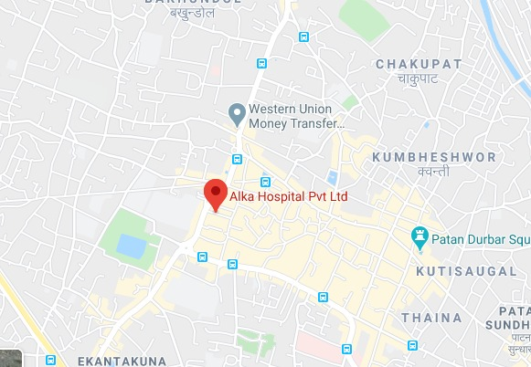
ALL Operator Near Cell Location: Alka Hospital Pvt Ltd Lat:- 27.674458 Long:- 85.315045

Slide 11
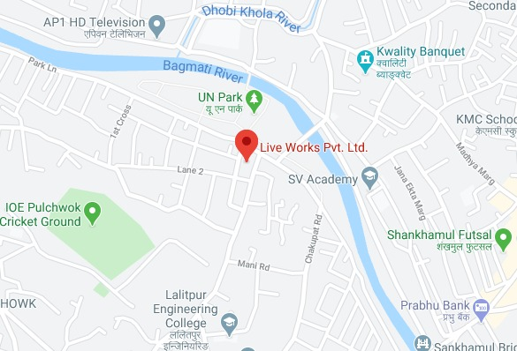
Mixed Mobility Coverage: Live Works Pvt. Ltd. Lat: 27.684594 Lon: 85.325984

Slide 12
Cell Edge : Live Works Pvt. Ltd. Lat: 27.684594 Lon: 85.325984

Slide 13
Top Most Popular Android Apps used in Nepal Top Most Popular Android Apps used in Nepal
Esewa
Hamro Patro
Khalti
Tiktok
PUBG mobile
Garena Free Fire: Rampage
Facebook
Whatsapp Messenger
Messenger
Shareit
Instagram
Hamro Nepali Keyboard
Pi Network
Zoom Cloud Meetings

Slide 14
Local EM number used in Nepal
Emergency phone number
Local Police | 100
Ambulance | 102
Traffic Police | 103
Police, Ambulance, Fire | 112/911

Slide 15
THANK YOU
MARQUIS TECHNOLOGIES
www.marquistech.com

