Slide 1
MARQUIS TECHNOLOGIES
Drive Route – Jakarta (Indonesia)

Slide 2
Travel to Jakarta (Indonesia)
Country | Indonesia
Continent | Southeast Asian
City | Jakarta
Duration of travel from Mumbai | Approx. 8 Hrs.
Time Zone | GMT +7
International Dialing Code | +62
VISA | Business Visa
VISA Duration | 1 Month , Multiple Entry
VISA Fees | Contact Nisha Deshpande
VISA Requirements | VISA ON ARRIVAL
Yellow Fever Vaccination Certificate | Not Required

Slide 3
Operator Information
MCC | MNC | Operator | Bands (MHz)
510 | 10 | Telkomsel | GSM 900 / 1800 / UMTS 2100
510 | 01 | Indosat | GSM 900 / 1800 / UMTS 2100
510 | 11 | XL | GSM 900 / 1800 / UMTS 2100
510 | 89 | 3 | GSM 900 / 1800 / UMTS 2100

Slide 4
USSD Codes for operators
Service | Indosat | Telkomsel | XL | Smartfren | 3 Tri
Top up Recharge | *123*Voucher Code# | *888*Voucher Code# | *123*Voucher Code# | NA | *111*Voucher Code#
Check your Own Number | *123*30# | *808# | *123*7*1*1*1*# | *995# | *111#
Check Remaining Balance | *123# | *888# | *123# | *999# | *111#
Customer Care | 111 | 133 | 818 | 999 | 123
Check Internet Balance | *123# | *889# | *123# | *995# | *111*1#

Slide 5
Manual APN Settings
Attached is a sheet which has Manual APN Settings for all operators in Indonesia (Jakarta)

Slide 6
RSRP Criteria
Near Cell :-Stationary: RSRP : -55dbm to -85dbm
Cell Edge :-Stationary: RSRP : -95dbm to -110dbm
Mixed :-Mobility: RSRP : -55dbm to -120dbm

Slide 7
Services Supported by Operators
Operator | Features/Services | Supports(Yes/No)
Telkomsel | Reselection | Yes
 | Redirection | Yes
 | MMS | Yes
 | CSFB | Yes(3G)
 | VoLTE | No
 | PS Handover | Yes
Indosat | Reselection | Yes
 | Redirection | Yes
 | MMS | Yes
 | CSFB | Yes(3G)
 | VoLTE | No
 | PS Handover | Yes
XL | Reselection | Yes
 | Redirection | Yes
 | MMS | Yes
 | CSFB | Yes(3G)
 | VoLTE | No
 | PS Handover | Yes
3 | Reselection | Yes
 | Redirection | Yes
 | MMS | Yes
 | CSFB | Yes(3G)
 | VoLTE | No
 | PS Handover | Yes

Slide 8
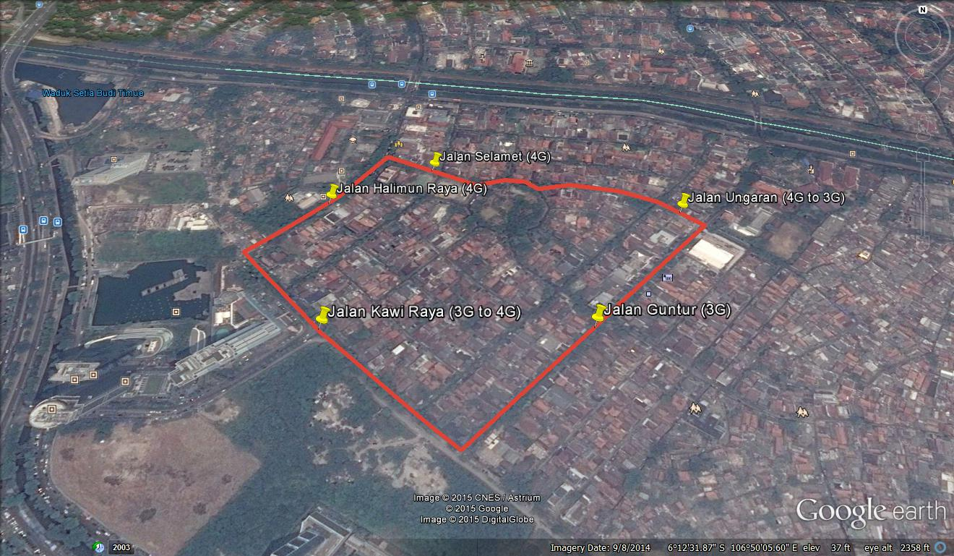
Telkomsel: Inter-RAT Cell Reselection from LTE to UMTS during Connected Mode

Slide 9
Telkomsel: Inter-RAT Cell Reselection from LTE to UMTS during Idle Mode

Slide 10
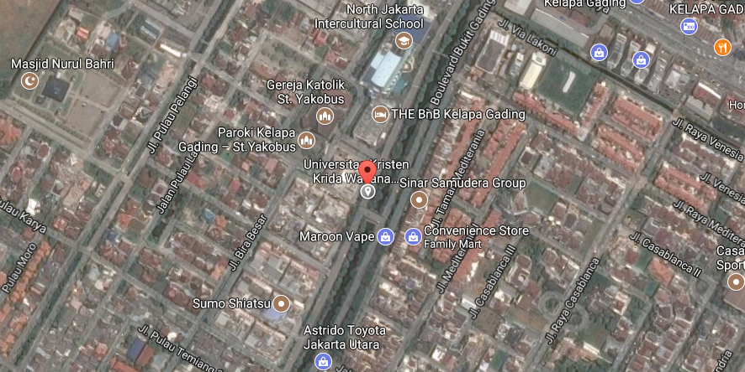
Telkomsel: Near cell location : -73 dbm ,SNR:23 ,KLP GADING

Slide 11
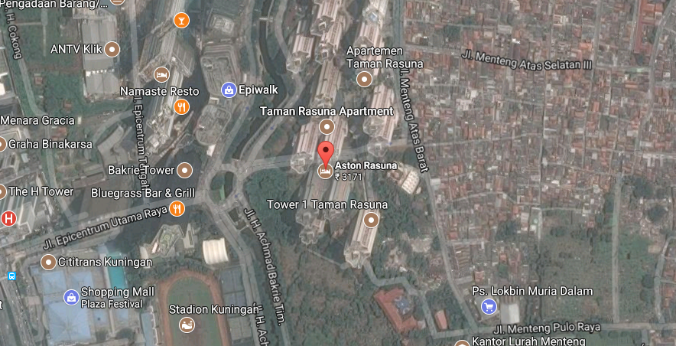
Telkomsel: Edge cell location : above -95 dbm ,SNR:0-5 ,Astun Rasuna

Slide 12
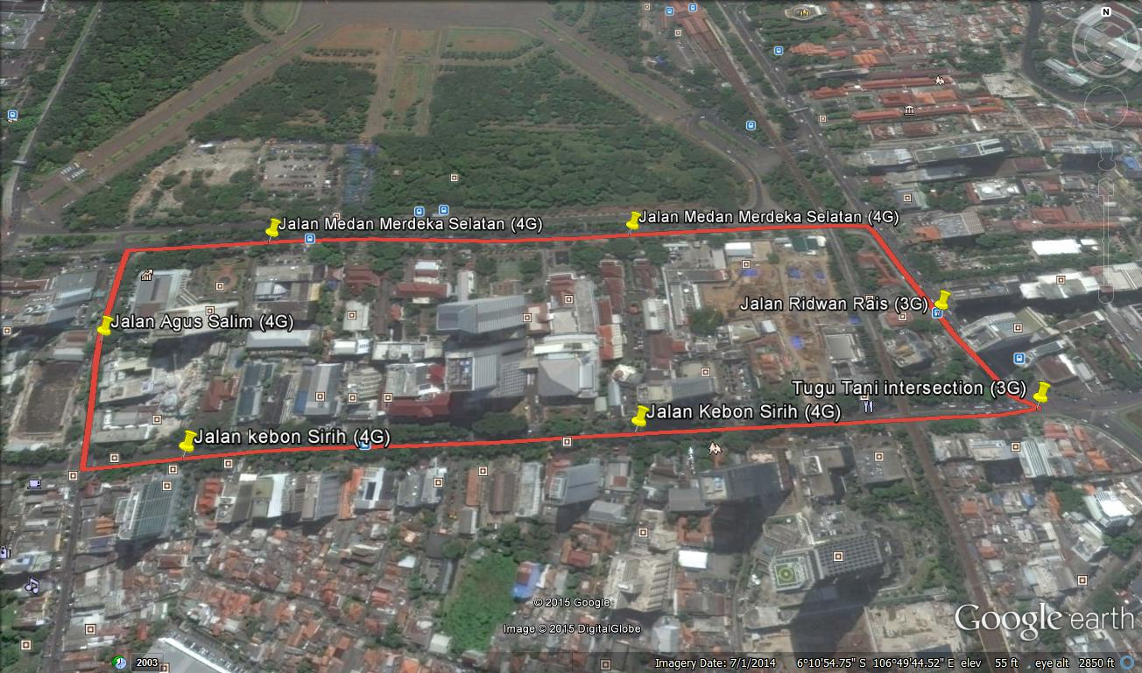
Indosat: Inter-RAT Cell Reselection from LTE to UMTS during Connected Mode

Slide 13
Indosat: Inter-RAT Cell Reselection from LTE to UMTS during Idle Mode

Slide 14
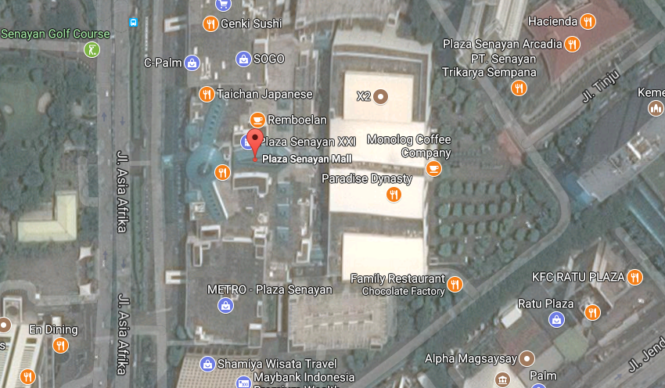
Indosat: Near cell location : -76 dbm ,SNR:22 ,Plaza Senayan

Slide 15
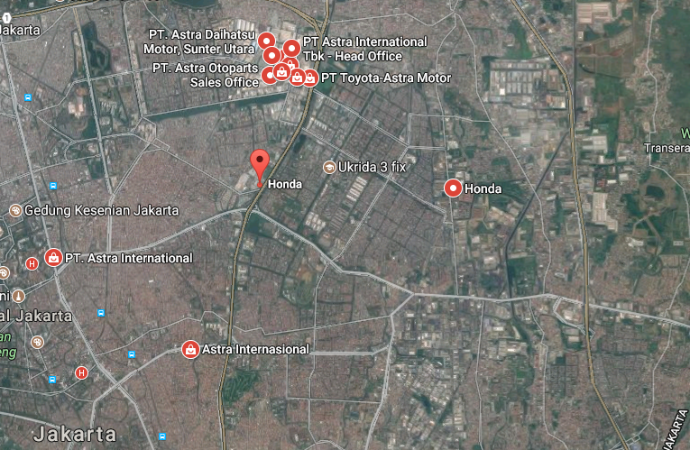
Indosat: Edge cell location : above -95 dbm ,SNR:0-5 ,PT Astra Motors

Slide 16
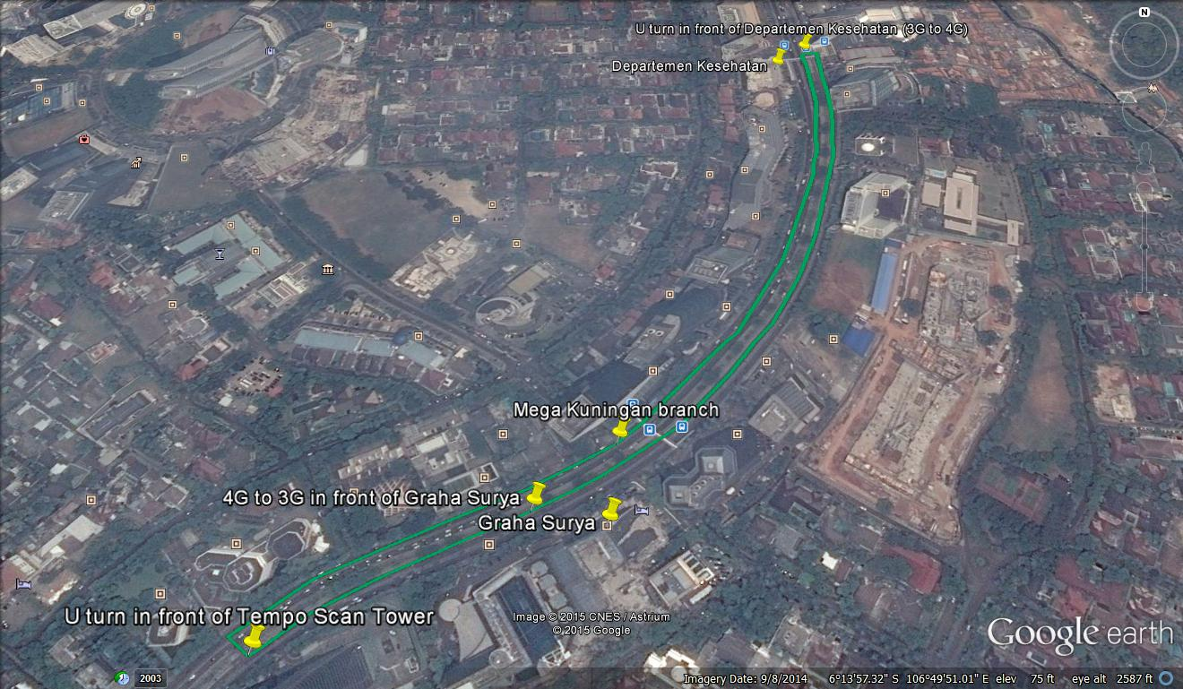
XL: Inter-RAT Cell Reselection from LTE to UMTS during Connected Mode

Slide 17
XL: Inter-RAT Cell Reselection from LTE to UMTS during Idle Mode

Slide 18
XL: Near cell location : -76 dbm ,SNR:22 ,KLP Gading

Slide 19
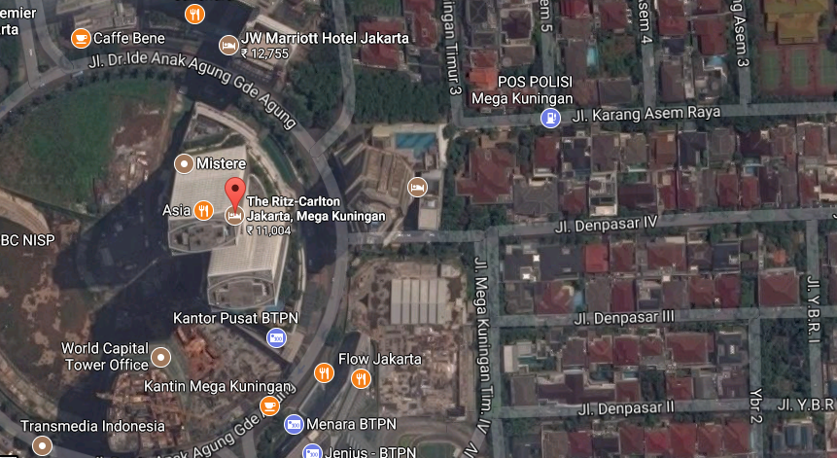
XL: Edge cell location : above -95 dbm ,SNR:0-5 ,Opp Embassy of Saudi arabia(magakuningan)

Slide 20
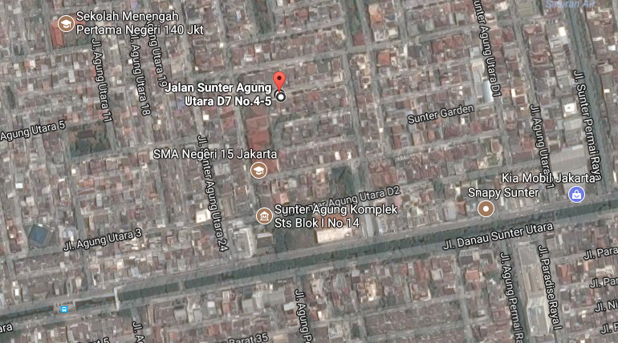
TRI: Inter-RAT Cell Reselection from LTE to UMTS during Connected Mode

Slide 21
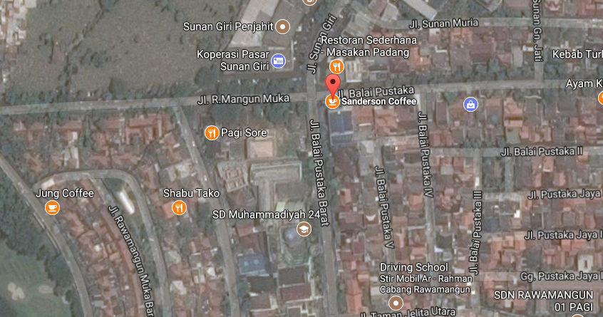
Tri(3): Near cell location : -76 dbm ,SNR:22 ,Rawamangun

Slide 22
Tri: Edge cell location : above -95 dbm ,SNR:0-5 ,Opp Embassy of Saudi arabia(magakuningan)

Slide 23
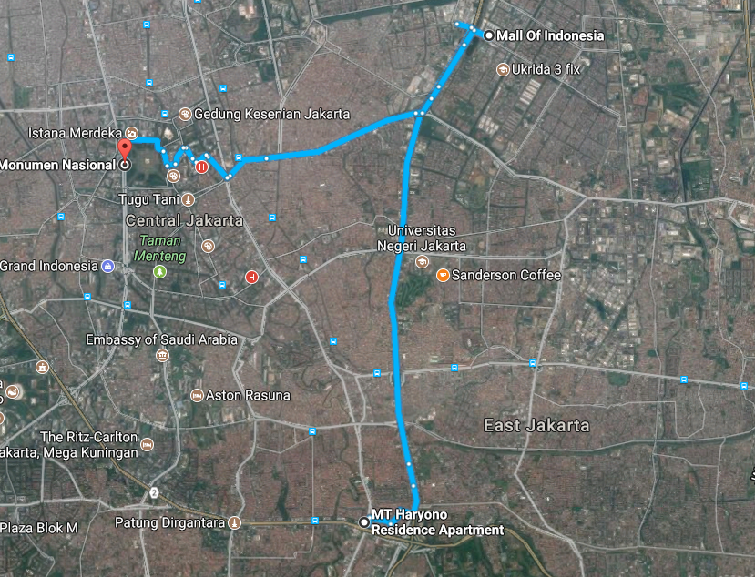
Mobility Route1:4G (Aston rasuna-Monas)

Slide 24
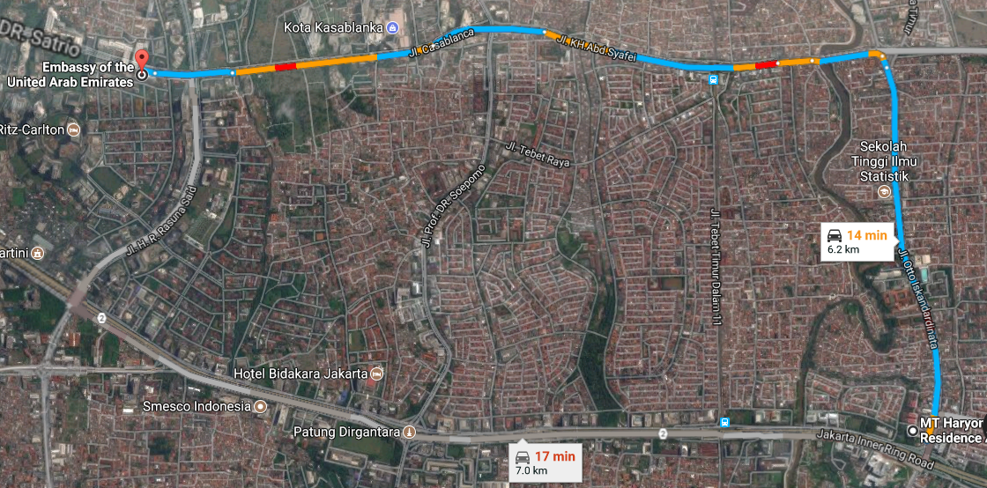
Mobility Route2:4G (MT Haryano – Embessy of Saudi)

Slide 25
Top Most Popular Android Apps used in Jakarta
Go-Jak
Grab
Facebook
Facebook Messenger
WhatsApp Messenger
Share it
Uber
We chat
Bigo Live
Viber
UC browser

Slide 26
Local EM number used in Jakarta
Police | 110
Search & Rescue | 115
Ambulance | 118
Fire Bridge | 113

Slide 27
THANK YOU
MARQUIS TECHNOLOGIES
www.marquistech.com

