Slide 1

MARQUIS TECHNOLOGIES
DRIVE ROUTE : DOHA, QATAR
VODAFONE OPERATOR
OOREDOO OPERATOR
Notes:
CONFIDENTIAL

Slide 2
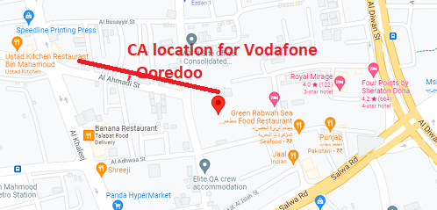
CA Location for vodafone and Ooredoo Operator (Al Ahmadi street, Doha, Qatar

Slide 3
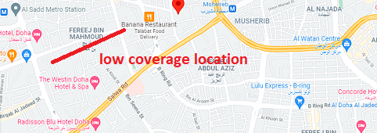
Low coverage Location for vodafone and Ooredoo Operator (Fereej bin mahmoud, Doha, Qatar

Slide 4
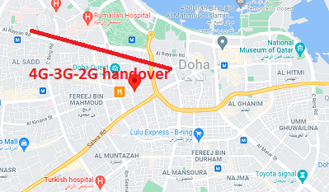
Low coverage Location for vodafone and Ooredoo Operator (Doha Quest, Doha, Qatar

Slide 5
Thank You

