Slide 1
DRIVE ROUTE- United Kingdom
Improvisation required during NXT FT
ESIM
SRVCC: (O2, Vodafone,EE & Three)
4g to 3g in idle & connected mode (O2, Vodafone & Three)
5G NSA Data throughput (O2, EE, Vodafone & Three)
Service to OOS locations (O2, EE, Vodafone & Three)

Slide 2
EE NW info
MCC | 234
MNC | 30
APN | EE Internet , EE MMS
Country/City | United Kingdom / London
Country Code | +44
NRCA support | No
NR & LTE Bands Frequency & BW | NR : Band 78, LTE : Band 1 , 3 , 20
VoNR support | Yes (Issue raised for 5G SA)
NSA support | Yes
MIMO supported | Yes
RF bag availability | Yes

Slide 3
Vodafone NW info
MCC | 234
MNC | 15
APN | Vodafone UK Data
Country/City | United Kingdom / London
Country Code | +44
NRCA support | No
NR & LTE Bands Frequency & BW | NR : Band N1, N78, LTE : Band 1 , B3 , B20
VoNR support | No
NSA support | Yes
MIMO supported | Yes
RF bag availability | Yes

Slide 4
Three NW info
MCC | 234
MNC | 20
APN | 3
Country/City | United Kingdom / London
Country Code | +44
NRCA support | No
NR & LTE Bands Frequency & BW | NR : Band 78, LTE : Band 1 , 3 , 20
VoNR support | No
NSA support | Yes
MIMO supported | Yes
RF bag availability | Yes

Slide 5
O2 NW info
MCC | 234
MNC | 10
APN | O2 pay Monthly
Country/City | United Kingdom / London
Country Code | +44
NRCA support | No
NR & LTE Bands Frequency & BW | NR Band : N78 , N28 , LTE : Band 1 , 3 , 20 , 40
VoNR support | No
NSA support | Yes
MIMO supported | Yes
RF bag availability | Yes

Slide 6
Major UK Operators : Locations for 5G /NR Field Test
Operator | PLMN | 5G Tested Locations | Longitude / Latitude | ENDC combination Tested
O2-UK | 234/10 | Near Telefonica Office 260 Bath Rd, Slough SL1 4DX | 51.518087, -0.629636 | LTE Band 1 + NR 78
 |  | Gadebridge, Hemel Hempstead HP1 3LG | 51.764493, -0.489978 | LTE Band 20 + NR 78
EE | 234/30 | Clayponds Ave Brentford, TW8 9QE | 51.494568, -0.301006 | LTE Band 1 + NR 78
 |  | High Street Green, Hemel Hempstead HP2 7AA | 51.763959, -0.448073 | LTE Band 3 + NR 78
3-UK | 234/20 | A4147 Hemel Hempstead Industrial Estate, HP2 7DW | 51.766102, -0.446926 | LTE Band 3 + NR 78
 |  | Preston, Wembley, London | 51.569351, -0.299794 | LTE Band 1 + NR78
Vodafone | 234/15 | Baron St, The Angel, London N1 9LL | 51.532802, -0.109065 | LTE Band 1 + NR 78
 |  | 48 Glenthorne Rd, Hammersmith, London W6 0LS | 51.494453, -0.229098 | LTE Band 7 + NR78

Slide 7
Mobility Scenarios Execution Spots: (London, UK)
Operator | Mobility Scenario | Location Tested | Longitude / Latitude
EE | 4G-3G-4G HO SPOT | Mill Ln, Ascot SL5 7RT | 51.414036, -0.637551
 | SRVCC to 3G | Wick Lane Christchurch BH23 1HT | 50.733024, -1.777673 (Approx.)
 | IRAT | A332, Winkfield, Windsor SL4 2BZ | 51.440293, -0.646446
 | Good Coverage for Testing | High Street Green, Hemel Hempstead HP2 7AA | 51.763959, -0.448073
 | Poor Coverage for testing | Kingsley Road, Hounslow | 51.473987, -0.357468
 | OOS Area | London UnderGround stations
O2-UK | SRVCC to 2G | Faggs Rd, Hounslow | 51.467470, -0.422530
 | SRVCC to 3G | Near A41, Kings Langley WD4 9NA | 51.726641, -0.475227
 | 4G-3G-4G HO SPOT | the mille, 1000 Great West Rd, Brentford TW8 9HH | 51.488851, -0.313307
 | IRAT | A30, Feltham | 51.457101, -0.441195
 | Good Coverage for Testing | Near Telefonica Office 260 Bath Rd, Slough SL1 4DX | 51.518087, -0.629636
 | Poor Coverage for testing | Stanwell Stains | 51.448751, -0.479966 (Approx.)
 | OOS Area | London UnderGround stations
3-UK | SRVCC to 3G | Hartley Wintney, Hook RG27 8JN | 51.302458, -0.929699
 | SRVCC to 2G | Not supported /Location not Found
 | 4G-3G-4G HO SPOT | Hartley Wintney, Hook RG27 8JN | 51.306306, -0.930912 (Approx.)
 | IRAT | Hartley Wintney, Hook RG27 8JN | 51.306306, -0.930912 (Approx.)
 | Good Coverage for Testing | A4147 Hemel Hempstead Industrial Estate, HP2 7DW | 51.766102, -0.446926
 | Poor Coverage for testing | Hotel Premier Inn, South gate back gate | 51.631263, -0.126450
 | OOS Area | London UnderGround stations
Vodafone | SRVCC to 3G | Wick Lane Christchurch BH23 1HT | 50.733037, -1.777652 (Approx.)
 | SRVCC to 2G | Wick Lane Christchurch BH23 1HT And Runnymede | 50.733037, -1.777652 (Approx.)
 | 4G-3G-4G HO SPOT | 89 Kingsley Rd, Lampton, Hounslow TW3 4AH | 51.474167, -0.357594
 | IRAT | 89 Kingsley Rd, Lampton, Hounslow TW3 4AH | 51.474167, -0.357594
 | Good Coverage for Testing | 48 Glenthorne Rd, Hammersmith, London W6 0LS | 51.494453, -0.229098
 | Poor Coverage for testing | Kingsley Road, Hounslow | 51.473987, -0.357468
 | OOS Area | London UnderGround stations

Slide 8
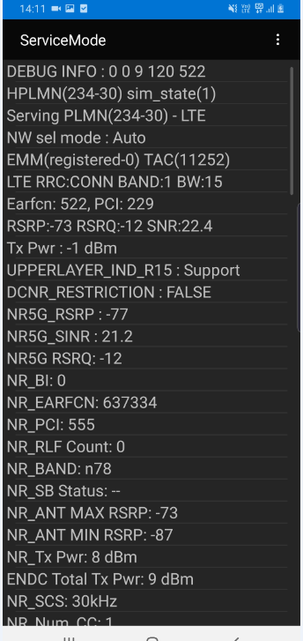
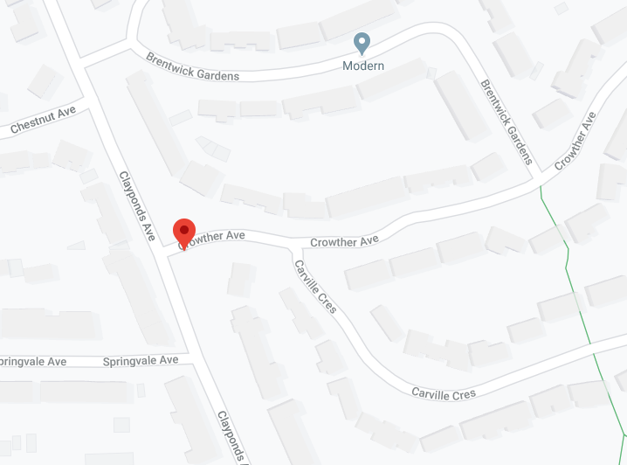
5G NR Location (Good Coverage)
EE Location (NR-RSRP -60dBm ~ -80dBm)
Location- Clayponds Ave, Brentford, TW8 9QE

Slide 9
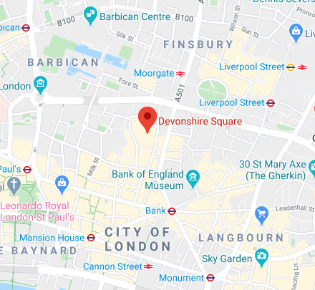
EE Central London Location
Location - Devonshire Square Parking, Spitafields, London. EC2M 4YE

Slide 10
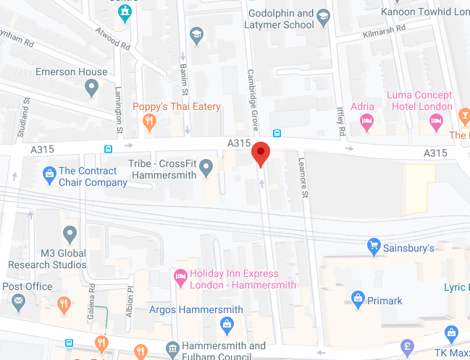
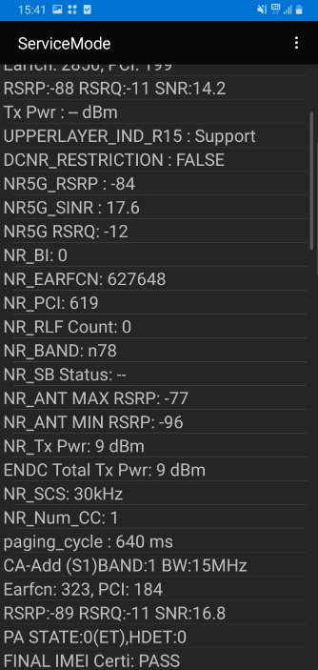
5G NR Location (Good Coverage)
Vodafone Location (NR-RSRP -70dBm ~ -80dBm)
Cambridge Grove, Hammersmith, London

Slide 11
5G locations: SA
EE
Location 1:51.65742896209082, -0.25644674679219599(Warwick Rd) (Source Ankit patel)
Issue raised for EE SA
THREE:
Location 1: SA not supported
Vodafone
Location 1: south wimbledon uk (Source Ankit patel)
Issue raised for VDF SA
O2
Location 1: 260 Bath Rd, Slough SL1 4DX, United Kingdom (Source Ankit patel)

Slide 12
5G locations: NSA
EE
Location 1:51.494208,0.301138
Location 2: 51.4894,-0.2725
Location 3: 51.4781859,-0.3640995
Vodafone
Location 1:51.483,0.339 Location 2:51.482,-0.341
Location 3: 51.4888222,-0.3160342
Three
Location 1:51.494208,-0.301138
Location 2:51.4950504,-0.3023544
Location 3: 51.4888222,-0.3160342
O2
Location 1:51.483,-0.326
Location 2: 51.479,-0.371
Location 3: 51.4888222,-0.3160342

Slide 13
5G Throughput location 1 and 2 for _SA
EE
Location 1:51.65742896209082, -0.25644674679219599(Warwick Rd) (Source Ankit patel)
Issue raised for EE SA
Vodafone
Location 1: south wimbledon uk (Source Ankit patel)
Issue raised for VDF SA
Three
Location 1:SA not supported
Location 2:SA not supported
O2
Location 1: 260 Bath Rd, Slough SL1 4DX, United Kingdom (Source Ankit patel)

Slide 14
5G Throughput location 1 and 2_NSA
EE
Location 1: 51.494876, -0.302033
Location 2: 51.4894433,-0.2725371
Vodafone
Location A:51.482181,-0.341389
Near cell
Location 2:51.482,-0.341
Three
Location 1:51.494208,-0.301138
Location 2:51.4950504,-0.3023544
O2
Location A: 51.478137,-0.371563
Location B: 51.482190,-0.373952

Slide 15
EE : 5G-4G-5G handover location:
Second location: 51°29'38.1"N 0°19'11.2"W (NR) and
First location : 51.49461230420481, -0.3014521343388934
Second location: 51.493915,-0.319779 (NR)

Slide 16
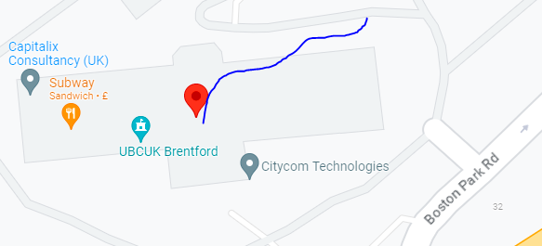
Three : 5G-4G-5G handover location: 51.4888694,-0.3135572

Slide 17
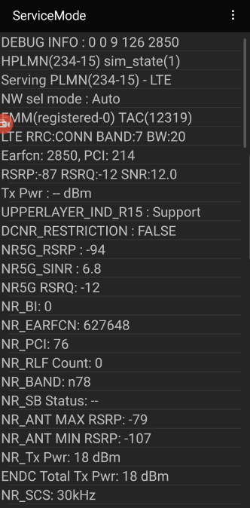
Vodafone Central London Location
Location - Devonshire Square Parking, Spitafields, London. EC2M 4YE

Slide 18
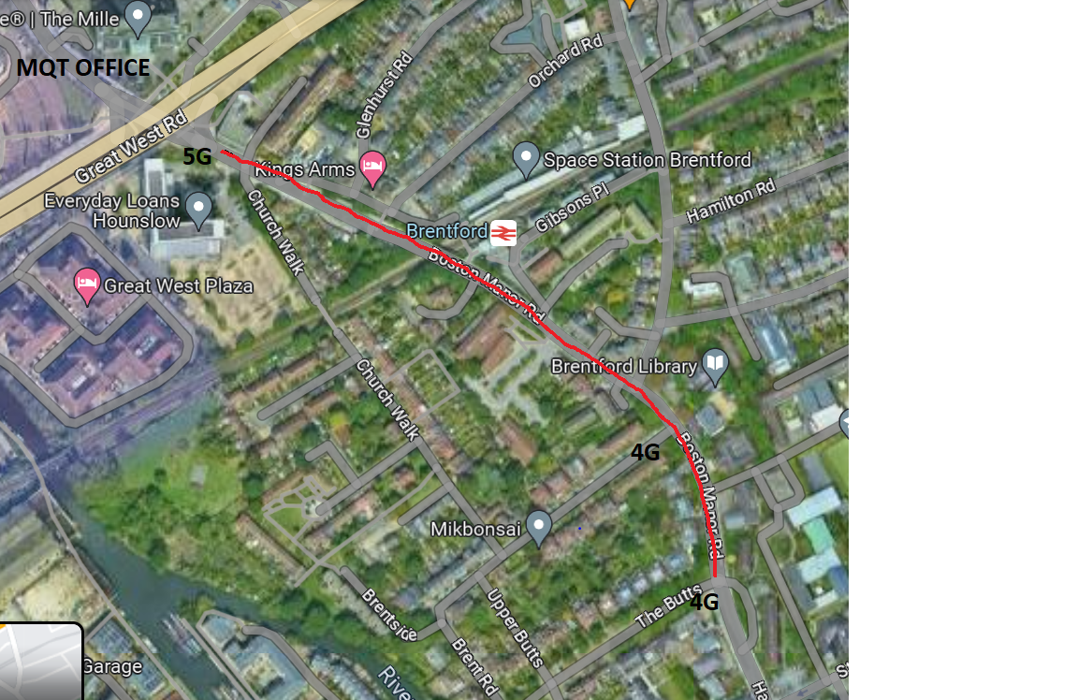
VDF: 5G-4G-5G handover
51.48803160066793, -0.31247537058311675(5G) >>>>>>>>>>> 51.48526741397951, -0.3073362581430255 (4G)

Slide 19
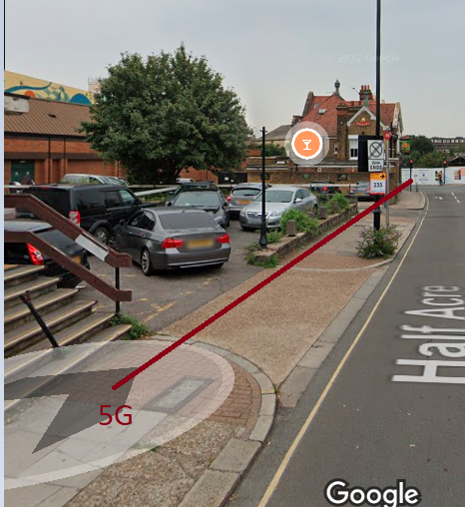
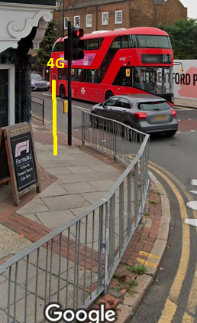
VF New location: 51.48360860855636, -0.30638916693654905

Slide 20
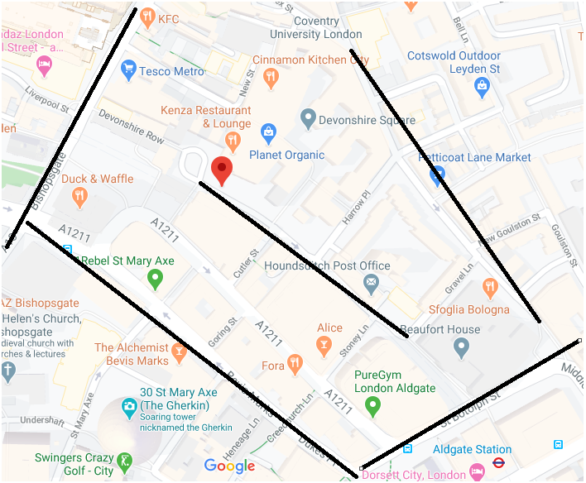
5G to 5G NR intra Handover for EE and Vodafone operator
Location- Near to Devonshire Square, EC2M 4YE

Slide 21
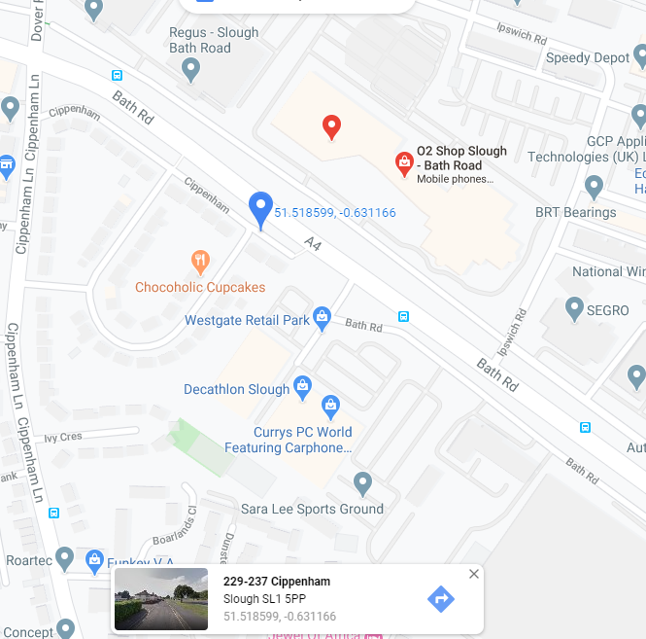
(O2 NR Location- Good Coverage) (NR-RSRP: -55dBm ~ 70dBm)
Location- 229-237 Cippenham,Slough SL1 5PP.
Landmark: Opposite of O2 Slough office

Slide 22
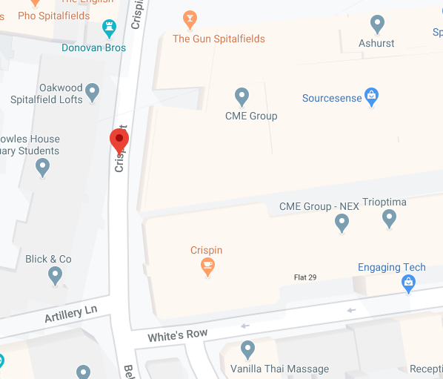
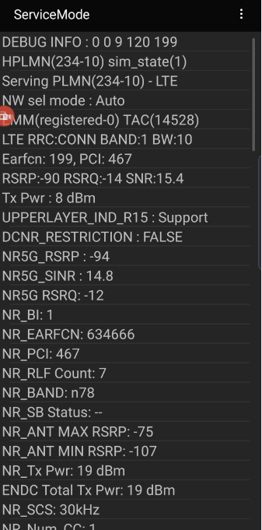
(O2 NR Location- Good Coverage) (NR-RSRP: -70dBm ~ 90dBm)
Location- Crispin St Spitalfields, Central London, E1 6HQ

Slide 23
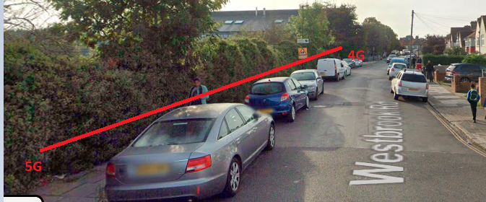
O2/SKY: 5G-4G-5G handover
51.484066420700465, -0.37737402037153345
BY : Shuvam Sharma

Slide 24
Supported LTE band combination’s & their locations:
Source : Atul / Ankit
EE
B3, 1: 51.4742896,-0.3602959
Vodafone
B20, 1: location-51.4742896,-0.3602959
Three
B1, 1: location-51.4742896,-0.3602959
O2
1. B40 , 1: location-51.4742896,-0.3602959

Slide 25
Supported NRCA band combination’s & their locations:
EE
No combination observed
Vodafone
No combination observed
Three
No combination observed
O2
No combination observed

Slide 26
Supported NSA band combination’s & their locations:
EE
NR: N78 LTE: B7, B1
Location:- 51.494208,0.301138
Vodafone
NR: N78 LTE :B20, B1,
Location:- 51.483,-0.339
Three
N78+B1 1: location- 51.4888222,-0.3160342
O2
N78+b20 1: location-51.4888222,-0.3160342
N28+b1 2: location-51.4742896,-0.3602959

Slide 27
ESIM activation process (SOP)
ESIM is supported only for the postpaid SIMcards for all the operators.
To activate the ESIM the customer must call the customer care.
Ask them to provide Esim for postpaid SIM.
Share them the EID for the device on which we need to activate ESIM on.
They will share the ESIM profile/QR code over registered e-mail address of the customer.

Slide 28
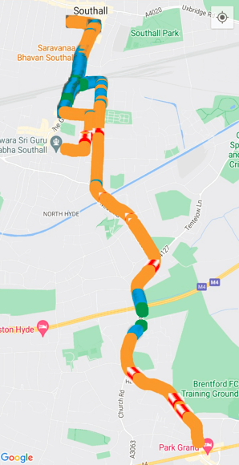
EE , Vodafone, O2 Mix coverage mobility route (2-3 routes that you follow during FT

Slide 29
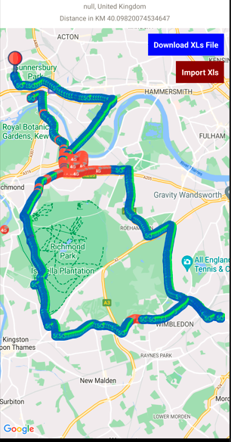
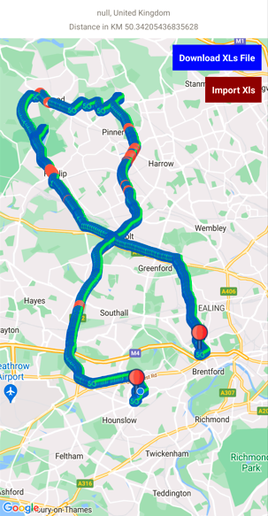
EE, Three and Vodafone Mix coverage mobility route (2-3 routes that you follow during FT)

Slide 30
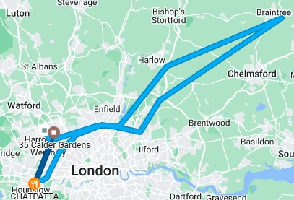
EE , Vodafone Mix coverage mobility route (2-3 routes that you follow during FT)

Slide 31
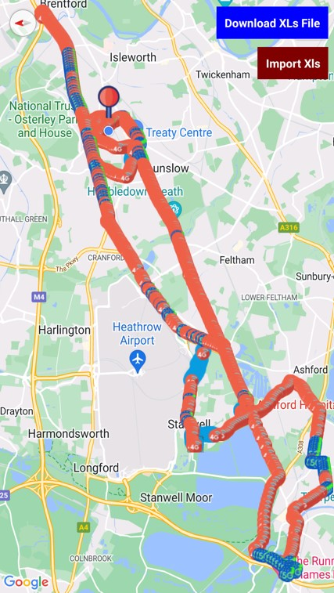
EE , Vodafone, O2 Mix coverage mobility route (2-3 routes that you follow during FT

Slide 32
SRVCC locations
O2: During SRVCC call got diconnected and then it goes to 2G same with reference. So it was marked as NA.
EE: Location: 51.4707° N, 0.3101° W
VDF: Location: 51.4707° N, 0.3101° W
Three: Location: 51.4707° N, 0.3101° W

Slide 33
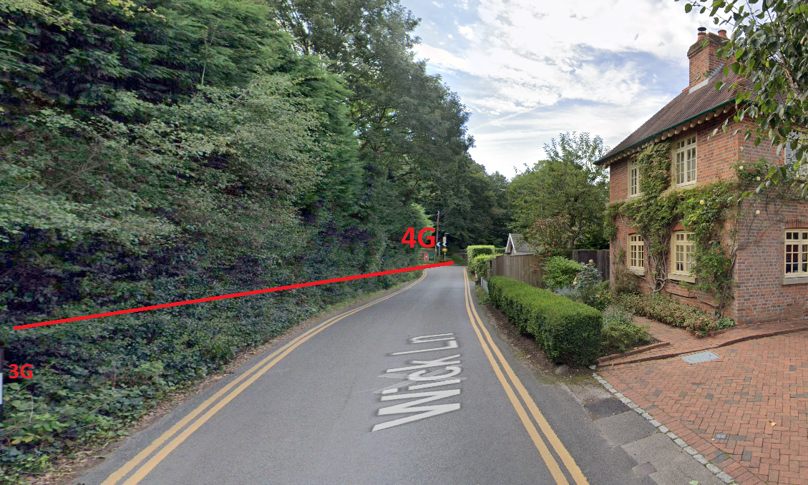
SRVCC Location : 51°25'12.7"N 0°35'14.1"W (O2)
BY : Shuvam Sharma

Slide 34
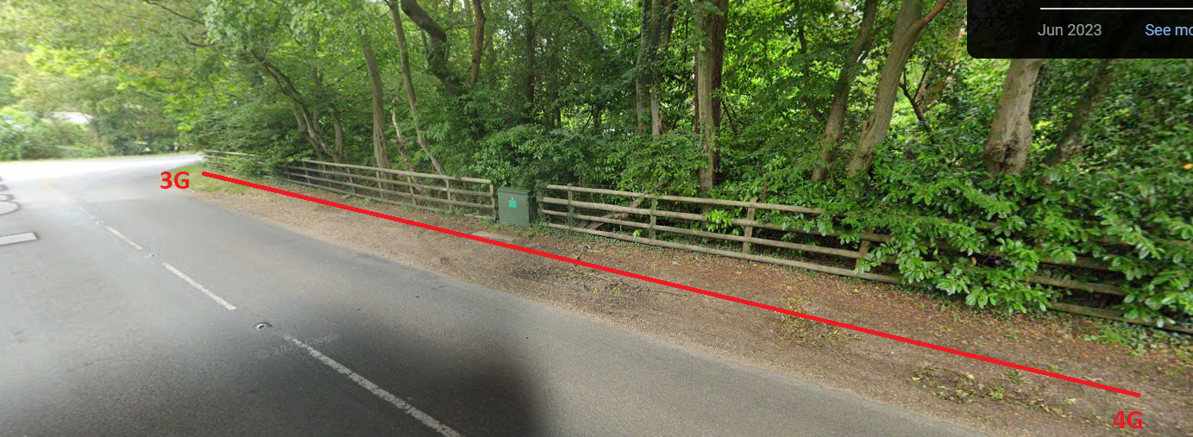
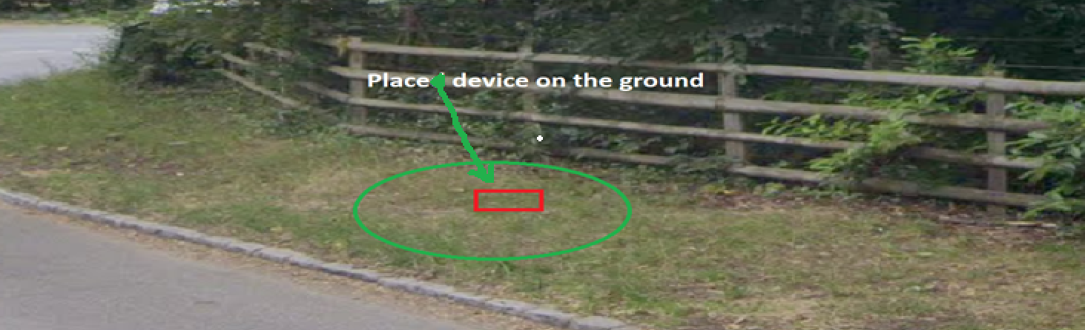
SRVCC Location : 51.55685576334532, -0.5660216418791645(Three)
BY : Shuvam Sharma

Slide 35
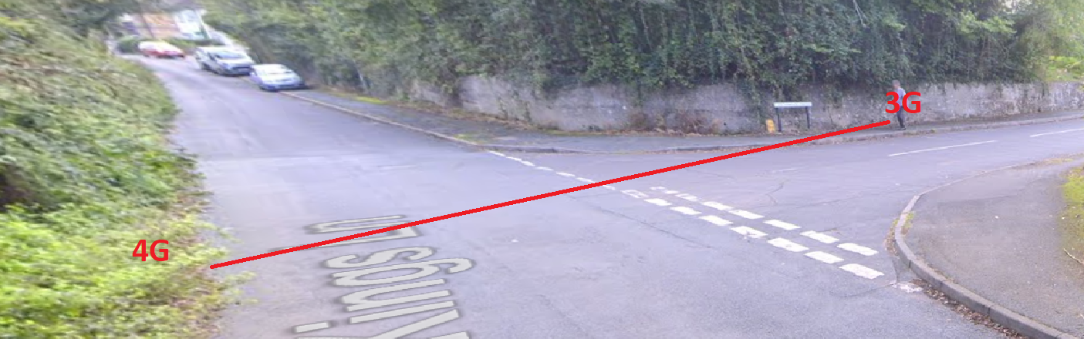
SRVCC Location : VDF (51.428221,-0.583407)
BY : Shuvam Sharma

Slide 36
Service to OOS locations:
EE
51.4710383,-0.3636224.
ASDA Under ground Parking
Vodafone
51.4710383,-0.3636224.
ASDA Under ground Parking
Three
51.4710383,-0.3636224.
ASDA Under ground Parking
O2
51.4710383,-0.3636224.
ASDA Under ground Parking

Slide 37
Cellular preferred VoWiFi case's locations:
EE
51.4710383,-0.3636224.
ASDA Under ground Parking
Vodafone
51.4710383,-0.3636224.
ASDA Under ground Parking
Three
51.4710383,-0.3636224.
ASDA Under ground Parking
O2
51.4710383,-0.3636224.
ASDA Under ground Parking

Slide 38
DSS location
02 Location :51.419027,-0.200157/ 51.422279141462994, -0.20827434232857986 New location source Atul
VDF: 51.488818,-0.313528 / 51.48852389261859, -0.3135893960642087 New location source Atul

Slide 39
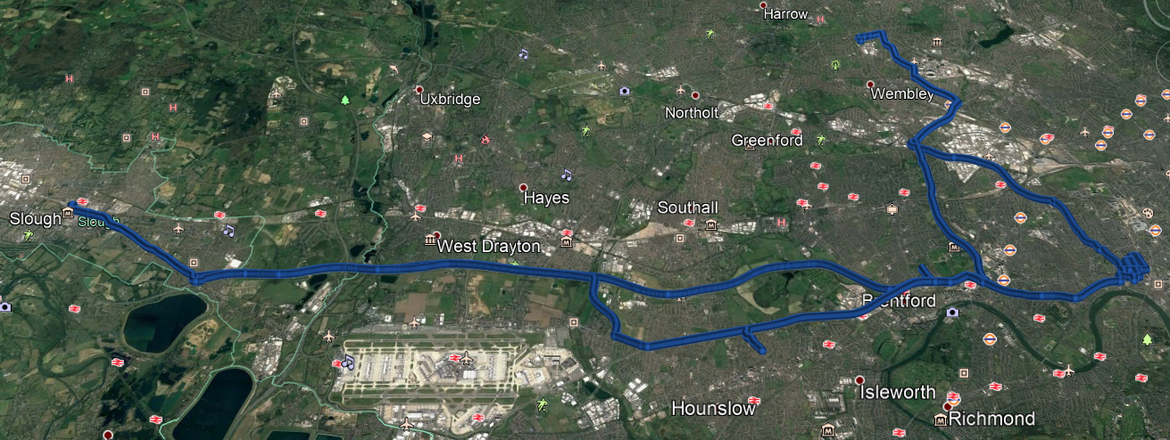
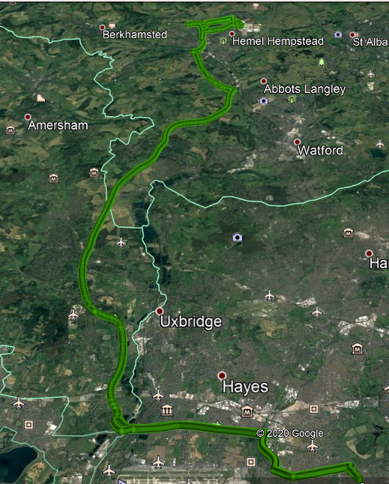
London, UK drive Routes for 5G Field Testing
Hounslow >> Richings park >> Chandler’s Cross >> Hemel Hempstead
Slough >> Hounslow >> Brentford >> Hammersmith >> Wembley

Slide 40
Thank You

