Slide 1
MARQUIS TECHNOLOGIES
5G/4G Drive Route – SINGAPORE

Slide 2
Drive Route
Near Cell :-Stationary: RSRP: -65dbm to -90dbm
Mixed :-Mobility: RSRP : -75dbm to -100dbm
Cell Edge :-Stationary: RSRP : -95dbm to -120dbm

Slide 3
Services Supported by 5G Operators
Operator | Network Service Supported
 | 5G NSA | VoLTE | VoWiFi | 2CA | SRVCC | CSFB | MMS on 4G | IRAT Reselection/PS Handover | Inter-Freq Reselection/Handover
STAR HUB | Yes | Yes | Yes | Yes | Yes | Yes | Yes | Yes | Yes
Singtel | Yes | Yes | Yes | Yes | Yes | Yes | Yes | Yes | Yes
M1 | Yes | Yes | No | Yes | Yes | Yes | Yes | Yes | Yes

Slide 4
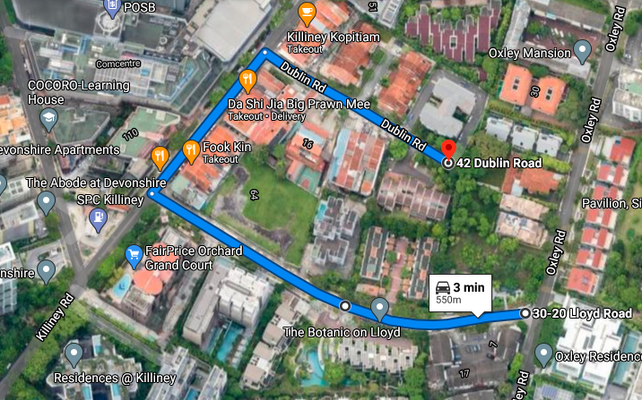
Star hub 5G location Route>>30-20 Lloyd Rd>>Dublin Rd
Lat long; 1.2983385,103.8396733,59
RSRP:-80 T0 -87

Slide 5
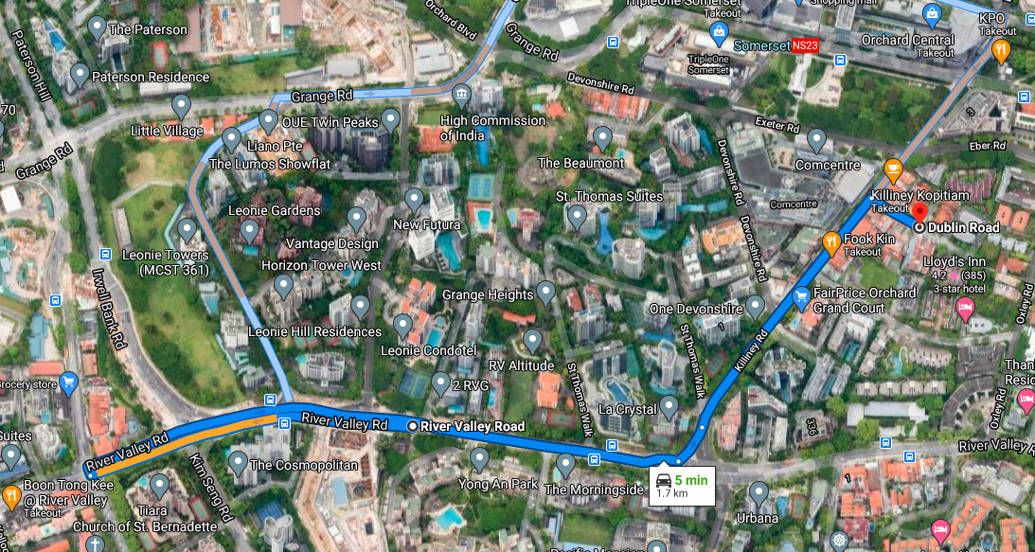
Star hub 5G to 4g handover location Route>>River Valley Rd>>Dublin Rd

Slide 6
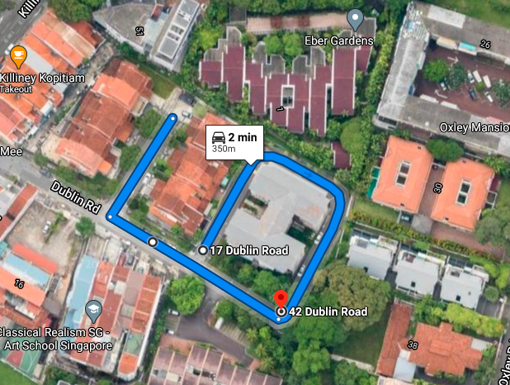
Singtel 5G location Route>>42 Dublin Rd>>Dublin Rd
Lat long; 1.2981967,103.839904
RSRP: -72 TO -79

Slide 7
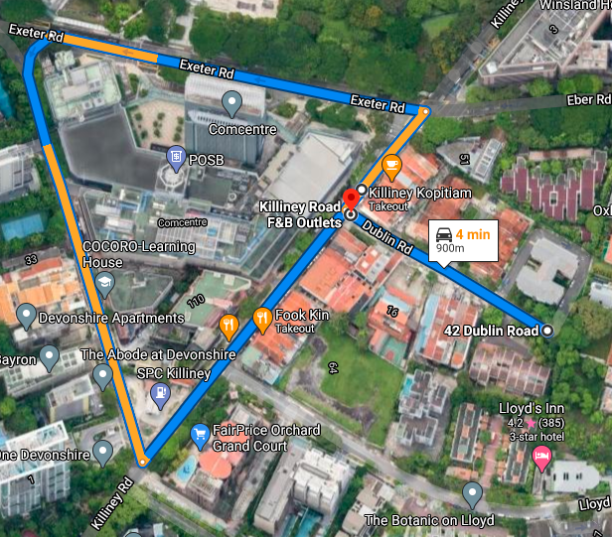
SINGTEL 5G to 4g Handover location Route>>Killiney Road F&B Outlets>>Dublin Rd

Slide 8
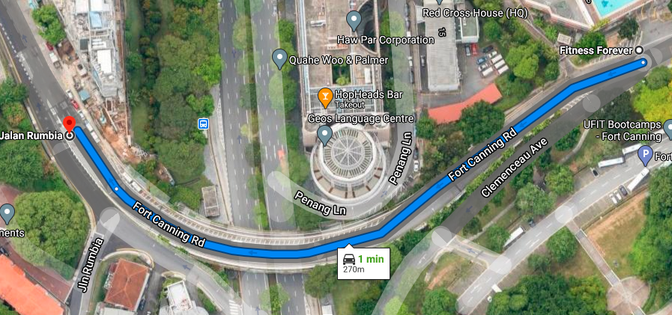
M1 5G location Route>>Jln Rumbia
Lat long; 1.2964343,103.8436492
RSRP:-83 TO -88

Slide 9
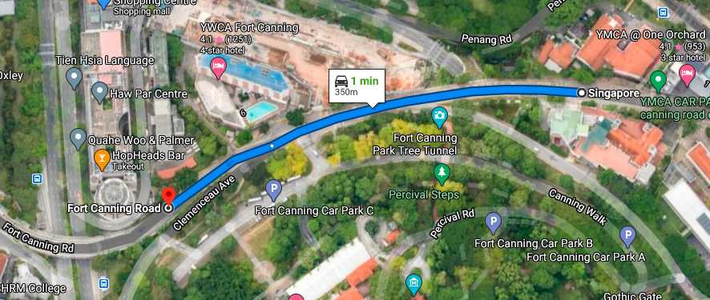
M1 5G to 4g handover location Route>>Jln Rumbia>>Fort Canning Rd

Slide 10
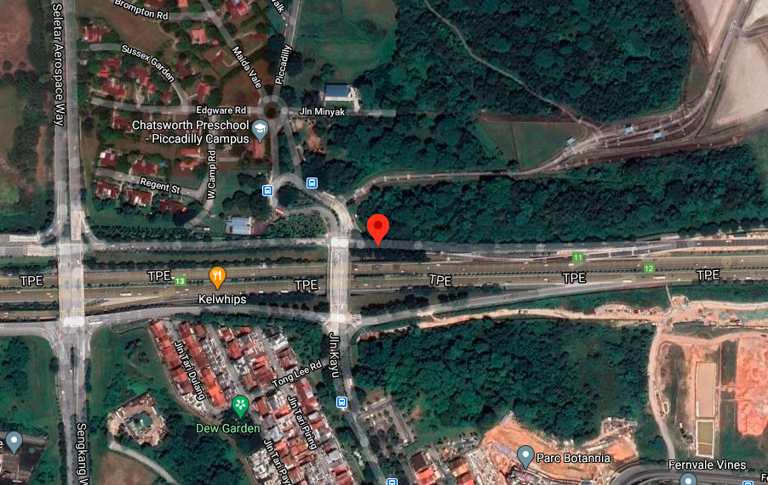
Star hub 4G VoLTE operator CA(BAND 3 location Route>>Seletar, Singapore Lat long; 1.4044171,103.8687678 RSRP:-70 TO -78
EC:2

Slide 11
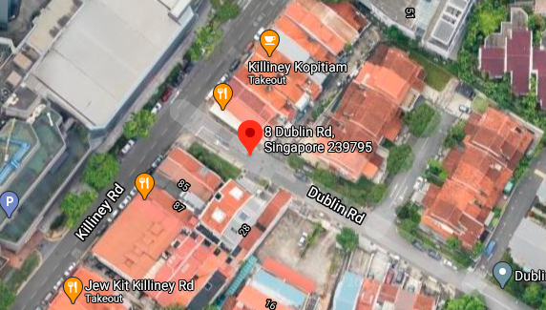
Singtel 4G VoLTE operator CA location 8 dublin road Lat long :1.2985923,103.8392407 RSRP:-71 TO -79

Slide 12
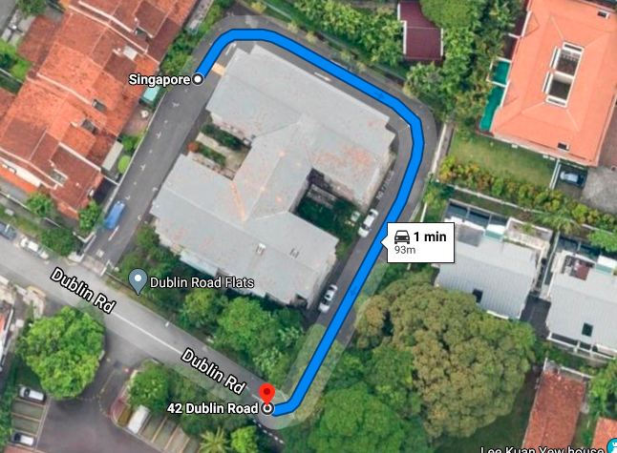
M1 4G VoLTE operator CA location Dublin road in Orchard Lat long : 1.2983631,103.8401025 RSRP:-80 TO -85

Slide 13
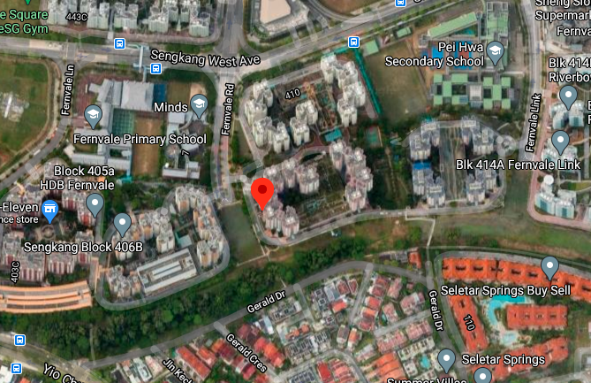
STAR HUB SRVCC VoLTE to 3g RAT 408B Fernvale Rd, Block 408B, Singapore Lat long : 1.3890186,103.8749656 RSRP:- -95 TO -110

Slide 14
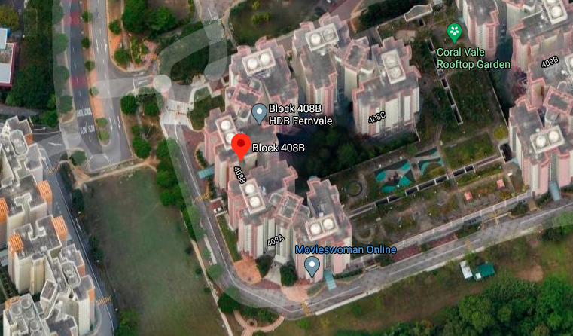
SINGTEL SRVCC VoLTE to 3g RAT 408B Fernvale Rd, Block 408B, Singapore Lat long : 1.3890692,103.8759091 RSRP:- -95 TO -110

Slide 15
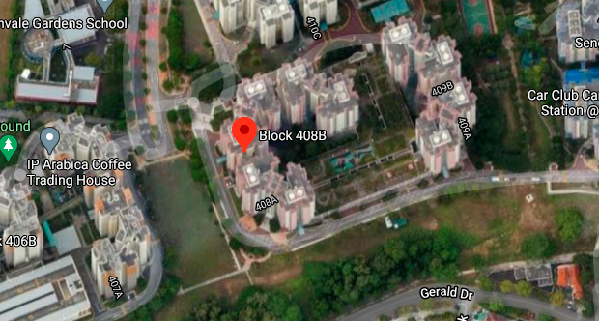
M1 SRVCC VoLTE to 3g RAT 408B Fernvale Rd,Singapore Lat long : 1.3890692,103.8749515 RSRP:- -95 TO -110

Slide 16
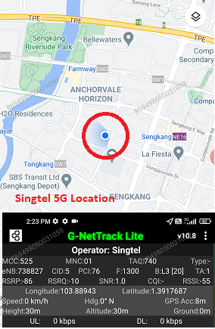
Singtel 5G good coverage:

Slide 17
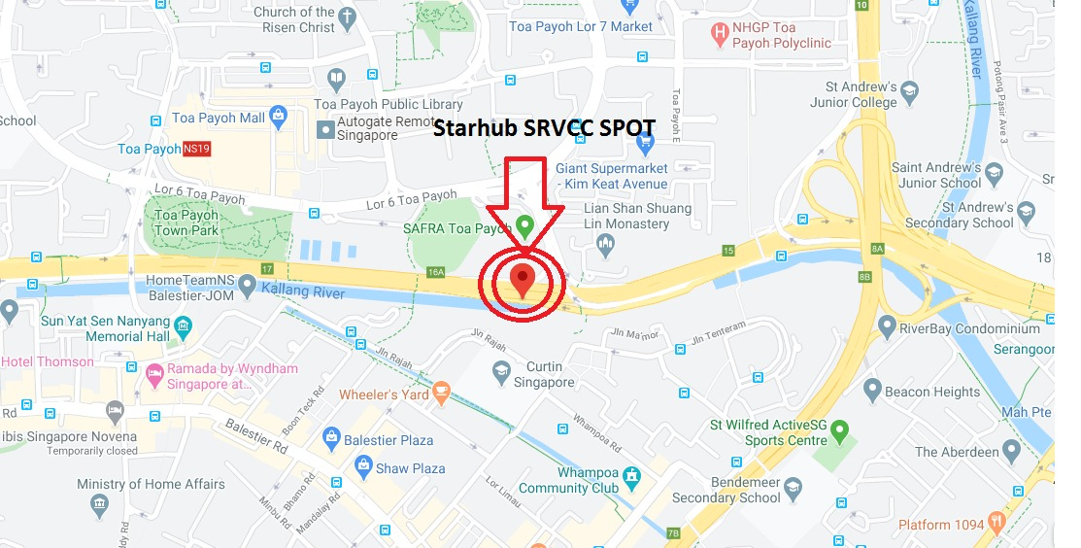
Starhub SRVCC:

Slide 18
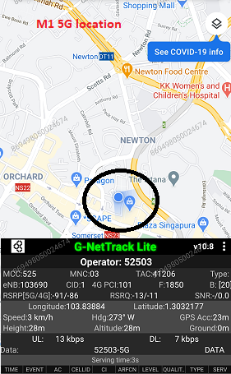
M1 Good coverge 5G spot:

Slide 19
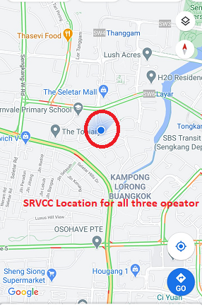
Srvcc SPOT for all three operaor:

Slide 20
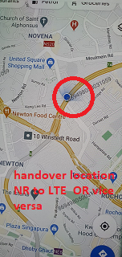
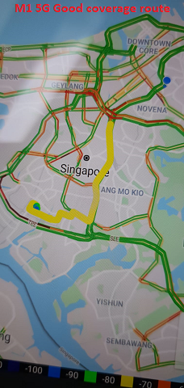
5G NSR TO LTE handover spot for M1 opertor:

Slide 21
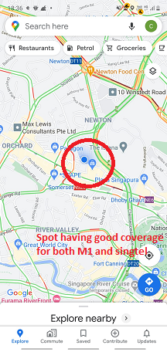
M1 and Singtel 5G good coverage common spot:

Slide 22
THANK YOU
MARQUIS TECHNOLOGIES
www.marquistech.com

