Slide 1
MARQUIS TECHNOLOGIES
Drive Route
Greece
OPERATORS -:
COSMOTE.
WIND
VODAFONE.

Slide 2
Drive Route Cosmote 5G
Near Cell :-Stationary: RSRP: -70 dbm to -80dbm
Mixed :-Mobility: RSRP : -80 dbm to -97dbm
Cell Edge :-Stationary: RSRP : -97 dbm to -115dbm

Slide 3
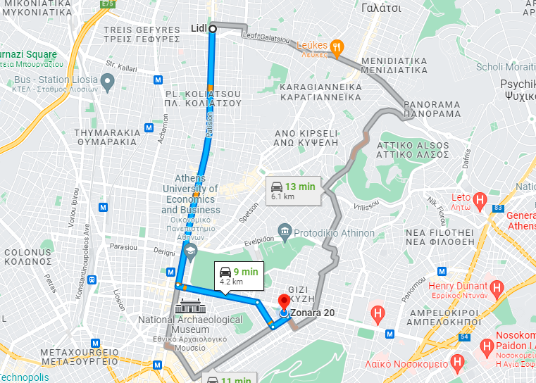
Cosmote N1 NSA (Near Cell):- PATISIA , GREECE
Operator: Cosmote
Band: N1
Cell ID: 2
E-ARFCN : 42854
RSRP 5G: -80dBm to -95dBm
NC:1

Slide 4
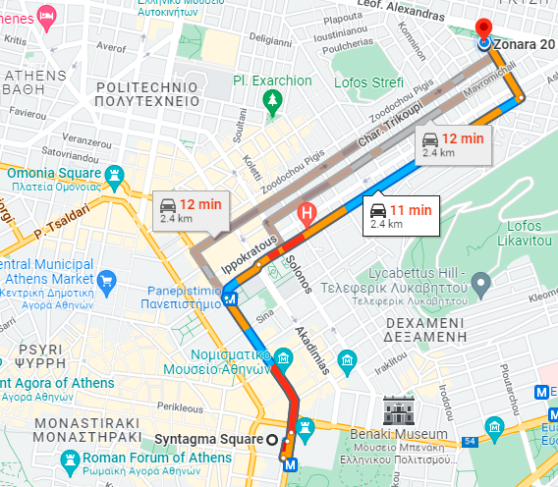
Cosmote N48 NSA (Near Cell):- ZONARA , ATHENS
Operator: Cosmote
Band: N48
Cell ID: 10
E-ARFCN : 636666
RSRP: -80dBm to -95dBm
EC:1

Slide 5
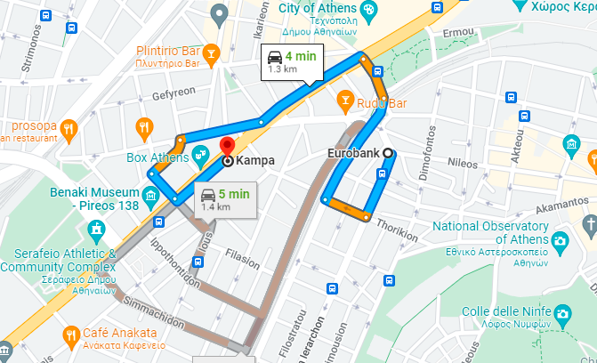
Cosmote L20 (Near Cell):- EVRITHOES , ATHENS
Operator: Cosmote
Band: L20
Cell ID: 11
E-ARFCN : 156510
RSRP: -80dBm to -95dBm
EC:1

Slide 6
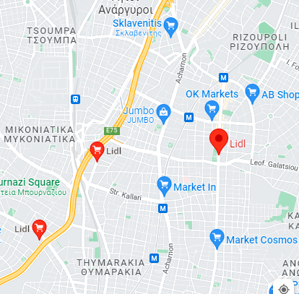
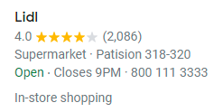
Cosmote (Inter-frequency Band Handover):- LIDL PATISIA
Operator: Cosmote.
Band Handover: B20-B1-B20

Slide 7
Cosmote (L to G Reselection):-NA
Operator: Cosmote.
L to G Reselection:
Cosmote has eradicated its GSM Networks . Hence no location found where reselection happens

Slide 8
Drive Route Wind
Near Cell :-Stationary: RSRP: -75dbm to -80dbm
Mixed :-Mobility: RSRP : -80dbm to -95dbm
Cell Edge :-Stationary: RSRP : -95dbm to -115dbm

Slide 9
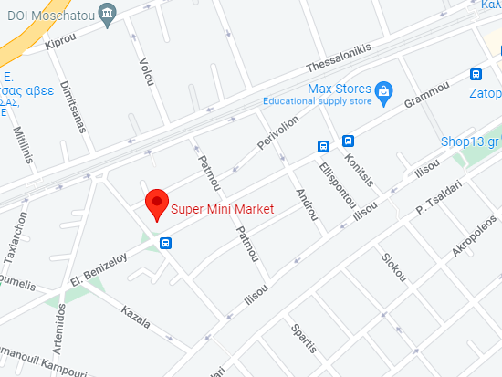

WIND Band-N1 (Near Cell)-Super Mini Mart Kallithea
Operator: Wind
Band: N1
Cell ID: 21
E-ARFCN : 428856
RSRP: -75dBm to -85dBm
NC:1

Slide 10
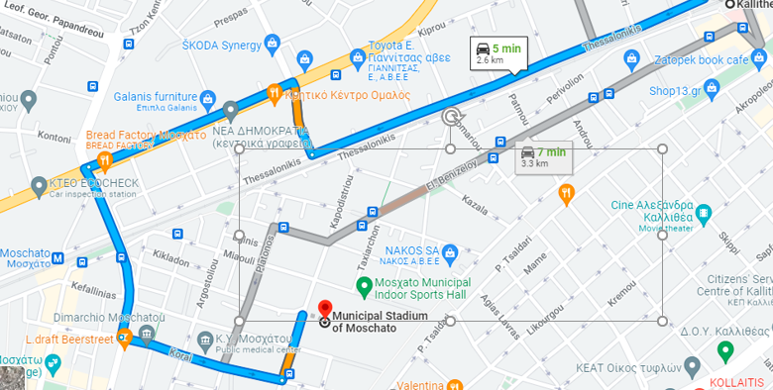
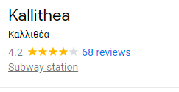
Wind Band-L3 (Edge Cell)
Kallithea Metro Station to Moschato Municipal Stadium
Operator: Wind
Band: N1
Cell ID: 33
E-ARFCN : 12862
RSRP: -75dBm to -85dBm
EC:1

Slide 11
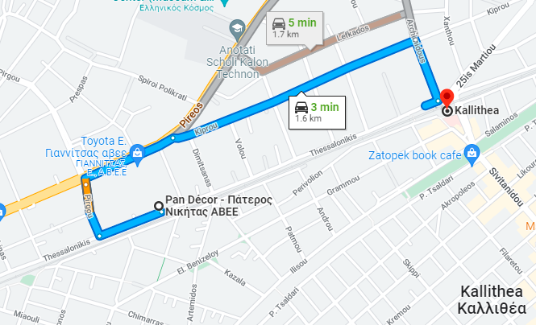
Inter-Frequency Band Reselection L3 TO L10
Kallithea Metro Station to Moschato Municipal Stadium

Slide 12
Drive Route Vodafone 5G
Near Cell :-Stationary: RSRP: -75dbm to -85dbm
Mixed :-Mobility: RSRP : -85dbm to -95dbm
Cell Edge :-Stationary: RSRP : -95dbm to -115dbm

Slide 13
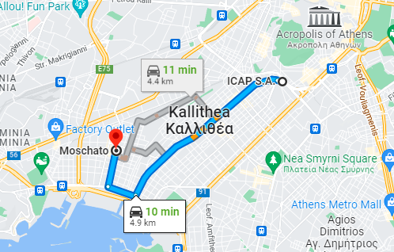
Vodafone Band-N1 (Near Cell)- Moschato Athens
Operator: Vodafone
Band: N1
Cell ID: 21
E-ARFCN : 428856
RSRP: -75dBm to -85dBm

Slide 14
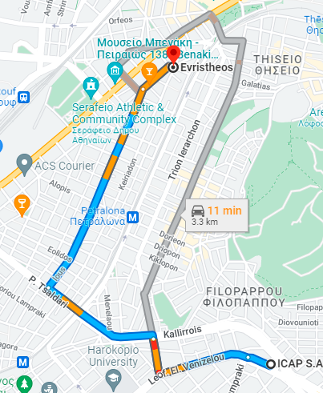
Vodafone Band-N48 (Near Cell)- EVRITHOES Athens
Operator: Vodafone
Band: N48
Cell ID: 8
E-ARFCN : 643322
RSRP: -85 dBm to -99 dBm

Slide 15
Vodafone Inter-Frequency Band Reselection L3 TO L20 -
ICAP SA Kallithea to Evritheos Athens.
Operator: Vodafone
Band: N48
Cell ID: 8
E-ARFCN : 643322
RSRP: -85 dBm to -99 dBm
EC:1

Slide 16
THANK YOU
MARQUIS TECHNOLOGIES
www.marquistech.com

