Slide 1
MARQUIS TECHNOLOGIES
Drive Route –Airtel, VI & Reliance JIO (FDD/TDD) LTE
Location : Jamnagar

Slide 2
Operator Information:
Operator | JIO 4G
MCC | 405
MNC | 857
APN | jionet
Operator | Airtel 4G
MCC | 404
MNC | 98
APN | airtelgprs.com
Operator | VI
MCC | 404
MNC | 05
APN | internet
Operator | BSNL
MCC | 404
MNC | 57
APN | Bsnlnet

Slide 3
Jamnagar/India
Operator Details:
S. No. | Operator |  | Supported Bands | Supported Features by Network
1 | Major | Airtel | LTE FDD B1/B3/B8 & TDD B40/N78 | VoWiFi/VoLTE/4G/2G/5G
2 |  | JIO | LTE FDD B3/B5 & TDD B40/N78/N28 | VoWiFi/VoLTE/4G/5G
3 |  | VI | LTE FDD B1/B3/B8 & TDD B41 | VoWiFi/VoLTE/4G/2G
4 | Minor | BSNL | LTE FDD B28 | VoLTE/4G/3G/2G

Slide 4
Operator Information 1
Functionality | Airtel
Website: https://www.airtel.in/ WAP APN: airtelgprs.com
Customer care | 121
MNC | 98
Bands supported | Both FDD and TDD
 | LTE 2300 MHz – TDD(Band 40)
 | LTE 1800 – FDD(Band 3) LTE 2100 – FDD (Band 1)
USSD | To check MDN: *282#
 | Balance check: *123#
 | To check all services: *121#
VoLTE | Supported
VoWiFi | Supported
CSFB | Supported (CSFB to 2G)

Slide 5
Operator Information 2
Functionality | RELIANCE JIO
Website: https://www.jio.com WAP APN: jionet
Customer care | 198
MNC | 857
Bands supported | Both FDD and TDD
 | LTE 2300 MHz –TDD(Band 40)
 | LTE 850 MHz – FDD(Band 5)
 | LTE 1800 MHz –FDD(Band 3)
USSD | NA
 | NA
 | NA
VoLTE | Supported
VoWiFi | Supported
CSFB | Not Supported

Slide 6
Operator Information 3
Functionality | VI
Website: https://www.myvi.in WAP APN: internet
Customer care | 198
MNC | 05
Bands supported | Both FDD and TDD
 | LTE 2300 MHz –TDD(Band 40)
 | LTE 2500 MHz –TDD(Band 41)
 | LTE 1800 MHz –FDD(Band 3) LTE 900 MHz –FDD(Band 8) LTE 2100MHZ-FDD(Band 1)
USSD | To check MSISDN :*199#
 | Recharge : *199*5#
 | Balance check : *199*2#
VoLTE | Supported
VoWiFi | Not Supported
CSFB | Supported (CSFB to 2G/3G)

Slide 7
Drive Route
Near Cell : Stationary: RSRP : -65dbm to -75dbm
Edge Cell : Stationary: RSRP : -95dbm to -110dbm
Mixed : Mobility: RSRP : -65dbm to -110dbm

Slide 8
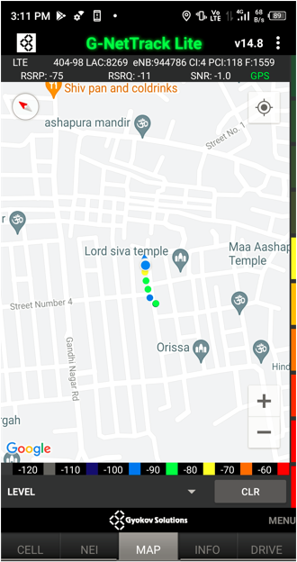
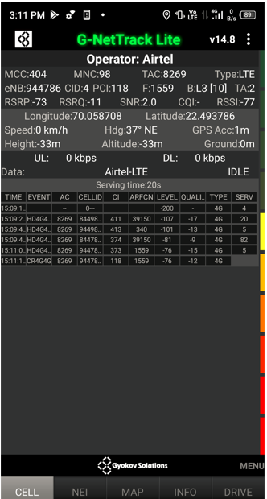
Near Cell (Airtel)
Near cell | longitude | latitude | RSRP (dbm) | Cell id | E-ARFCN
1 | 70.058708 | 22.493786 | -73 | 4 | 1559
RSRP Range for Near Cell :
-65dbm to -75dbm
Street no-4 macharsheri ,jamnagar

Slide 9
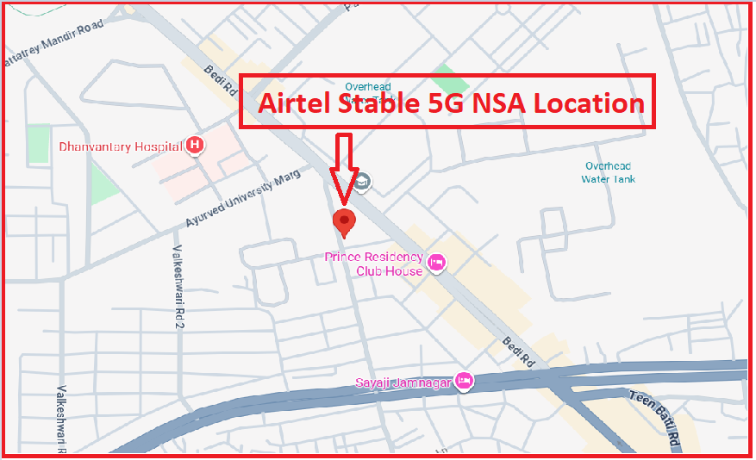
5G Near Cell,Airtel
Lat/Long -22.476125, 70.064795
Specification –Stable Airtel 5G NSA network
Average Throughput

Slide 10
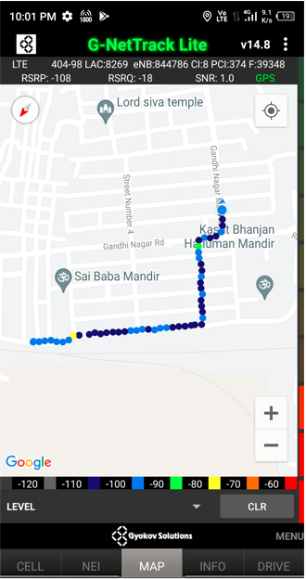
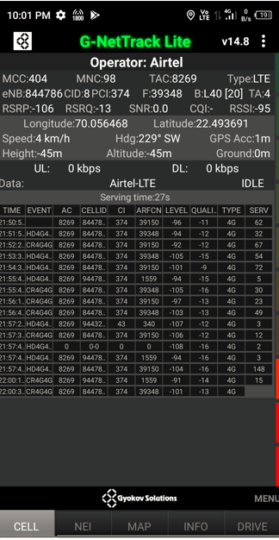
Edge Cell (Airtel)
Edge cell | longitude | latitude | RSRP (dbm) | Cell id | E-ARFCN
1 | 70.056468 | 22.493691 | -106 | 8 | 39348
RSRP Range for Edge Cell :
-95dbm to -110dbm
Hanuman mandir,
near Gandhinagar railway
st jamnagar

Slide 11
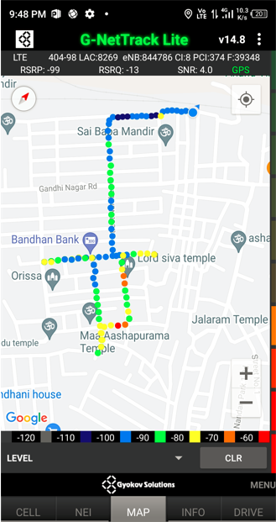
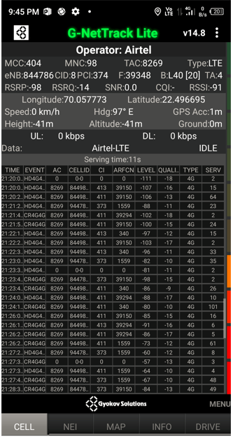
Mixed Coverage Area for Airtel

Slide 12
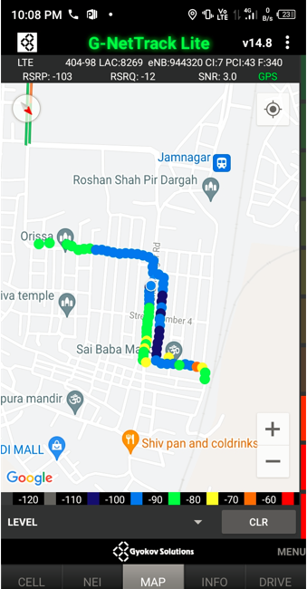
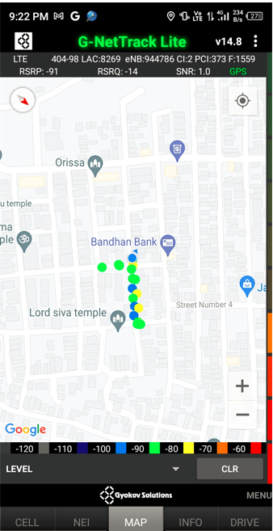
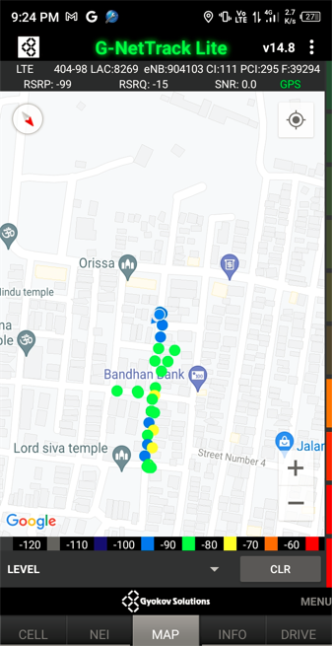
Airtel Inter Band HO
Band 1 BAND 3 BAND 40

Slide 13
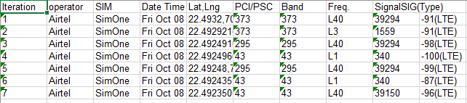
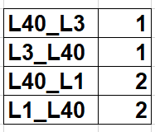
MATT Tool InterBand Handover Results for Airtel

Slide 14
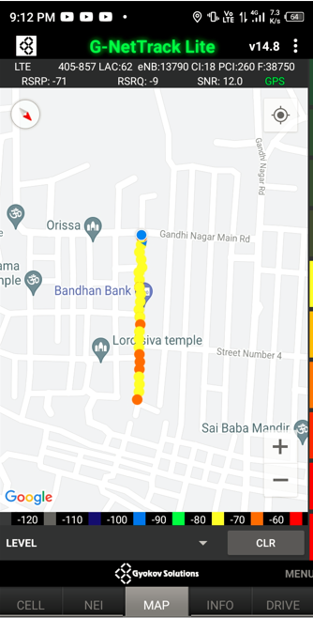
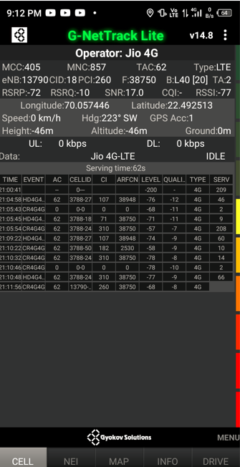
Near Cell (Reliance JIO)
Near cell | longitude | latitude | RSRP (dbm) | Cell id | E-ARFCN
1 | 70.057446 | 22.492513 | -72 | 18 | 38750
RSRP Range for Near Cell :
-65dbm to -75dbm
Lord shiv temple,Gandhi
Nagar,Jamnagar

Slide 15
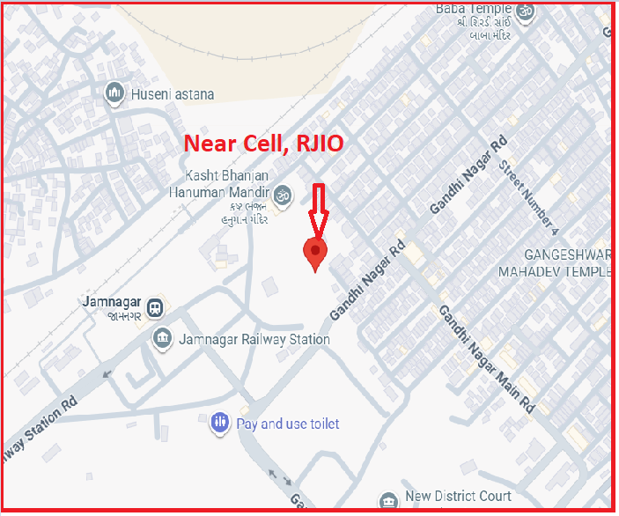
NR 5G Near Cell,RJIO
Lat/Long -22.493351,70.055380
Specification –Stable RJIO 5G SA network
Good Throughput

Slide 16
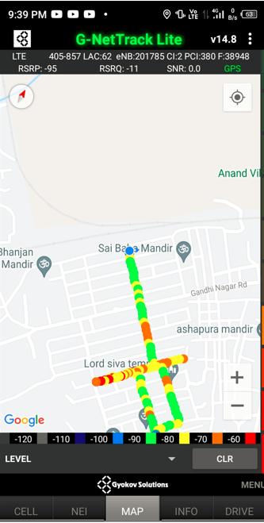
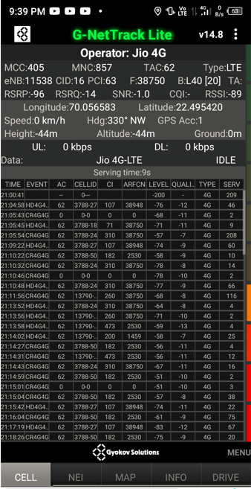
Edge Cell (Reliance JIO)
Edge Cell | longitude | latitude | RSRP (dbm) | Cell id | E-ARFCN
1 | 70.056583 | 22.495420 | -96 | 16 | 38750
RSRP Range for Edge Cell :
-95dbm to -110dbm
Saibaba mandir,
jamnagar

Slide 17
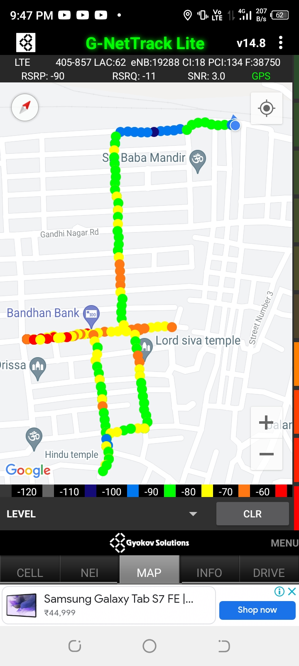
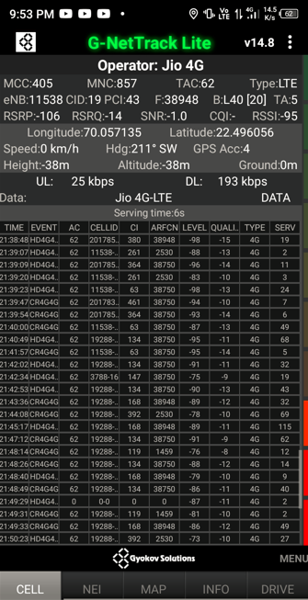
Mixed Coverage Area for Reliance JIO

Slide 18
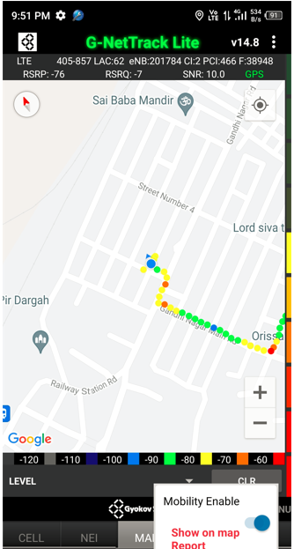
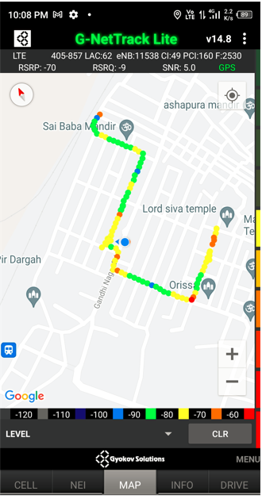
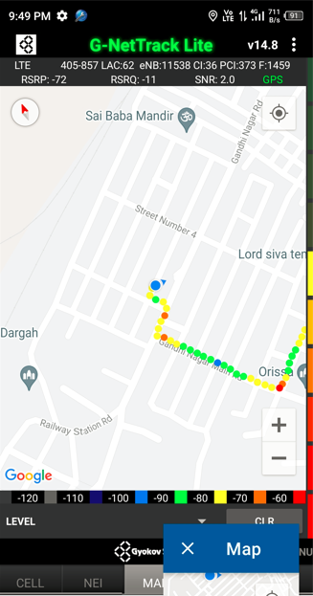
Inter Band Handover (FDD-TDD) for JIO 4G
Band 40 Band 5 Band 3

Slide 19
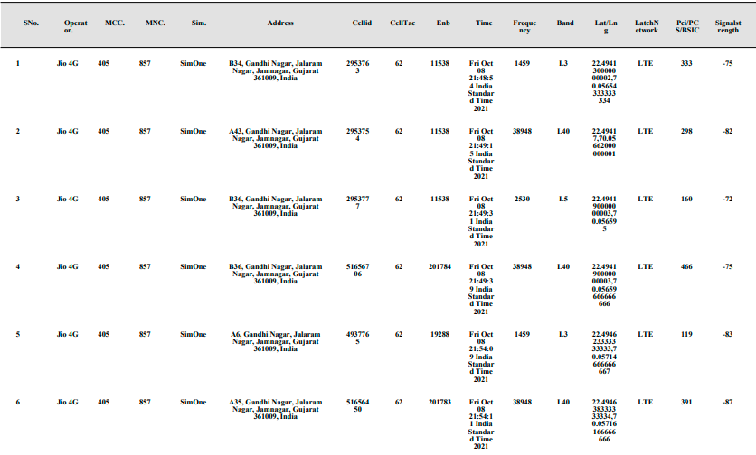
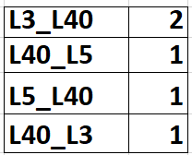
MATT Tool InterBand Handover Results for Jio

Slide 20
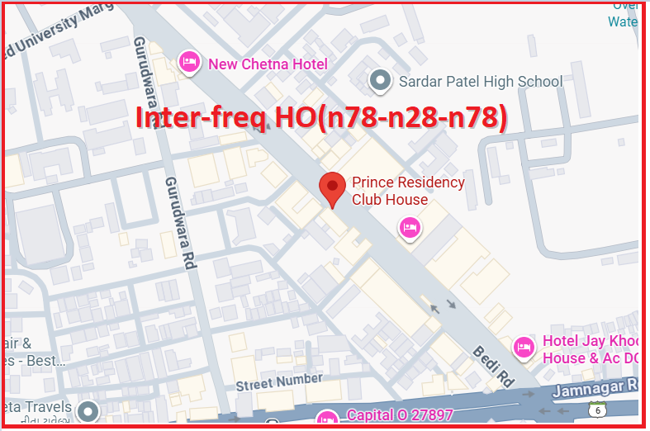
Inter-freq HO on NR ,JIO(n78-n28-n78)
Prince Residency Club House:-Lat. 22.475519 & Long. 70.066459, Reception to Room no. 206,203,207
The Vraj Hotel:- Lat. 22.469423 & Long. 70.041470, Room no:- 203 to 301 Location - Jamnagar,
(Prince Residency Club House, Opp. Amber Talkies Jamnagar and The Vraj Hotal)

Slide 21
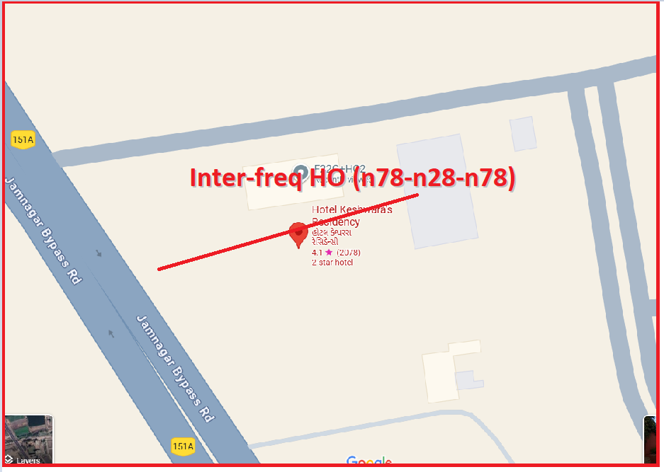
Inter-freq HO on NR ,JIO (n78-n28-n78)
Lat. 22.451490 & Long. 70.025938 to
Lat. 22.451243 & Long. 70.025667 Location – Hotel Keshwara's Residency Jamnagar

Slide 22
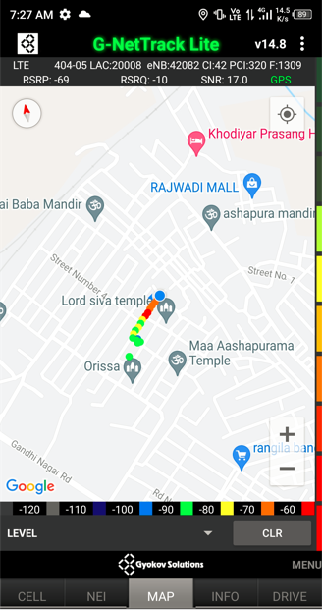
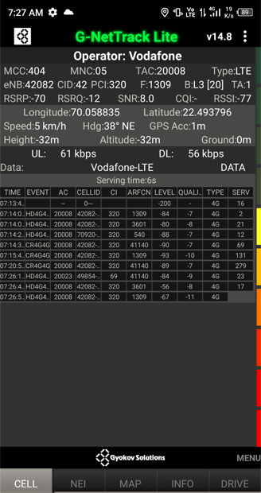
Near Cell for VI:
Near Cell | longitude | latitude | RSRP (dbm) | Cell id | E-ARFCN
1 | 70.058835 | 22.493796 | -70 | 42 | 1309
RSRP Range for Near Cell :
-65dbm to -75dbm
Lord shivtemple
street no-4
jamnagar

Slide 23
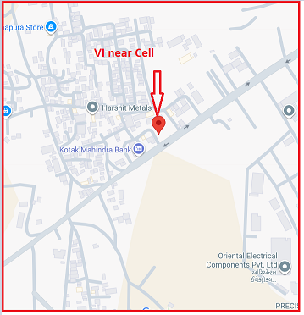
4G Near Cell,Vi
Lat/Long -22.476125, 70.064795
Specification –Stable Vi 4G LTE network
Good Throughput

Slide 24
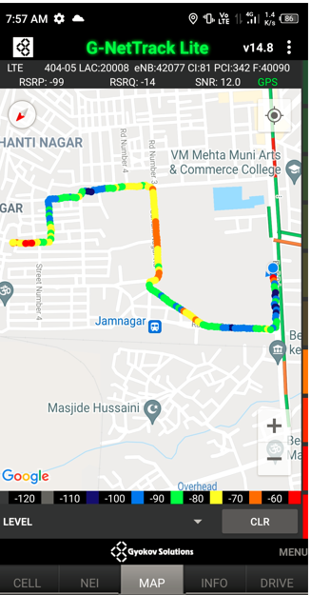
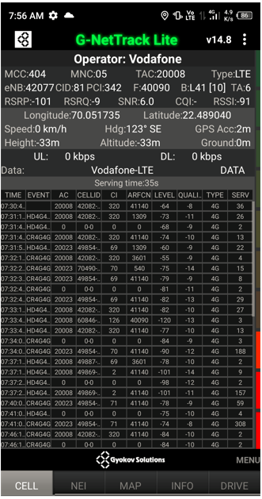
Edge Cell for VI:
Edge cell(EC) | longitude | latitude | RSRP (dbm) | Cell id | E-ARFCN
1 | 70.051735 | 22.489040 | -101 | 81 | 40090
RSRP Range for Edge Cell :
-95dbm to -110dbm
Bedi overbridge,
near Jamnagar
railway
station

Slide 25
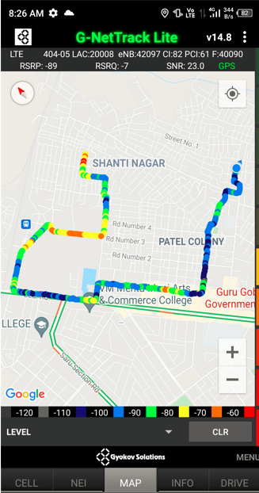

Mixed Coverage Area for VI:

Slide 26
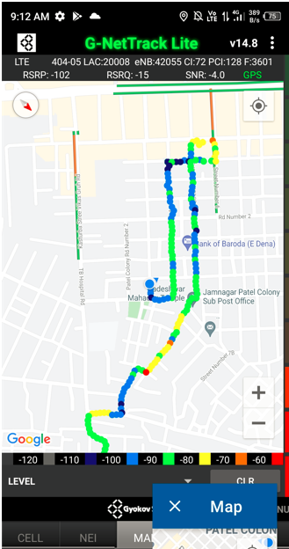
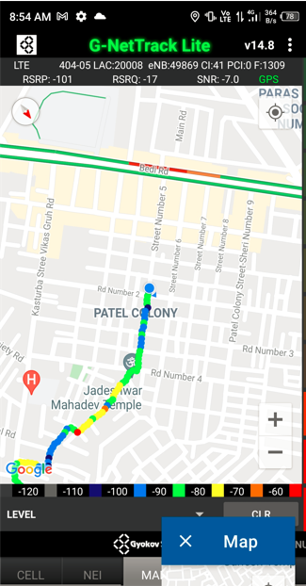
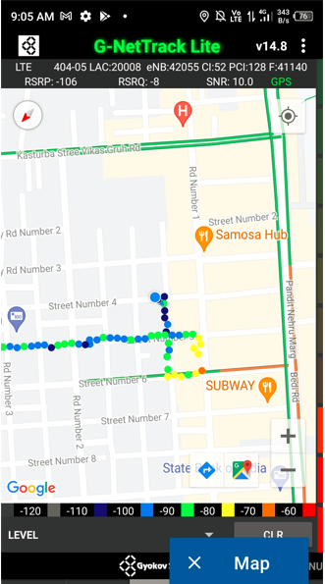
VI Band Handover
Band 8 Band 3 Band 41

Slide 27
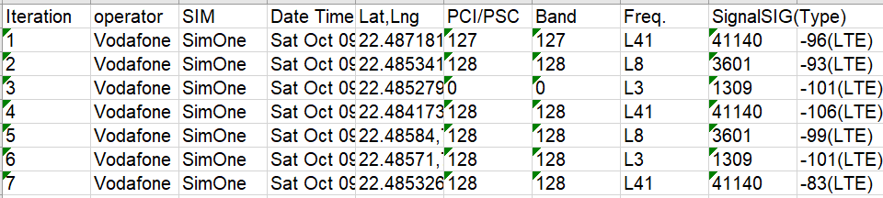
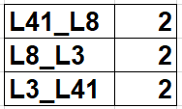
MATT Tool InterBand Handover Results for VI

Slide 28
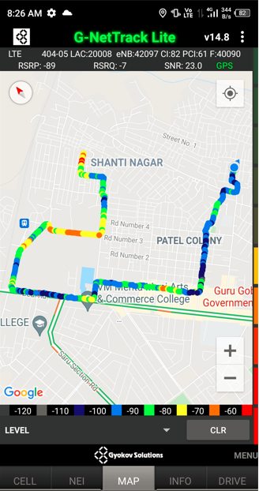
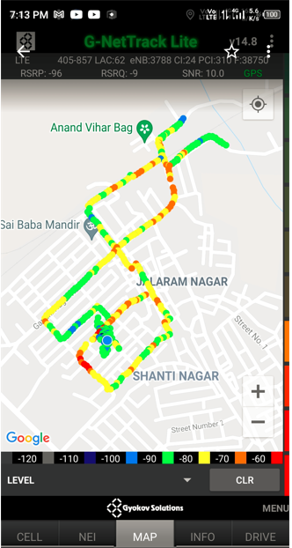
G-net Tracker Drive Route

Slide 29
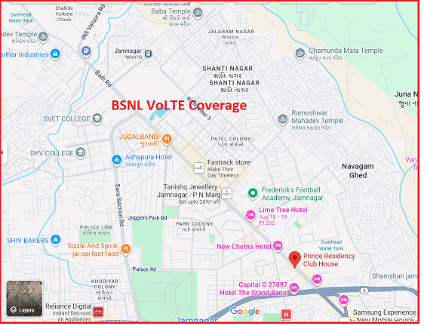
BSNL VOLTE AREA Lat/Long - Lat. 22.475519 & Long. 70.066459 Location –Jamnagar

Slide 30
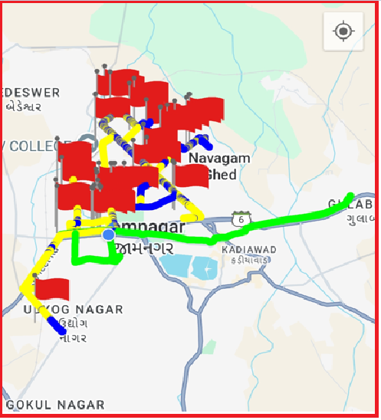
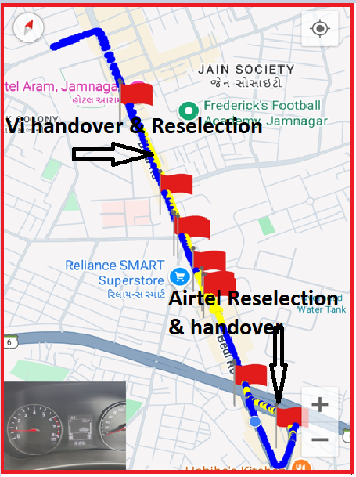
DRIVE ROUTE

Slide 31
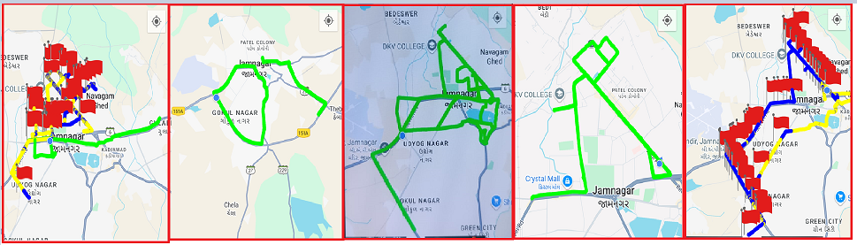
DRIVE ROUTE

Slide 32
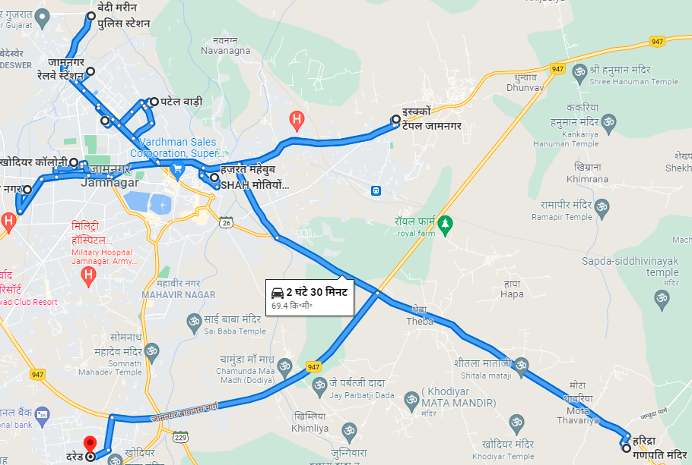
Drive Route

Slide 33
THANK YOU
MARQUIS TECHNOLOGIES

