Slide 1
MARQUIS TECHNOLOGIES
Drive Route –Airtel, VI& Reliance JIO ,BSNL(FDD/TDD) LTE

Slide 2
Dehradun/India
Operator Details:
S. No. | Operator |  | Supported Bands | Supported Features by Network
1 | Major | Airtel | LTE FDD B5 & TDD B40/N78 | VoWiFi/VoLTE/4G/2G/5G NSA
2 |  | JIO | LTE FDD B3/B5& TDD B40/N78/N28 | VoWiFi/VoLTE/4G/5G SA
3 |  | VI | LTE FDD B3,B8 TDD-B40 | VoWiFi/VoLTE/4G/2G
4 | Minor | BSNL | UTMS2100/1800 ,GSM 1800/900MHZ & LTE-2100MHz | 3G/2G/4G

Slide 3
Operator Information:
Operator | JIO 4G
MCC | 405
MNC | 870
APN | Jionet
Operator | Airtel 4G
MCC | 404
MNC | 97
APN | Airtelgprs.com
Operator | VI
MCC | 404
MNC | 56
APN | Internet
Operator | BSNL
MCC | 404
MNC | 54
APN | bsnlnet

Slide 4
Operator Information 1
Functionality | Airtel
Website: http://www.airtel.com/ WAP APN: airtelgprs.com
Customer care | 199
MNC | 97
Bands supported | Both FDD and TDD
 | LTE 2300 MHz – TDD(Band 40)
 | LTE 1800,850 MHz – FDD(Band 3)
USSD | To check MDN: *282#
 | Balance check: *123#
 | Data Balance check: *121*114#
VoLTE | Supported
CSFB | Supported (CSFB to 2G)

Slide 5
Operator Information 2
Functionality | RELIANCE JIO
Website: http://www.jio.com WAP APN: jionet
Customer care | 198
MNC | 870
Bands supported | Both FDD and TDD
 | LTE 2300 MHz –TDD(Band 40)
 | LTE 850 MHz – FDD(Band 5)
 | LTE 1800 MHz –FDD(Band 3)
USSD | NA
 | NA
 | NA
VoLTE | Supported
CSFB | Not Supported

Slide 6
Operator Information 3
Functionality | VI
Website: http://www.jio.com WAP APN: jionet
Customer care | 198
MNC | 56
Bands supported | Both FDD and TDD
 | LTE 2300 MHz –TDD(Band 40,41)
 | LTE 850 MHz – FDD(Band 5)
 | LTE 1800 MHz –FDD(Band 3)
USSD | To check MDN*199#
 | Balance check198
 | Data Balance check: 121
VoLTE | Not supported
CSFB | NA

Slide 7
Drive Route
Near Cell :- Stationary: RSRP : -65dbm to -75dbm
Cell Edge :- Stationary: RSRP : -95dbm to -110dbm
Mixed :- Mobility: RSRP : -65dbm to -110dbm

Slide 8
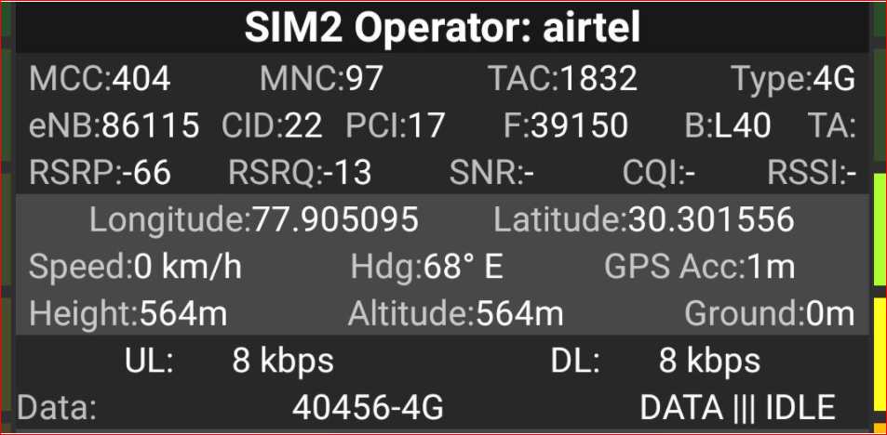
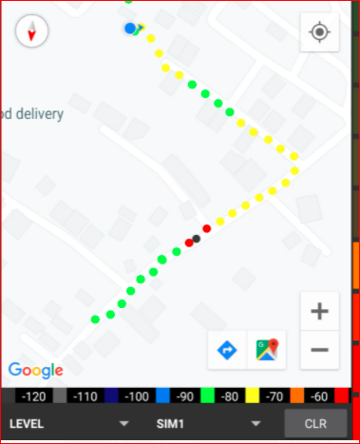
Near Cell (Airtel)
Near cell(NC) | longitude | latitude | RSRP | Cell id | E-ARFCN
1 | 77.905095 | 30.30156 | -66 | 22 | 40140
DEV COLONY RATANPUR DEHRADUN
RSRP:
-65dbm to 75dbm

Slide 9
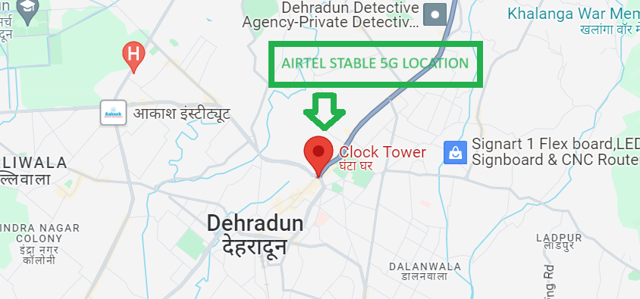
5G Near Cell,Airtel
Lat/Long -30.3278452,78.047343
Specification –Stable Airtel 5G NSA network
Good Throughput

Slide 10
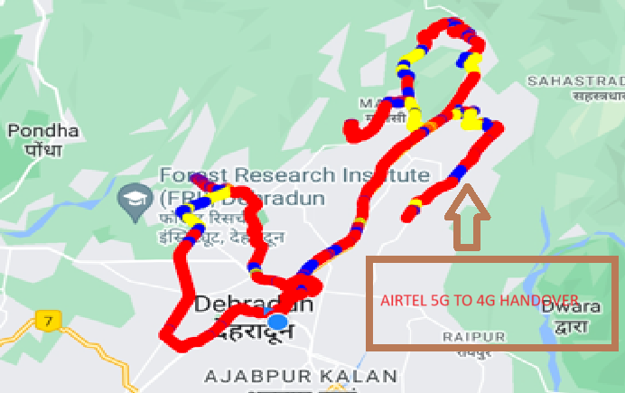
NR to LTE Handover ,Airtel
Lat. 30.342522, 78.016255 Location –Near Forest Research Institute ,Chakratta Road Specification –Band Handover ,Weak coverage

Slide 11
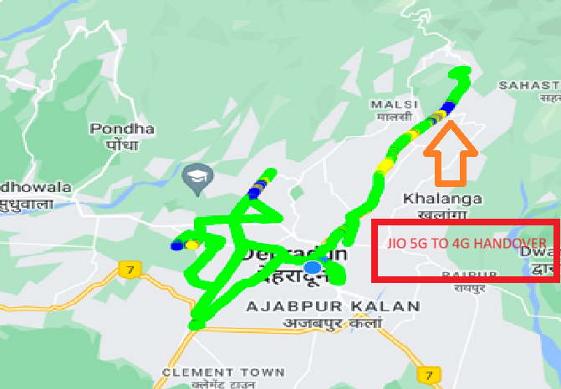
NR to LTE Handover ,JIO
Lat/Long 30.368942,78.0942517to
Lat/Long 30.3700158,78.0817204 Location – Dehradun to Mussoorie Diversion Road

Slide 12
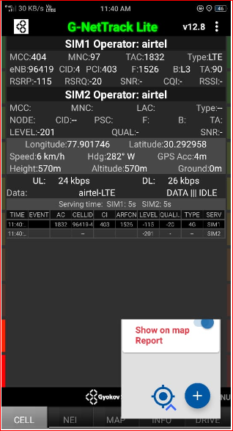
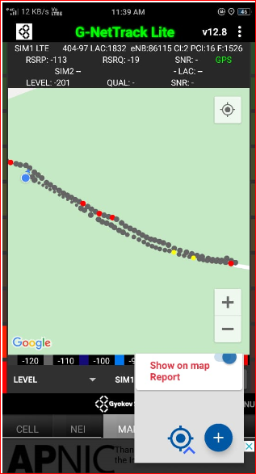
Edge Cell (Airtel)
Edge cell(EC) | longitude | latitude | RSRP | Cell id | TDD E-ARFCN
1 | 77.901746 | 30.292958 | -115 | 4 | 1526
KADWAPANI ,MALAN DEHRADUN
RSRP:
--100 - -115

Slide 13
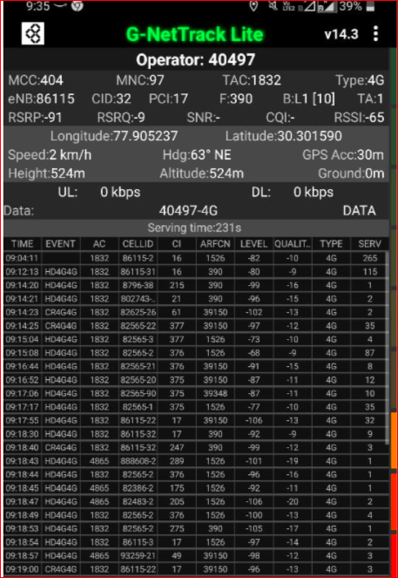
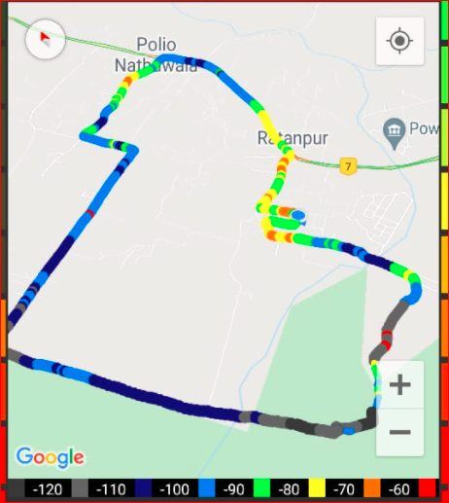
Mixed Mobility:- Airtel (Dehradun )
RSRP: -60dbm to -110dbm

Slide 14
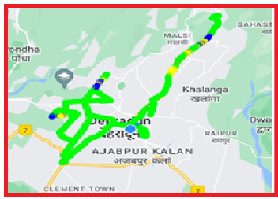
DRIVE ROUTE Airtel 5G (Dehradun) Specification-Call/Handover/Cell Reselection/Redirection

Slide 15
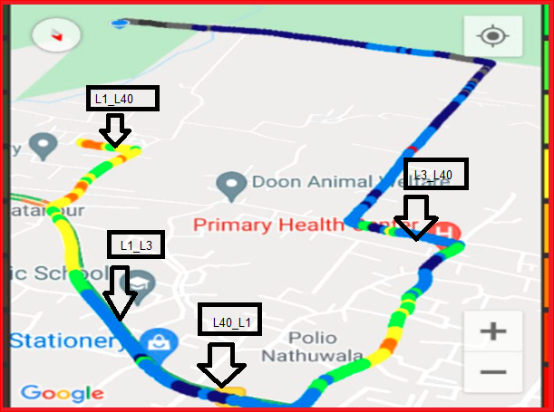
Airtel Band HO
Band 1<>3<>40 Handover

Slide 16
MATT Tool InterBand Handover Results for Airtel

Slide 17
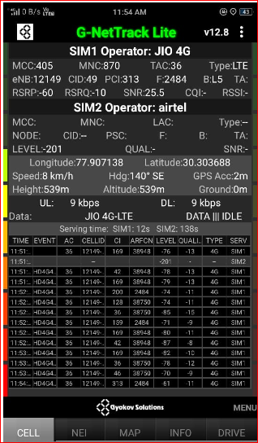
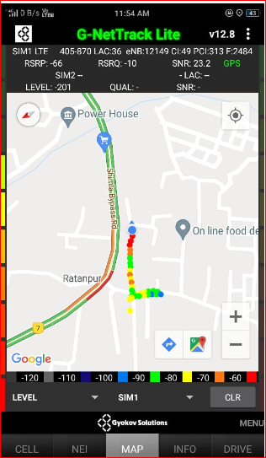
Near Cell (Reliance JIO)
Near cell(NC) | longitude | latitude | RSRP | Cell id | E-ARFCN
1 | 77.907138 | 30.303688 | -60 | 49 | 2484
Ratanpur chok Dehradun
RSRP:
-57dbm to -75dbm

Slide 18
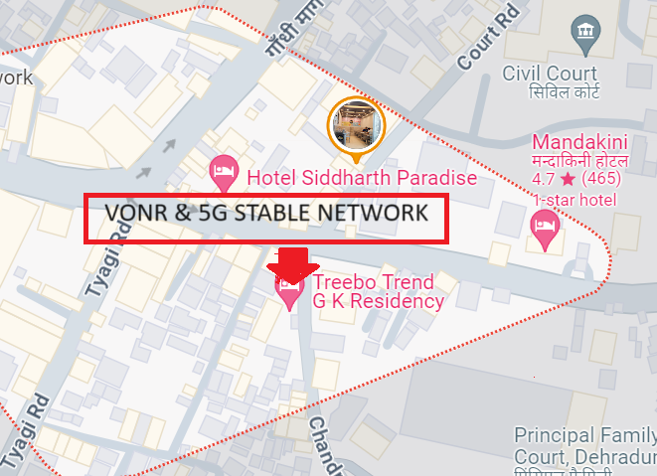
5G Near Cell JIO ,Dehradun
Lat/Long. 30.3153536,78.0355921 Location – Near Prince Chowk ,Dehradun Specification –VONR & 5G STABLE NETWORK

Slide 19
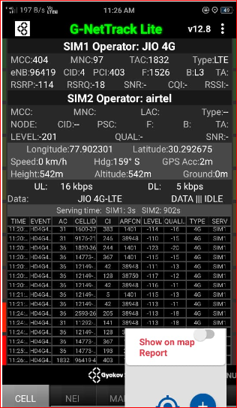
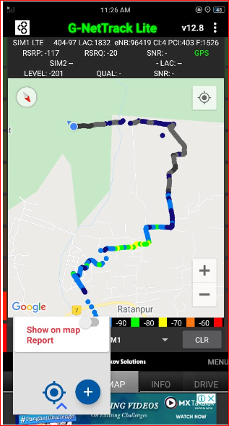
Edge Cell (Reliance JIO)
Edge cell(NC) | longitude | latitude | RSRP | Cell id | E-ARFCN
1 | 77.902301 | 30.292675 | -114 | 4 | 1526
Malan Dehradun
RSRP:
-95dbm to -110dbm

Slide 20
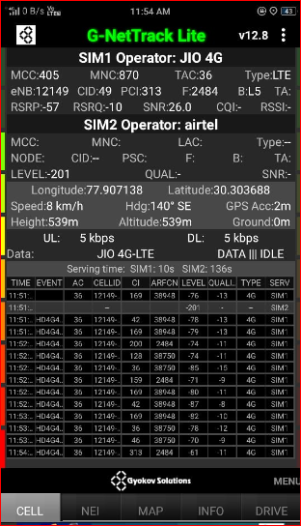
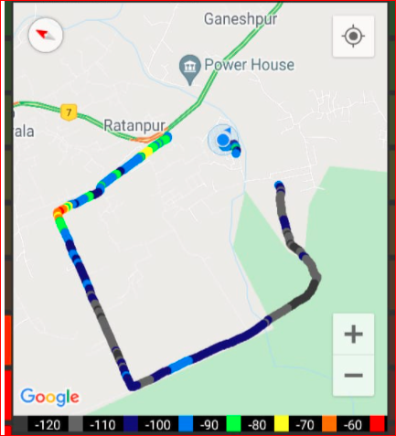
Mixed Mobility:- JI0 RATANPUR Dehradun
RSRP: -60dbm to -110dbm

Slide 21
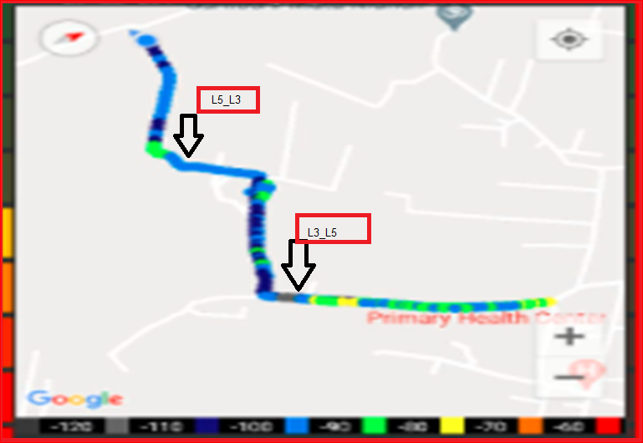
Inter Band Handover (FDD-TDD), JIO 4G

Slide 22
MATT Tool InterBand Handover Results for Jio

Slide 23
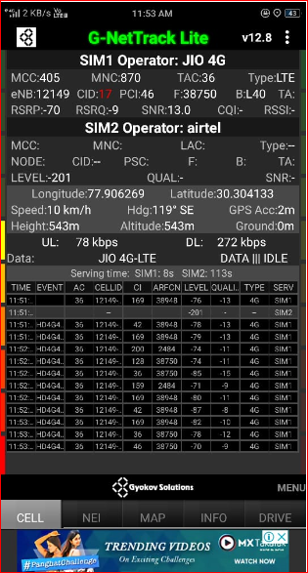
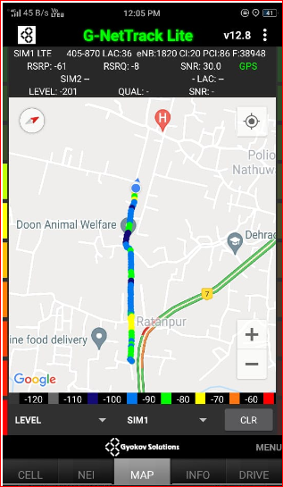
RJIO Band 40 Near Cell:
RSRP Range for Near Cell :
-65dbm to -75dbm
RATANPUR CHOK DEHRADUN

Slide 24
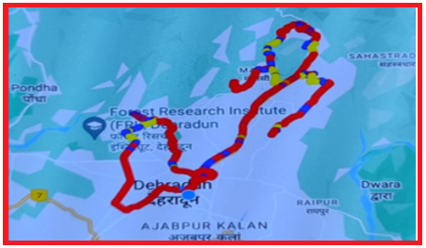
DRIVE ROUTE JIO 5G (Dehradun) Specification-Call/Handover/Cell Reselection/Redirection

Slide 25
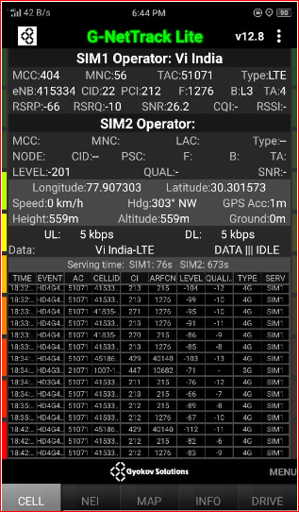
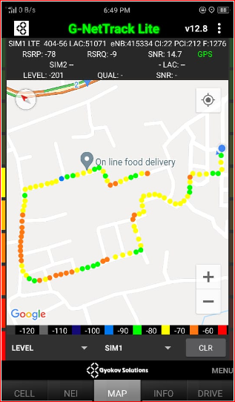
Near Cell VI:
Near cell(NC) | longitude | latitude | RSRP | Cell id | TDD E-ARFCN
1 | 77.907303 | 30.301573 | -66 | 22 | 1276
ADARSH COLONY RATANPUR DEHRADUN
RSRP:
-65dbm to -75dbm

Slide 26
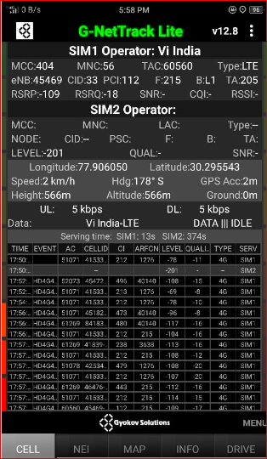
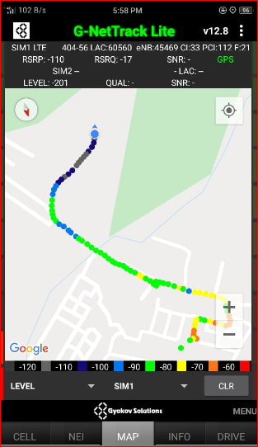
Cell Edge VI:
Edge cell(EC) | longitude | latitude | RSRP | Cell id | E-ARFCN
1 | 77.906050 | 30.295543 | -109 | 33 | 215
KARBARI GRANT DEHRADUN
RSRP:
-95dbm to -105dbm

Slide 27
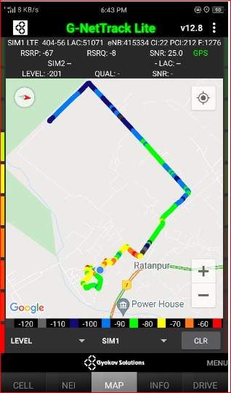
Mixed coverage area Vodafone:

Slide 28
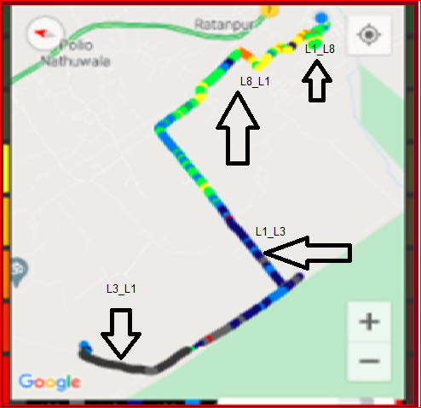
VIBand 1<>3<>8 Handover

Slide 29
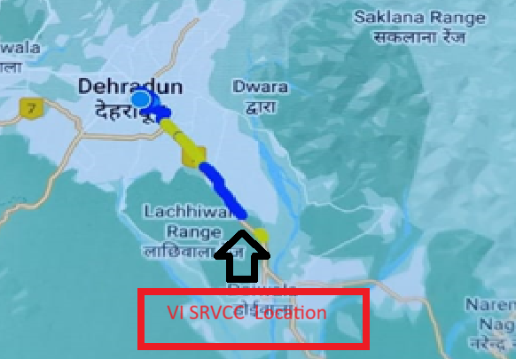
SRVCC for VI operator
Lat/Long 30.368942,78.0942517to
Lat/Long 30.216554, 78.122021 Location – Dehradun to Haridwar Road

Slide 30
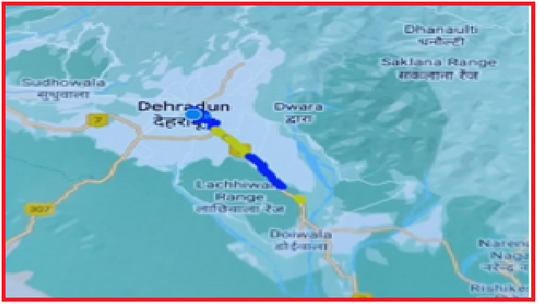
DRIVE ROUTE Vi 4G (Dehradun) Specification-Call/Handover/Cell Reselection/Redirection

Slide 31
MATT Tool InterBand Handover Results for VI

Slide 32
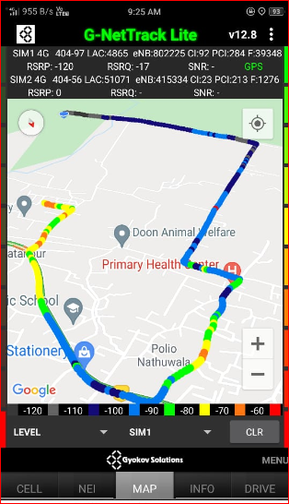
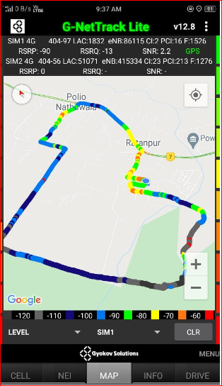
G net Tracker Drive Route

Slide 33
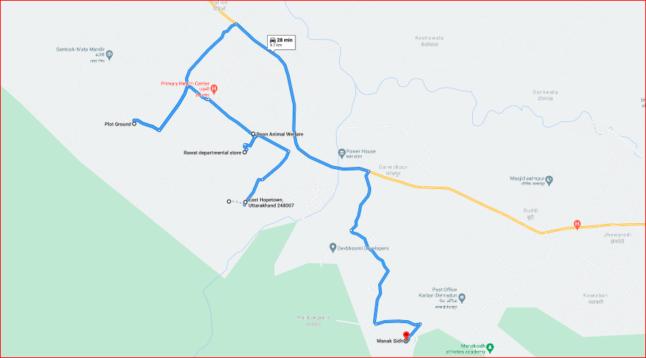
Drive Route

Slide 34
THANK YOU
MARQUIS TECHNOLOGIES

