Slide 1
MARQUIS TECHNOLOGIES
Drive Route

Slide 2
Lucknow/India
Operator Details:
S. No. | Operator |  | Supported Bands | Supported Features by Network
1 | Major | Airtel | LTE FDD B1/B3/B8 & TDD B40/N78 | VoWiFi/VoLTE/4G/2G/5G
2 |  | JIO | LTE FDD B3/B5 & TDD B40/N78/N28 | VoWiFi/VoLTE/4G/5G
3 |  | VI | LTE FDD B3/B8 & TDD B41/N78 | VoWiFi/VoLTE/4G/3G/2G
4 | Minor | BSNL | LTE FDD B1 | Volte/4G/3G/2G

Slide 3
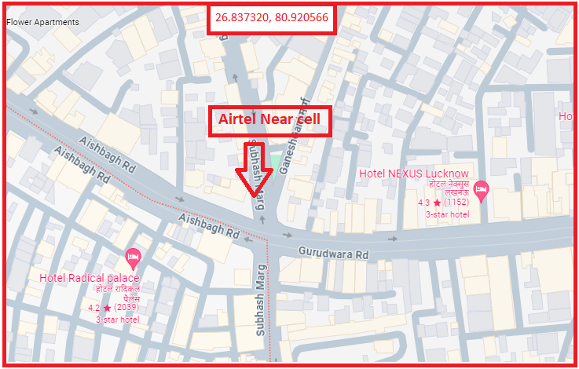
AIRTEL 5G Near Cell
Lat/Long -26.837320° N, 80.920566° E
Specification –Stable Airtel 5G NSA network

Slide 4
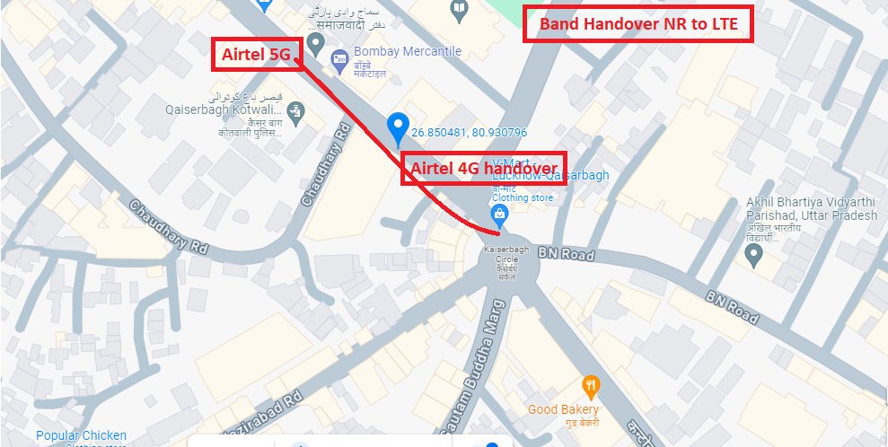
NR to LTE Handover Airtel
Lat. 26.850481 & Long. 80.930796 to Location –Kesar ganj Specification –Band Handover

Slide 5
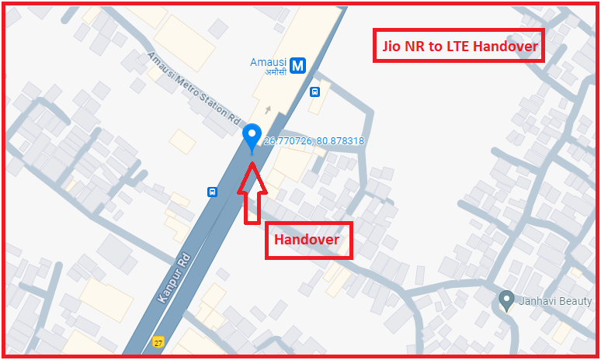
NR to LTE Handover JIO
Lat. 26.770726 & Long. 80.878318 Location –Near Amausi Metro Station

Slide 6
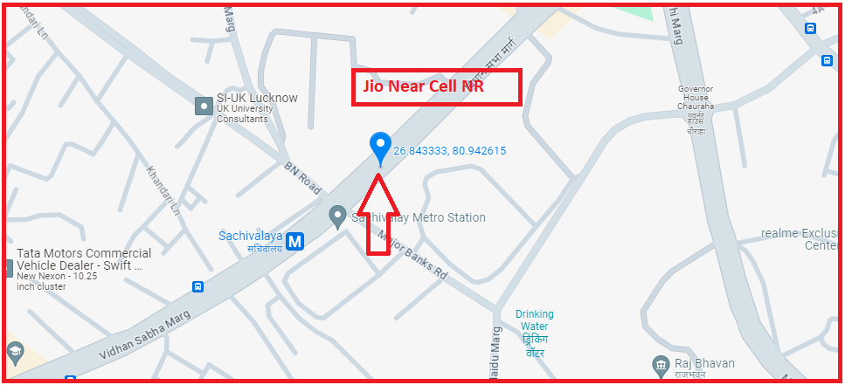
JIO Near Cell NR
Lat. 26.843333 & Long. 80.942615

Slide 7
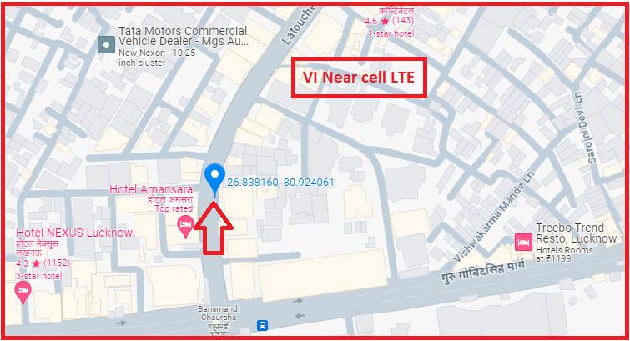
VI LTE Near Cell
Lat. 26.838160° N, Long 80.924061° E Location – Near BansMandi Chauraha

Slide 8
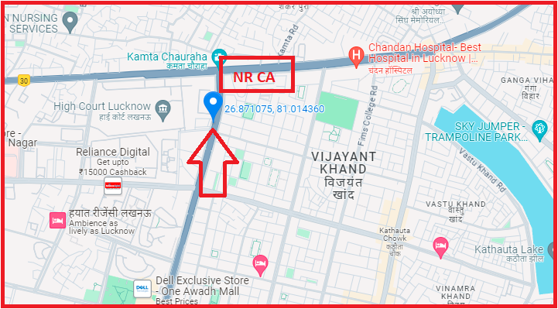
NR CA Jio
Lat. 26.871075 & Long. 81.014360 to
Vibhuti Khand

Slide 9
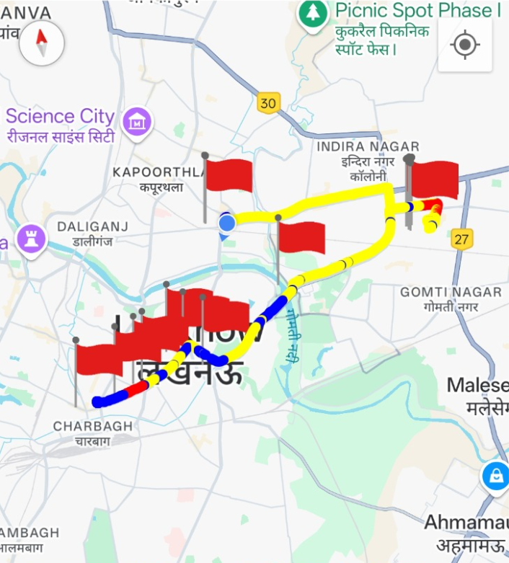
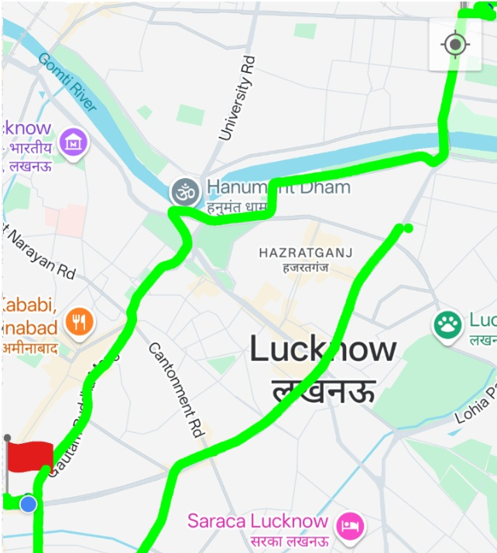
DRIVE ROUTE

Slide 10
THANK YOU
MARQUIS TECHNOLOGIES
www.marquistech.com

