Slide 1
MARQUIS TECHNOLOGIES
Drive Route

Slide 2
Guwahati/Assam
Operator Details:
S.NO | Operator Name | Service Supported | Band Supported | Band Tested | ENDC Combination | CA Combination
1 | Airtel | 5G/VoLTE/4G/2G | 4G BAND 1/3/8/40, N78 | N78,B1,B3 | N78+B40/N78+B1/N78+B3 | B40+B40
2 | RJIO | 5G SA/VoWiFi /VoLTE/VoNR/4G | 4G BAND 3/5/40,5G Band N78,N28 | N78,N28 | NSA Not support | B40+B40
3 | VI | VoWiFi /VoLTE /4G/2G | 4G BAND 1/3 | B3/B1 | NSA Not support at test location | B3+B1
3 | BSNL | 4G/3G/2G/VoLTE | B1/B28 | B28 | NSA Not support | NA

Slide 3
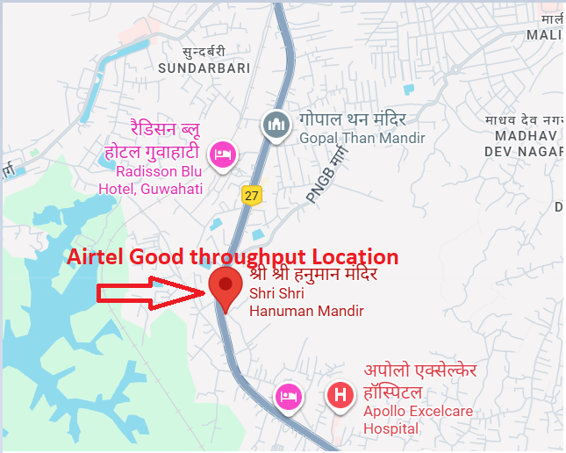
5G Near Cell,Airtel
Lat/Long –26.136371 91.674073 (Shri Shri Hanuman Mandir)
Specification –Stable Airtel 5G NSA network
Good Throughput

Slide 4
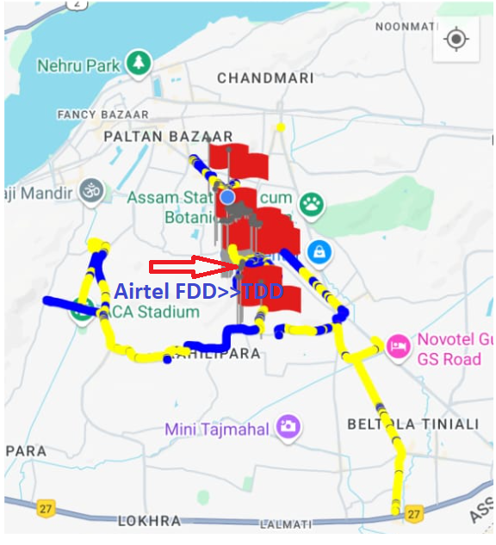
Band Handover ,Airtel
Lat/Long:TV tower Hill Top Marg Location – 26.153550, 91.767776

Slide 5
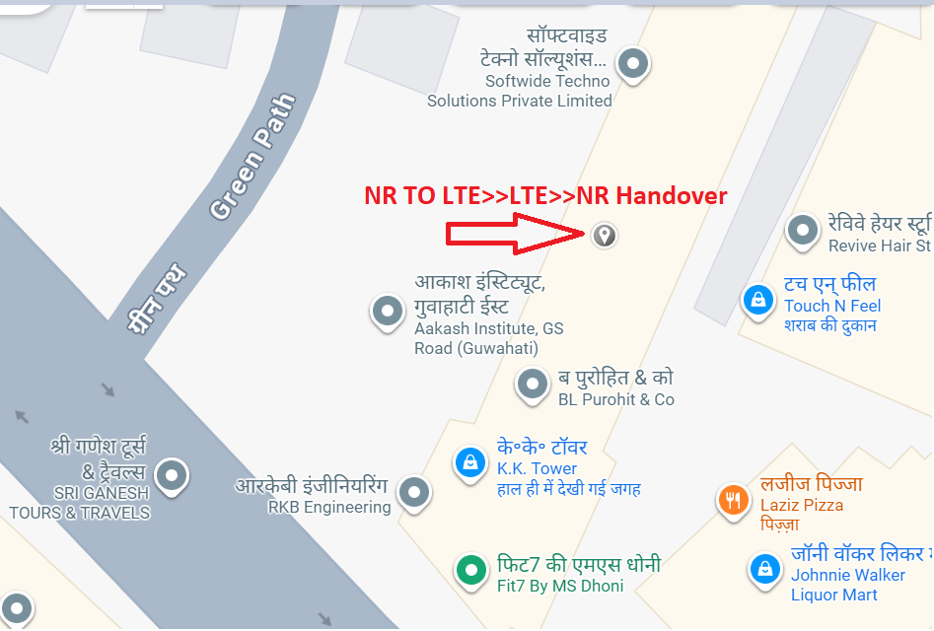
NR to LTE Handover ,JIO
Lat/Long : 26.168686 91.765177
Location : K.K Tower G.S Road Bhangagarh

Slide 6
NR To LTE Handover, Airtel
Lat/Long : 26.168686 91.765177
Location : K.K Tower G.S Road Bhangagarh

Slide 7
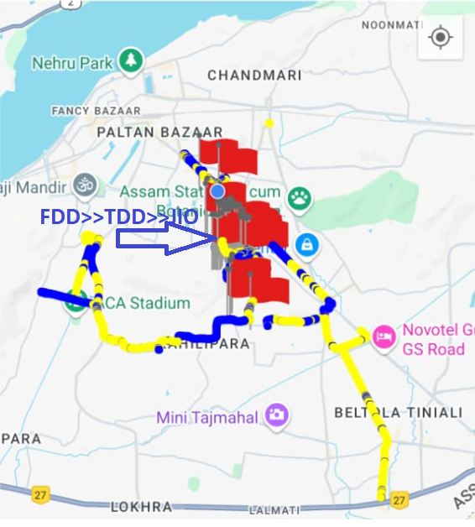
TDD to FDD & FDD to TDD Handover,Jio
Lat/Long: 26.155025, 91.769621
Location:Hill Top Marg

Slide 8
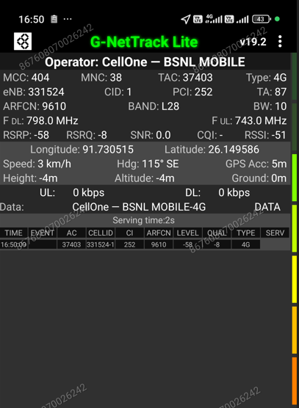
BSNL B28 Good coverage location Lat/Long – 26.149586 91.730515
,

Slide 9
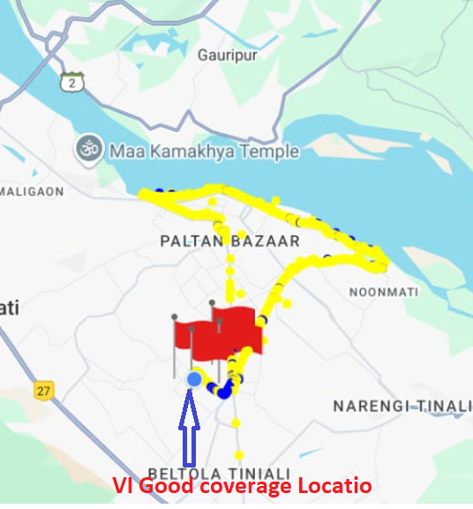
VI Good coverage location Lat/Long – 26.143424, 91.775003
Wisdom Appartment Jatia kahilipara
,

Slide 10
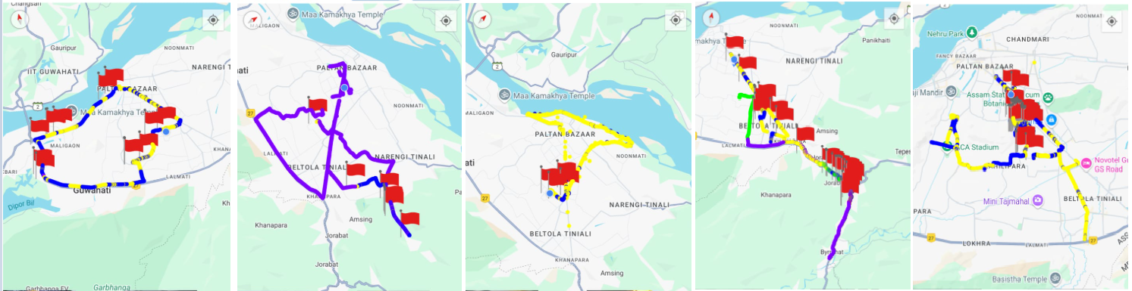
DRIVE ROUTE

Slide 11
THANK YOU
MARQUIS TECHNOLOGIES
www.marquistech.com

