Slide 1
MARQUIS TECHNOLOGIES
Drive Route FOR Jio 5g SA Technology

Slide 2
Drive Route Jio 5G for SA Technology
Operator | Band | A-ERFCN | PCI
Jio | N78 | 634080 | 48
 |  |  | 49
 |  |  | 50
 |  |  | 59
Note :-
CA, VoWiFi and During Call NR to LTE handover still not implemented
Mixed :-Mobility: RSRP : -75dbm to -95dbm
Cell Edge :-Stationary: RSRP : -95dbm to -115dbm
Near Cell :-Stationary: RSRP: -60dbm to -75dbm

Slide 3
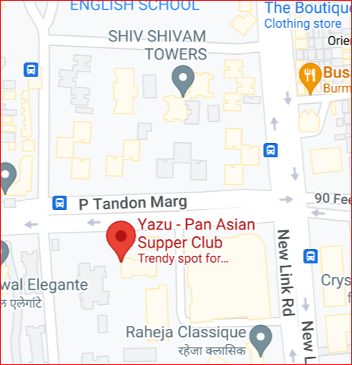

Jio Band N77(Near Cell):- P Tandon Marg, Andheri West
Operator: Jio
B: N78
gNB: 393236and:
Cell ID: 2
PCI: 49
E-ARFCN : 634080
RSRP: -60dBm to -75dBm
PCI 49
PCI 59

Slide 4
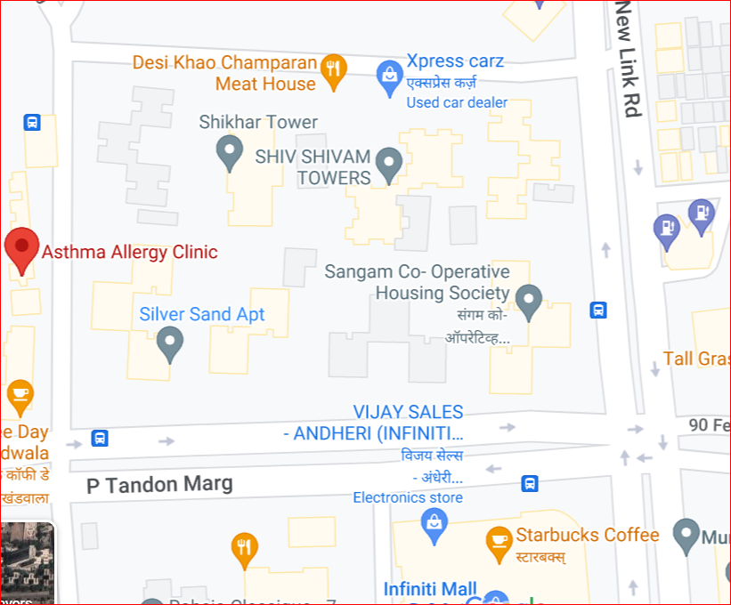

Jio Band N77(Mixed Cell):- Lion Sole Marg, Andheri west
Operator: Jio
B: N78
gNB: 393236and:
Cell ID: 1
PCI: 50
E-ARFCN : 634080
RSRP: -76dBm to -90dBm
PCI 50

Slide 5
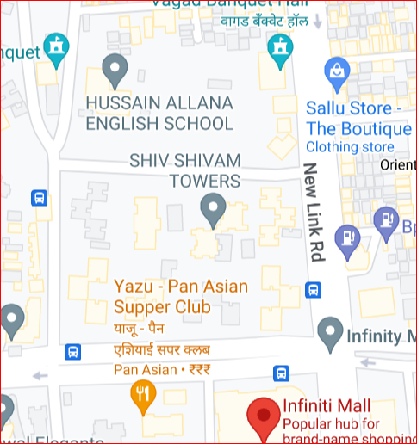

Jio Band N77(Edge Cell):- Adarsh Nagar Road, Andheri west
Operator: Jio
B: N78
gNB: 393236and:
Cell ID: 0
PCI: 49
E-ARFCN : 634080
RSRP:-91dBm to -110dBm
PCI 48

Slide 6
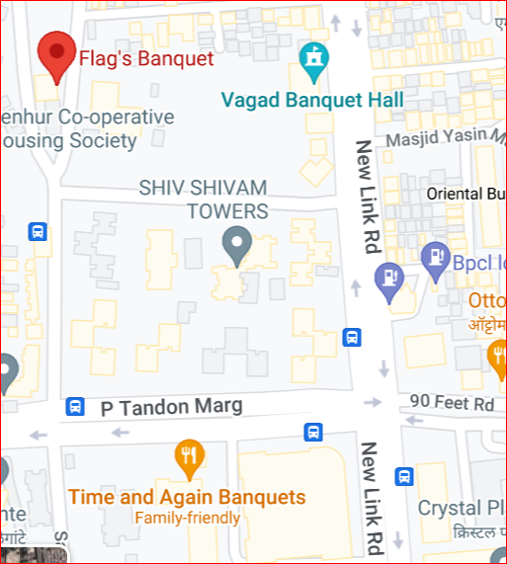

Jio (5G to 4G Reselection):- Adarsh Nagar road Lion Sole Marg Andheri West
Operator: Jio
5G to 4G Reselection:
PCI 48 TO PCI 112

Slide 7
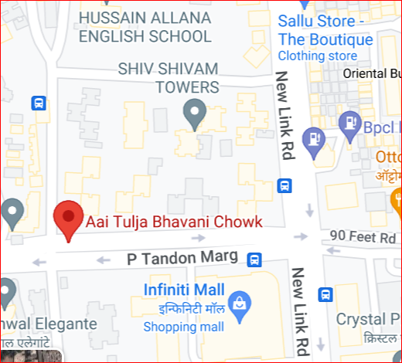

Jio (4G to 5G Reselection):- Lion Sole Marg Adarsh Nagar Road, Andheri West
Operator: Jio
4G to 5G Reselection:
PCI 181 to PCI 50

Slide 8
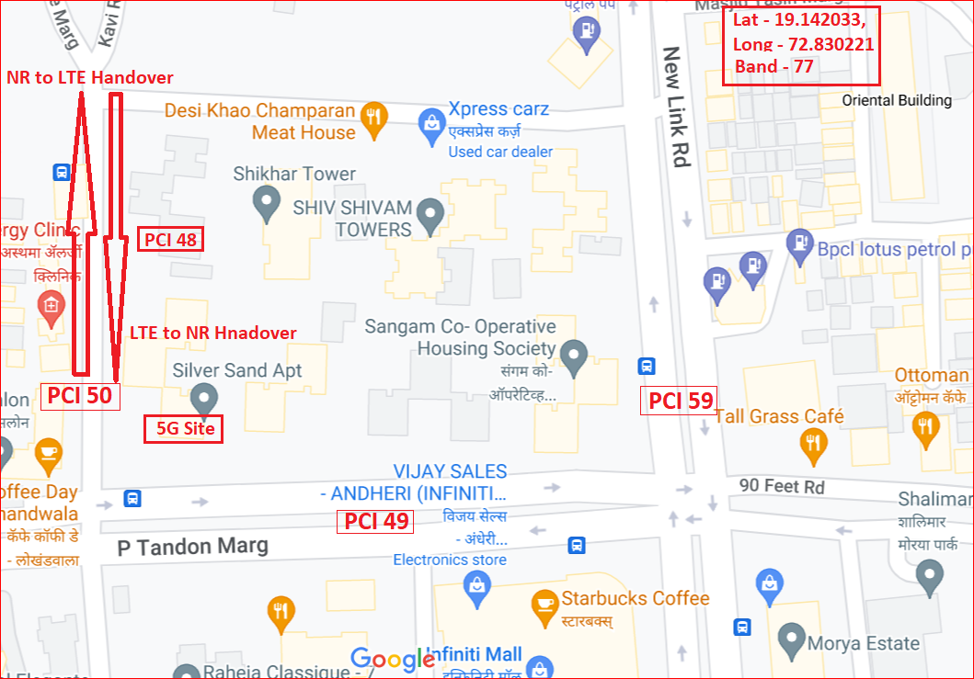
Jio Band and PCI Info for Jio 5G SA Technology Summary of Test Location:-
Band N78

Slide 9
Thank You

