Slide 1
MARQUIS TECHNOLOGIES
Drive Route –Airtel, VI & Reliance JIO (FDD/TDD) LTE
Location : Bangalore

Slide 2
Operator Information:
Operator | JIO 4G
MCC | 405
MNC | 861
APN | jionet
Operator | Airtel 4G
MCC | 404
MNC | 45
APN | airtelgprs.com
Operator | VI
MCC | 404
MNC | 86
APN | internet
Operator | BSNL
MCC | 404
MNC | 71
APN | Bsnlnet

Slide 3
Operator Information 1
Functionality | Airtel
Website: https://www.airtel.in/ WAP APN: airtelgprs.com
Customer care | 198
MNC | 45
Bands supported | Both FDD and TDD
 | LTE 2300 MHz – TDD(Band 40)
 | LTE 1800 – FDD(Band 3) LTE 900 – FDD(Band 8) LTE 2100 – FDD (Band 1)
USSD | To check MDN: *282#
 | Balance check: *123#
 | To check all services: *121#
VoLTE | Supported
VoWiFi | Supported
CSFB | Supported (CSFB to 2G)

Slide 4
Operator Information 2
Functionality | RELIANCE JIO
Website: https://www.jio.com WAP APN: jionet
Customer care | 198
MNC | 861
Bands supported | Both FDD and TDD
 | LTE 2300 MHz –TDD(Band 40)
 | LTE 850 MHz – FDD(Band 5)
 | LTE 1800 MHz –FDD(Band 3)
USSD | NA
 | NA
 | NA
VoLTE | Supported
VoWiFi | Supported
CSFB | Not Supported

Slide 5
Operator Information 3
Functionality | VI
Website: https://www.myvi.in WAP APN: internet
Customer care | 198
MNC | 86
Bands supported | FDD
 | LTE 900 MHz – (Band 8)
 | LTE 2100 MHz – (Band 1)
 | LTE 1800 MHz – (Band 3)
USSD | To check MSISDN :*199#
 | Recharge : *199*5#
 | Balance check : *199*2#
VoLTE | Supported
VoWiFi | Not Supported
CSFB | Supported (CSFB to 2G/3G)

Slide 6
Drive Route
Near Cell : Stationary: RSRP : -65dbm to -75dbm
Edge Cell : Stationary: RSRP : -95dbm to -110dbm
Mixed : Mobility: RSRP : -65dbm to -110dbm

Slide 7
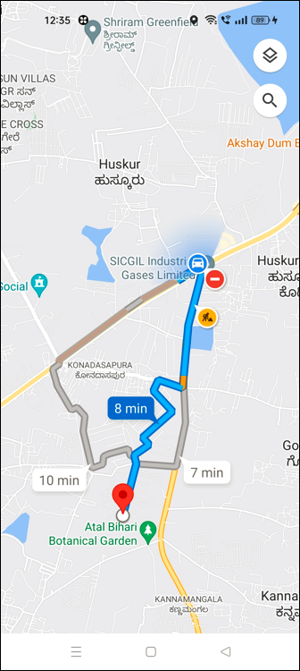
Near Cell (Airtel)
Near cell | longitude | Latitude | RSRP (dbm)
1 | 13.068945305972239 | 77.78497641252783 | -71
RSRP Range for Near Cell :
-65dbm to -75dbm
Near Safal market,
Bangalore

Slide 8
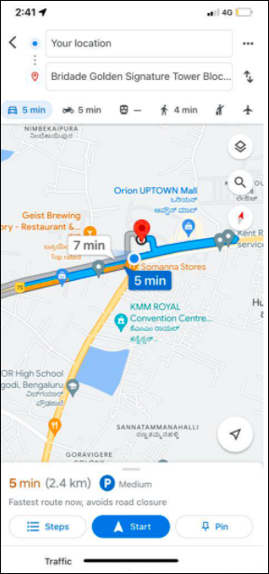
Edge Cell (Airtel)
Edge cell | longitude | latitude | RSRP (dbm)
1 | 13.053365634511652 | 77.76178095703837 7 | -102
RSRP Range for Edge Cell :
-95dbm to -110dbm
Near
Kattamanallur,
Bangalore

Slide 9
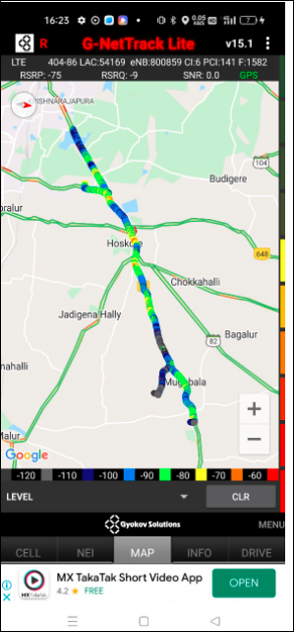
Mixed Coverage Area for Airtel
Mugabala to Krishnarajapura,
Bangalore

Slide 10
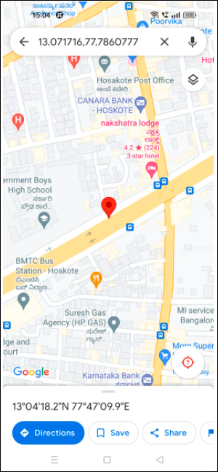
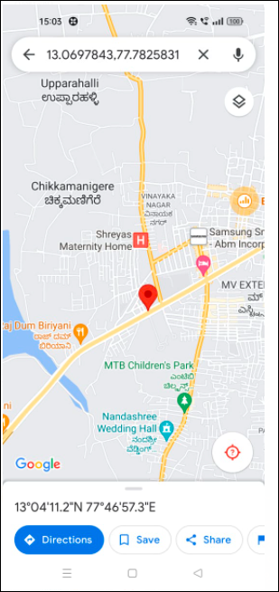
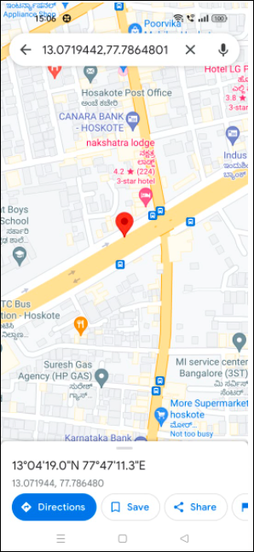
Airtel Inter Band HO
Band 8 BAND 40 BAND 3

Slide 11
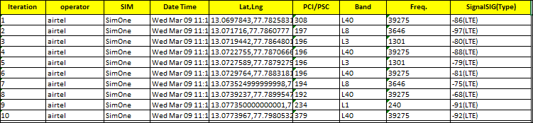
MATT Tool InterBand Handover Results for Airtel

Slide 12
Near Cell (Reliance JIO)
Near cell | longitude | Latitude | RSRP (dbm)
1 | 13.068945305972239 | 77.78497641252783 | -71
RSRP Range for Near Cell : -65dbm to -75dbm
Near Safal Market, Bangalore

Slide 13
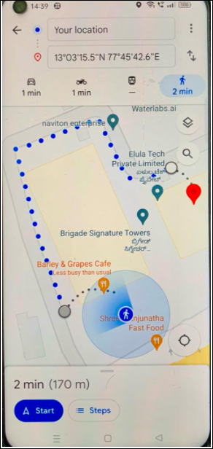
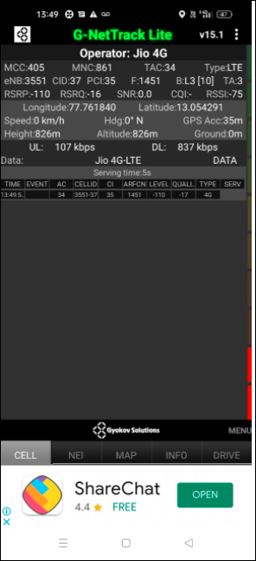
Edge Cell (Reliance JIO)
Edge cell | longitude | latitude | RSRP (dbm)
1 | 13.053365634511652 | 77.76178095703837 7 | -102
RSRP Range for Edge Cell :
-95dbm to -110dbm
Near
Kattamanallur,
Bangalore

Slide 14
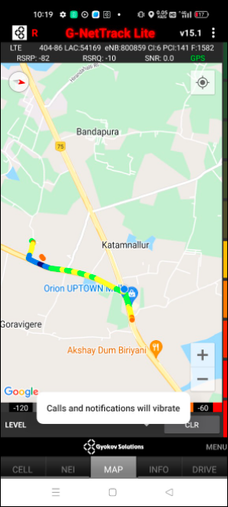
Mixed Coverage Area for Reliance JIO
KHB Layout to Kajisonnanahalli,
Bangalore

Slide 15
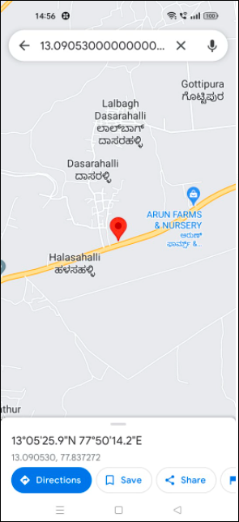
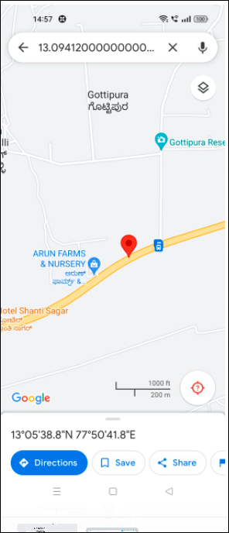
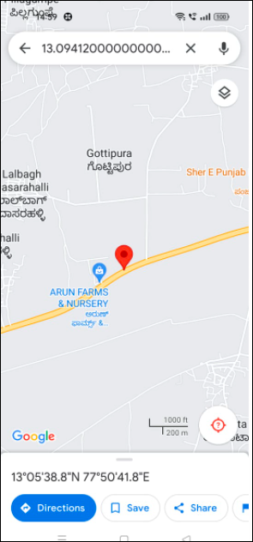
Inter Band Handover (FDD-TDD) for JIO 4G
Band 40 Band 5 Band 3

Slide 16
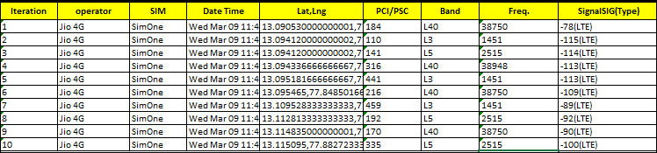
MATT Tool InterBand Handover Results for Jio

Slide 17
Near Cell for VI:
Near cell | longitude | Latitude | RSRP (dbm)
1 | 13.068945305972239 | 77.78497641252783 | -71
RSRP Range for Near Cell :
-65dbm to -75dbm
Near Safal Market,
Bangalore

Slide 18
Edge Cell for VI:
Edge cell | longitude | latitude | RSRP (dbm)
1 | 13.053365634511652 | 77.76178095703837 7 | -102
RSRP Range for Edge Cell :
-95dbm to -110dbm
Near
Kattamanallur,
Bangalore

Slide 19
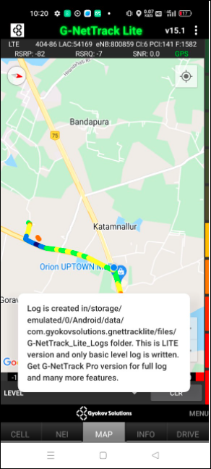
Mixed Coverage Area for VI:
KHB Layout to Kajisonnanahalli,
Bangalore

Slide 20
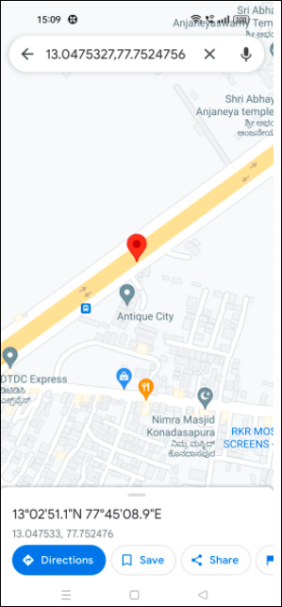
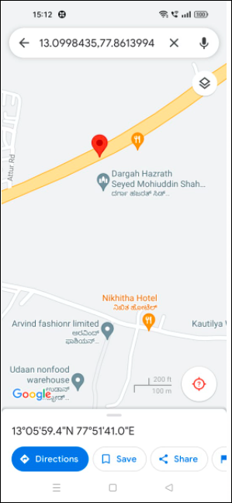
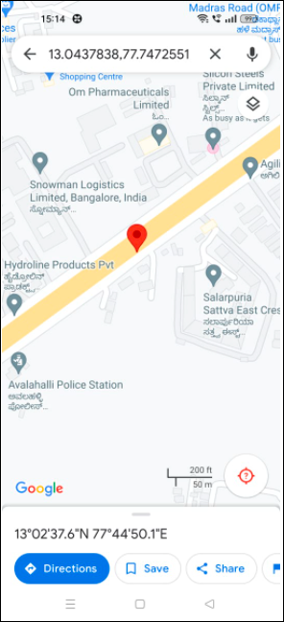
VI Band Handover
Band 1 Band 3 Band 8

Slide 21
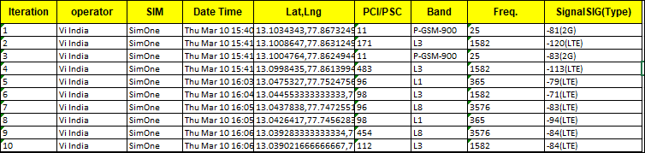
MATT Tool InterBand Handover Results for VI

Slide 22
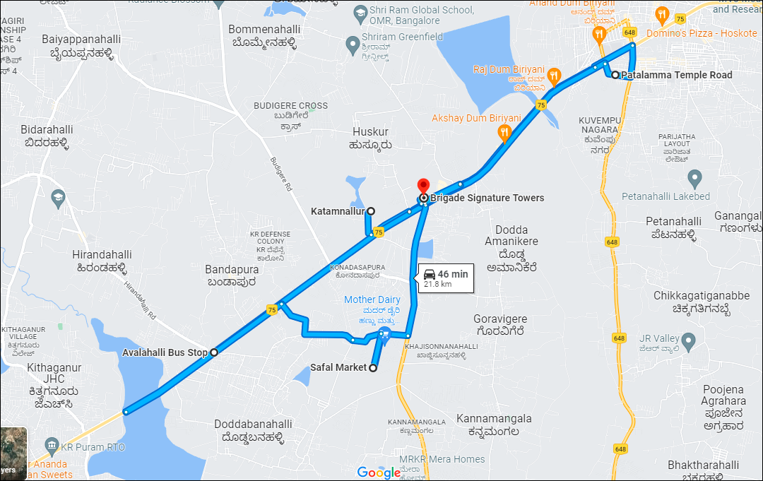
Drive Route

Slide 23
THANK YOU
MARQUIS TECHNOLOGIES

