Slide 1
MARQUIS TECHNOLOGIES
Drive Route

Slide 2
(Location Name)
Country | INDIA
Continent | ASIA
City | BANGALORE
Time Zone | GMT+ 5:30

Slide 3
Operators in Location
MCC | MNC | Operator
405 | 874 | Jio
404 | 45 | Airtel
404 | 44 | VI
JIO operator Network Info
RAT | Band | Comment
5G | n78, n28
4G | 3, 5, 40
3G | NA | Not Supported
2G | NA | Not Supported
AIRTEL operator Network Info
RAT | Band | Comment
5G | n77
4G | 1, 3, 8, 40
3G | NA | not Supported
2G | 3, 8
VI operator Network Info
RAT | Band | Comment
5G | NA
4G | 1, 3, 8
3G | NA | not Supported
2G | 3, 8

Slide 4
Drive Route operator
Near Cell :-Stationary: RSRP: -60dbm to -75dbm
Mixed :-Mobility: RSRP : -75dbm to -95dbm
Cell Edge :-Stationary: RSRP : -95dbm to -115dbm

Slide 5
JIO,AIRTEL,VI

Slide 6
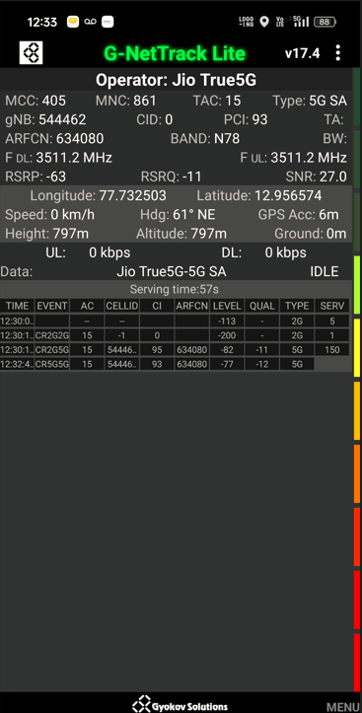
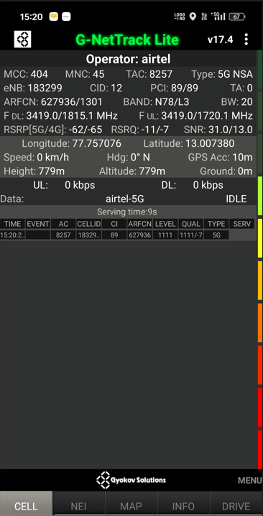
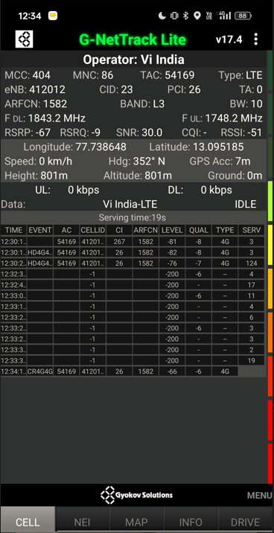
Near cell screenshots of all band with Network INFO. Which includes 5G also
Operator: JIO
Band: N78
Cell ID: 0
E-ARFCN : 634080
RSRP: -60dbm to 75dbm
Operator: AIRTEL
Band: N78 , L3
Cell ID: 12 ,12
E-ARFCN : 627936, 1301
RSRP: -60dbm to 75dbm
Operator: VI
Band: L3
Cell ID: 23
E-ARFCN : 1582
RSRP: -60dbm to 75dbm

Slide 7
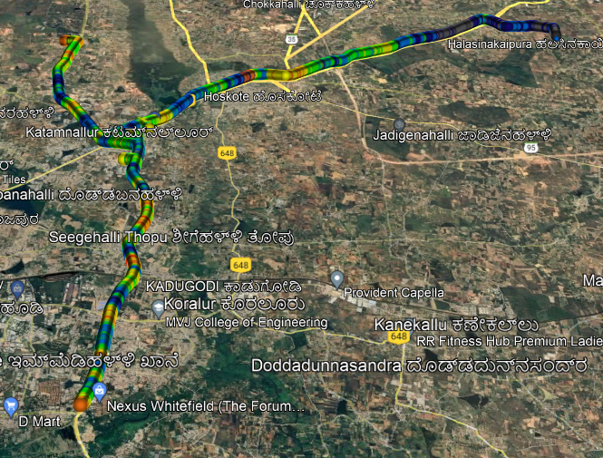
( Mixed Mobility Area) screenshots

Slide 8
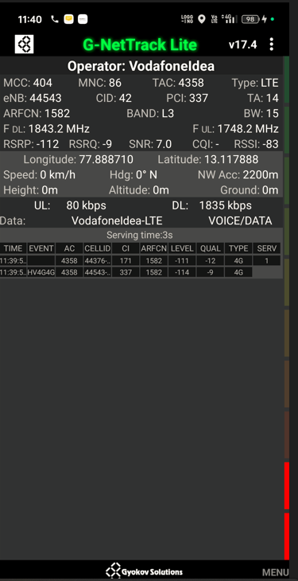
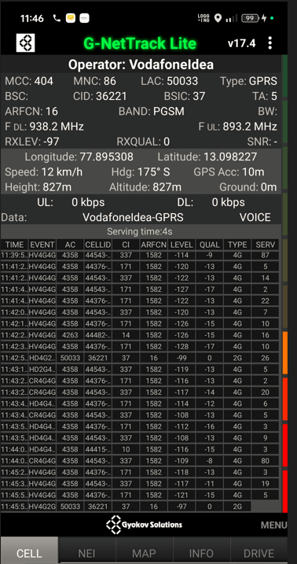
SRVCC screenshots of all band with Network INFO.
Operator: VI
Band: L3
Cell ID: 42
E-ARFCN : 1582
RSRP: -99dbm

Slide 9
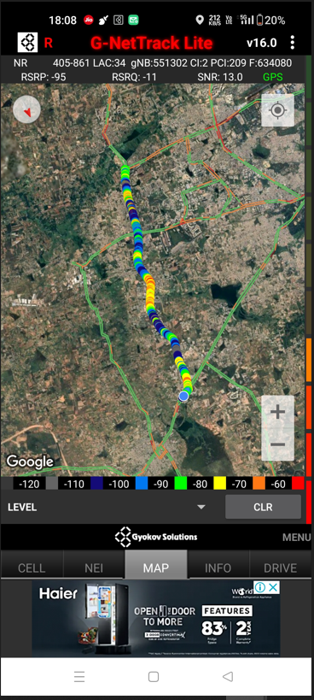
Band Handover – It will include all 5G to 4G
Operator: JIO
Band Handover: N77—B3
E-ARFCN : 39025-1800

Slide 10
(Reselection)
Operator: JIO
Band reselection: N77-N28-B5-B8
E-ARFCN : 551302-1800

Slide 11
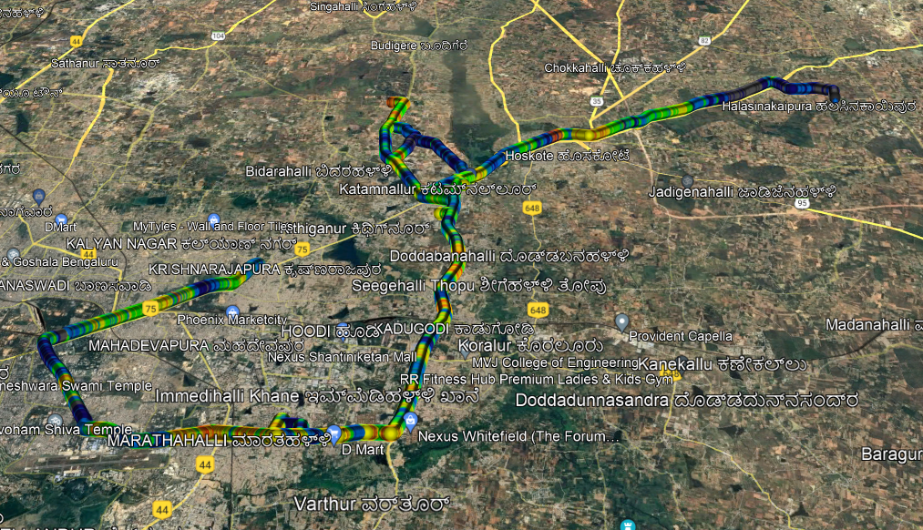
( Drive Route covered during mobility. )

Slide 12
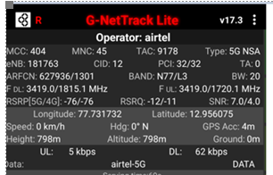
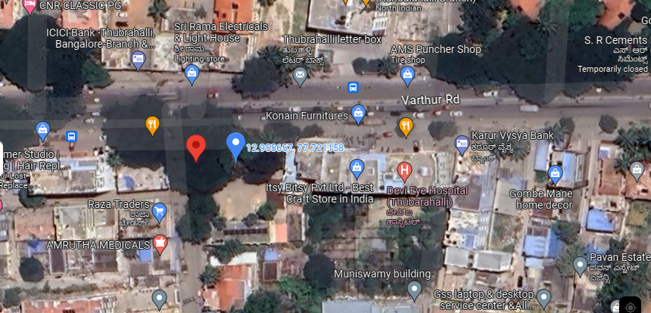
5G Near Cell, Airtel
Lat/Long –12.956075/77.731732
Location:- Siddapura Primary Health Centre PHC
Specification –Stable Airtel 5G NSA network

Slide 13
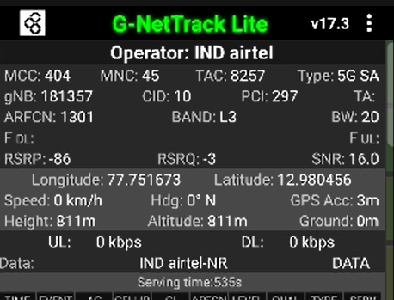
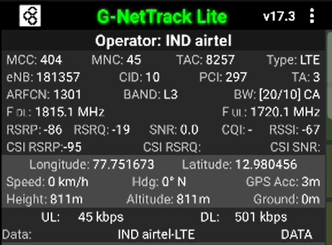
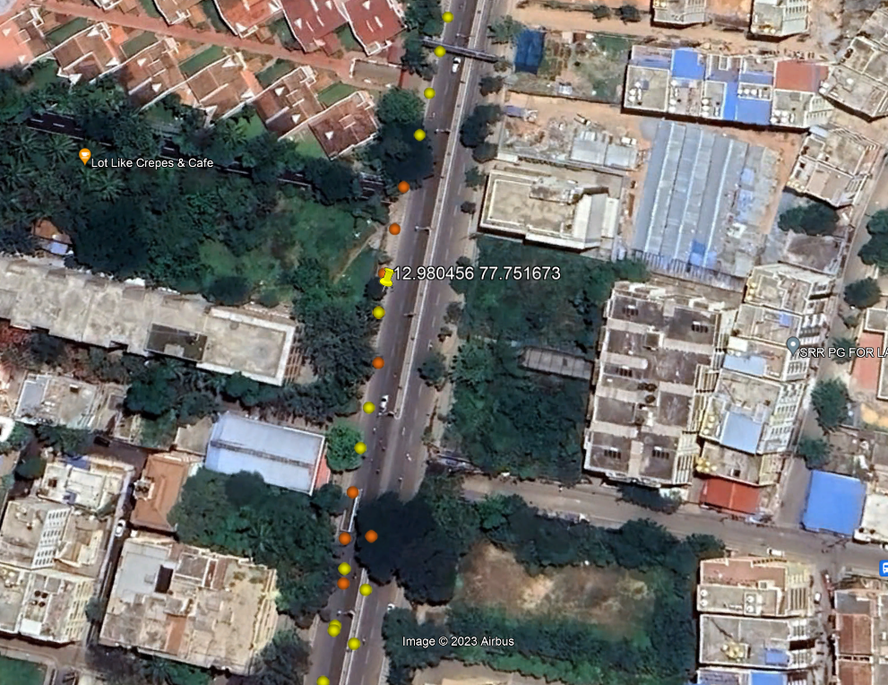
NR to LTE Handover ,Airtel
Lat/Long. 12.976339, 77.750847
Lat/Long. 12.982287, 77.752124
Location – Near Hope Farm Jn.
Specification –NR to LTE Handover
NR2L HO

Slide 14
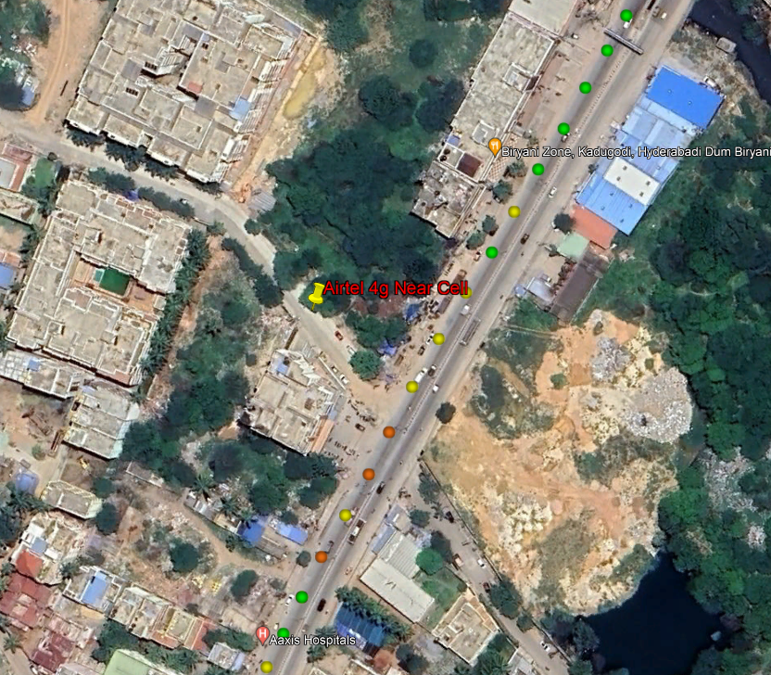
Airtel 4G VoLTE Good Coverage Area
Lat/Long 13.007293, 77.757333
Location – Belathur

Slide 15
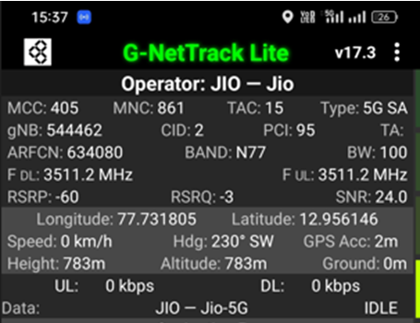
5G Near Cell,JIO
Lat/Long –12.956075/77.731732
Location:- Siddapura Primary Health Centre PHC
Specification –Stable JIO 5G SA network

Slide 16
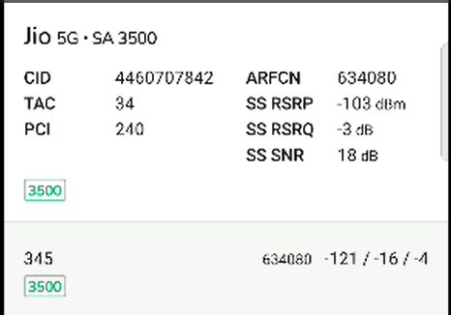
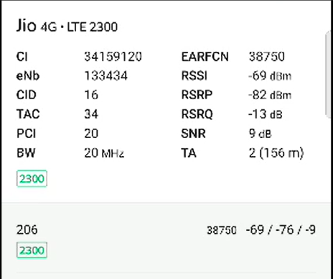
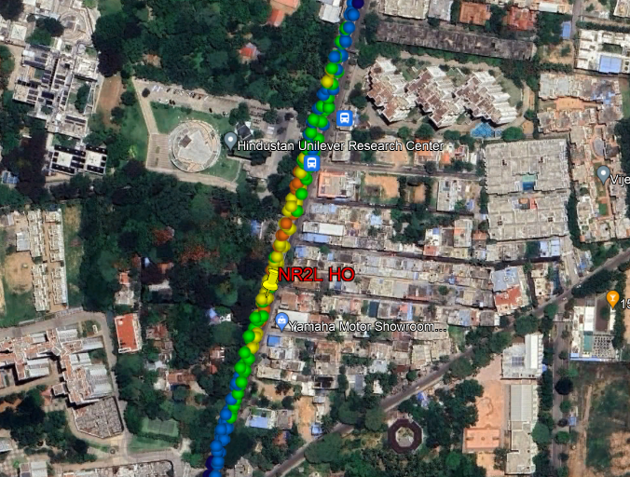
NR To LTE Handover, Jio
Lat/Long 12.958508, 77.746125
Lat/Long. 12.965942, 77.749075
Location – Hindustan Unilever Research Center
Specification –NR to LTE Handover

Slide 17
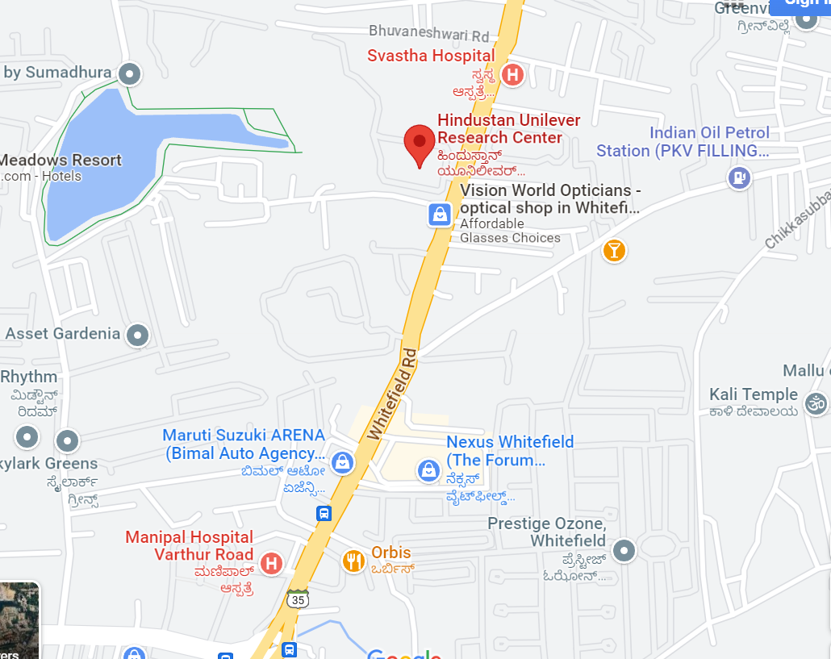
Inter-freq HO on NR ,JIO (n78-n28-n78)
Lat/Long. 12.959805, 77.746854 to
Lat/Long. 12.964071, 77.748442
Location: Hindustan Unilever Research Center
N78-N28-N78 HO

Slide 18
JIO 4G VoLTE Good Coverage Area
Lat/Long –12.956075/77.731732
Location:- Siddapura Primary Health Centre PHC

Slide 19
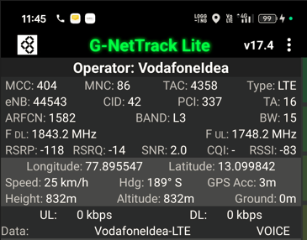
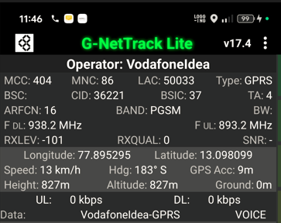
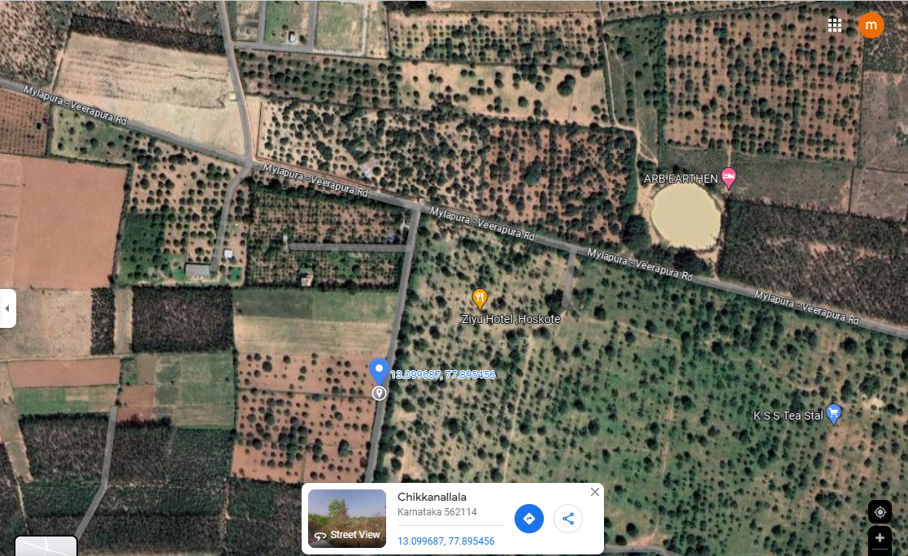
SRVCC VI Operator
Lat Long- . 13.099430 77.895475
Location- Mylapura Gate
Specification –SRVCC

Slide 20
DRIVE ROUTE

Slide 21
THANK YOU
MARQUIS TECHNOLOGIES
www.marquistech.com

