Slide 1
MARQUIS TECHNOLOGIES
Drive Route –Airtel, VI& Reliance JIO ,BSNL(FDD/TDD) LTE

Slide 2
Operator Information:
Operator | JIO 4G
MCC | 405
MNC | 870
APN | Jionet
Operator | Airtel 4G
MCC | 404
MNC | 97
APN | Airtelgprs.com
Operator | VI
MCC | 404
MNC | 56
APN | Internet
Operator | BSNL
MCC | 404
MNC | 54
APN | bsnlnet

Slide 3
Operator Information 1
Functionality | Airtel
Website: http://www.airtel.com/ WAP APN: airtelgprs.com
Customer care | 199
MNC | 97
Bands supported | Both FDD and TDD
 | LTE 2300 MHz – TDD(Band 40)
 | LTE 1800,850 MHz – FDD(Band 3)
USSD | To check MDN: *282#
 | Balance check: *123#
 | Data Balance check: *121*114#
VoLTE | Supported
CSFB | Supported (CSFB to 2G)

Slide 4
Operator Information 2
Functionality | RELIANCE JIO
Website: http://www.jio.com WAP APN: jionet
Customer care | 198
MNC | 870
Bands supported | Both FDD and TDD
 | LTE 2300 MHz –TDD(Band 40)
 | LTE 850 MHz – FDD(Band 5)
 | LTE 1800 MHz –FDD(Band 3)
USSD | NA
 | NA
 | NA
VoLTE | Supported
CSFB | Not Supported

Slide 5
Operator Information 3
Functionality | VI
Website: http://www.jio.com WAP APN: jionet
Customer care | 198
MNC | 56
Bands supported | Both FDD and TDD
 | LTE 2300 MHz –TDD(Band 40,41)
 | LTE 850 MHz – FDD(Band 5)
 | LTE 1800 MHz –FDD(Band 3)
USSD | To check MDN*199#
 | Balance check198
 | Data Balance check: 121
VoLTE | Not supported
CSFB | NA

Slide 6
Drive Route
Near Cell :- Stationary: RSRP : -65dbm to -75dbm
Cell Edge :- Stationary: RSRP : -95dbm to -110dbm
Mixed :- Mobility: RSRP : -65dbm to -110dbm

Slide 7
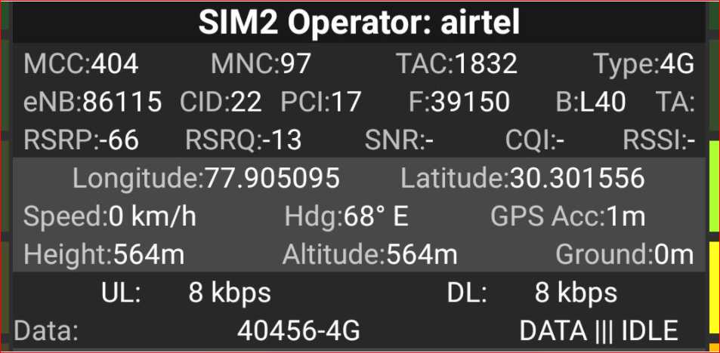
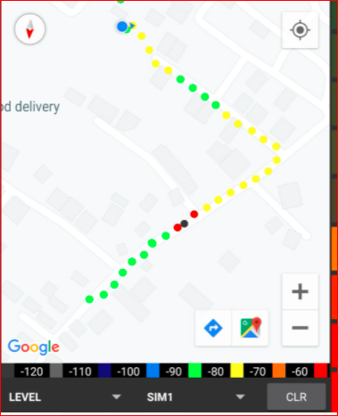
Near Cell (Airtel)
Near cell(NC) | longitude | latitude | RSRP | Cell id | E-ARFCN
1 | 77.905095 | 30.30156 | -66 | 22 | 40140
DEV COLONY RATANPUR DEHRADUN
RSRP:
-65dbm to 75dbm

Slide 8
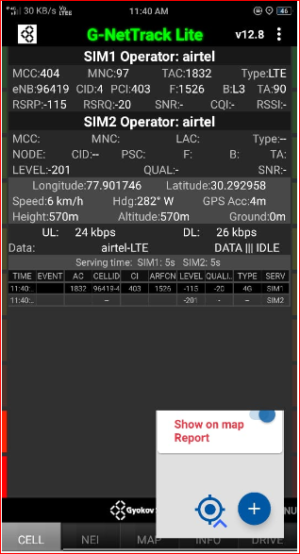
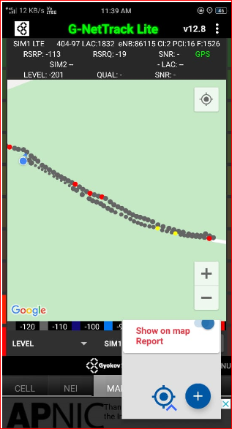
Edge Cell (Airtel)
Edge cell(EC) | longitude | latitude | RSRP | Cell id | TDD E-ARFCN
1 | 77.901746 | 30.292958 | -115 | 4 | 1526
KADWAPANI ,MALAN DEHRADUN
RSRP:
--100 - -115

Slide 9
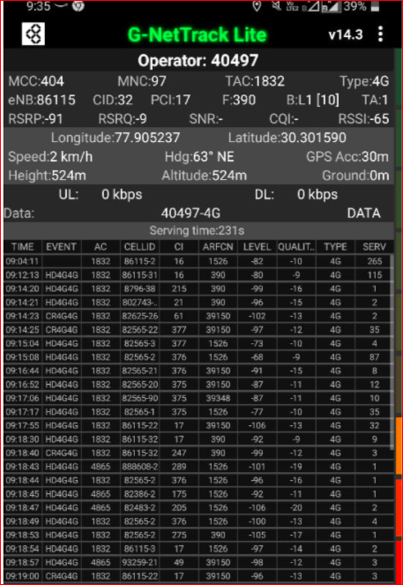
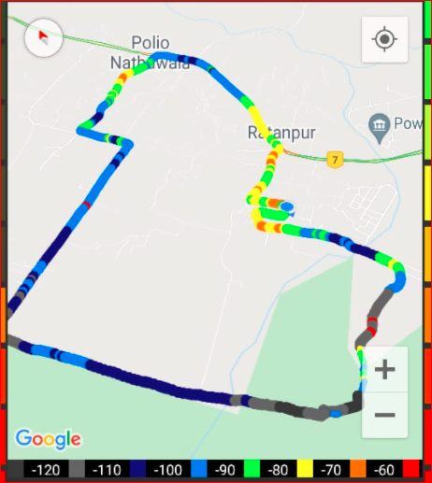
Mixed Mobility:- Airtel (Dehradun )
RSRP: -60dbm to -110dbm

Slide 10
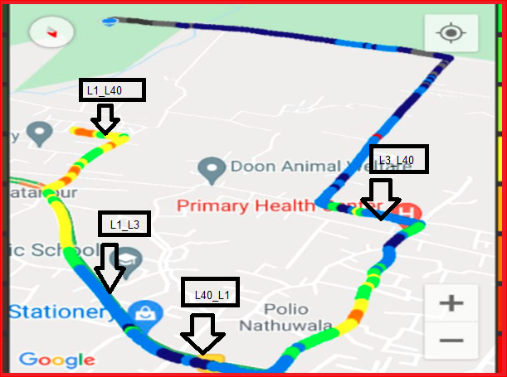
Airtel Band HO
Band 1<>3<>40 Handover

Slide 11
MATT Tool InterBand Handover Results for Airtel

Slide 12
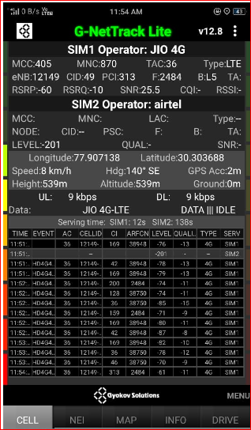
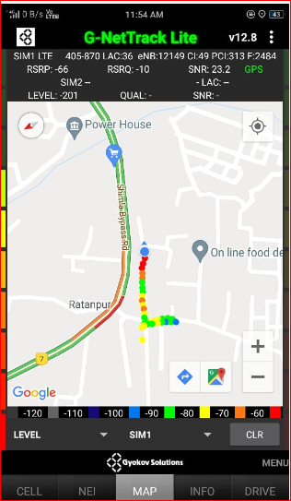
Near Cell (Reliance JIO)
Near cell(NC) | longitude | latitude | RSRP | Cell id | E-ARFCN
1 | 77.907138 | 30.303688 | -60 | 49 | 2484
Ratanpur chok Dehradun
RSRP:
-57dbm to -75dbm

Slide 13
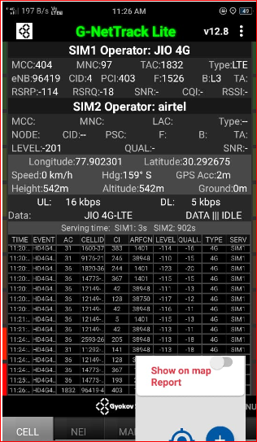
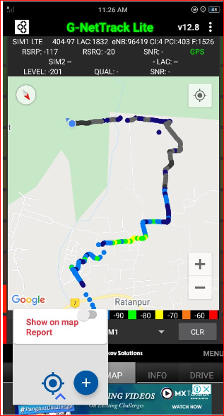
Edge Cell (Reliance JIO)
Edge cell(NC) | longitude | latitude | RSRP | Cell id | E-ARFCN
1 | 77.902301 | 30.292675 | -114 | 4 | 1526
Malan Dehradun
RSRP:
-95dbm to -110dbm

Slide 14
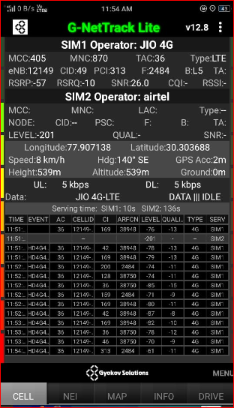
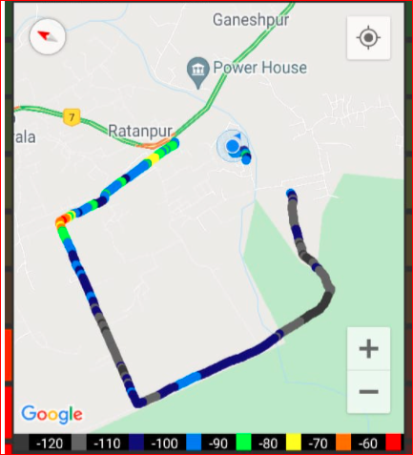
Mixed Mobility:- JI0 RATANPUR Dehradun
RSRP: -60dbm to -110dbm

Slide 15
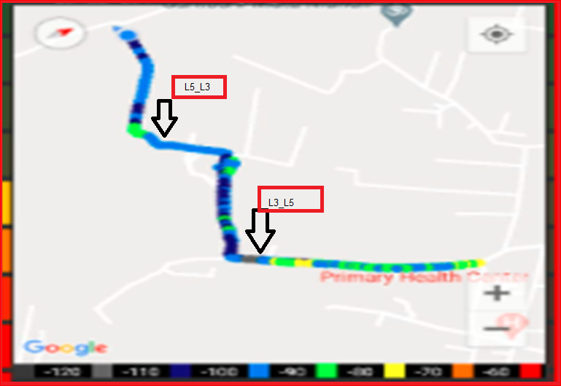
Inter Band Handover (FDD-TDD), JIO 4G

Slide 16
MATT Tool InterBand Handover Results for Jio

Slide 17
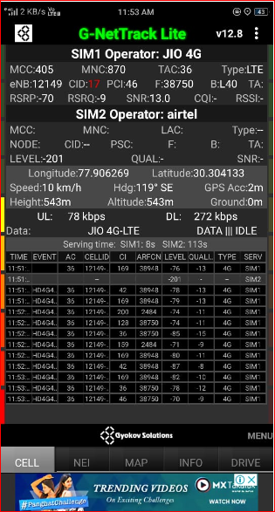
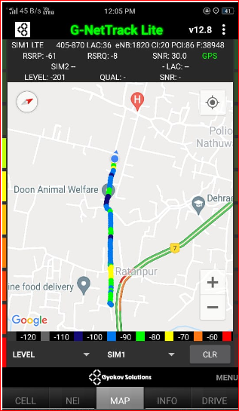
RJIO Band 40 Near Cell:
RSRP Range for Near Cell :
-65dbm to -75dbm
RATANPUR CHOK
DEHRADUN

Slide 18
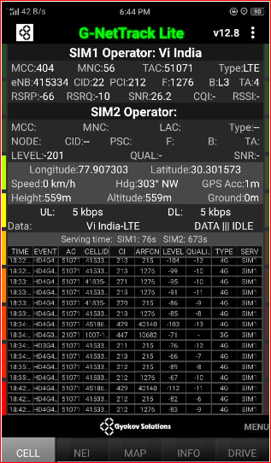
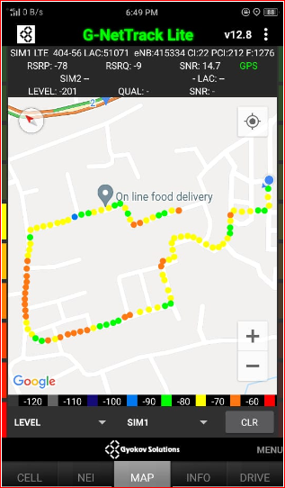
Near Cell VI:
Near cell(NC) | longitude | latitude | RSRP | Cell id | TDD E-ARFCN
1 | 77.907303 | 30.301573 | -66 | 22 | 1276
ADARSH COLONY RATANPUR DEHRADUN
RSRP:
-65dbm to -75dbm

Slide 19
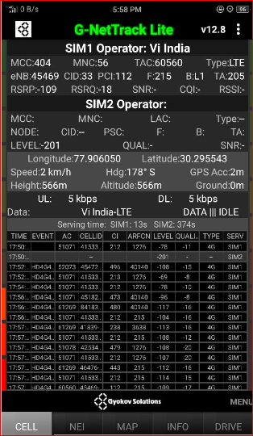
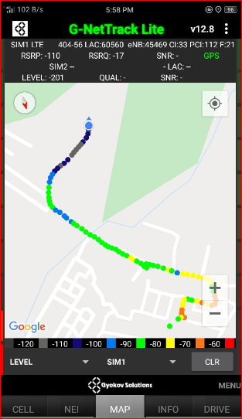
Cell Edge VI:
Edge cell(EC) | longitude | latitude | RSRP | Cell id | E-ARFCN
1 | 77.906050 | 30.295543 | -109 | 33 | 215
KARBARI GRANT DEHRADUN
RSRP:
-95dbm to -105dbm

Slide 20
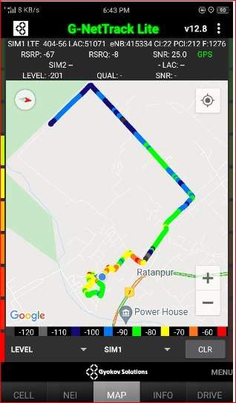
Mixed coverage area Vodafone:

Slide 21
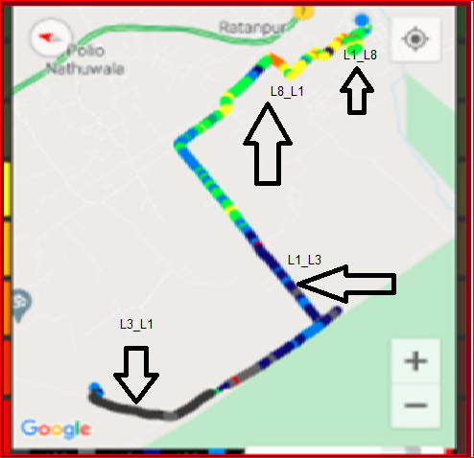
VIBand 1<>3<>8 Handover

Slide 22
MATT Tool InterBand Handover Results for VI

Slide 23
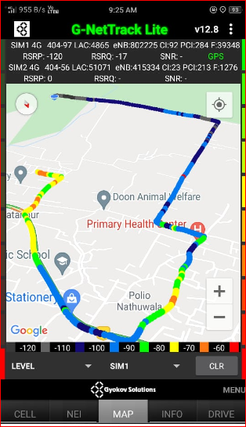
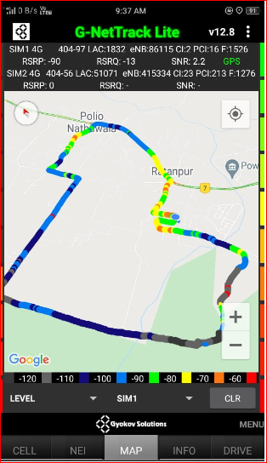
G net Tracker Drive Route

Slide 24
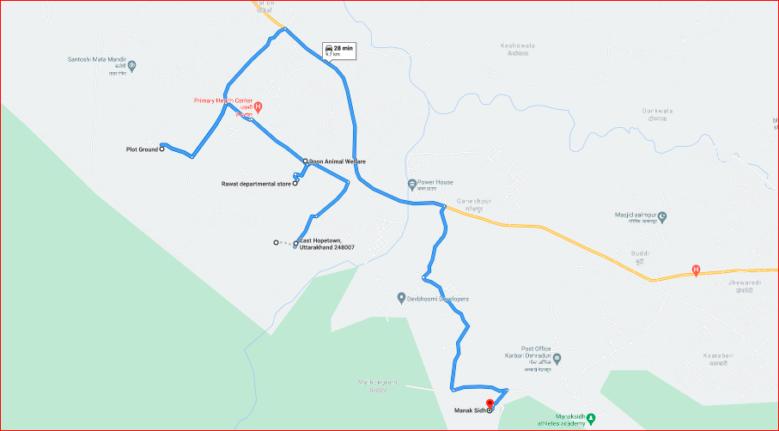
Drive Route

Slide 25
THANK YOU
MARQUIS TECHNOLOGIES

