Slide 1
MARQUIS TECHNOLOGIES
Drive Route

Slide 2
Bhubeneswar/India
Operator Details:
S. No. | Operator |  | Supported Bands | Supported Features by Network
1 | Major | Airtel | LTE FDD B1/B3/B8 & TDD B40/N78 | VoWiFi/VoLTE/4G/2G/5G
2 |  | JIO | LTE FDD B3/B5 & TDD B40/N78/N28 | VoWiFi/VoLTE/4G/5G
3 |  | VI | LTE FDD B3 | VoWiFi/VoLTE/4G/2G
4 | Minor | BSNL | LTE FDD B1, B28,U1 | LTE/3G/2G

Slide 3
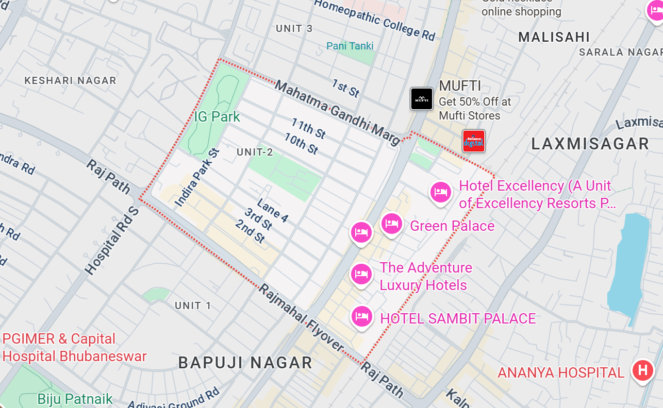
Long call
Lat/Long - 20.26485922887549, 85.8345025762255
Specification – JIO , Airtel, VI

Slide 4
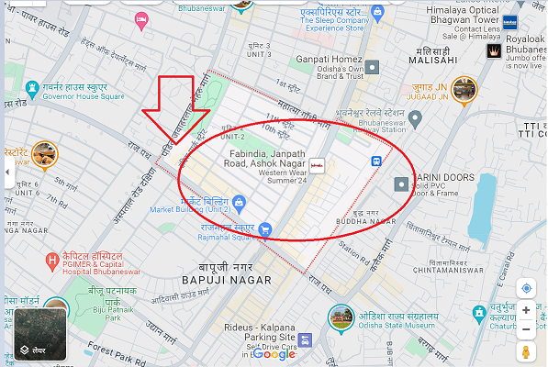
Airtel 5G SA location-Ashok Nagar lat/long-20.2663890, 85.837549

Slide 5
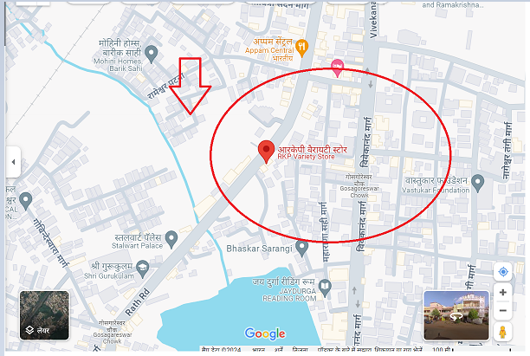
Airtel SA Throughput location- RKP variety store near Shiva Nagar lat/long-20.2486586, 85.8346281

Slide 6
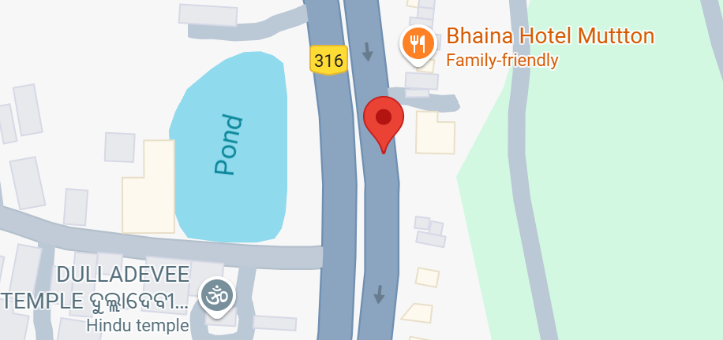
Airtel NSA Throughput location- near bhaina hotel lat/long- 20.1962559970576, 85.85988713515906

Slide 7
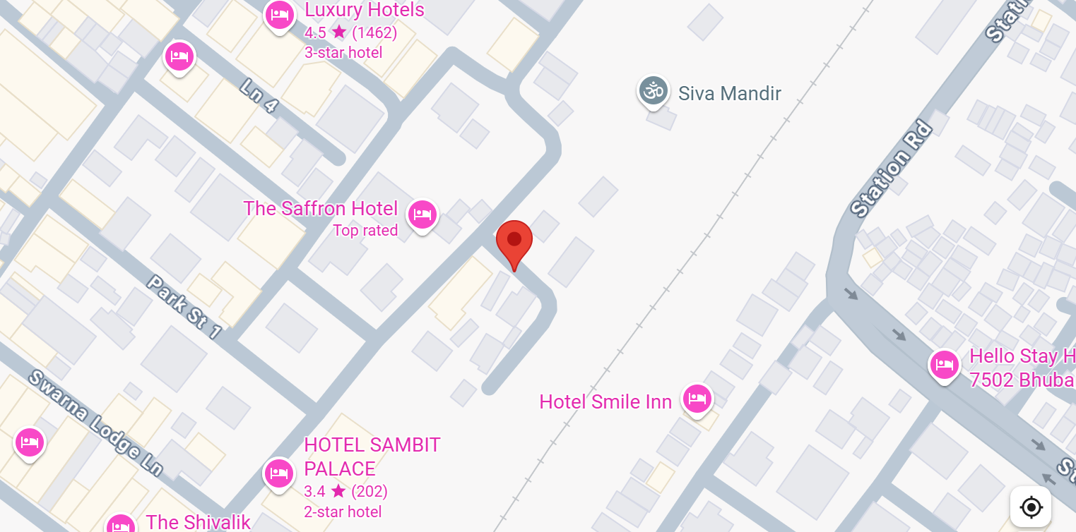
Jio LTE and SA Throughput location- the saffron hotel, ashok nagar lat/long- 20.262036954516592, 85.8398605945562

Slide 8
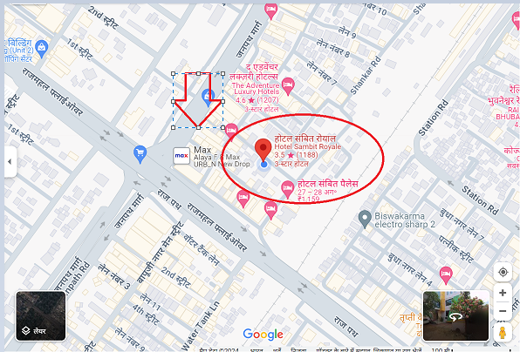
Location for 2 CA Throughput for JiO, Airtel,VI Lat / Long-20.262032, 85.83858 Location- Near Hotel Sambit Royale

Slide 9
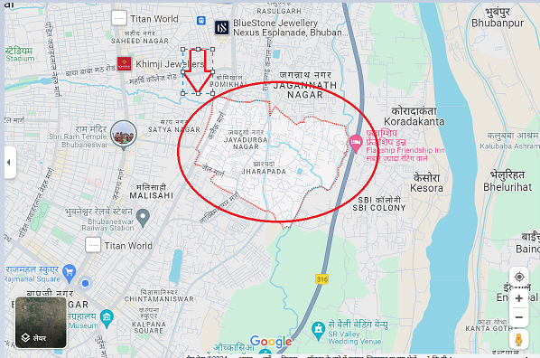
JIO 5G Location
Lat/ long 20.276639, 85.862195
Location –Jharapada

Slide 10
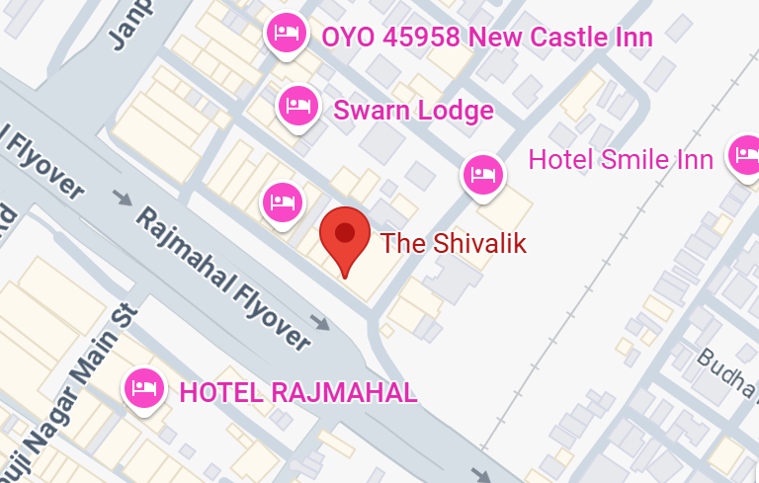
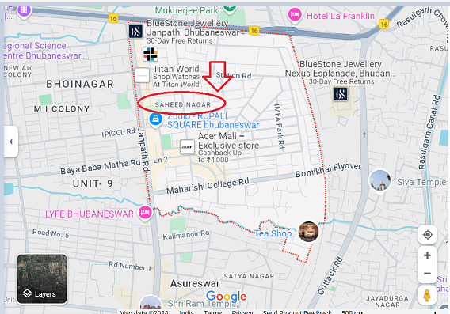
JIO 5G SA to 4G VoLTE handover Ashok Nagar Lat/Long- 20.261114312381487, 85.83839848628462

Slide 11
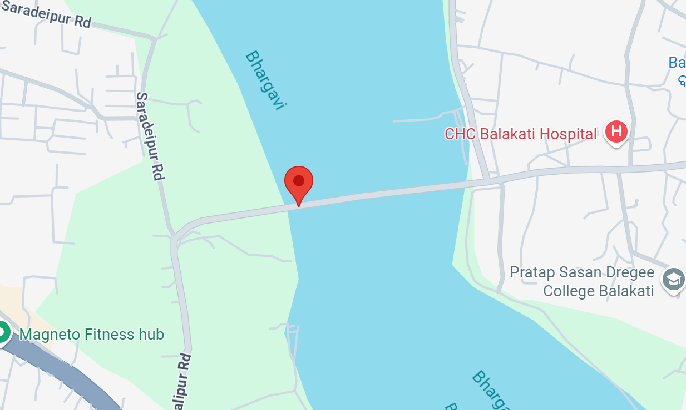
Airtel 5G to 4G VoLTE handover Banamalipur road Lat/Long- 20.202291381491747, 85.86243135573218

Slide 12
THANK YOU
MARQUIS TECHNOLOGIES
www.marquistech.com

