Slide 1
DRIVE ROUTE- United Kingdom
Improvisation required during NXT FT
ESIM
SRVCC: (O2, Vodafone,EE & Three)
4g to 3g in idle & connected mode (O2, Vodafone & Three)
5G NSA Data throughput (O2, EE, Vodafone & Three)
Service to OOS locations (O2, EE, Vodafone & Three)

Slide 2
EE NW info
MCC | 234
MNC | 30
APN | EE Internet , EE MMS
Country/City | United Kingdom / London
Country Code | +44
NRCA support | No
NR & LTE Bands Frequency & BW | NR : Band 78, LTE : Band 1 , 3 , 20
VoNR support | Yes (Issue raised for 5G SA)
NSA support | Yes
MIMO supported | Yes
RF bag availability | Yes

Slide 3
Vodafone NW info
MCC | 234
MNC | 15
APN | Vodafone UK Data
Country/City | United Kingdom / London
Country Code | +44
NRCA support | No
NR & LTE Bands Frequency & BW | NR : Band N1, N78, LTE : Band 1 , B3 , B20
VoNR support | No
NSA support | Yes
MIMO supported | Yes
RF bag availability | Yes

Slide 4
Three NW info
MCC | 234
MNC | 20
APN | 3
Country/City | United Kingdom / London
Country Code | +44
NRCA support | No
NR & LTE Bands Frequency & BW | NR : Band 78, LTE : Band 1 , 3 , 20
VoNR support | No
NSA support | Yes
MIMO supported | Yes
RF bag availability | Yes

Slide 5
O2 NW info
MCC | 234
MNC | 10
APN | O2 pay Monthly
Country/City | United Kingdom / London
Country Code | +44
NRCA support | No
NR & LTE Bands Frequency & BW | NR Band : N78 , N28 , LTE : Band 1 , 3 , 20 , 40
VoNR support | No
NSA support | Yes
MIMO supported | Yes
RF bag availability | Yes

Slide 6
5G locations: SA
EE
Location 1:51.65742896209082, -0.25644674679219599(Warwick Rd) (Source Ankit patel)
Issue raised for EE SA
THREE:
Location 1: SA not supported
Vodafone
Location 1: south wimbledon uk (Source Ankit patel)
Issue raised for VDF SA
O2
Location 1: 260 Bath Rd, Slough SL1 4DX, United Kingdom (Source Ankit patel)

Slide 7
5G locations: NSA
EE
Location 1:51.494208,0.301138
Location 2: 51.4894,-0.2725
Location 3: 51.4781859,-0.3640995
Vodafone
Location 1:51.483,0.339 Location 2:51.482,-0.341
Location 3: 51.4888222,-0.3160342
Three
Location 1:51.494208,-0.301138
Location 2:51.4950504,-0.3023544
Location 3: 51.4888222,-0.3160342
O2
Location 1:51.483,-0.326
Location 2: 51.479,-0.371
Location 3: 51.4888222,-0.3160342

Slide 8
5G Throughput location 1 and 2 for _SA
EE
Location 1:51.65742896209082, -0.25644674679219599(Warwick Rd) (Source Ankit patel)
Issue raised for EE SA
Vodafone
Location 1: south wimbledon uk (Source Ankit patel)
Issue raised for VDF SA
Three
Location 1:SA not supported
Location 2:SA not supported
O2
Location 1: 260 Bath Rd, Slough SL1 4DX, United Kingdom (Source Ankit patel)

Slide 9
5G Throughput location 1 and 2_NSA
EE
Location 1: 51.494876, -0.302033
Location 2: 51.4894433,-0.2725371
Vodafone
Location A:51.482181,-0.341389
Near cell
Location 2:51.482,-0.341
Three
Location 1:51.494208,-0.301138
Location 2:51.4950504,-0.3023544
O2
Location A: 51.478137,-0.371563
Location B: 51.482190,-0.373952

Slide 10
EE : 5G-4G-5G handover location:
Second location: 51°29'38.1"N 0°19'11.2"W (NR) and
First location : 51.49461230420481, -0.3014521343388934
Second location: 51.493915,-0.319779 (NR)

Slide 11
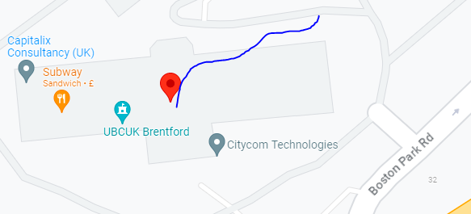
Three : 5G-4G-5G handover location: 51.4888694,-0.3135572

Slide 12
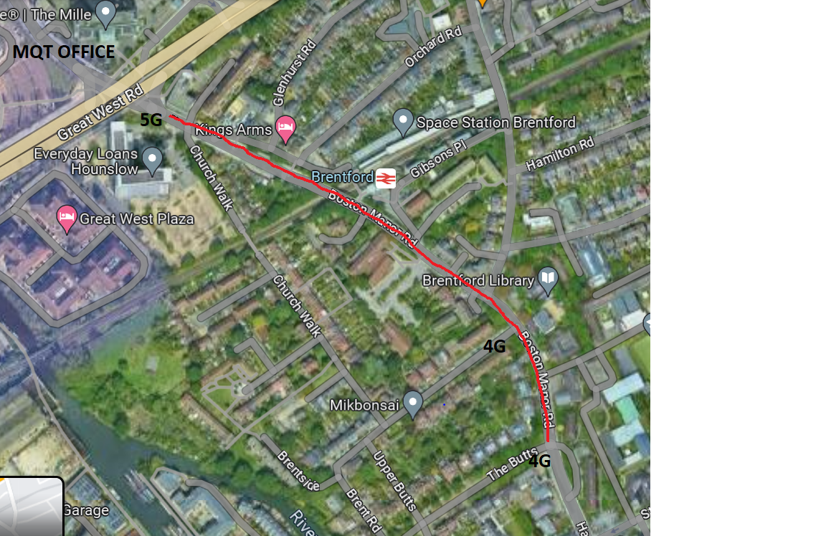
VDF: 5G-4G-5G handover
51.48803160066793, -0.31247537058311675(5G) >>>>>>>>>>> 51.48526741397951, -0.3073362581430255 (4G)

Slide 13
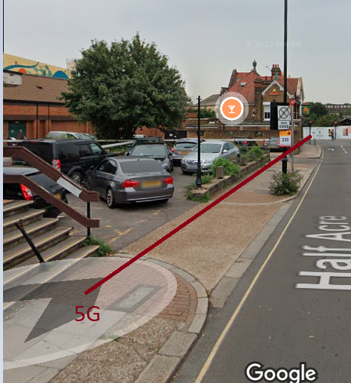
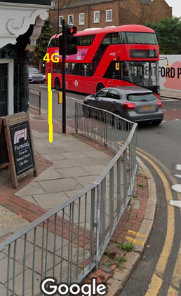
VF New location: 51.48360860855636, -0.30638916693654905

Slide 14
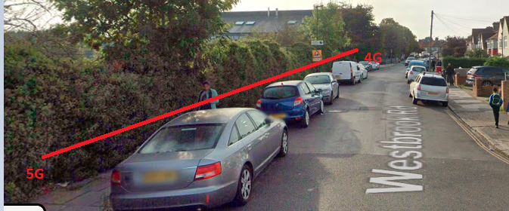
O2/SKY: 5G-4G-5G handover
51.484066420700465, -0.37737402037153345
BY : Shuvam Sharma

Slide 15
Supported LTE band combination’s & their locations:
Source : Atul / Ankit
EE
B3, 1: 51.4742896,-0.3602959
Vodafone
B20, 1: location-51.4742896,-0.3602959
Three
B1, 1: location-51.4742896,-0.3602959
O2
1. B40 , 1: location-51.4742896,-0.3602959

Slide 16
Supported NRCA band combination’s & their locations:
EE
No combination observed
Vodafone
No combination observed
Three
No combination observed
O2
No combination observed

Slide 17
Supported NSA band combination’s & their locations:
EE
NR: N78 LTE: B7, B1
Location:- 51.494208,0.301138
Vodafone
NR: N78 LTE :B20, B1,
Location:- 51.483,-0.339
Three
N78+B1 1: location- 51.4888222,-0.3160342
O2
N78+b20 1: location-51.4888222,-0.3160342
N28+b1 2: location-51.4742896,-0.3602959

Slide 18
ESIM activation process (SOP)
ESIM is supported only for the postpaid SIMcards for all the operators.
To activate the ESIM the customer must call the customer care.
Ask them to provide Esim for postpaid SIM.
Share them the EID for the device on which we need to activate ESIM on.
They will share the ESIM profile/QR code over registered e-mail address of the customer.

Slide 19
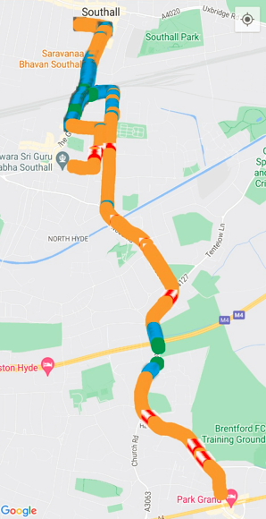
EE , Vodafone, O2 Mix coverage mobility route (2-3 routes that you follow during FT

Slide 20
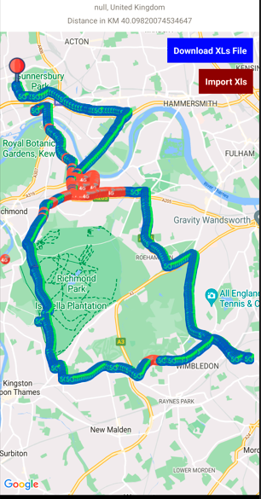
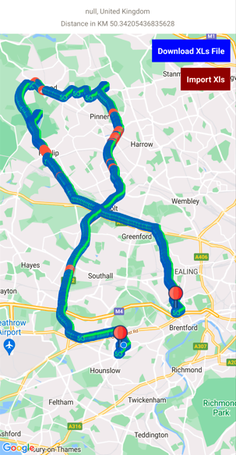
EE, Three and Vodafone Mix coverage mobility route (2-3 routes that you follow during FT)

Slide 21
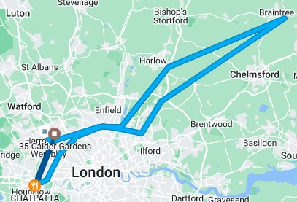
EE , Vodafone Mix coverage mobility route (2-3 routes that you follow during FT)

Slide 22
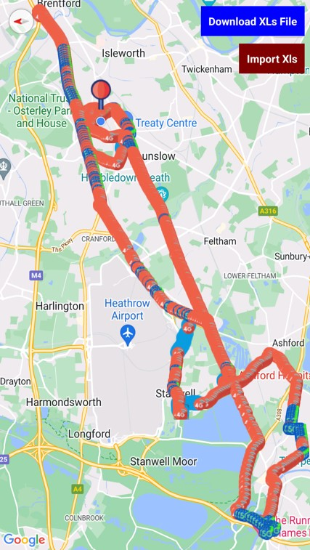
EE , Vodafone, O2 Mix coverage mobility route (2-3 routes that you follow during FT

Slide 23
SRVCC locations
O2: During SRVCC call got diconnected and then it goes to 2G same with reference. So it was marked as NA.
EE: Location: 51.4707° N, 0.3101° W
VDF: Location: 51.4707° N, 0.3101° W
Three: Location: 51.4707° N, 0.3101° W

Slide 24
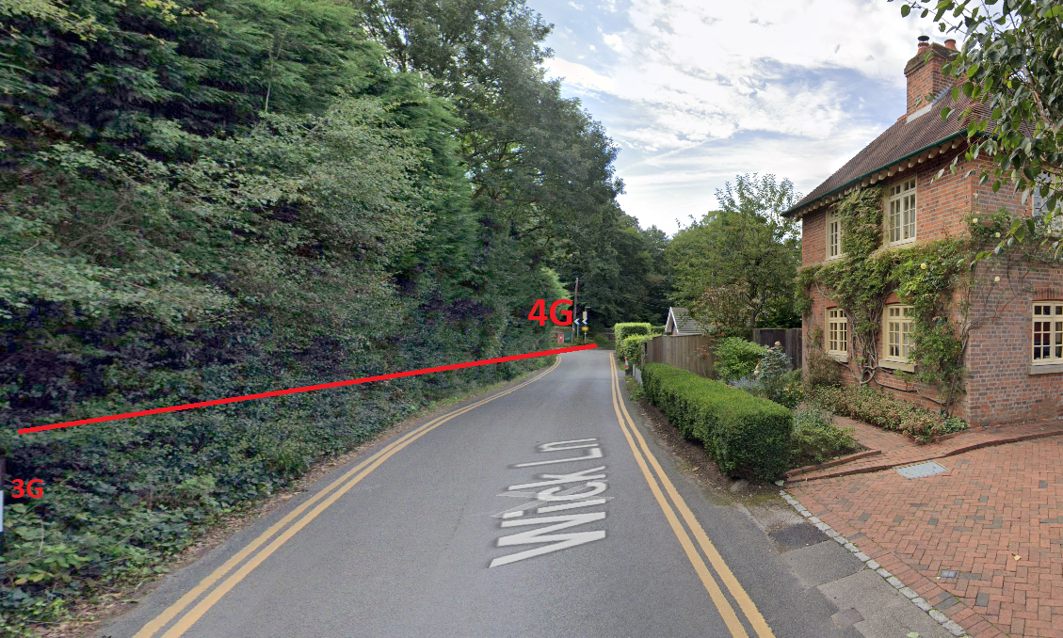
SRVCC Location : 51°25'12.7"N 0°35'14.1"W (O2)
BY : Shuvam Sharma

Slide 25
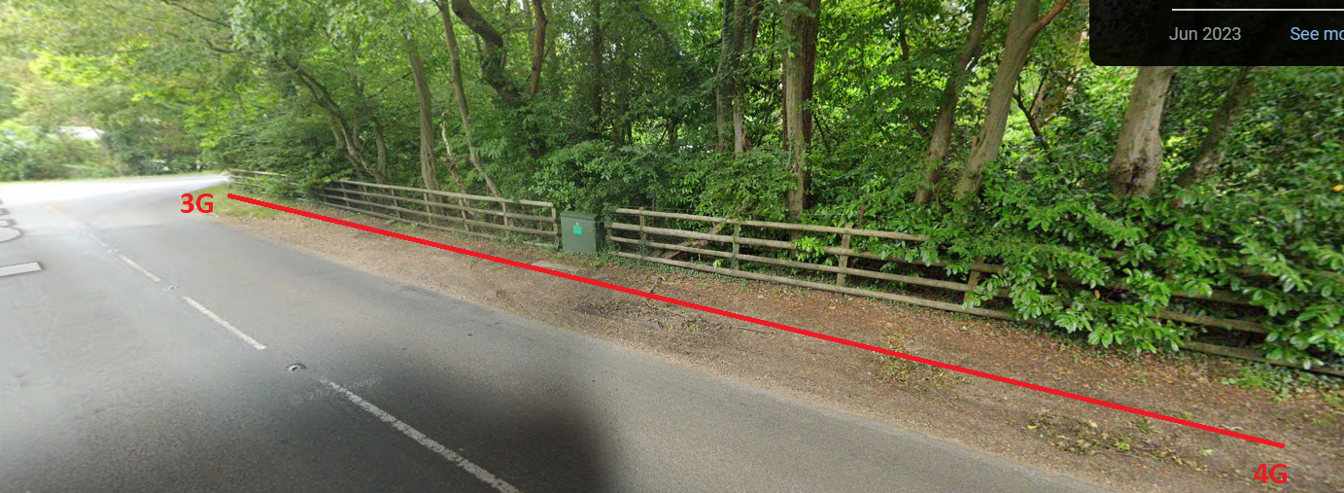
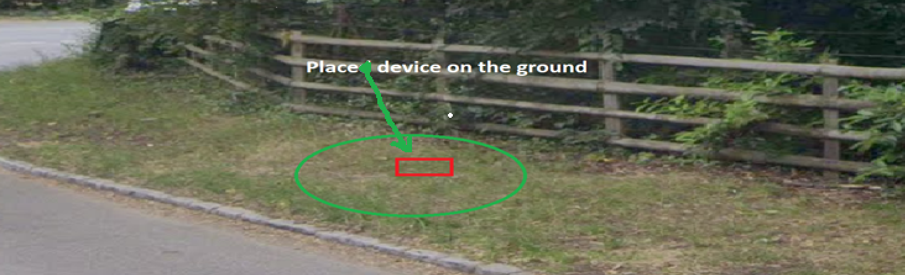
SRVCC Location : 51.55685576334532, -0.5660216418791645(Three)
BY : Shuvam Sharma

Slide 26
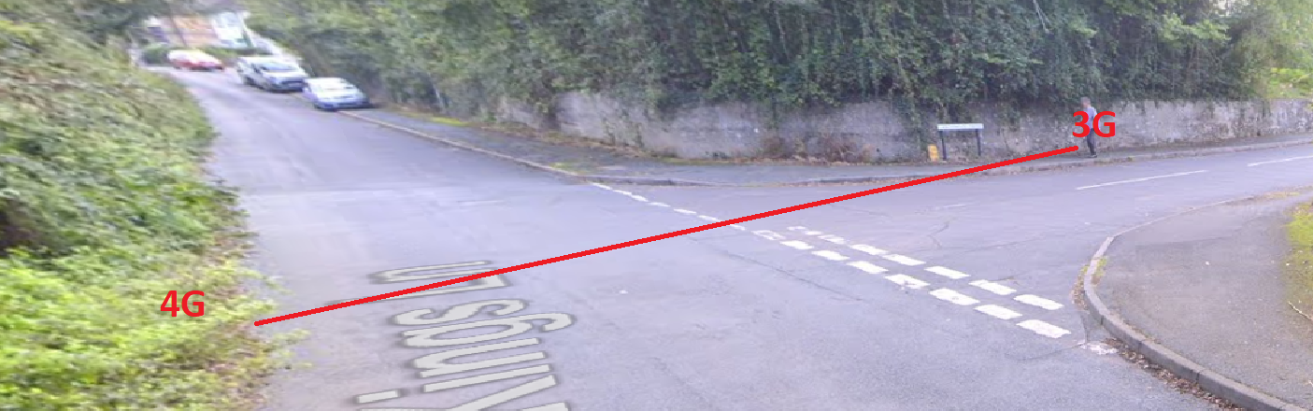
SRVCC Location : VDF (51.428221,-0.583407)
BY : Shuvam Sharma

Slide 27
Service to OOS locations:
EE
51.4710383,-0.3636224.
ASDA Under ground Parking
Vodafone
51.4710383,-0.3636224.
ASDA Under ground Parking
Three
51.4710383,-0.3636224.
ASDA Under ground Parking
O2
51.4710383,-0.3636224.
ASDA Under ground Parking

Slide 28
Cellular preferred VoWiFi case's locations:
EE
51.4710383,-0.3636224.
ASDA Under ground Parking
Vodafone
51.4710383,-0.3636224.
ASDA Under ground Parking
Three
51.4710383,-0.3636224.
ASDA Under ground Parking
O2
51.4710383,-0.3636224.
ASDA Under ground Parking

Slide 29
DSS location
02 Location :51.419027,-0.200157/ 51.422279141462994, -0.20827434232857986 New location source Atul
VDF: 51.488818,-0.313528 / 51.48852389261859, -0.3135893960642087 New location source Atul

Slide 30
Thank You

