Slide 1
MARQUIS TECHNOLOGIES
Drive Route –Airtel, VI& Reliance JIO (FDD/TDD) LTE

Slide 2
Operator Information:
Operator | JIO 4G
MCC | 405
MNC | 856
APN | Jionet
Operator | Airtel 4G
MCC | 404
MNC | 52
APN | Airtelgprs.com
Operator | VI
MCC | 404
MNC | 70
APN | Internet

Slide 3
Operator Information 1
Functionality | Airtel
Website: http://www.airtel.com/ WAP APN: airtelgprs.com
Customer care | 199
MNC | 52
Bands supported | Both FDD and TDD
 | LTE 2300 MHz – TDD(Band 40)
 | LTE 1800,850 MHz – FDD(Band 3)
USSD | To check MDN: *282#
 | Balance check: *123#
 | Data Balance check: *121*114#
VoLTE | Supported
CSFB | Supported (CSFB to 2G)

Slide 4
Operator Information 2
Functionality | RELIANCE JIO
Website: http://www.jio.com WAP APN: jionet
Customer care | 198
MNC | 856
Bands supported | Both FDD and TDD
 | LTE 2300 MHz –TDD(Band 40)
 | LTE 850 MHz – FDD(Band 5)
 | LTE 1800 MHz –FDD(Band 3)
USSD | NA
 | NA
 | NA
VoLTE | Supported
CSFB | Not Supported

Slide 5
Operator Information 3
Functionality | VI
Website: http://www.vodafoneidea.com WAP APN: Ideainternet
Customer care | 198
MNC | 70
Bands supported | Both FDD and TDD
 | LTE 2300 MHz –TDD(Band 41)
 | LTE 850 MHz – FDD(Band 8)
 | LTE 1800 MHz –FDD(Band 3)
USSD | To check MDN*199#
 | Balance check198
 | Data Balance check: 121
VoLTE | Supported
CSFB | Supported

Slide 6
Drive Route
Near Cell :- Stationary: RSRP : -65dbm to -75dbm
Cell Edge :- Stationary: RSRP : -95dbm to -110dbm
Mixed :- Mobility: RSRP : -65dbm to -110dbm

Slide 7
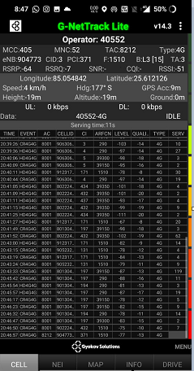
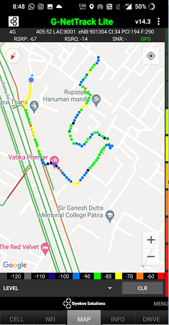
Near Cell (Airtel)
Near cell(NC) | longitude | Latitude | RSRP | Cell id | FDD E-ARFCN
1 | 85.054842 | 25.612126 | -64 | 3 | 1510
RSRP:
-65dbm to 75dbm
Near Gola road Rupaspur Thana

Slide 8
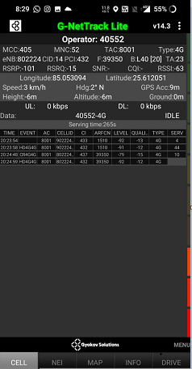
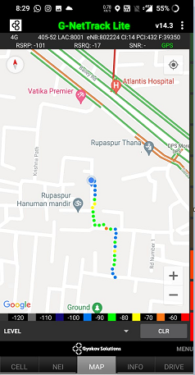
Edge Cell (Airtel)
Edge cell(EC) | longitude | latitude | RSRP | Cell id | TDD E-ARFCN
1 | 85.053094 | 25.612051 | -101 | 14 | 39350
RSRP:
--101

Slide 9
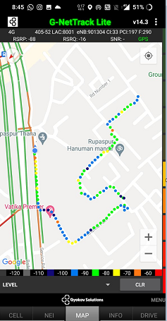
Mixed Mobility:- Airtel (Bihar )
RSRP: -60dbm to -110dbm
Rupaspur Thana to Saguna more

Slide 10
Airtel Band HO
Band 1<>3<>40 Handover
Iteration | operator | SIM | Date Time | Lat,Lng | PCI/PSC | Band | Freq. | SignalSIG(Type)
1 | airtel | SimOne | Thu Jun 17 14:51:22 India Standard Time 2021 | 25.61095793,85.05398967 | 197 | L40 | 39300 | -98(LTE)
2 | airtel | SimOne | Thu Jun 17 14:51:26 India Standard Time 2021 | 25.61098386,85.05406746 | 197 | L3 | 1510 | -84(LTE)
3 | airtel | SimOne | Thu Jun 17 14:52:14 India Standard Time 2021 | 25.61175406,85.05505139 | 197 | L40 | 39300 | -86(LTE)
4 | airtel | SimOne | Thu Jun 17 14:53:09 India Standard Time 2021 | 25.61178751,85.05576241 | 197 | L3 | 1510 | -74(LTE)
5 | airtel | SimOne | Thu Jun 17 14:53:33 India Standard Time 2021 | 25.6113402,85.0564944 | 192 | L40 | 39300 | -75(LTE)
6 | airtel | SimOne | Thu Jun 17 14:55:40 India Standard Time 2021 | 25.60775129,85.05750533 | 368 | L3 | 1510 | -74(LTE)
7 | airtel | SimOne | Thu Jun 17 14:56:48 India Standard Time 2021 | 25.60637758,85.05863071 | 33 | L1 | 290 | -96(LTE)
8 | airtel | SimOne | Thu Jun 17 14:56:55 India Standard Time 2021 | 25.60632406,85.05873674 | 34 | L3 | 1510 | -93(LTE)
9 | airtel | SimOne | Thu Jun 17 14:58:15 India Standard Time 2021 | 25.60688153,85.0576188 | 368 | L1 | 290 | -92(LTE)
10 | airtel | SimOne | Thu Jun 17 15:00:06 India Standard Time 2021 | 25.6100454,85.05650683 | 371 | L3 | 1510 | -65(LTE)
SBand Details
L1_L40 | 0
L1_L3 | 2
L40_L1 | 0
L40_L3 | 3
L3_L1 | 2
L3_L40 | 2

Slide 11
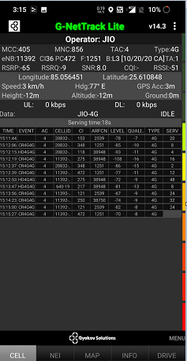
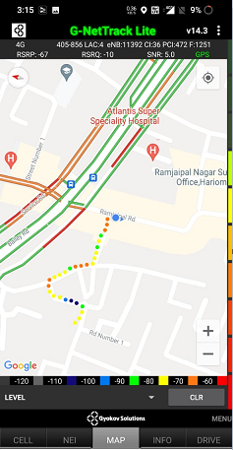
Near Cell (Reliance JIO)
Near cell(NC) | longitude | Latitude | RSRP | Cell id | FDD E-ARFCN
1 | 85.056451 | 25.610848 | -65 | 36 | 1251
DPS More,
Gola Road
Patna
RSRP:
-57dbm to -75dbm

Slide 12
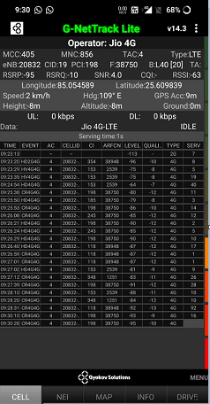
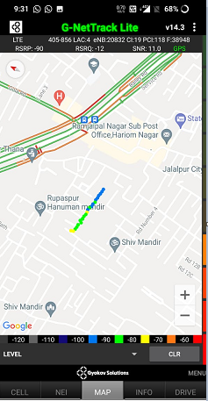
Edge Cell (Reliance JIO)
Edge cell(NC) | longitude | latitude | RSRP | Cell id | TDD E-ARFCN
1 | 85.054589 | 25.609839 | -95 | 19 | 38750
RSRP:
-95dbm to -110dbm

Slide 13
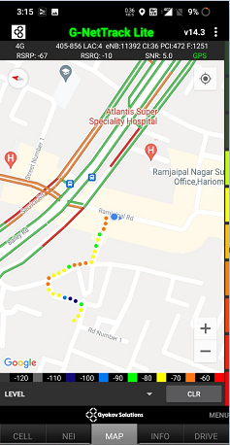
Mixed Mobility:- JI0 Bihar
RSRP: -60dbm to -110dbm

Slide 14
Inter Band Handover (FDD-TDD), JIO 4G
Iteration | operator | SIM | Date Time | Lat,Lng | PCI/PSC | Band | Freq. | SignalSIG(Type)
1 | JIO | SimOne | Thu Jun 17 11:32:01 India Standard Time 2021 | 25.61167646,85.05510729 | 472 | L3 | 1251 | -67(LTE)
2 | JIO | SimOne | Thu Jun 17 11:32:29 India Standard Time 2021 | 25.61188869,85.05500994 | 347 | L40 | 38750 | -80(LTE)
3 | JIO | SimOne | Thu Jun 17 11:37:35 India Standard Time 2021 | 25.60658939,85.07061523 | 35 | L5 | 2539 | -91(LTE)
4 | JIO | SimOne | Thu Jun 17 11:37:37 India Standard Time 2021 | 25.6065767,85.07070348 | 358 | L40 | 38750 | -73(LTE)
5 | JIO | SimOne | Thu Jun 17 11:42:33 India Standard Time 2021 | 25.61104805,85.05764107 | 96 | L3 | 1251 | -81(LTE)
6 | JIO | SimOne | Thu Jun 17 11:42:35 India Standard Time 2021 | 25.61110866,85.05749994 | 34 | L5 | 2539 | -83(LTE)
7 | JIO | SimOne | Thu Jun 17 11:42:37 India Standard Time 2021 | 25.6111647,85.0573646 | 308 | L3 | 1251 | -80(LTE)
8 | JIO | SimOne | Thu Jun 17 11:42:39 India Standard Time 2021 | 25.61121933,85.05724882 | 347 | L40 | 38750 | -89(LTE)
9 | JIO | SimOne | Thu Jun 17 11:51:29 India Standard Time 2021 | 25.6108239,85.05766604 | 96 | L3 | 1251 | -80(LTE)
10 | JIO | SimOne | Thu Jun 17 11:51:36 India Standard Time 2021 | 25.61075096,85.05779337 | 330 | L5 | 2539 | -85(LTE)
Band Details
L40_L5 | 1
L5_L40 | 1
L5_L3 | 1
L3_L5 | 2
L40_L3 | 2
L3_L40 | 2

Slide 15
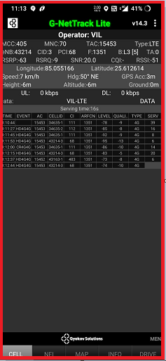
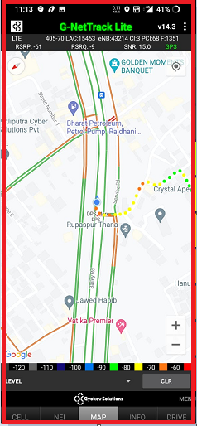
Near Cell VI:
Near cell(NC) | longitude | latitude | RSRP | Cell id | FDD E-ARFCN
1 | 85.055166 | 25.612614 | -63 | 3 | 1351
RSRP:
-65dbm to -75dbm

Slide 16
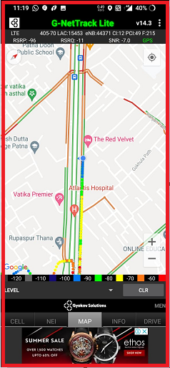
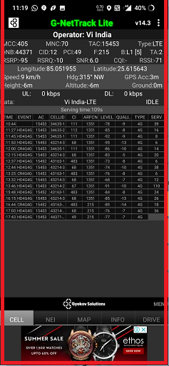
Cell Edge VI:
Edge cell(EC) | longitude | latitude | RSRP | Cell id | FDD E-ARFCN
1 | 85.051955 | 25.615643 | -95 | 12 | 215
RSRP:
-95dbm to -105dbm

Slide 17
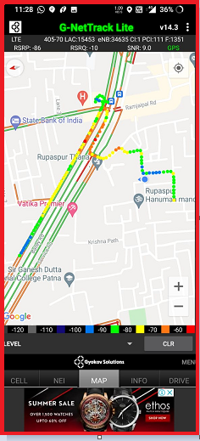
Mixed coverage area VI:

Slide 18
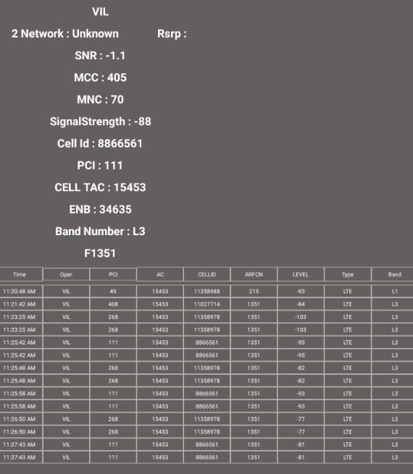
VIBand 3<>5<>40 Handover
Report not Generated

Slide 19
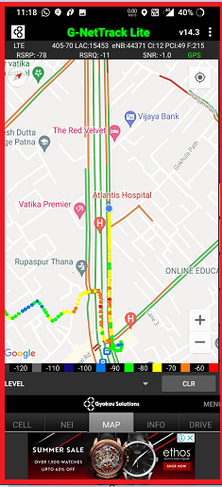
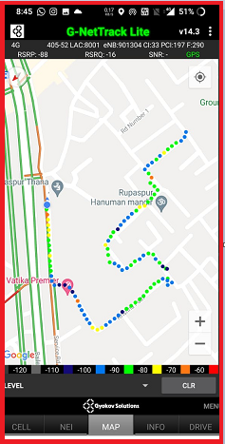
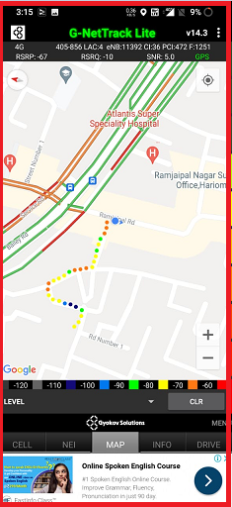
G net Tracker Drive Route

Slide 20
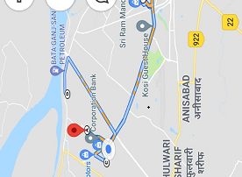
Drive Route

Slide 21
THANK YOU
MARQUIS TECHNOLOGIES

