Slide 1
MARQUIS TECHNOLOGIES
Drive Route –Airtel, VODAFONE/IDEA & Reliance JIO (FDD/TDD) LTE

Slide 2
Operator Information:
Operator | JIO 4G
MCC | 405
MNC | 856
APN | Jionet
Operator | Airtel 4G
MCC | 405
MNC | 52
APN | Airtelgprs.com
Operator | VI
MCC | 405
MNC | 70
APN | www
Operator | BSNL
MCC | 404
MNC | 75
APN | Bsnlmms

Slide 3
Operator Information 1
Functionality | Airtel
Website: http://www.airtel.com/ WAP APN: airtelgprs.com
Customer care | 199
MNC | 52
Bands supported | Both FDD and TDD
 | LTE 2300 MHz – TDD(Band 40)
 | LTE 2100,850 MHz – FDD(Band 3 ,1)
USSD | To check MDN: *282#
 | Balance check: *123#
 | Data Balance check: *121*114#
VoLTE | Supported
CSFB | Supported (CSFB to 2G)

Slide 4
Operator Information 2
Functionality | RELIANCE JIO
Website: http://www.jio.com WAP APN: jionet
Customer care | 198
MNC | 856
Bands supported | Both FDD and TDD
 | LTE 2300 MHz –TDD(Band 40)
 | LTE 850 MHz – FDD(Band 5)
 | LTE 1800 MHz –FDD(Band 3)
USSD | NA
 | NA
 | NA
VoLTE | Supported
CSFB | Not Supported

Slide 5
Operator Information 3
Functionality | VI
Website: http://www.myvi.com WAP APN: www
Customer care | 198
MNC | 70
Bands supported | FDD
 | LTE 2100 MHz – FDD(Band 1)
 | LTE 1800 MHz –FDD(Band 3)
USSD | To check MDN*199#
 | Balance check198
 | Data Balance check: 121
VoLTE | Not Supported
CSFB | Supported(Switched to 2G only)

Slide 6
Drive Route
Near Cell :- Stationary: RSRP : -60dbm to -75dbm
Cell Edge :- Stationary: RSRP : -95dbm to -110dbm
Mixed :- Mobility: RSRP : -60dbm to -110dbm

Slide 7
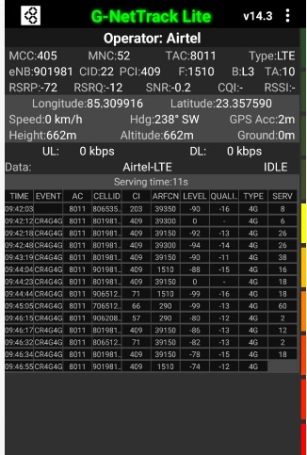
Near Cell (Airtel)
Near cell(NC) | longitude | latitude | RSRP | Cell id | FDD E-ARFCN
1 | 85.309916 | 23.357590 | -72 | 22 | 1510
Sahajanand Choke,Harmu, Ranchi
RSRP:
-60dbm to 75dbm

Slide 8
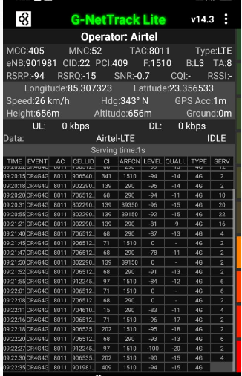
Edge Cell (Airtel)
Edge cell(EC) | longitude | latitude | RSRP | Cell id | TDD E-ARFCN
1 | 85.307323 | 23.356533 | -94 | 22 | 1510
Sahajanad Choke, harmu, Ranchi
RSRP:
-95dbm to -110dbm

Slide 9
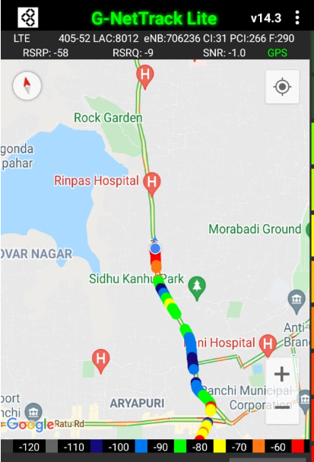
Mixed Mobility Airtel:- Ranchi,Jharkhand
Kanke Road, Ranchi
RSRP: -65dbm to -110dbm

Slide 10
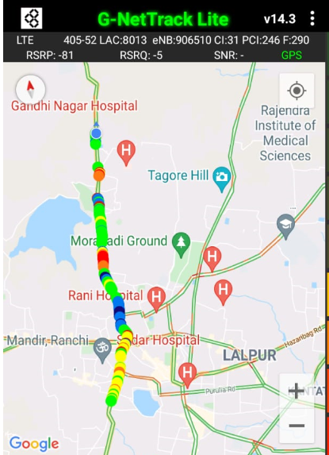
Airtel Band HO
Iteration | operator | Lat,Lng | PCI/PSC | Band | Freq. | SignalSIG(Type)
1 | Airtel | 23.358843333333333,85.30816666666666 | 66 | L1 | 290 | -88(LTE)
2 | Airtel | 23.359185000000004,85.30830166666668 | 203 | L40 | 39350 | -96(LTE)
3 | Airtel | 23.365018333333335,85.310915 | 47 | L1 | 290 | -77(LTE)
4 | Airtel | 23.368119999999998,85.31080666666666 | 154 | L3 | 1510 | -81(LTE)
5 | Airtel | 23.369678333333333,85.31173333333332 | 150 | L1 | 290 | -76(LTE)
6 | Airtel | 23.378445000000003,85.31572999999999 | 224 | L40 | 39350 | -100(LTE)
7 | Airtel | 23.378755,85.31595833333334 | 9 | L1 | 290 | -80(LTE)
8 | Airtel | 23.379331666666666,85.31629333333333 | 9 | L3 | 1535 | -77(LTE)
9 | Airtel | 23.379403333333336,85.31629666666667 | 7 | L1 | 290 | -77(LTE)
10 | Airtel | 23.379836666666666,85.31641166666668 | 10 | L3 | 1535 | -84(LTE)

Slide 11
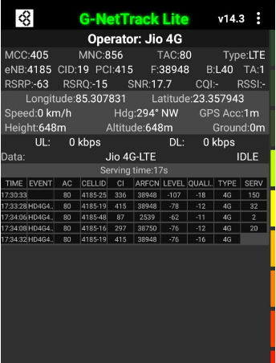
Near Cell (Reliance JIO)
Near cell(NC) | longitude | latitude | RSRP | Cell id | TDD E-ARFCN
1 | 85.307831 | 23.357943 | -63 | 19 | 38948
Sahajanad choke, Ranchi
RSRP:
-60dbm to -75dbm

Slide 12
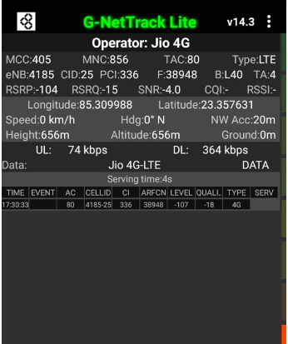
Edge Cell (Reliance JIO)
Edge cell(NC) | longitude | latitude | RSRP | Cell id | TDD E-ARFCN
1 | 85.309988 | 23.357631 | -104 | 25 | 38948
Vasant Vihar, Ranchi
RSRP:
-95dbm to -110dbm

Slide 13
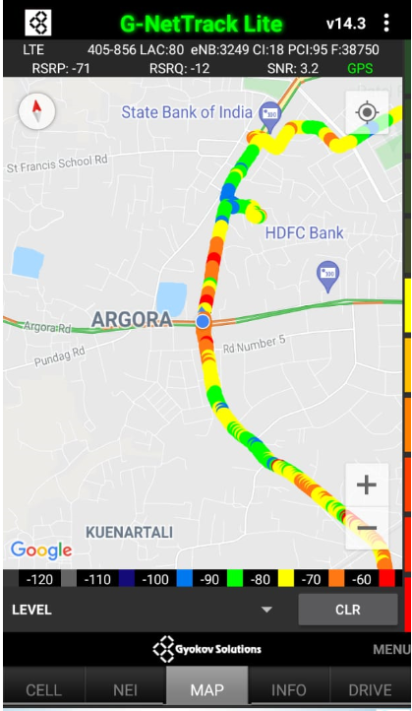
Mixed Mobility Jio:- Ranchi, Jharkhand
RSRP: -65dbm to -96dbm
Harmu to Birsa choke road, Ranchi

Slide 14
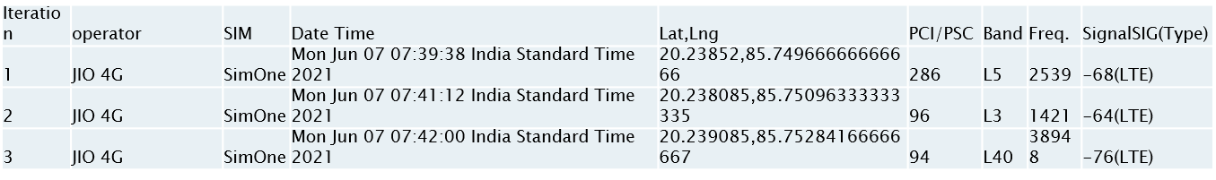
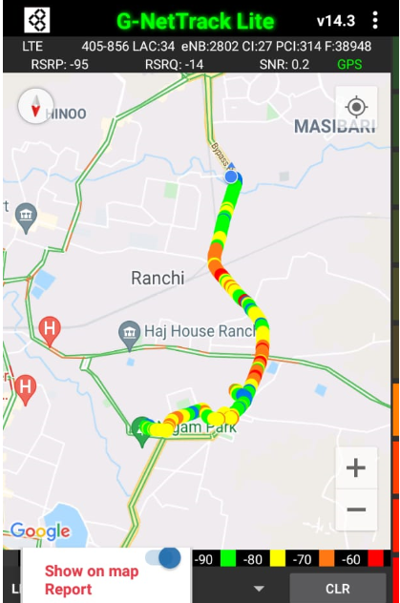
Inter Band Handover (FDD-TDD), JIO 4G

Slide 15
RJIO Band 40 Near Cell:
Edge cell(NC) | longitude | latitude | RSRP | Cell id | TDD E-ARFCN
1 | 85.307831 | 23.357943 | -63 | 19 | 38948
JIO band 40 Near Cell
Sahajanand Choke, ranchi

Slide 16
RJIO Band 40 Edge Cell:
Edge cell(EC) | longitude | latitude | RSRP | Cell id | TDD E-ARFCN
1 | 85.309988 | 23.357631 | -104 | 25 | 38948
Sahajand Choke , Ranchi
JIO band 40 Edge Cell

Slide 17
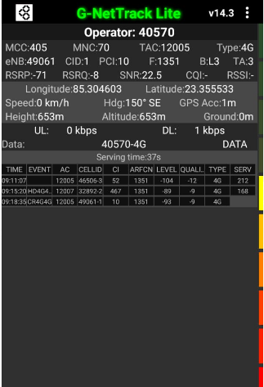
Near Cell VI:
Near cell(NC) | longitude | latitude | RSRP | Cell id | TDD E-ARFCN
1 | 85.304603 | 23.355533 | -71 | 1 | 1351
Sahajand choke, harmu, Ranchi
RSRP:
-65dbm to -75dbm

Slide 18
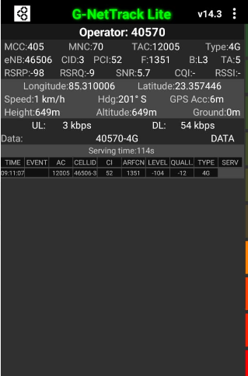
Cell Edge VI:
Edge cell(EC) | longitude | latitude | RSRP | Cell id | TDD E-ARFCN
1 | 85.310006 | 23.357446 | -98 | 3 | 1351
Sahajand Choke,Harmu, Ranchi
RSRP:
-95dbm to -105dbm

Slide 19
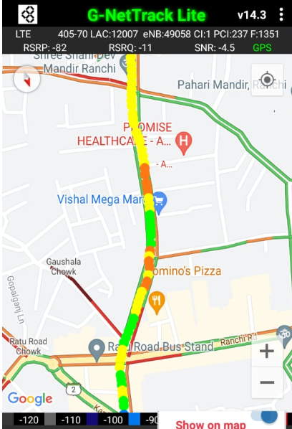
Mixed coverage area Vodafone:
RSRP:
-65dbm to -95dbm
Ratu road to harmu , Ranchi

Slide 20
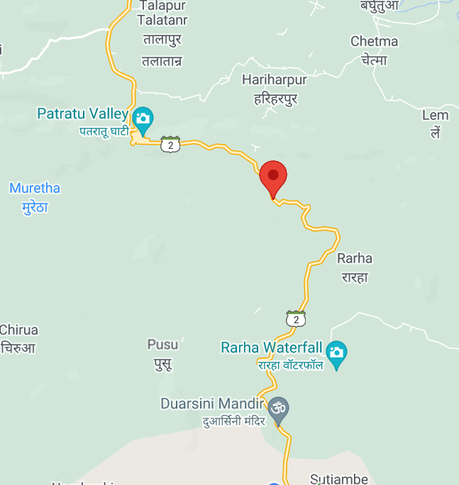
Airtel SRVCC to UTRAN:

Slide 21
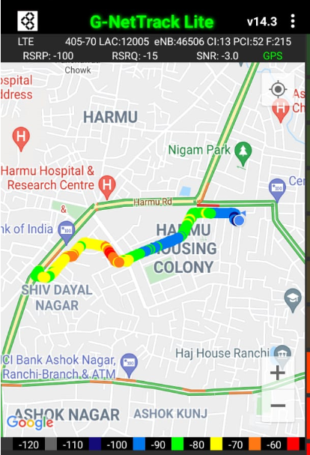
VIBand 3<>1 Handover
Iteration | operator | SIM | Date Time | Lat,Lng | PCI/PSC | Band | Freq. | SignalSIG(Type)
1 | Vodafone | SimOne | Fri Jun 18 08:36:56 India Standard Time 2021 | 23.355268333333335,85.30017166666667 | 9 | L3 | 1351 | -83(LTE)
2 | Vodafone | SimOne | Fri Jun 18 08:53:47 India Standard Time 2021 | 23.35525,85.300185 | 9 | L1 | 215 | -85(LTE)

Slide 22
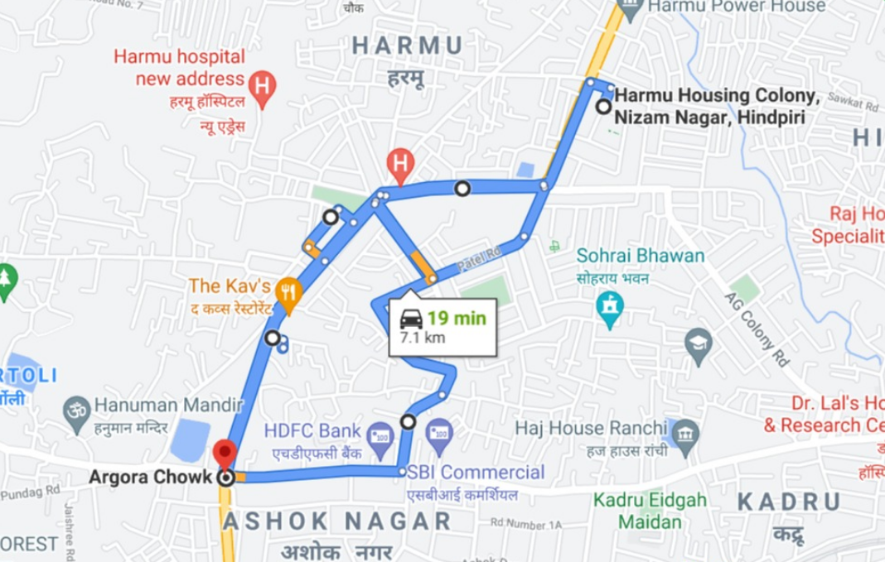
OverallDrive Route

Slide 23
THANK YOU
MARQUIS TECHNOLOGIES

