Slide 1
MARQUIS TECHNOLOGIES
Drive Route

Slide 2
(Location Ludhiana)
Country | India
Continent | Asia
City | Ludhiana
Time Zone | 12:00

Slide 3
Ludhiana/India
Operators in Location
MCC | MNC | Operator
405 | 02 | Airtel
405 | 867 | Jio
404 | 14 | VI
S. No. | Operator |  | Supported Bands | Supported Features by Network
1 | Major | Airtel | LTE FDD B1/B3/B5/B8/N78 & TDD B40 | VoWiFi/VoLTE/4G/2G/5G
2 |  | JIO | LTE FDD B3/B5/N78 & TDD B40 | VoWiFi/VoLTE/4G/5G
3 |  | VI | LTE FDD B1/B3/B8 & TDD B41 | VoWiFi/VoLTE/4G/2G/
4 | Minor | BSNL | LTE FDD B1 | VoLTE/3G/2G

Slide 4
Drive Route operator
Near Cell :-Stationary: RSRP: -60dbm to -75dbm
Mixed :-Mobility: RSRP : -75dbm to -95dbm
Cell Edge :-Stationary: RSRP : -95dbm to -115dbm

Slide 5
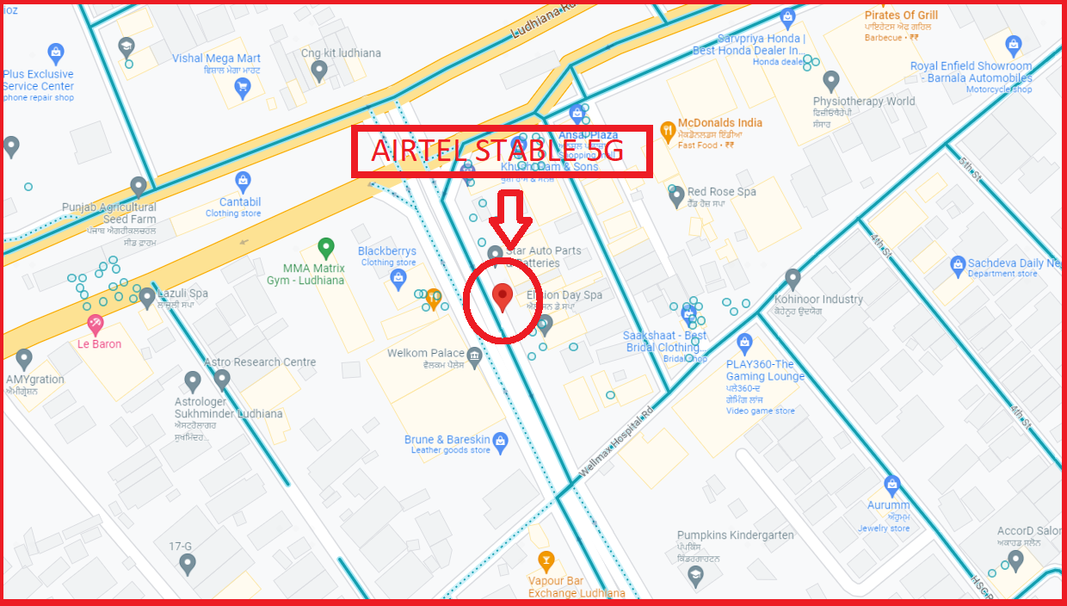
5G Near Cell,Airtel
Lat/Long -30.897269° N, 75.820776° E
Specification –Stable Airtel 5G NSA network, Good Throughput

Slide 6
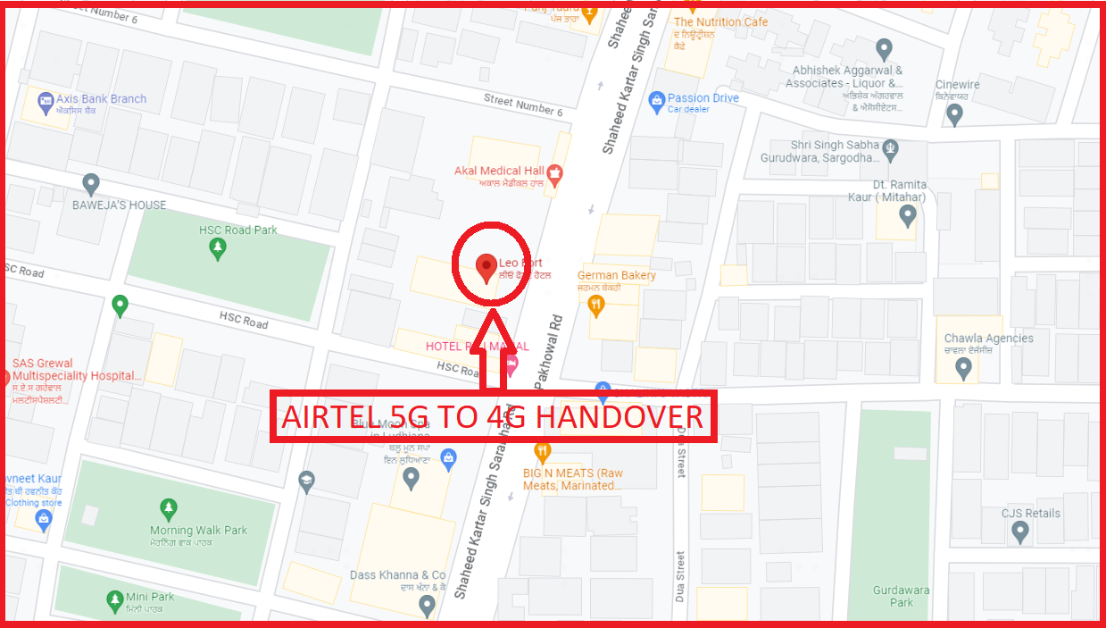
NR to LTE Handover ,Airtel
Lat. 30.894198 & Long. 75.829420 to Location –Near Leo Fort Hotel Ludhiana Specification –Band Handover ,Weak coverage

Slide 7
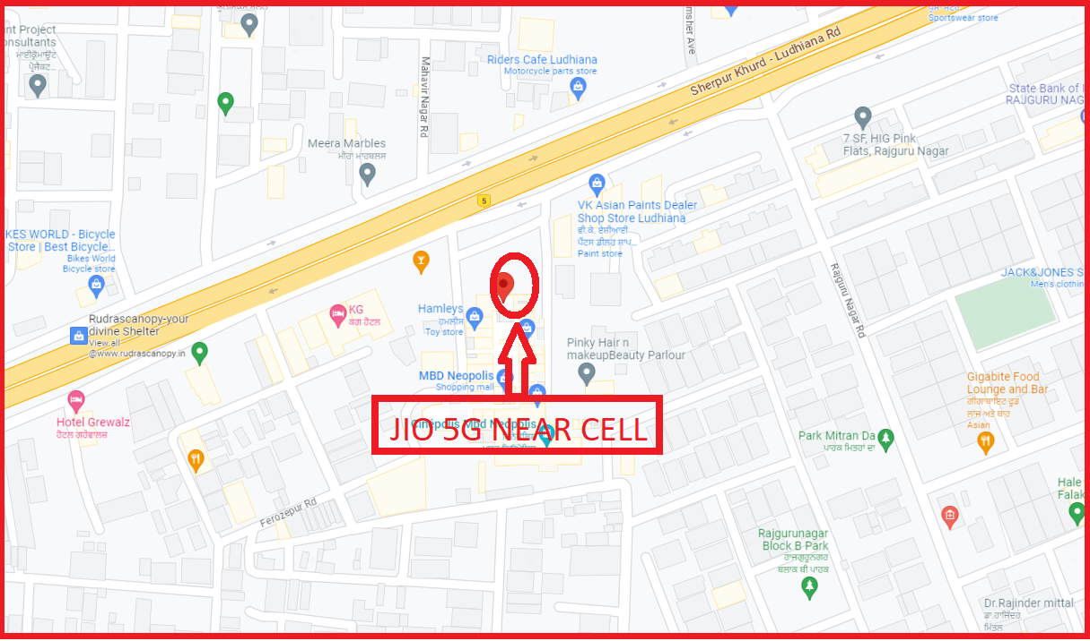
5G NR Near Cell, JIO
Lat/Long -30.883387° N, 75.781708° E
Specification –Stable JIO 5G SA network, Good Throughput

Slide 8
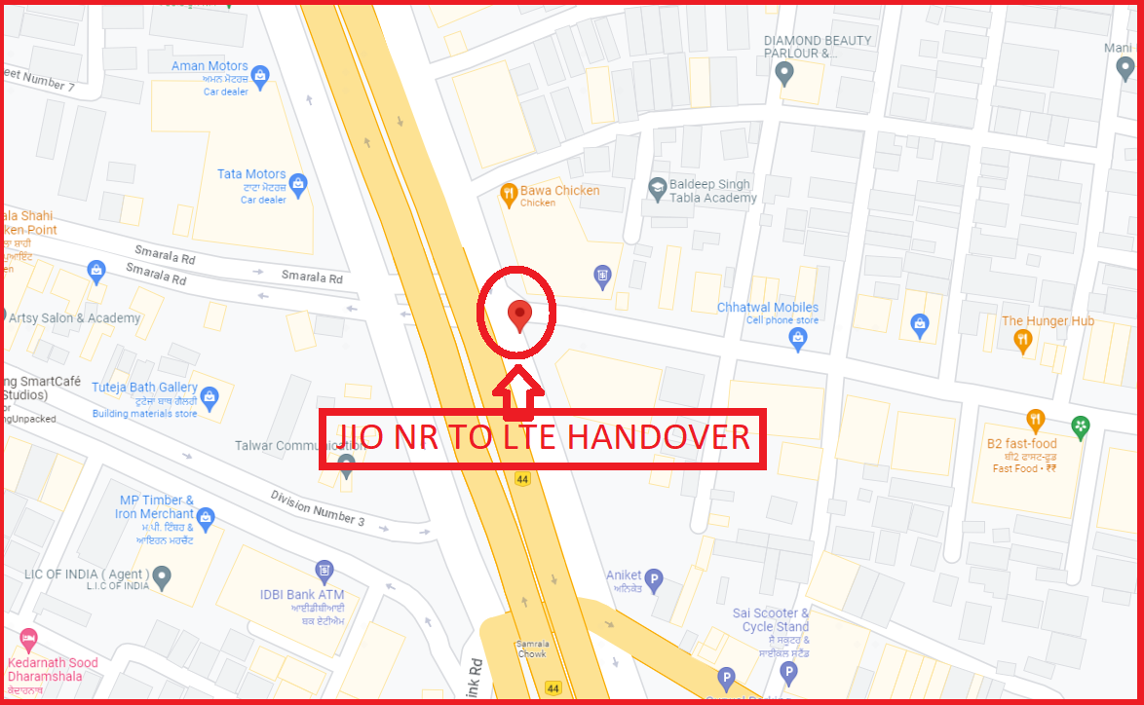
NR To LTE Handover, Jio
Lat. 30.911773 & Long. 75.879296 to Lat. 30.910283 & Long. 75.881642

Slide 9
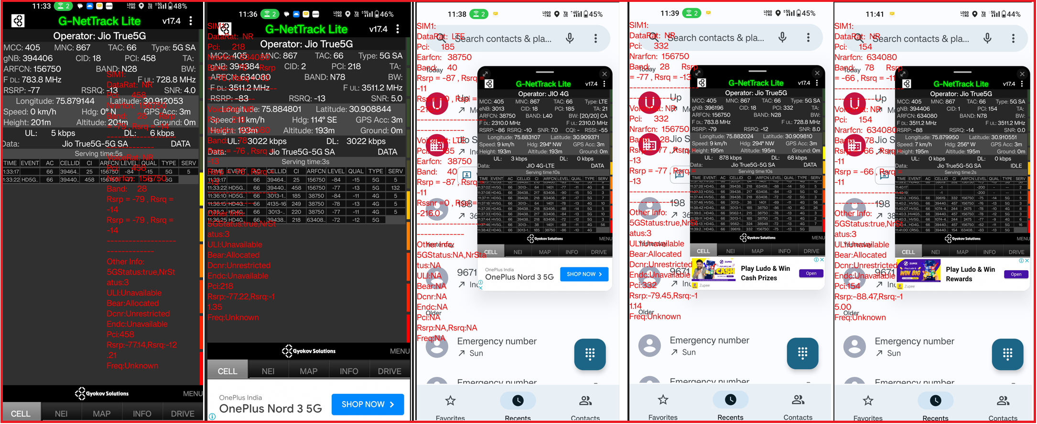
Inter-Freq HO on NR ,JIO (N78-N28-N78)
Lat. 30.910551 & Long. 75.879950 to
Lat. 30.912053 & Long. 75.879144 Location – Chandigarh Rd, Karam Colony, Beantpura, Guru Arjan Dev Nagar, Ludhiana, Punjab 141008
(Jagrati Apartment, Pocket A3)

Slide 10
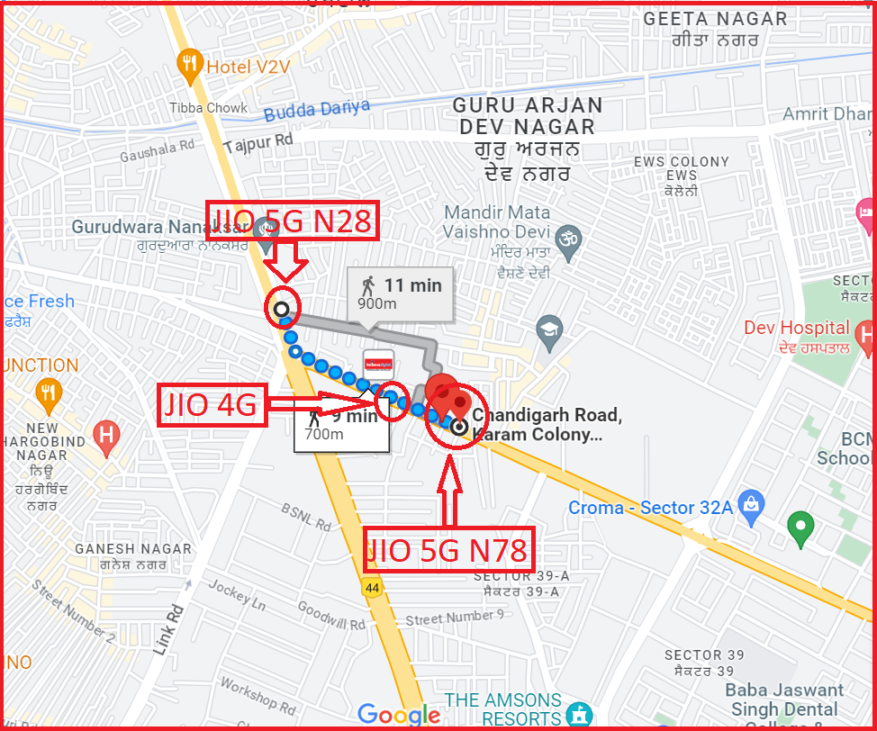
Inter-freq HO on NR ,JIO (n78-n28-n78)
Lat. 30.910551 & Long. 75.879950 to
Lat. 30.912053 & Long. 75.879144 Location – Chandigarh Rd, Karam Colony, Beantpura, Guru Arjan Dev Nagar, Ludhiana, Punjab 141008

Slide 11
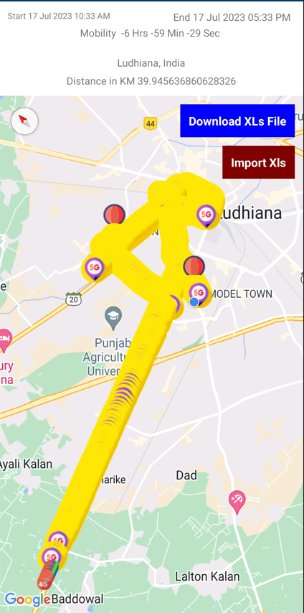
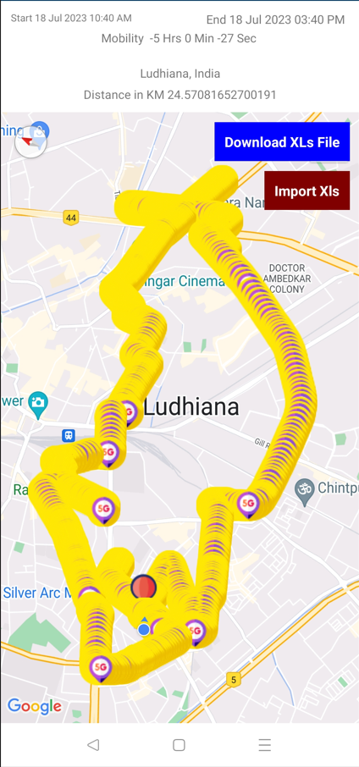
DRIVE ROUTE

Slide 12
THANK YOU
MARQUIS TECHNOLOGIES
www.marquistech.com

