Slide 1
MARQUIS TECHNOLOGIES
Drive Route

Slide 2
Delhi/India
Operator Details:
S. No. | Operator |  | Supported Bands | Supported Features by Network
1 | Major | T-Mobile | Band 2(1900 Mhz), Band 4 (1700 Mhz), Band 12(700 Mhz), 66(2100Mhz), 71 | VoLTE /VoWiFi/ 5G / 4G / 3G/ 2G
2 |  | AT&T | Band 2(1900 Mhz), Band 4 (1700 Mhz) Band 5(850 Mhz), Band 12(700Mhz) ,Band 17 (700 Mhz) | VoLTE / 5G / 4G
3 |  | Verizon | Band 2(1900MHz), Band 5(850MHz), Band 4 (1700-2100MHz) | VoLTE / 5G / 4G

Slide 3
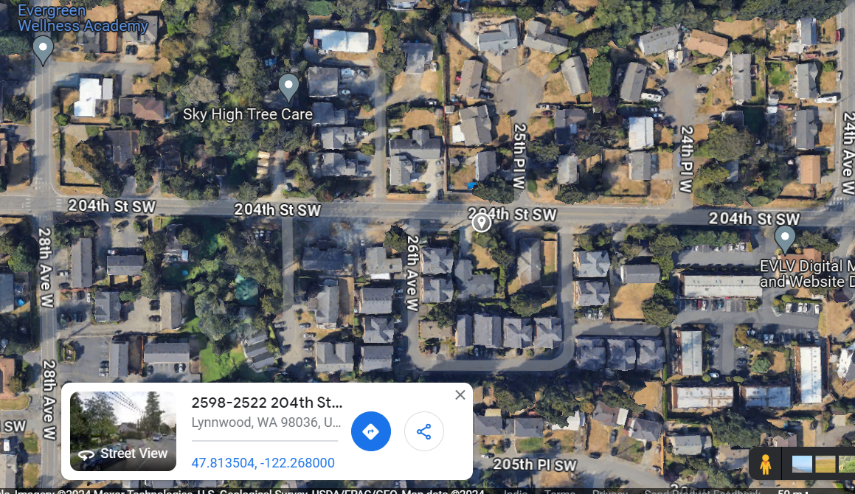
TMO 5G Near Cell
Lat/Long 47°48'48.8"N 122°16'04.8"W
Specification – T-Mobile 5G SA network

Slide 4
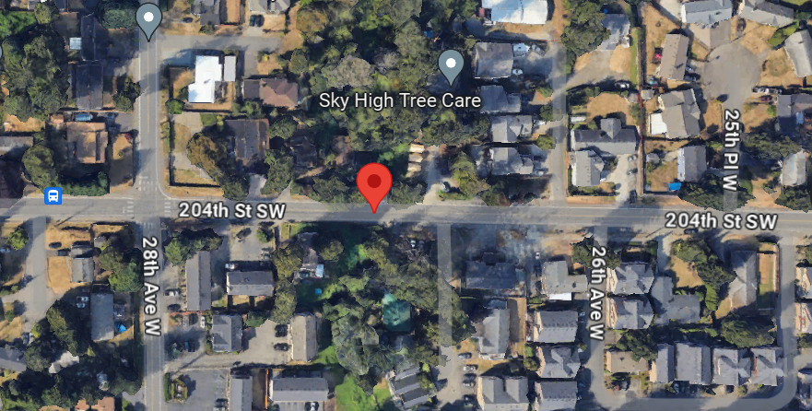
NR to LTE Handover TMO
Lat. 47°48'48.9"N 122°16'10.9"W Specification –Band Handover

Slide 5
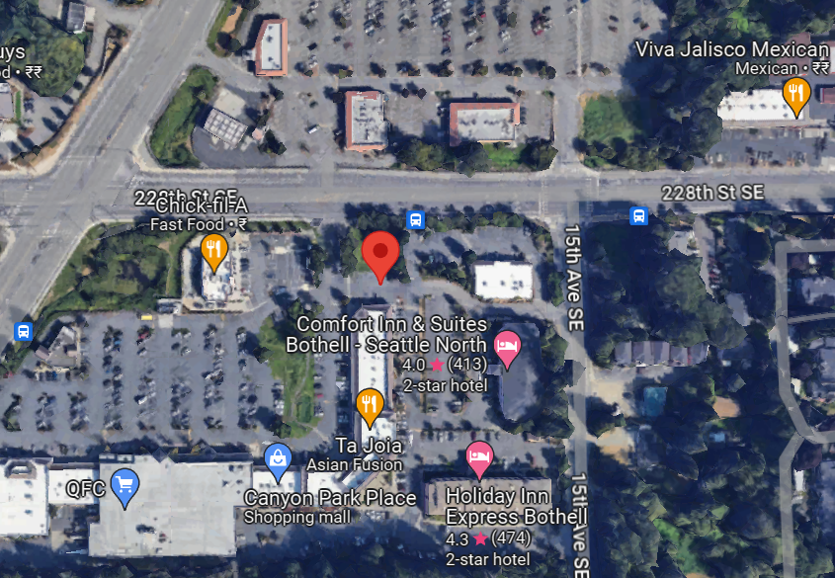
Verizon 5G near cell
Lat. 47°47'27.2"N 122°12'52.2"W

Slide 6
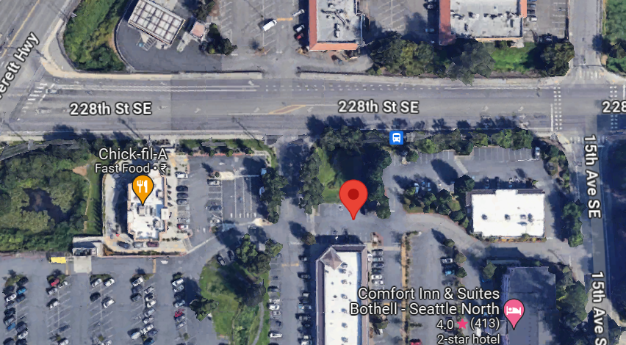
AT&T 5G NEAR CELL 47°47'27.2"N 122°12'52.2"W

Slide 7
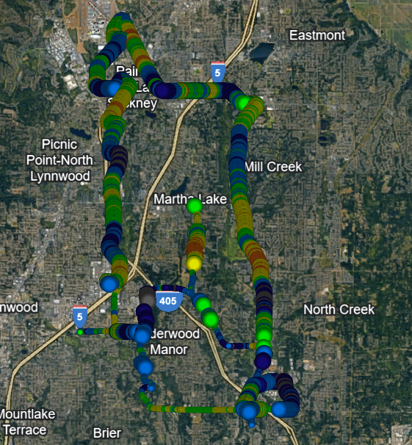
DRIVE ROUTE

Slide 8
THANK YOU
MARQUIS TECHNOLOGIES
www.marquistech.com

