Slide 1
MARQUIS TECHNOLOGIES
Drive Route

Slide 2
Istanbul/Turkey
Operator Details:
S. No. | Operator |  | Network
1 | Major | Vodafone | Volte/4G/3G/2G
2 |  | Turkcell | Volte/4G/3G/2G
3 |  | Turk Telekom | Volte/4G/3G/2G

Slide 3
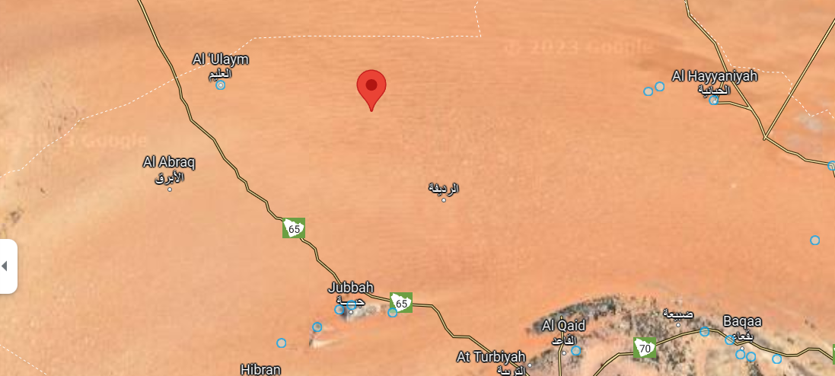
4G Near Cell,TELEKOM
Lat/Long -28.680977/° 41.016338

Slide 4
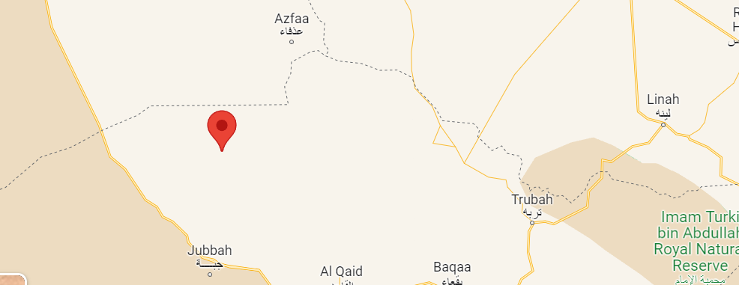
4G Near Cell,Vodafone
Lat/Long -28.683299/° 41.015644

Slide 5
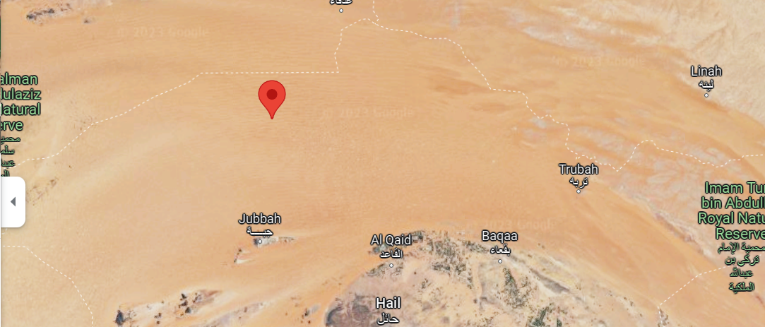
4G NEAR CELL TURKCELL
Lat/Long -28.681122/° 41.016682

Slide 6
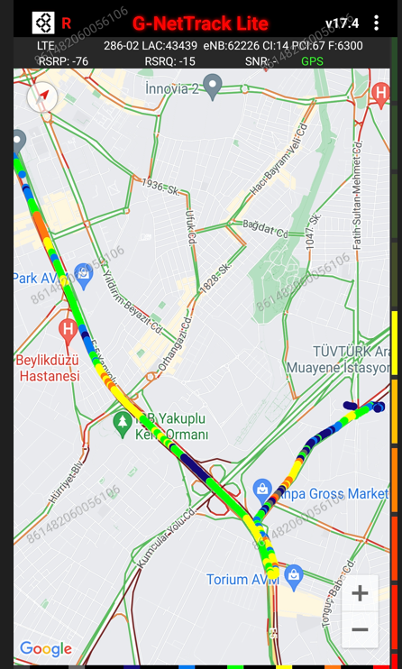
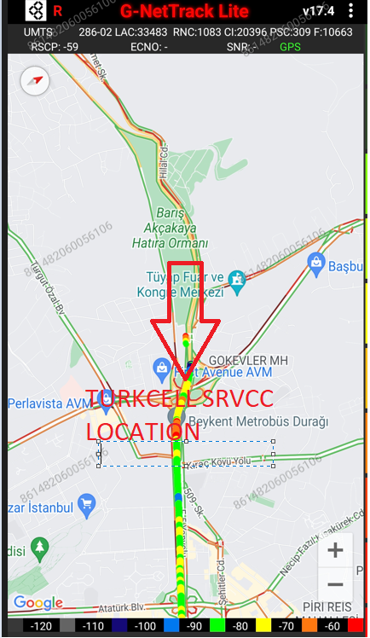
SRVCC location drive route Turkcell -
Lat/Long -28.624826/41.022637

Slide 7
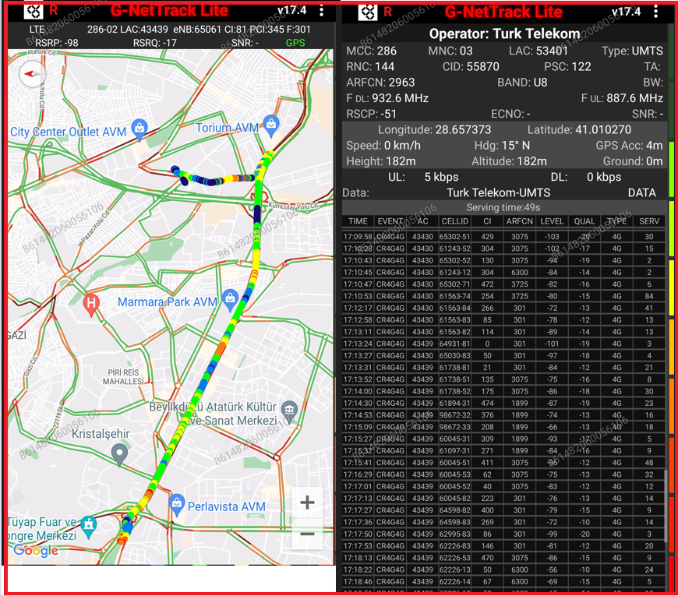
SRVCC location TELEKOM
Lat. 28.657373° N, Long 41.010270

Slide 8
THANK YOU
MARQUIS TECHNOLOGIES
www.marquistech.com

