Slide 1
MARQUIS TECHNOLOGIES
Drive Route –Airtel, VI & Reliance JIO

Slide 2
Operator Information:
Operator | JIO 4G
MCC | 405
MNC | 863
APN | Jionet
Operator | Airtel 4G
MCC | 404
MNC | 93
APN | Airtelgprs.com
Operator | VI
MCC | 404
MNC | 78
APN | internet
Operator | BSNL
MCC | 404
MNC | 58
APN | bsnlnet

Slide 3
Operator Information 1
Functionality | Airtel
Website: http://www.airtel.com WAP APN: airtelgprs.com
Customer care | 121
MNC | 93
Bands supported | Both FDD and TDD
 | LTE 2300 MHz – TDD(Band 40)
 | LTE 1800,2100– FDD(Band 3 and 1)
USSD | To check MDN: *282#
 | Balance check: *123#
 | Data Balance check: *121*114#
VoLTE/Vo-Wifi | Supported
CSFB | Supported (CSFB to 2G)

Slide 4
Operator Information 2
Functionality | RELIANCE JIO
Website: http://www.jio.com WAP APN: Jionet
Customer care | 198
MNC | 863
Bands supported | Both FDD and TDD
 | LTE 2300 MHz –TDD(Band 40)
 | LTE 850 MHz – FDD(Band 5)
 | LTE 1800 MHz –FDD(Band 3)
USSD | NA
 | NA
 | NA
VoLTE/Vo-Wifi | Supported
CSFB | Not Supported

Slide 5
Operator Information 3
Functionality | VI
Website: http://www.myvi.in WAP APN: internet
Customer care | 198
MNC | 78
Bands supported | Both FDD and TDD
 | LTE 2300 MHz –TDD(Band 40,41)
 | LTE 1800 MHz –FDD(Band 3)
USSD | To check MDN *199#
 | Recharge *199*5#
 | All Balance Chk: *199*2*1#
VoLTE/VoWifi | Supported / Not Support
CSFB | Supported

Slide 6
Drive Route
Near Cell :- Stationary: RSRP : -65dbm to -75dbm
Cell Edge :- Stationary: RSRP : -95dbm to -110dbm
Mixed :- Mobility: RSRP : -65dbm to -110dbm

Slide 7
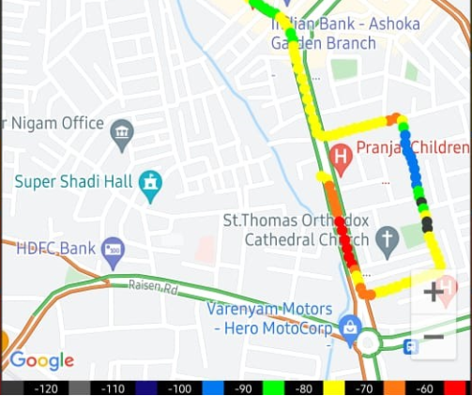
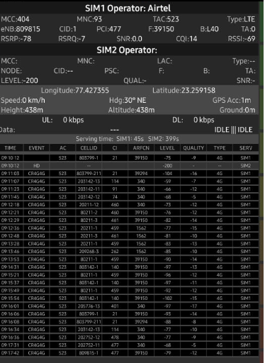
Airtel Network Parameters :Near Cell
Near cell(NC) | longitude | latitude | RSRP | PCI | FDD E-ARFCN
1 | 77.427355 | 23.259158 | -70 | 477 | 39150
RSRP: -65dbm to -75dbm

Slide 8
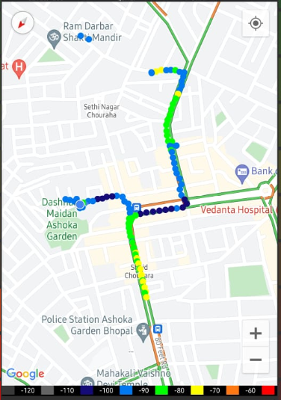
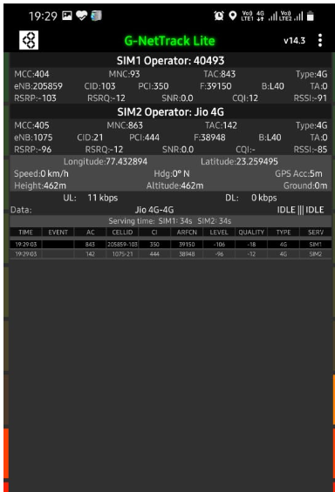
Edge Cell (Airtel):
Near cell(NC) | longitude | latitude | RSRP | PCI | FDD E-ARFCN
1 | 77.432894 | 23.259495 | -103 | 350 | 39150
RSRP: -95dbm to -110dbm

Slide 9
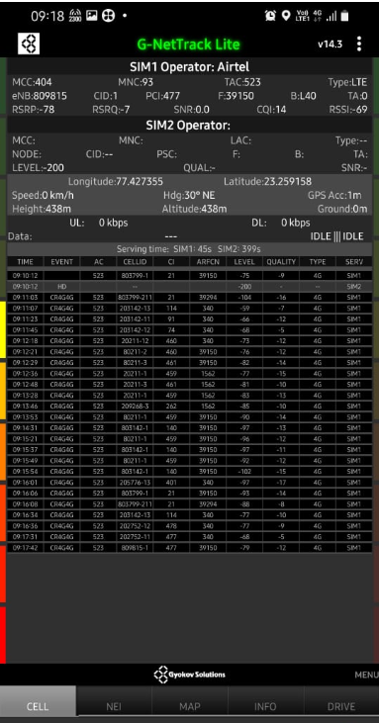
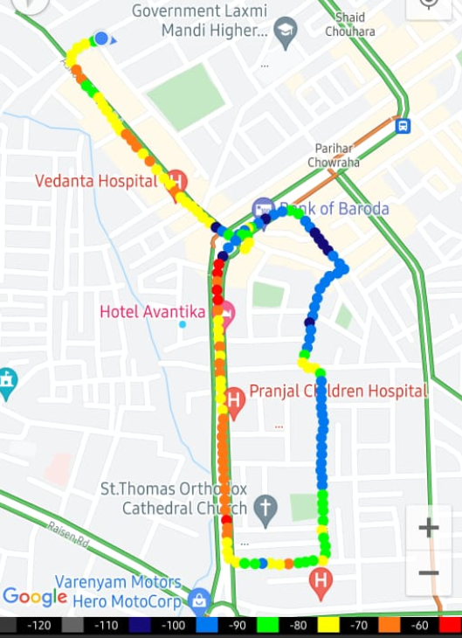
Mixed Mobility Airtel:
RSRP: -65dbm to -110dbm
New Ashoka Garden Area, Bhopal ,M.P

Slide 10
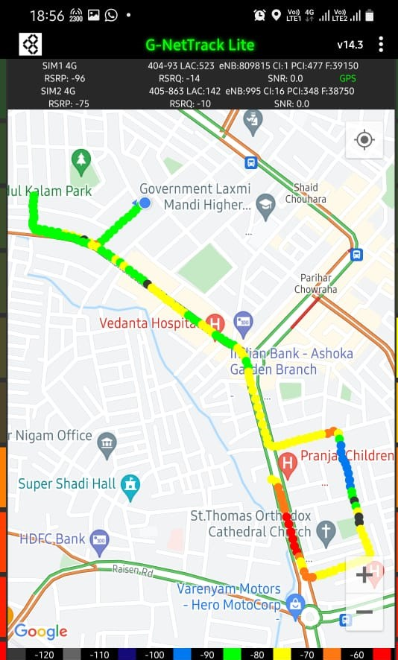
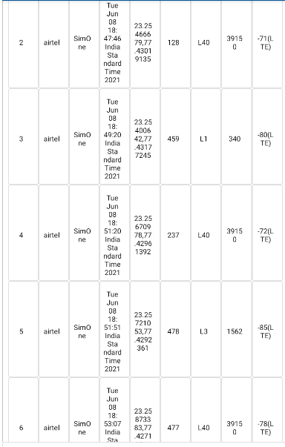
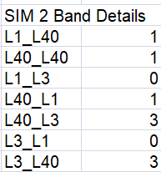
Airtel Inter-Band HO:
No of Band Handovers | longitude | Latitude | RSRP
9 | 77.425543 | 23.263715 | -75 to -105 dBM

Slide 11
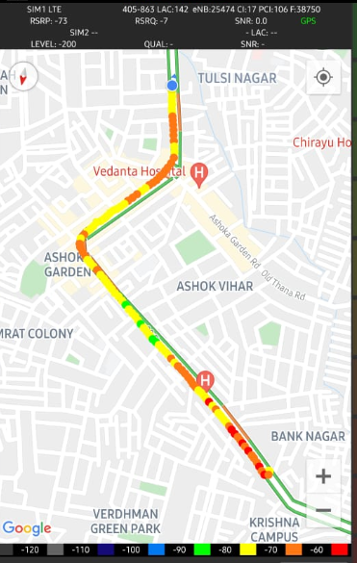
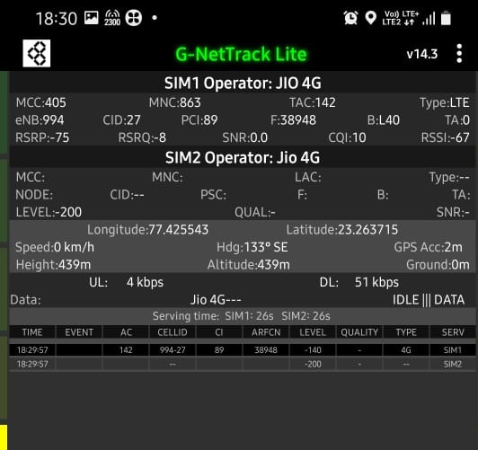
Jio Network Parameters Near Cell:
Near cell(NC) | longitude | latitude | RSRP | PCI | FDD E-ARFCN
1 | 77.425543 | 23.263715 | -75 | 89 | 38948
RSRP: -65dbm to -75dbm

Slide 12
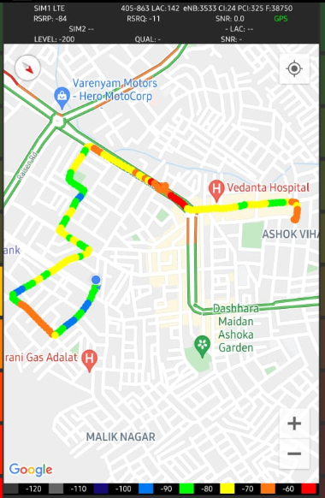
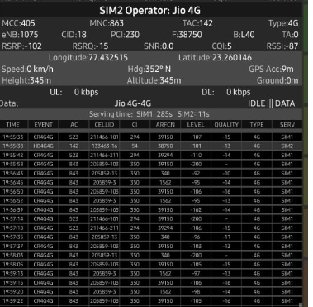
Edge Cell (Reliance JIO)
Near cell(NC) | longitude | latitude | RSRP | PCI | FDD E-ARFCN
1 | 77.432515 | 23.260146 | -102 | 230 | 38750
RSRP: -95dbm to -110dbm

Slide 13
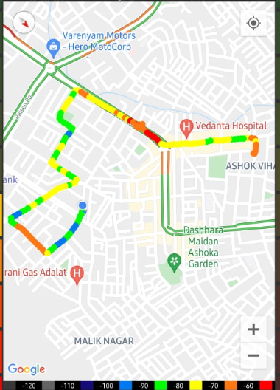
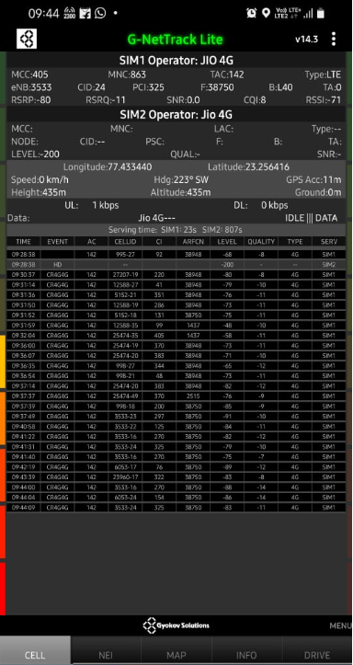
Mixed Mobility Jio:- Bhopal,M.P
RSRP: -65dbm to -110dbm

Slide 14
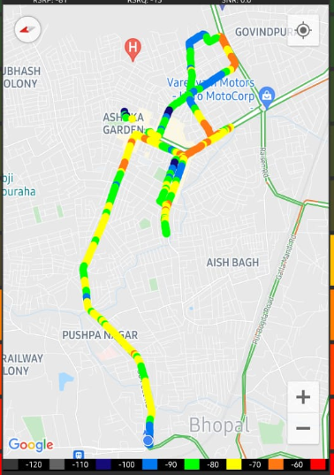
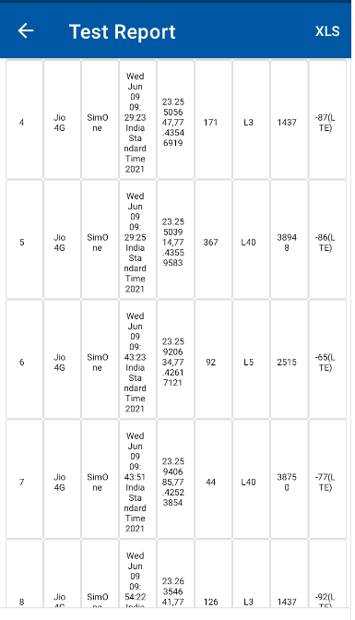
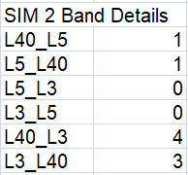
Jio Inter-Band HO:
Band Handover | longitude | latitude | RSRP | PCI | TDD E-ARFCN
9 | 77.425543 | 23.263715 | -75 | 89 | 38948

Slide 15
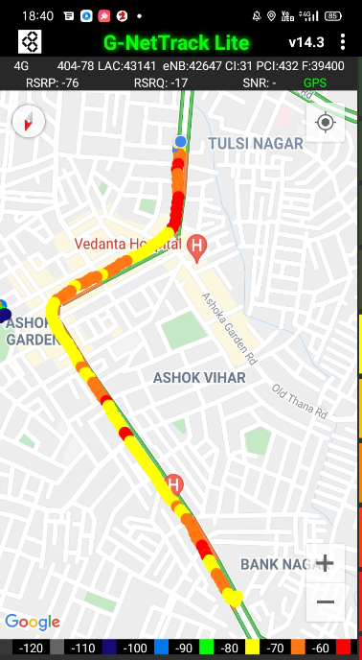
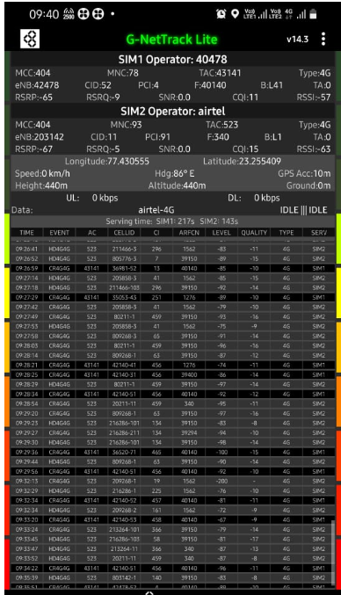
VI Network Parameters Near Cell:
Near cell(NC) | longitude | latitude | RSRP | PCI | FDD E-ARFCN
1 | 77.430555 | 23.255409 | -65 | 4 | 40140
RSRP: -65dbm to -75dbm

Slide 16
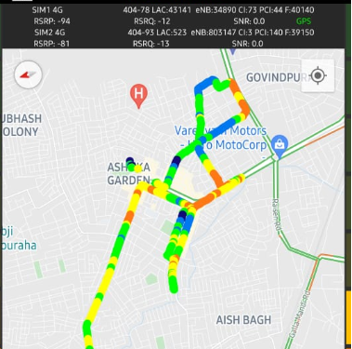
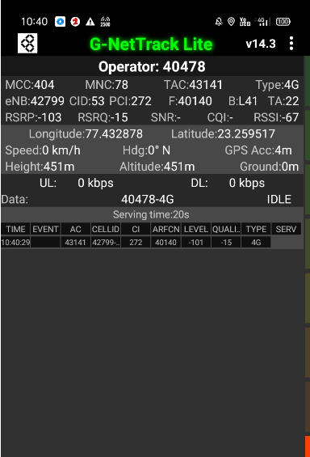
Cell Edge VI:
Near cell(NC) | longitude | latitude | RSRP | PCI | FDD E-ARFCN
1 | 77.432878 | 23.259517 | -103 | 272 | 40140
RSRP: -95dbm to -105dbm

Slide 17
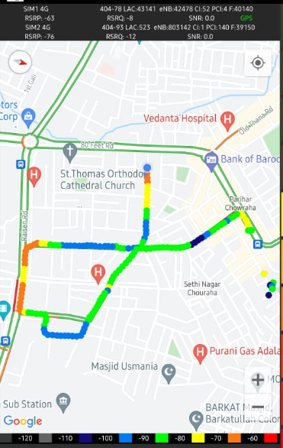
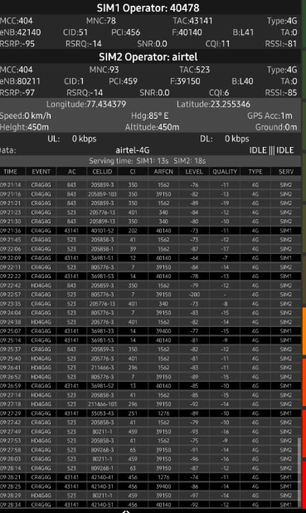
Mixed coverage area Vodafone:
RSRP: -65dbm to -110dbm

Slide 18
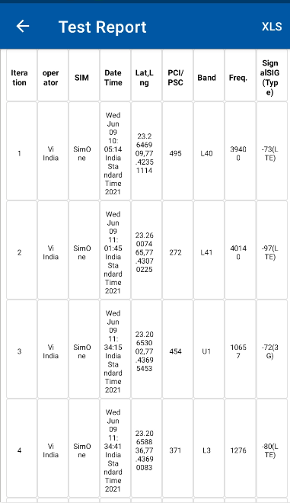
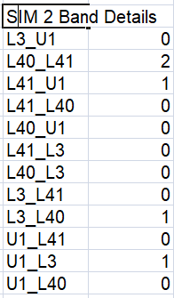
VI Inter-Band HO:
Band Handover | longitude | latitude | RSRP | PCI | TDD E-ARFCN
5 | 77.434379 | 23.255346 | -63 | 459 | 39150

Slide 19
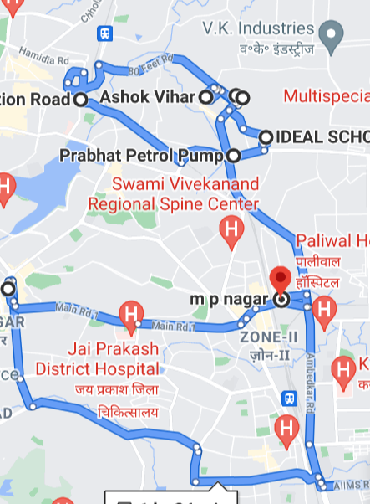
Drive Route

Slide 20
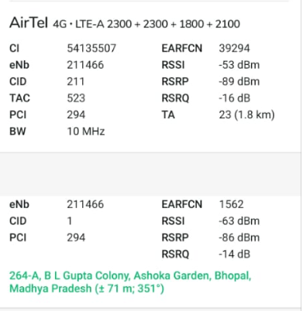
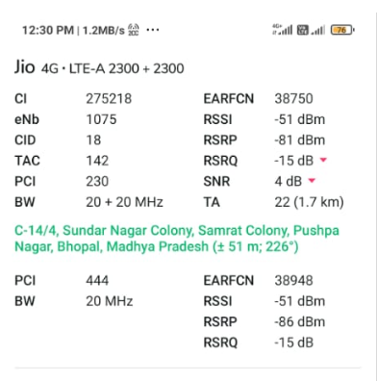
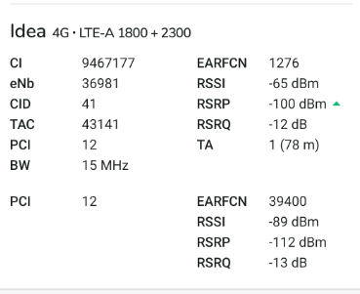
CA Combinations:
Airtel Operator

Slide 21
THANK YOU
MARQUIS TECHNOLOGIES

