Slide 1
MARQUIS TECHNOLOGIES
Drive Route- Bratislava/ Slovakia

Slide 2
Travel to Slovakia (Bratislava City)
Country | Slovakia
Continent | Europe
City | Bratislava
Time Zone | GMT +02 Central European Time

Slide 3
Operators in Slovakia:
MCC | MNC | Operator
231 | 02/04 | T-Mobile
231 | 01 | Orange
231 | 06 | O2
T-Mobile Network Info1
RAT | Band | Comment
5G | N1 (15 MHz) | NSA
4G | B3 (1800 +), B7 (2600), B20 (800 DD)
3G | B1 (2100)
2G | 900 (E-GSM), 1800 (DCS)
Orange Network Info
RAT | Band | Comment
5G | N78 (60 MHz) | NSA
4G | B7 (2600), B20 (800 DD)
3G | B1 (2100)
2G | 900 (E-GSM), 1800 (DCS)
O2 Network Info
RAT | Band | Comment
5G | N28 (10 MHz) , N78 (110 MHz) | NSA
4G | B3 (1800 +), B20 (800 DD)
3G | B1 2100 MHz
2G | 900 Mhz

Slide 4
Operators and general Information
T-Mobile- Supports 5G,LTE, VoLTE, WCDMA and 2G
Orange- Supports 5G, LTE, VoLTE ,VoWifi, WCDMA and 2G
O2- Supports 5G , LTE, VoLTE, VoWiFi, WCDMA and 2G

Slide 5
RSRP Criteria
Near Cell :-Stationary: RSRP : -65dbm to -85dbm
Cell Edge :-Stationary: RSRP : -95dbm to -110dbm
Mixed :-Mobility: RSRP : -65dbm to -120dbm

Slide 6
Operator | Mobility Scenario | Location Tested | Longitude / Latitude
T-Mobile | 4G-3G-4G HO SPOT | No Location Found | NA
 | SRVCC to 3G/2G | Most SNP 1, 851 01 Petržalka | 48.1368956,17.1024094
 | IRAT | No Location Found | NA
 | Good Coverage for Testing | Viedenská cesta, Petržalka | 48.1349271,17.0990097
 | Poor Coverage for testing | Sky Park Bratislava, Jurkovičova Tepláreň | 48.1390041,17.0980103
 | OOS Area | No Location Found | NA
Orange | 4G-3G-4G HO SPOT | No Location Found | NA
 | SRVCC to 3G/2G | VIVO Mall, Vajnorská 10645/100, 831 04 Bratislava | 48.1686645,17.1365012
 | IRAT | No Location Found | NA
 | Good Coverage for Testing | Shell Petrol pump, Panónska cesta, Petržalka | 48.1190742,17.0972165
 | Poor Coverage for testing | Pasienky, Trnavská, Bratislava | 48.1648759,17.1353173
 | OOS Area | No Location Found | NA
O2 | 4G-3G-4G HO SPOT | No Location Found | NA
 | SRVCC to 3G/2G | VIVO Mall, Vajnorská 10645/100, 831 04 Bratislava | 48.1686645,17.1365012
 | IRAT | No Location Found | NA
 | Good Coverage for Testing | OXICO, Panónska cesta, Petržalka, | 48.1219119,17.0988628
 | Poor Coverage for testing | Pasienky, Trnavská, Bratislava | 48.1648759,17.1353173
 | OOS Area | No Location Found | NA

Slide 7
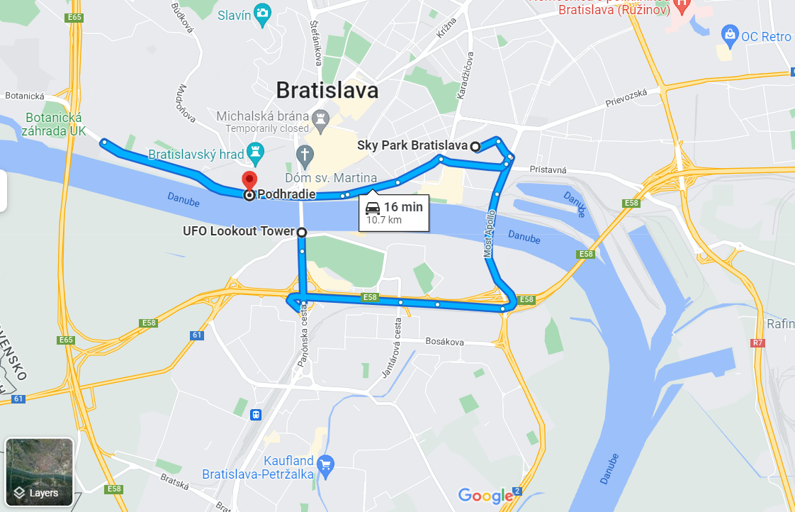
G-4G HO SPOT
SRVCC to 3G
4G-3G-4G HO SPOT, SRVCC-3G/2G (T-Mobile):
Route: UFO Lookout Tower>> Sky Park Bratislava>> Podhradie
RSRP: -100dbm to -125dbm Lat & Long: 48.1368956,17.1024094

Slide 8
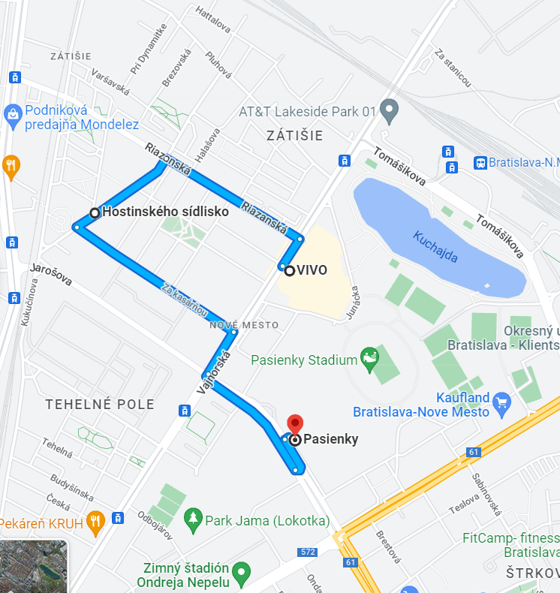
G
4G-34G HO SPOT
SRVCC to 3G
4G-3G-4G HO SPOT, SRVCC-3G/2G (Orange & O2):
to 3G
Route: VIVO (Vajnorská) >> Hostinského sídlisko >>Pasienky
RSRP: -100dbm to -125dbm Lat & Long: 48.1686645,17.1365012

Slide 9
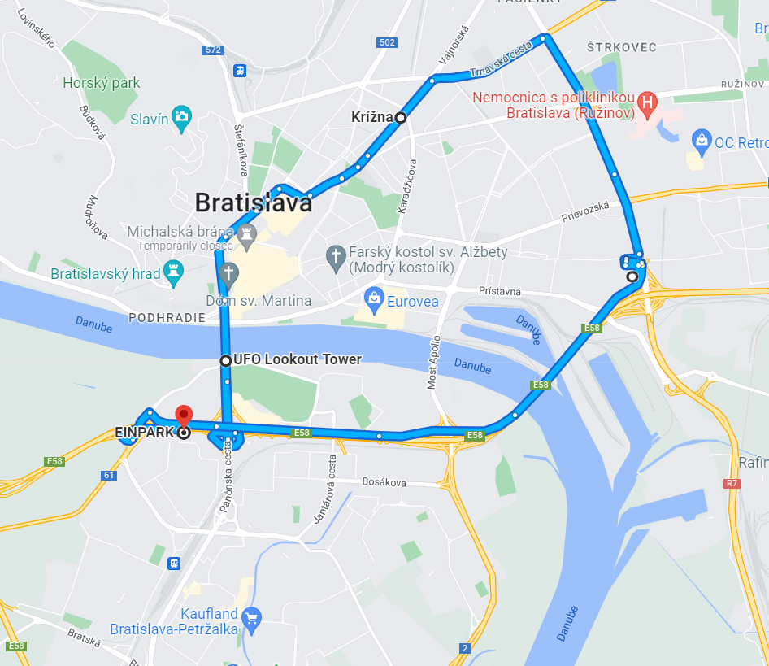
5G T-Mobile Drive Route
Route: Most SNP>> Krížna>> Ružinov>> Bajkalská>> EINPARK (Petržalka).
RSRP: -65dbm to -110dbm Lat & Long: 48.1314797,17.0976981

Slide 10
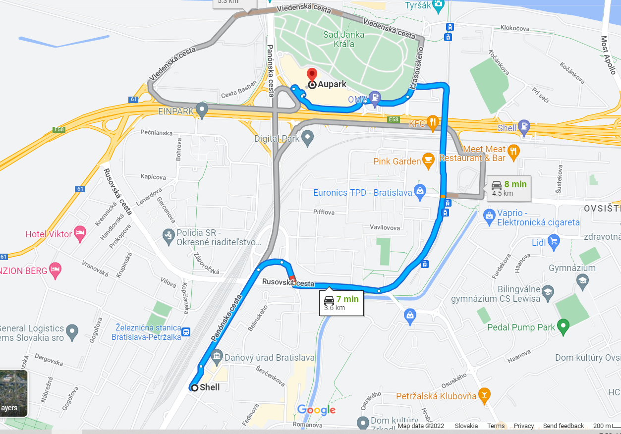
5G Orange Drive Route
Route: Panónska cesta >>Petržalka >> Aupark >>Einsteinova
RSRP: -65dbm to -110dbm Lat & Long: 48.1328591,17.1054255

Slide 11
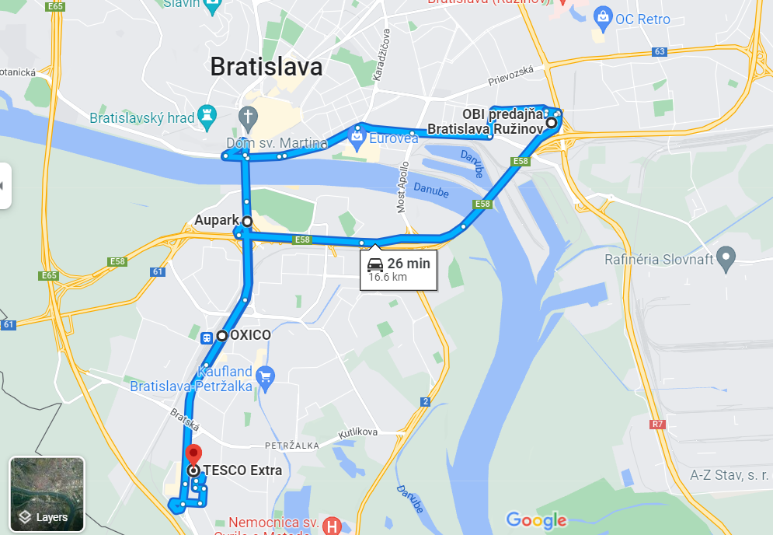
5G O2 Drive Route
Route: OXICO>> Panónska cesta >> Aupark>> Ružinov>> TESCO Extra (Panónska cesta)
RSRP: -80dbm to -110dbm Long/Lat: 48.1219119,17.0988628

Slide 12
THANK YOU
MARQUIS TECHNOLOGIES
www.marquistech.com

