Slide 1
MARQUIS TECHNOLOGIES
Drive Route- Phnom Penh, Cambodia

Slide 2
Country | Cambodia
Continent | APAC
City | Phnom Penh
Time Zone | GMT +7 hour
Currency | KHR
International Dialing Code | +855

Slide 3
Operators in Cambodia
MCC | MNC | Operator
456 | 06 | Smart
456 | 11 | Seatel
456 | 08 | Metfone
Smart Network Info
RAT | Band | Comment
5G | NA | Not supported
4G | Band 1 (2100 MHz), Band 3 (1800 MHz)
3G | B1(2100MHz)
2G | 900Mhz, 1800MHz

Slide 4
Seatel Network Info
RAT | Band | Comment
5G | NA | Not supported
4G | Band 5 (850 MHz)
3G | NA
2G | NA
Metfone Network Info
RAT | Band | Comment
5G | NA | Not supported
4G | B3(1800MHz), Band 5(850MHz), Band7 (2600MHz)
3G | B1 (2100MHz)
2G | 900Mhz, 1800MHz

Slide 5
Operators and General Information
Smart- Supports VoLTE, LTE, WCDMA and 2G only
Seatel- Supports VoLTE and LTE only
Metfone- Supports VoLTE and LTE , WCDMA and 2G only

Slide 6
USSD codes for balance check
Smart balance check: *123#
Seatel balance check: NA
Metfone balance check: *097#

Slide 7

Supplementary Services
Smart: Call forwarding and Call Waiting supported
Seatel: NA
Metfone: Call Waiting supported

Slide 8
RSRP Criteria
Near Cell :-Stationary: RSRP : -65dbm to -85dbm
Cell Edge :-Stationary: RSRP : -95dbm to -110dbm
Mixed :-Mobility: RSRP : -65dbm to -120dbm

Slide 9
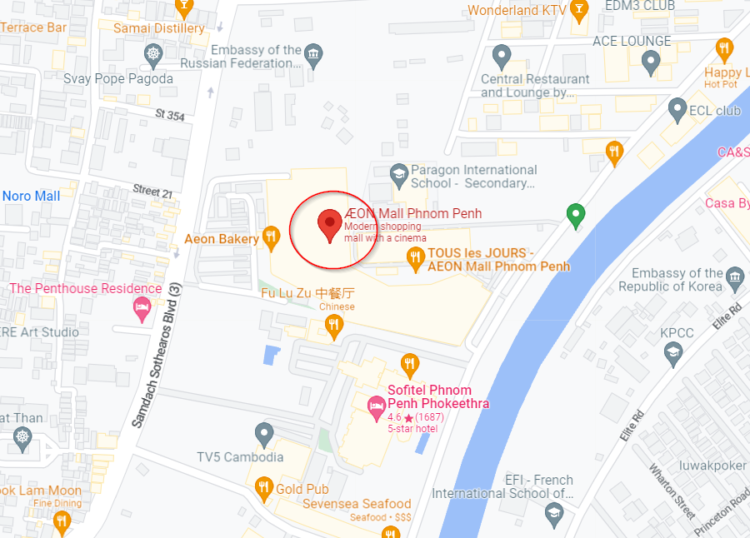
4G Near Cell (Smart, Seatel, Metfone):

Slide 10
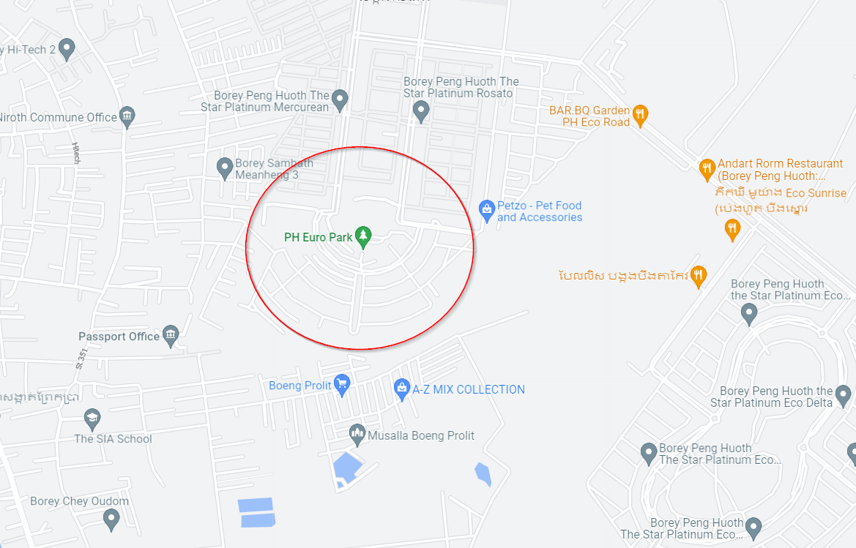
Edge Cell(Smart, Seatel, Metfone):

Slide 11
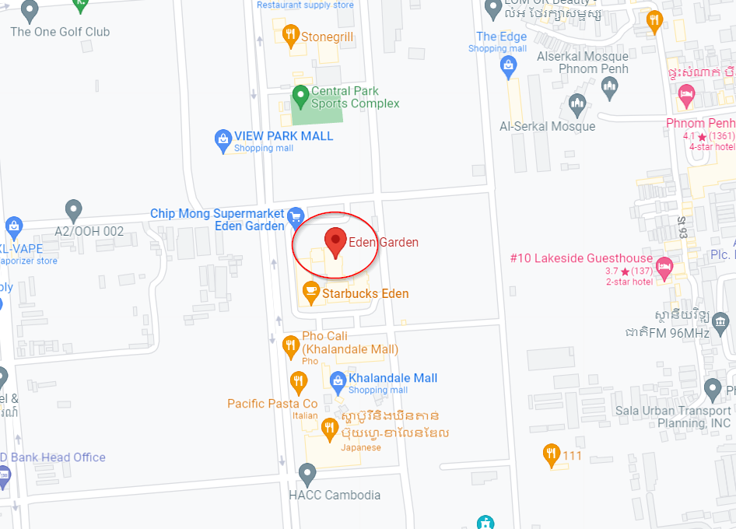
Near cell Smart 4G VoLTE Coverage:

Slide 12
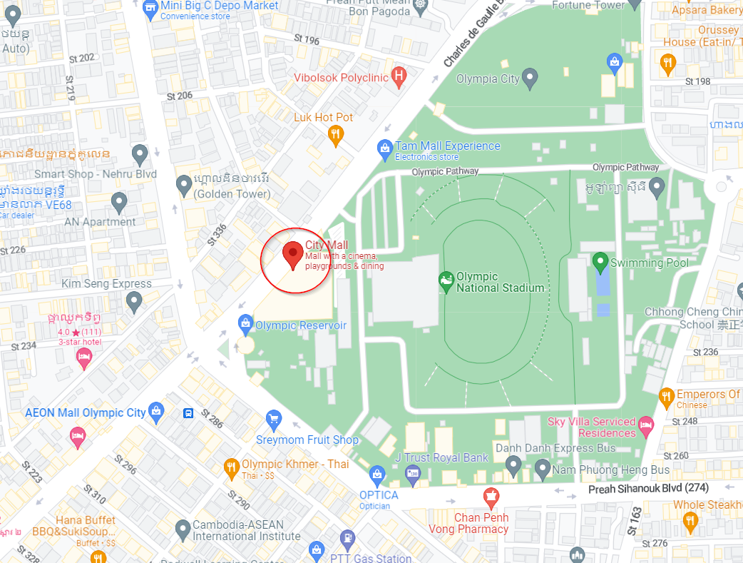
Near cell Seatel 4G VoLTE Coverage:

Slide 13
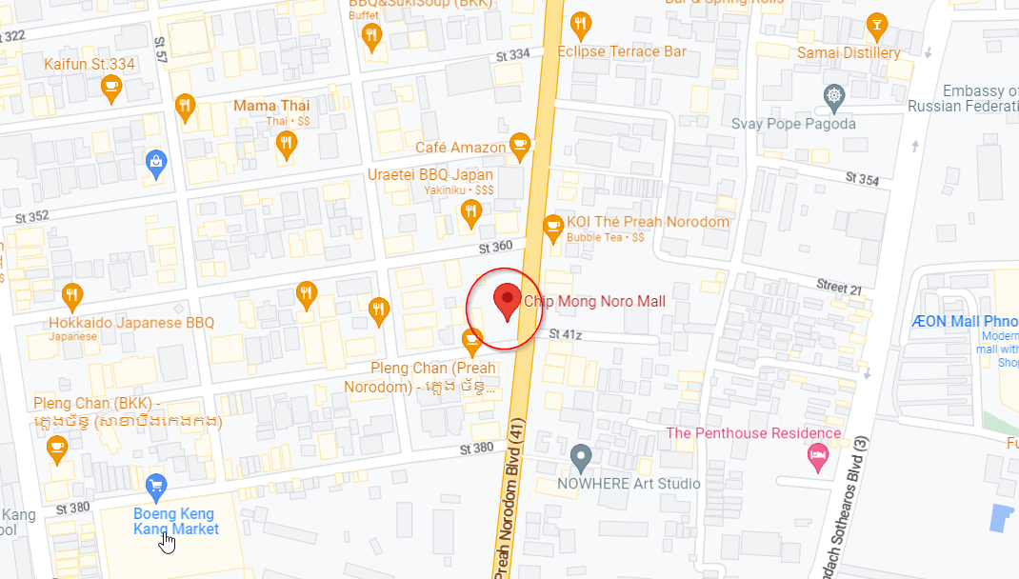
Near cell Metfone 4G VoLTE Coverage:

Slide 14
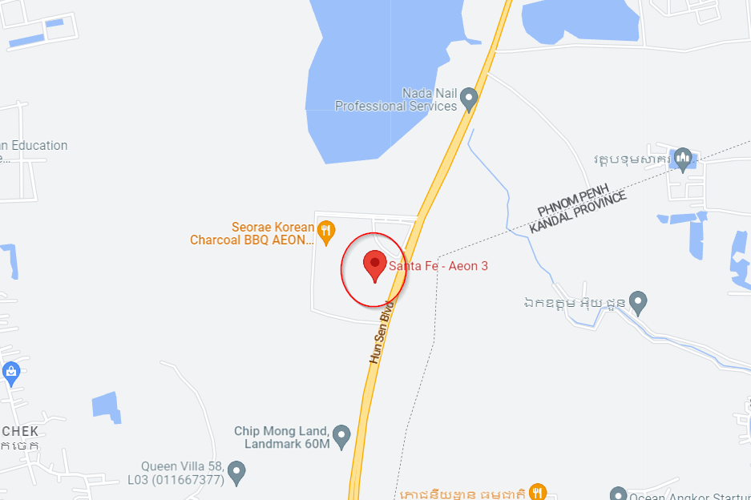
Smart 4G to 3G & 3G to 4G:

Slide 15
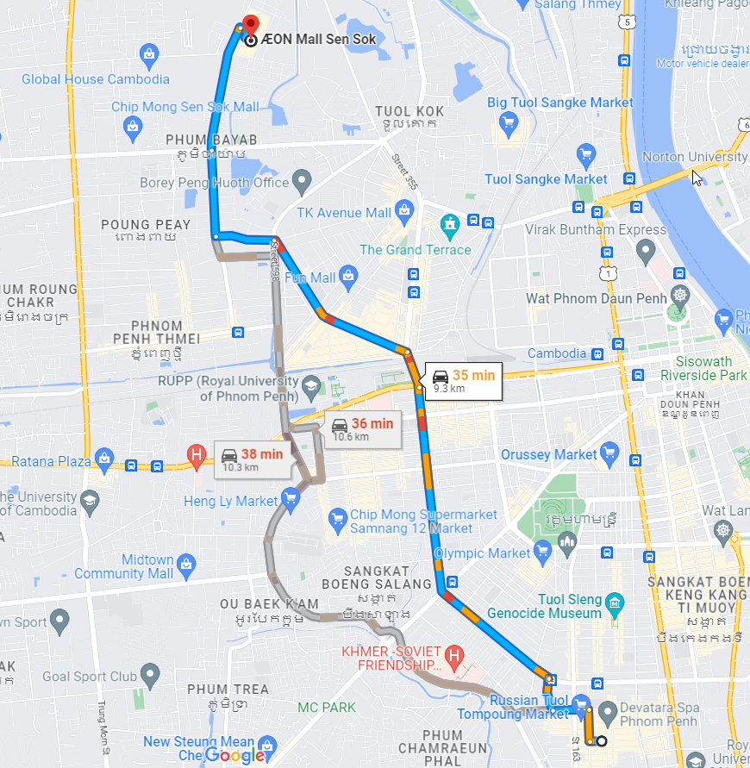
Metfone 4G to 3G & 3G to 4G:
Drive from st 456 to St 598 to street #1003

Slide 16
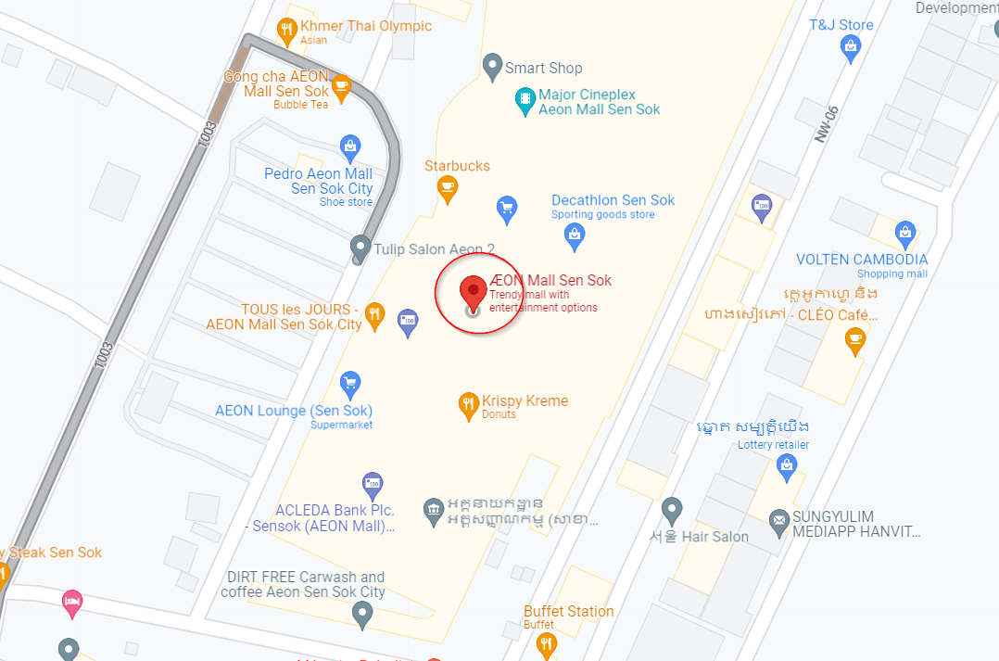
Smart 4G Handover inside Aeon Mall

Slide 17
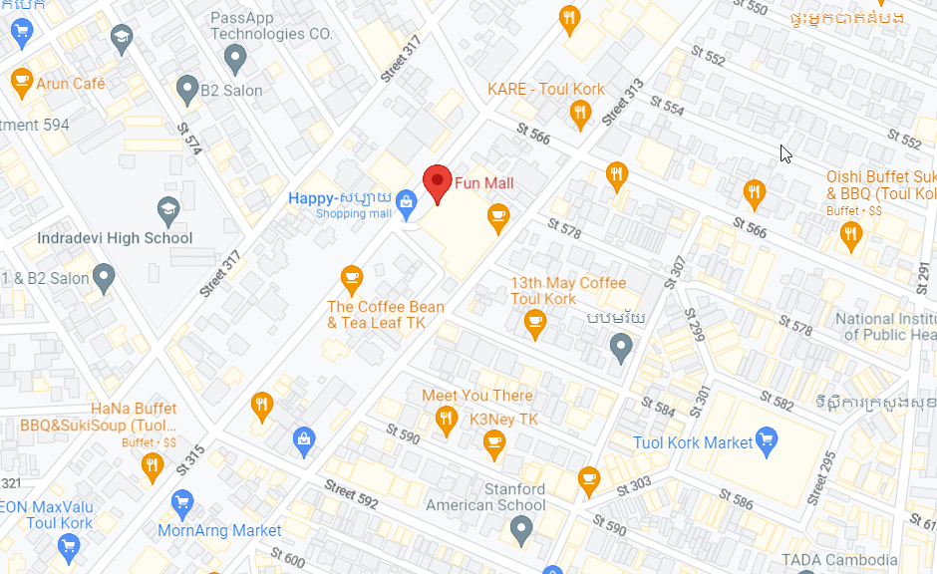
Metfone 4G Handover
Drive route: Toul Tompoung >> Mao Tse Tong Blvd. >>Yothapol khemarak Blvd. >> Jawaharlal Nehru Blvd

Slide 18
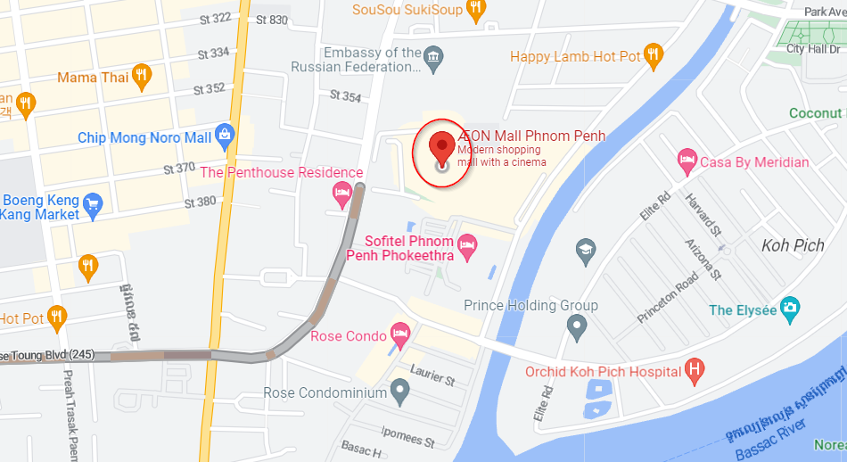
Smart, Seatel & Metfone 4G Area without fluctuation:

Slide 19
THANK YOU
MARQUIS TECHNOLOGIES
www.marquistech.com

