Slide 1
MARQUIS TECHNOLOGIES
Drive Route- Budapest/ Hungary

Slide 2
Travel to Johannesburg (South Africa)
Country | Hungary
Continent | Europe
City | Budapest
Time Zone | Budapest, Hungary (GMT+2)

Slide 3
Operators in South Africa:
MCC | MNC | Operator
216 | 30 | Telekom HU
216 | 01 | Telenor HU
216 | 70 | Vodafone HU
216 | 03 | DIGI HU
Telekom Network Info
RAT | Band | Comment
5G | N77 | NSA
4G | Band 3, Band 7,Band 20
3G | U1
2G | 900 / 1800MHz
Telenor Network Info
RAT | Band | Comment
5G | N77 | NSA
4G | Band 3, Band 20
3G | U1, U8
2G | 900, 1800Mhz
Vodafone Network Info1
RAT | Band | Comment
5G | N77 | NSA
4G | Band 7, band 20
3G | U1, U8
2G | 900 / 1800MHz
DIGI Network Info
RAT | Band | Comment
5G | N77 | NSA
4G | Band 3, Band 1
3G | NA | Not supported
2G | 900 / 1800MHz

Slide 4
Operators and general Information
Telekom HU- Supports 5G,LTE, VoLTE, VoWifi , WCDMA and 2G
Telenor HU- Supports 5G, LTE, VoLTE, WCDMA and 2G
Vodafone HU- Supports 5G, LTE, VoLTE, WCDMA and 2G
DIGI HU- Supports 5G , LTE, VoLTE, VoWIFI, and 2G

Slide 5
RSRP Criteria
Near Cell :-Stationary: RSRP : -65dbm to -85dbm
Cell Edge :-Stationary: RSRP : -95dbm to -110dbm
Mixed :-Mobility: RSRP : -65dbm to -120dbm

Slide 6
Operator | Mobility Scenario | Location Tested | Latitude/ Longitude
Telekom HU | 4G-3G-4G HO SPOT | Astoria > Blaha > Keleti | 47.494257, 19.060247
 | SRVCC to 3G/2G | Location not found | NA
 | IRAT | Astoria > Blaha > Keleti | 47.492892, 19.059967
 | Good Coverage for Testing | Astoria > Blaha > Keleti | 47.494257, 19.060247
 | Poor Coverage for testing | Astoria > Blaha > Keleti | 47.492892, 19.059967
 | OOS Area | Astoria > Blaha > Keleti | 47.492894, 19.059970
Telenor HU | 4G-3G-4G HO SPOT | Astoria > Blaha > Keleti | 47.494257, 19.060247
 | SRVCC to 3G/2G | Location not found | NA
 | IRAT | Astoria > Blaha > Keleti | 47.492892, 19.059967
 | Good Coverage for Testing | Astoria > Blaha > Keleti | 47.494257, 19.060247
 | Poor Coverage for testing | Astoria > Blaha > Keleti | 47.492892, 19.059967
 | OOS Area | Astoria > Blaha > Keleti | 47.492880, 19.059963
Vodafone HU | 4G-3G-4G HO SPOT | Astoria > Blaha > Keleti | 47.494257, 19.060247
 | SRVCC to 3G/2G | Location not found | NA
 | IRAT | Astoria > Blaha > Keleti | 47.492892, 19.059967
 | Good Coverage for Testing | Astoria > Blaha > Keleti | 47.494257, 19.060247
 | Poor Coverage for testing | Astoria > Blaha > Keleti | 47.492892, 19.059967
 | OOS Area | Astoria > Blaha > Keleti | 47.492892, 19.059970
DIGI HU | 4G-3G-4G HO SPOT | Astoria > Blaha > Keleti | NA(Testing was only done for Vowifi on DIGI)
 | SRVCC to 3G/2G | Location not found | NA(Testing was only done for Vowifi on DIGI)
 | IRAT | Astoria > Blaha > Keleti | NA(Testing was only done for Vowifi on DIGI)
 | Good Coverage for Testing | Astoria > Blaha > Keleti | NA(Testing was only done for Vowifi on DIGI)
 | Poor Coverage for testing | Astoria > Blaha > Keleti | NA(Testing was only done for Vowifi on DIGI)
 | OOS Area | Astoria > Blaha > Keleti | NA(Testing was only done for Vowifi on DIGI)

Slide 7
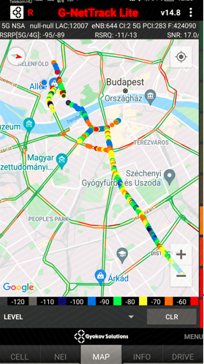
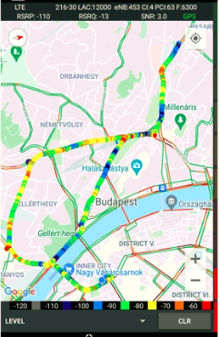
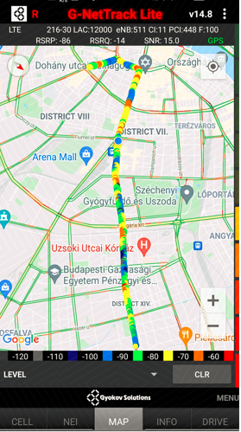
4G-3G-4G HO SPOT SRVCC to 3G NSA, 4G,3G,2G, HO SPOT
to 3G
Astoria > Blaha > Keleti (Telekom HU 5G)

Slide 8
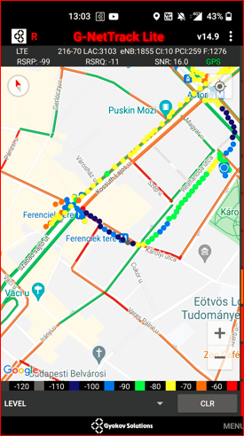
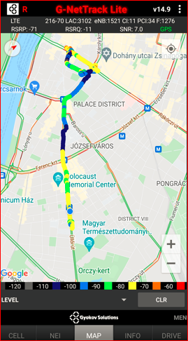
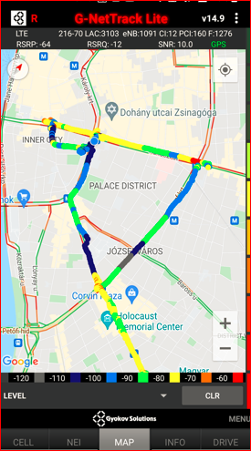
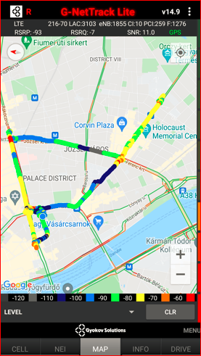
Astoria > Blaha > Keleti (Telenor HU 5G)

Slide 9
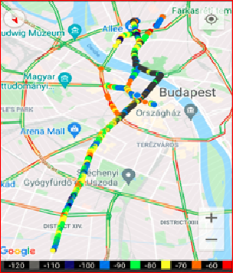
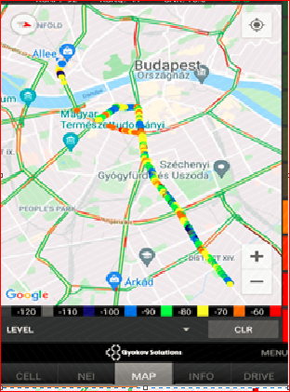
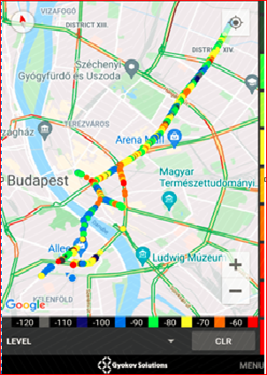
Astoria > Blaha > Keleti (Vodafone HU 5G)

Slide 10
THANK YOU
MARQUIS TECHNOLOGIES
www.marquistech.com

