Slide 1
MARQUIS TECHNOLOGIES
Drive Routes - Sri Lanka/Colombo

Slide 2
Travel to Colombo (Srilanka)
Country | Sri Lanka
Continent | Asia
City | Colombo
Time Zone | GMT +5:30 Hour
International Dialing Code | +94
VISA | On Arrival Visa
VISA Duration | 15 days, Single Entry
VISA Fees | Contact Nisha Deshpande
VISA Requirements | Need to provide 2 passport size photographs
Yellow Fever Vaccination Certificate | Not Required

Slide 3
Operators in Srilanka
MCC | MNC | Operator | Bands (MHz)
413 | 1 | Mobitel | LTE- B3, WCDMA- B1, GSM- B4
413 | 2 | Dialog | LTE- B3, WCDMA- B1, GSM- B1
413 | 5 | Airtel | WCDMA- B1, GSM- B4
413 | 8 | Hutch | LTE- B1, WCDMA-B1 , GSM- B4

Slide 4
Operators and Related Information
Dialog- Supports VoLTE, LTE, WCDMA and 2G
Mobitel- Supports VoLTE, LTE, WCDMA and 2G
Hutch- LTE, WCDMA and 2G
Airtel- WCDMA and 2G.
Mobitel support VoLTE only on few devices

Slide 5
General Info of Operators
Dialog network being the best in Sir Lanka CSFB is commendably strong just like the other operators.
Mobitel Network is to be ranked second although number of subscribers and network conditions are equally good as that of Dialog.
Hutch & Airtel service is inferior compared to other operators, but they are strengthening based on their latest implementations.

Slide 6
USSD codes for balance check
Dialog balance check: *132# or #132#
Mobitel balance check: #132#
Airtel balance check: #132#
Hutch balance check: #132#

Slide 7

Supplementary Services
Dialog: Call forwarding and Call Waiting supported
Mobitel: Call forwarding and Call Waiting supported
Hutch : Call forwarding and Call Waiting supported
Airtel: Call forwarding and Call Waiting supported

Slide 8
MCC MNC for Colombo Operators:-
MCC MNC for Dialog GSM/UMTS/LTE: 413 02
MCC MNC for Mobitel GSM/UMTS/LTE: 413 01
MCC MNC for Airtel GSM/UMTS/LTE : 413 05
MCC MNC for Hutch GSM/UMTS/LTE: 413 08

Slide 9
RSRP Criteria
Near Cell :-Stationary: RSRP : -55dbm to -85dbm
Cell Edge :-Stationary: RSRP : -95dbm to -110dbm
Mixed :-Mobility: RSRP : -55dbm to -120dbm

Slide 10
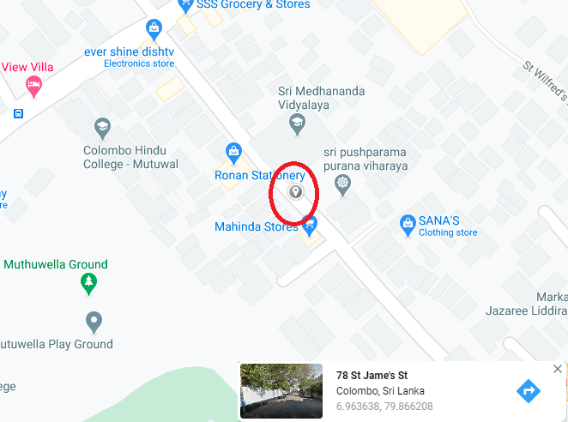
Near Cell for Dialog Operator:- St James street,Mutwal, Colombo

Slide 11
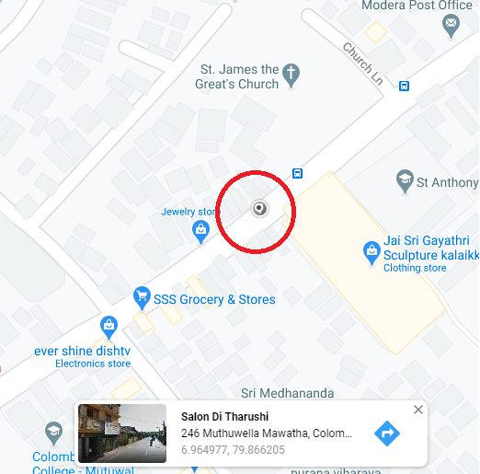
Edge Cell for Mobitel Operator:- Muthuwella Mawatha

Slide 12
Near Cell of Hutch operator: St James street,Mutwal, Colombo

Slide 13
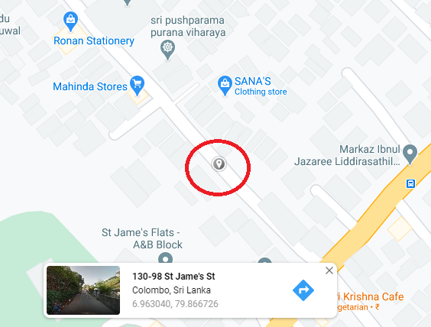
Poor Coverage of Airtel operator: 100-1A-½ Mutwal Colombo

Slide 14
Thank You

