Slide 1
MARQUIS TECHNOLOGIES
5G Drive Route of Sydney(Australia)

Slide 2
Operator Information
MCC | MNC | Operator | Bands (MHz)
505 | 01 | Telstra | LTE Band- 7/3/28, NR- N78
505 | 02 | Optus | LTE Band -1/3/7/28/40, NR N78
505 | 03 | Vodafone | LTE Band -1/3/5, NR N78,N20

Slide 3
Services Supported by Operators
Operator | Features/Services | Supports(Yes/No)
Telstra | 5G | Yes
 | VoLTE | Yes
 | VoWiFi | Yes
 | Reselection | Yes
 | Redirection | Yes
 | MMS | Yes
 | CSFB | Yes
 | PS Handover | Yes
Optus | 5G | Yes
 | VoLTE | Yes
 | VoWiFi | Yes
 | Reselection | Yes
 | Redirection | Yes
 | MMS | Yes
 | CSFB | NO
 | PS Handover | Yes
Vodafone | 5G | Yes
 | VoLTE | Yes
 | VoWiFi | Yes
 | Reselection | Yes
 | Redirection | Yes
 | MMS | Yes
 | CSFB | NO
 | PS Handover | Yes

Slide 4
RSRP Criteria
Near Cell :-Stationary: RSRP : -55dbM to -75dbm
Cell Edge :-Stationary: RSRP : -90dbM to -105dbM
Mixed :-Mobility: RSRP : -55dbM to -120dbM

Slide 5
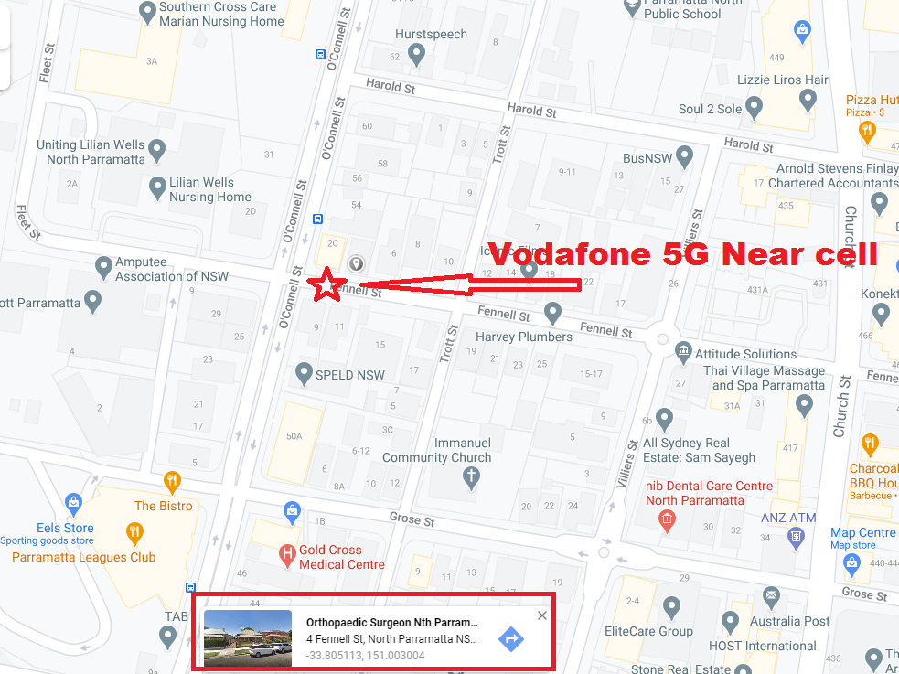
Vodafone 5G N78 Good Coverage : Near 4 Fennell St, North Parramatta, Sydney 2151.

Slide 6
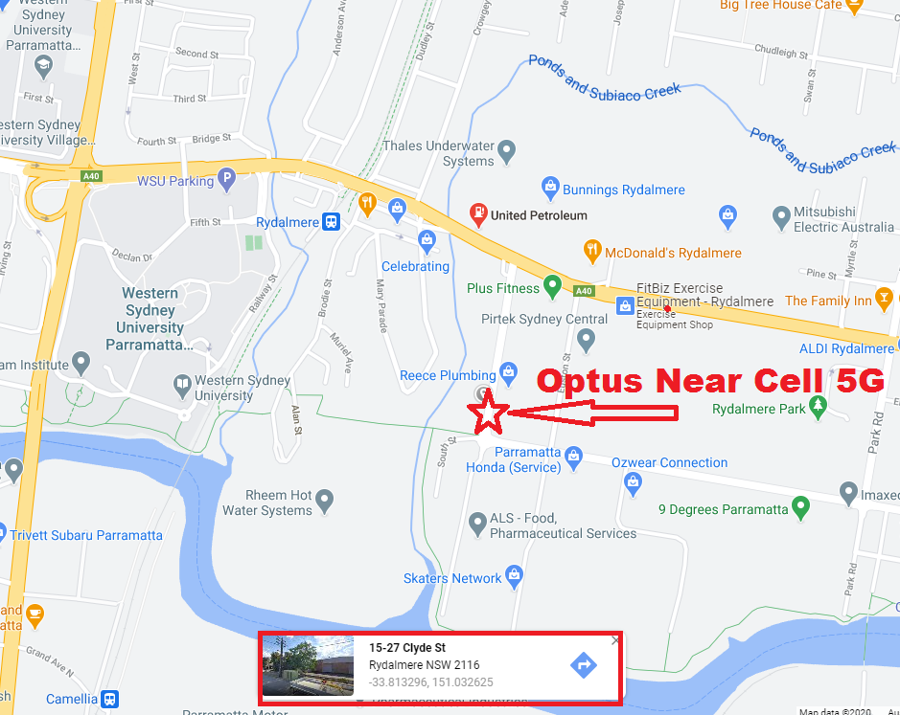
Optus 5G N78 Good Coverage : 15 Clyde St, Rydalmere, NSW-2116.

Slide 7
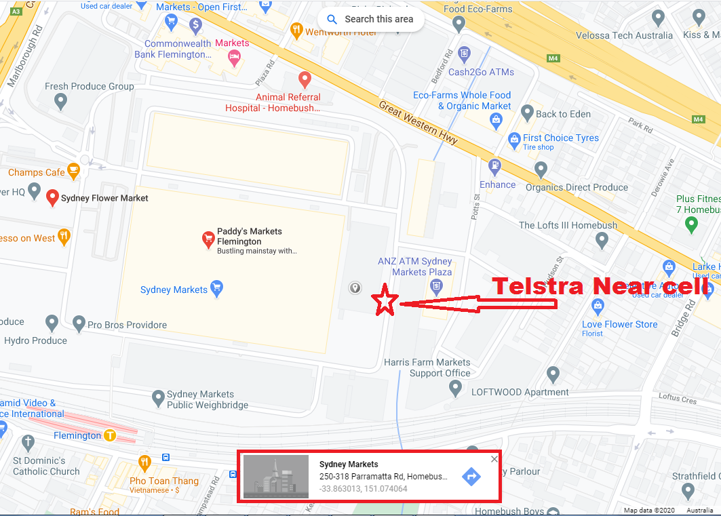
Telstra 5G N78 Good Coverage : Inside Flemengtion Market Parking, West Homebush, Sydney:-

Slide 8
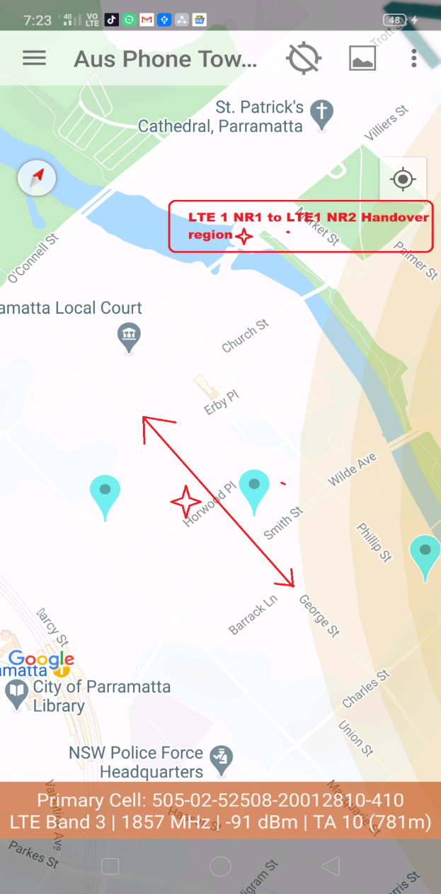
Optus- Handover: LTE#1+NR#1 → LTE#1+NR#2

Slide 9
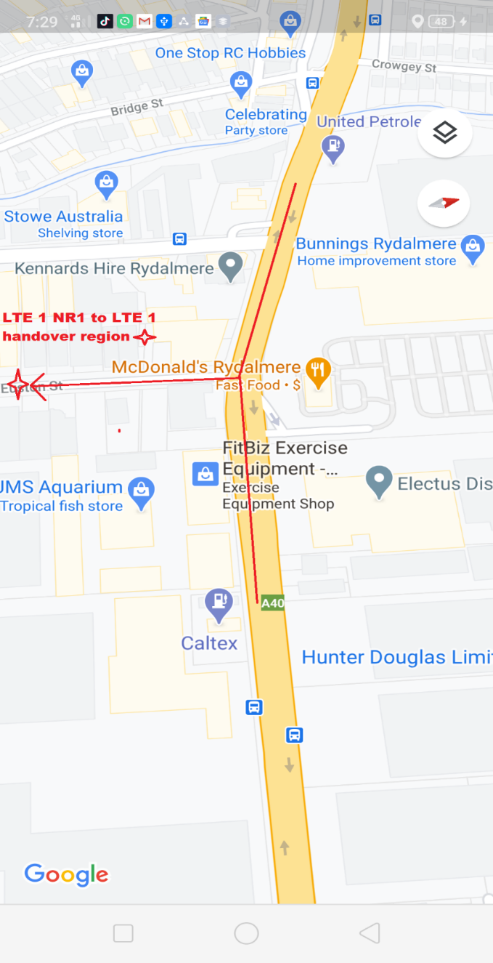
Optus - Handover: LTE#1+NR#1 → LTE#1 only

Slide 10
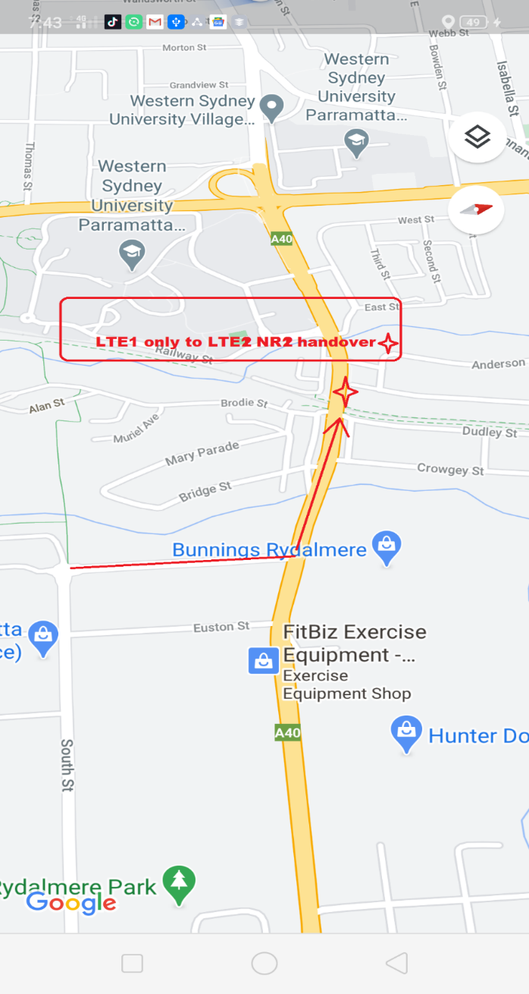
Optus - Handover: LTE#1 only → LTE#2+NR#2

Slide 11
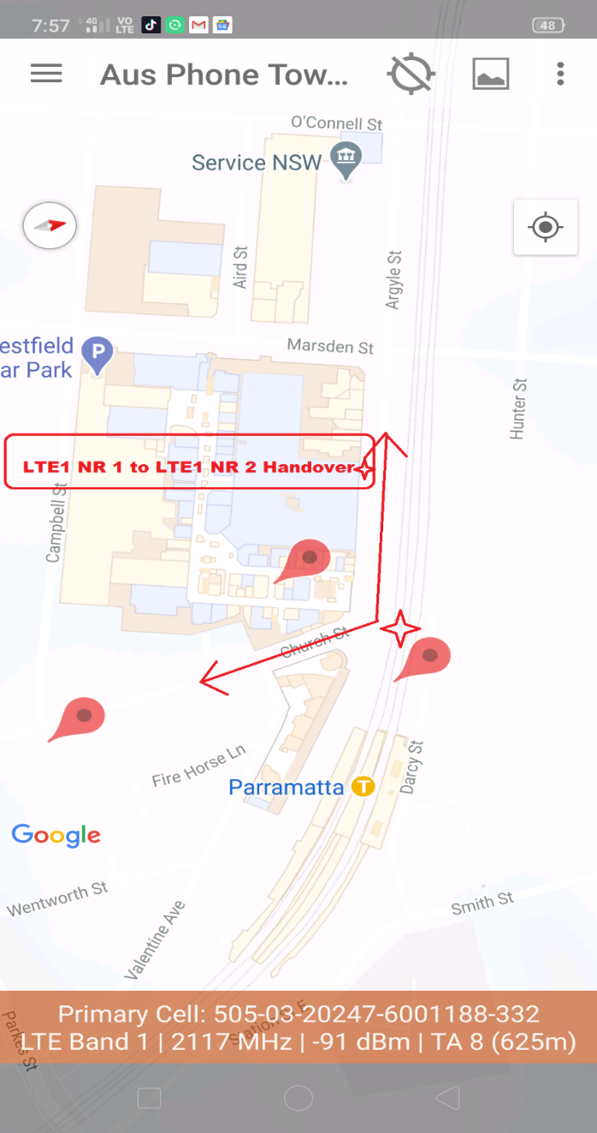
VHA - Handover: LTE#1+NR#1 → LTE#1+NR#2

Slide 12
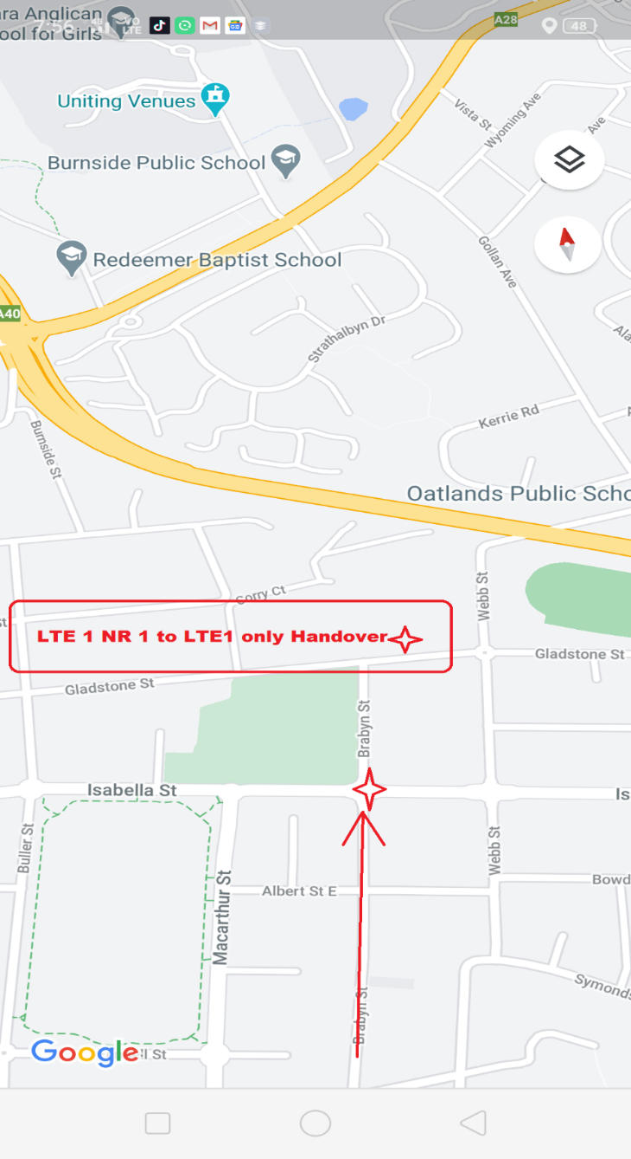
VHA - Handover: LTE#1+NR#1 → LTE#1 only

Slide 13
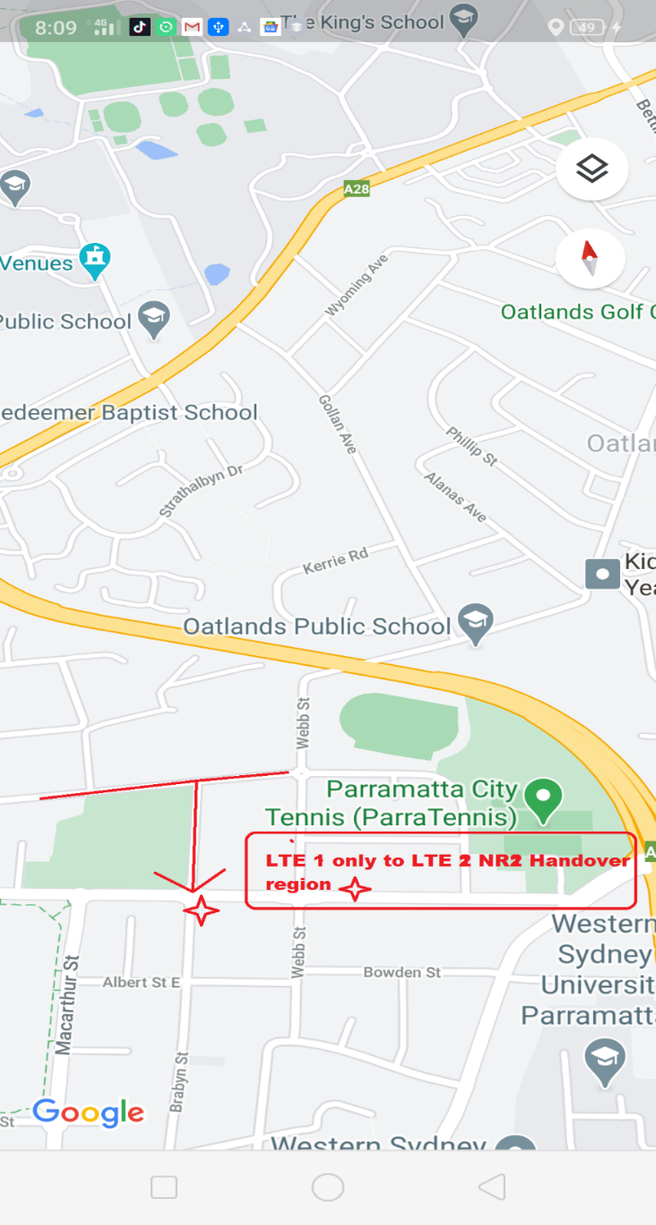
VHA - Handover: LTE#1 only → LTE#2+NR#2

Slide 14
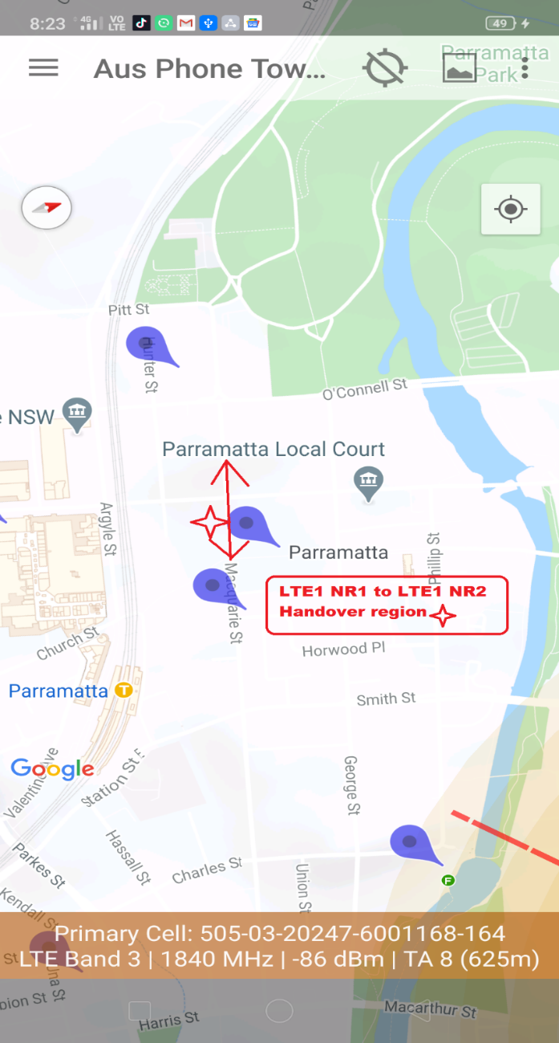
Telstra - Handover: LTE#1+NR#1 → LTE#1+NR#2

Slide 15
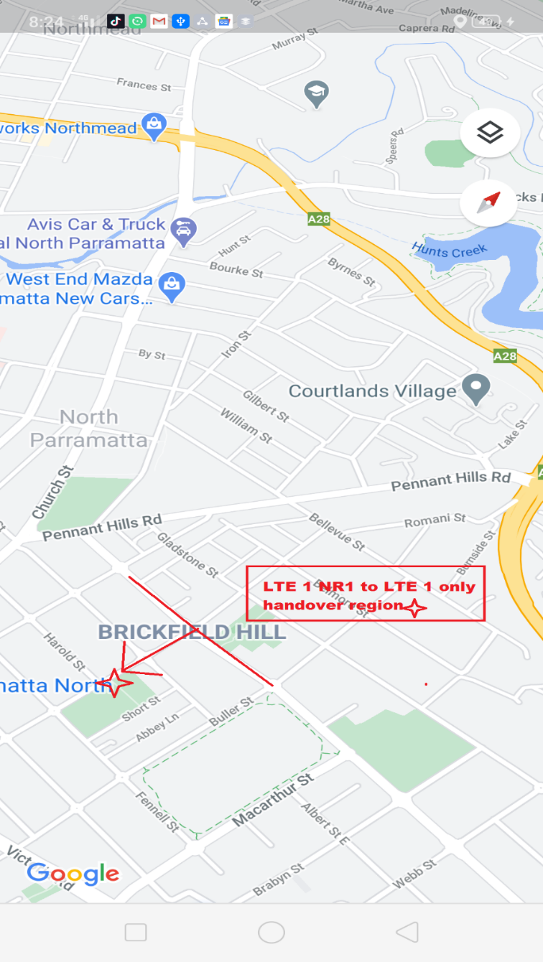
Telstra - Handover: LTE#1+NR#1 → LTE#1 only

Slide 16
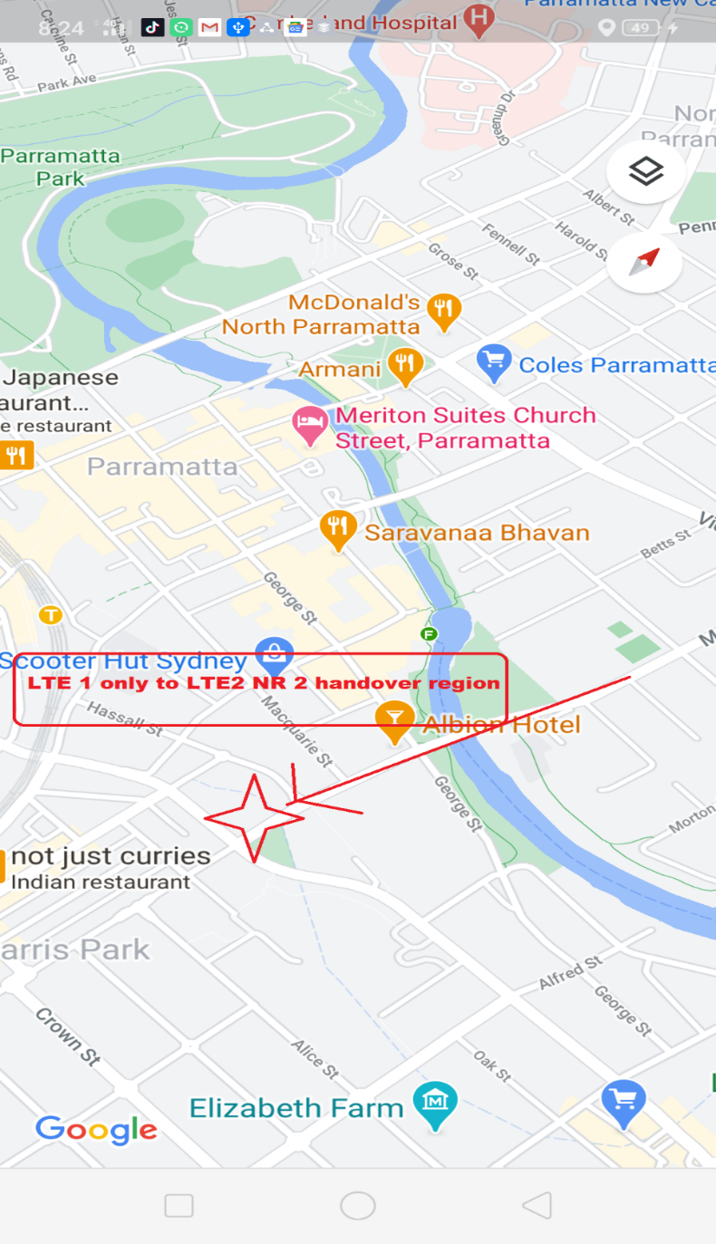
Telstra - Handover: LTE#1 only → LTE#2+NR#2

Slide 17
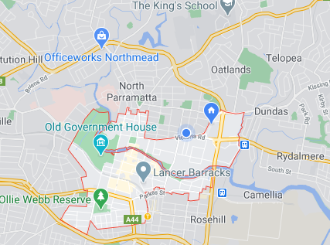
Telstra/Optus/Voda- 5G Network Mixed coverage Route:-

Slide 18
THANK YOU
MARQUIS TECHNOLOGIES
www.marquistech.com

