Slide 1
MARQUIS TECHNOLOGIES
Drive Route

Slide 2
(Pune / India)
Country | India
Continent | Asia
City | Pune
Time Zone | +5:30

Slide 3
(Pune / India)
Operator Details:
S. No. | Operator |  | Supported Bands | Supported Features by Network
1 | Major | Airtel | LTE FDD B1/B3/B8 & TDD B40/N78 | VoWiFi/VoLTE/4G/2G/5G
2 |  | JIO | LTE FDD B3/B5 & TDD B40/N78/N28 | VoWiFi/VoLTE/4G/5G
3 |  | VI | LTE FDD B3/B8 & TDD B41/N78 | VoWiFi/VoLTE/4G/3G/2G/5G
4 | Minor | BSNL | 2100/900 | 3G/2G

Slide 4
Operator 1 - JIO

Slide 6
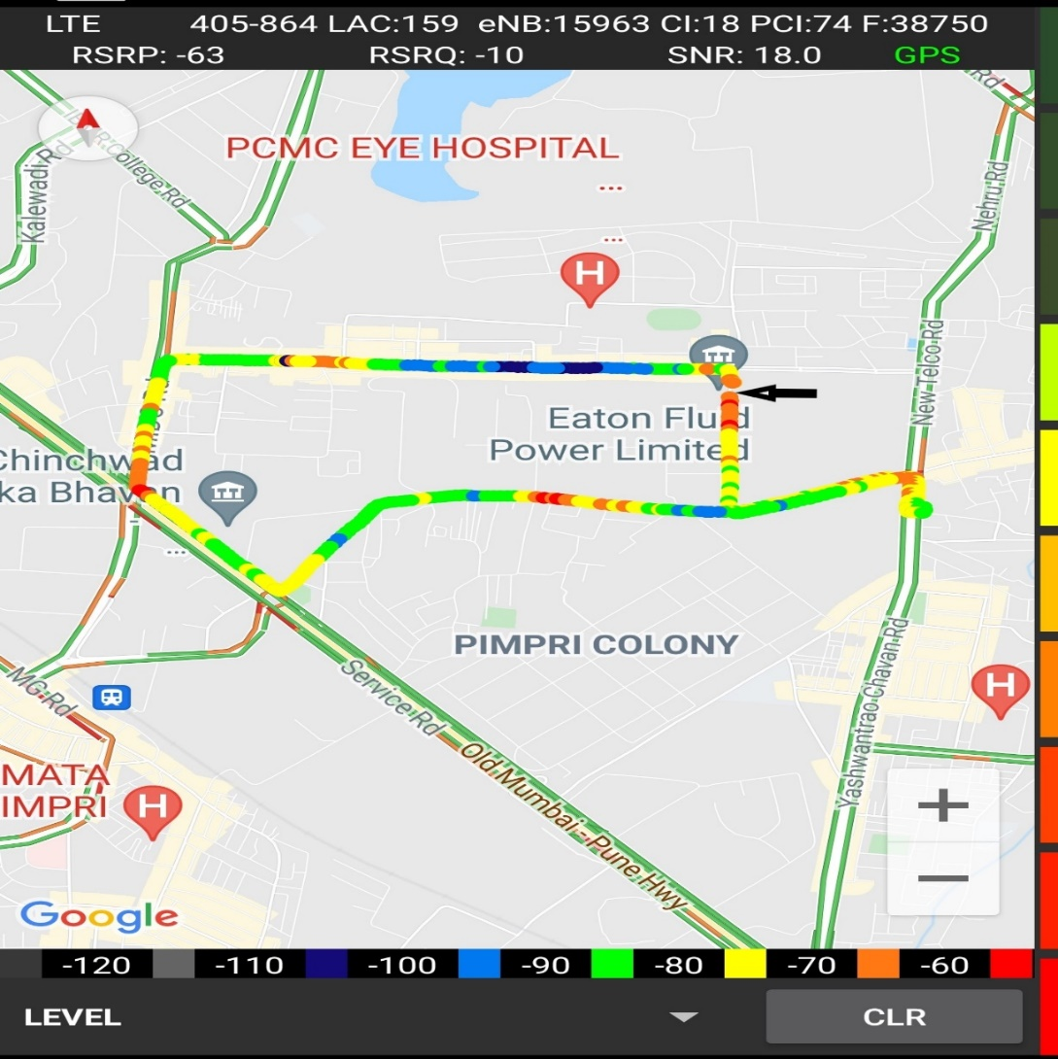
Near Cell (Reliance JIO)
Near cell(NC) | longitude | latitude | RSRP | Cell id | TDD E-ARFCN
1 | 73.81759 | 18.63194 | -62 | 18 | 38948
Eaton power,Pune
RSRP:
-65dbm to -75dbm

Slide 7
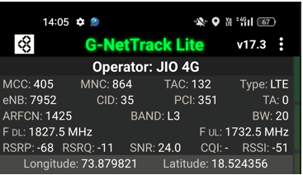
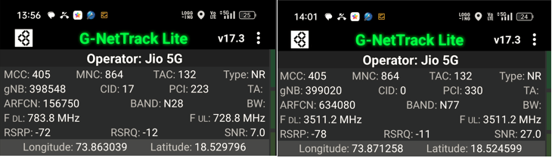
Good Coverage Screenshots
Operator: Jio
Band: B3 | B5 | B40 | N78 | N28

Slide 8
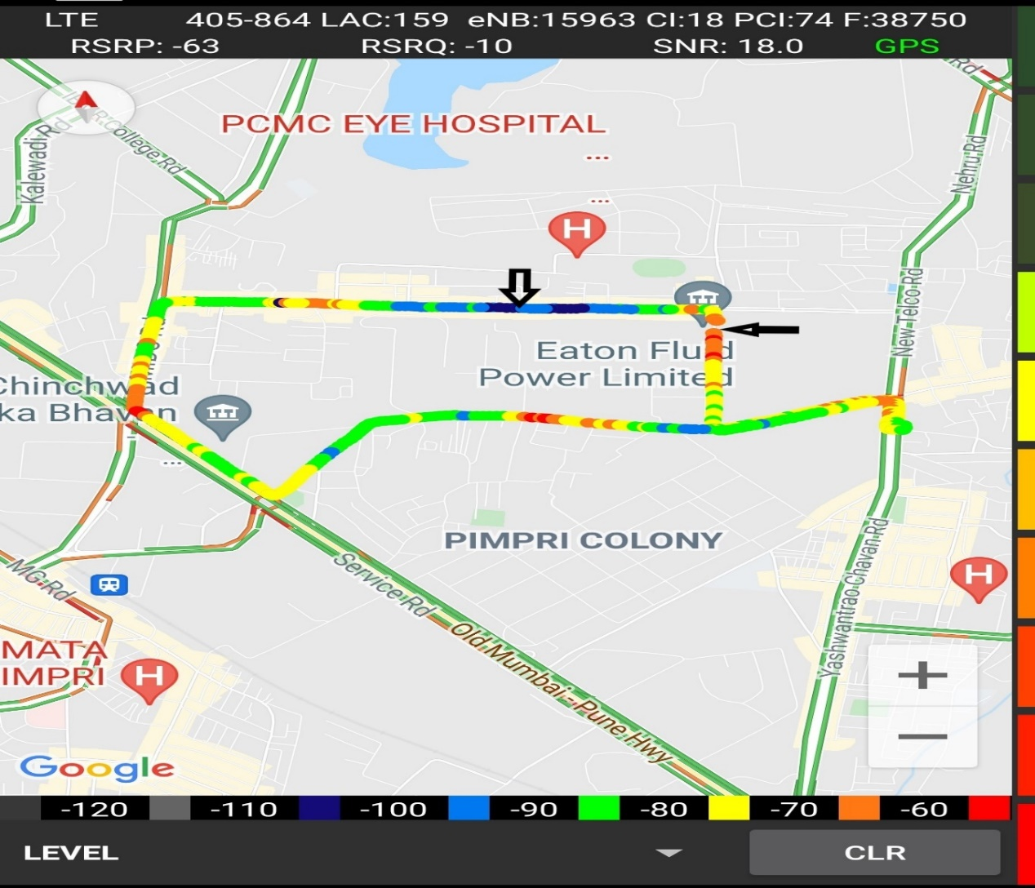
Edge Cell (Reliance JIO)
Edge cell(NC) | longitude | latitude | RSRP | Cell id | TDD E-ARFCN
1 | 73.81066 | 18.63377 | -106 | 16 | 38948
Kalubaiche mandir, PUNE
RSRP:
-95dbm to -110dbm

Slide 9
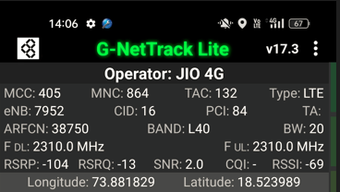
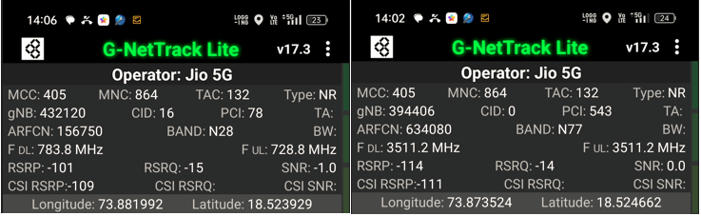
Weak Coverage Screenshots
Operator: Jio
Band: B3 | B5 | B40 | N78 | N28

Slide 10
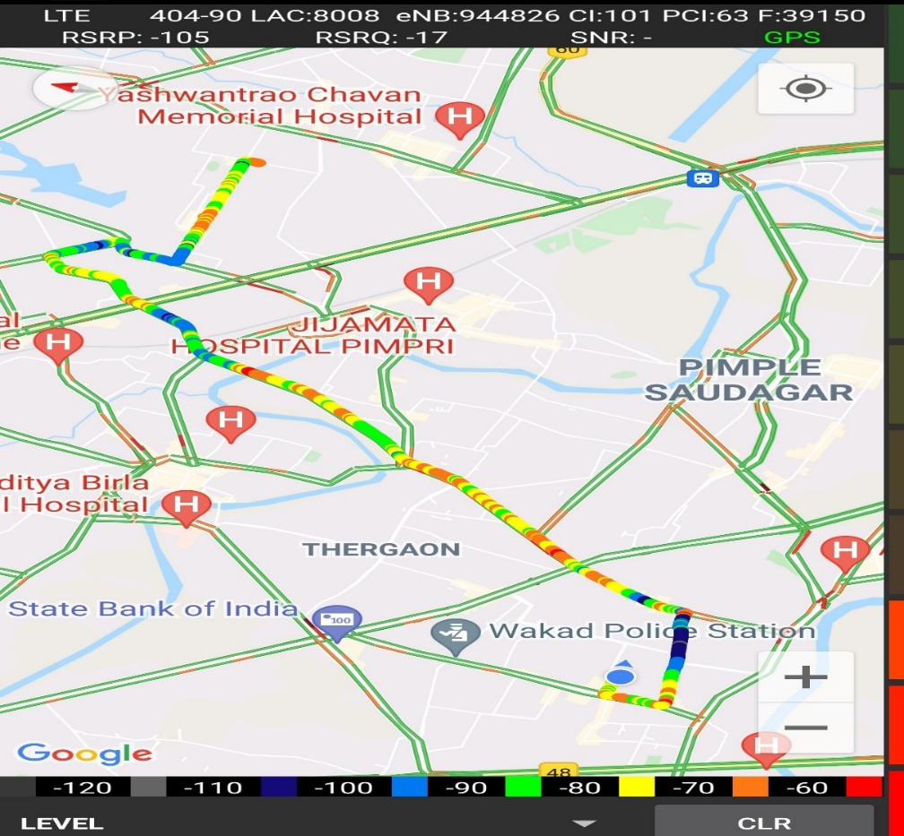
Inter Band Handover (FDD-TDD), JIO 4G
Band Handover | longitude | latitude | RSRP | PCI | TDD E-ARFCN
L3 | 73.76609085 | 18.59816997 | -99 | 26 | 1375
L40 | 73.76609043 | 18.59816918 | -116 | 260 | 38948

Slide 11
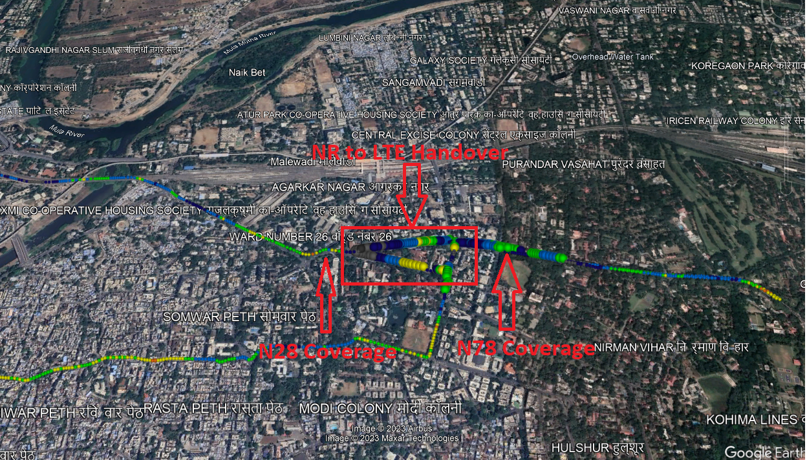
Band Handover – 5G to 4G
Operator: Jio
Band Handover: N78 – B40 – N78

Slide 12
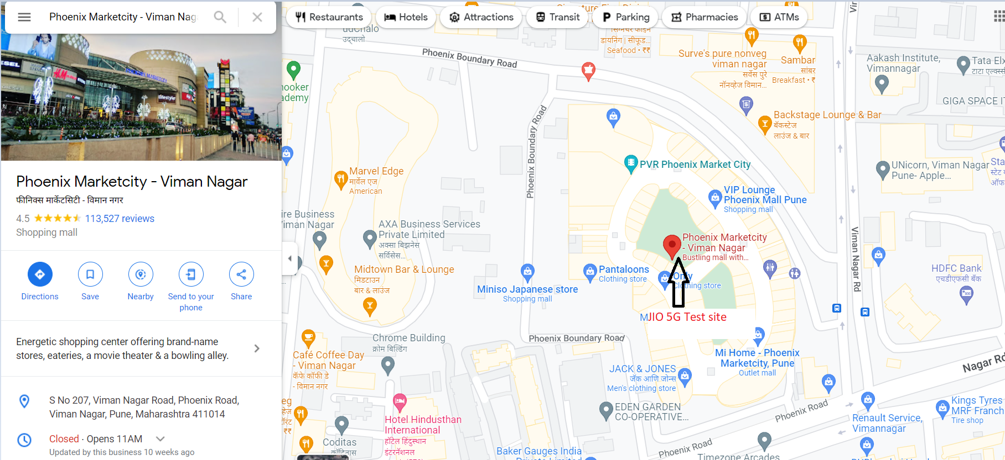
Jio 5G
Phoenix Marketcity - Viman Nagar Latitude Longitude : (18.56226466137539, 73.91674507606142)

Slide 13
Operator 2 - Airtel

Slide 15
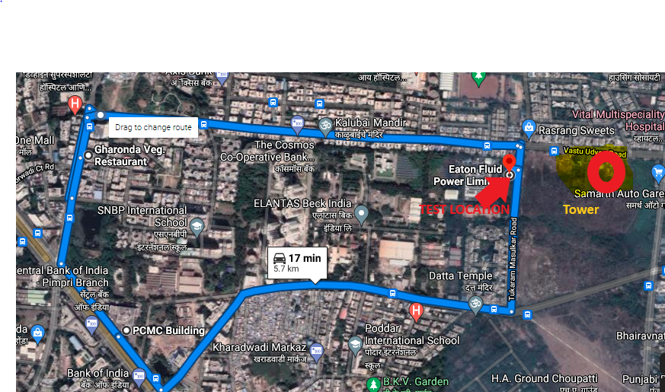
Near Cell (Airtel)
Near cell(NC) | longitude | latitude | RSRP | Cell id | TDD E-ARFCN
1 | 73.81565458 | 18.63223605 | 66 | 425 | 39150
Eaton fluid power ltd,PCMC,PUNE ,INDIA
RSRP:
-65dbm to 75dbm

Slide 16
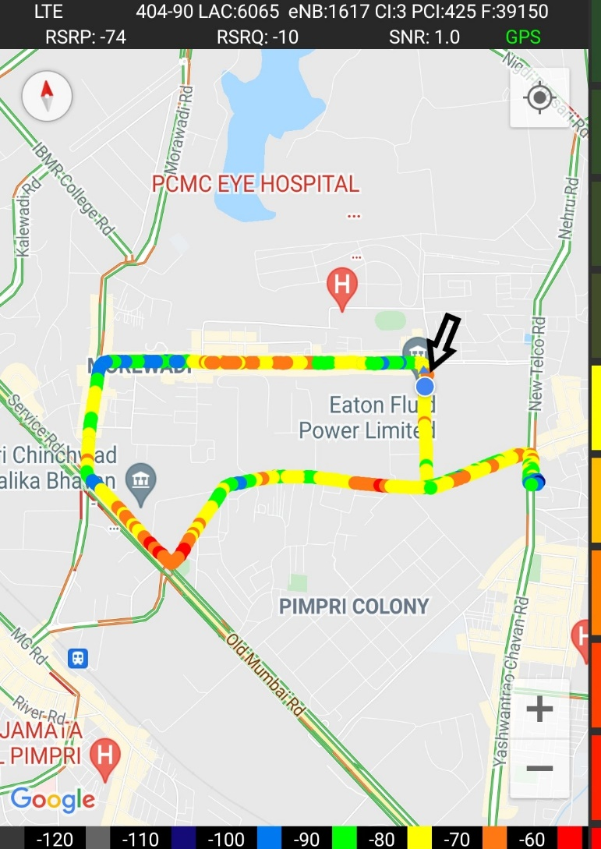
Near Cell (Airtel)

Slide 17
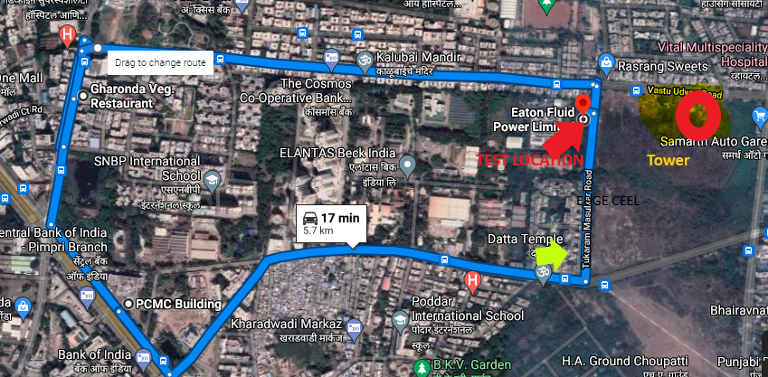
Edge Cell (Airtel)
Edge cell(EC) | longitude | latitude | RSRP | Cell id | TDD E-ARFCN
1 | 73.81554 | 18.62905 | 107 | 412 | 39150
Tukaram Masulkar Road PUNE
RSRP:
-95dbm to -110dbm

Slide 18
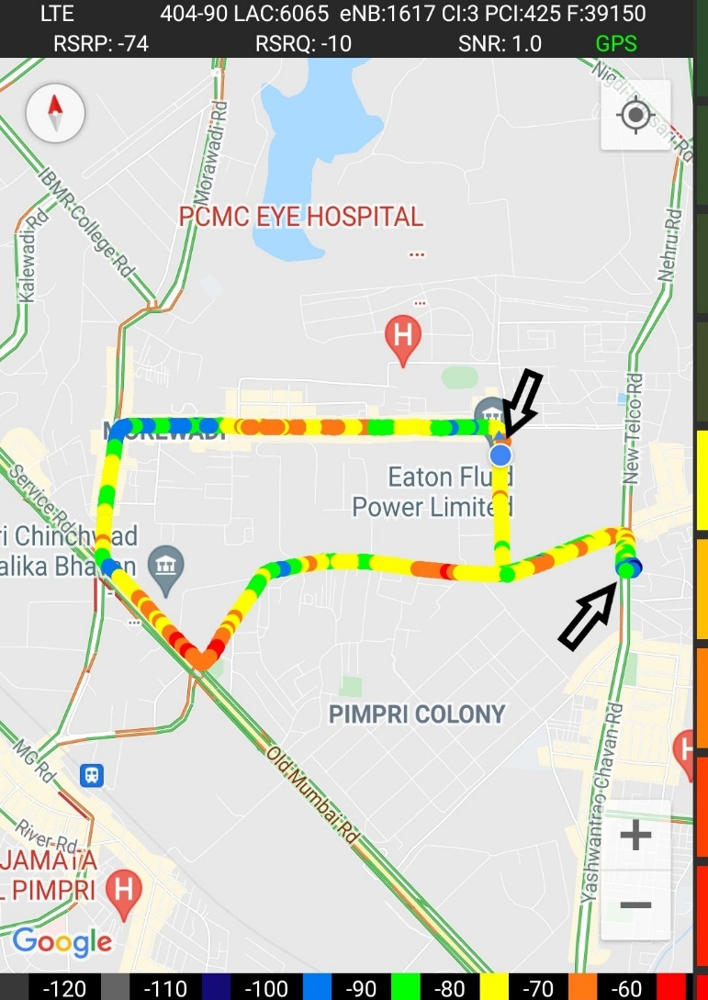
Edge Cell (Airtel)

Slide 19
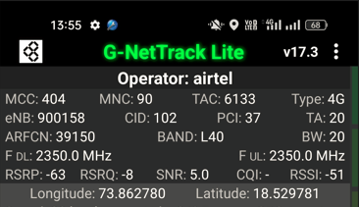
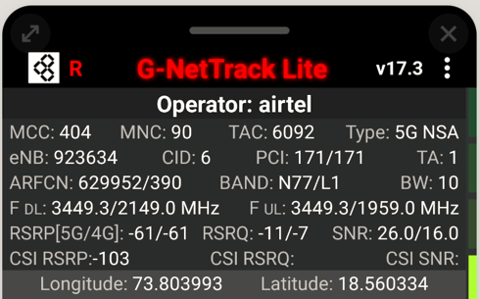
Good Coverage Screenshots
Operator: Airtel
Band : B3 | B8 | B40 | N78

Slide 20
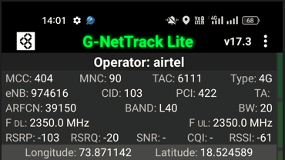
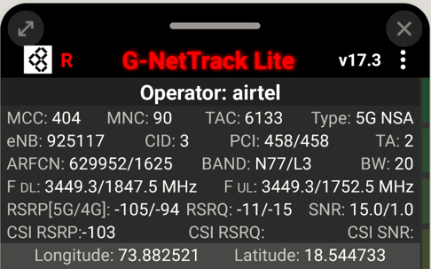
Weak Coverage Screenshots
Operator: Airtel
Band : B3 | B8 | B40 | N78

Slide 21
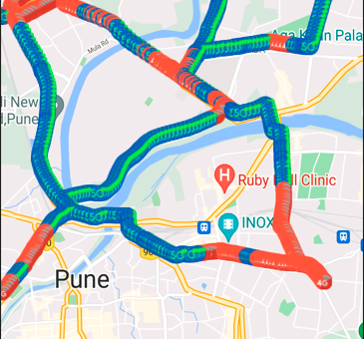
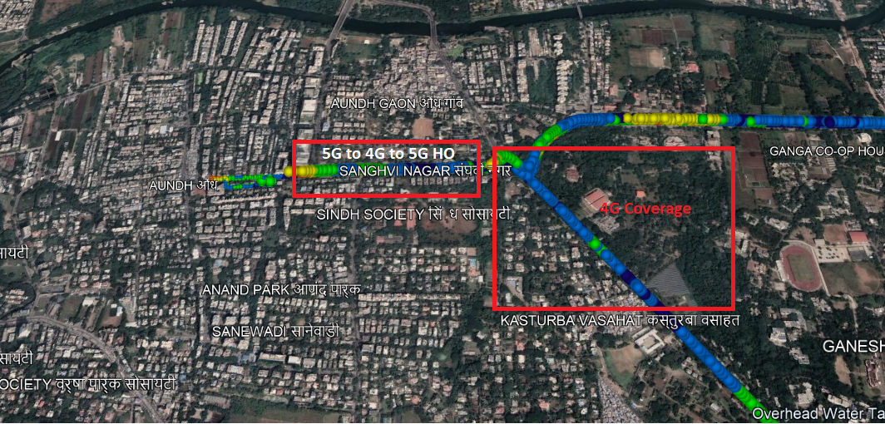
Band Handover – 5G to 4G
Operator: Airtel
HO : NSA to LTE to NSA

Slide 22
Operator 3 - VI

Slide 23
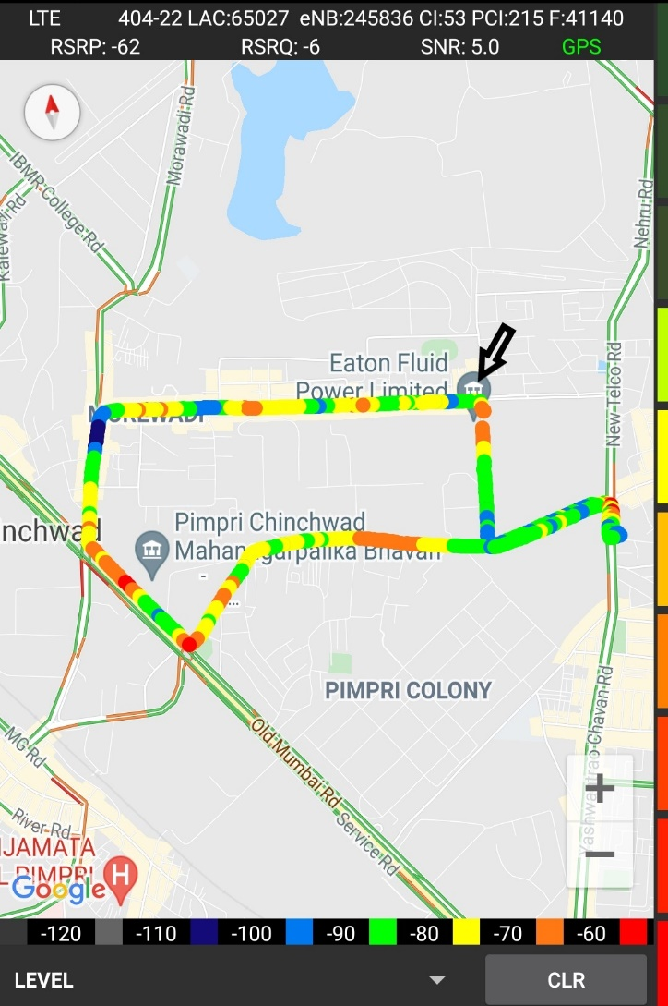
Near Cell VI:
Near cell(NC) | longitude | latitude | RSRP | Cell id | TDD E-ARFCN
1 | 73.81573486 | 18.68151169 | -62 | 215 | 41140
Maradu Cochin , Kerala
RSRP:
-65dbm to -75dbm

Slide 24
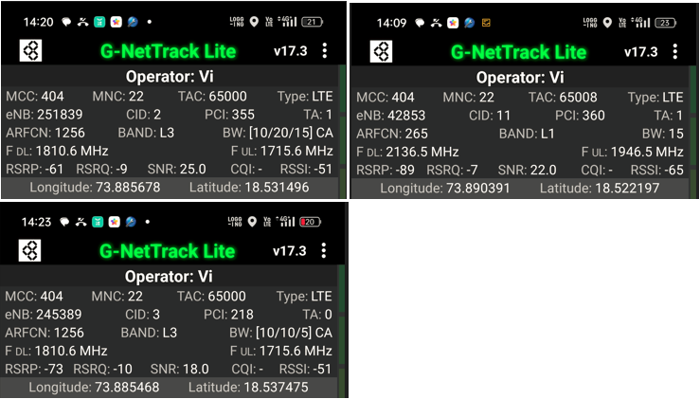
Good Coverage Screenshots
Operator: VI
Band : B1 | B3 | B8 | B40 | B41

Slide 25
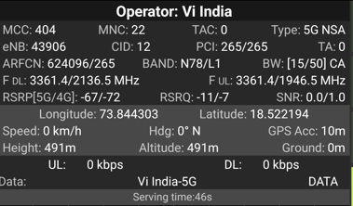
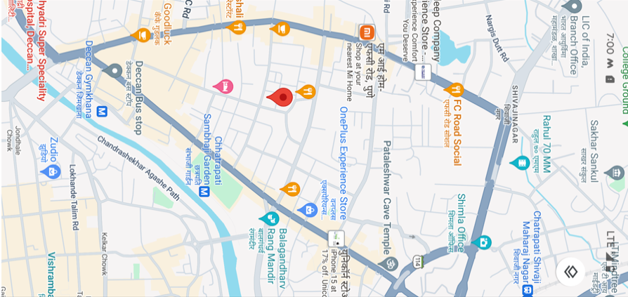
VI 5G
Lat long – 18.522194° N, 73.844303° E Location – Shivaji Nagar, Pune, India Specification –VI 5G limited coverage

Slide 26
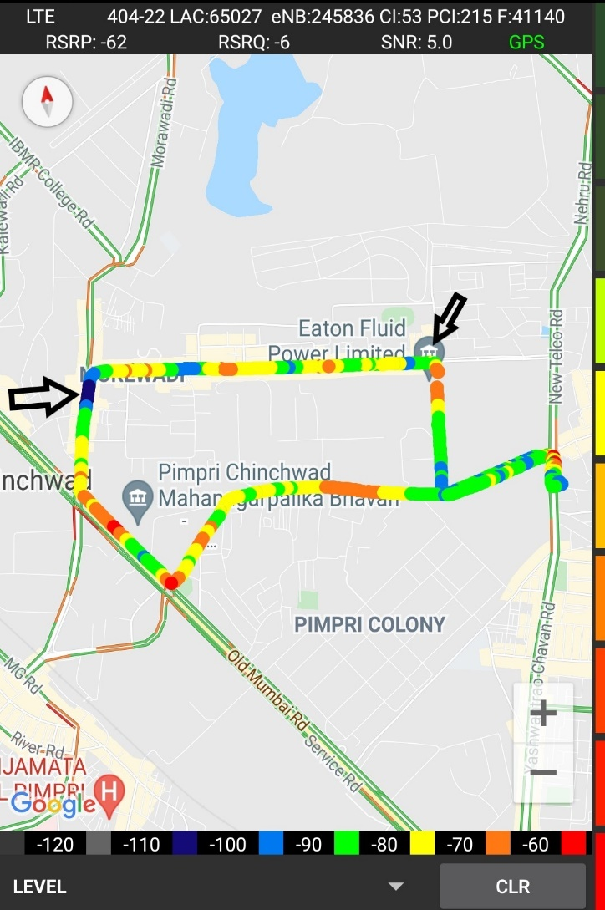
Cell Edge VI:
Edge cell(EC) | longitude | latitude | RSRP | Cell id | TDD E-ARFCN
1 | 73.80358 | 18.63377 | -106 | 214 | 41140
Ajmera Main road Pune
RSRP:
-95dbm to -105dbm

Slide 27
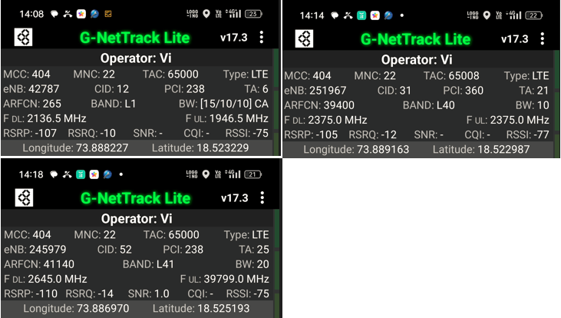
Weak Coverage Screenshots
Operator: VI
Band : B1 | B3 | B8 | B40 | B41

Slide 28
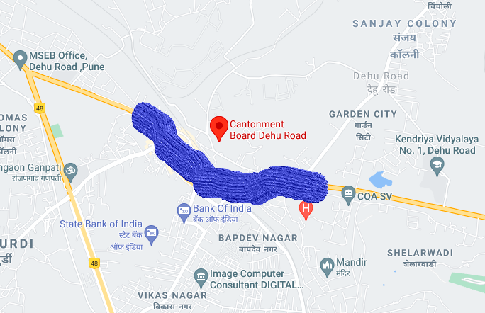
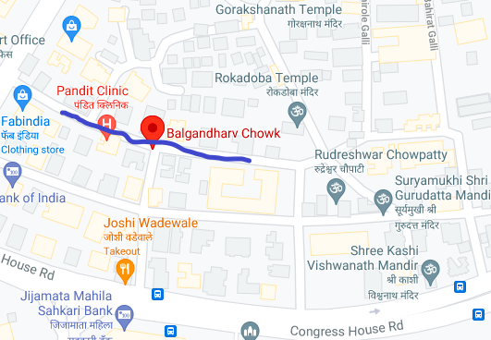
Airtel & VI SRVCC to UTRAN:
SRVCC
SRVCC and OOS

Slide 29
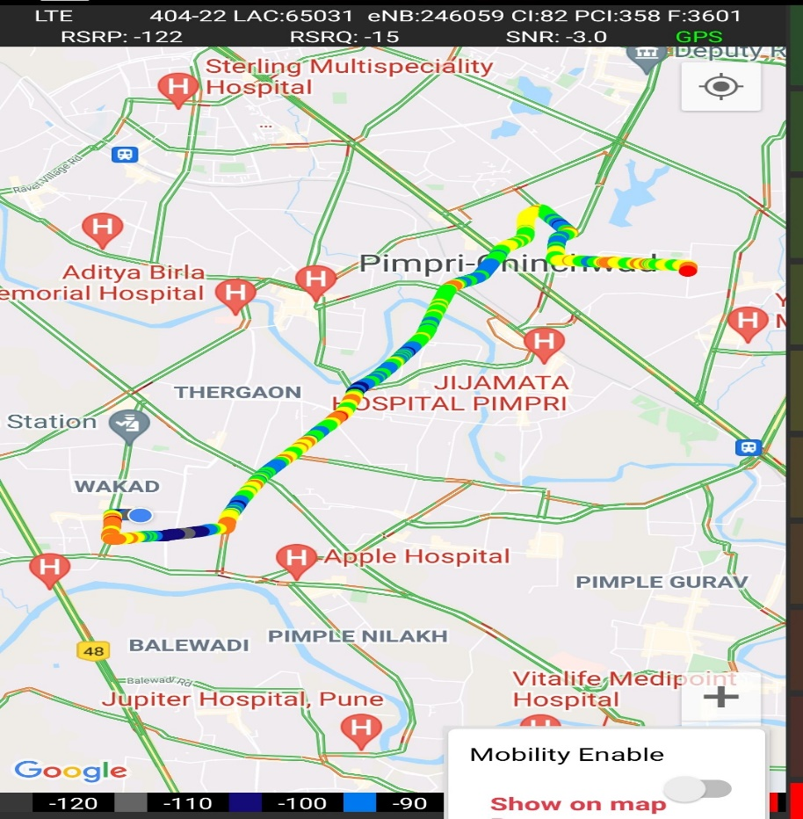
VIBand 3<>5<>40 Handover
Band Handover | longitude | latitude | RSRP | PCI | TDD E-ARFCN
L3 | 73.78554433 | 18.61491389 | -81 | 225 | 1256
L41 | 73.78462002 | 18.61242288 | -78 | 145 | 41140
L8 | 73.76593703 | 18.5980963 | -112 | 358 | 3601

Slide 30
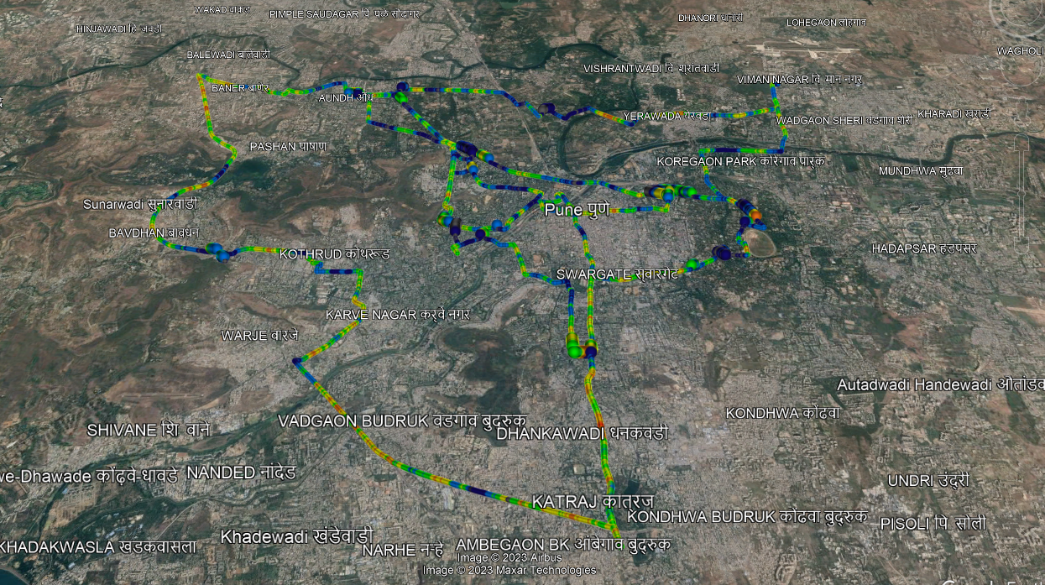
( Drive Route covered during mobility. )

Slide 31
THANK YOU
MARQUIS TECHNOLOGIES
www.marquistech.com

