Slide 1

MARQUIS TECHNOLOGIES
NR(5G) LOCATION: Lisbon, Portugal
Notes:
CONFIDENTIAL

Slide 2
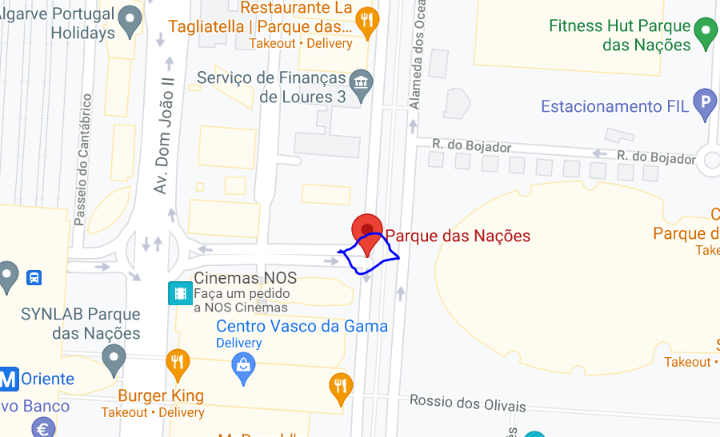
5G Location for VDF & NOS Operator (Good Coverage) Location- Parque das Nações1990-083 Lisbon, Portugal

Slide 3
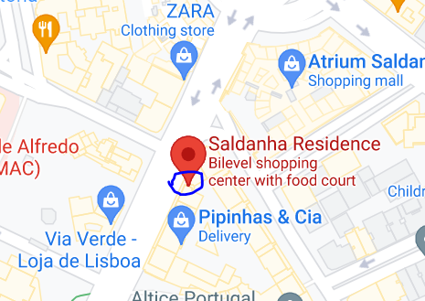
5G NR Location for MEO operator Location- Saldanha ResidenceAv. Fontes Pereira de Melo 42 E, 1050-250 Lisboa, Portugal

Slide 4
Thank You Marquis Technologies Pvt Ltd

