Slide 1
MARQUIS TECHNOLOGIES
Drive Routes - Morocco/Casablanca

Slide 2
Travel to (Morocco/Casablanca)
Country | Morocco
Continent | Africa
City | Casablanca
Time Zone | GMT +01:00
International Dialing Code | +212
VISA | On Arrival Visa
VISA Duration | -
VISA Fees | Contact Nisha Deshpande
VISA Requirements | -
Yellow Fever Vaccination Certificate | Not Required

Slide 3
Operators in Morocco
MCC | MNC | Operator | Bands (MHz)
604 | 01 | Maroc Telecom | UMTS B1(2100MHz), LTE B7/B20 (2600MHz/800MHz)
604 | 02/05 | INWI | UMTS B1(2100MHz), LTE B3/B7/B20 (1800MHz/2600MHz/800Mhz)
604 | 00 | Orange | UMTS B1(2100MHz), LTE B3/B7/B20 (1800MHz/2600MHz/800Mhz)

Slide 4
Operators and Related Information
All the operators are having implementation
Maroc Telecom- Supports LTE, WCDMA and 2G
INWI- Supports LTE, WCDMA and 2G
Orange- Supports LTE, WCDMA and 2G

Slide 5
General Info of Operators
Maroc Telecom network is strong in the network just like the other two operator.
Inwi Network is to number of subscribers and network conditions are equally good.
Orange service is inferior compared to other two Operator, but they are strengthening based on their latest implementations.

Slide 6
USSD codes for balance check
Maroc Telecom balance check: #580#
Maroc Telecom Internet balance check: #580#
Inwi balance check: *120#
Orange balance check: #554#

Slide 7

Supplementary Services
Maroc Telecom: Call forwarding and Call Waiting supported
Inwi: Call forwarding and Call Waiting supported
Orange: Call forwarding and Call Waiting supported

Slide 8
RSRP Criteria
Near Cell :-Stationary: RSRP : -55dbm to -85dbm
Cell Edge :-Stationary: RSRP : -95dbm to -110dbm
Mixed :-Mobility: RSRP : -55dbm to -120dbm

Slide 9
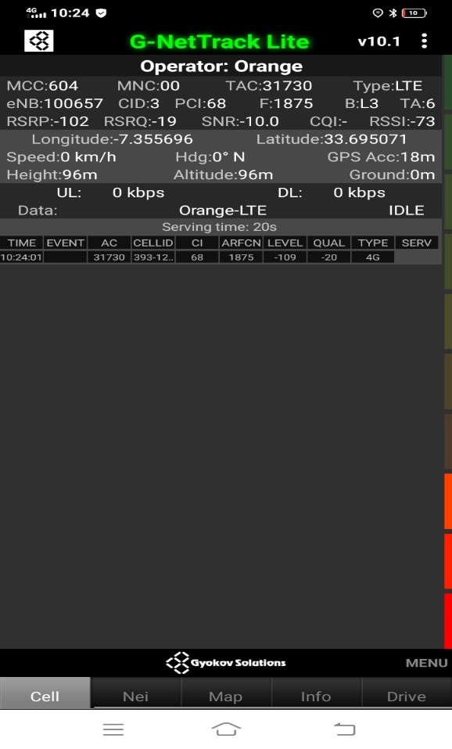
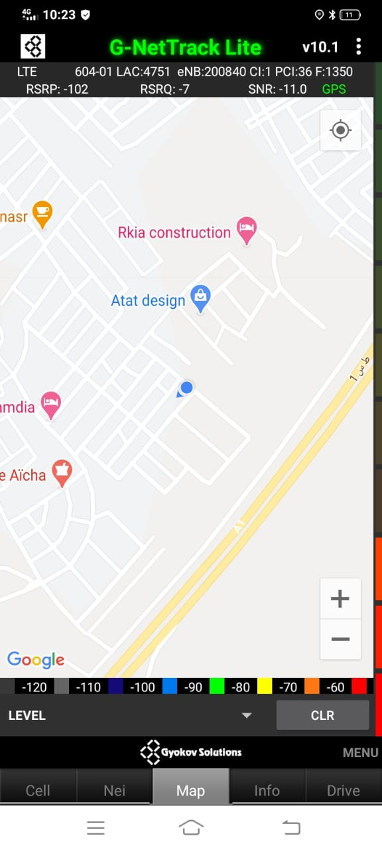
Band 3 Edge Cell for Orange Operator:- Mohammedia
B3
Maps

Slide 10
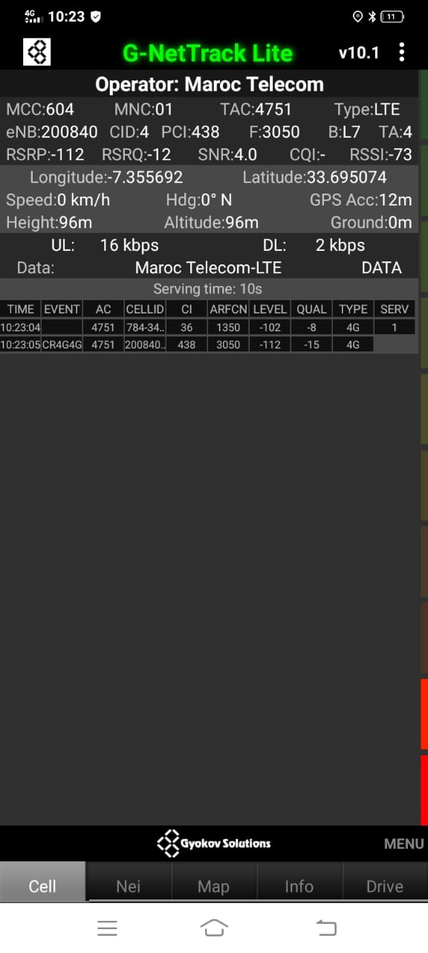
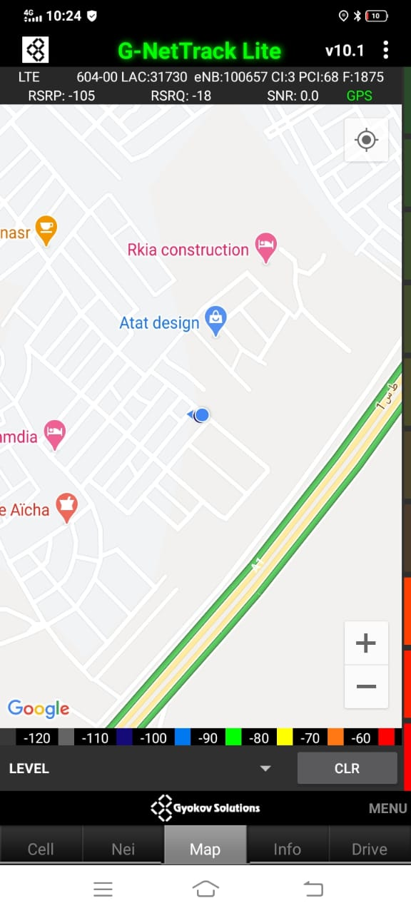
Band 7 Edge Cell for Maroc Telecom Operator:- Mohammedia
B7
Maps

Slide 11
Top most Popular Android Apps used in Morocco
Attijari mobile
CIH Mobile
My Inwi
Athan Now : Prayer Times, Quran & Qibla
Salaat First (Prayer Times)
Amazon Shopping - Search, Find, Ship, and Save
Snapchat
Messenger – Text and Video Chat for Free
WhatsApp Messenger
imo free video calls and chat
Viber Messenger - Messages, Group Chats & Calls
Skype - free IM & video calls

Slide 12
Local EM Number for Morocco
general emergency phone number | 112
Local Police | 19
Ambulance(First aid Centre) | 15
Fire Brigade | 15
Emergency Centre | 911

Slide 13
Thank You

