Slide 1
Drive Route Coverage

Slide 2
Drive Route Coverage : Vodafone

Slide 3
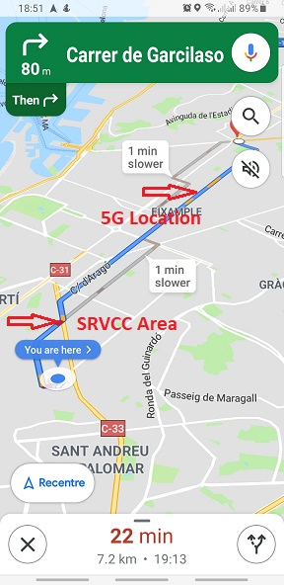
Operator: Vodafone: B3,B7,B20,B38,n78 1.Avinguda de I’Estadi

Slide 4
Thank You..!!

