Slide 1
MARQUIS TECHNOLOGIES
Drive Route

Slide 2
Major Czech Operators : Locations for 5G Field Test
Operator | PLMN | 5G Tested Locations | ENDC | Longitude / Latitude
Vodafone | 230-03 | Skacelova, Kralove pole | B3+N1 | 49.22229233977069, 16.587508311552288
DT | 230-01 | Ceska & Stranice | B20+N1 | 49.19698576227207, 16.60571052689412
O2 | NA | Ceska & Vankovka | B20+N1 | 49.19698576227207, 16.60571052689412

Slide 3
Drive Route T Mobile 5G
Near Cell :-Stationary: RSRP: -60dbm to -75dbm
Mixed :-Mobility: RSRP : -75dbm to -95dbm
Cell Edge :-Stationary: RSRP : -95dbm to -115dbm

Slide 4
Service support by Telia Operator
Services Supported by T-Mobile Operator
DT 5G/4G/3G/2G | E-GSM (900), 1800(DCS), B1 (2100) B3 (1800 +),B7 (2600),B20 (800 DD), n1 (2100MHz)
OPERATOR | Features /Services | Supported(yes/No)
DT (Major) | Reselection | Yes
 | Redirection | Yes
 | MMS /SMS | Yes
 | Volte | Yes
 | vowifi | Yes
 | PS Handover | Yes

Slide 5
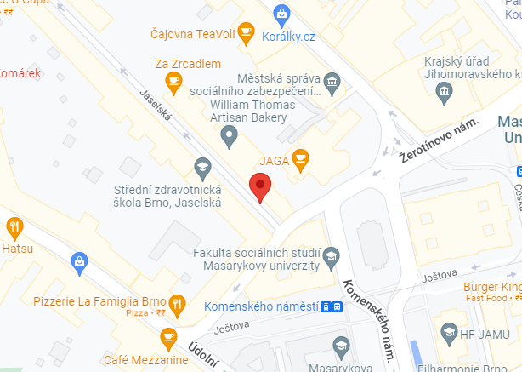

T Mobile Band N1(Mixed coverage):-JaselsKa Brno- Czechia
Operator: T mobile
Band: N1
Cell ID: 23
E-ARFCN : 1579
RSRP: -80dBm to -90dBm
NC:1

Slide 6
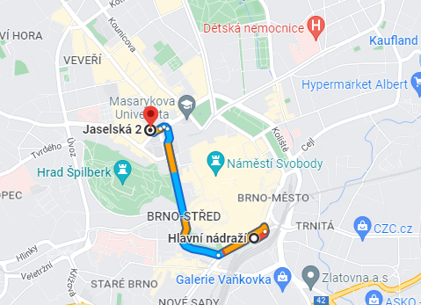
T Mobile Band N1(Mixed coverage):-JaselsKa Brno- Czechia
Operator: T mobile
Band: N1
Cell ID: 23
E-ARFCN : 1579
RSRP: -80dBm to -90dBm
NC:1

Slide 7
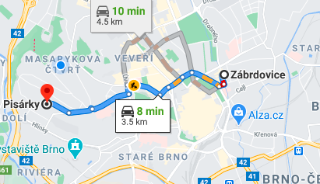
T Mobile 5G Good Coverage Area (B20+N1),RSRP=-80db Zabrdovice>> Pisarky

Slide 8
Drive Route Vodafone 5G
Near Cell :-Stationary: RSRP: -60dbm to -75dbm
Mixed :-Mobility: RSRP : -75dbm to -95dbm
Cell Edge :-Stationary: RSRP : -95dbm to -110dbm

Slide 9
Service support by Telia Operator
Services Supported by Vodafone Operator
Vodafone 5G/4G/3G/2G | E-GSM (900), DCS (1800), B1 (2100) B3 (1800 +)B7(2600),B8(900),B20 (800 DD), n1 (2100MHz
OPERATOR | Features /Services | Supported(yes/No)
Vodafone (Major) | Reselection | Yes
 | Redirection | Yes
 | MMS /SMS | Yes
 | Volte | Yes
 | vowifi | Yes
 | PS Handover | Yes

Slide 10
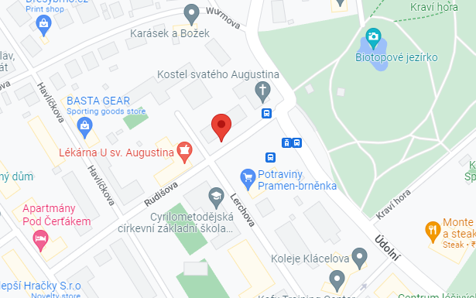

Vodafone Band-N1 (Mixed)-Brno-Stred-Stranice, Czech
Operator: Vodafone
Band: 1
Cell ID: 3
E-ARFCN : 1849
RSRP: -80dBm to -87dBm
NC:1

Slide 11
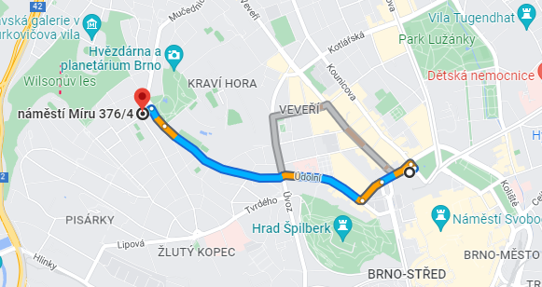
Vodafone Band-N1 (Mixed)-Brno-Stred-Stranice, Czech
Operator: Vodafone
Band: 1
Cell ID: 3
E-ARFCN : 1849
RSRP: -80dBm to -87dBm
NC:1

Slide 12
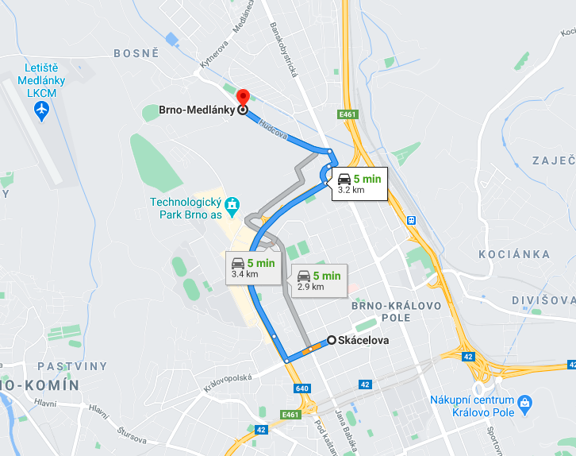
Vodafone 5G Good Coverage Area (B3+N1),RSRP=-83db Skacelova>> Medlanky

Slide 13
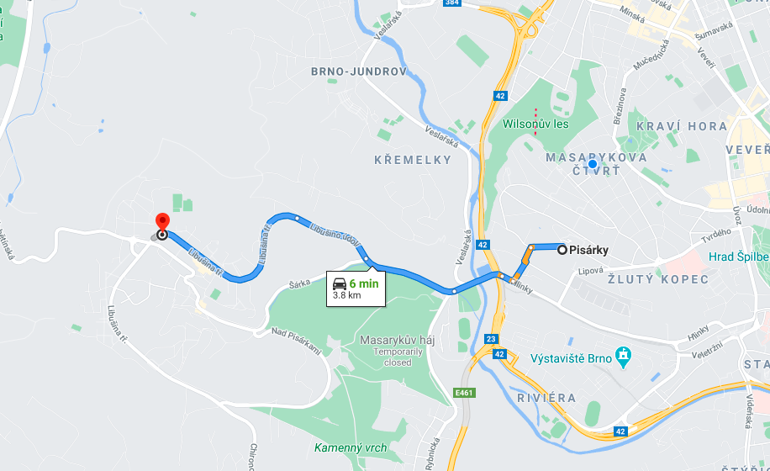
SRVCC 4G to 3G location for Vodafone Brno-Kohoutovice>> pisarky

Slide 14
Drive Route O2 Mobile
Near Cell :-Stationary: RSRP: -60dbm to -75dbm
Mixed :-Mobility: RSRP : -75dbm to -95dbm
Cell Edge :-Stationary: RSRP : -95dbm to -115dbm

Slide 15
Services Supported by O2 Operator
O2 5G/4G/3G/2G | E-GSM (900), DCS (1800), B1 (2100),B7(2600), N78
OPERATOR | Features /Services | Supported(yes/No)
O2(Major) | Reselection | Yes
 | Redirection | Yes
 | MMS /SMS | Yes
 | Volte | Yes
 | vowifi | Yes
 | PS Handover | Yes

Slide 16
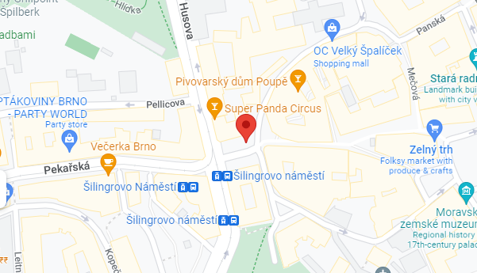

O2 Mobile Band1(Mixed ):- Silingrovo namestic Brno, Czech
Operator: O2
Band: 3
Cell ID: 181
E-ARFCN : 362670
RSRP: -70dBm to -80dBm
NC:1

Slide 17
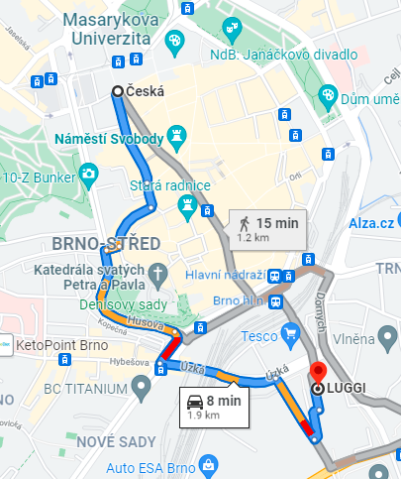
O2 5G Good Coverage Area (N78)RSRP=-82db Ceska >> Vankovka

Slide 18
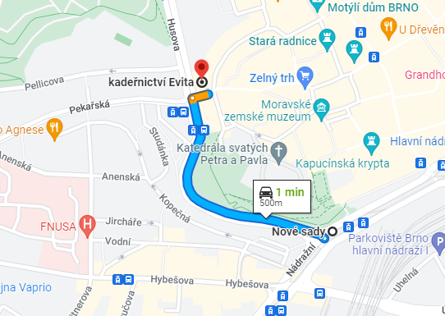
O2 Mobile Band1(Mixed ):- Silingrovo namestic Brno, Czech
Operator: O2
Band: 3
Cell ID: 181
E-ARFCN : 362670
RSRP: -70dBm to -80dBm
NC:1

Slide 19
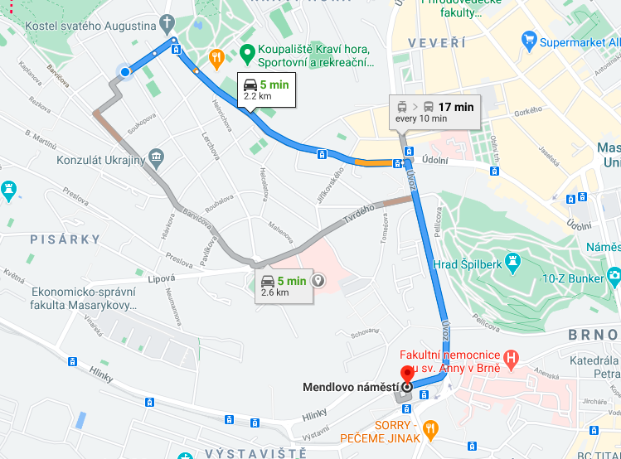
DT and Vodafone 4G Good Coverage Area Rudisova >> Menlove namesti

Slide 20
THANK YOU
MARQUIS TECHNOLOGIES
www.marquistech.com

