Slide 1
MARQUIS TECHNOLOGIES
5G Drive Route of Sydney(Australia)

Slide 2
Operator Information
MCC | MNC | Operator | Bands (MHz)
505 | 01 | Telstra | W-CDMA 2100/850, LTE Band- 7/3/28, NR- N78
505 | 02 | Optus | W-CDMA 2100/900, LTE Band -1/3/7/28/40, NR N78
505 | 03 | Vodafone | W-CDMA 900/2100, LTE Band -1/3/5, NR N78

Slide 3
Services Supported by Operators
Operator | Features/Services | Supports(Yes/No)
Telstra | 5G | Yes
 | VoLTE | Yes
 | VoWiFi | Yes
 | Reselection | Yes
 | Redirection | Yes
 | MMS | Yes
 | CSFB | Yes
 | PS Handover | Yes
Optus | 5G | Yes
 | VoLTE | Yes
 | VoWiFi | Yes
 | Reselection | Yes
 | Redirection | Yes
 | MMS | Yes
 | CSFB | NO
 | PS Handover | Yes
Vodafone | 5G | Yes
 | VoLTE | Yes
 | VoWiFi | Yes
 | Reselection | Yes
 | Redirection | Yes
 | MMS | Yes
 | CSFB | NO
 | PS Handover | Yes

Slide 4
RSRP Criteria
Near Cell :-Stationary: RSRP : -55dbM to -75dbm
Cell Edge :-Stationary: RSRP : -90dbM to -105dbM
Mixed :-Mobility: RSRP : -55dbM to -120dbM

Slide 5
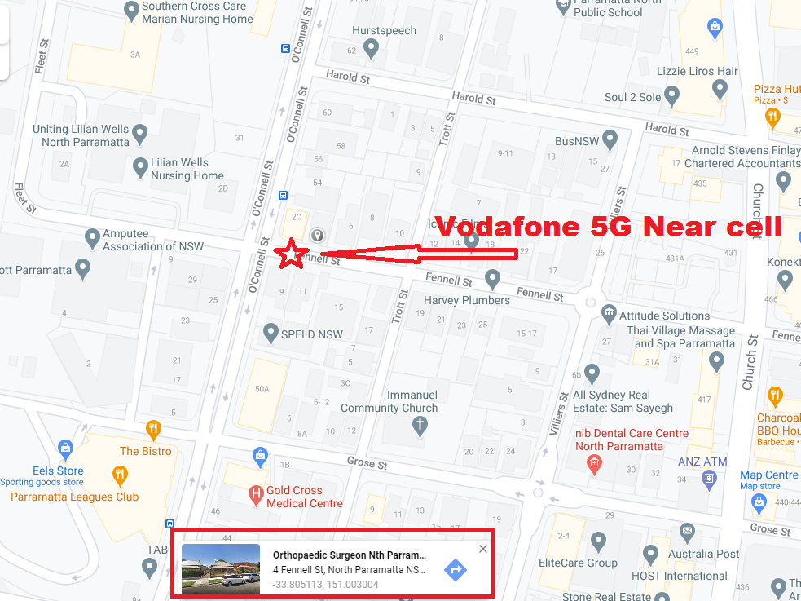
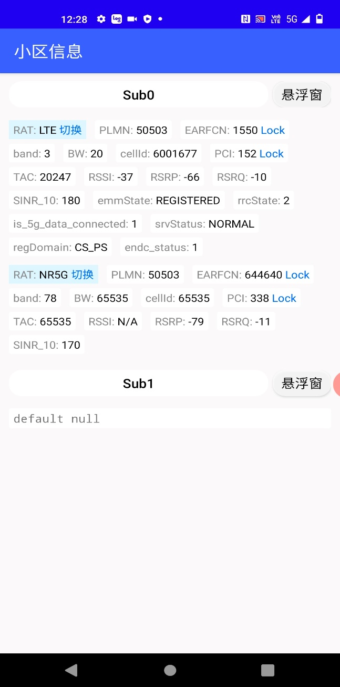
Vodafone 5G N78 Good Coverage : Near 4 Fennell St, North Parramatta, Sydney 2151.

Slide 6
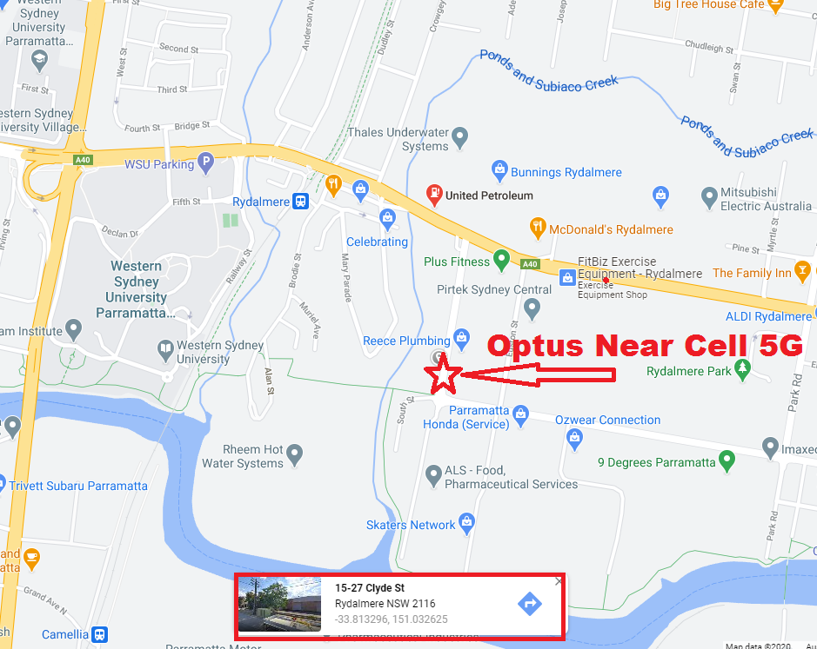
Optus 5G N78 Good Coverage : 15 Clyde St, Rydalmere, NSW-2116.

Slide 7
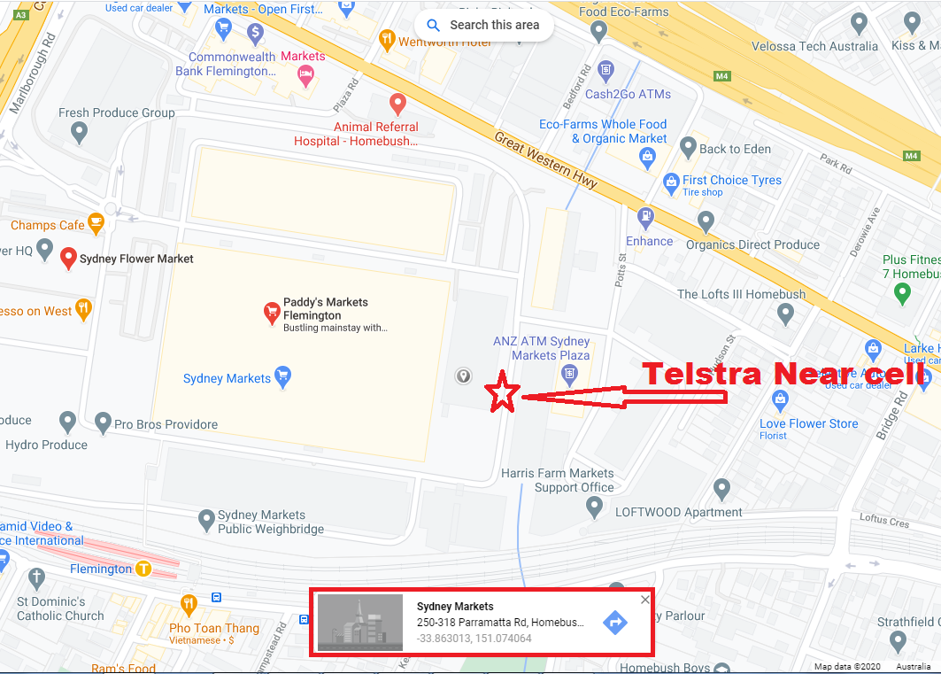
Telstra 5G N78 Good Coverage : Inside Flemengtion Market Parking, West Homebush, Sydney:-

Slide 8
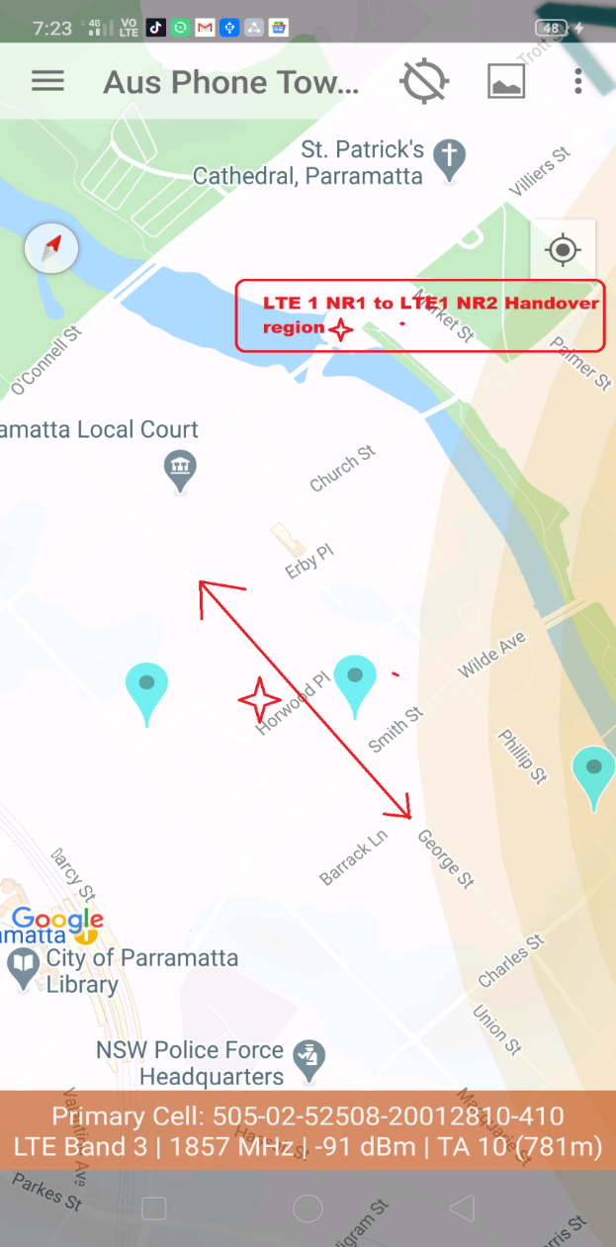
Optus- Handover: LTE#1+NR#1 → LTE#1+NR#2

Slide 9
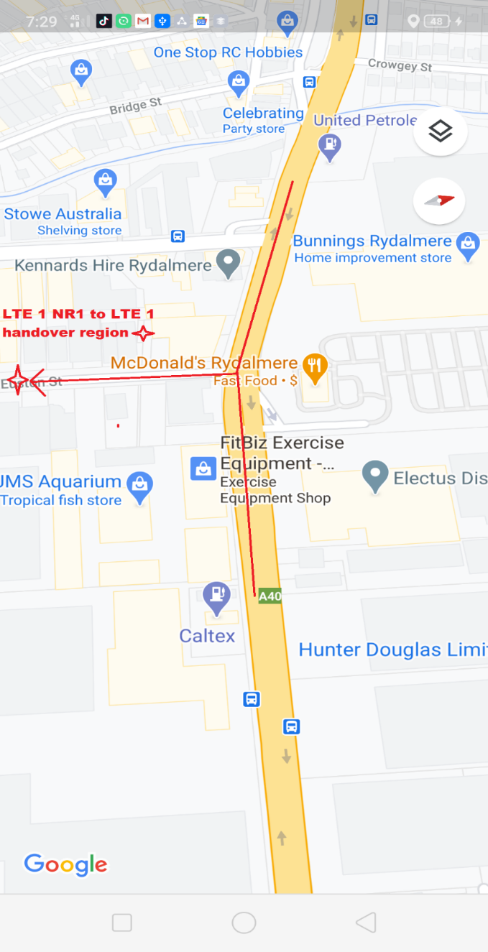
Optus - Handover: LTE#1+NR#1 → LTE#1 only

Slide 10
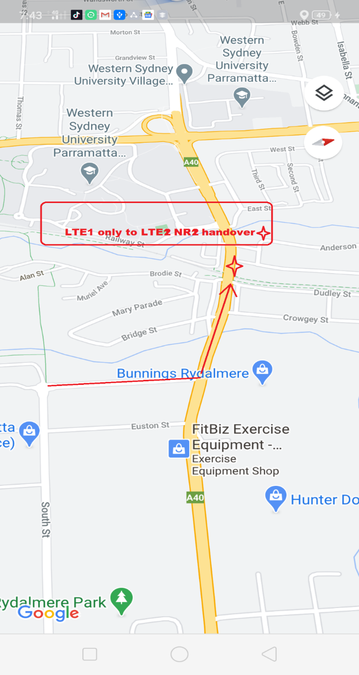
Optus - Handover: LTE#1 only → LTE#2+NR#2

Slide 11
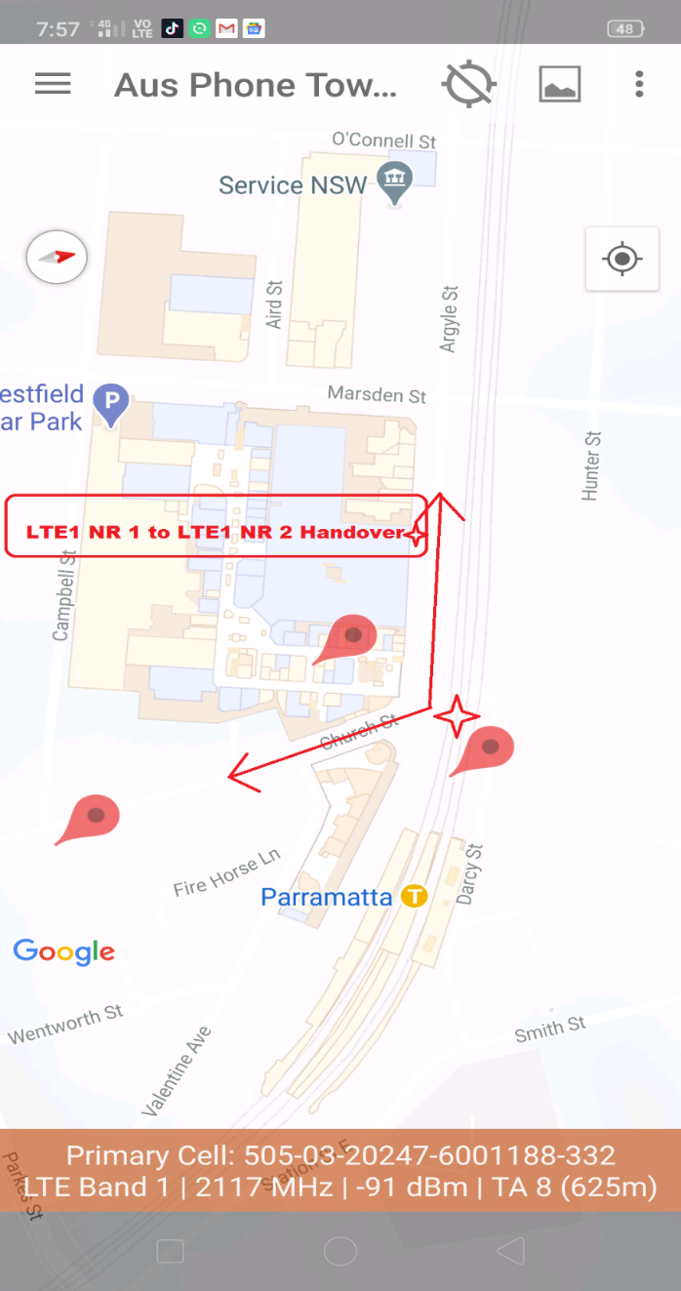
VHA - Handover: LTE#1+NR#1 → LTE#1+NR#2

Slide 12
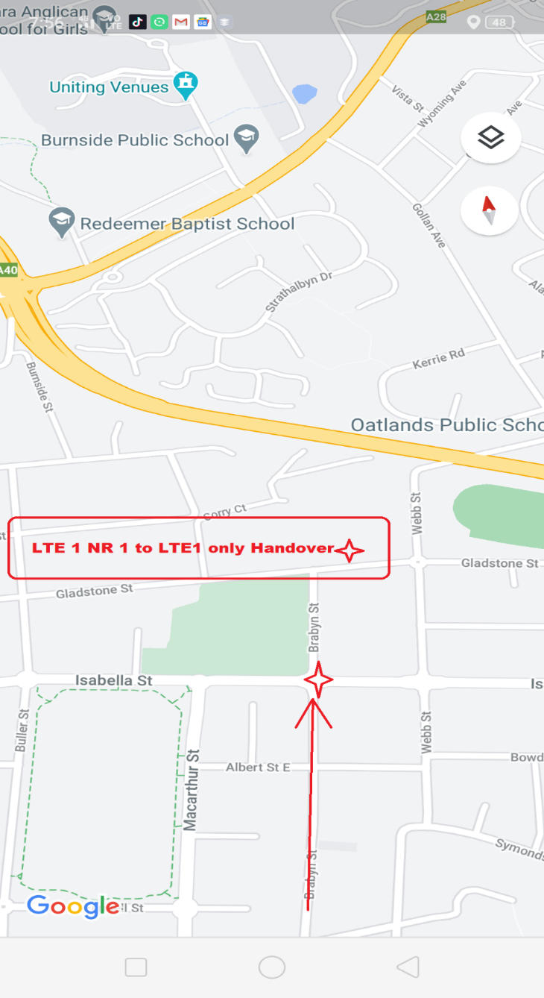
VHA - Handover: LTE#1+NR#1 → LTE#1 only

Slide 13
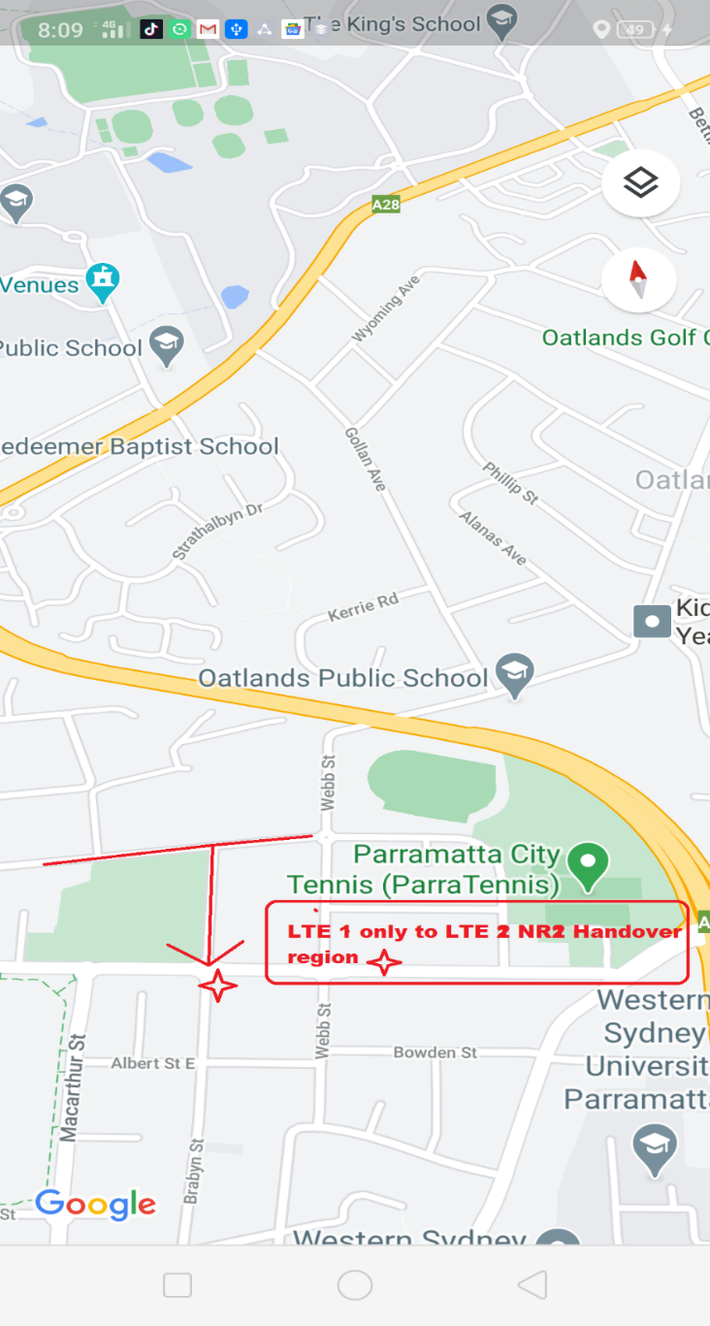
VHA - Handover: LTE#1 only → LTE#2+NR#2

Slide 14
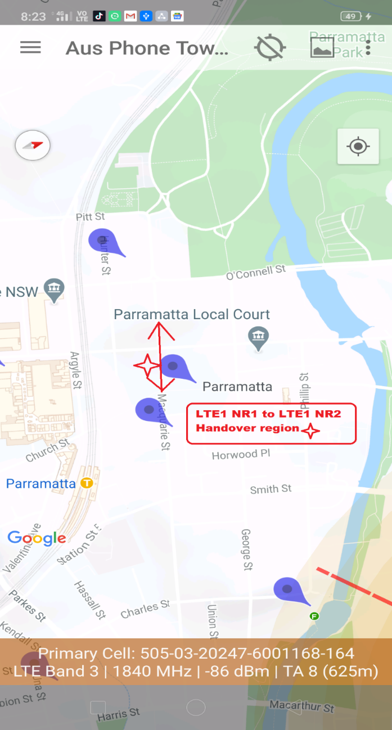
Telstra - Handover: LTE#1+NR#1 → LTE#1+NR#2

Slide 15
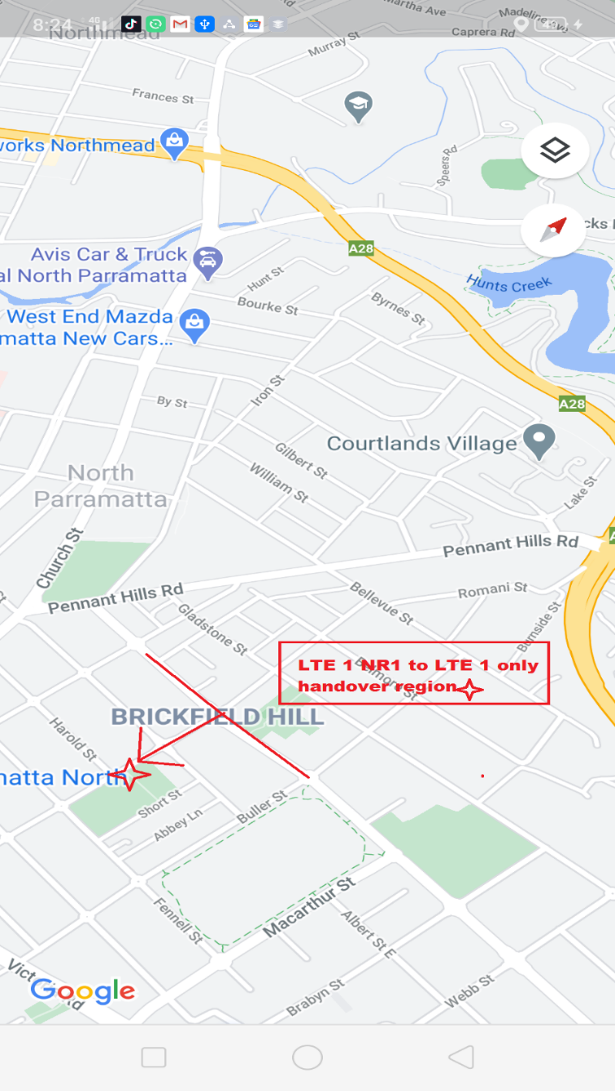
Telstra - Handover: LTE#1+NR#1 → LTE#1 only

Slide 16
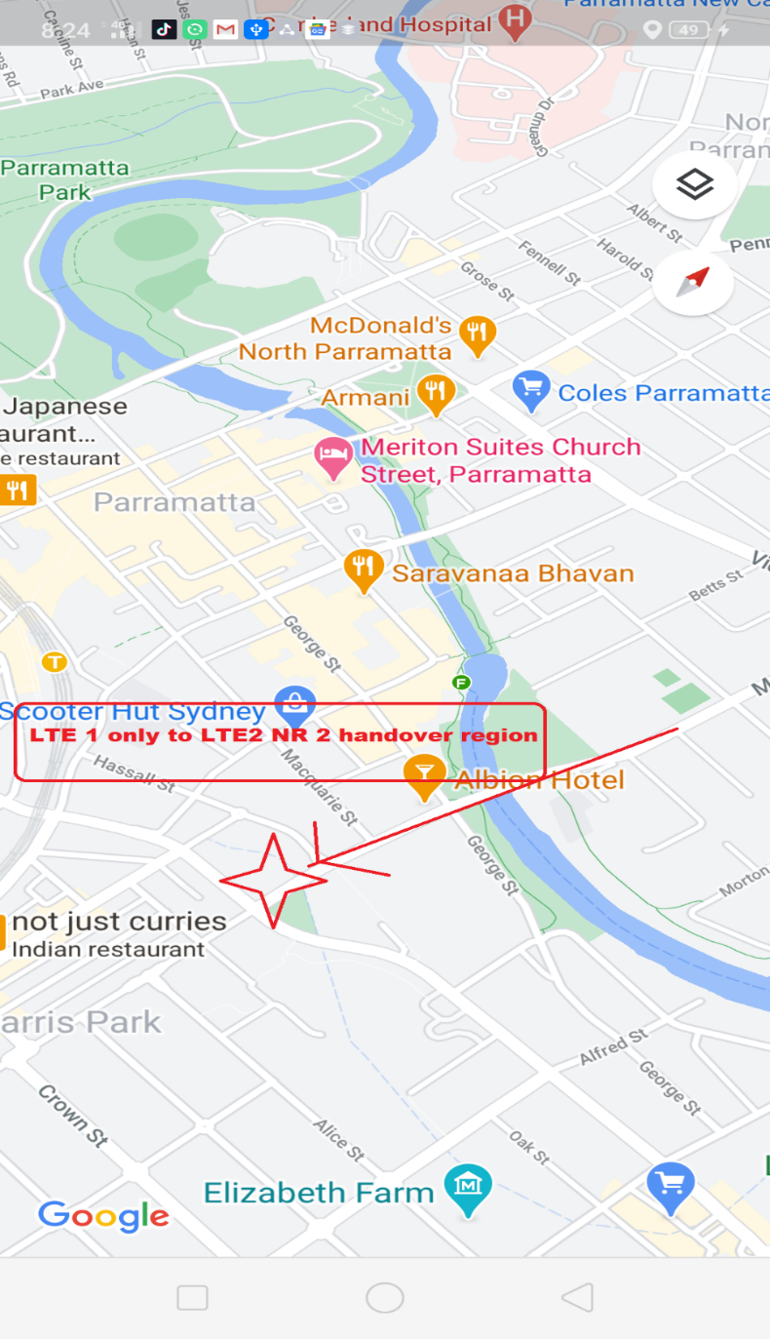
Telstra - Handover: LTE#1 only → LTE#2+NR#2

Slide 17
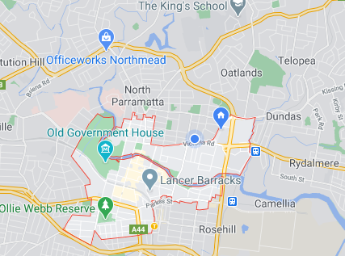
Telstra/Optus/Voda- 5G Network Mixed coverage Route:-

Slide 18
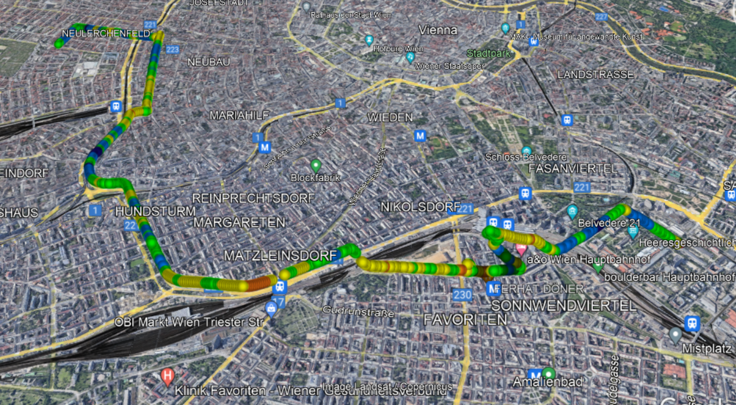
5G T-Mobile Drive Route
Alliogasse>>Westbahnhoff >> Mariahilfer strasse >>Gumpndorfer >>Friedrich Engelsplatz
RSRP: -78dbm to -100dbm Long/Lat: 16.380716 ; 48.243968

Slide 19
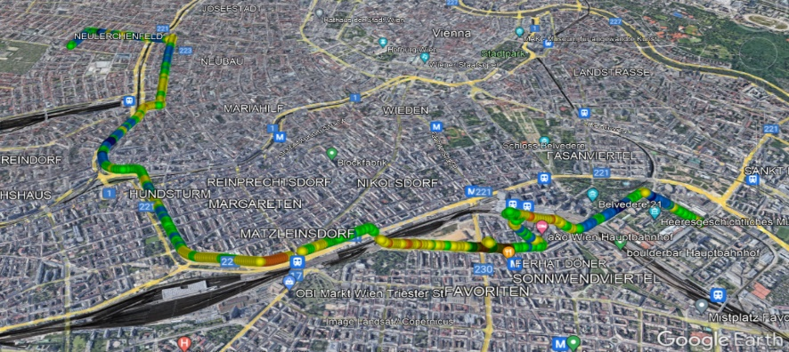
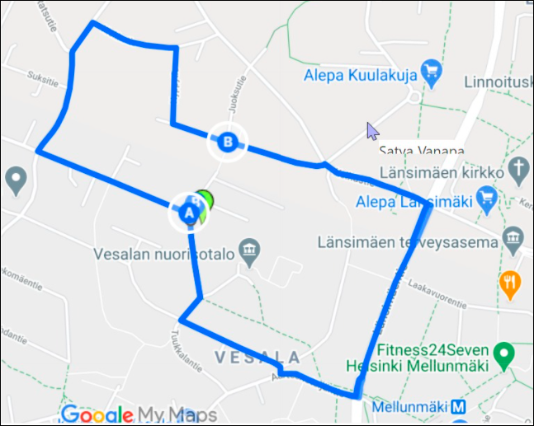
5G A1 Drive Route
Alliogasse >>Urban Loritz platz>>Westbahnhof >>Marihilfer Gurtel >> Gumpendrofer strasse>>Arbietergasse gurtel>>Arsenal
RSRP: -68dbm to -102dbm Long/Lat: 16.393115, 48.183412

Slide 20
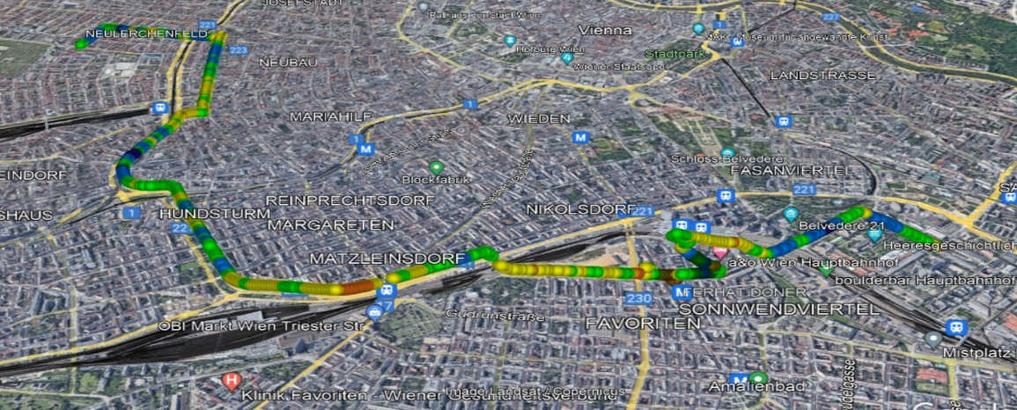
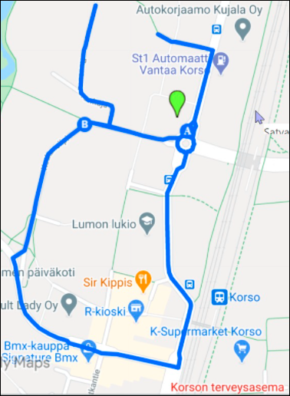
5G 3AT Drive Route
Josefstdt>>Himmelpfortgrund>>Thurygrund >> Spittelau>> Allerheiligrnplatz
RSRP: -dbm to -100dbm Long/Lat: 16.393118, 48.183417

Slide 21
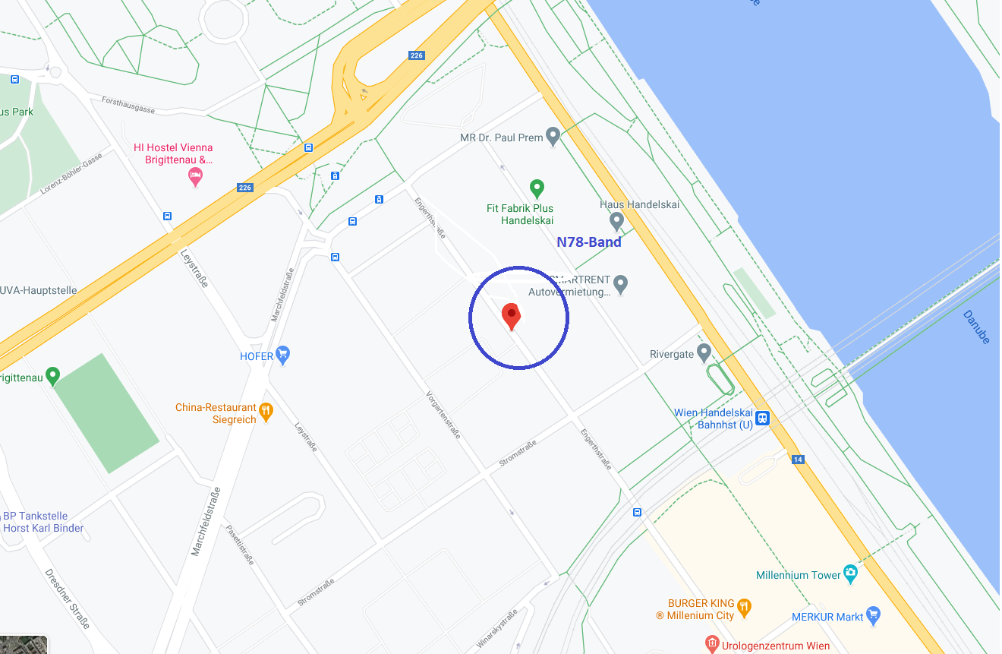
Operator: Tmobile Band: N78
Engerthstr. 51-47, 1200 Wien, Austria, 48.2428055, 16.3820908

Slide 22
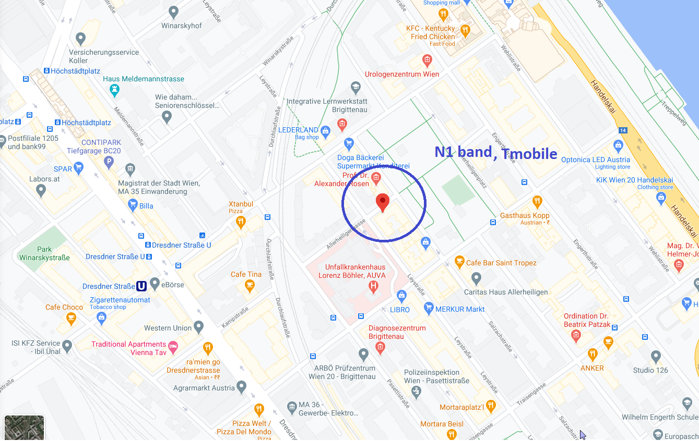
Operator: Tmobile Band: N1
Allerheiligengasse 13-7, 1200 Wien, Austria, 48.237778 16.384025

Slide 23
THANK YOU
MARQUIS TECHNOLOGIES
www.marquistech.com

