Slide 1
MARQUIS TECHNOLOGIES
Drive Route – Cairo (Egypt)

Slide 2
Travel to Cairo (Egypt)
Country | Egypt
Continent | Africa
City | Cairo
Duration of travel from Mumbai | Approx. 10 Hrs.
Time Zone | GMT +2
International Dialing Code | +20
VISA | Business Visa
VISA Duration | 1 Month , Multiple Entry
VISA Fees | Contact Nisha Deshpande
VISA Requirements | Need to provide 2 passport size photographs, 6 month bank statement
Yellow Fever Vaccination Certificate | Not Required

Slide 3
Operator Information
MCC | MNC | Operator | Bands (MHz)
602 | 02 | Vodafone | GSM 900 / 1800 / UMTS 2100
602 | 03 | Etisalat | GSM 900 / 1800 / UMTS 2100
602 | 01 | Orange | GSM 900 / 1800 / UMTS 2100

Slide 4
USSD Codes for operators
No. | Operator | Balance Check Code | Customer Care | Voice Mail No.
1 | Vodafone | *868# | Call 808 for Prepaid | 808
2 | Etisalat | *134# | Call 111 for Prepaid | 333
3 | Orange | #100# | Call 140 for Prepaid | 110

Slide 5
Manual APN Settings
Attached is a sheet which has Manual APN Settings for all operators in Cairo (Egypt)

Slide 6
RSRP Criteria
Near Cell :-Stationary: RSRP : -55dbm to -85dbm
Cell Edge :-Stationary: RSRP : -95dbm to -110dbm
Mixed :-Mobility: RSRP : -55dbm to -120dbm

Slide 7
Services Supported by Operators
Operator | Features/Services | Supports(Yes/No)
Vodafone | Reselection | Yes
 | Redirection | Yes
 | MMS | Yes
 | CSFB | Yes(3G)
 | VoLTE | No
 | PS Handover | Yes
Etisalat | Reselection | Yes
 | Redirection | Yes
 | MMS | Yes
 | CSFB | Yes(3G)
 | VoLTE | No
 | PS Handover | Yes
Orange | Reselection | Yes
 | Redirection | Yes
 | MMS | Yes
 | CSFB | Yes(3G)
 | VoLTE | No
 | PS Handover | Yes

Slide 8
Additional Information
Where to Get SIM cards?
Sun City Mall and Novatel Cairo Hotel
What Documents Required to Purchase SIM?
Passport ID and Colored Photographs.
Best Recharge Option for 8 days Testing?
Recharges are available in all confectionery shop.
Best Hotel to Stay
Hotel Radisson Blue
Driver Details for Mobility?
Mob: +2001005846217

Slide 9
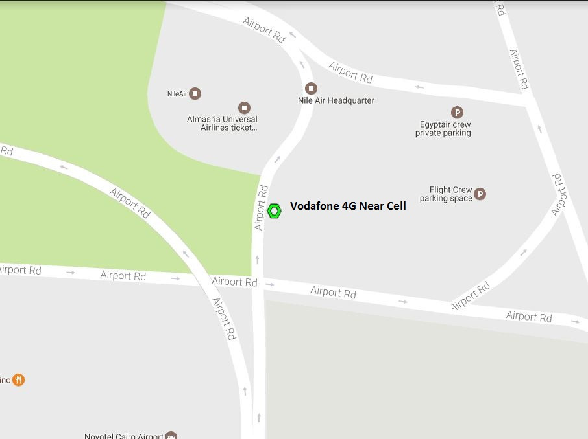
Near Cell Location of Vodafone
Location :Novotel Cairo Airport Hotel
Lat: 30° 7'23.59
Long:31°24'9.90

Slide 10
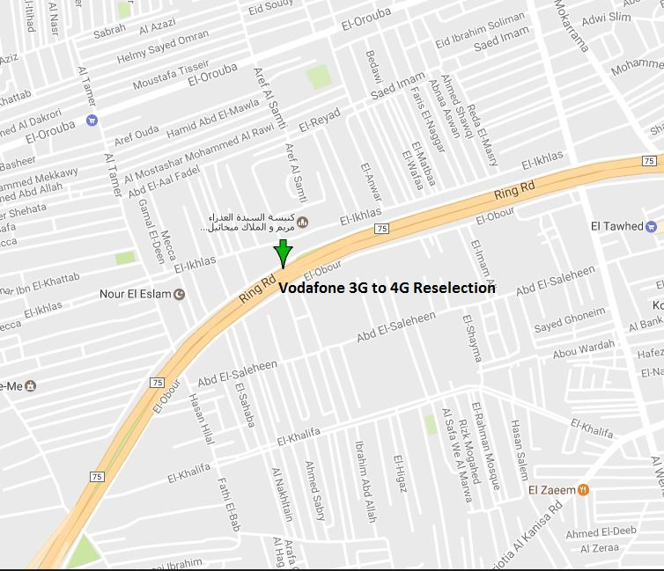
Edge Cell Location of Vodafone
Location :ALMAZA AVENUE
Lat: 30° 5'9.88
Long:31°22'2.30

Slide 11
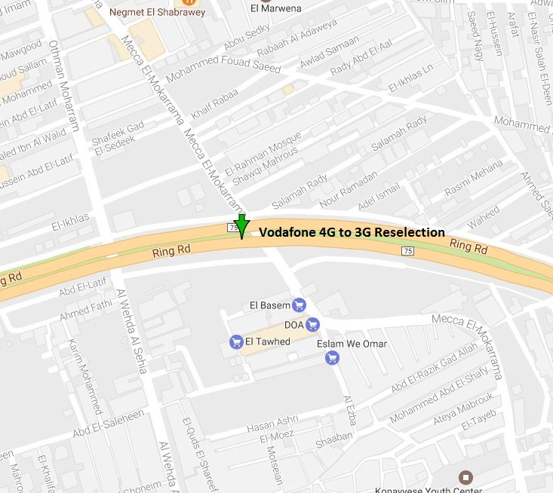
4G to 3G Reselection Location of Vodafone
Location :The Road of Pyramids
Lat: 29°59'13.16
Long:31°11'25.55

Slide 12
3G to 4G Reselection Location of Vodafone
Location :The Road of Pyramids
Lat: 29°59'5.39
Long:31°10'53.30

Slide 13
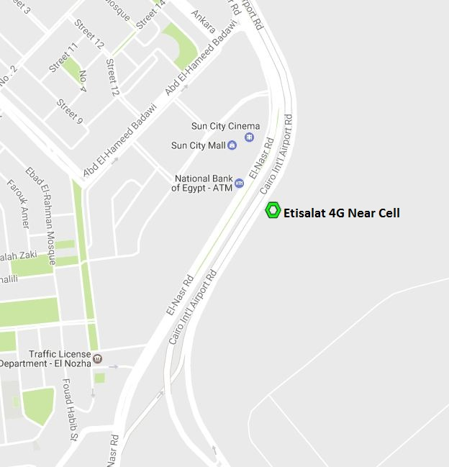
Near Cell Location of Etisalat
Location :Sun City Mall
Lat: 30° 6'2.22
Long:31°23'13.78

Slide 14
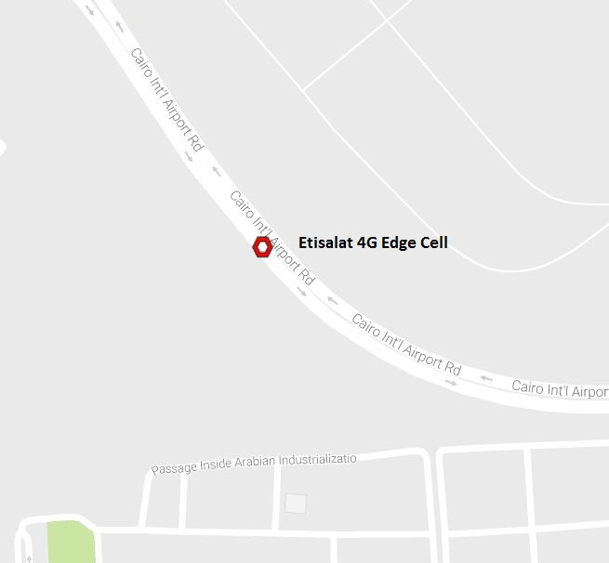
Edge Cell Location of Etisalat
Location : Wedi Degle, Egypt31
Lat: 30° 5'28.53
Long: 31°23'17.48

Slide 15
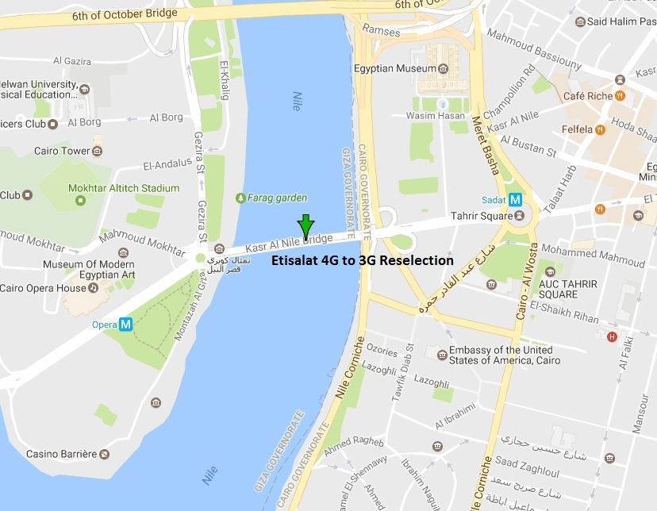
4G to 3G Reselection Location of Etisalat
Location : Opera Square
Lat: 30° 2'37.67
Long:31°13'48.32

Slide 16
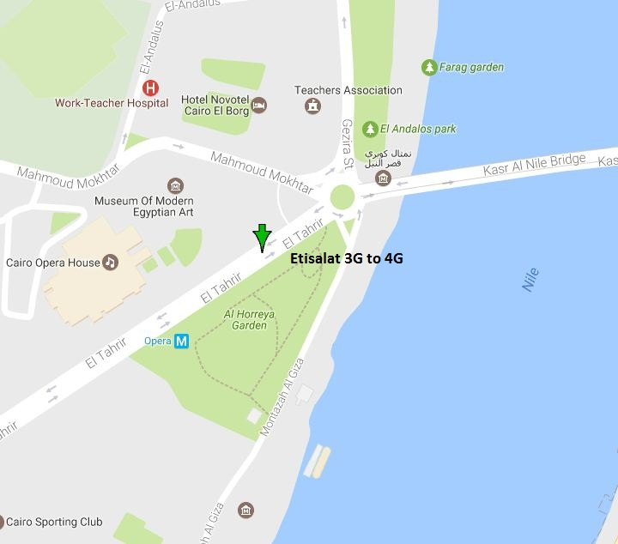
3G to 4G Reselection Location of Etisalat
Location : Mohammed Ali Park
Lat: 30° 2'34.10
Long: 31°13'34.16

Slide 17
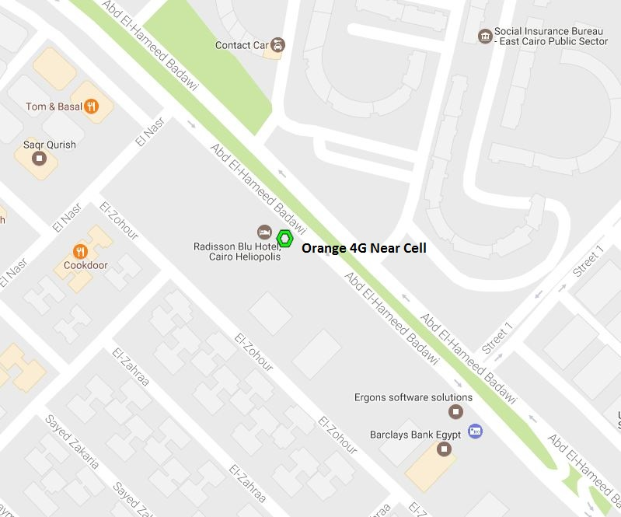
Near Cell Location of Orange
Location : Street of Sheraton Place
Lat: 30° 6'22.81
Long: 31°22'32.97

Slide 18
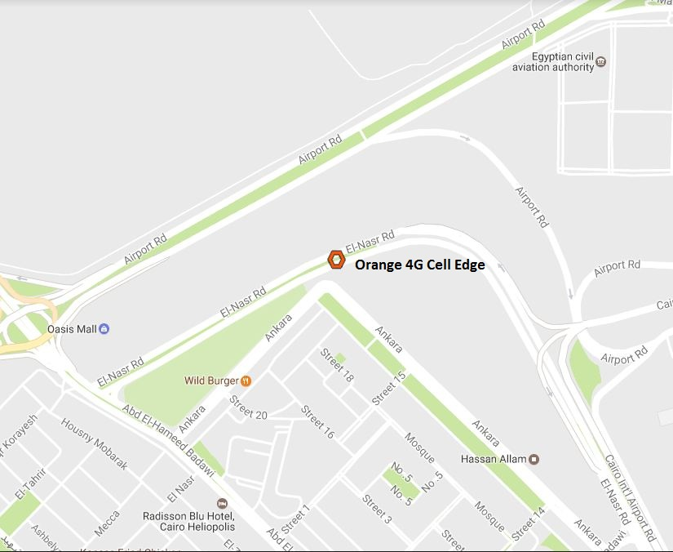
Edge Cell Location of Orange
Location : Sakr Quresh Building
Lat: 30° 6'42.13
Long:31°22'43.28

Slide 19
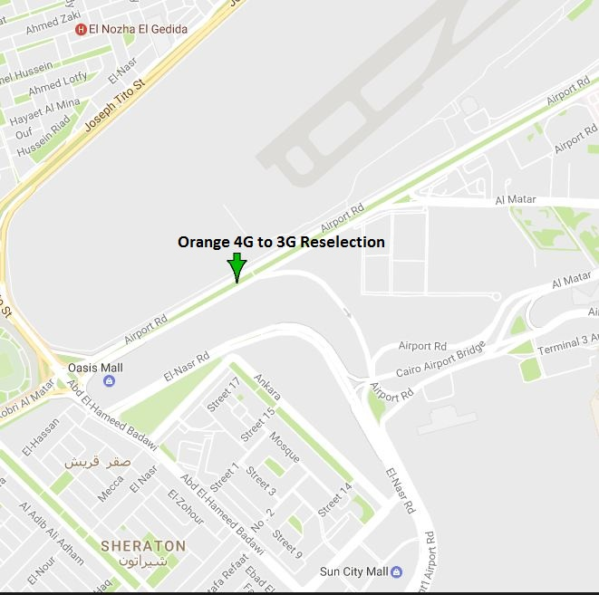
4G to 3G Reselection Location of Orange
Location :Airport Road
Lat: 30° 6'51.91
Long:31°22'44.19

Slide 20
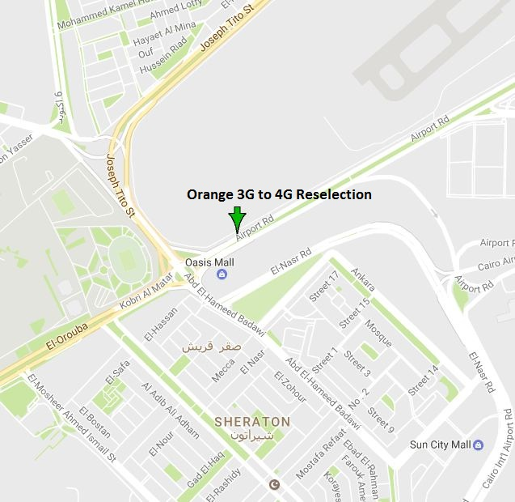
3G to 4G Reselection Location of Orange
Location :Airport Road
Lat: 30° 6'44.18
Long:31°22'25.35

Slide 21
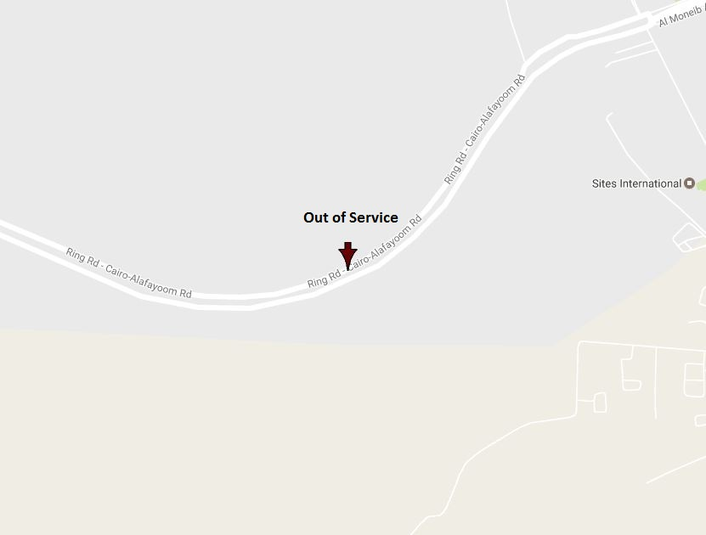
Out of Service Location of All Operators
Location :Ring Rd-Cairo-Alafayoom Rd
Lat: 29°56'33.81
Long:31° 8'6.17

Slide 22
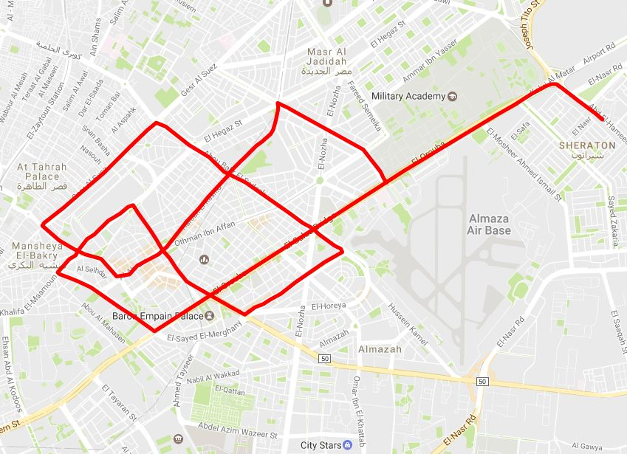
Mobility Route1:4G

Slide 23
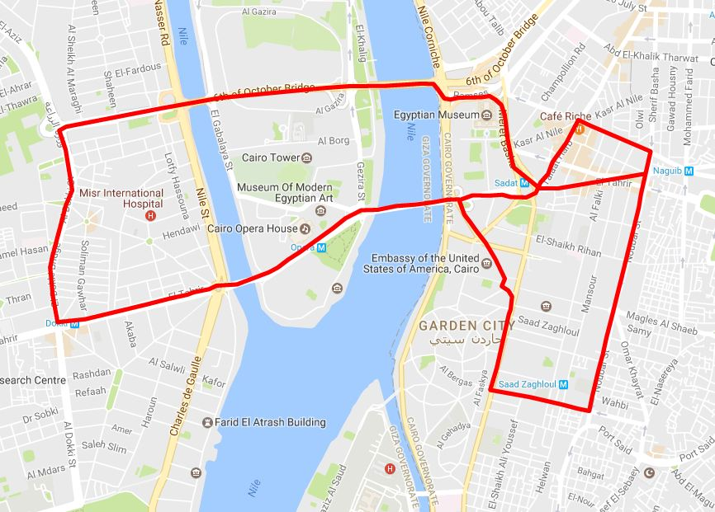
Mobility Route2:4G

Slide 24
Top Most Popular Android Apps used in Egypt
Facebook
Facebook Messenger
WhatsApp Messenger
Share it
Uber
IMO
True caller
Bigo Live
Viber
Careem

Slide 25
Local EM number used in Egypt
Police | 122
Traffic Police | 128
Tourist Police | 126
Ambulance | 123
Fire Bridge | 180

Slide 26
THANK YOU
MARQUIS TECHNOLOGIES
www.marquistech.com

