Slide 1
MARQUIS TECHNOLOGIES
5G Drive Route – Thailand

Slide 2
Drive Route
Near Cell :-Stationary: RSRP: -65dbm to -90dbm
Mixed :-Mobility: RSRP : -75dbm to -100dbm
Cell Edge :-Stationary: RSRP : -95dbm to -120dbm

Slide 3
Operator | Mobility Scenario | Location Tested | Longitude / Latitude
AIS | 4G-3G-4G HO SPOT | SV City Parking | 13.67208, 100.54382
 | SRVCC to 3G | SV City Parking | 13.67208, 100.54382
 | IRAT | SV City Parking | 13.67208, 100.54382
 | Good Coverage for Testing | Flash express rama 3 | 13.67474, 100.53830
 | Poor Coverage for testing | SV City, Parking | 13.67208, 100.54382
 | OOS Area | SV City Basement | 13.67208, 100.54382
TrueMoveH | SRVCC to 2G | Not supported /Location not Found | NA
 | SRVCC to 3G | SV City Parking | 13.67208, 100.54382
 | 4G-3G-4G HO SPOT | SV City Parking | 13.67208, 100.54382
 | IRAT | SV City Parking | 13.67208, 100.54382
 | Good Coverage for Testing | RN Building | 13.67622, 100.54481
 | Poor Coverage for testing | SV City Parking | 13.67208, 100.54382
 | OOS Area | SV City Basement | 13.67208, 100.54382
DTAC | SRVCC to 3G | SV City Parking | 13.67208, 100.54382
 | SRVCC to 2G | Not supported /Location not Found
 | 4G-3G-4G HO SPOT | SV City Parking | 13.67208, 100.54382
 | IRAT | SV City Parking | 13.67208, 100.54382
 | Good Coverage for Testing | PATEX Flagship Store Rama 3 | 13.67461, 100.54320
 | Poor Coverage for testing | SV City Parking | 13.67208, 100.54382
 | OOS Area | SV City Basement | 13.67208, 100.54382

Slide 4
Services Supported by AIS VoLTE Operator
AIS 5G/4G/3G/2G | GSM-900MHz & 1800MHz, B1(2100 MHz), B3(1800MHz), NR41 (2600 MHz),
OPERATOR | Features /Services | Supported(yes/No)
AIS (Major) | Reselection | Yes
 | Redirection | Yes
 | MMS /SMS | Yes
 | Volte | Yes
 | vowifi | Yes
 | PS Handover | Yes

Slide 5
Major Thailand Operators : Locations for 5G /NR Field Test
Operator | PLMN | 5G Tested Locations | Longitude / Latitude | ENDC combination Tested
AIS | 520/03 | Siam Square One | 13.74517, 100.53382 | LTE Band 1 + NR 41
 |  | SV City Rama3 | 13.67208, 100.54382 | LTE Band 1 + NR 41
TrueMoveH | 520/04 | Siam Square One | 13.74517, 100.53382 | LTE Band 3 + NR 07
 |  | SV City Rama3 | 13.67208, 100.54382 | LTE Band 3 + NR 07
DTAC | 520/05 | 5G Not Tested Till Now

Slide 6
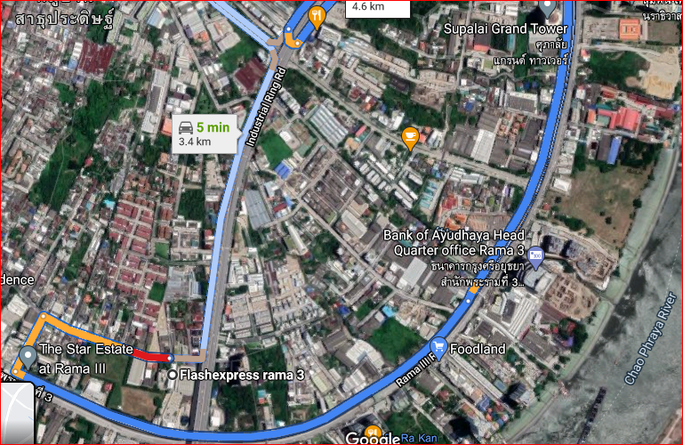
AIS 5G VoLTE Good Coverage Area Band L1,L3 AND L8 WITH NR 41 BAND Route >>Flash Express Rama3 >> MS Saim
L1 AND L8 BANDS WITH NR 41
L1 AND L3 BAND WITH NR 41

Slide 7
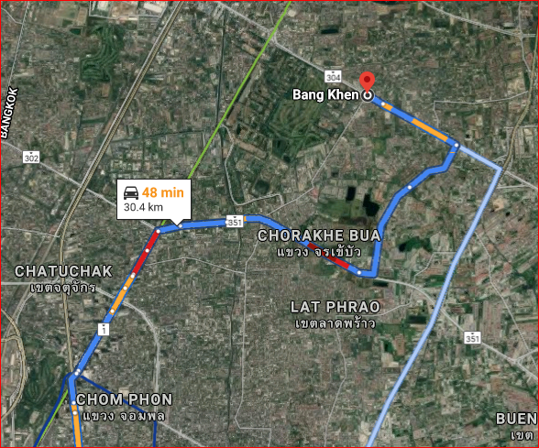
AIS 5G and 4g VoLTE Mix Coverage Area Route >> Chatukchak >> Bang Khen Road
5g coverage ends here
4g and 5g mixed coverage
5g area

Slide 8
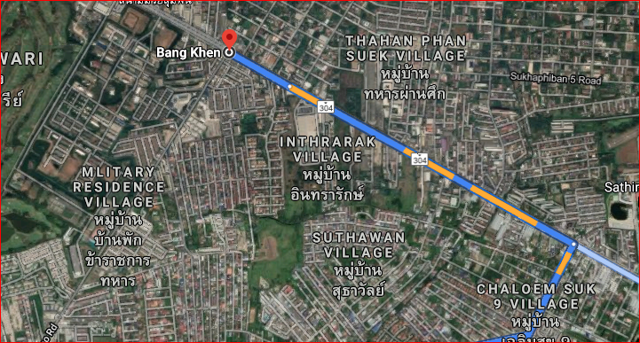
AIS weak 5G VoLTE Coverage Area Band NR 41, LTE band L1,L3 AND L8 Route >> Bang sue Road >> Bang Khen
5g coverage ends
Weak 5g area AIS

Slide 9
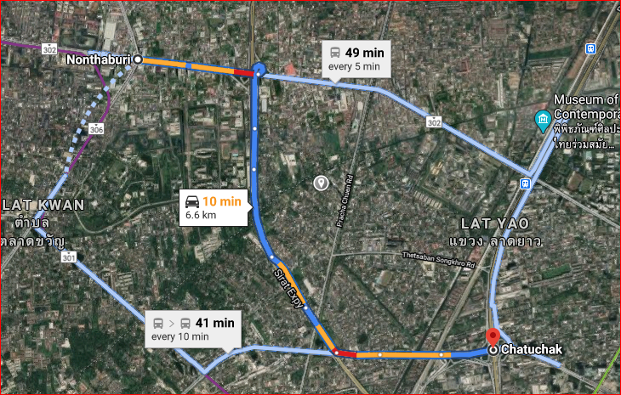
AIS 5G VoLTE operator CA to non CA HO (B3_CA NR 41 to 4G L8_Non CA) Route>>Chatukchak to Nonthaburi road
First handover point
5g to 4g handover
EC:2

Slide 10
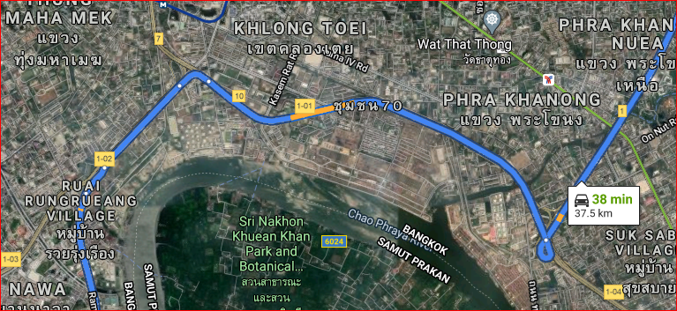
Band HO from B3 to B1 and B1 to B40 for DTAC VoLTE operator Route Rama 3 to Saim Road

Slide 11
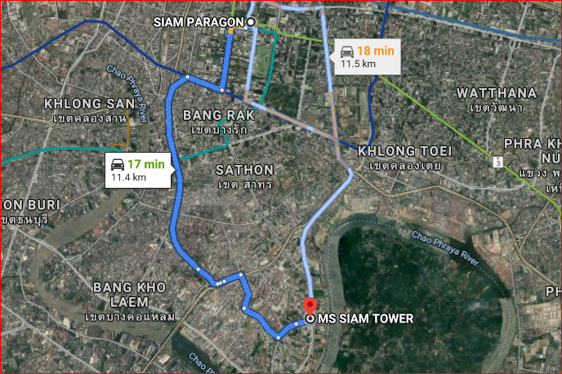
Band HO from B1 to B3 in NR41 region during ongoing MO call AIS Route>> MS Saim to Saim Paragon

Slide 12
Band HO from B1 to B8 during ongoing MO call for AIS Saim to MS Saim

Slide 13
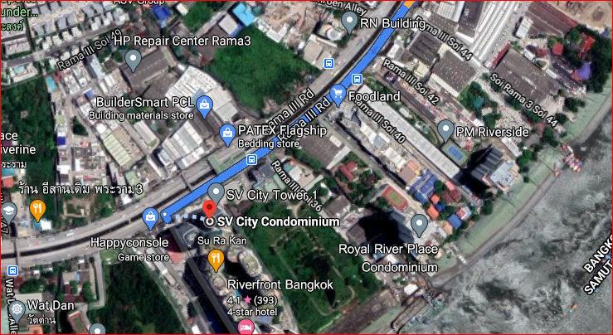
SRVCC AIS 5G VoLTE to 4G Volte On Rama 3 Road

Slide 14
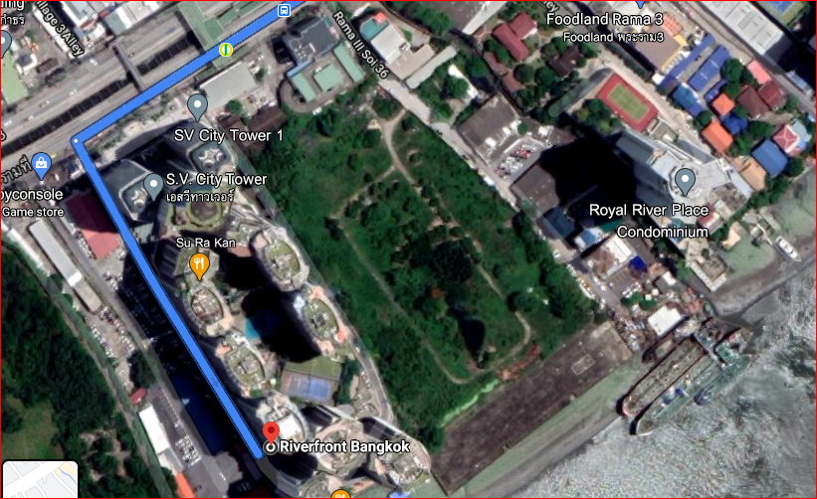
SRVCC 4G TO 3G – Happens ( 4G to 2G Not Found Loaction) Near Rame 3 River Front

Slide 15
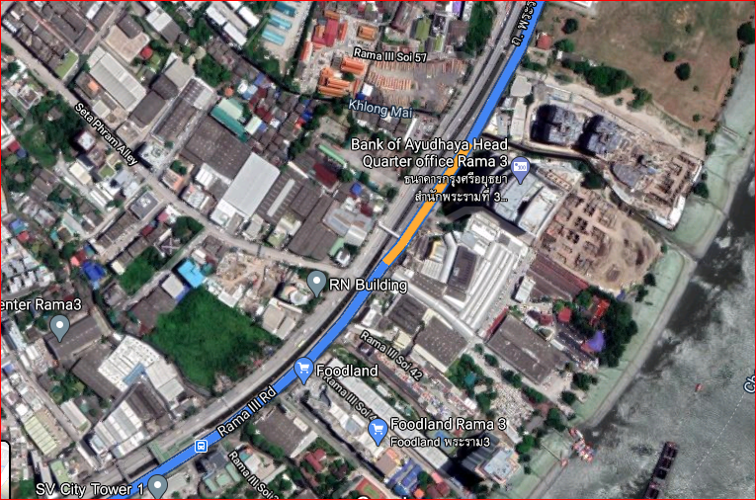
HO from one CA (B1+B3 AND NR 41) cell to another CA cell for NR CELLS AIS 5G VoLTE operator Route>> SV City Rama 3 to Ms Saim Road

Slide 16
TruemoveH 5G LTE BAND HANDOVER (B3 +B1) to Non CA B28 Route >>Ms Saim to River Front Road

Slide 17
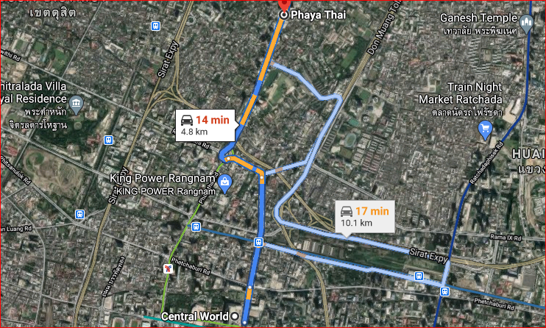
TrueMoveH 5G Volte Operator Band Handover (B1 – B41) Route >>Central Saim >>> Paya Thai

Slide 18
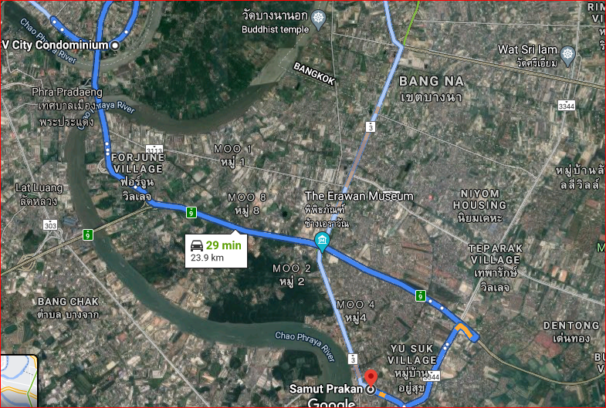
DTAC 4G VoLTE Band Handover B1 to B40 Route >> SV City >> Samut Prakan

Slide 19
TrueMoveH 5G Volte operator CA (B1+B3) to Non CA B41 Route >> Central world Road >> Paya Thai

Slide 20
TrueMoveH 5G Volte operator CA to CA Handover(B1) to (B3) Route >>MS Saim to SV City Rama3

Slide 21
TrueMoveH 5G to 4G Volte operator SRVCC Location Route >> Near River Front Rama3

Slide 22
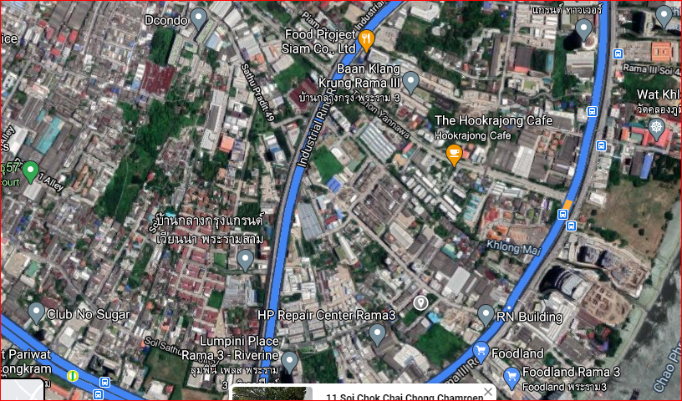
TRuemoveH 5G Volte operator 4G to 3G to 4G Handover ( 4G To 2G to 4G Location Not Found) Route >>MS Saim to SV City and River front area

Slide 23
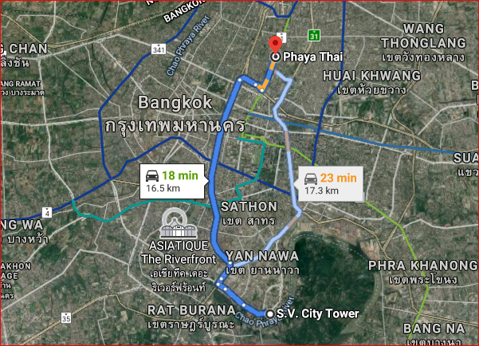
TrueMoveH 4G long calls SV City to Phaya Thai

Slide 24
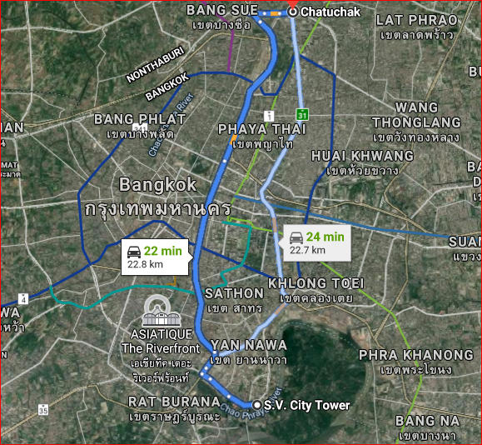
ICE 4G Volte operator 4G to 3G to 4G Handover Route >> SV City to Chatuchak

Slide 25
THANK YOU
MARQUIS TECHNOLOGIES
www.marquistech.com

