Slide 1
MARQUIS TECHNOLOGIES
Drive Route Hyderabad/ india
Prepared by suri babu

Slide 2
Signal Strength
Near Cell :-Stationary: RSRP: -60dbm to -75dbm
Mixed :-Mobility: RSRP : -75dbm to -95dbm
Cell Edge :-Stationary: RSRP : -95dbm to -115dbm

Slide 3
Services Supported by JIO Operator
Country | India
City | Hyderabad
Operator Name | JIO
Technologies support | VoLTE/ViLTE/VoWiFi/ViWiFi/CA/LTE
Emergency Call | 112, 911
USSD Code | NO
VoLTE Support | YES
ViLTE Call Support | YES
CSFB support | NO
VoWiFi Support | YES
ViWiFi Call Support | YES
VoWiFi support in Airplane mode | NO
CA Combination | B40+B40 B40+B3 B3+B5
SRVCC to 3G/2G | NO
5G Band | NA
Dedicate Mode/NSA/SA | NA
Band Combination (NR + LTE) | NA
4G Band | Band 3 Band 5 Band 40
3G Band | NO
2G Band | NO
Infra vendor Name | Samsung
Voicemail Services | NO
UT /XCAP | YES
Conference Call Support | YES
Supplementary Services | YES
Prepaid APN | jionet

Slide 4
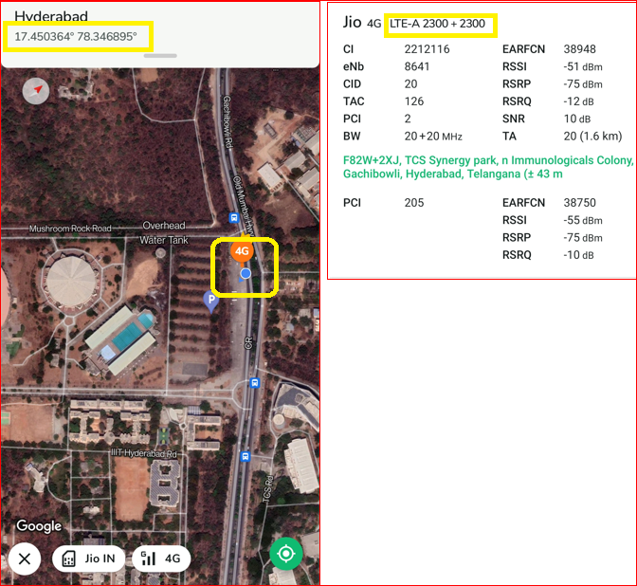
JIO Near-cell CA location
Band combination: B40+B40
RSRP: -70 to -75dbm
Area->Gachibowli
Landmark->Stadium

Slide 5
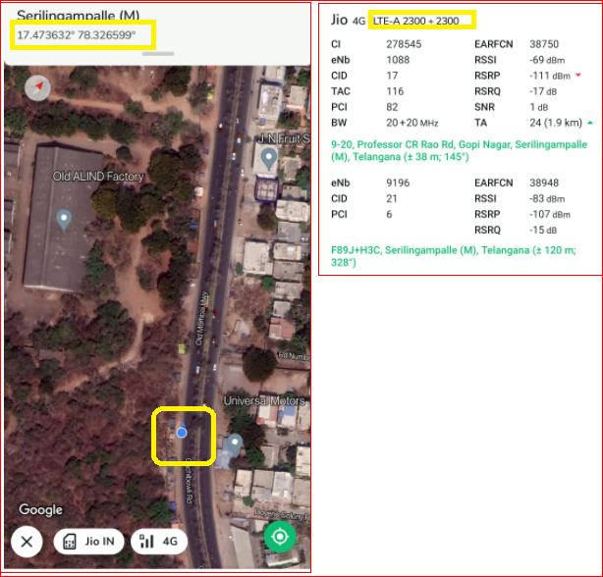
JIO Edge-cell CA location
Band combination: B40+B40
RSRP: -108 to -115dbm
Area->Lingampally
Landmark->Aluminium factory

Slide 6
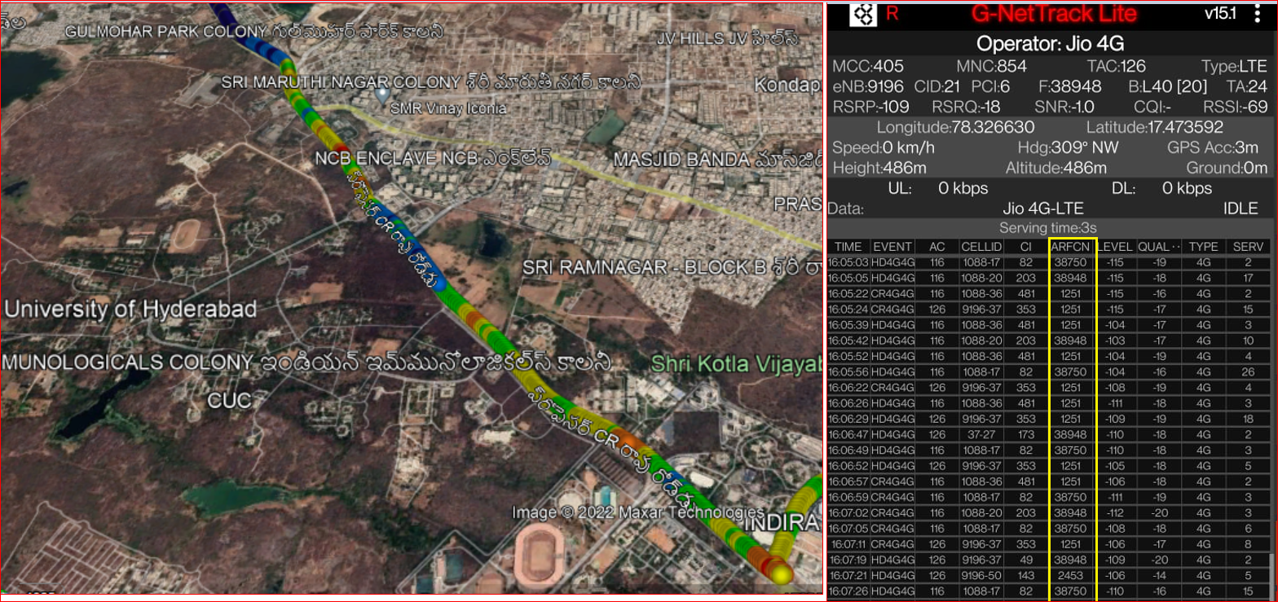
JIO Mixed-coverage CA location
Route : HCU Road <-> Linmagapally

Slide 7
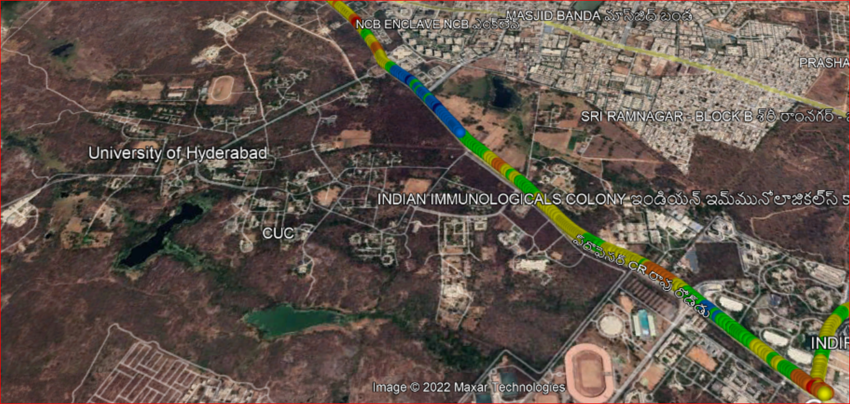
JIO CA to CA Handover location
Route : Gachibowli stadium <-> Linmagapally

Slide 8
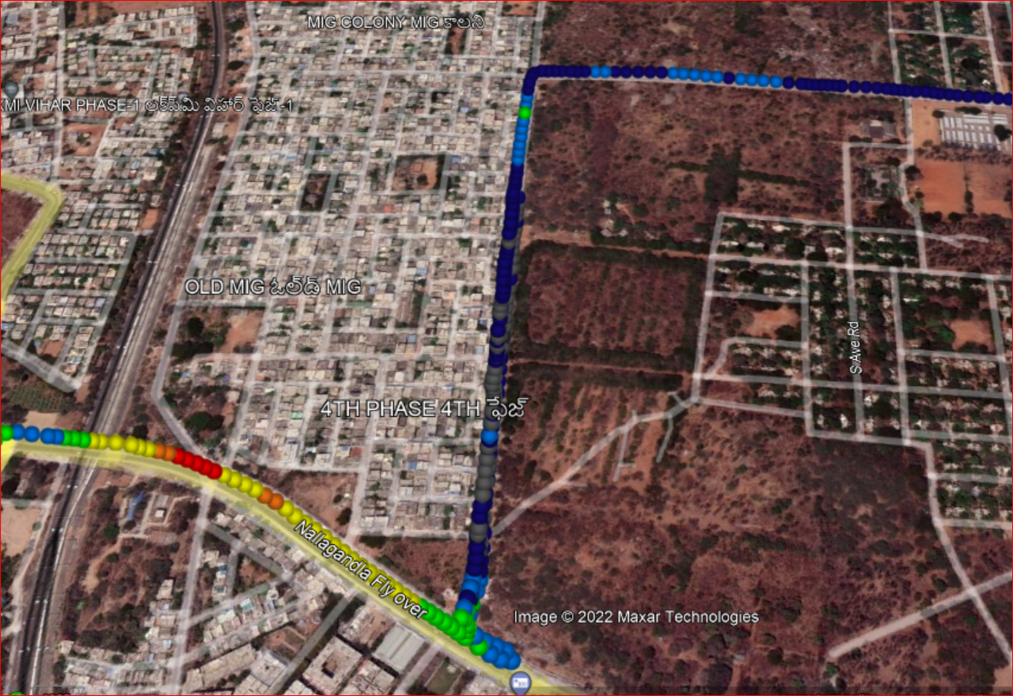
JIO CA to Non-CA Handover location
Route : Nallagandla Flyover -> OLD MIG Road

Slide 9
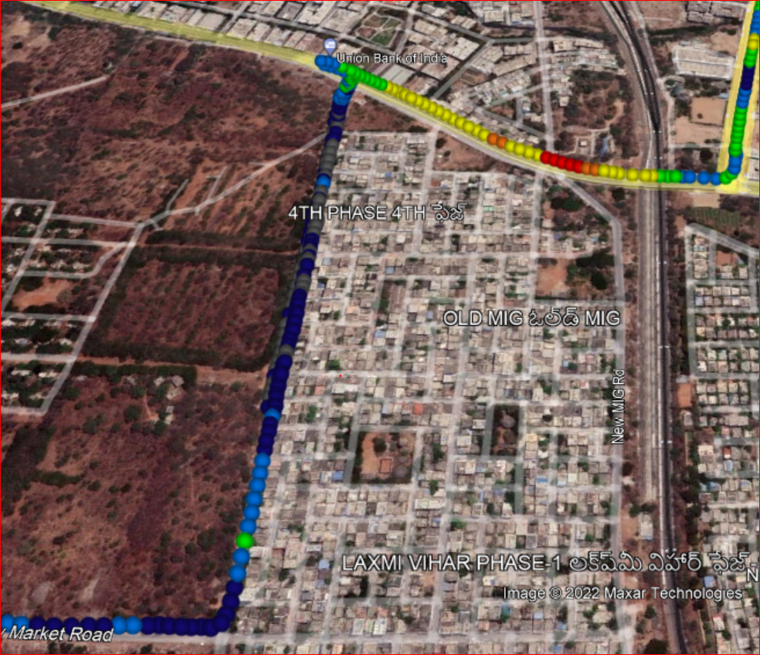
JIO Non-CA to CA Handover location
Route : OLD MIG -> Nallagandla flyover

Slide 10
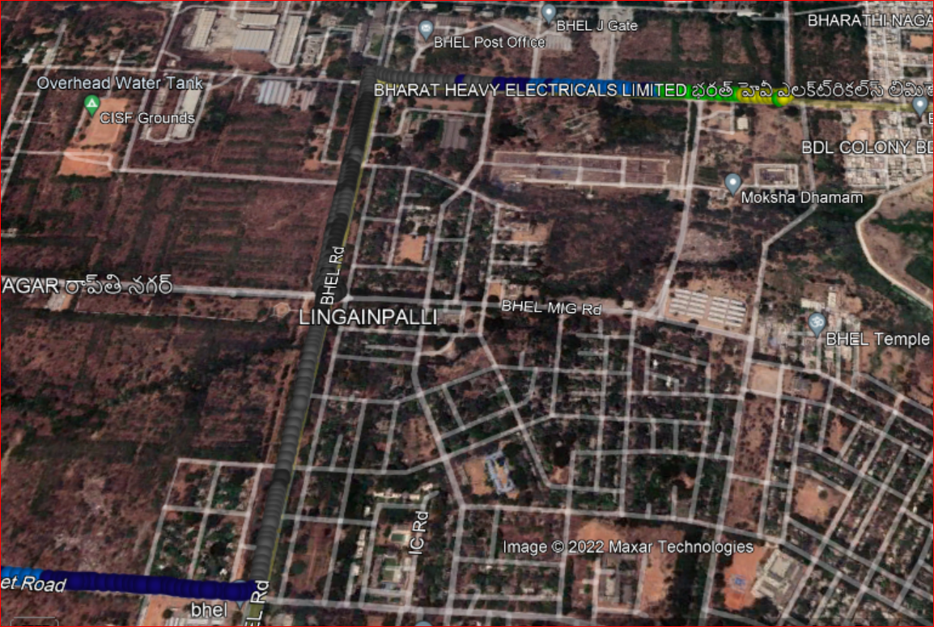
JIO Non-CA to Non-CA Handover location
Route : BHEL Wednesday market-> BHEL TEMPLE

Slide 11
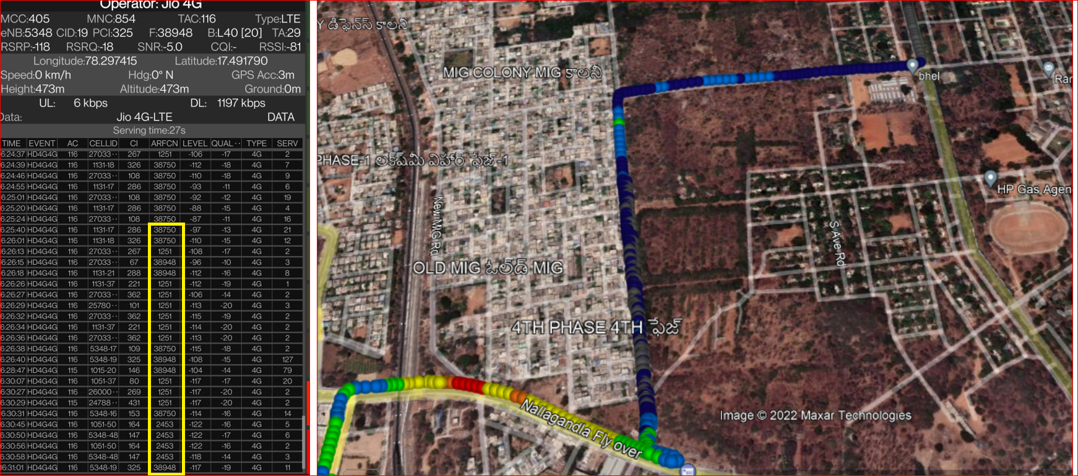
JIO Inter Band Handover location from B40<->B3 & B40<->B5
Route : Nallagandla flyover <-> OLD MIG <-> BHEL Temple

Slide 12
JIO Inter Band Reselection location from B40<->B3 & B40<->B5
Route : Nallagandla flyover <-> OLD MIG <-> BHEL Temple

Slide 13
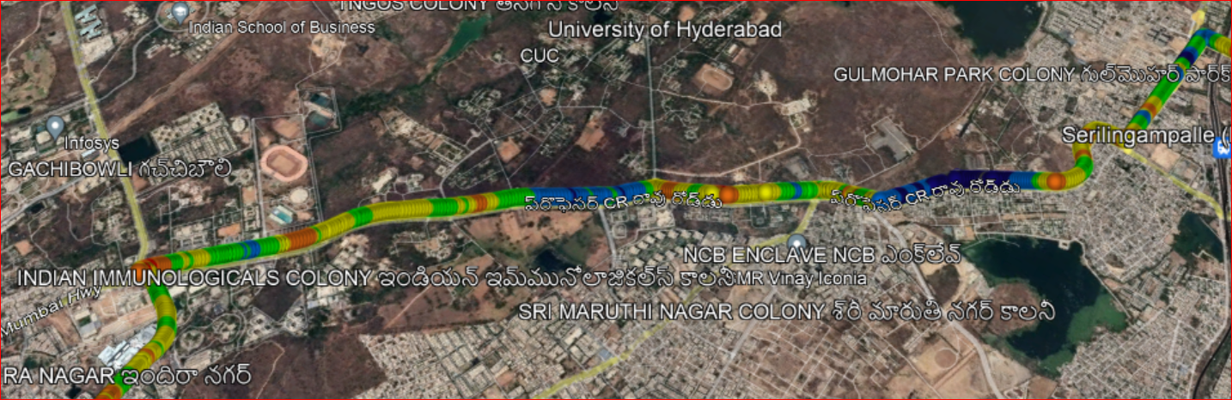
JIO Intra Band Handover/Reselection location
Route: Gachibowli <-> Lingampally road

Slide 14
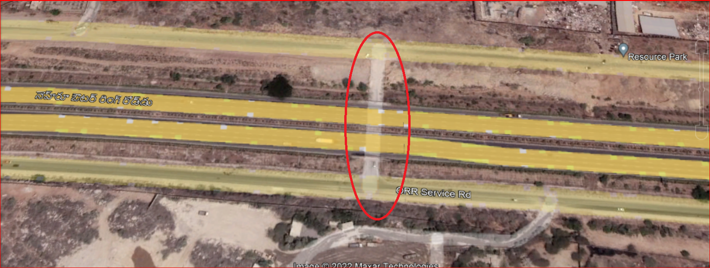
JIO Out of service location
Route : Tunnel 2 towards Narsingi OOR Circle to Movie tower
Location: 17.412561 , 78.304849

Slide 15
Services Supported by Airtel Operator
Country | India
City | Hyderabad
Operator Name | Airtel
Technologies support | VoLTE/ViLTE/VoWiFi/ViWiFi/CA/LTE/2G
Emergency Call | 112, 911
USSD Code | YES
VoLTE Support | YES
ViLTE Call Support | YES
CSFB support | YES
VoWiFi Support | YES
ViWiFi Call Support | YES
VoWiFi support in Airplane mode | NO
CA Combination | B40+B40 B3+B8 B3+B40
SRVCC to 3G/2G | YES
5G Band | NA
Dedicate Mode/NSA/SA | NA
Band Combination (NR + LTE) | NA
4G Band | Band 3 Band 8 Band 40
3G Band | NO
2G Band | GSM1800
Infra vendor Name | Ericsson
Voicemail Services | NO
UT /XCAP | NO
Conference Call Support | YES
Supplementary Services | YES
Prepaid APN | airtelgprs.com

Slide 16
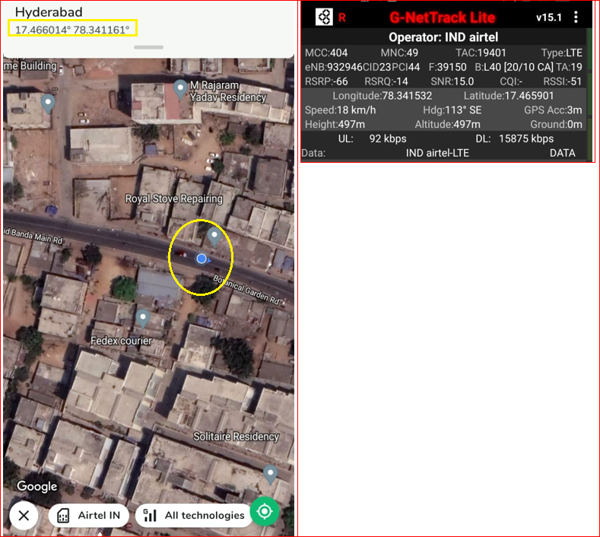
Airtel Near-cell CA location
Band combination:B40+B40
RSRP: -65dbm to -75dbm
Area->Masjid banda road
Landmark->Aditya pharmacy

Slide 17
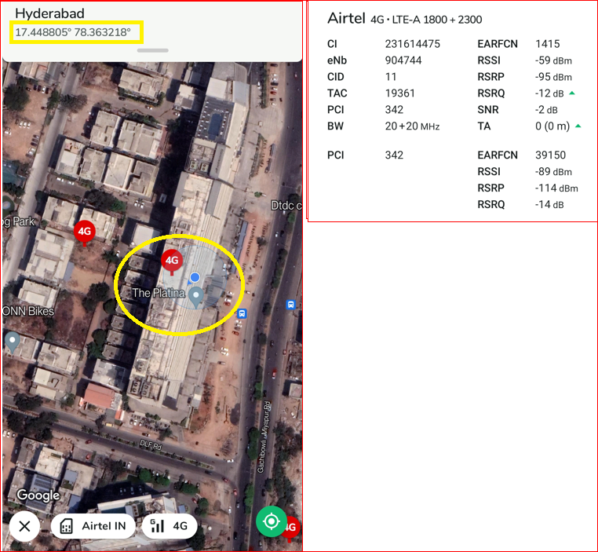
Airtel Edge-cell CA location
Band combination: B3+B4
RSRP: -95dbm to -100dbm
Area->Gachibowli
Landmark->The Platina

Slide 18
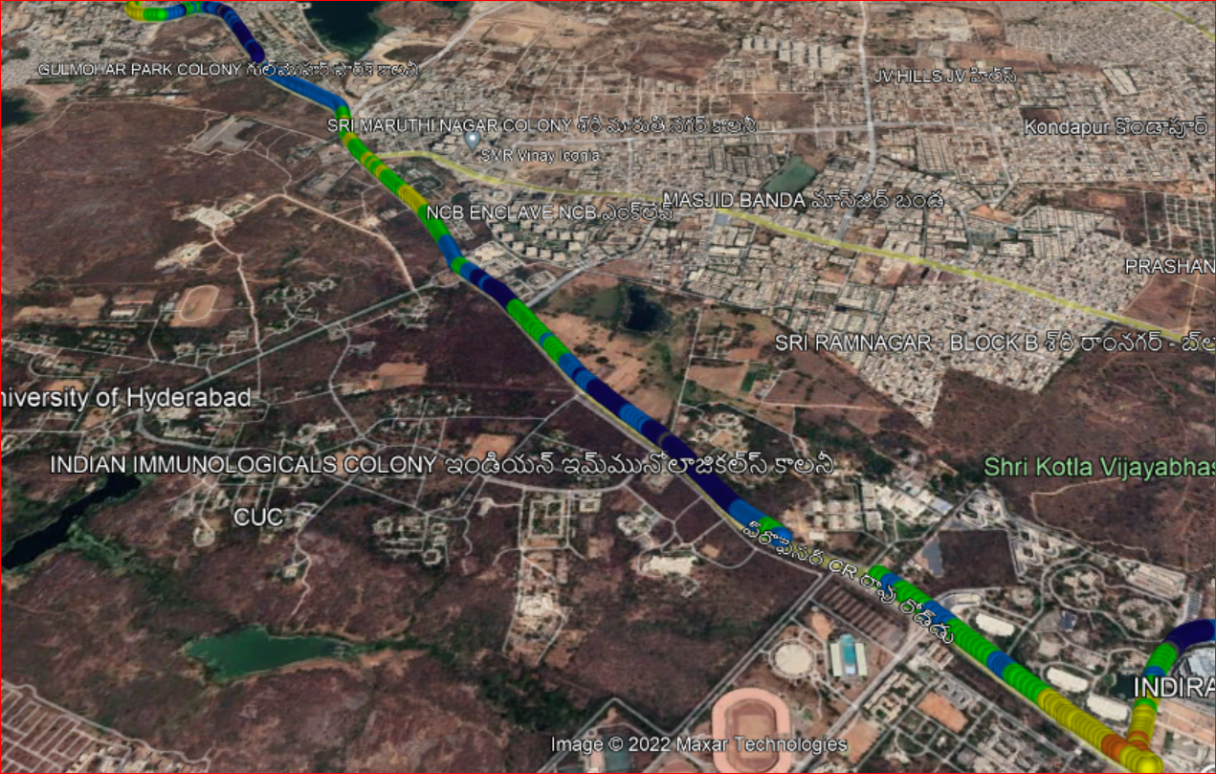
Airtel Mixed-coverage CA location
Route : Gachibowli stadium <-> Lingampally

Slide 19
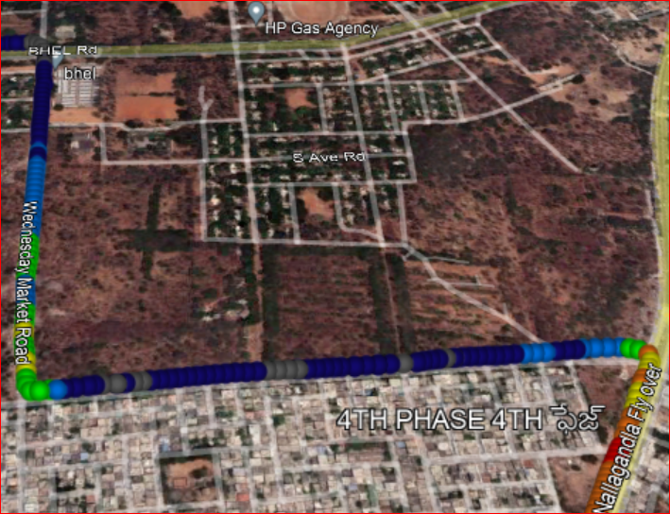
Airtel CA to CA Handover location
Route : Nallagandla flyover to OLD MIG to BHEL Market

Slide 20
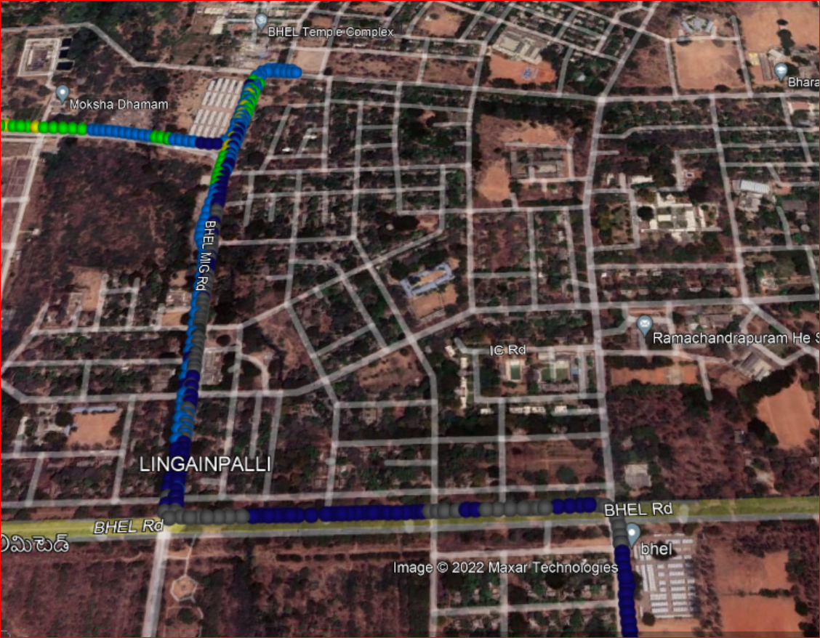
Airtel CA <-> Non-CA Handover location
Route : BHEL Wednesday market to BHEL Saturday market

Slide 21
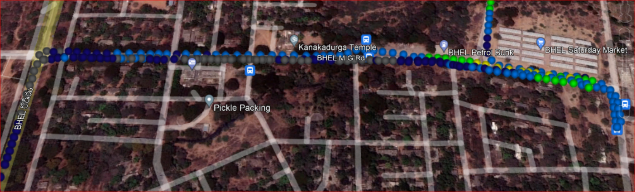
Airtel Non-CA to Non-CA Handover location
Route : BHEL road to BHEL Saturday market

Slide 22
Airtel Inter Band Handover location
Route : Gachibowli stadium <-> BHEL

Slide 23
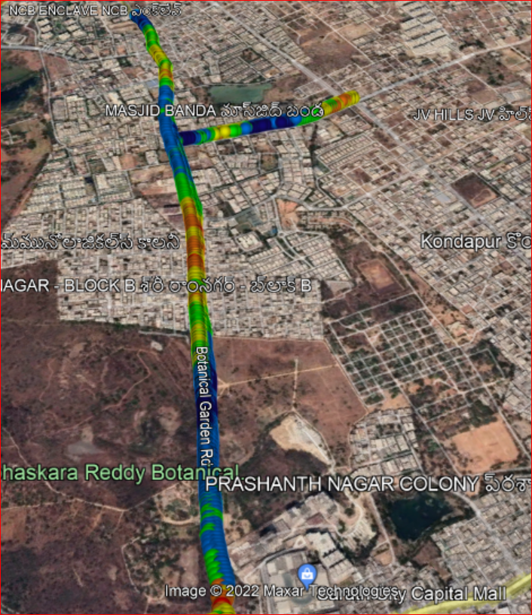
Airtel Intra Band Handover location
Route : Botanical Garden <-> Masjid band road

Slide 24
Airtel Inter band Reselection location
Route : Gachibowli stadium <-> BHEL

Slide 25
Airtel Intra Band Reselection location
Route : Botanical Garden <-> Masjid band road

Slide 26
Airtel Out of service location
Route : Tunnel 2 towards Narsingi OOR Circle to Movie tower
Location: 17.412561 , 78.304849

Slide 27
Services Supported by VI Operator
Country | India
City | Hyderabad
Operator Name | VI
Technologies support | VoLTE/ViLTE/LTE/2G
Emergency Call | 112, 911
USSD Code | YES
VoLTE Support | YES
ViLTE Call Support | YES
CSFB support | YES
VoWiFi Support | NO
ViWiFi Call Support | NO
VoWiFi support in Airplane mode | NO
CA Combination | B3+B1
SRVCC to 3G/2G | YES
5G Band | NA
Dedicate Mode/NSA/SA | NA
Band Combination (NR + LTE) | NA
4G Band | Band 1 Band 3 Band 41
3G Band | NO
2G Band | GSM900
Infra vendor Name | Nokia
Voicemail Services | NO
UT /XCAP | NO
Conference Call Support | YES
Supplementary Services | YES
Prepaid APN | www

Slide 28
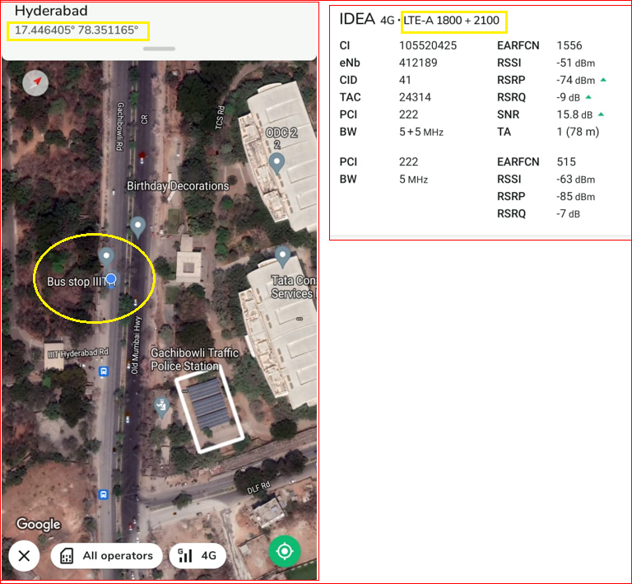
VI Near-cell CA location
Band combination: B3+B1
RSRP: -70 TO 75dbm
Area->Gachibowli
Landmark-> IIT BUS STOP

Slide 29
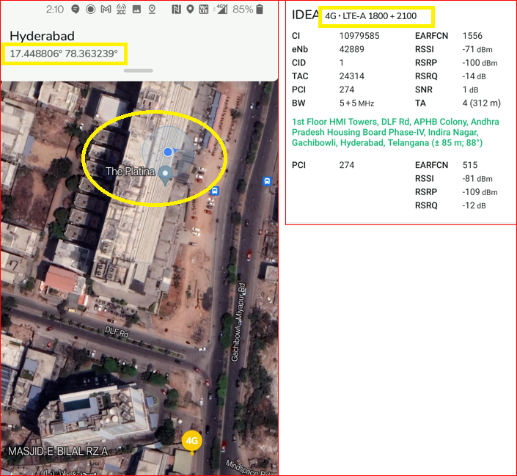
VI Edge-cell CA location
Band combination: B3+B1
RSRP: -100dbm to -105dbm
Area->Gachibowli
Landmark->The Platina

Slide 30
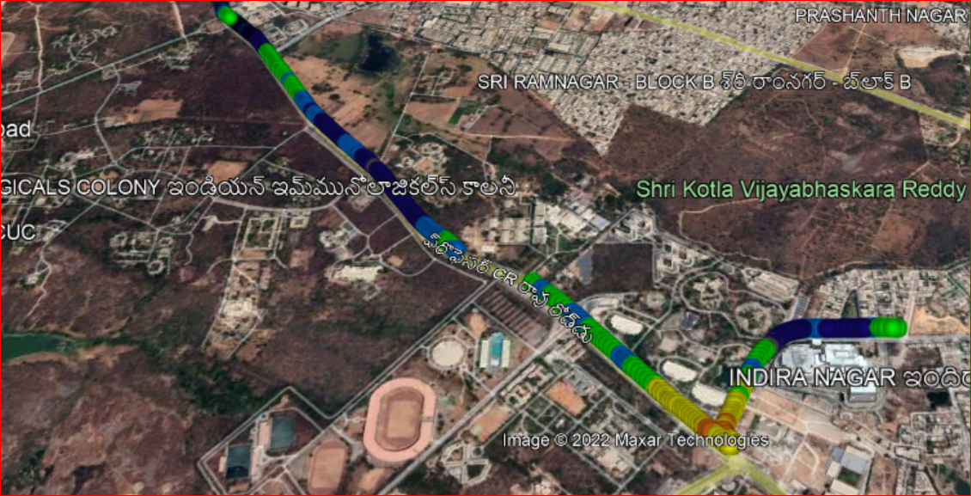
VI Mixed-coverage CA location
Route : Gachibowli DLF road to <-> HCU bus stop

Slide 31
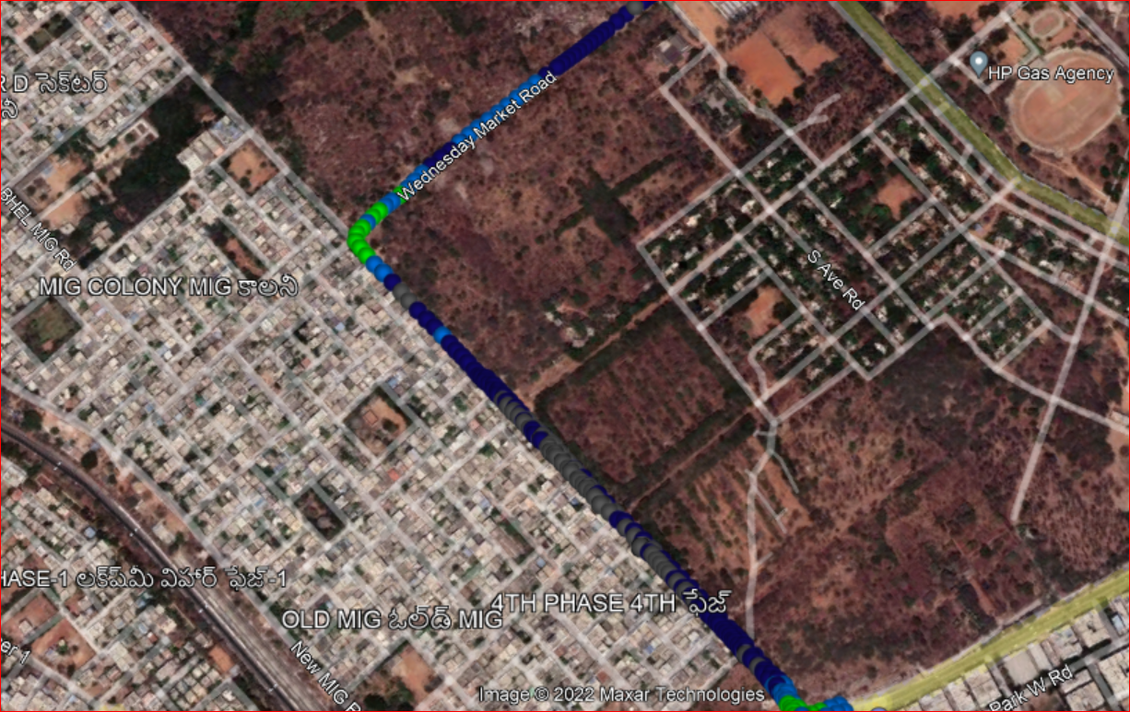
VI CA to CA Handover location
Route : MIG Colony to BHEL Wednesday market

Slide 32
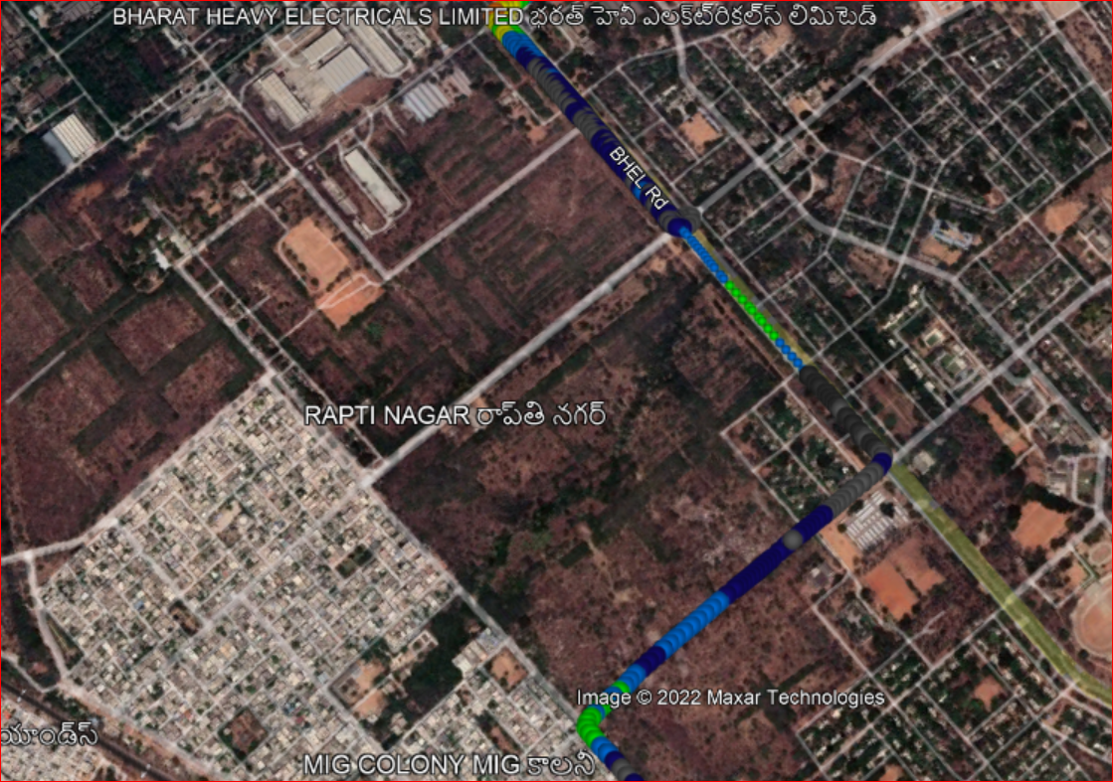
VI CA<->Non-CA Handover location
Route : MIG colony to BHEL Peddamma temple road

Slide 33
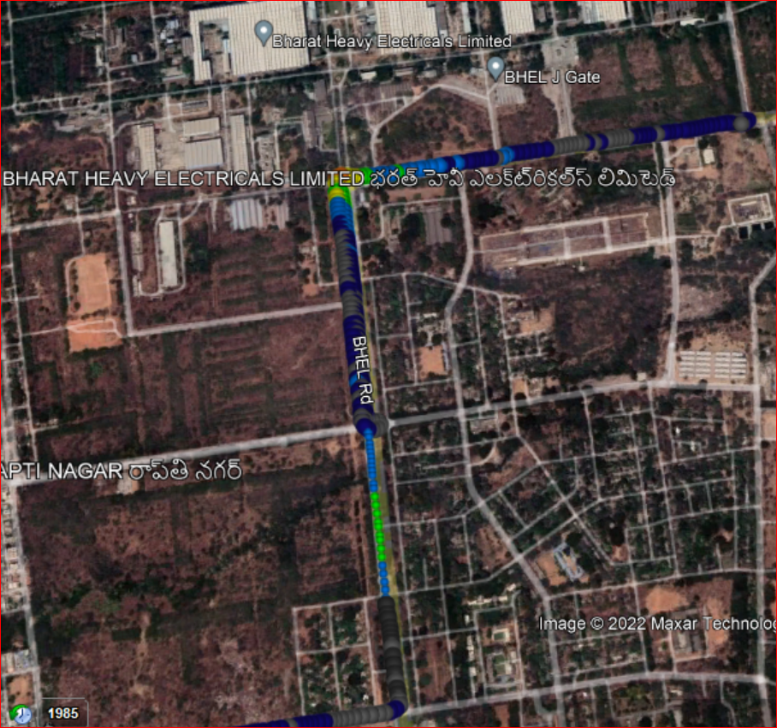
VI Non-CA to Non-CA Handover location
Route : BHEL Wednesday market to BHEL Peddamma temple road

Slide 34
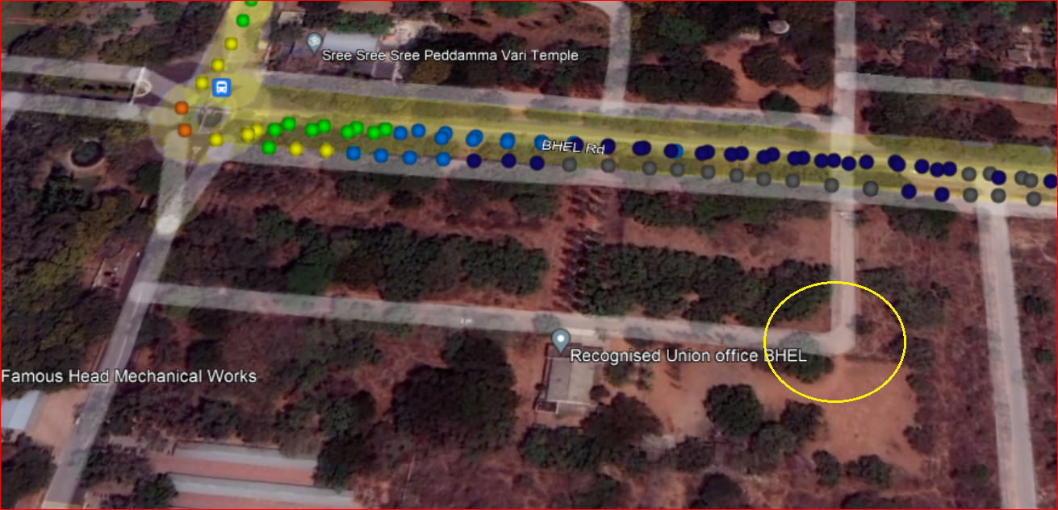
VI SRVCC location
Route : BHEL Peddamma temple <-> Recognised Union office BHEL

Slide 35
VI Redirection location from 4G <->2G
Route : BHEL Peddamma temple <-> Recognised Union office BHEL

Slide 36
VI Handover location from B41 to B3 to B1
Route : Gachibowli stadium <-> Nallagandla flyover

Slide 37
VI Reselection location from B41 to B3 to B1
Route : Gachibowli stadium <-> Nallagandla flyover

Slide 38
VI Out of service location
Route : Tunnel 2 towards Narsingi OOR Circle to Movie tower
Location: 17.412561 , 78.304849

Slide 39
Services Supported by BSNL Operator
Country | India
City | Hyderabad
Operator Name | BSNL
Technologies support | VoLTE/ViLTE/LTE/3G/2G
Emergency Call | 112, 911
USSD Code | YES
VoLTE Support | YES
ViLTE Call Support | YES
CSFB support | YES
VoWiFi Support | NO
ViWiFi Call Support | NO
VoWiFi support in Airplane mode | NO
CA Combination | NA
SRVCC to 3G/2G | YES
5G Band | NA
Dedicate Mode/NSA/SA | NA
Band Combination (NR + LTE) | NA
4G Band | Band 1
3G Band | Band 1
2G Band | GSM900
Infra vendor Name | ZTE
Voicemail Services | NO
UT /XCAP | NO
Conference Call Support | YES
Supplementary Services | YES
Prepaid APN | bsnlnet

Slide 40
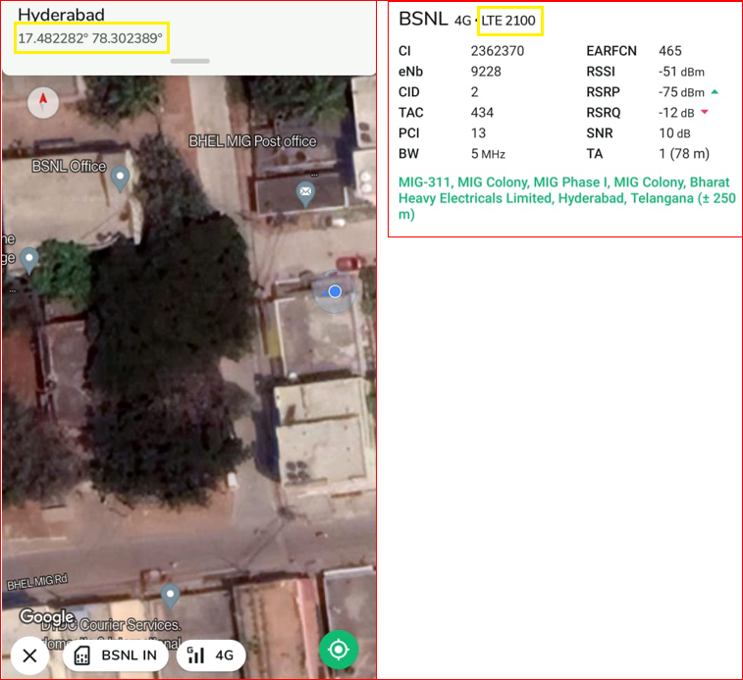
BSNL Near-cell location
Band : B1
RSRP: -70 to -78dbm
Area->OLD MIG
Landmark->BSNL OFFICE

Slide 41
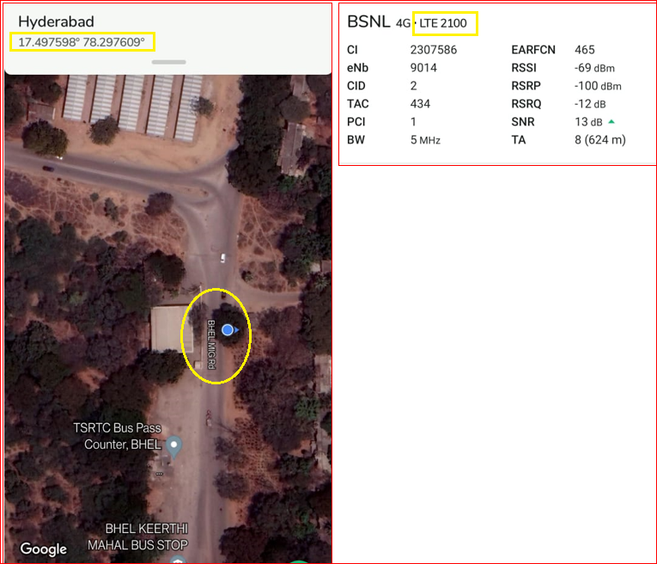
BSNL Edge-cell location
Band : B1
RSRP: -100 to -110dbm
Area->BHEL
Landmark->BHEL BUS PASS Counter

Slide 42
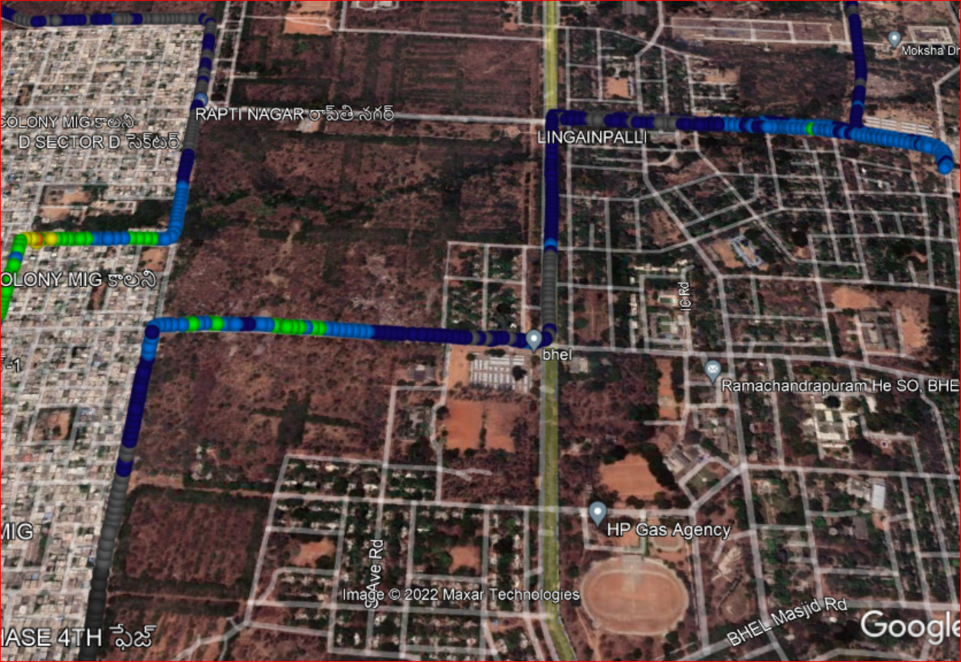
BSNL Mixed-coverage location
Route : OLD MIG <-> BHEL Temple

Slide 43
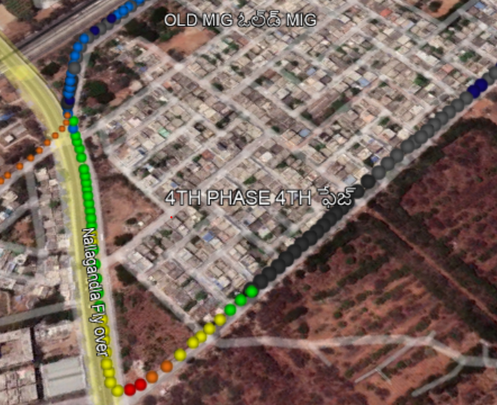
BSNL Redirection location from 4G <-> 3G
Route: BSNL office to Nallagandla flyover
Landmark: 17.485304 , 78.312561
78.310964 17.485605

Slide 44
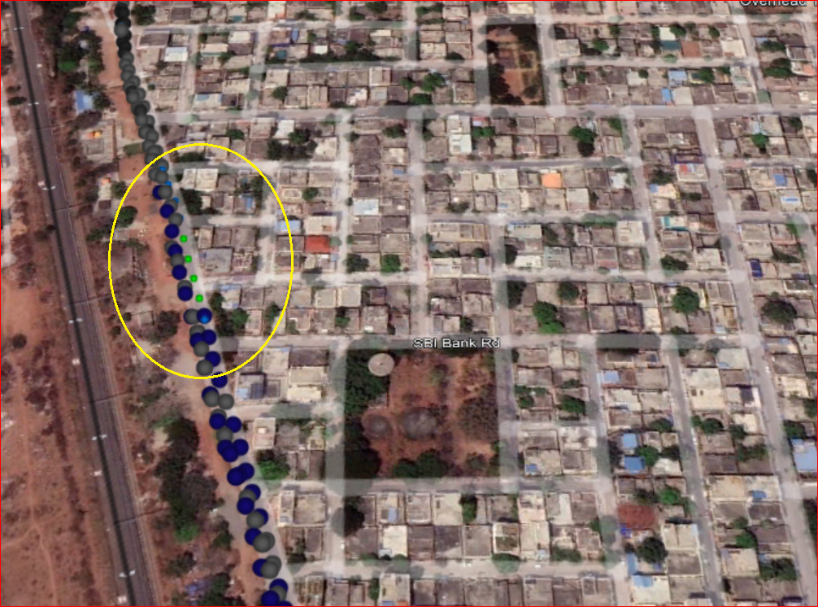
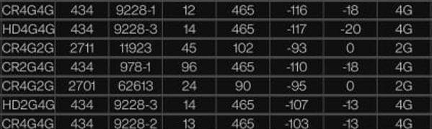
BSNL Redirection location from 4G <-> 2G
Route: NEW MIG Road
Landmark: MIG Phase 1 Playground (17.478463 , 78.297100)
78.297118 17.478465

Slide 45

BSNL Redirection location from 3G <-> 2G
Route: NEW MIG Road to Linapally railway station
78.313377 17.482964

Slide 46
BSNL Out of service location
Route : Tunnel 2 towards Narsingi OOR Circle to Movie tower
Location: 17.412561 , 78.304849

Slide 47
Balance enquiry codes.
Operator | Balance enquiry
JIO | Dial to 1299
Airtel | *282# or *121#
VI | *199#
BSNL | *1# or *123#
Customer care numbers.
Operator | Customer care number
JIO | 198
Airtel | 121
VI | 199
BSNL | 198

Slide 48
USSI codes.
Operator | Supplementary service | Activate | Deactivate | Check status of call forwarding
JIO Airtel VI BSNL | Always Call forwading | *21*xxx# | #21# or ##21# | *#21#
 | When Busy | *67*xxx# | #67# or ##67# | *#67#
 | When Unanswered | *61*xxx# or *61*xxxxxx**5# | #61# or ##61# | *#61#
 | When unreachable | *62*xxx# | #62# or ##62# | *#62#

Slide 49
Airtel video call forwarding codes.
Operator | Supplementary service | Activate | Deactivate
Airtel | Always Call forwading | *401*DN | *402*DN
 | When Busy | *405*DN | *406*DN
 | When Unanswered | *403*DN | *404*DN
 | When unreachable | *409*DN | *410*DN

Slide 50
Local emergency numbers.
Local Emergency Contacts | Contact Numbers
Police | 100
Fire | 101
Ambulance | 102,108

Slide 51


