Slide 1
MARQUIS TECHNOLOGIES
Drive Route –Airtel, VI& Reliance JIO ,BSNL(FDD/TDD) LTE

Slide 2
Operator Information:
Operator | Airtel 4G
MCC | 404
MNC | 02
APN | Airtelgprs.com
Operator | JIO 4G
MCC | 405
MNC | 867
APN | Jionet
Operator | VI
MCC | 404
MNC | 14
APN | Internet
Operator | BSNL
MCC | 404
MNC | 53
APN | bsnlnet

Slide 3
Operator Information 1
Functionality | Airtel
Website: http://www.airtel.com/ WAP APN: airtelgprs.com
Customer care | 199
MNC | 02
Bands supported | Both FDD and TDD
 | LTE 2300 MHz, 2500 MHz – TDD(Band 40, BAND 41)
 | LTE 1800 – FDD(Band 3)
USSD | To check MDN: *282#
 | Balance check: *123#
 | Data Balance check: *121*114#
VoLTE | Supported
CSFB | Supported (CSFB to 2G)

Slide 4
Operator Information 2
Functionality | RELIANCE JIO
Website: http://www.jio.com WAP APN: jionet
Customer care | 198
MNC | 867
Bands supported | Both FDD and TDD
 | LTE 2300 MHz –TDD(Band 40)
 | LTE 850 MHz – FDD(Band 5)
 | LTE 1800 MHz –FDD(Band 3)
USSD | NA
 | NA
 | NA
VoLTE | Supported
CSFB | Not Supported

Slide 5
Operator Information 3
Functionality | VI
Website: http://www.myvi.in WAP APN: Internet
Customer care | 198
MNC | 14
Bands supported | Both FDD and TDD
 | LTE 2300 MHz –TDD(Band 41)
 | LTE 850 MHz – FDD(Band 8)
 | LTE 1800 MHz –FDD(Band 3)
USSD | To check MDN*199#
 | Balance check198
 | Data Balance check: 121
VoLTE | supported
CSFB | 2G/3G

Slide 6
Drive Route
Near Cell :- Stationary: RSRP : -65dbm to -75dbm
Cell Edge :- Stationary: RSRP : -95dbm to -110dbm
Mixed :- Mobility: RSRP : -65dbm to -110dbm

Slide 7
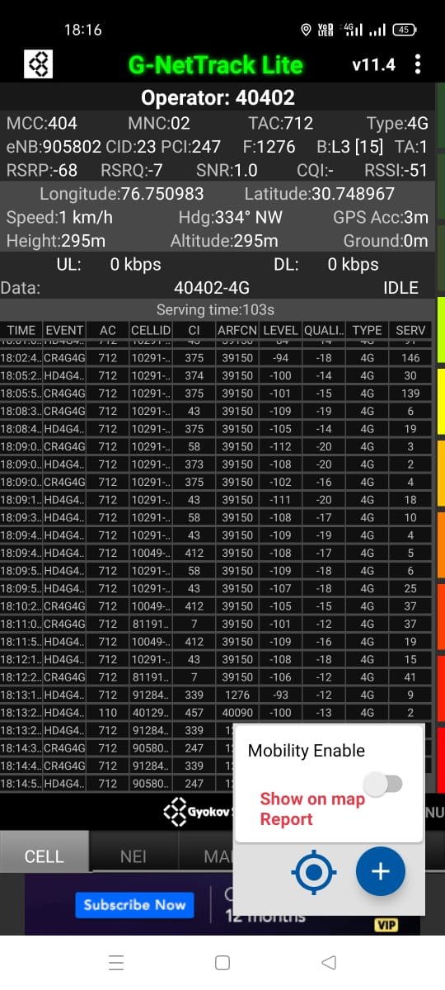
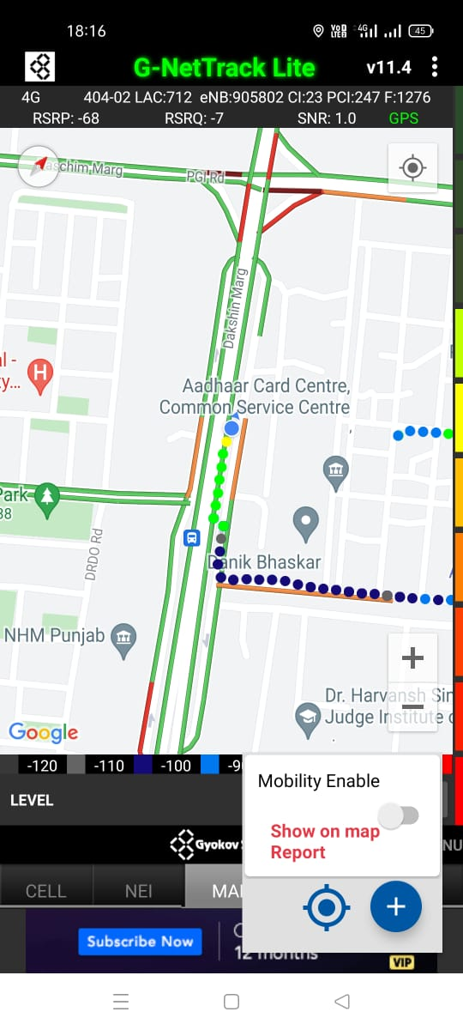
Near Cell (Airtel)
Near cell(NC) | longitude | latitude | RSRP | Cell id | FDD E-ARFCN
1 | 76.750983 | 30.74897 | -68 | 23 | 1276
Sector-25 D
Chandigarh
RSRP:
-65dbm to 75dbm

Slide 8
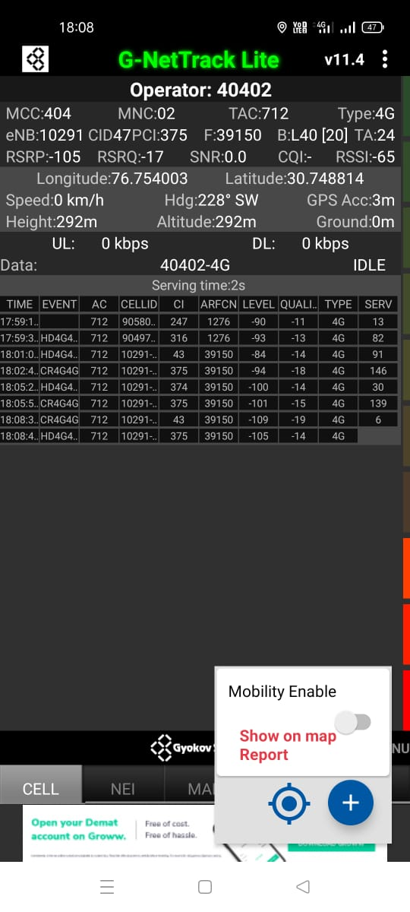
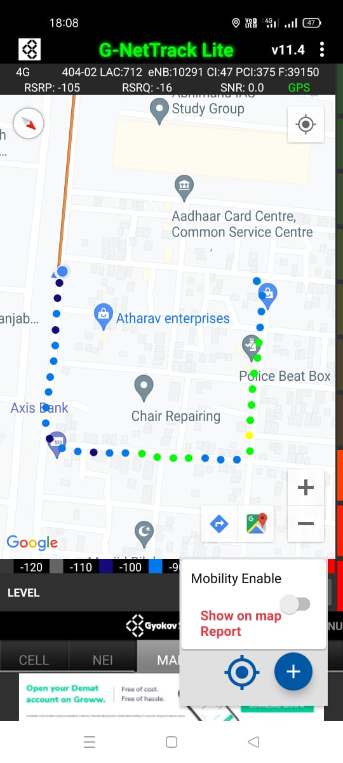
Edge Cell (Airtel)
Edge cell(EC) | longitude | latitude | RSRP | Cell id | TDD E-ARFCN
1 | 76.754003 | 30.748814 | -105 | 47 | 39150
Sector-25 D
Chandigarh
RSRP:
-95dbm to -110dbm

Slide 9
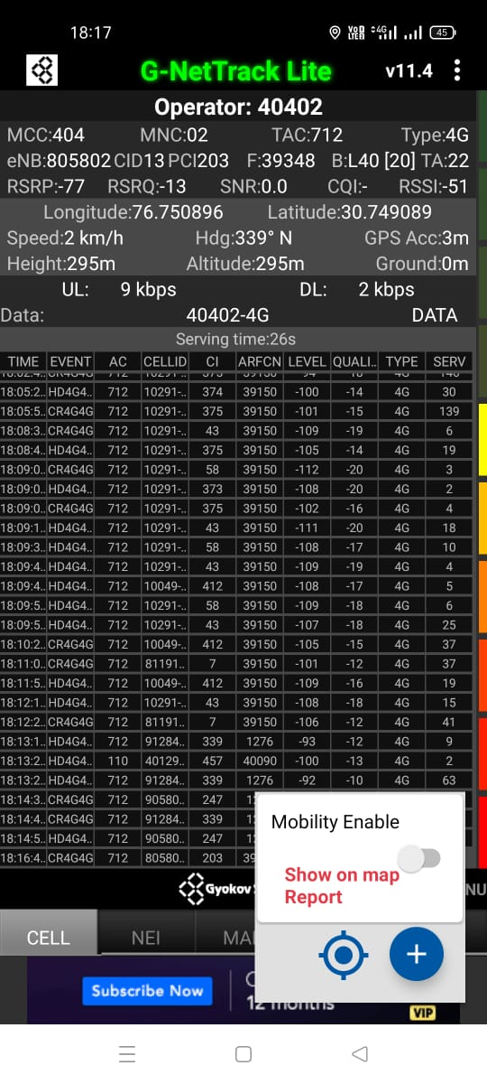
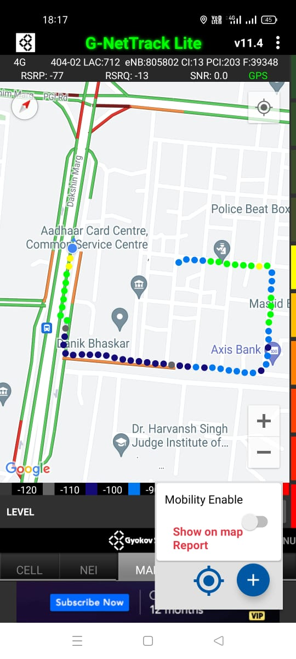
Mixed Mobility:- Airtel (Chandigarh )
Sector-25 D
Chandigarh
RSRP: -60dbm to -110dbm

Slide 10
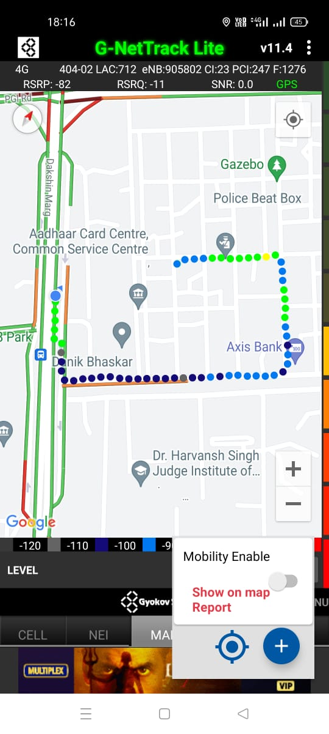
Airtel Band HO
Band 3<>40<>41 Handover

Slide 11
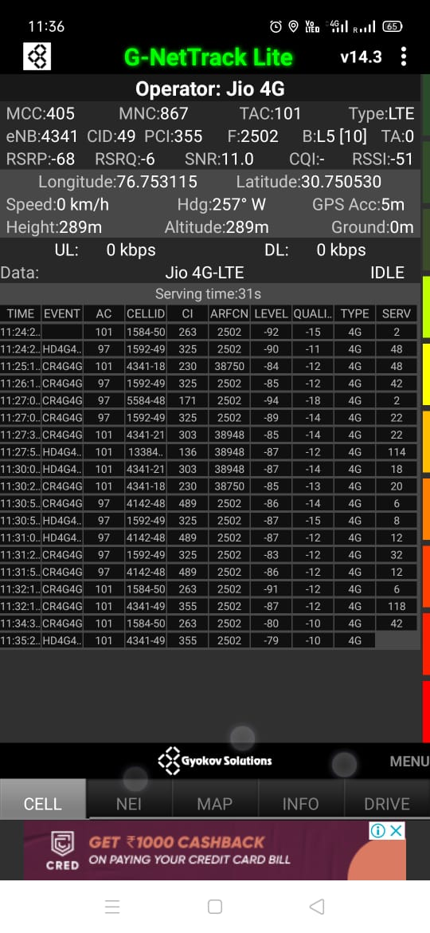
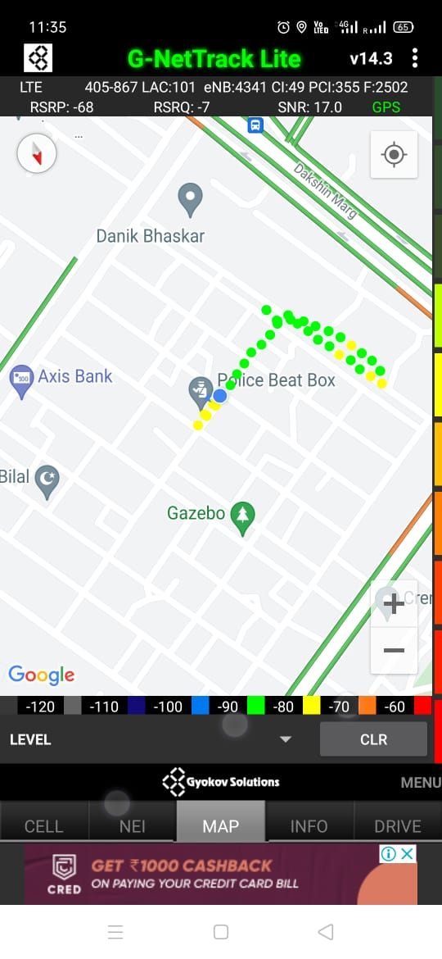
Near Cell (Reliance JIO)
Near cell(NC) | longitude | Latitude | RSRP | Cell id | TDD E-ARFCN
1 | 76.753115 | 30.750530 | -68 | 49 | 2502
Sector-25 D
Chandigarh
RSRP:
-57dbm to -75dbm

Slide 12
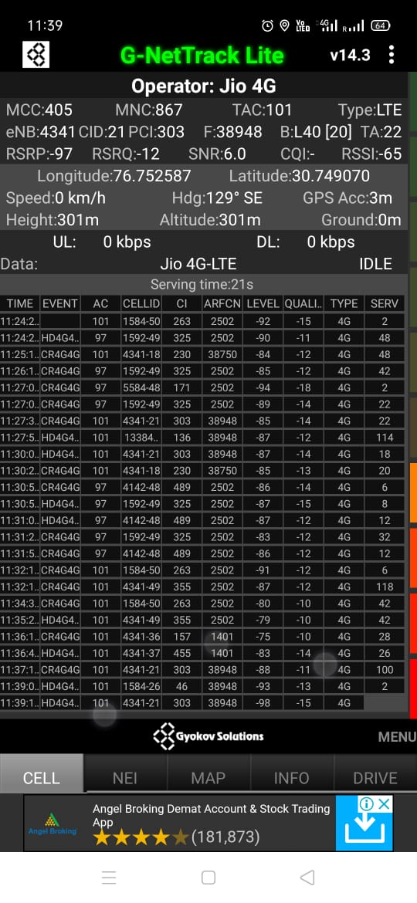
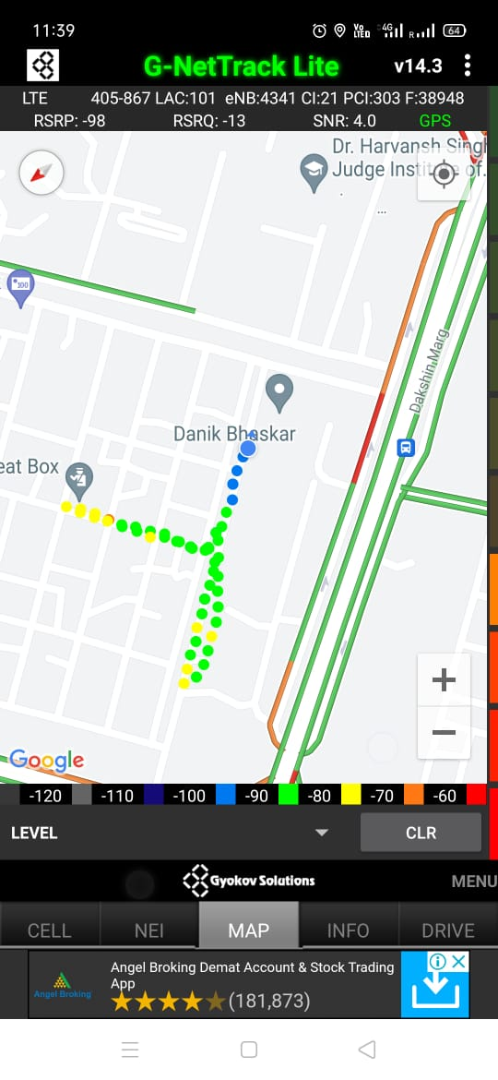
Edge Cell (Reliance JIO)
Edge cell(NC) | longitude | latitude | RSRP | Cell id | TDD E-ARFCN
1 | 76.752587 | 30.749070 | -97 | 21 | 38948
Sector-25 D
Chandigarh
RSRP:
-95dbm to -110dbm

Slide 13
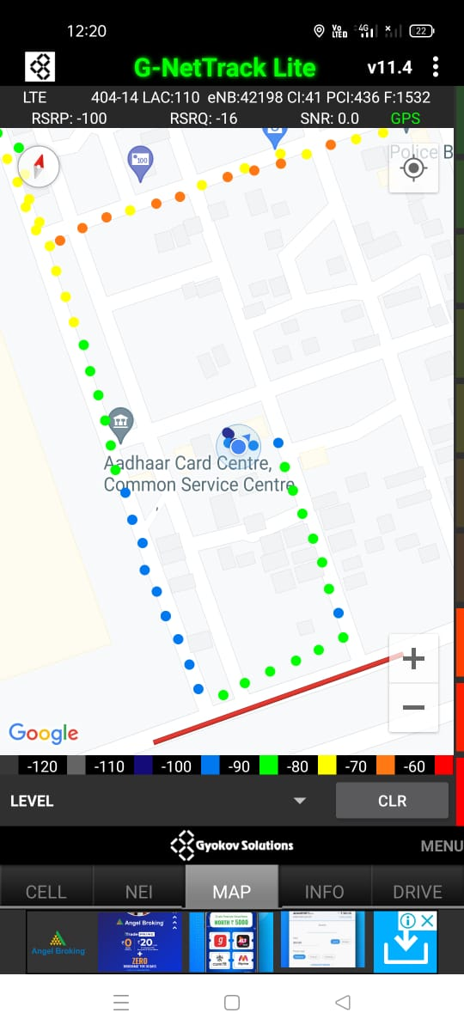
Mixed Mobility:- JI0 Chandigarh
RSRP: -60dbm to -110dbm

Slide 14
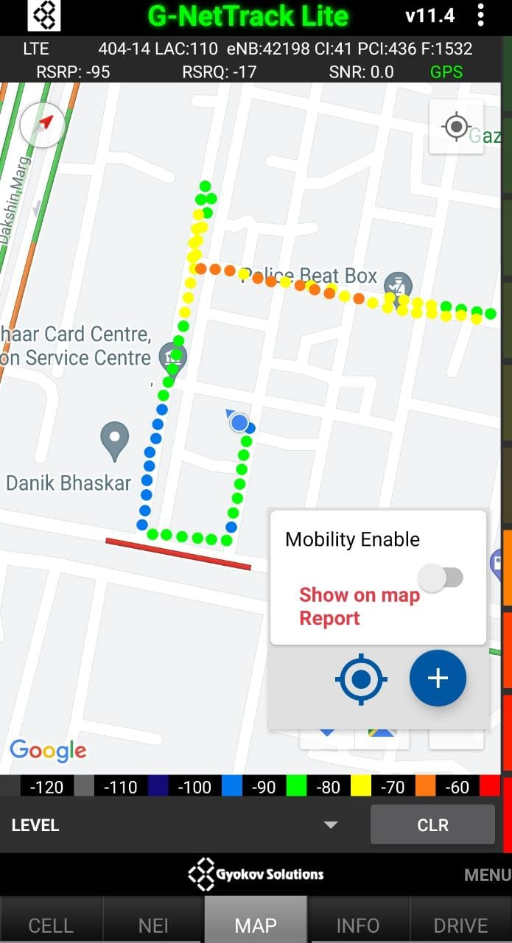
JIO 4G Band Handover
Band 3<>5<>40 Handover

Slide 15
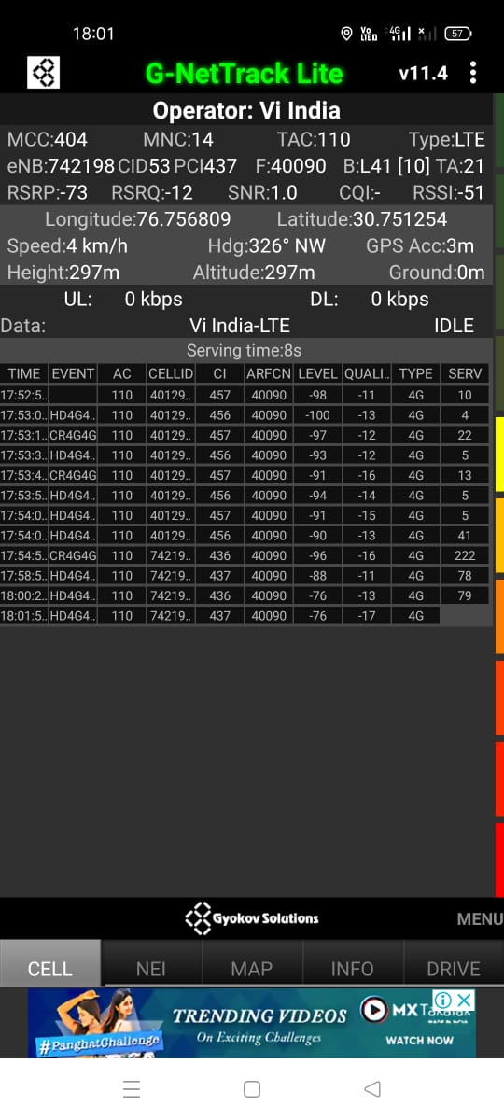
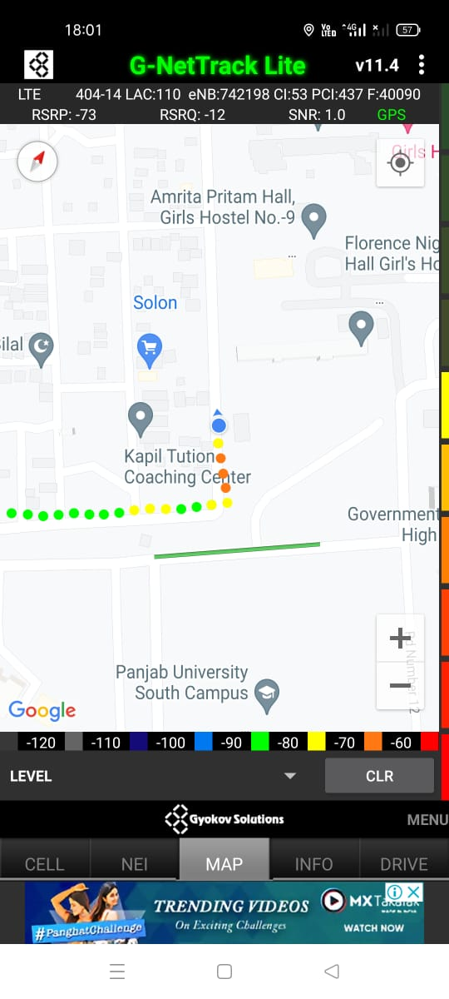
Near Cell VI:
Near cell(NC) | longitude | latitude | RSRP | Cell id | TDD E-ARFCN
1 | 76.756809 | 30.751254 | -73 | 53 | 40090
Sector-25 D
Chandigarh
RSRP:
-65dbm to -75dbm

Slide 16
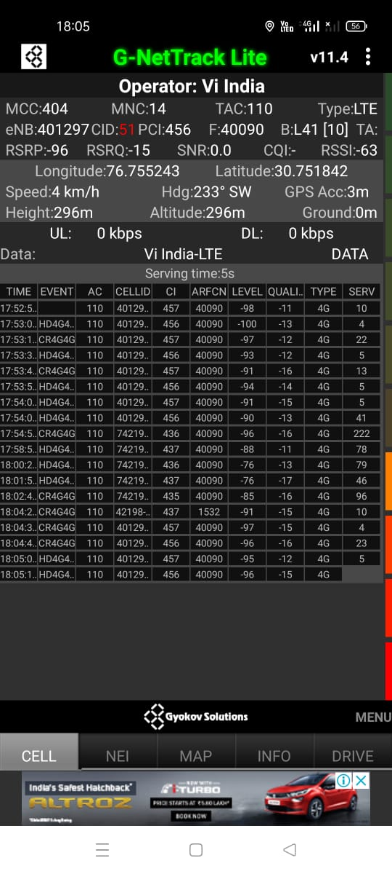
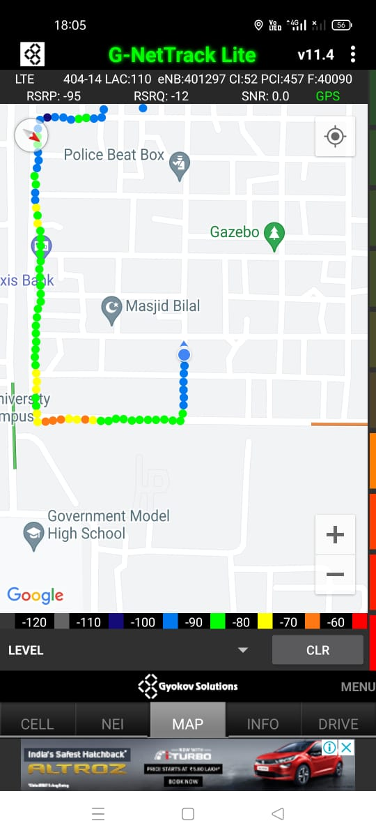
Cell Edge VI:
Edge cell(EC) | longitude | latitude | RSRP | Cell id | TDD E-ARFCN
1 | 76.755243 | 30.751842 | -96 | 51 | 40090
Sector-25 D
Chandigarh
RSRP:
-95dbm to -105dbm

Slide 17
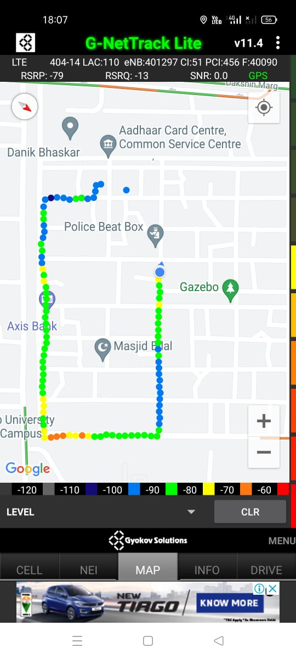
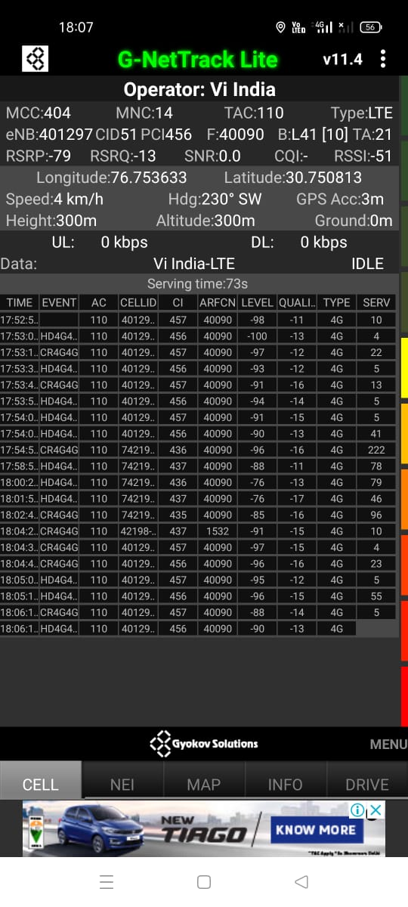
Mixed coverage area Vodafone:
Sector-25 D
Chandigarh

Slide 18
VIBand 3<>41 Handover

Slide 19
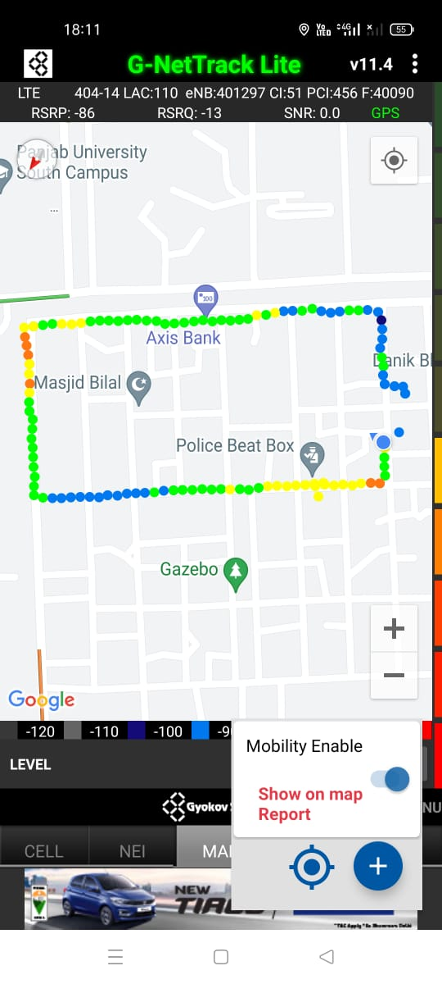
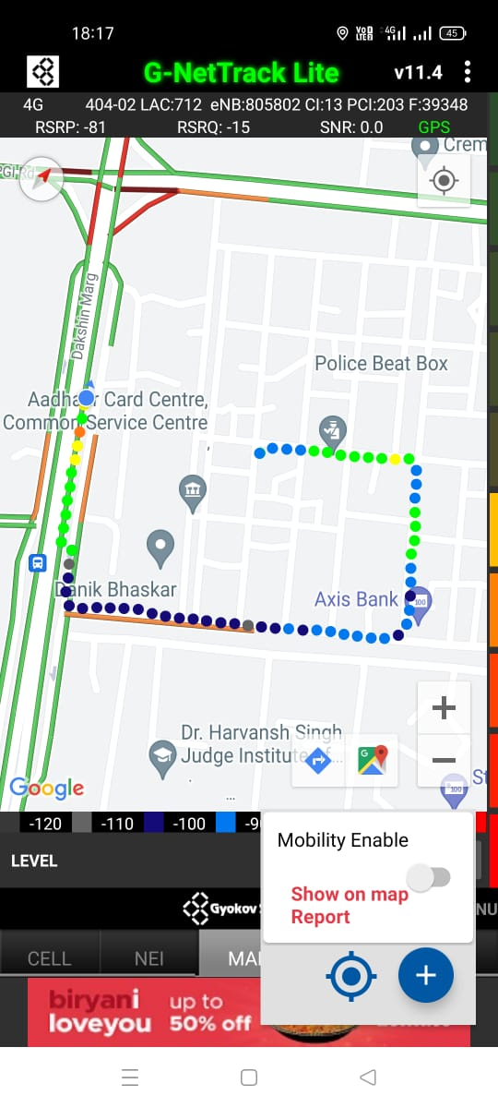
G net Tracker Drive Route

Slide 20
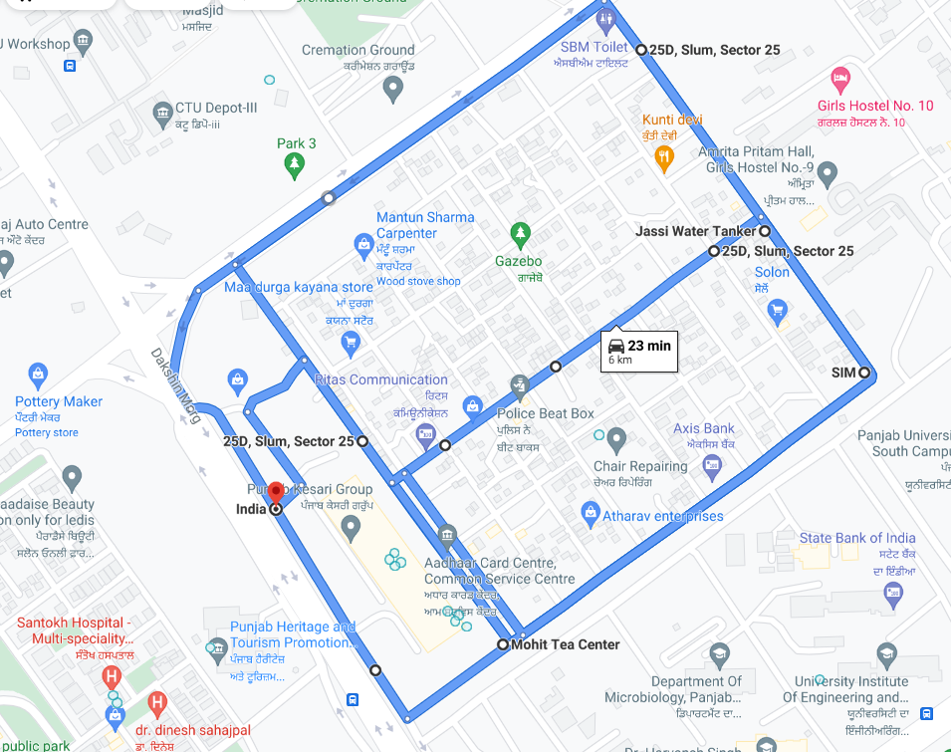
Google Drive Route

Slide 21
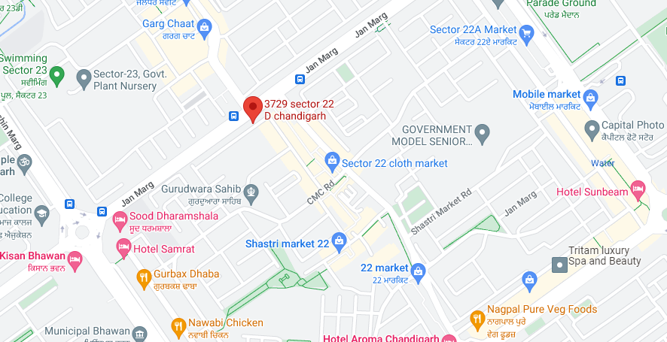
5G Near Cell, Airtel Operator
Lat/Long - 30.73511, 76.76774
Specification –Stable Airtel 5G NSA network - Good Throughput
Achieved 700 Mbps
AIRTEL THROUGHPUT GOOD COVERAGE

Slide 22
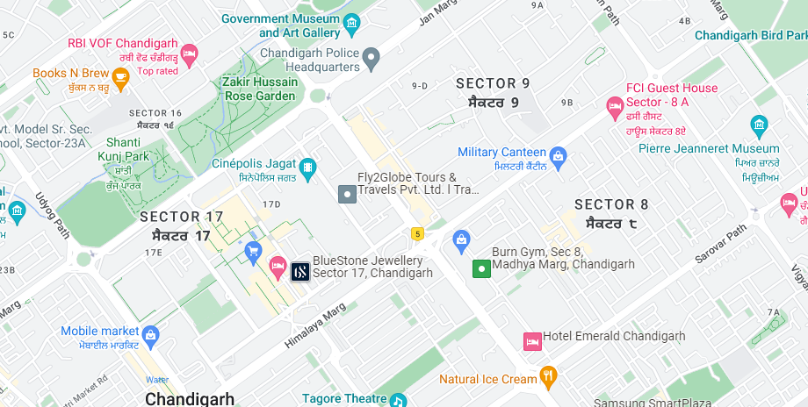
NR to LTE Handover ,Airtel
Lat. 30.7388831 , Long. 76.783419 Location –Sector 17 C Chandigarh Specification –Band Handover, Weak coverage
NR To LTE and LTE To NR Handover

Slide 23
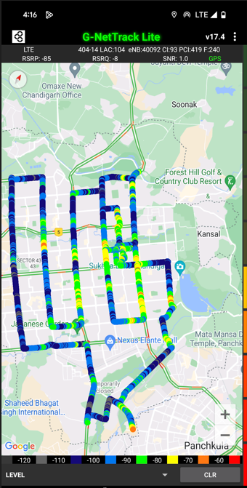
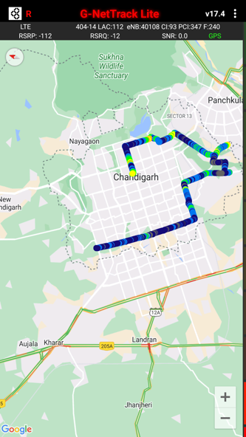
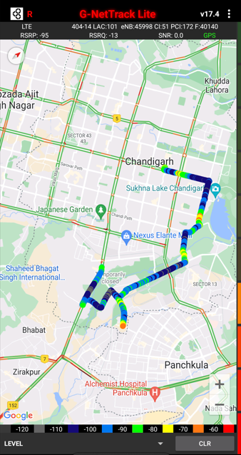
DRIVE ROUTE

Slide 24
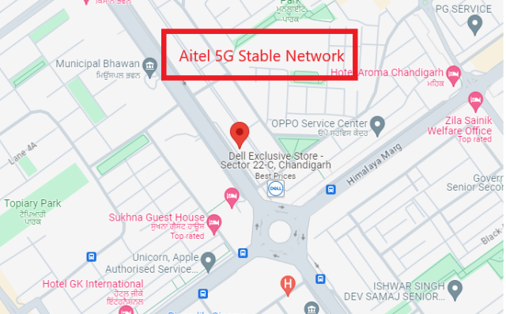
5G Near Cell, Airtel
Lat/Long -30.7284126° N, 76.7672529° E
Specification –Stable Airtel 5G NSA network
Good Throughput

Slide 25
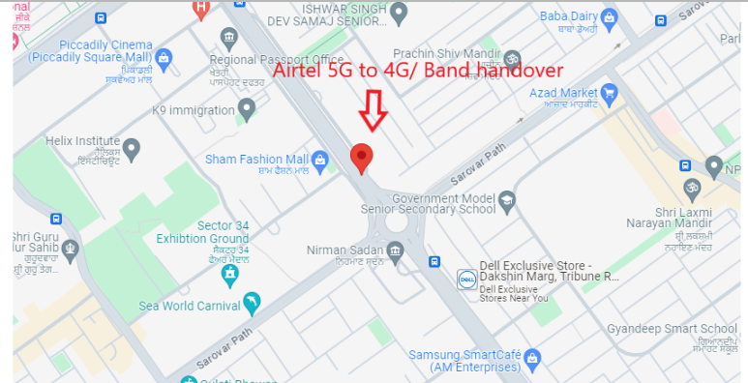
5G to 4G Handover ,Airtel
Lat. 30.7214744 & Long. 76.7725953 to Location – City center Sector 34B Specification –Band Handover ,Weak coverage

Slide 26
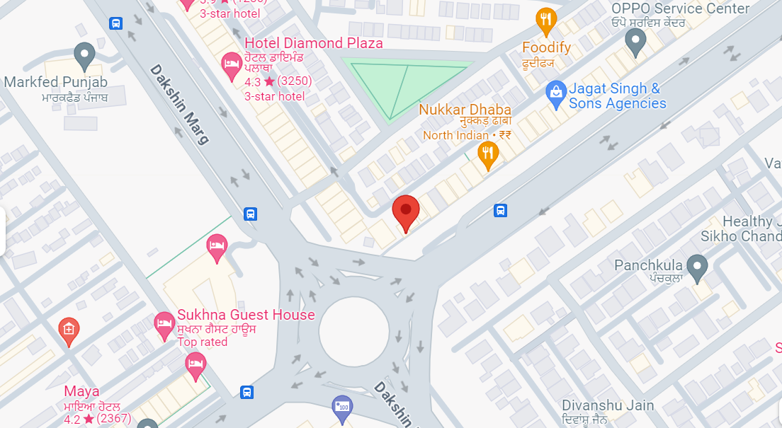
5G to 4G Handover, Jio
Lat/Long : 30.727179° N, 76.768945° E
Specification –5G to 4G Handover, Jio
5G to 4G Handover

Slide 27
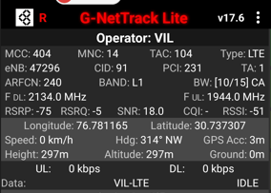
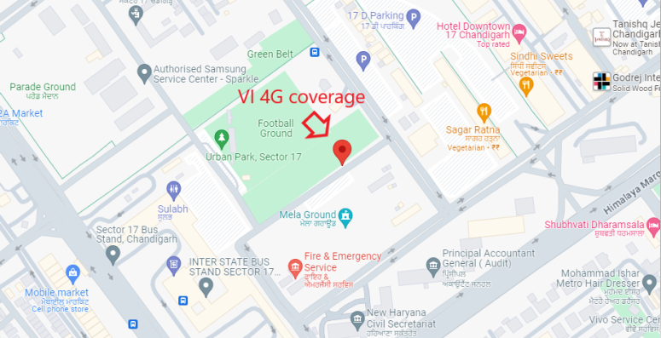
VI 4G
Lat long – 30.737307° N, 76.781165° E Location – Sector 17, Chandigarh, India Specification –VI 4G

Slide 28
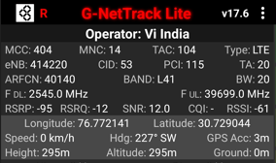
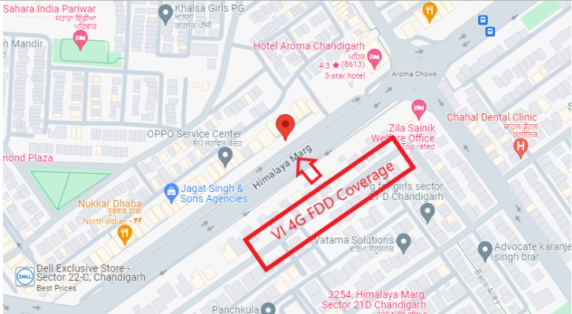
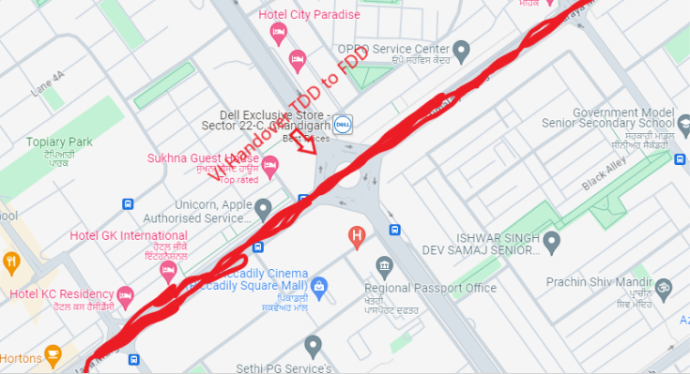
VI 4G FDD COVERAGE
Lat Long- 30.729044/ 76.772141 Location- near Aroma Taxi Stand, Sector 22C, Sector 22,
Vi Handover :- Himalaya Marg, Near sector 22C

Slide 29
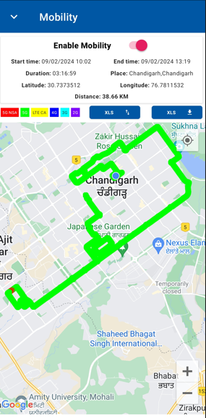
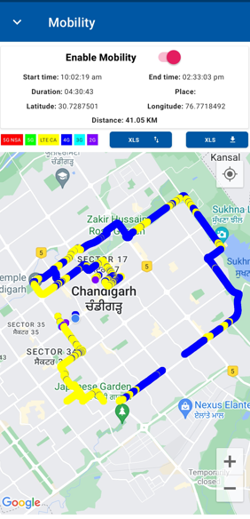
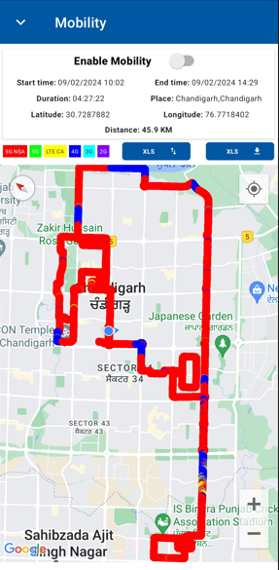
DRIVE ROUTE: Chandigarh

Slide 30
THANK YOU
MARQUIS TECHNOLOGIES

