Slide 1
MARQUIS TECHNOLOGIES
Drive Route

Slide 2
Amman/Jordan
Operator Details:
S. No. | Operator | Supported Bands | Supported Features by Network
1 | Orange | LTE FDD B3/B7/B8 & 5G-N78 | 2G/3G/4G/5G/VoLTE
2 | Umniah | LTE FDD B3 & 5G-N78 | 3G/4G/5G/VoLTE

Slide 3
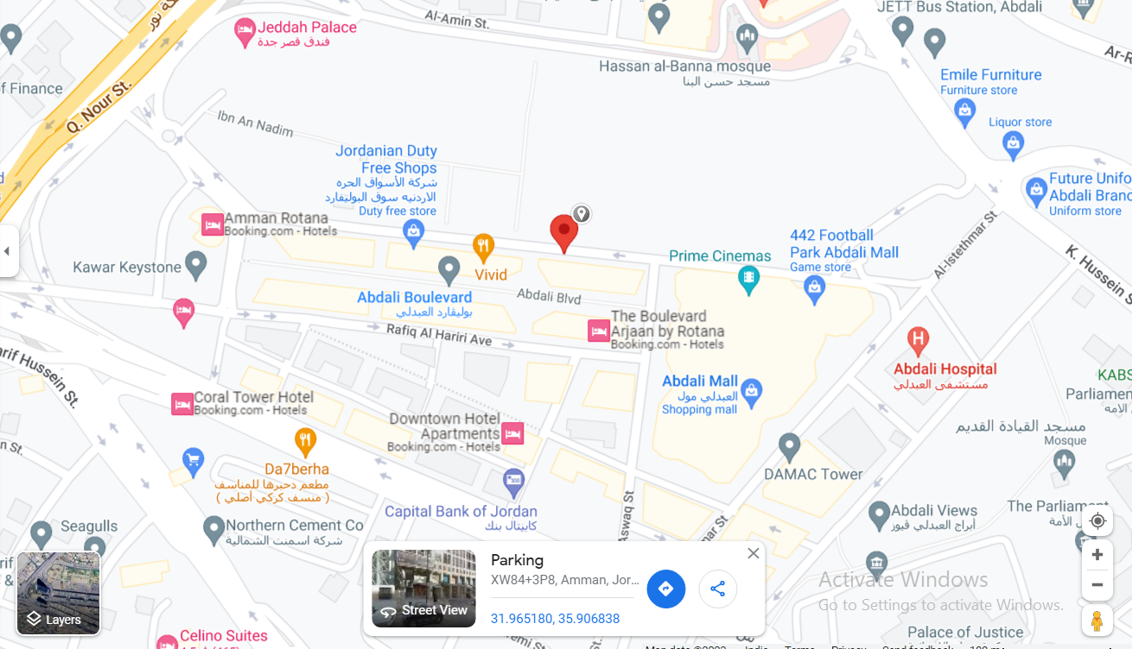
5G Near Cell,Orange
Lat 31.964760 Long 35.906060
Specification –Stable Orange 5G NSA network
Good Throughput
Orange 5G NSA Cell

Slide 4
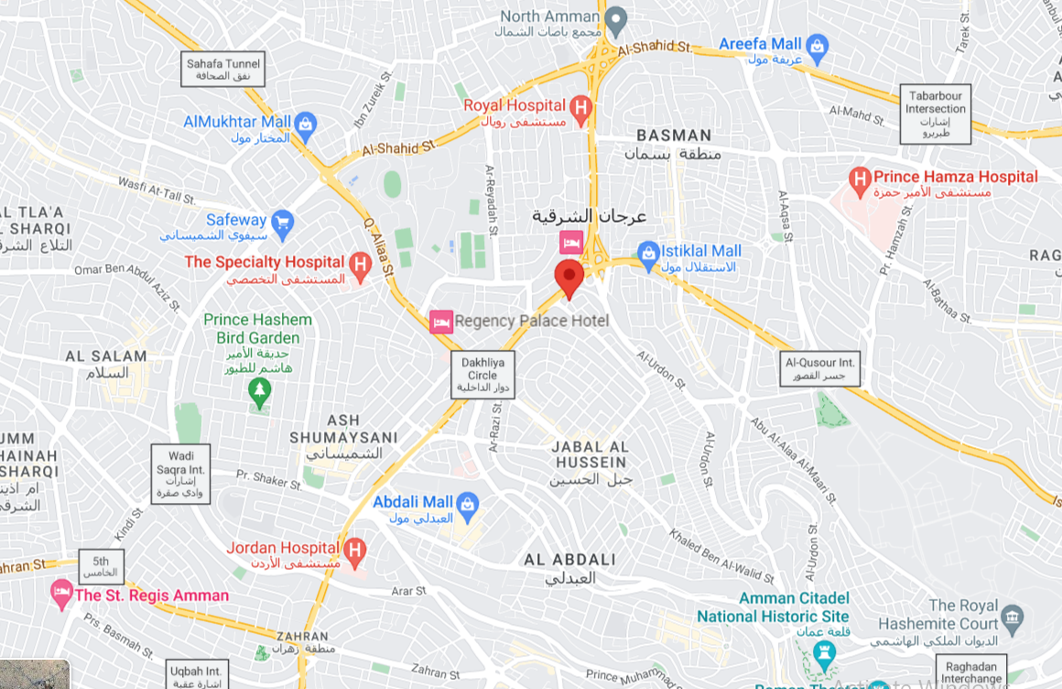
NR to LTE Handover ,Orange
Lat 31.964760 Long 35.906060 to
Lat 31.977865 Long 35.916102 Specification –Band Handover ,Weak coverage
NR to LTE Handover

Slide 5
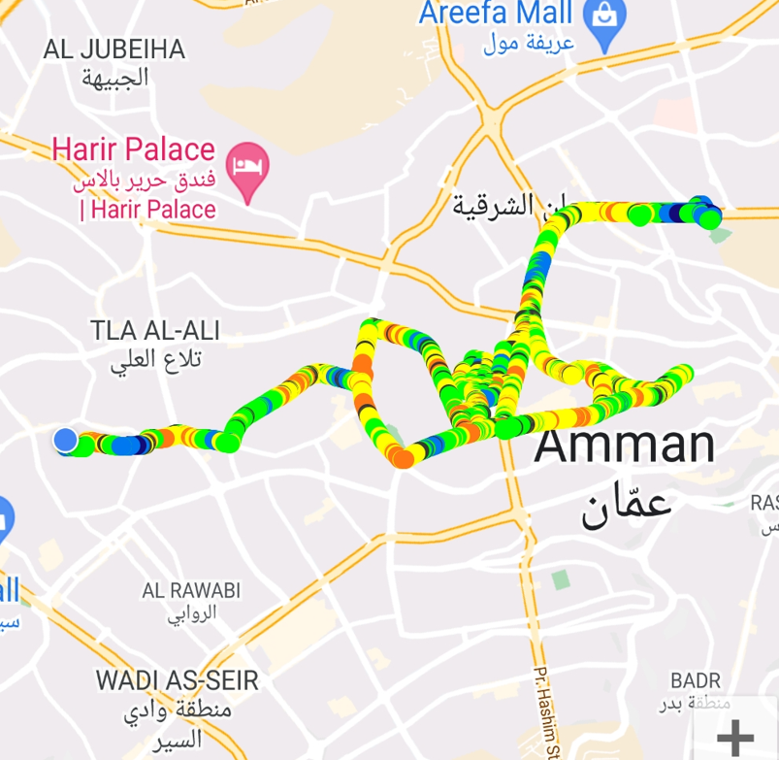
Orange 5G NSA Drive route

Slide 6
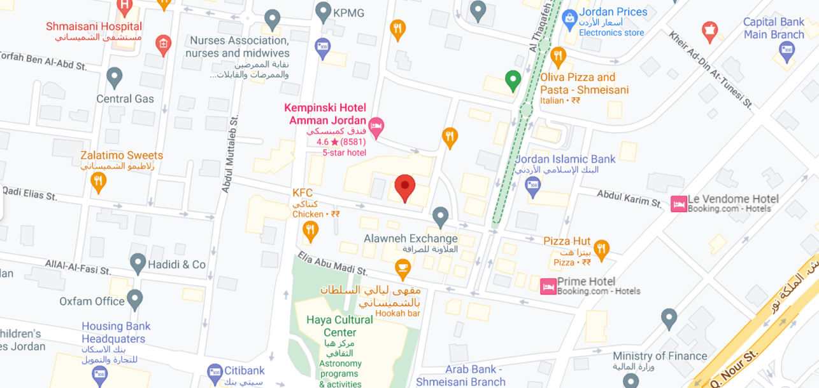
5G Near Cell,Umniah
Lat. 31.968000 & Long. 35.897611
5G NSA Umniah

Slide 7
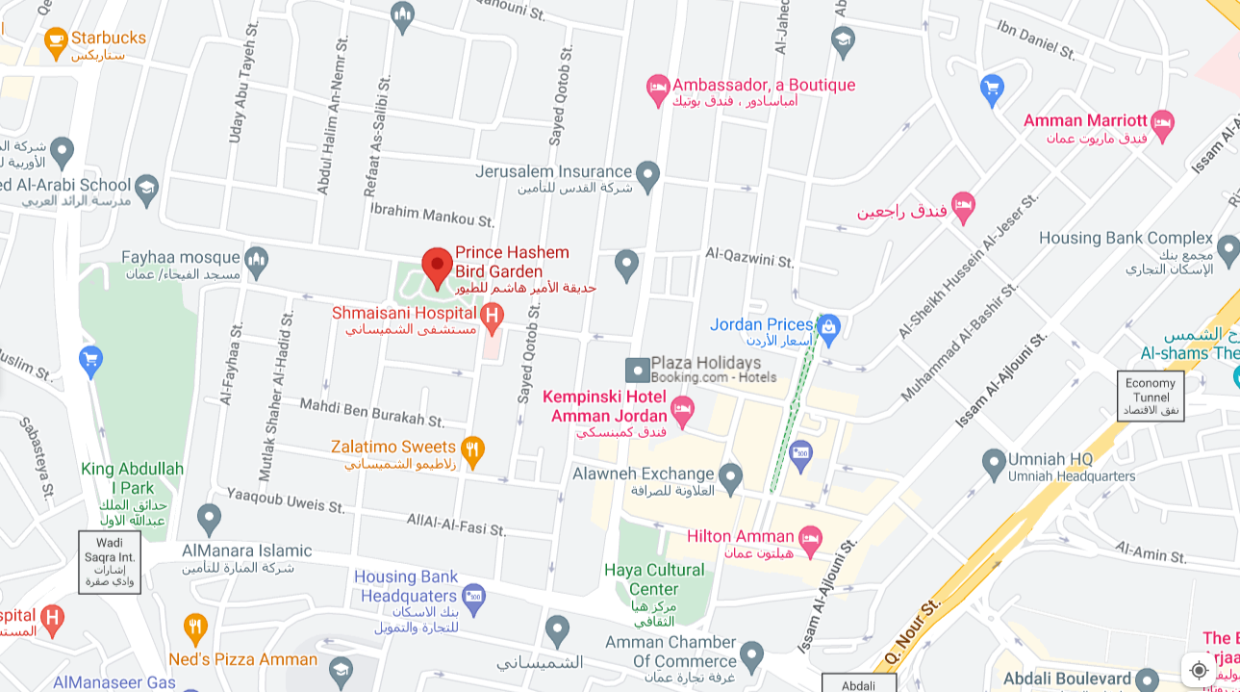
NR To LTE Handover, Umniah
Lat. 31.968000 & Long. 35.897611 to
Lat. 31.967844 & Long. 35.897751
NR to LTE Handover

Slide 8
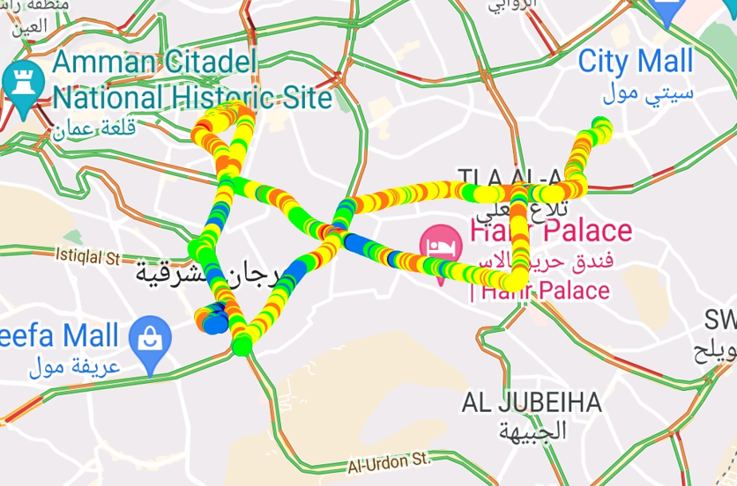
Umniah 5G NSA Drive Route

Slide 9
THANK YOU
MARQUIS TECHNOLOGIES
www.marquistech.com

