Slide 1
MARQUIS TECHNOLOGIES
5G/4G Drive Route – Amsterdam/
Netherlands

Slide 2
Drive Route
Near Cell :- Stationary: RSRP: -65 dBm to -80 dBm
Mixed :- Mobility: RSRP : -80 dBm to -100 dBm
Cell Edge :- Stationary: RSRP : -95 dBm to -110 dBm

Slide 3
Operator | Mobility Scenario | Location Tested | Longitude / Latitude
T-Mobile | 4G-3G-4G HO SPOT | Location not found | NA
 | SRVCC to 3G | Lelystad-Zwolle train way | 52.562778, 5.531468(Approx)
 | IRAT | Location not found | NA
 | Good Coverage for Testing | Wimbledonpark, Amstelveen | 52.290014, 4.844757
 | Poor Coverage for testing | Wittgensteinlaan, 1062 KH Amsterdam | 52.353202, 4.835730
 | OOS Area | Wittgensteinlaan 214, 1062KE, Amsterdam(Basement) | 52.352370, 4.835709
Vodafone | SRVCC to 2G | Lelystad-Zwolle train way | 52.562778, 5.531468(Approx)
 | 4G-2G-4G HO SPOT | Location not found | NA
 | IRAT | Location not found | NA
 | Good Coverage for Testing | Pieter Calandlaan, Amsterdam | 52.356342, 4.821280
 | Poor Coverage for testing | Pieter Calandlaan, 1065 HN Amsterdam | 52.356055, 4.819290
 | OOS Area | Wittgensteinlaan 214, 1062KE, Amsterdam(Basement) | 52.352370, 4.835709
KPN | SRVCC to 3G | Lelystad-Zwolle train way | 52.562778, 5.531468(Approx)
 | 4G-3G-4G HO SPOT | Location not found | NA
 | IRAT | Location not found | NA
 | Good Coverage for Testing | Wittgensteinlaan 214, 1062KE, Amsterdam | 52.352370, 4.835709
 | Poor Coverage for testing | Fregelaan 2, 1062 KK Amsterdam | 52.353104, 4.838756
 | OOS Area | Wittgensteinlaan 214, 1062KE, Amsterdam(Basement) | 52.352370, 4.835709
Tele2 | 4G-3G-4G HO SPOT | Location not found | NA
 | SRVCC to 3G | Lelystad-Zwolle train way | 52.562778, 5.531468(Approx)
 | IRAT | Location not found | NA
 | Good Coverage for Testing | Wimbledonpark, Amstelveen | 52.290014, 4.844757
 | Poor Coverage for testing | Wittgensteinlaan, 1062 KH Amsterdam | 52.353202, 4.835730
 | OOS Area | Wittgensteinlaan 214, 1062KE, Amsterdam(Basement) | 52.352370, 4.835709

Slide 4
Major Netherlands Operators : Locations for 5G /NR Field Test
Operator | PLMN | 5G Tested Locations | Longitude / Latitude | ENDC combination Tested
T-Mobile | 204/16 | Wimbledonpark, Amselveen | 52.290014, 4.844757 | LTE Band 20 + NR 28
 |  | Wittgensteinlaan 214, 1062KE, Amsterdam | 52.352370, 4.835709 | LTE Band 20 + NR 78
Vodafone | 204/04 | Pieter Calandlaan, Amsterdam | 52.356342, 4.821280 | LTE Band 20 + NR 3
 |  | Wittgensteinlaan 214, 1062KE, Amsterdam | 52.352370, 4.835709 | LTE Band 3 + NR 78
KPN | 204/8 | Wittgensteinlaan 214, 1062KE, Amsterdam | 52.352370, 4.835709 | LTE Band 20 + NR 28

Slide 5
Services Supported by T-Mobile Operator
T-Mobile 5G/4G/3G/2G | GSM-900MHz & 1800MHz, B3(1800MHz), B7(2600MHz), B8 (900MHz), B20(800MHz), NR28 (700 MHz),
OPERATOR | Features /Services | Supported(yes/No)
T-Mobile (Major) | Reselection | Yes
 | Redirection | Yes
 | MMS /SMS | Yes (MMS not supported)
 | Volte | Yes
 | VoWiFi | Yes
 | PS Handover | Yes

Slide 6
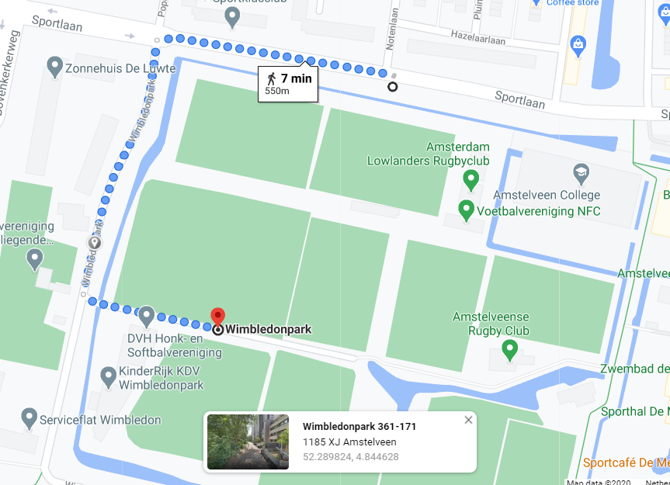
Operator Name | T-Mobile (Good Coverage)
Lat & Long | 52.290014, 4.844757
Route Covered | Amstelveen >> Wimbledon park
RSRP Range | (-70 dBm to -80 dBm)
Band detail | B20+N28

Slide 7
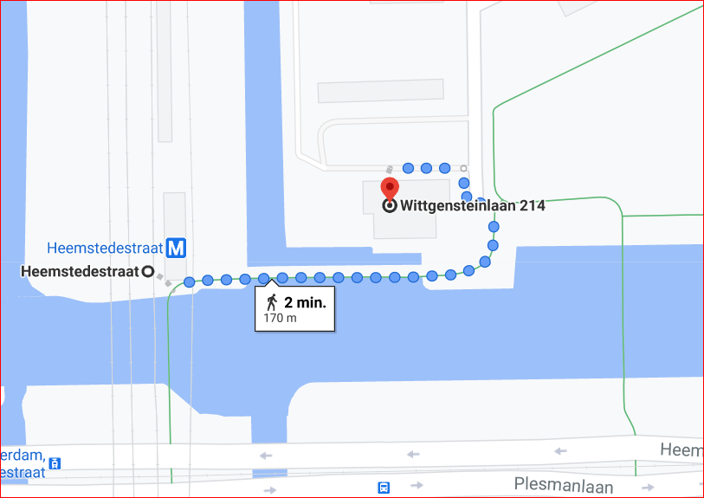
Operator Name | T-Mobile (Mixed Coverage)
Lat & Long | 52.352370, 4.835709
Route Covered | Wittgensteinlaan >> Heemstedestraat
RSRP Range | (-85 dBm to -100 dBm)
Band detail | B20+N28
Weak 5g area Telenor

Slide 8
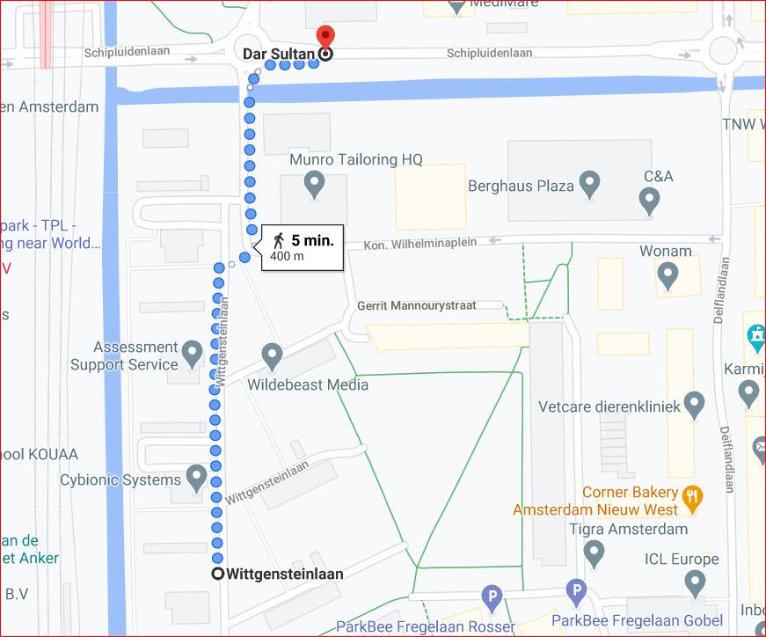
Operator Name | T-Mobile (Poor Coverage)
Lat & Long | 52.353202, 4.835730
Route Covered | Dar Sultan >> Wittgensteinlaan 206
RSRP Range | (-95 dBm to -110 dBm)
Band detail | B20+N28
Weak 5g area Telenor

Slide 9
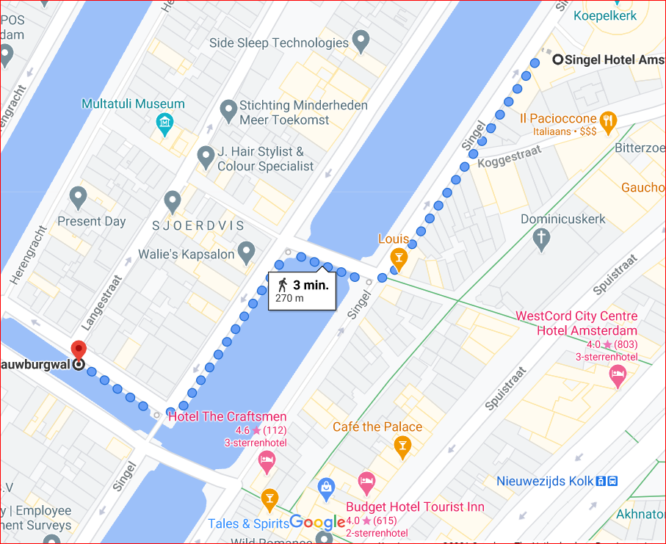
Operator Name | T-Mobile (5G-4G, B20+N28 to B8 HO)
Lat & Long | 52.377331, 4.892645
Route Covered | Singel Hotel>> Langestraat
RSRP Range | (-95 dBm to -105 dBm)
Band detail | B20+N28 to B8

Slide 10
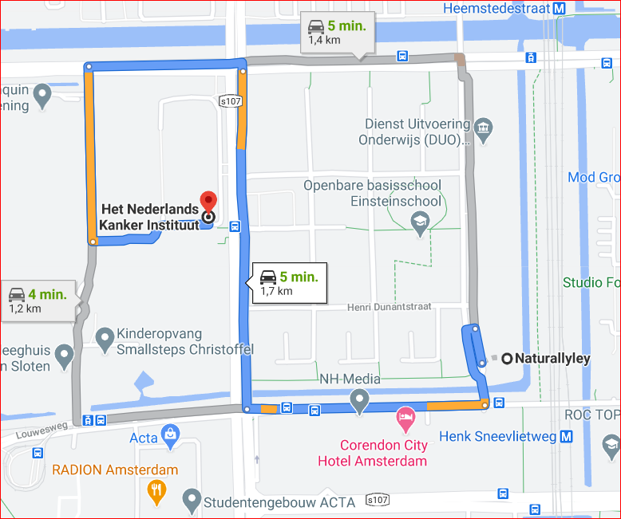
Operator Name | T-Mobile (Band HO: B3-B8, B8-B20)
Lat & Long | 52.348728, 4.832281
Route Covered | Kanker Institute to Founara to Corendon City Hotel
RSRP Range | (-85 dBm to -100 dBm)
Band detail | B3 to B8 and B8 to B20

Slide 11
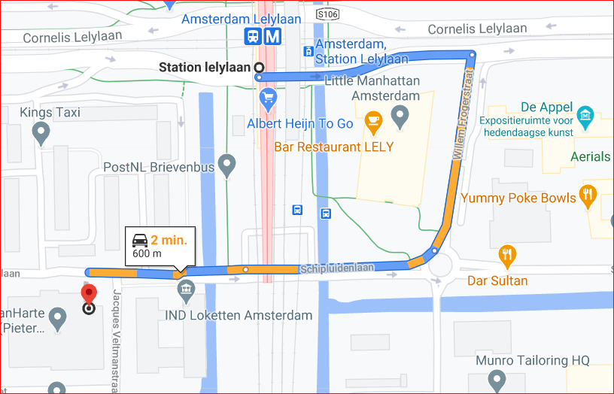
Operator Name | T-Mobile (CA to CA Location)
Lat & Long | 52.357749, 4.830004
Route Covered | Lelylaan Station to Calvijn College
RSRP Range | (-80 dBm to -95 dBm)
Band detail | B3, B8

Slide 12
Services Supported by Vodafone Operator
Vodafone 5G/4G/2G | GSM-900MHz & 1800MHz,B3(1800MHz), B7(2600MHz), B8 (900MHz), B20(800MHz) , NR3 (1800 MHz),
OPERATOR | Features /Services | Supported(yes/No)
Vodafone (Major) | Reselection | Yes
 | Redirection | Yes
 | MMS /SMS | Yes (MMS not supported)
 | Volte | Yes
 | VoWiFi | Yes
 | PS Handover | Yes

Slide 13
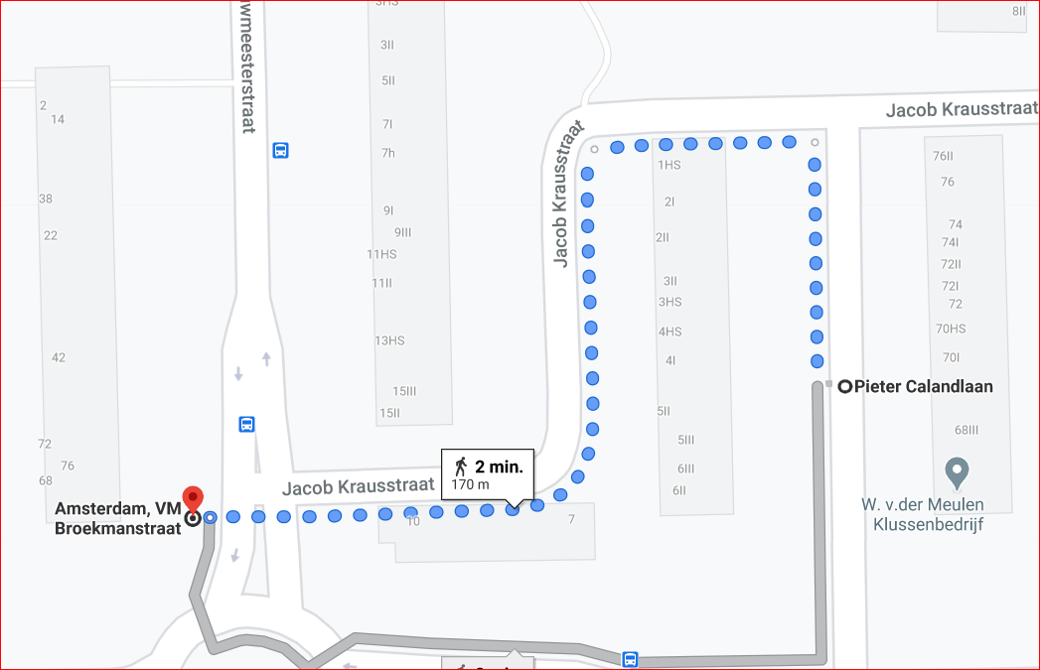
Operator Name | Vodafone (Good Coverage)
Lat & Long | 52.356342, 4.821280
Route Covered | Lelylaan >> Pieter Calandlaan
RSRP Range | (-65 dBm to -75 dBm)
Band detail | B20+N3

Slide 14
Operator Name | Vodafone (Mixed Coverage)
Lat & Long | 52.352370, 4.835709
Route Covered | Wittgensteinlaan >> Heemstedestraat
RSRP Range | (-80 dBm to -100 dBm)
Band detail | B20+N3

Slide 15
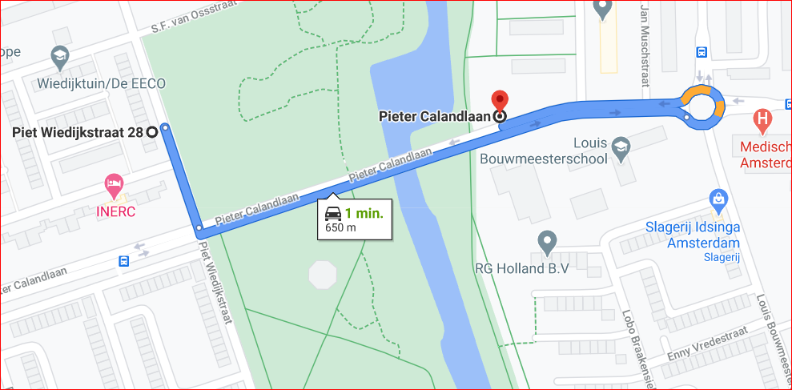
Operator Name | Vodafone (Poor Coverage)
Lat & Long | 52.356055, 4.819290
Route Covered | Pieter Calandlaan >> Piet Wiedijkstraat
RSRP Range | (-95 dBm to -110 dBm)
Band detail | B20+N3

Slide 16
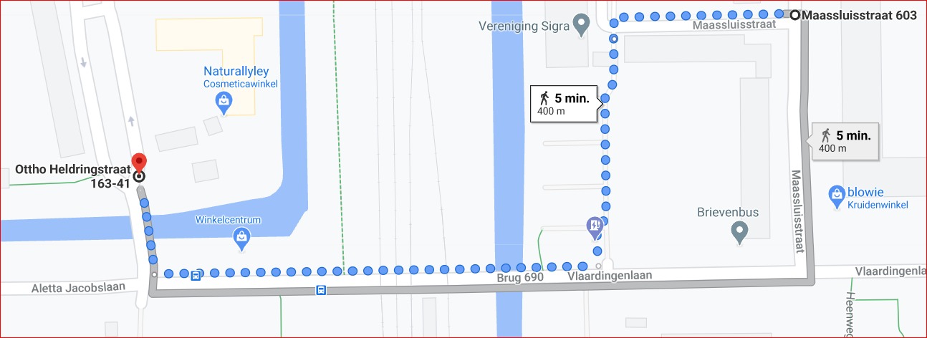
Operator Name | Vodafone (5G-4G, B20+N3 to B3 HO)
Lat & Long | 52.347360, 4.836695
Route Covered | Massluistraat >> Ottho Heldringstraat
RSRP Range | (-85 dBm to -100 dBm)
Band detail | B20+N3 to B3

Slide 17
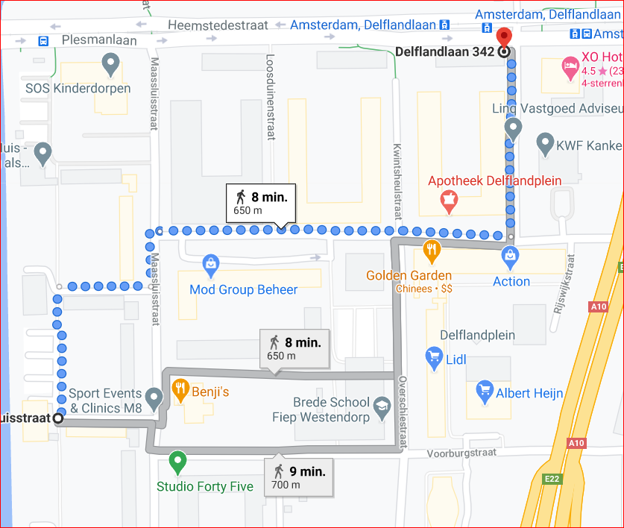
Operator Name | Vodafone (Band HO: B3-B20, B20-B8)
Lat & Long | 52.349393, 4.839487
Route Covered | Massluistraat to Golden Garden to Delflandlaan tram station
RSRP Range | (-80 dBm to -95 dBm)
Band detail | B3 to B20 and B20 to B8

Slide 18
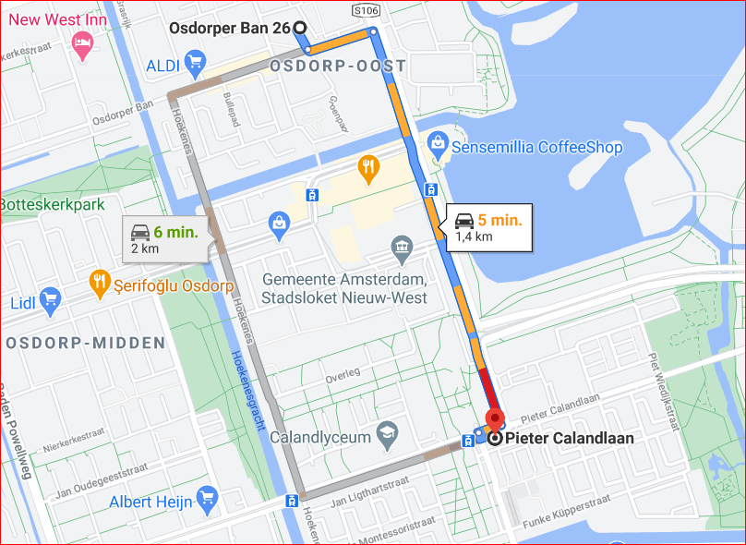
Operator Name | Vodafone (CA to CA Location)
Lat & Long | 52.359975, 4.807480
Route Covered | Osdorp to PieterCalandlaan
RSRP Range | (-75 dBm to -90 dBm)
Band detail | B20+N3, B8

Slide 19
Services Supported by KPN Operator
KPN 5G/4G/3G/2G | GSM-900MHz & 1800MHz,B3(1800MHz), B7(2600MHz), B8 (900MHz), B20(800MHz), NR28 (700 MHz),
OPERATOR | Features /Services | Supported(yes/No)
KPN (Major) | Reselection | Yes
 | Redirection | Yes
 | MMS /SMS | Yes (MMS not supported)
 | Volte | Yes
 | VoWiFi | Yes
 | PS Handover | Yes

Slide 20
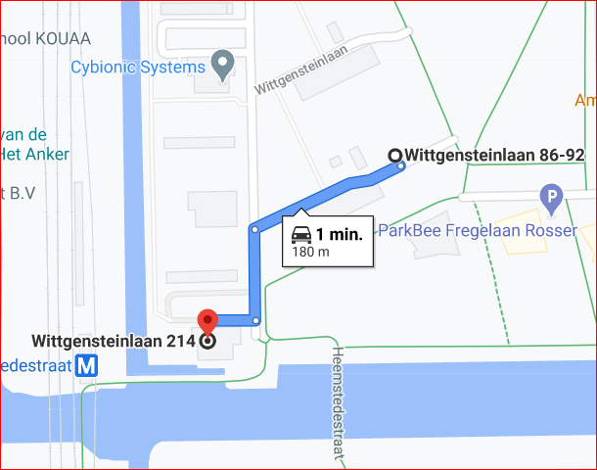
Operator Name | KPN (Good Coverage)
Lat & Long | 52.352370, 4.835709
Route Covered | Wittgensteinlaan >> Childrens’ playground
RSRP Range | (-65 dBm to -75 dBm)
Band detail | B20+N28

Slide 21
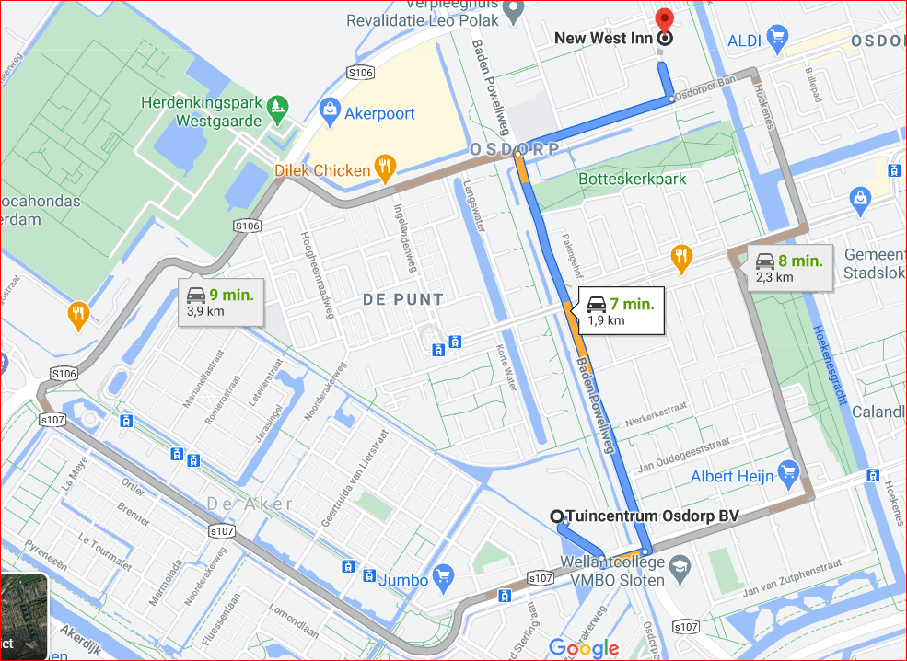
Operator Name | KPN (Mixed Coverage)
Lat & Long | 52.361880, 4.794582
Route Covered | Osdorp Area >> West INN
RSRP Range | (-80 dBm to -100 dBm)
Band detail | B20+N28

Slide 22
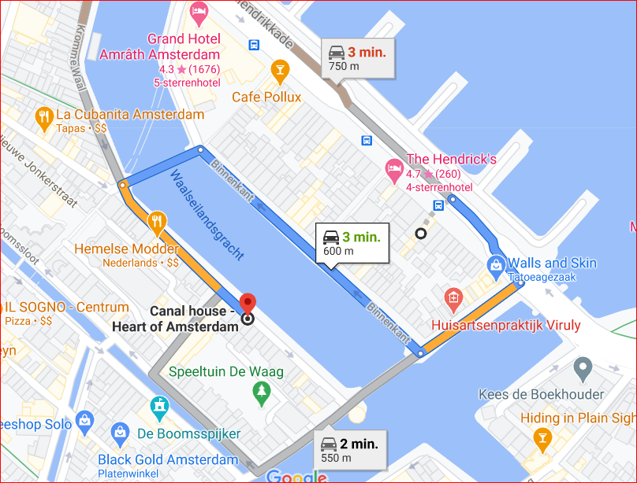
Operator Name | KPN (Poor Coverage)
Lat & Long | 52.353104, 4.838756
Route Covered | Amsterdam Centrum>> Canal House
RSRP Range | (-95 dBm to -110 dBm)
Band detail | B20+N28

Slide 23
Operator Name | KPN (5G-4G, B20+N28 to B3 HO)
Lat & Long | 52.377331, 4.892645
Route Covered | Singel Hotel>> Langestraat
RSRP Range | (-95 dBm to -105 dBm)
Band detail | B20+N28 to B8

Slide 24
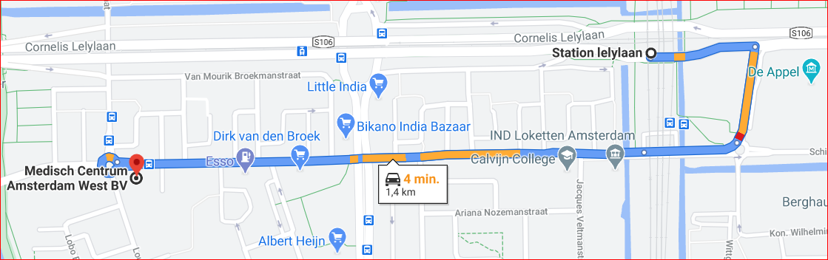
Operator Name | KPN (Band HO: B8-B20, B20-B3)
Lat & Long | 52.356147, 4.823594
Route Covered | Lelylaan Station to IND Loketten to Medical Center Amsterdam West
RSRP Range | (-80 dBm to -100 dBm)
Band detail | B8 to B20 and B20 to B3

Slide 25
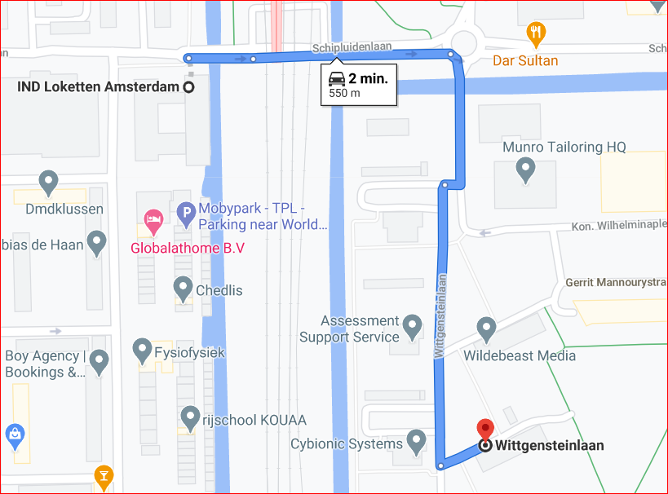
Operator Name | KPN (CA to CA Location)
Lat & Long | 52.356272, 4.833778
Route Covered | IND Loketten to Wittgensteinlaan
RSRP Range | (-85 dBm to -100 dBm)
Band detail | B28+N28, B3

Slide 26
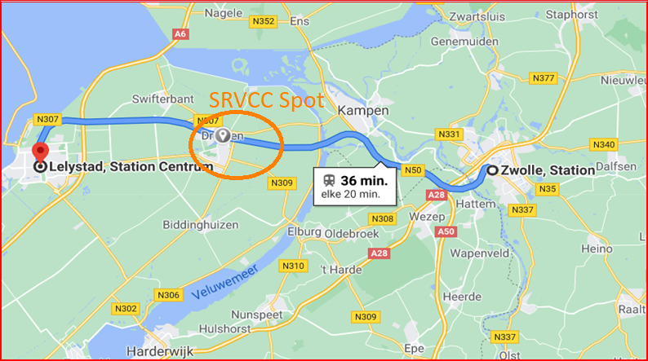
Operator Name | T-Mobile, Vodafone, KPN (SRVCC- 5G/4G to 3G)
Lat & Long | 52.562778, 5.531468
Route Covered | Station Zwolle to Station Lelystad
RSRP Range | (-90 dBm to -110 dBm)
Band detail | B20+N28, B3

Slide 27
THANK YOU
MARQUIS TECHNOLOGIES
www.marquistech.com

