Slide 1
MARQUIS TECHNOLOGIES
Drive Route

Slide 2
Colombo/Sri Lanka
Operator Details:
S. No. | Operator | Supported Bands | Supported Features by Network
1 | Mobitel | LTE FDD B1/B3/B8 & 5G-N78 | 2G/3G/4G/5G/VoLTE
2 | Dialog | LTE FDD B1/B3 & 5G-N78 | 2G/3G/4G/5G/VoLTE

Slide 3
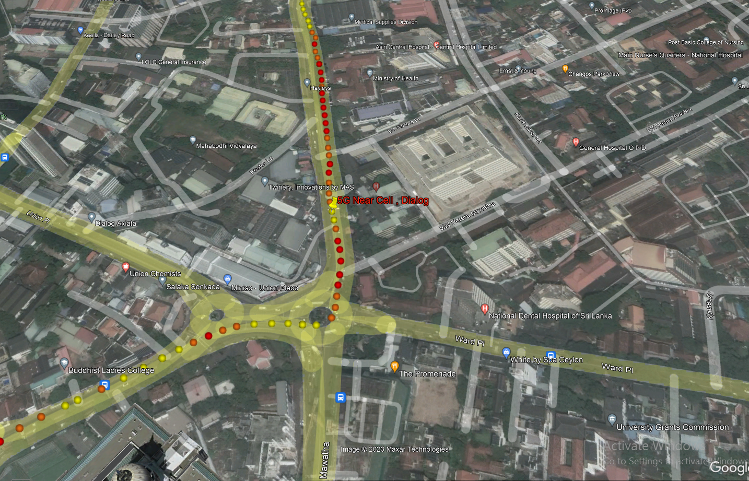
5G Near Cell,Dialog
Lat 6.918331 Long 79.864842
Specification –Stable Dialog 5G NSA network
Good Throughput

Slide 4
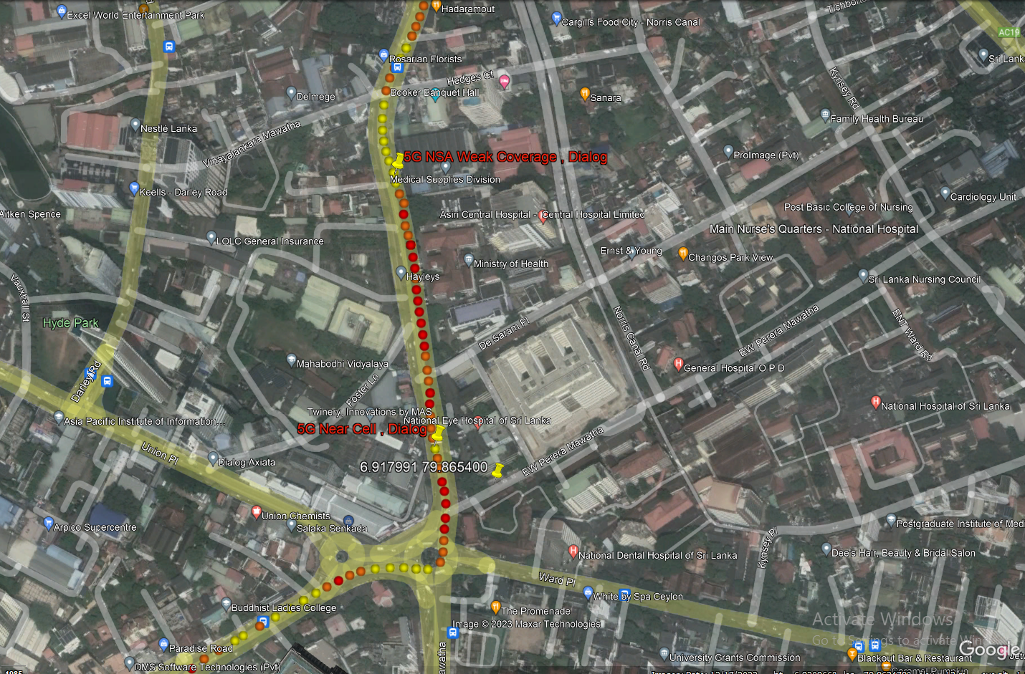
NR to LTE Handover ,Dialog
Lat 6.918331 Long 79.864842 to
Lat 6.920915 Long 79.864452
Specification –Band Handover ,Weak coverage

Slide 5
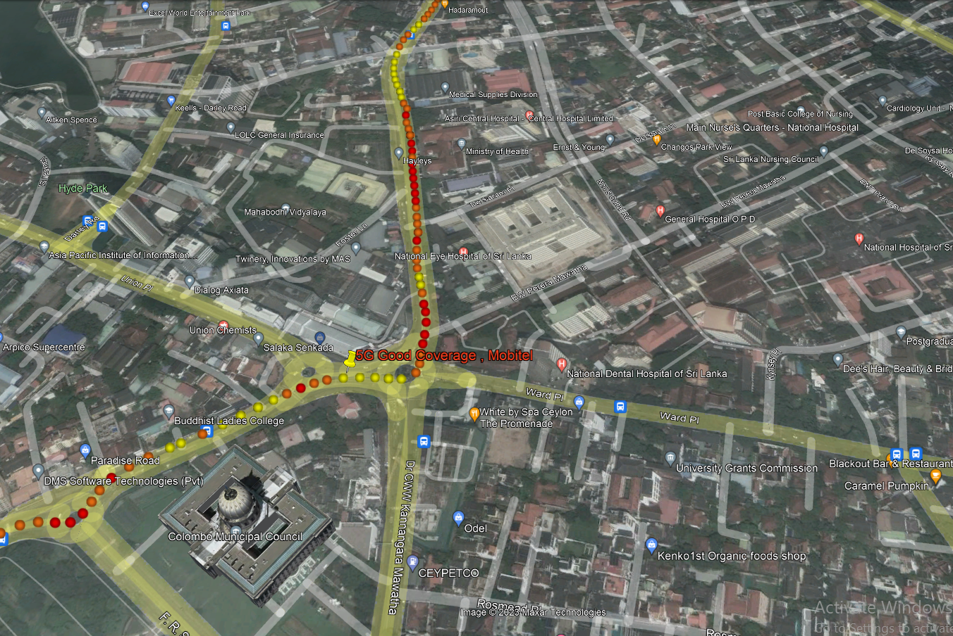
5G Near Cell,Mobitel
Lat. 6.917224 & Long. 79.864294

Slide 6
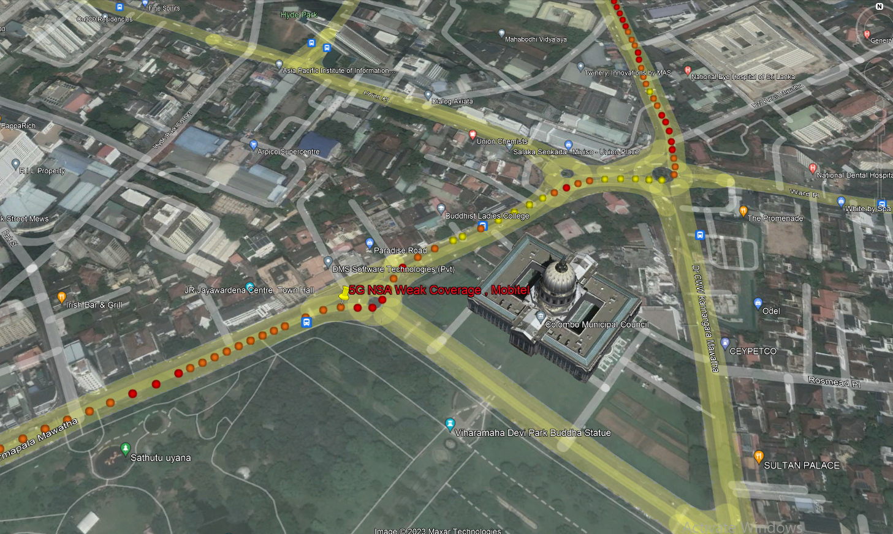
NR To LTE Handover, Mobitel
Lat. 6.917248 & Long. 79.864273 to
Lat. 6.915914 & Long. 79.862043

Slide 7
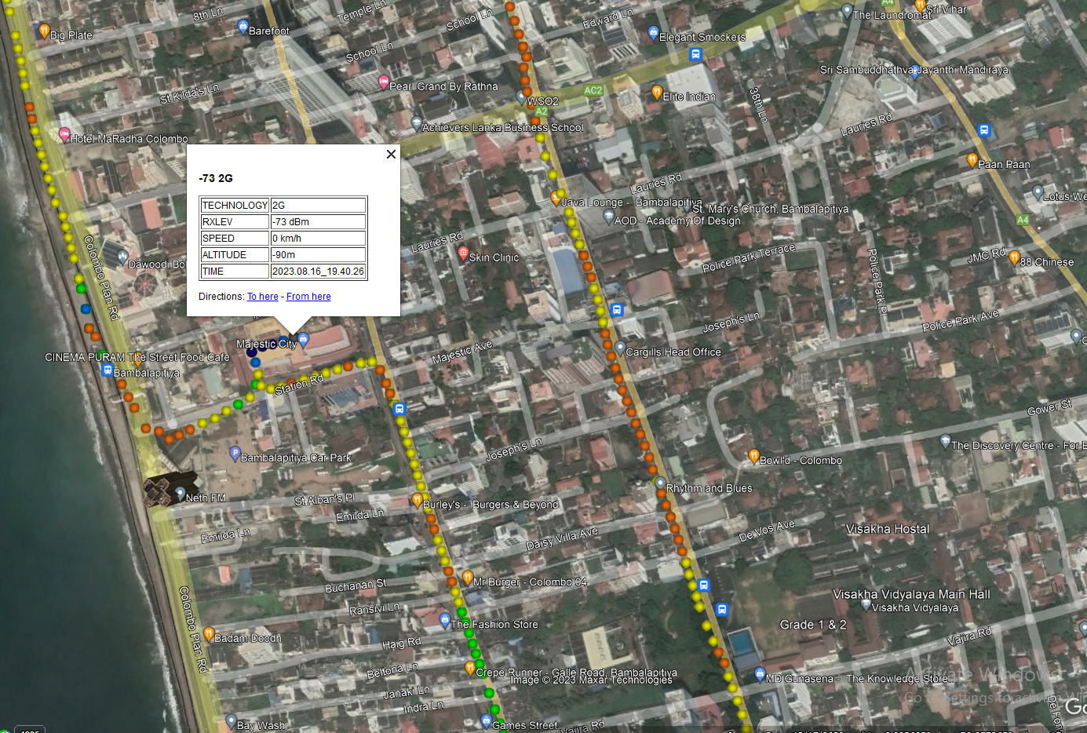
Lat. 6.8939805 & Long. 79.854676
SRVCC, Airtel

Slide 8
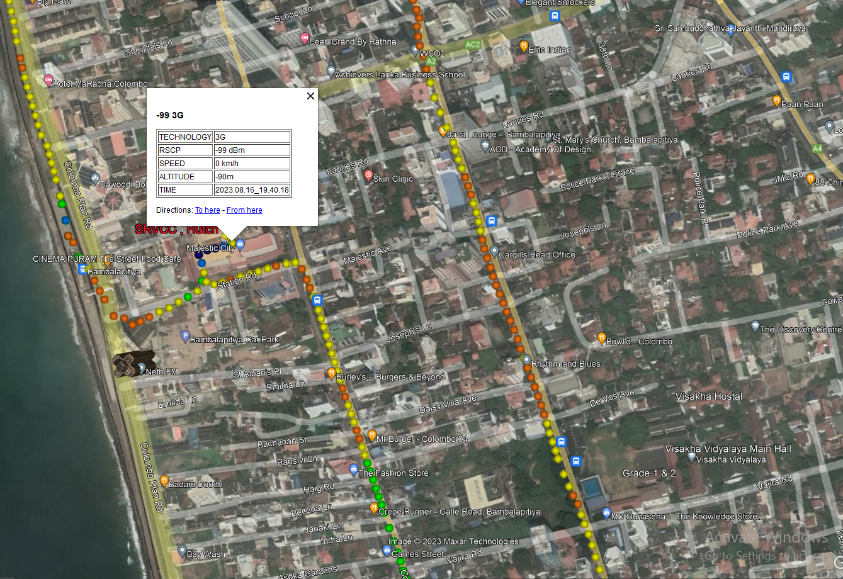
SRVCC, Hutch
Lat. 6.8939805 & Long. 79.854676

Slide 9
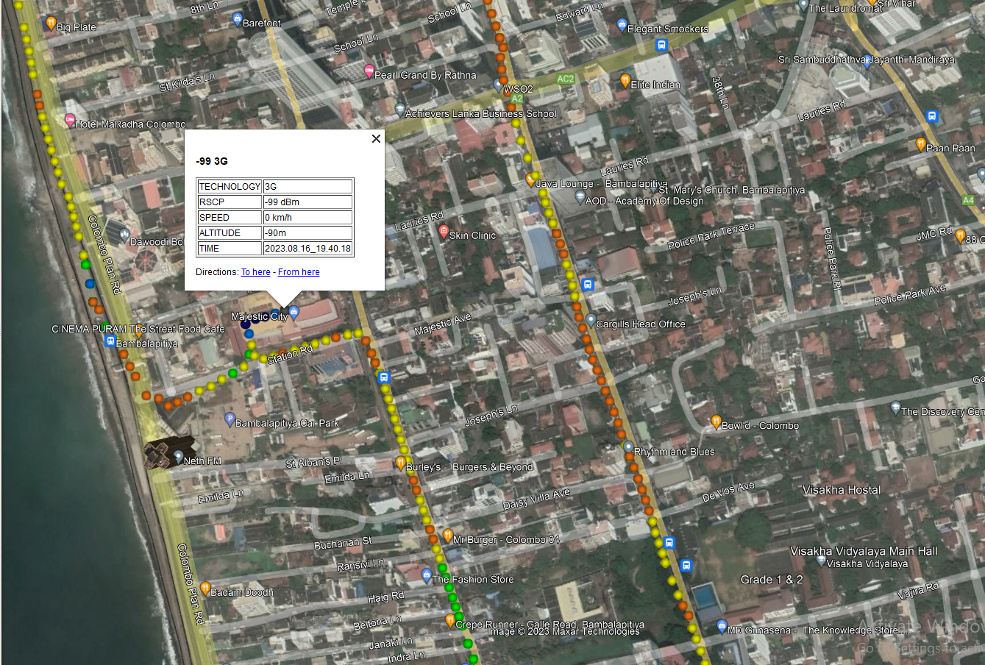
SRVCC, Mobitel
Lat. 6.8939805 & Long. 79.854676

Slide 10

SRVCC, Dialog
Lat. 6.8939805 & Long. 79.854676

Slide 11
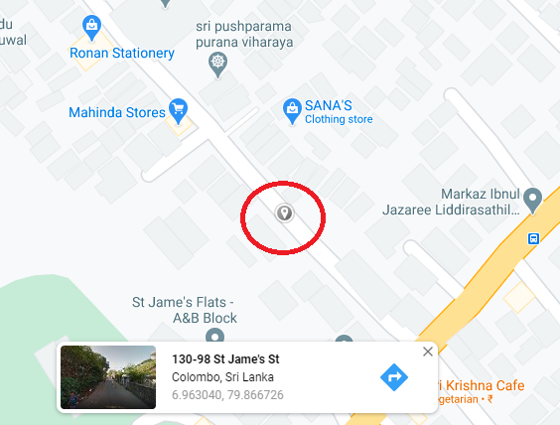
Poor Coverage of Airtel operator: 100-1A-½ Mutwal Colombo

Slide 12
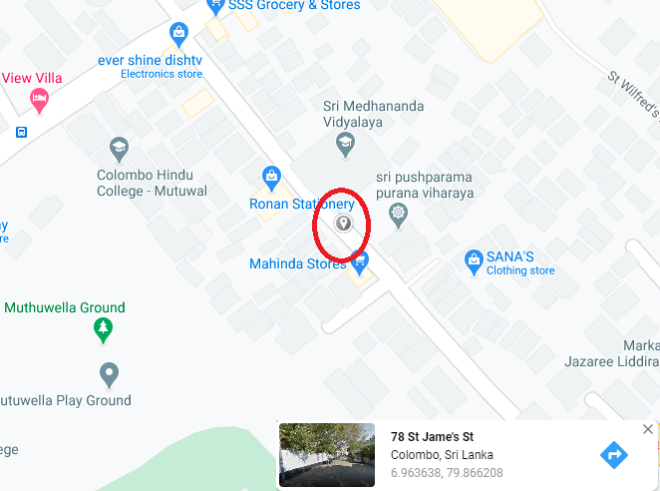
Near Cell of Hutch operator: St James street,Mutwal, Colombo

Slide 13
THANK YOU
MARQUIS TECHNOLOGIES
www.marquistech.com

