Slide 1
MARQUIS TECHNOLOGIES
Drive Route

Slide 2
Drive Route Omantel Mobile 5G
Near Cell :-Stationary: RSRP: -60dbm to -75dbm
Mixed :-Mobility: RSRP : -75dbm to -95dbm
Cell Edge :-Stationary: RSRP : -95dbm to -115dbm

Slide 3
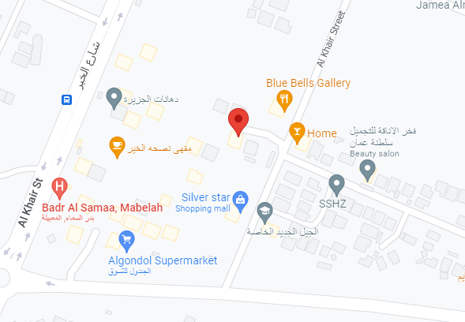

Omantel Band N77(Mixed coverage):-Al Maabilah, Seeb, Oman
Operator: Omantel
Band: N77
Cell ID: 3
E-ARFCN : 629988
RSRP: -80dBm to -85dBm
NC:1

Slide 4
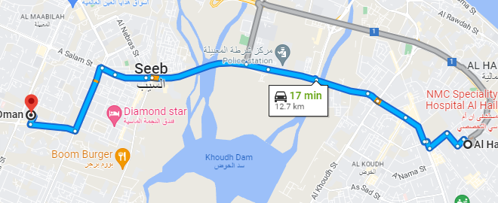
Omantel Band N77(Mixed coverage):-Al Maabilah, Seeb, Oman
Operator: Omantel
Band: N77
Cell ID: 3
E-ARFCN : 629988
RSRP: -80dBm to -85dBm
NC:1

Slide 5
Drive Route Ooredoo 5G
Near Cell :-Stationary: RSRP: -60dbm to -75dbm
Mixed :-Mobility: RSRP : -75dbm to -95dbm
Cell Edge :-Stationary: RSRP : -95dbm to -110dbm

Slide 6
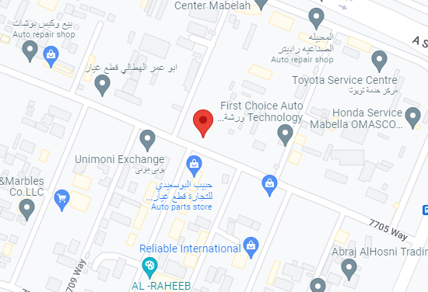

Ooredoo Band N77(Mixed coverage):-Al Maabilah, Seeb, Oman
Operator: Ooredoo
Band: N77
Cell ID: 332
E-ARFCN : 636654
RSRP: -78dBm to -85dBm
NC:1

Slide 7
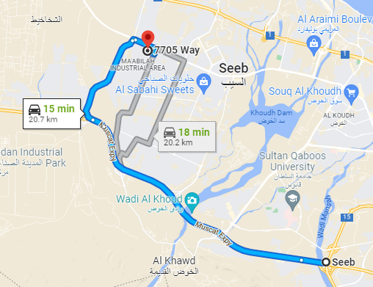
Ooredoo Band N77(Mixed coverage):-Al Maabilah, Seeb, Oman
Operator: Ooredoo
Band: N77
Cell ID: 332
E-ARFCN : 636654
RSRP: -78dBm to -85dBm
NC:1

Slide 8
THANK YOU
MARQUIS TECHNOLOGIES
www.marquistech.com

