Slide 1
MARQUIS TECHNOLOGIES
5G Drive Route – Brussels, Belgium

Slide 2
Belgium Operator Details
Location | Service Provider | Operator | RAT
Brussels, Belgium | Proximus | Major | 5G/4G/3G/2G
Brussels, Belgium | Orange |  | 4G/3G/2G
Brussels, Belgium | Telenet |  | 4G/3G/2G
Brussels, Belgium | Base |  | 4G/3G/2G

Slide 3
Operator | Mobility Scenario | Location Tested | Longitude / Latitude
Proximus | 4G-3G-4G HO SPOT | Overijse De Leegheid, R. Borremansstraat 3090 | 50.7894, 4.5853
 | SRVCC to 3G | Overijse De Leegheid, De Peuthystraat, 3090, Brussels | 50.789, 4.5754
 | IRAT | Location not found | NA
 | Good Coverage for Testing | Josse Biesmansstraat, 54 Hoeilaart | 50.7709, 4.4660
 | Poor Coverage for testing | Josse Biesmansstraat, 54 Hoeilaart | 50.7708, 4.4660
 | OOS Area | Location not found | NA
Orange | SRVCC to 2G | Location not found | NA
 | SRVCC to 3G | Overijse De Leegheid, R. Borremansstraat 3090 | 50.7894, 4.5853
 | 4G-3G-4G HO SPOT | Overijse De Leegheid, De Peuthystraat, 3090, Brussels | 50.789, 4.5754
 | IRAT | Location not found | NA
 | Good Coverage for Testing | Josse Biesmansstraat, 54 Hoeilaart | 50.7709, 4.4660
 | Poor Coverage for testing | Josse Biesmansstraat, 54 Hoeilaart | 50.7708, 4.4660
 | OOS Area | Location not found | NA
Telenet | SRVCC to 3G | Location not found | NA
 | SRVCC to 2G | Overijse De Leegheid, R. Borremansstraat 3090 | 50.7894, 4.5853
 | 4G-3G-4G HO SPOT | Overijse De Leegheid, De Peuthystraat, 3090, Brussels | 50.789, 4.5754
 | IRAT | Location not found | NA
 | Good Coverage for Testing | Josse Biesmansstraat, 54 Hoeilaart | 50.7709, 4.4660
 | Poor Coverage for testing | Josse Biesmansstraat, 54 Hoeilaart | 50.7708, 4.4660
 | OOS Area | Location not found | NA
Base | SRVCC to 3G | Location not found | NA
 | SRVCC to 2G | Overijse De Leegheid, R. Borremansstraat 3090 | 50.7894, 4.5853
 | 4G-3G-4G HO SPOT | Overijse De Leegheid, De Peuthystraat, 3090, Brussels | 50.789, 4.5754
 | IRAT | Location not found | NA
 | Good Coverage for Testing | Josse Biesmansstraat, 54 Hoeilaart | 50.7709, 4.4660
 | Poor Coverage for testing | Josse Biesmansstraat, 54 Hoeilaart | 50.7708, 4.4660
 | OOS Area | Location not found | NA

Slide 4
Drive Route
Near Cell :-Stationary: RSRP: -78dbm to -95dbm
Mixed :-Mobility: RSRP : -83dbm to -105dbm
Cell Edge :-Stationary: RSRP : -105dbm to -114dbm

Slide 5
Services Supported by Proximus VoLTE Operator
Proximus: 5G/4G/3G/2G | GSM-900MHz & 1800MHz, B1(2100 MHz), B8(900MHz), B1(2100MHz) B3(1800MHz), B7(2100MHz) , B20(800MHz), NR78 (3500 MHz),
OPERATOR | Features /Services | Supported(yes/No)
Proximus (Major) | Reselection | Yes
 | Redirection | Yes
 | MMS /SMS | Yes
 | Volte | Yes
 | VoWifi | Yes

Slide 6
Services Supported by Orange VoLTE Operator
Orange: 4G/3G/2G | B1(2100 MHz), B8(900MHz), B3(1800MHz), B7(2100MHz) , B20(800MHz)
OPERATOR | Features /Services | Supported(yes/No)
Orange | Reselection | Yes
 | Redirection | Yes
 | MMS /SMS | Yes
 | Volte | Yes
 | VoWifi | Yes

Slide 7
Services Supported by Telenet VoLTE Operator
Telenet: 4G/3G/2G | B1(2100 MHz), B8(900MHz), B3(1800MHz), B7(2100MHz) , B20(800MHz)
OPERATOR | Features /Services | Supported(yes/No)
Telenet | Reselection | Yes
 | Redirection | Yes
 | MMS /SMS | Yes
 | Volte | Yes
 | VoWifi | Yes

Slide 8
Services Supported by Base VoLTE Operator
Base: 4G/3G/2G | B1(2100 MHz), B8(900MHz), B3(1800MHz), B7(2100MHz) , B20(800MHz)
OPERATOR | Features /Services | Supported(yes/No)
Base | Reselection | Yes
 | Redirection | Yes
 | MMS /SMS | Yes
 | Volte | Yes
 | VoWifi | Yes

Slide 9
Major Belgium Operators : Locations for 5G /NR Field Test
Operator | PLMN | 5G Tested Locations | Longitude / Latitude | ENDC combination Tested
Proximus | 234/10 | Heverlee Station, Leuven, Belgium | 51.518087, -0.629636 | LTE Band 3 + NR 78
 |  | Overijse, Schavei, Brussels, Belgium | 4.5270504, 50.77517129 | LTE Band B1 + NR 78

Slide 10
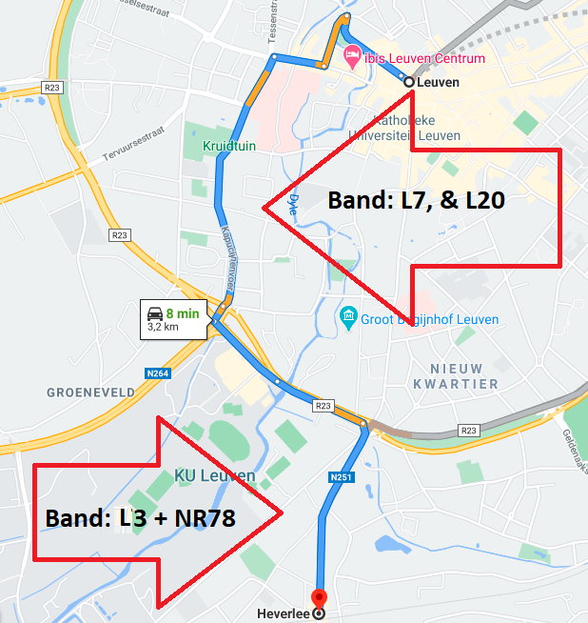
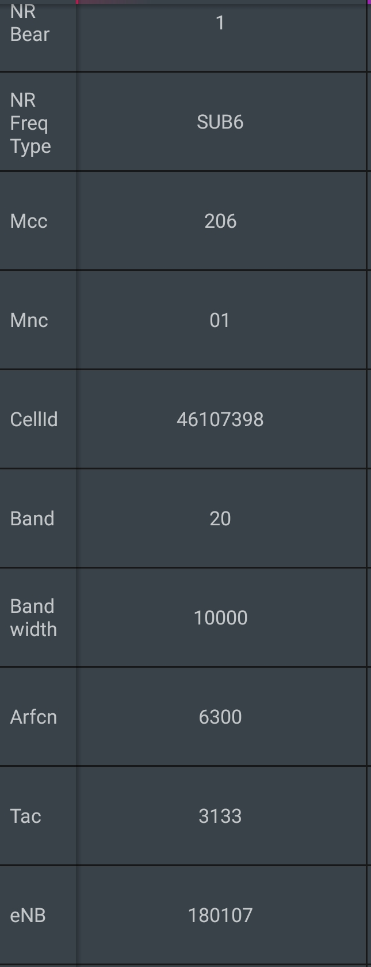
Proximus 5G VoLTE Good Coverage Area Band L3,L7 AND L20 WITH NR 78 BAND Route >> Leuven Centrum 3000 >> Heverlee Station 3001

Slide 11
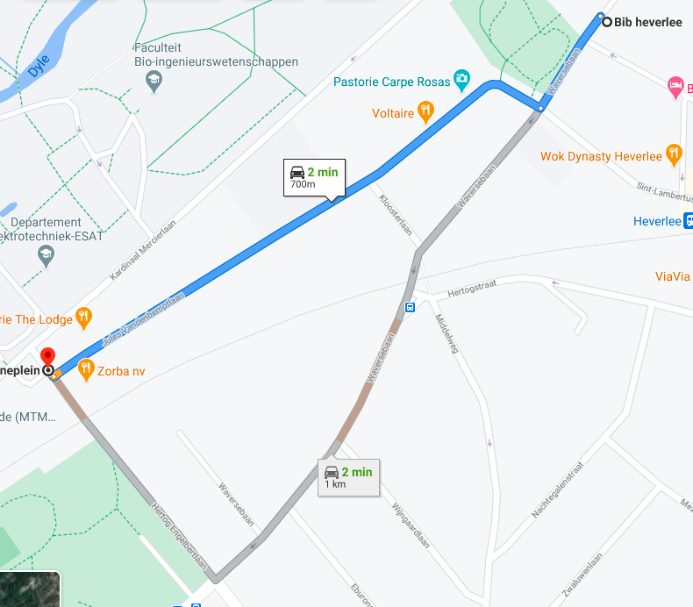
Proximus 5G and 4G VoLTE Mix Coverage Area Route >> Bib Heverlee >> Kantineplein
4g and 5g mixed coverage
5G area
5g coverage ends here

Slide 12
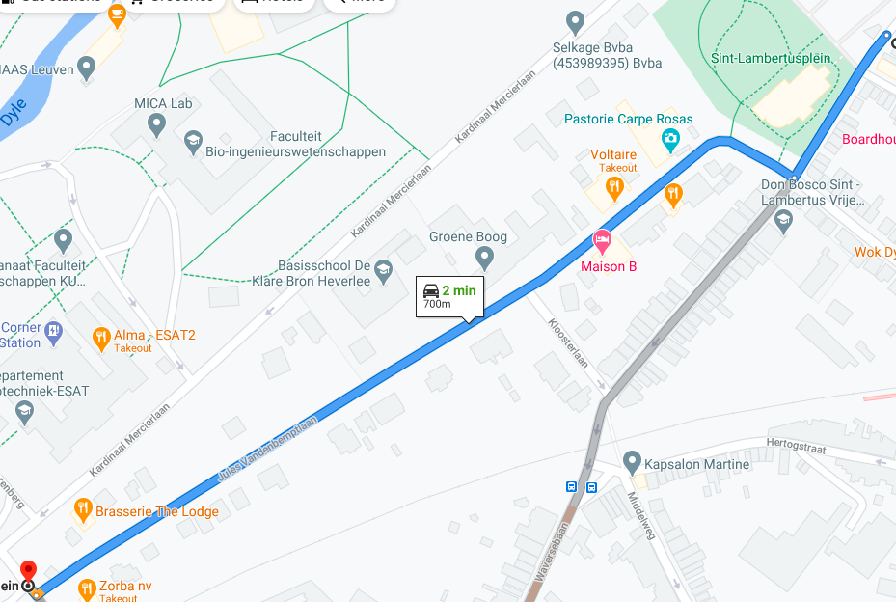
Proximus weak 5G VoLTE Coverage Area Band NR 78 , LTE band L3 Route >> Jules Vandenbemptlaan >> Kantineplein
5G Coverage Start
5g coverage ends
Weak 5G Signal
5G Ends

Slide 13
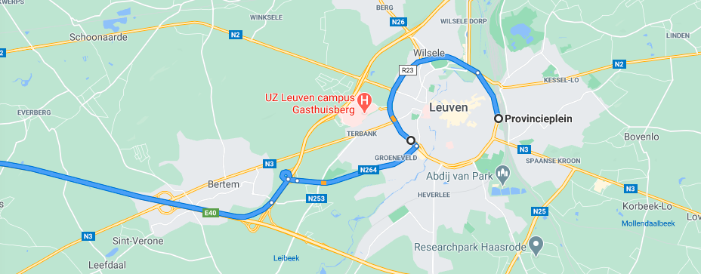
Band HO from B3 to B7 and B7 to B20 for Proximus 4G VoLTE operator Route >> Leuven Centrum >> Heverlee >> Brussels Speedway
Band NR78

Slide 14
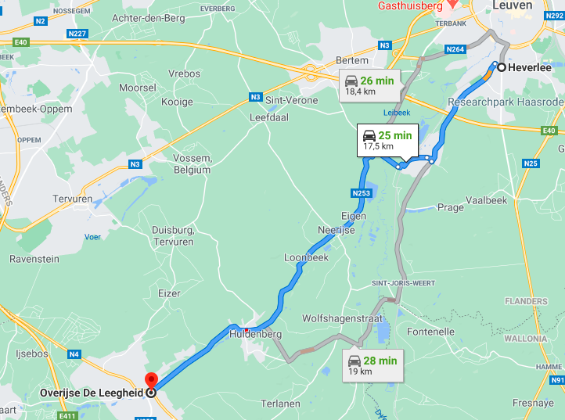
SRVCC: Proximus, Orange, Telenet, & Base 4G TO 3G Route >> Leuven Centrum >> Overijse De Leegheeid
Handover 4G to 3G

Slide 15
THANK YOU
MARQUIS TECHNOLOGIES
www.marquistech.com

