Slide 1
MARQUIS TECHNOLOGIES
Drive Route

Slide 2
Travel to Slovenia
(Ljubljana)
Country | Slovenia
Continent | Slovenia
City | Ljubljana
Time Zone | GMT +02 Hour Central European Summer Time GMT +02 Hour UTC/GMT

Slide 3
Operators and general Information
Mobitel- Supports 5G,LTE, VoLTE, VoWifi , WCDMA and 2G
Telemach- Supports 5G, LTE, VoLTE , WCDMA and 2G
A1-Supports 5G, LTE, VoLTE, WCDMA and 2G

Slide 4
RSRP Criteria
Near Cell :-Stationary: RSRP : -60dbm to -75dbm
Cell Edge :-Stationary: RSRP : -75dbm to -95dbm
Mixed :-Mobility: RSRP : -95dbm to -115dbm

Slide 5
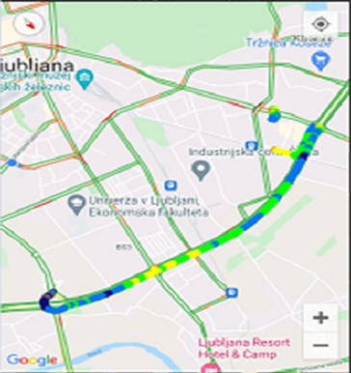
Mobitel B3(4G):-Litijska cesta 152
Operator: Mobitel
Band: B3
E-ARFCN : 2620
RSRP: -75dBm to -90Bm
NC:1

Slide 6
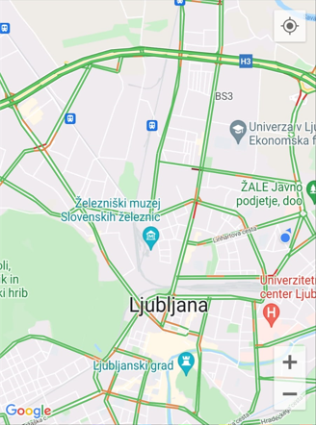
Teleach B20(4G):-Novo naselje, 1261 Ljubljana - Dobrunje
Operator: Telemach
Band: B20
Cell ID: 4
E-ARFCN : 3700
RSRP: -95dbm to 115dbm
EC:1

Slide 7
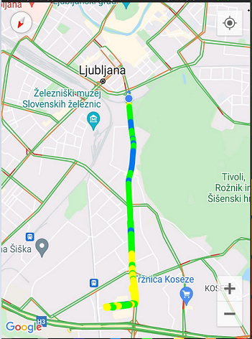
Telemach (SRVCC):- 1351 Lukovica pri Brezovici, Slovenia
Operator: Telemach
SRVCC location
EC:1

Slide 8
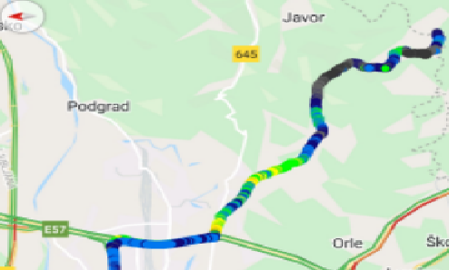
Mobitel (SRVCC):- 1351 Lukovica pri Brezovici, Slovenia
Operator:Mobitel
SRVCC location

Slide 9
THANK YOU
MARQUIS TECHNOLOGIES
www.marquistech.com

